Slide 1
Proposal
Team 4

Slide 2
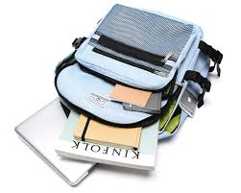
책가방
BackPack
Reliable used deal community

Slide 3
Index
Intro
-Background
-Needs
-Target
-Trend
Previous apps
Our apps
-Speciality
-Process Flow
Expected Effects
Development Plan
-Tech
-Development Cycle

Slide 4
Intro

Slide 5
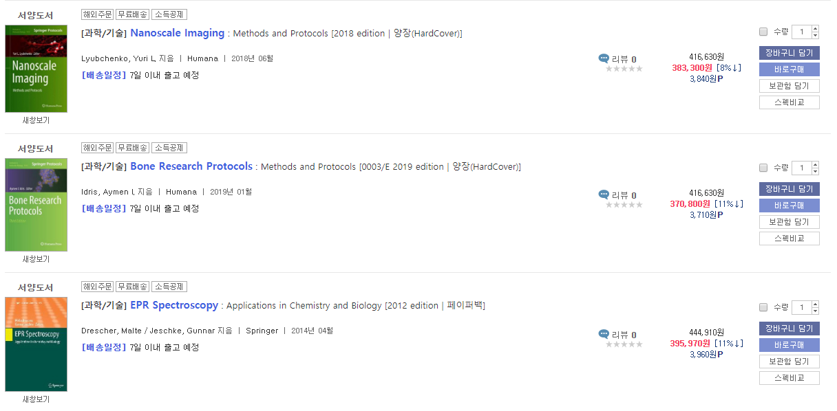
Background
Expensive major books
After finishing course, students rarely read major books again

Slide 6







Background
Students are in financial difficulties

Slide 7
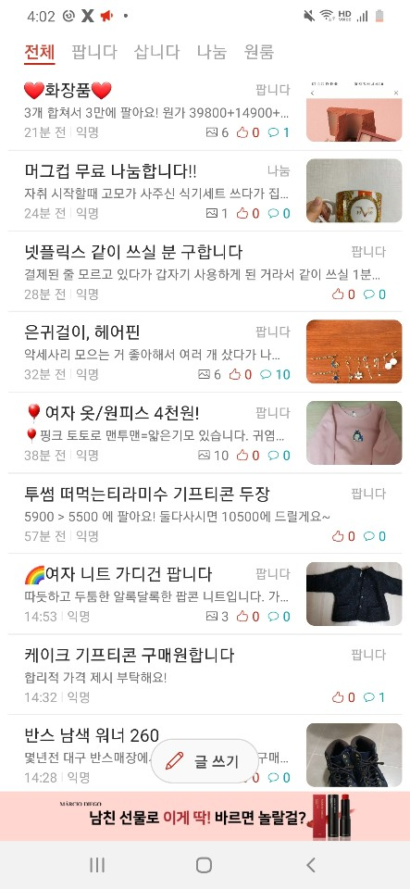
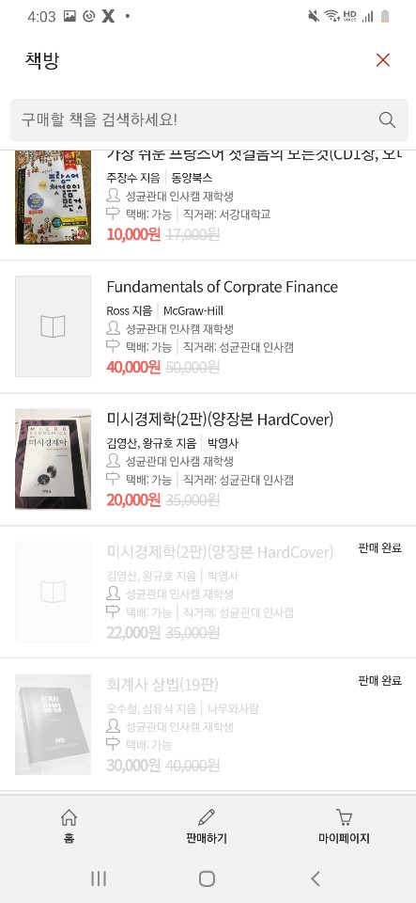
Needs
Absence of used transaction app → People have used ‘Everytime’ app
* Everytime : Timetable app

Slide 8



Student
University Worker
Store near University
Target

Slide 9
Target
Student & University Worker
Trade used items
Purchase items or service from stores
Store
Sell university-related items or services

Slide 10





Trend
Mobile Used Deal Application Users

Slide 11
Previous apps
- Problems with previous apps
- Not so great alternative options

Slide 12

There are many apps that sell used stuff, but:
Not trustworthy
Price ranges differ drastically
Potential scams
Difficult to check the item
Cautious to meet in-person
Too pricey
Not suitable for students

Slide 13

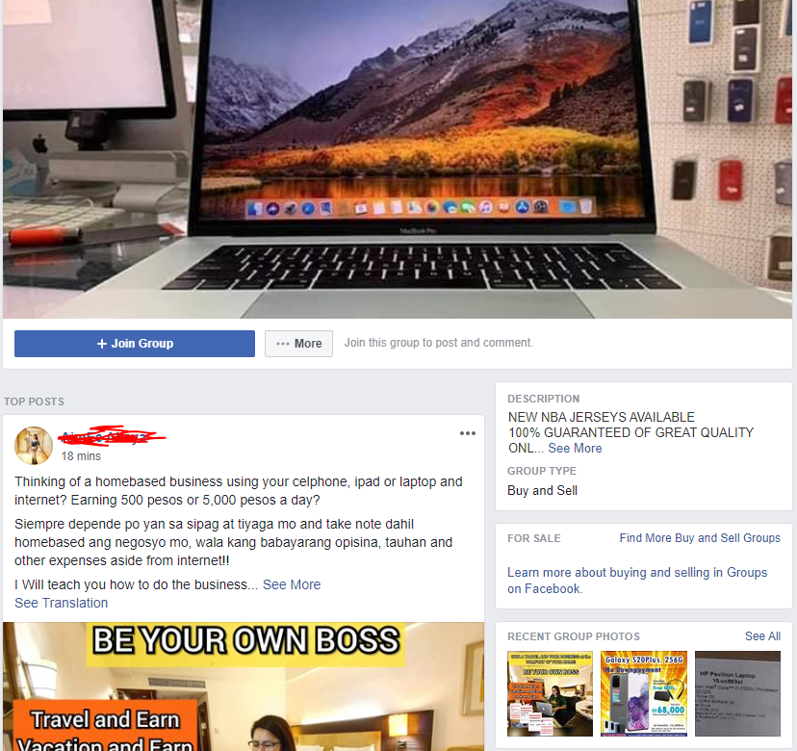
Alternative or previous options/apps
Facebook Groups
Many strangers on the websites can violate your privacy
Scams can exist
Fake accounts exist
Too many ads

Slide 14

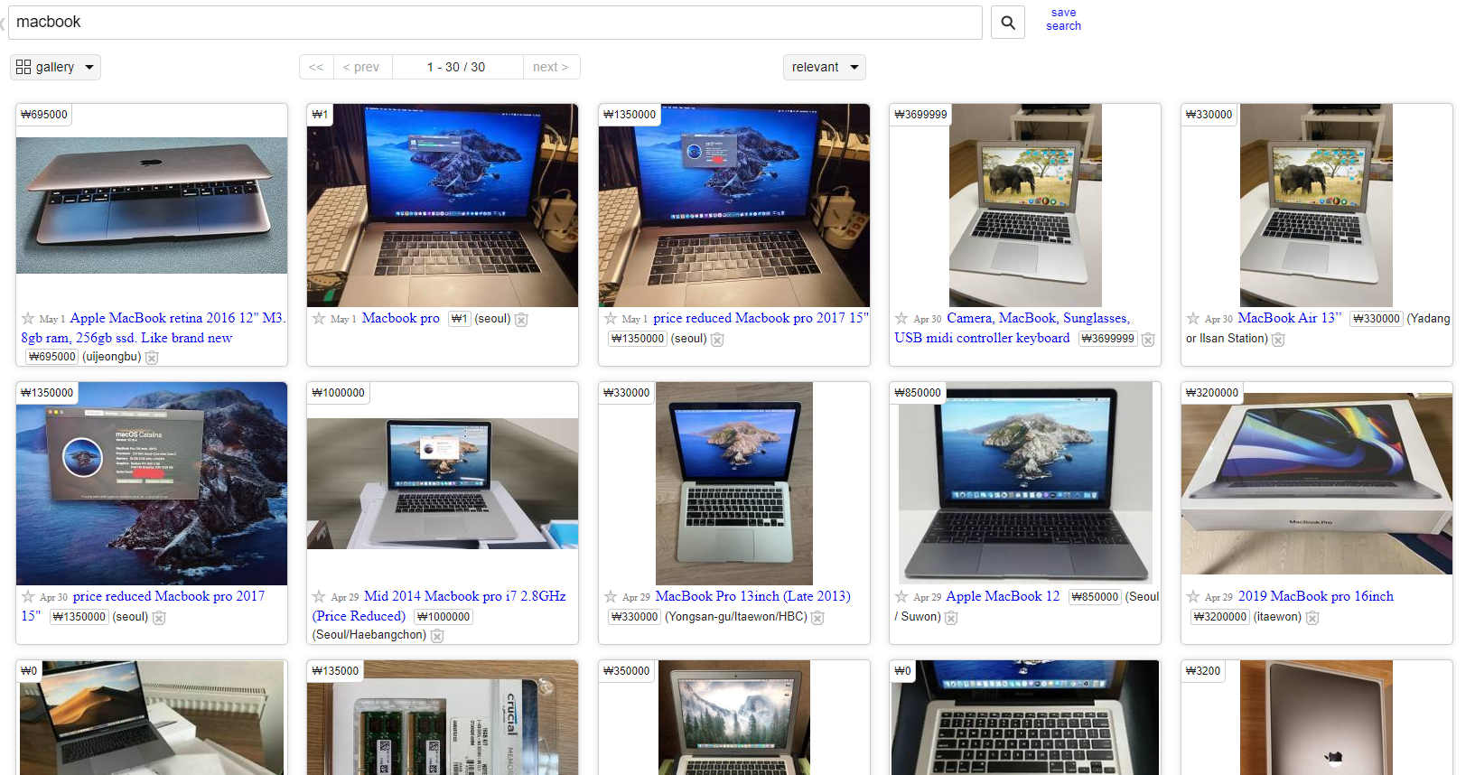
Alternative or previous options/apps
Still pricey
Few good deals
Potential scams
In-person meetings can be costly

Slide 15

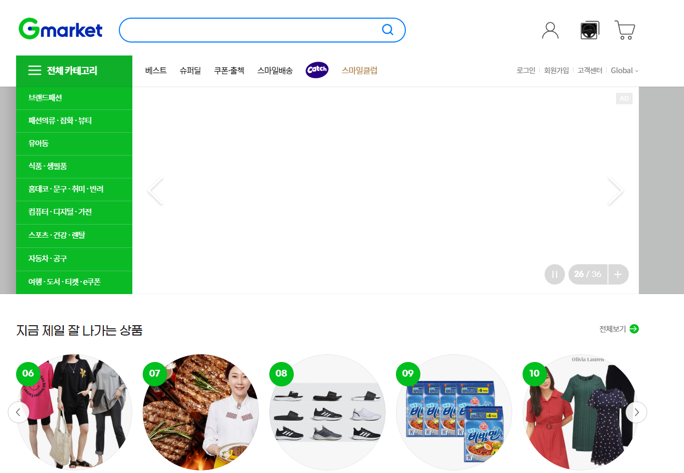
Alternative or previous options/apps
Difficult for foreign students
Still pricey
Shipping fees vary

Slide 16

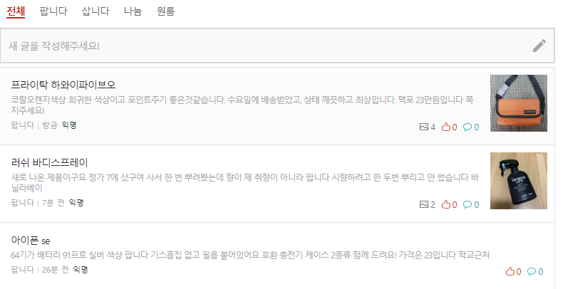
Alternative or previous options/apps
Everytime
No category : Hard to
Search related items.
In-person meetings can be costly(Time appointment)

Slide 17

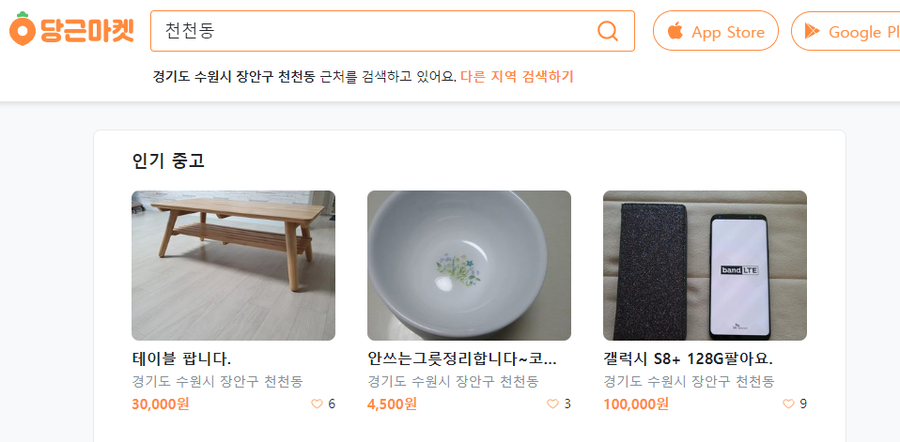
Alternative or previous options/apps
Location Based Service makes scam-safe.
Many different customers :
not focused on students.

Slide 18
Our app -Specialties -Process Flow

Slide 19
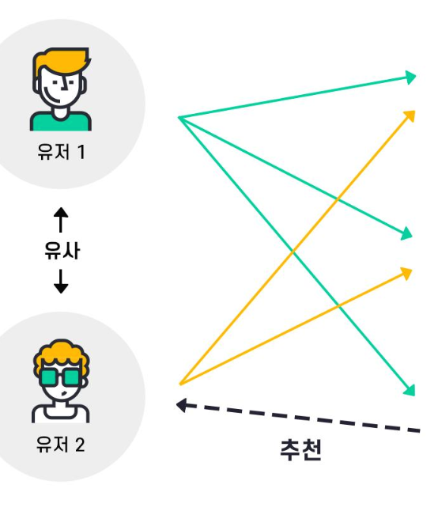

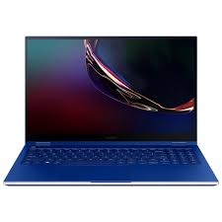
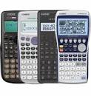
Specialties
- Recommendation System based on two criteria
[First Criteria] Recommendation according to similar user taste
(with Major, Gender, Grade)
Notes:
Buyer: 거래 안전성 향상 - 같은 학교 커뮤니티에 따른 신뢰도 증가, 상품 직접 확인 가능한 비대면 직거래에 따른 안전성 향상
비용 절감 - 학습 물품 중고 거래에 따른 교육 비용 절감
시간 제약X - 사물함 거래를 통해 시간제약을 받지 않는 직거래 형식
Seller: 빠른 거래 성사 - 추천 알고리즘을 통한 빠른 거래 매칭
시간 제약X - 사물함 거래를 통해 시간제약을 받지 않는 직거래 형식

Slide 20
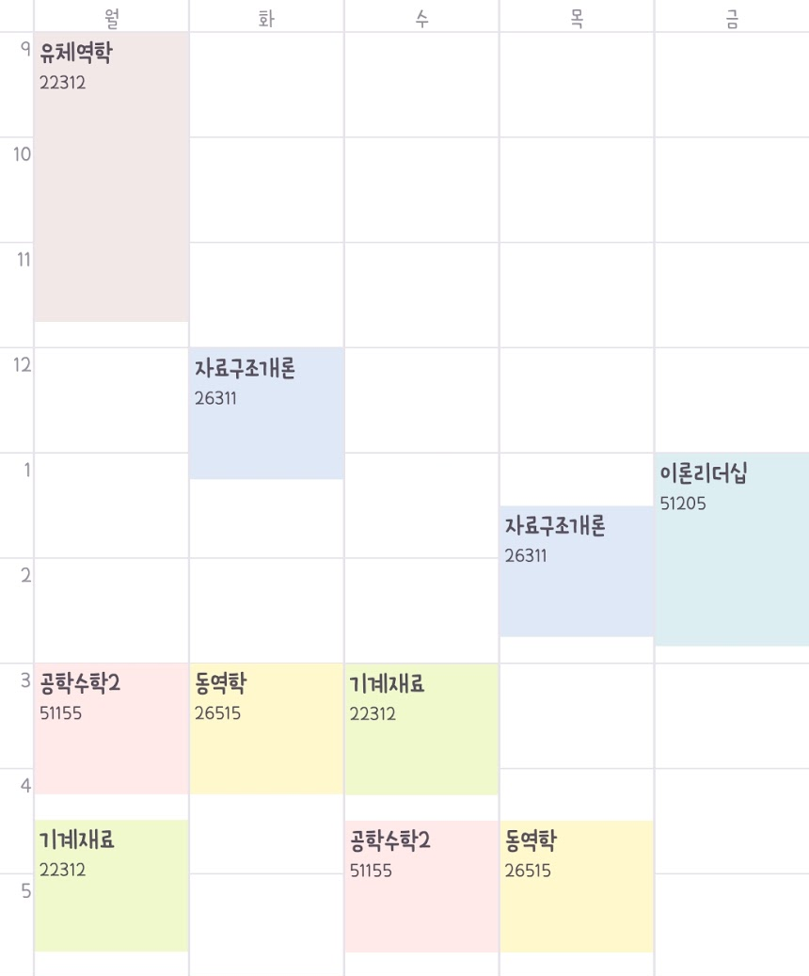
Specialties
- Recommendation System based on two criteria
[Second Criteria]
Recommendation according to subject of one’s time table
Time Table
Shop list
Subject | Items | Items (in detail) | number
Fluid mechanics | Major book | Fluid Mechanics: An Introduction to the Theory of Fluid Flows | 2
 | Engineering Calculator |  | 5
Engineering Mathematics 2 | Major book | Advanced Engineering Mathematics | 4
 | Calculator |  | 10
Data Structure | Major book | Fundamentals of Data Structures | 1
Notes:
Buyer: 거래 안전성 향상 - 같은 학교 커뮤니티에 따른 신뢰도 증가, 상품 직접 확인 가능한 비대면 직거래에 따른 안전성 향상
비용 절감 - 학습 물품 중고 거래에 따른 교육 비용 절감
시간 제약X - 사물함 거래를 통해 시간제약을 받지 않는 직거래 형식
Seller: 빠른 거래 성사 - 추천 알고리즘을 통한 빠른 거래 매칭
시간 제약X - 사물함 거래를 통해 시간제약을 받지 않는 직거래 형식

Slide 21
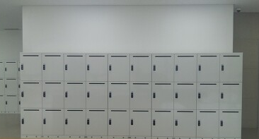
Specialties
Safe Trade
: Untact Trade between Seller and Buyer
Remove time restriction to meet
Utilize empty Locker in school with OTP
Notes:
Buyer: 거래 안전성 향상 - 같은 학교 커뮤니티에 따른 신뢰도 증가, 상품 직접 확인 가능한 비대면 직거래에 따른 안전성 향상
비용 절감 - 학습 물품 중고 거래에 따른 교육 비용 절감
시간 제약X - 사물함 거래를 통해 시간제약을 받지 않는 직거래 형식
Seller: 빠른 거래 성사 - 추천 알고리즘을 통한 빠른 거래 매칭
시간 제약X - 사물함 거래를 통해 시간제약을 받지 않는 직거래 형식

Slide 22
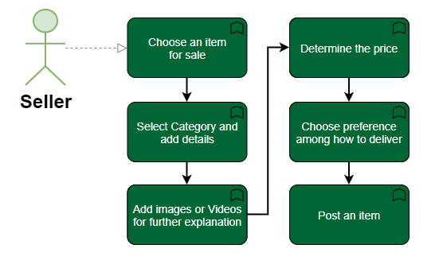
Seller’s Basic Process Flow

Slide 23
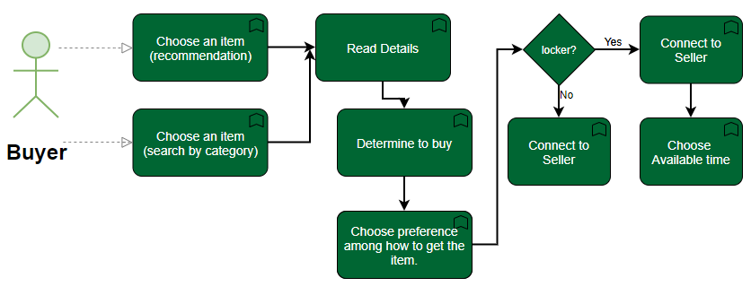
Buyer’s Basic Process Flow

Slide 24
Expected Effects

Slide 25


Expected Effect
Buyer
Seller
Improved deal safety
Cost Reduction
Non-Time Constraint
Fast deal match
Non-Time Constraint
Sell what is not needed
Notes:
Buyer: 거래 안전성 향상 - 같은 학교 커뮤니티에 따른 신뢰도 증가, 상품 직접 확인 가능한 비대면 직거래에 따른 안전성 향상
비용 절감 - 학습 물품 중고 거래에 따른 교육 비용 절감
시간 제약X - 사물함 거래를 통해 시간제약을 받지 않는 직거래 형식
Seller: 빠른 거래 성사 - 추천 알고리즘을 통한 빠른 거래 매칭
시간 제약X - 사물함 거래를 통해 시간제약을 받지 않는 직거래 형식

Slide 26

Expected Effect
Reliable used deal community
책가방

Slide 27
Development Plan
-Tech
-Development Cycle

Slide 28




Frontend
Secure
JavaScript
Vue.js
jQuery
Integral part of web programming
Fast & Secure Development
Future-proof
Progressive nature
Write less
Simple Integration with Frameworks

Slide 29






Backend
Cloud ML Engine
Offer machine learning services as cloud
Serverless
Cloud Endpoints
Develop, deploy, and manage REST APIs
Cloud Storage
Offer cloud storage and static website hosting
Cloud Functions
serverless execution environment for building and connecting cloud services
Google Cloud Platform
Firebase
Cloud-hosted NoSQL database

Slide 30




Recommendation
Provide convenient way
of handling data
Tool used for gathering data from the web
Provide Numerous Machine Learning
and Data preprocessing methods etc.

Slide 31
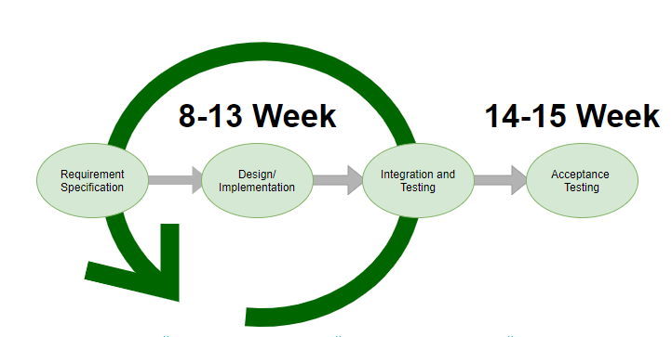
Development Cycle

Slide 32
Thank You!
Team 4

