Slide 1

4조 한채정, 송현욱, 서주원, 주원영, 문원준, 담딘바자르

Slide 2

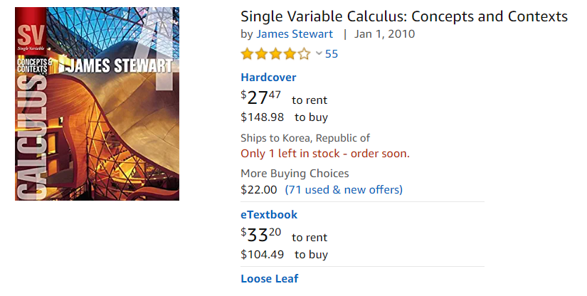
Background

Slide 3







Background

Slide 4



Background
alternatives
From Senior
PDF
Used Books

Slide 5
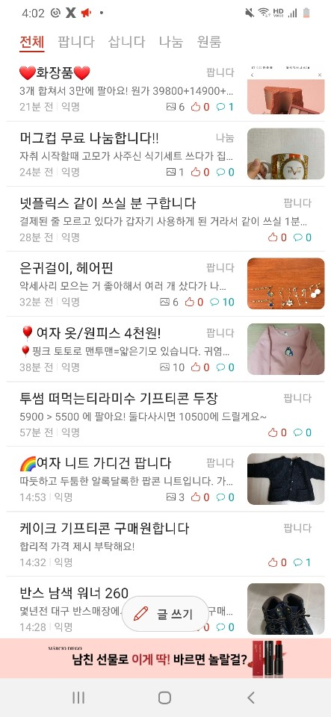
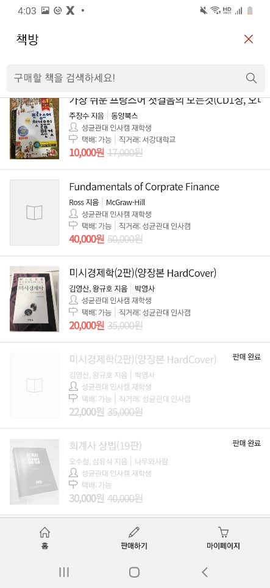
Background
Problems in current system

Slide 6
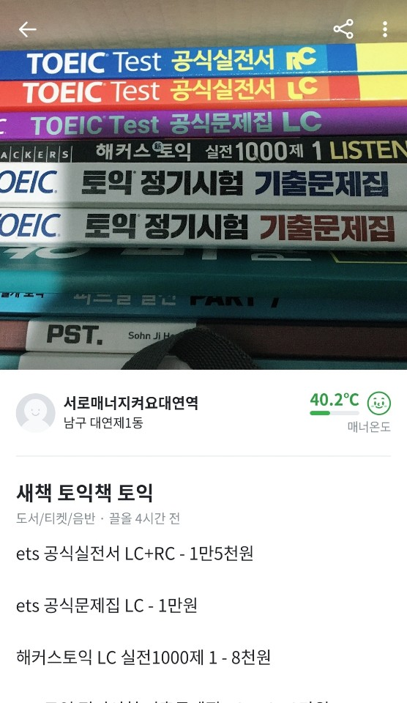

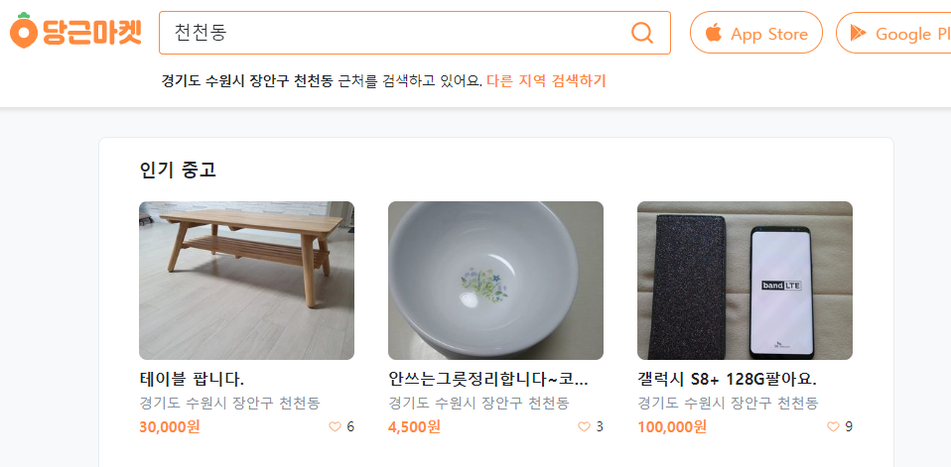
Background
Problems in current system

Slide 8
Functional Requirement
Plan in requirement specification
- Sign up/ Login
- Time Table
- Recommendation
- Safe deal using Locker
- Item Description
- Search
- My Page

Slide 9
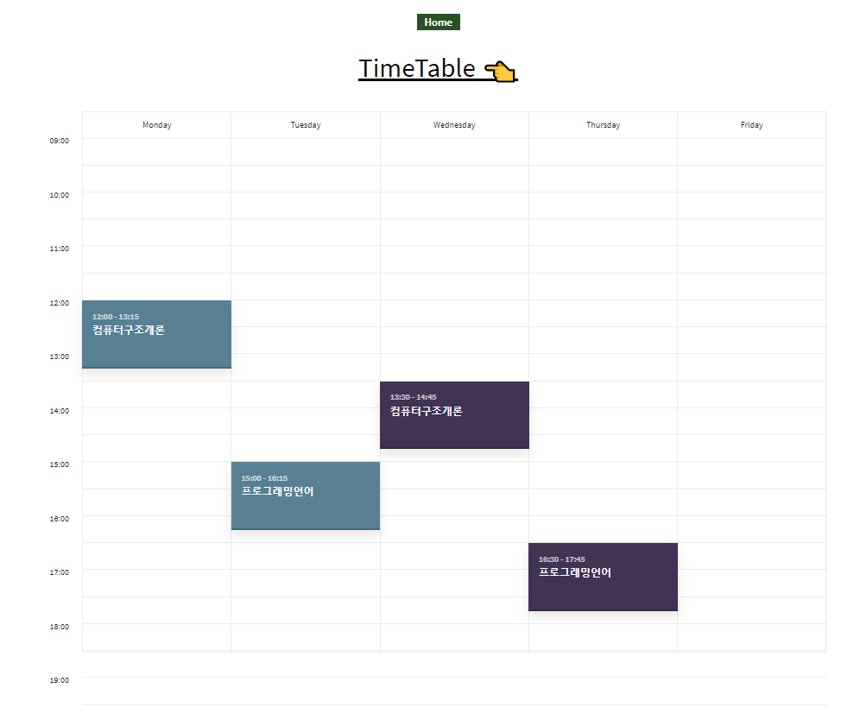
Non Functional Requirement
Plan in requirement specification
- Usability
Security
- Reliablity

Slide 10
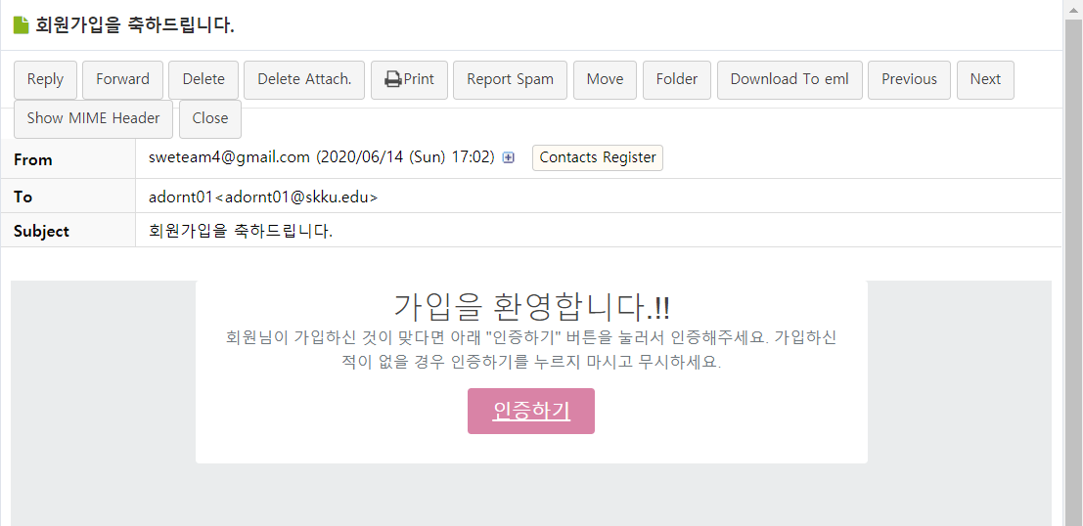
Non Functional Requirement
Plan in requirement specification
- Usability
Security
- Reliablity

Slide 11
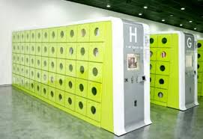
Non Functional Requirement
Plan in requirement specification
- Usability
Security
- Reliablity

Slide 12


Expected Effect
Buyer
Seller
Improved deal safety
Cost Reduction
Non-Time Constraint
Fast deal match
Non-Time Constraint
Sell what is not needed

Slide 13
THANK YOU

