Slide 1

Liquidity Providing Algorithm for RAM, Bancor Protocol
EOSeoul(eoseoul@neowiz.com)

Slide 2
Contents
Introduction
Smart Token
Pricing Algorithm: Bancor
Bancor in EOSIO

Slide 3
Introduction
Liquidity?

Slide 4
Smart Token
Token of Tokens
Automated market maker: Connector
Network of Tokens

Slide 5
Pricing Algorithm: Bancor
3 Values Bancor Connector Keep:
- Supply
- Balance
- Connecting Weight(CW)

Slide 6
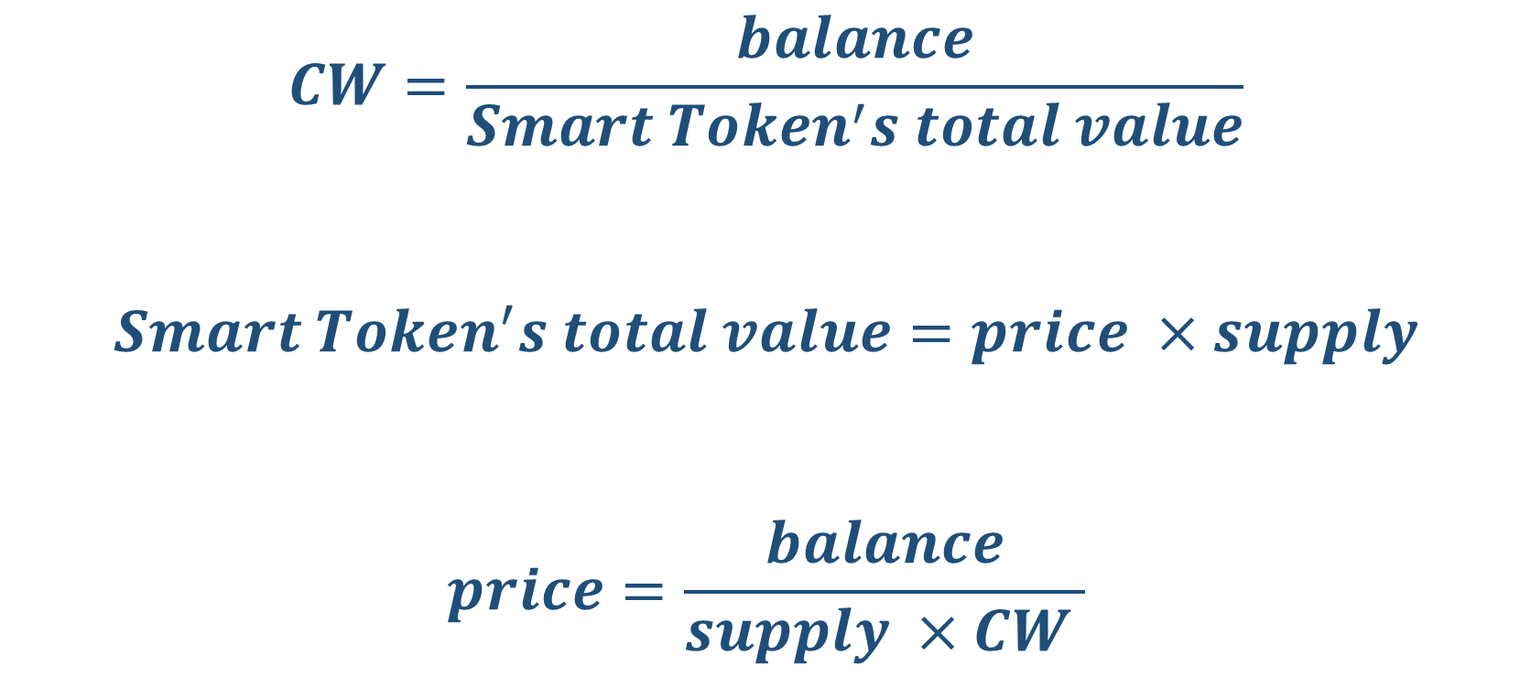
Pricing Formula of Bancor
$$CW=\frac{balance}{Smart Token^{′}s total value}$$
$$Smart Token^{′}s total value=price ×supply$$
$$price=\frac{balance}{supply ×CW }$$

Slide 7
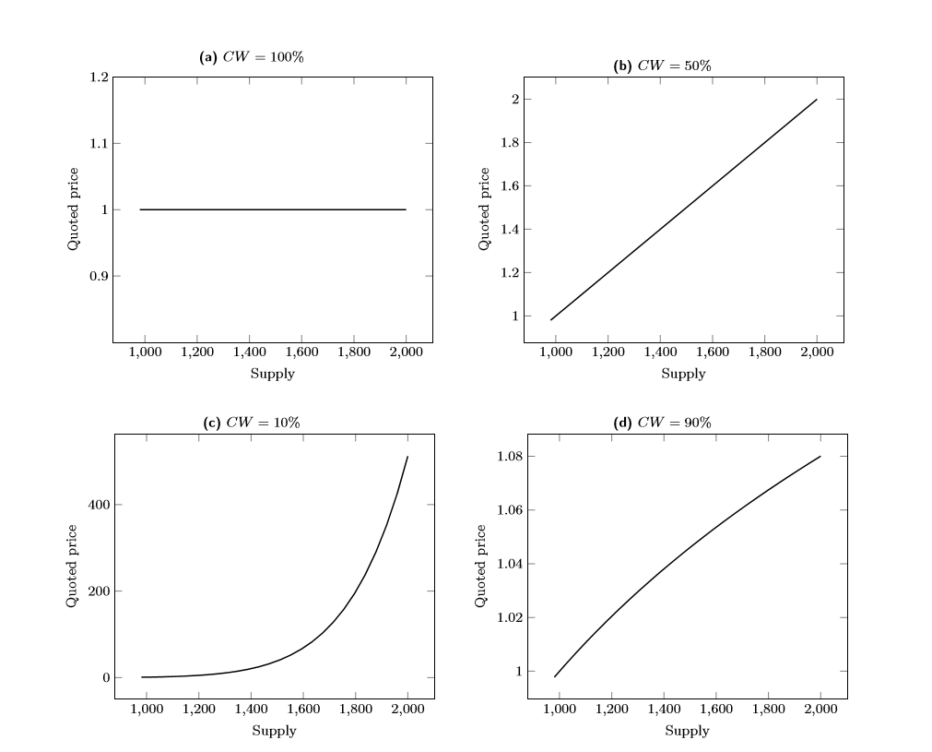
Eg) Price as a function of supply for varying CWs

Slide 8
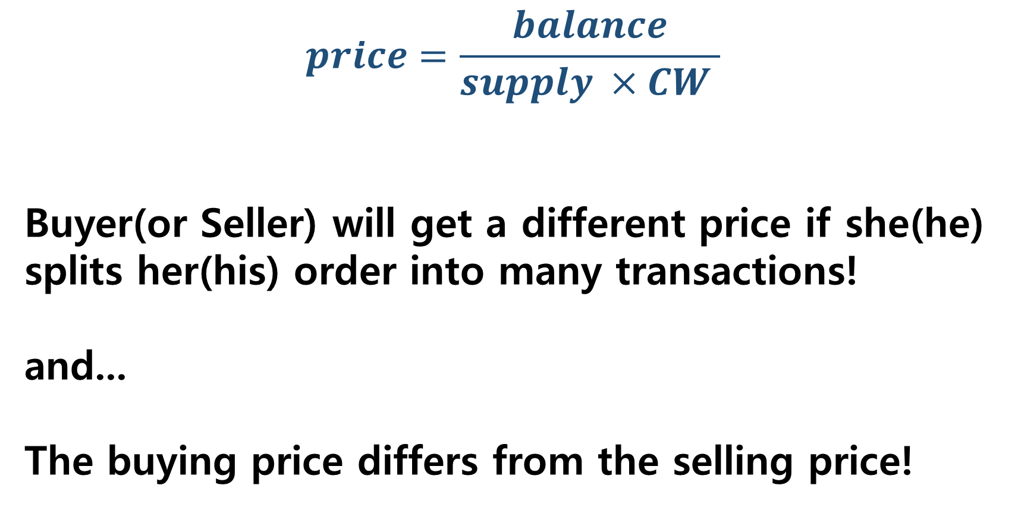
Price Slippage
$$price=\frac{balance}{supply ×CW }$$
Buyer(or Seller) will get a different price if she(he) splits her(his) order into many transactions!
and...
The buying price differs from the selling price!

Slide 9
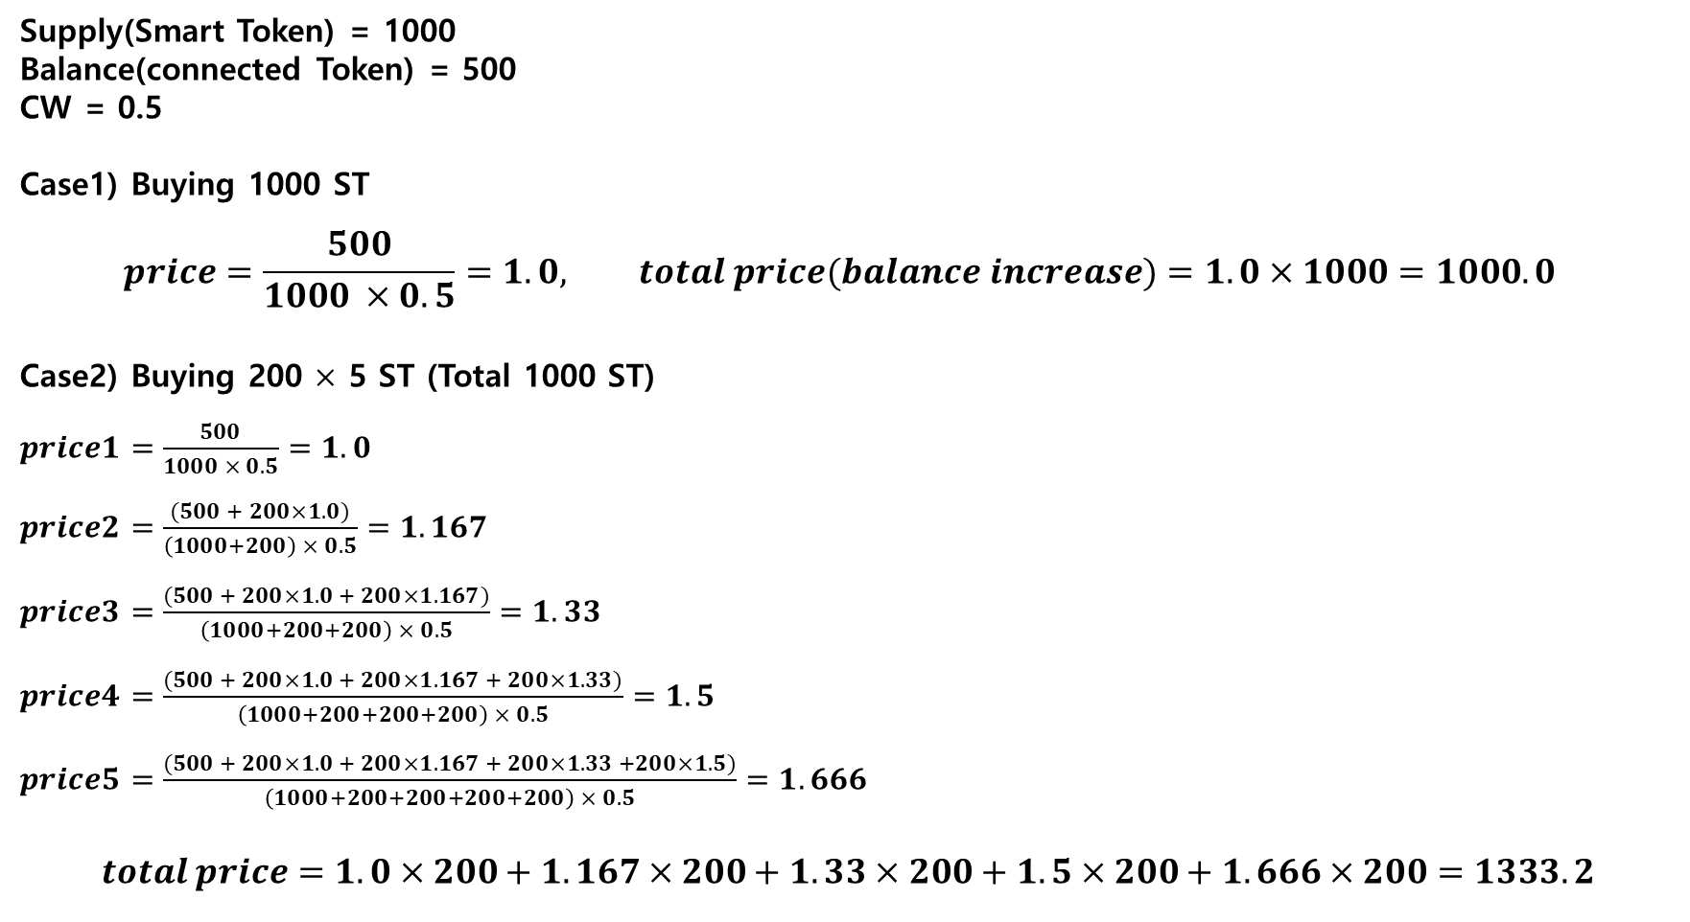
Eg) Price Slippage #1
Supply(Smart Token) = 1000
Balance(connected Token) = 500
CW = 0.5
Case1) Buying 1000 ST
$$price=\frac{500}{1000 ×0.5}=1.0, total price(balance increase)=1.0×1000=1000.0$$
Case2) Buying 200 $×$ 5 ST (Total 1000 ST)
$price1=\frac{500}{1000 × 0.5}=1.0$
$price2=\frac{(500 + 200×1.0)}{\left(1000+200\right) × 0.5}=1.167$
$price3=\frac{(500 + 200×1.0 + 200×1.167)}{\left(1000+200+200\right) × 0.5}=1.33$
$price4=\frac{(500 + 200×1.0 + 200×1.167 + 200×1.33)}{\left(1000+200+200+200\right) × 0.5}=1.5$
$price5=\frac{(500 + 200×1.0 + 200×1.167 + 200×1.33 +200×1.5)}{\left(1000+200+200+200+200\right) × 0.5}=1.666$
$$total price=1.0×200+1.167×200+1.33×200+1.5×200+1.666×200=1333.2$$

Slide 10

Eg) Price Slippage #2
Supply(Smart Token) = 1000
Balance(connected Token) = 500
CW = 0.5
Case1) Buying 1000 ST
$$price=\frac{500}{1000 ×0.5}=1.0, total price=1.0×1000=1000.0$$
Case2) After buying, selling 1000 ST(=bought)
$$price=\frac{(500+1.0×1000)}{(1000+1000) ×0.5}=1.5, total price=1.5×1000=1500.0$$

Slide 11

Handling Price Slippage
$$Smart Tokens issued=supply × \left\{{\left(1+ \frac{connected Tokens paid}{balance}\right)}^{CW}−1 \right\}$$
$$connected Tokens paid out=balance × \left(\sqrt[CW]{1+ \frac{Smart Token destroyed}{supply}} −1\right)$$
$$effective price= \frac{connected Tokens exchanged}{Smart Tokens exchanged}$$
For more information, please visit here

Slide 12
Initial Values
$$Smart Tokens issued=supply × \left\{{\left(1+ \frac{connected Tokens paid}{balance}\right)}^{CW}−1 \right\}$$
This formula works if and only if initial supply and balance > 0!
(Initial) balance provides THE liquidity!

Slide 13
Implementation
NOTE: This formula includes vectors!
$$connected Tokens paid out=balance × \left(\sqrt[CW]{1+ \frac{Smart Token destroyed}{supply}} −1\right)$$
So, implementation of Sell() must consider it

Slide 14
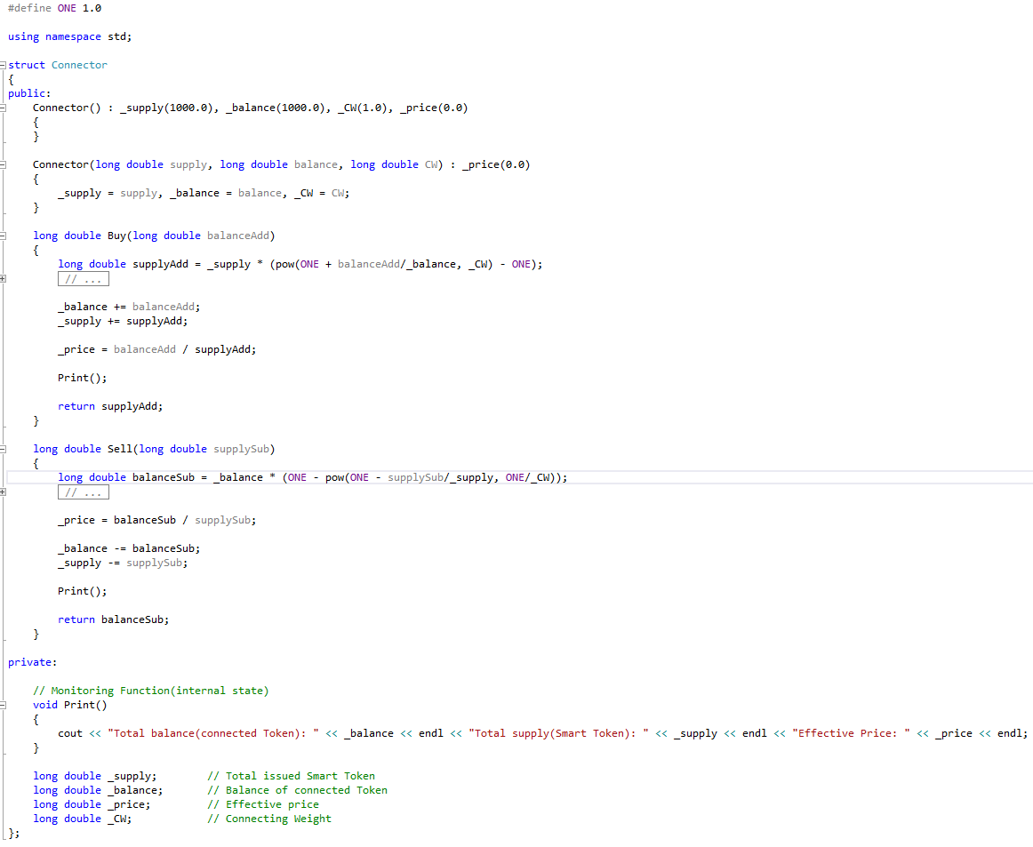
Implementation Examples(in C++ code)

Slide 15
Bancor in EOSIO: RAM market
eosio System contract for RAM buy and sell(till 2018/05/23):
void system_contract::buyram( account_name payer, account_name receiver, asset quant )
void system_contract::sellram( account_name account, int64_t bytes )
eos/contracts/eosio.system/eosio.system.hpp

Slide 16
Bancor in EOSIO: Relay Token
(EOS)
Relay token
CORE
RAM
RAMCORE
Token
Smart Token
Token

Slide 17
Bancor in EOSIO: Buying RAM
(EOS)
CORE
RAM
Buying
RAMCORE
Selling

Slide 18
Bancor in EOSIO: Selling RAM
(EOS)
RAM
CORE
Buying
RAMCORE
Selling

