Slide 1
The Evolution of Apache Kylin Realtime & Plugin Architecture in Kylin 1.5
Li, Yang | 李扬

Slide 2
Agenda
What’s Apache Kylin?
New Features in Kylin 1.5
Plugin Architecture
Fast Cubing
Parallel Scan
Streaming Cubing
User Defined Aggregation
Summary

Slide 3


What’s Kylin
kylin / ˈkiːˈlɪn / 麒麟
--n. (in Chinese art) a mythical animal of composite form
Extreme OLAP Engine for Big Data
Kylin is an open source Distributed Analytics Engine from eBay that provides SQL interface and multi-dimensional analysis (OLAP) on Hadoop supporting extremely large datasets
Open Sourced on Oct 1st, 2014
Accepted as Apache Incubator Project on Nov 25th, 2014
Notes:
Olap
Big data
Vs ubuntu kylin
Ebay 第一个贡献到apache的开源项目，也是完整由中国团队贡献到Apache的第一个项目

Slide 4
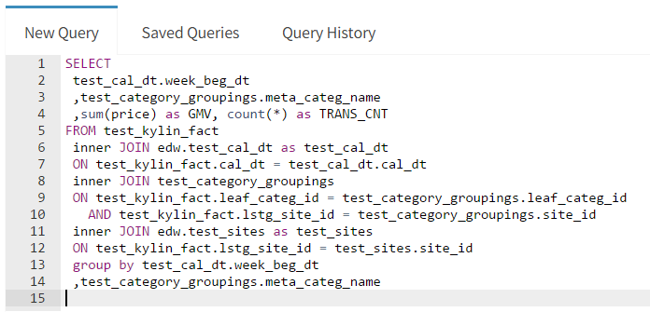
Feature – SQL Interface
Hive Table
Build Cube (Index)
SQL Query

Slide 5










Feature – Big Data
eBay
Case | Cube Size | Raw Records
Session Analysis | 20 TB | 81+ billion rows
Traffic Analysis | 30 TB | 28+ billion rows
Transaction Analysis | 560 GB | 1.2+ billion rows

Slide 6
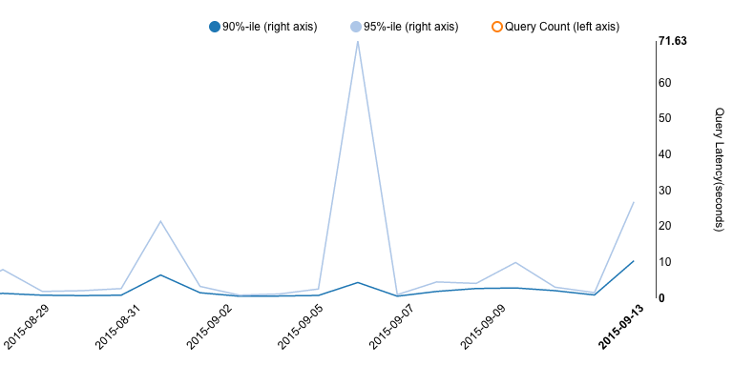
Feature – Low Latency
90% queries <5s
Dark-blue line: 90%tile queries
Light-blue line: 95%tile queries
90%ile query returns in 3 seconds

Slide 7
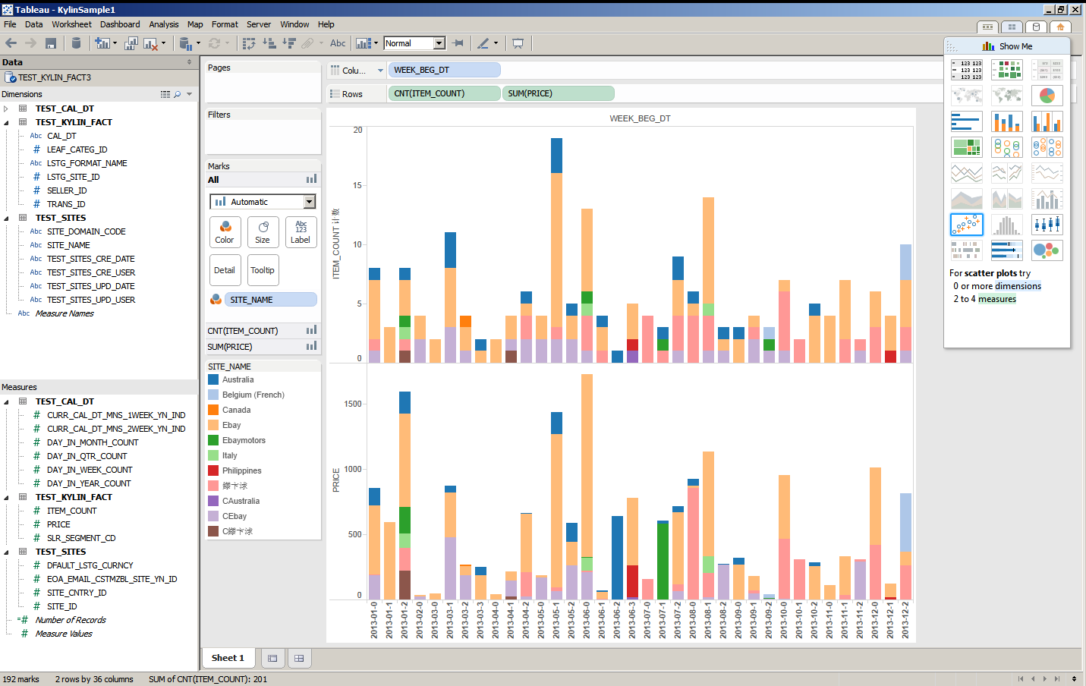
Feature – BI Integration via ODBC, JDBC

Slide 8
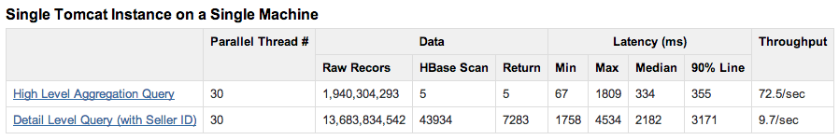
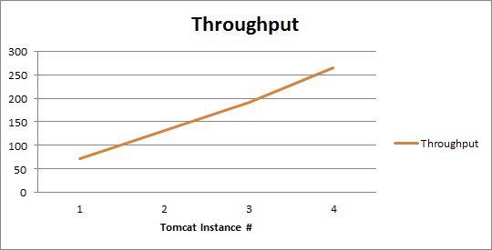
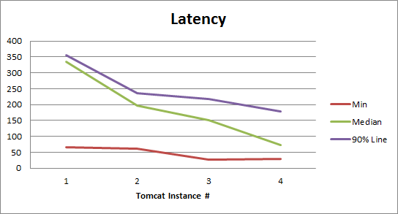
Feature – Scalable Throughput
Linear scale out with more nodes
Notes:
介绍query
1台机器4个tomcat instanc可以达到300左右的QPS

Slide 9
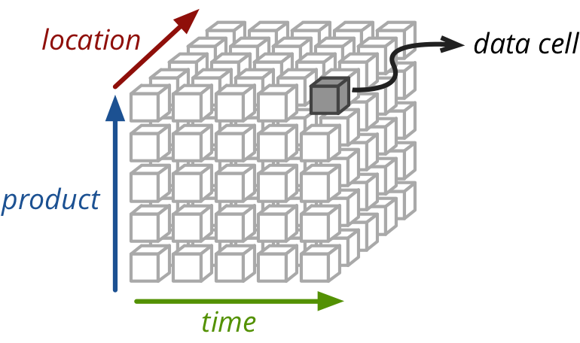
How it works – Materialized View
A query may consider only 3 dimensions

Slide 10
How it works – OLAP Cube, space for time
Cuboid = one combination of dimensions
Cube = all combination of dimensions (all cuboids)
0-D(apex) cuboid
time
item
location
supplier
1-D cuboids
time, item
time, location
item, location
location, supplier
Time, supplier
item, supplier
2-D cuboids
time, location, supplier
3-D cuboids
time, item, location
time, item, supplier
item, location, supplier
time, item, location, supplier
4-D(base) cuboid
Base vs. aggregate cells; ancestor vs. descendant cells; parent vs. child cells
(9/15, milk, Urbana, Dairy_land) - <time, item, location, supplier>
(9/15, milk, Urbana, *) - <time, item, location>
(*, milk, Urbana, *) - <item, location>
(*, milk, Chicago, *) - <item, location>
(*, milk, *, *) - <item>

Slide 11
Agenda
What’s Apache Kylin?
New Features in Kylin 1.5
Plugin Architecture
Fast Cubing
Parallel Scan
Streaming Cubing
User Defined Aggregation
Summary

Slide 12
Plugin Architecture Overview
3rd Party App
(Web App, Mobile…)
SQL-Based Tool
(BI Tools: Tableau…)
Online Analysis Data Flow
Offline Data Flow
Clients/Users interactive with Kylin via SQL
OLAP Cube is transparent to users
REST API
JDBC/ODBC
SQL
SQL
REST Server
Query Engine
Routing
Low Latency - Seconds
Hadoop
Hive
Data Cube
Engine
Abstraction
OLAP
Cubes
(HBase)
Data Source
Abstraction
Storage
Abstraction
Metadata
Cube Builder (MapReduce…)
Star Schema Data
Key Value Data
Notes:
A High Level Architecture for Kylin which is a Standard MOLAP Architecture built on Hadoop.
Data Sources to build your MOLAP Cubes primarily Hive, We have a fantastic project in the works for a Storage Abstraction Layer and support other NoSQL Stores such as Cassandra/CouchBase.
An Engine Abstraction which maintains the Cube Metadata and a Cube Builder. Today a set of Map Reduce Jobs to build the cubes.
A storage layer to store the Cubes in Hbase, primarily through a Bulk Load of the aggregrates into Hbase.
We are looking for active community participation to build out additional Data Source, Engine and Storage plugins into Kylin.
A Query Engine that directly index into the multi-dimensional arrays built into Hbase.

Slide 13
Plugin Architecture
Cube Metadata
SourceFactory
EngineFactory
StorageFactory
Hive Source
MR Engine
HBase Storage
IN
OUT

Slide 14
Plugin Architecture
adapt to IN
adapt to OUT
Hive Source
HBase Storage
MR Engine
load data
save cube
Hive Adapter
HBase Adapter

Slide 15
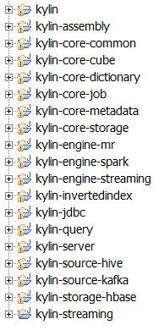
Developing Modules
Engine
MR V1
MR V2
Spark (early)
Streaming (experimental)
Source
Hive
Kafka
Spark SQL & DataFrames
Storage
HBase
? Kudu
? Cassandra

Slide 16
The Freedom, Extensibility, Flexibility
Freedom
Zoo break, not bound to Hadoop any more
Free to go to a better engine or storage
Extensibility
Accept any input, e.g. Kafka
Embrace next-gen distributed platform, e.g. Spark
Flexibility
Choose different engine for different data set

Slide 17
Layered Cubing (MR Engine V1)
Pros
Simple implementation, depends on MR shuffle to merge sort and then aggregate
Little requirement on memory
Cons
Aggregation happens at reducer side
Mapper outputs raw data thus shuffle is huge
Multiple rounds of MR overhead
Shuffle can be 100x of cube size, big I/O pressure
0-D Cuboid
MR
1-D Cuboid
MR
2-D Cuboid
MR
3-D Cuboid
A,B,C
A,B,D
A,C,D
B,C,D
MR
4-D Cuboid
A,B,C,D
MR
Full Data

Slide 18
Fast Cubing
Pros
In-mem cubing algorithm that can be reused by Streaming, Spark etc.
Mapper side aggregation
Lesser shuffling given the right data split
One round MR
Cons
Code complexity
High mapper CPU/Mem consumption
mapper
mapper
mapper
Data Split
Data Split
Data Split
……
Merge Sort
(Shuffle)
Final Cube
reducer

Slide 19
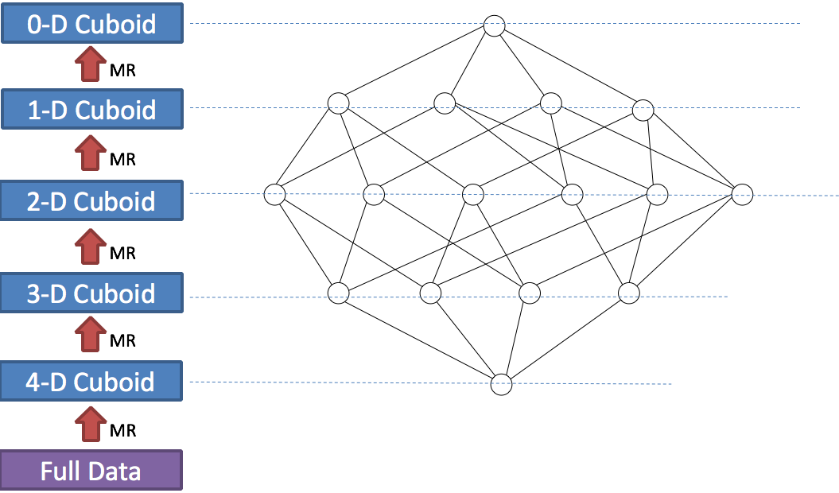
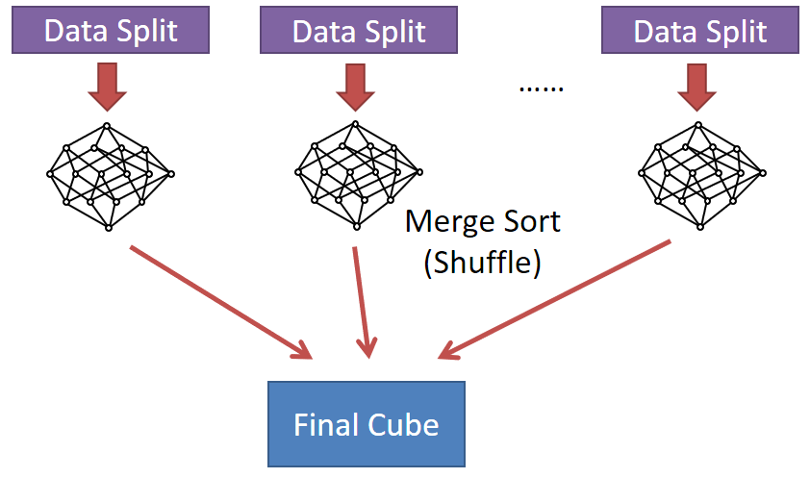
Fast Cubing (MR Engine V2)
If data splits are unique
Fast cubing wins
If data splits are common
Layer cubing wins
New cube engine chooses the right algorithm based on data sampling.
Overall build time is 1.5x faster, sum results from 500 jobs.

Slide 20
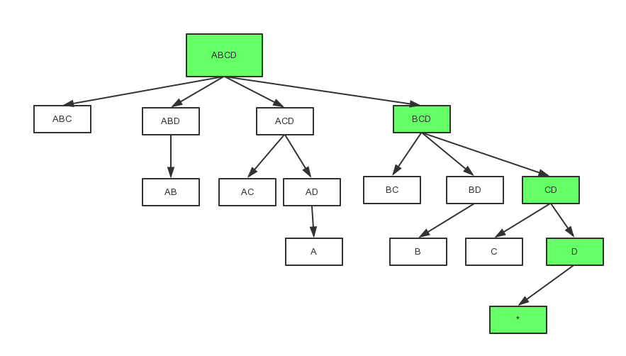
In-Mem Cubing
A simplified star cubing algorithm
Xin, Dong, et al. "Star-cubing: Computing iceberg cubes by top-down and bottom-up integration." Proceedings of the 29th international conference on Very large data bases-Volume 29. VLDB Endowment, 2003.
Top-down; Free resource on branch complete
Multi-threading if mem available; Ordered output

Slide 21
Parallel Scan
Cuboid A
Server 1
Slow queries are 5-10x faster.
New Hbase storage enables partition on cuboids that are big enough.
Overall query time is 2x faster than before, sum results from 10,000+ queries.
Query
Cuboid B
Server 2
Cuboid C
Server 3
A1
B1
Server 1
Query
A2
B2
Server 2
A3
C
Server 3

Slide 22
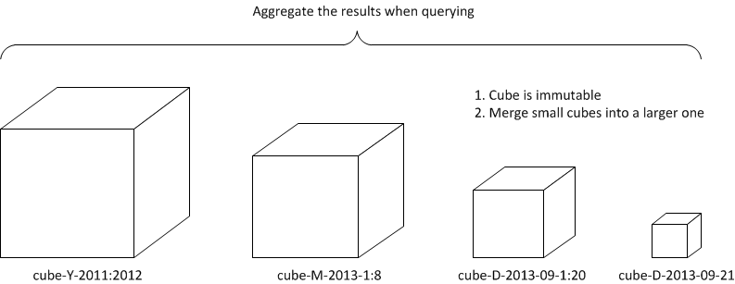
Near Realtime Incremental Build
Minutes micro cubes
Kafka source
In-mem cubing
Auto merge

Slide 23
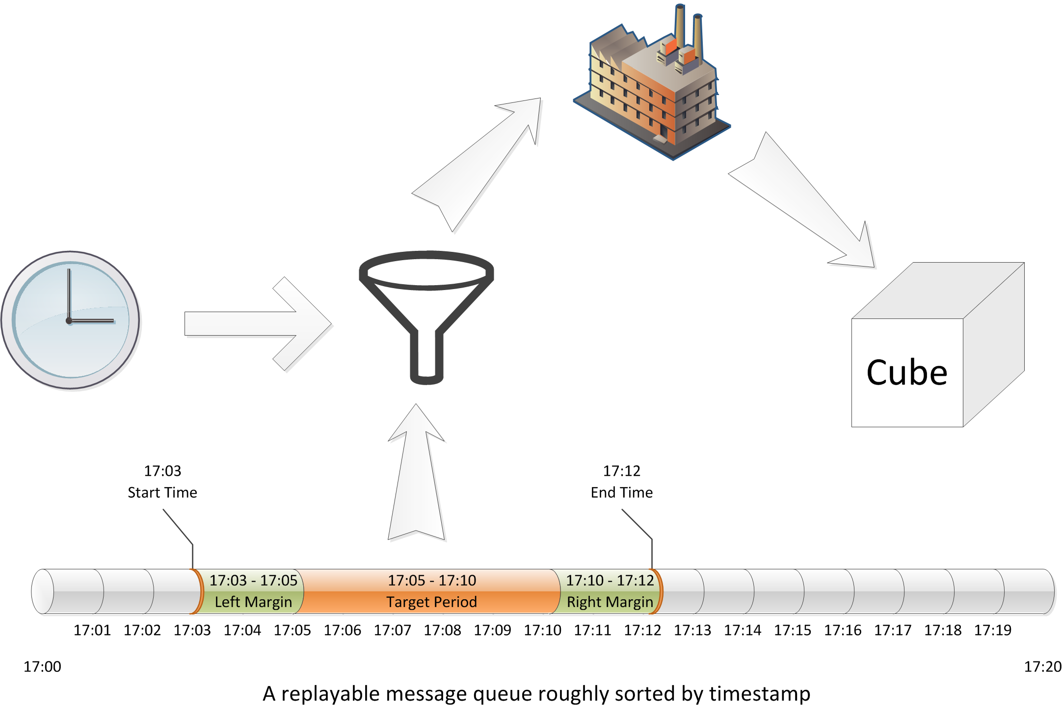
Stream Data Consuming

Slide 24
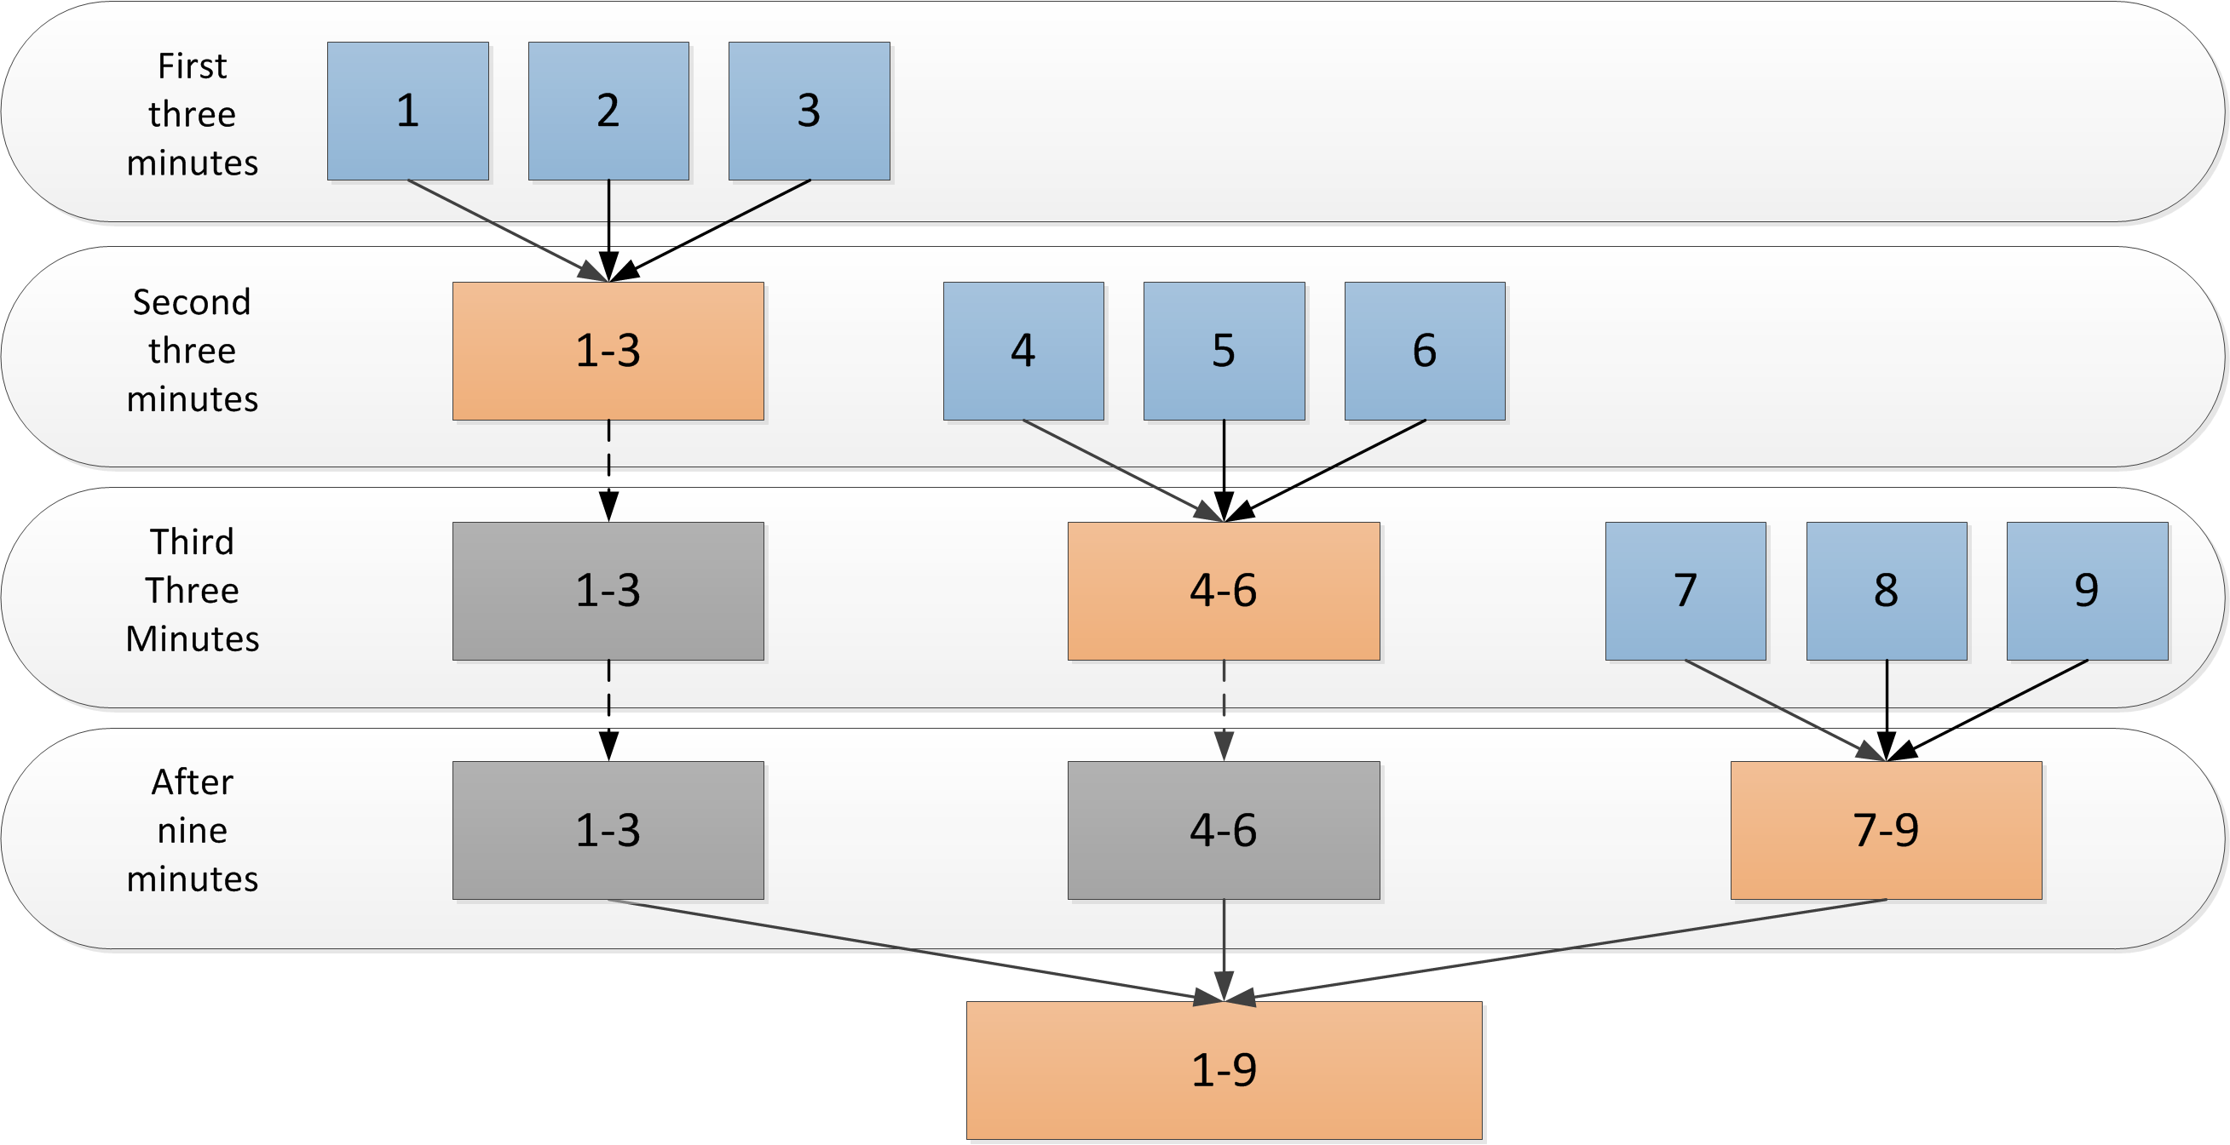
Cube Auto Merge
In-Memory Cube Building
Auto Cube Merge with MR

Slide 25
Future Lambda Architecture for Realtime
SQL Query
Hybrid Storage Interface
Real-time In-Mem Store
Cube Storage
Inverted Index
Cube
Latest second
minute batch
streaming
Kafka

Slide 26



Use Case: SEO Operational Dashboard
eBay Site
ebay.com, ebay.co.uk, ebay.de
Buyer Country
US, CN, RU
Search Engine
Google, Bing, Yahoo!
Referrer
google.com, google.co.uk
Page
Search, View Item, Product
User Experience
Desktop, Mobile APP, mWeb
Dimensions
Visits, GMB $, GMB share, conversion rate, bounce rate, # of view items, # of bought items etc.
Measurements

Slide 27
User Defined Aggregation Types
HyperLogLog Count Distinct
TopN
BitMap Precise Count Distinct
from Sun, Yerui (netease.com)
Raw Records
from Wang, Xiaoyu (jd.com)
Domain specific aggregations now become easy
aggregate user events to detect time serials or access patterns
draw a sketch of certain user groups
pre-calculate clusters of data points
histogram…

Slide 28
TopN Support
TopN as a measure
Approximate algorithm
SpaceSaving TopN
Ahmed Metwally, et al. “Efficient computation of frequent and top-k elements in data streams”. Proceeding ICDT'05 Proceedings of the 10th international conference on Database Theory, 2005.
A parallel version
Massimo Cafaro, et al. “A parallel space saving algorithm for frequent items and the Hurwitz zeta distribution”. Proceeding arXiv: 1401.0702v12 [cs.DS] 19 Setp 2015.
Answer TopN queries directly from pre-calculation
select dt, loc, item, sum(gmv)
from test_kylin_fact
where dt=‘2015-10-1’ and loc=‘CN’
group by dt, loc, item
order by 4 desc
limit 100
DT,LOC | TopN
2015-10-1,CN | Item A, $500 Item B, $300 …
cube pre-calculation

Slide 29
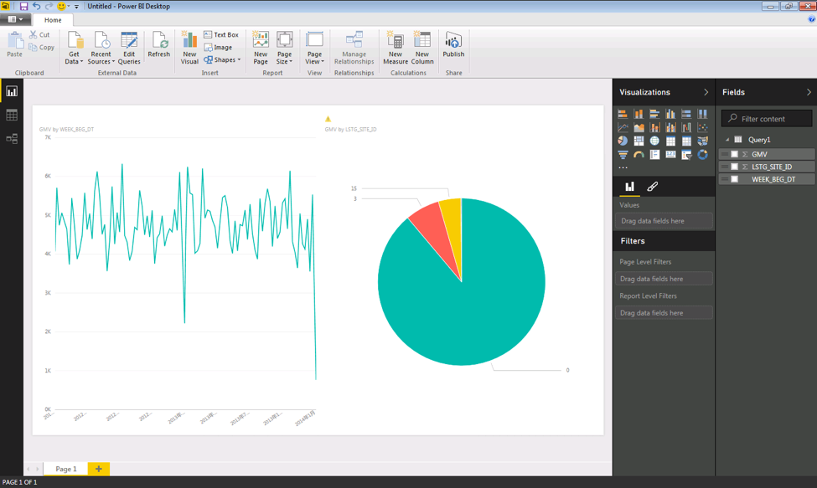
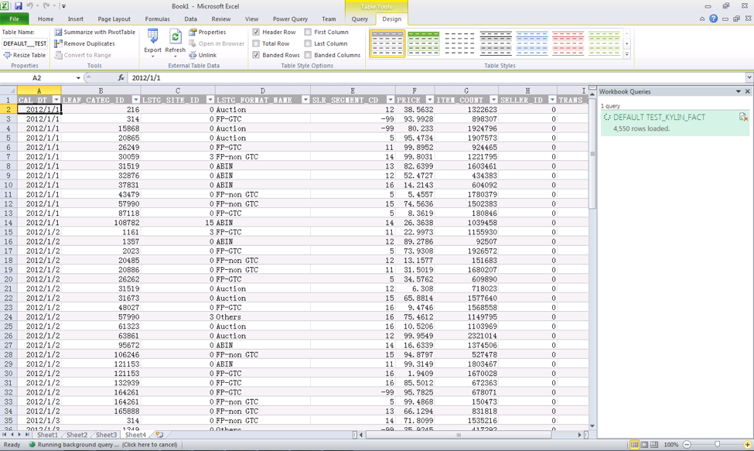
ODBC Enhancement
Works with Tableau 9.1
Works with MS Excel
Works with MS Power BI

Slide 30
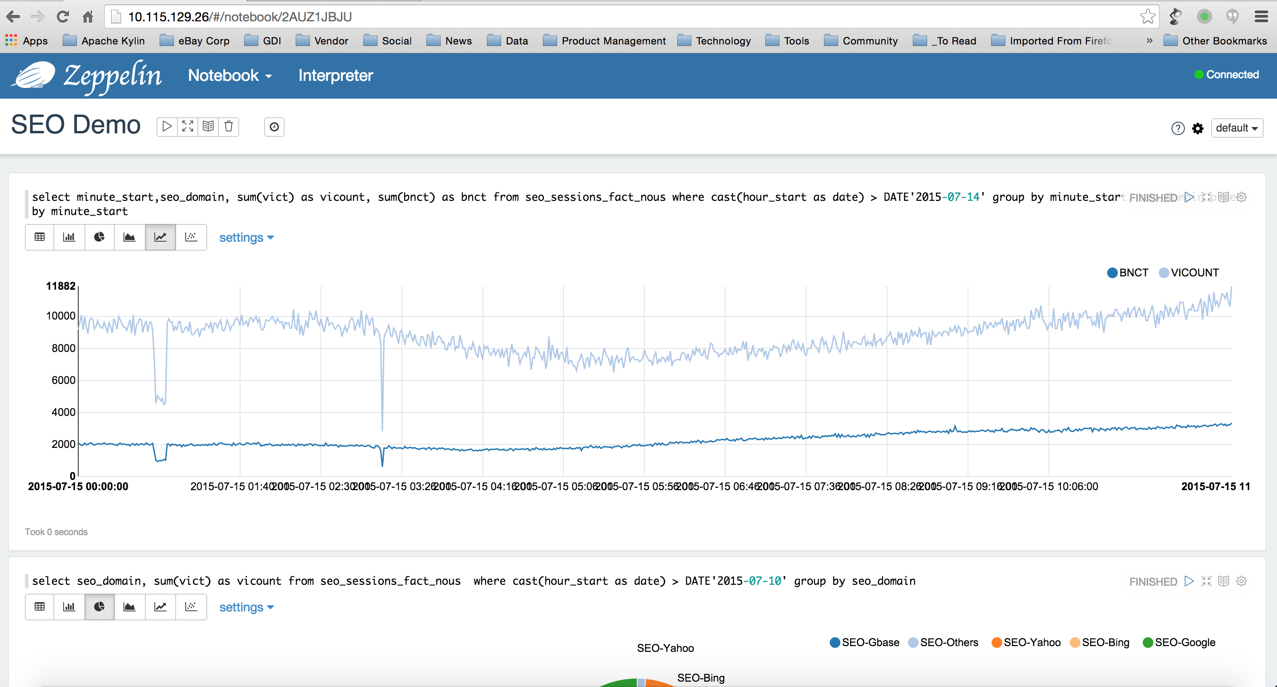
Zeppelin Integration

Slide 31
Agenda
What’s Apache Kylin?
New Features in Kylin 1.5
Plugin Architecture
Fast Cubing
Parallel Scan
Streaming Cubing
User Defined Aggregation
Summary

Slide 32
Summary
New in Apache Kylin 1.5
Plugin-able architecture
New MR Cube Engine with fast cubing (1.5x faster)
New HBase Storage with parallel scan (2x faster)
Near real-time analysis (experimental)
User defined aggregations
Excel / PowerBI / Zeppelin integration

Slide 33

Thanks!
http://kylin.io

