Slide 1
Hadoop Core : HDFS
Boyu Diao
2016.05.27

Slide 2
Outlines
Recall Hadoop Ecosystem and Hadoop Core
Some Concepts in Distributed System
HDFS Architecture
HDFS Read and Write
HDFS Shell and API

Slide 3
Outlines
Recall Hadoop Ecosystem and Hadoop Core
Some Concepts in Distributed System
HDFS Architecture
HDFS Read and Write
HDFS Shell and API

Slide 4
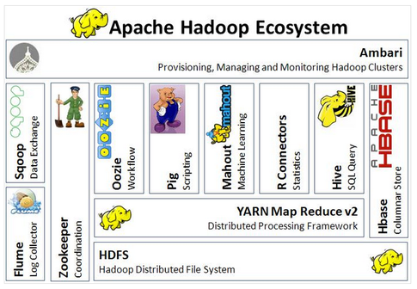
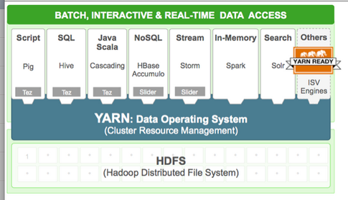
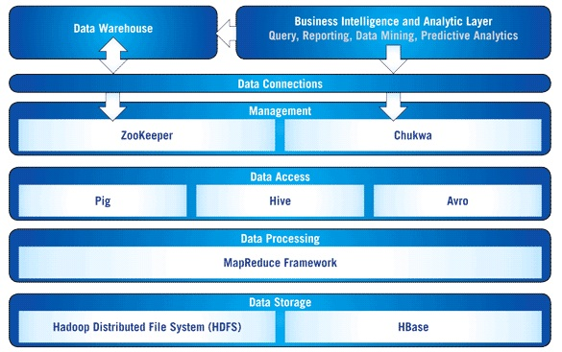
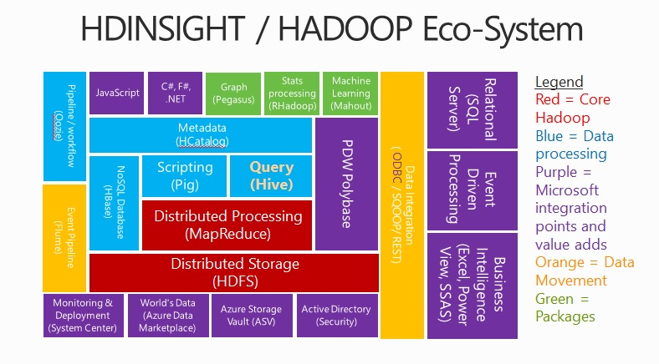
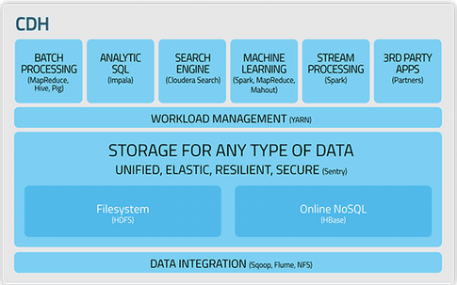
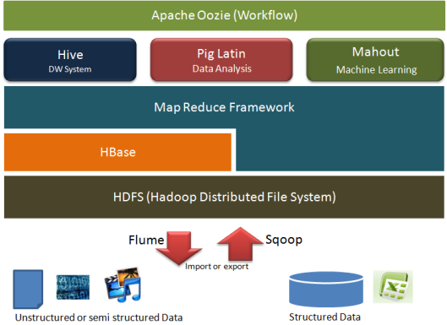
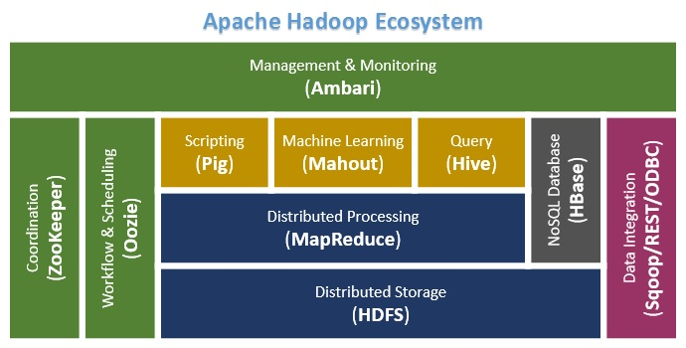
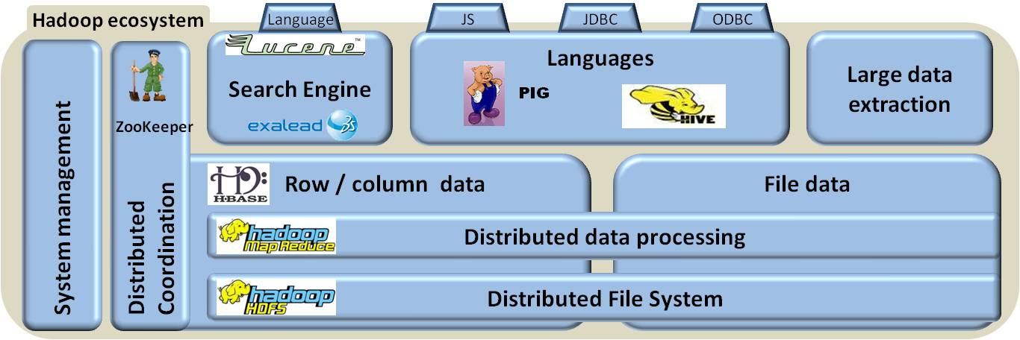
Recall Hadoop Ecosystem

Slide 5
Recall Hadoop Ecosystem
Hadoop Ecosystem Table https://hadoopecosystemtable.github.io/
Categories | Examples
Distributed Filesystem | HDFS, GlusterFS
Distributed Programming | MapReduce / Spark /Storm
SQL-On-Hadoop | HIVE / Drill
NoSQL Databases | Hbase / Cassandra
Data Ingestion | Sqoop / Flume
Service Programming | Thrift / Avor / Zookeeper
Machine Learning | Mahout

Slide 6
Recall Hadoop Core
Components | Introduction
HDFS | designed to reliably store very large files across machines in a large cluster.
YARN | The fundamental idea of YARN is to split up the functionalities of resource management and job scheduling/monitoring into separate daemons.
MapReduce | MapReduce is a programming model and an associated implementation for processing and generating large data sets with a parallel, distributed algorithm on a cluster.
Notes:
Wiki 对hadoop的定义非常精辟
首先，hadoop是一个software framework。而不是一个software。框架的意思，就是你可以基于框架，做特定的二次开发。
Software就好比是一个某一种口味的披萨饼，framework就好比是一个纯的饼，你可以根据你的需要，加烤肉，蔬菜，培根。
直观的看这句话，我们可以理解出hadoop的两个内涵，一个就是分布式存储，一个是分布式处理，这是hadoop两层内涵。
深入的琢磨一下，其实还有另一层内涵，对于一个computer cluster，数千台服务器，如何分配processing的资源，是一个大问题。
Hadoop的第三层内涵就是资源调度。
所以对hadoop的理解，首先他是一个分布式的软件框架
从Hadoop 2.0以后，内核包含三个部分

Slide 7
Outlines
Recall Hadoop Ecosystem and Hadoop Core
Some Concepts in Distributed System
HDFS Architecture
HDFS Read and Write
HDFS Shell and API

Slide 8
Some Concepts in Distributed System
Copy (副本)
replica
Copy consistency(一致性)
strong consistency
week consistency
eventual consistency
Monotonic(单调) consistency
Prototype | Copy consistency
HDFS | Eventual Consistency
Hbase | Strong Consistency

Slide 9
Some Concepts in Distributed System
Prototype | Data distribution
HDFS | Data Chunk
Cassandra | Consistence Hashing
HBase | Data Range
Big Pipe | Hashing
Data distribution
Hashing
Data Range
Data Chunk(块)
Consistency Hashing
Copy Control Protocol
Centralized
primary-secondary
Decentralized
Paxos
Prototype | CC Protocol
HDFS | Primary-Secondary
Megastore | Paxos

Slide 10
Some Concepts in Distributed System
Copy consistency(一致性)
strong consistency
当更新操作完成之后，任何多个后续进程或者线程的访问都会返回最新的更新过的值。
week consistency
系统并不保证续进程或者线程的访问都会返回最新的更新过的值。但保证每个副本都有相同的读写时序。
eventual consistency
弱一致性的特定形式。系统保证在没有后续更新的前提下，系统最终返回上一次更新操作的值。
Monotonic(单调) consistency

Slide 11
Outlines
Recall Hadoop Ecosystem and Hadoop Core
Some Concepts in Distributed System
HDFS Architecture
HDFS Read and Write
HDFS Shell and API

Slide 12
HDFS Architecture
HDFS is designed to reliably store very large files across machines in a large cluster.
Problems | Methods
Copy / Replica | Multiple
Copy Consistency | Eventual Consistency
Data Distribution | Data Chunk
Copy Control Protocol | Primary-Secondary
Ghemawat, S.; Gobioff, H.; Leung, S. T. (2003). "The Google file system". Proceedings of the nineteenth ACM Symposium on Operating Systems Principles - SOSP '03

Slide 13
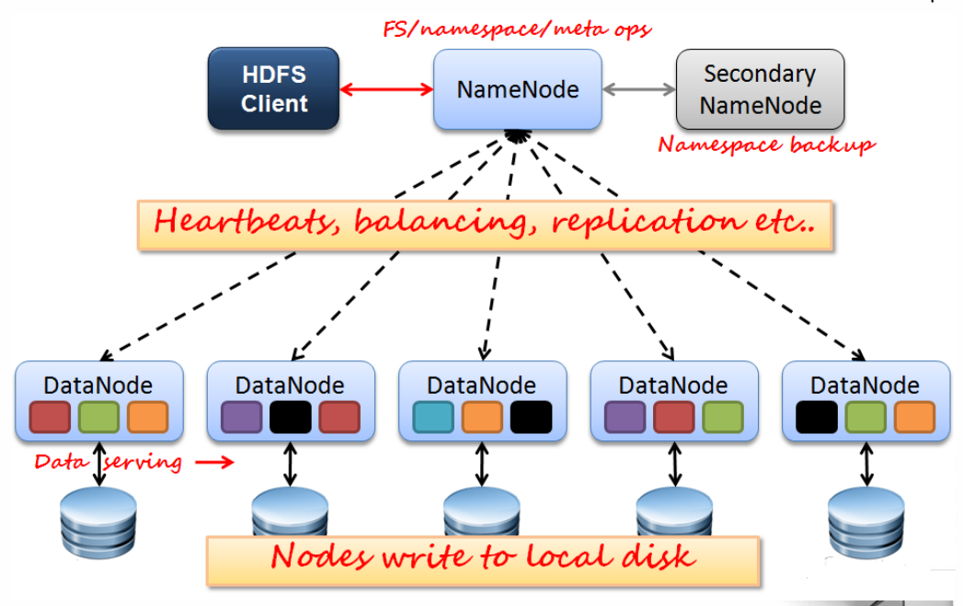
HDFS Architecture
Before HDFS 2.0

Slide 14




HDFS Architecture
Master
管理命名空间镜像文件（fsimage）和操作日志（fsedits）
管理数据块映射信息
管理副本策略
处理Client的请求
NameNode的热备
定期同步fsimage, fsedits
当NameNode出现故障时，帮助NameNode快速恢复
文件切分
与NameNode交互获取副本策略
与DataNode交互，进行文件读写
管理HDFS集群
Slave
负责数据在本地的读写，存储

Slide 15
Outlines
Recall Hadoop Ecosystem and Hadoop Core
Some Concepts in Distributed System
HDFS Architecture
HDFS Read and Write
HDFS Shell and API

Slide 16
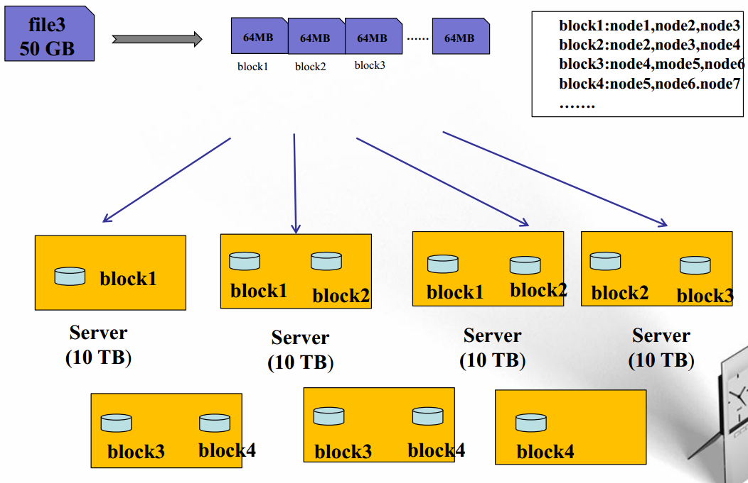
HDFS Read and Write

Slide 17
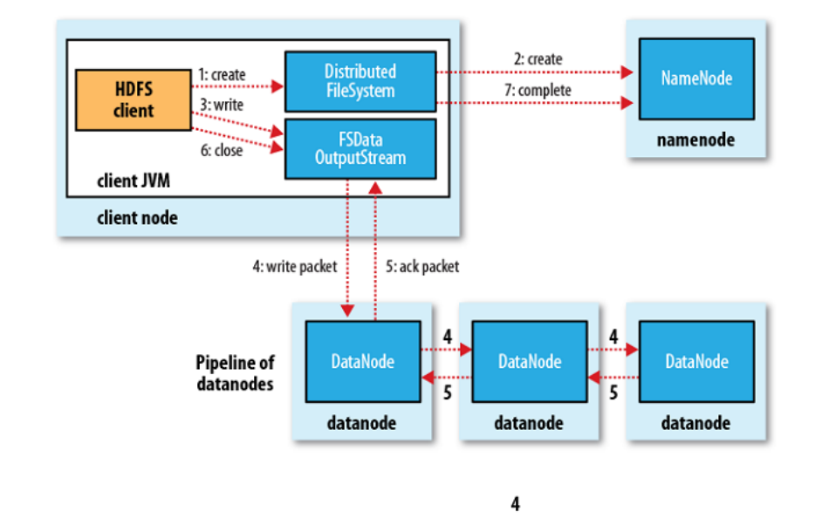
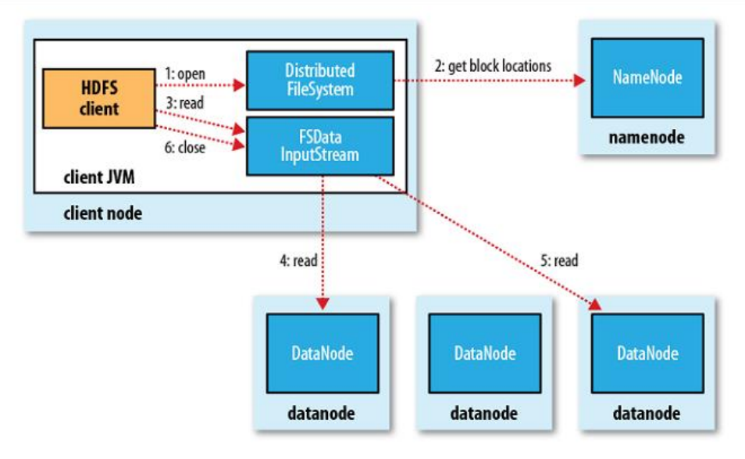
HDFS Read and Write

Slide 18
HDFS Read and Write

Slide 19
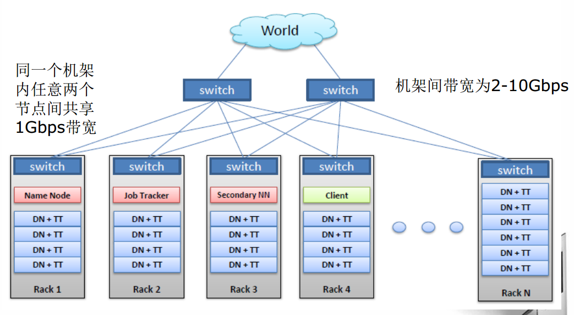
HDFS Read and Write

Slide 20
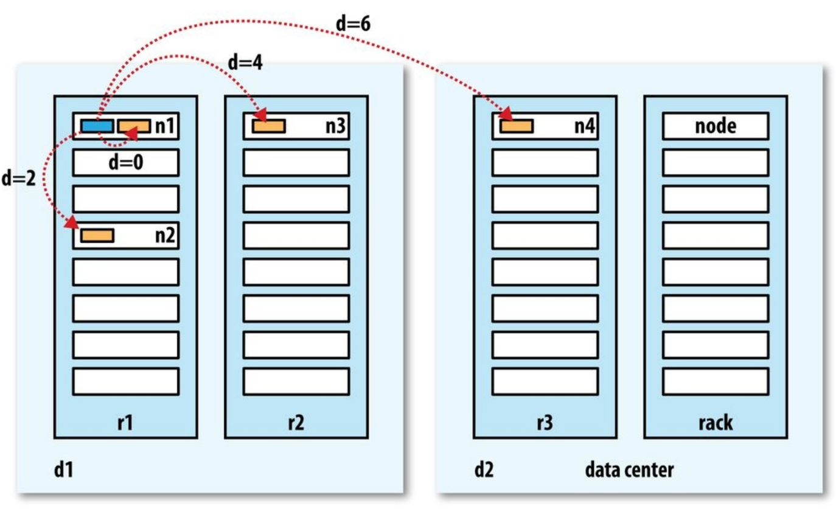
HDFS Read and Write

Slide 21
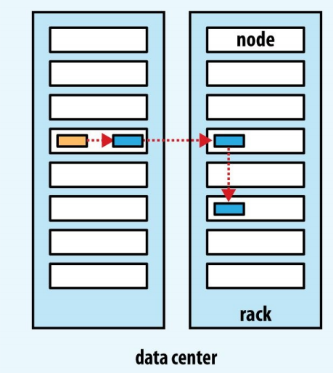
HDFS Read and Write
REPLICA PLACEMENT
1. Same node as Client
2. Node in Different Rack
3. Another node in this Rack
Random pick the first one
If client is not a cluster node

Slide 22
Outlines
Recall Hadoop Ecosystem and Hadoop Core
Some Concepts in Distributed System
HDFS Architecture
HDFS Read and Write
HDFS Shell and API

Slide 23
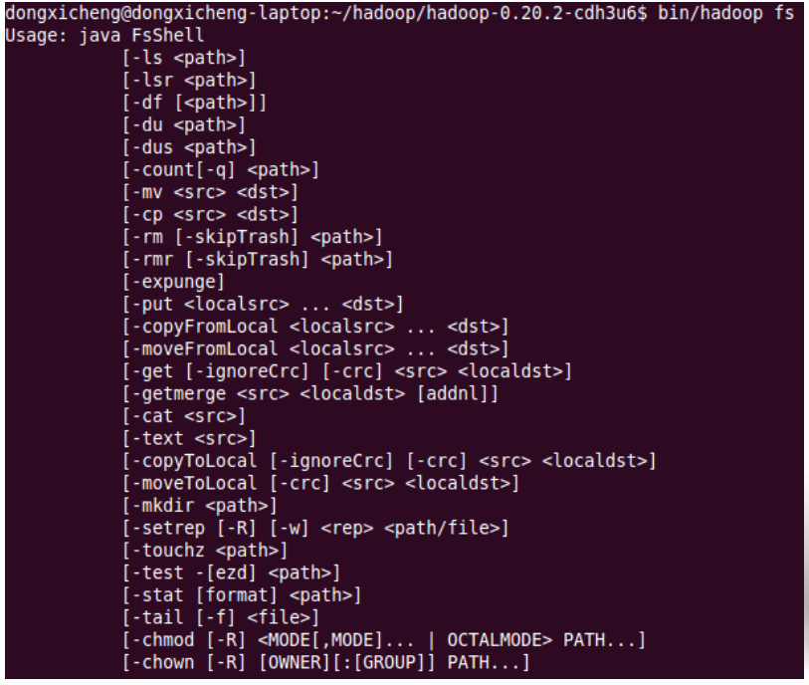
HDFS Shell and API
Shell命令
Hadoop fs –xxx
Hadoop dfsadmin –xxx
Hadoop fsck –xxx

Slide 24
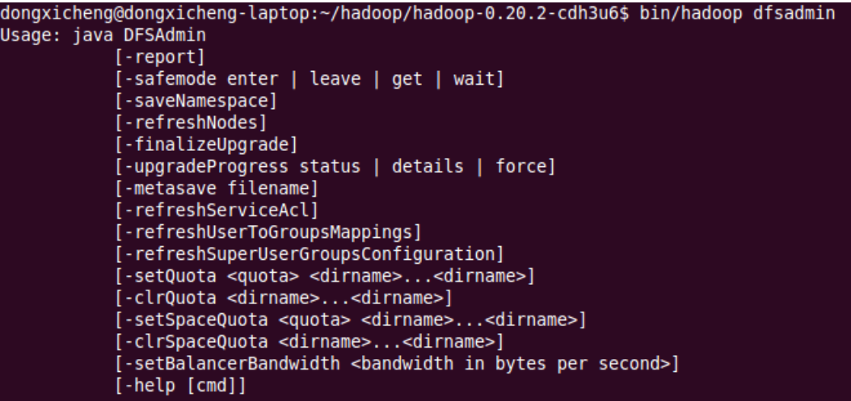
HDFS Shell and API
Hadoop dfsadmin –xxx

Slide 25
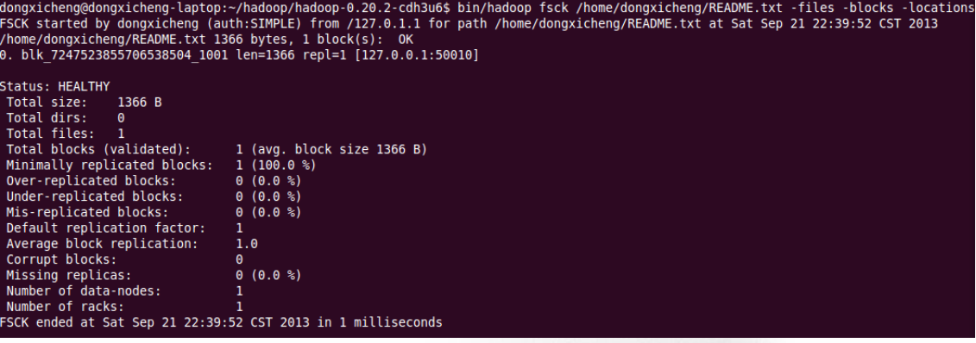
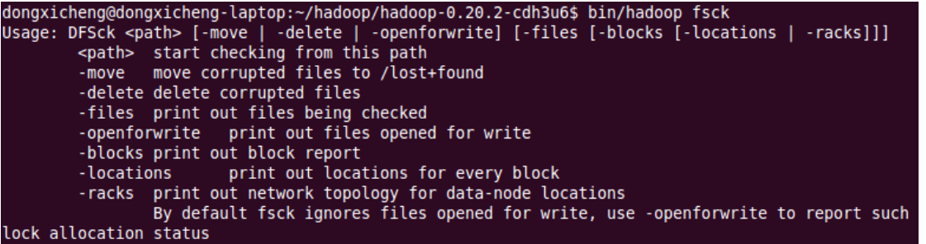
HDFS Shell and API
Hadoop fsck –xxx

Slide 26
HDFS Shell and API
Hadoop API https://hadoop.apache.org/docs/stable/api/
HTTP

Slide 27
HDFS Summary
适用
not a good fit
Low-latency data access
Lots of small files
Multiple writers, arbitrary file modifications
Random Writing is not allowed

Slide 28
Summary I
Recall Hadoop Ecosystem and Hadoop Core
Some Concepts in Distributed System
HDFS Architecture
HDFS Read and Write
HDFS Shell and API

Slide 29
Future Topic
时间 | 主题1 | 主题2 | 主题3 | 课后内容
2016.05.27 | Hadoop Ecosystem and HDFS | Sql-On-Hadoop |  | 选择一个Hadoop Ecosystem的一个开源项目，调研其功能和特性，准备一个10分钟的分享PPT
2016.06.03 | MapReduce 2.0 and YARN | Spark and SparkStreaming | Hadoop Ecosystem 1 | Hadoop：The Definitive guide 章节阅读
2016.06.17 | Advanced Distributed Algorithm Design | 待定 | Hadoop Ecosystem 2
2016.06.24 | Data Ingestion and Sqoop | 待定 | Hadoop：The Definitive guide 阅读分享
2016.07.01 | Massive Streaming Data Analysis ？ | 待定 | Hadoop：The Definitive guide 阅读分享
Notes:
本页待定

Slide 30


