Slide 1
YARN & MapReduce 2.0
Boyu Diao
2016.06.17

Slide 2
Outlines
Evolution of Hadoop Core
YARN:
Why YARN
YARN Architecture
Other Topics
MapReduce
Why MapReduce
MapReduce Architecture
Examples
Notes:
这周上周讨论了hadoop内核 hdfs
这周我们将讨论内核另外两个部分 yarn和mapreduce
其实hadoop的内核并不是在一开始就有这三个，而是从hadoop2.0开始才有的
我们首先来看一下hadoop内核发展的历程

Slide 3
Outlines
Evolution of Hadoop Core
YARN:
Why YARN
YARN Architecture
Other Topics
MapReduce
Why MapReduce
MapReduce Architecture
Examples

Slide 4
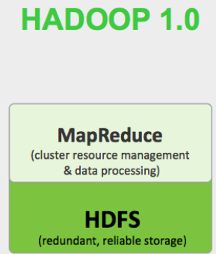
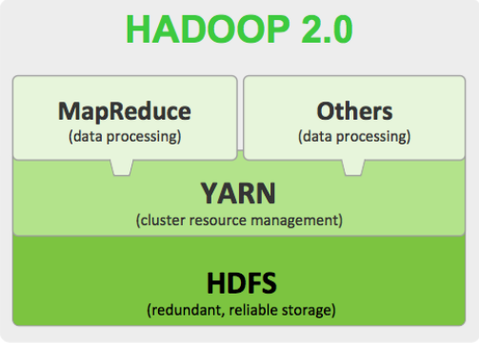
Evolution of Hadoop Core
Notes:
Hadoop的1.0版本 只有hdfs和mapreduce
到了2.0 加入了一个调度层yarn
Hadoop 2.0 还可以支持其他数据处理的框架

Slide 5
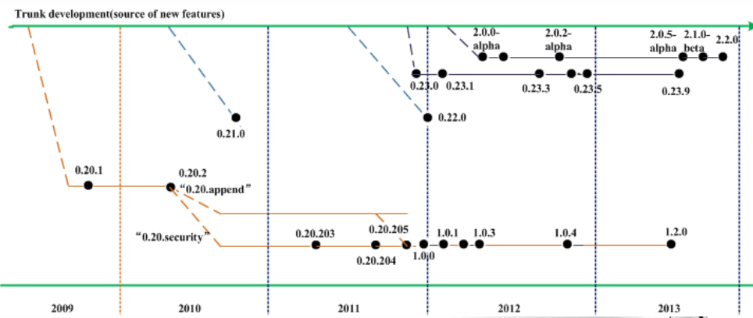
Evolution of Hadoop Core
Notes:
Apache 版本
1.2.1 2013年8月1日后 没有再更新过
0.23.11 2014年6月27日
2.X版本，比0.23版本多了hdfs HA
2.6.4
2.7.2 2016年2月左右

Slide 6
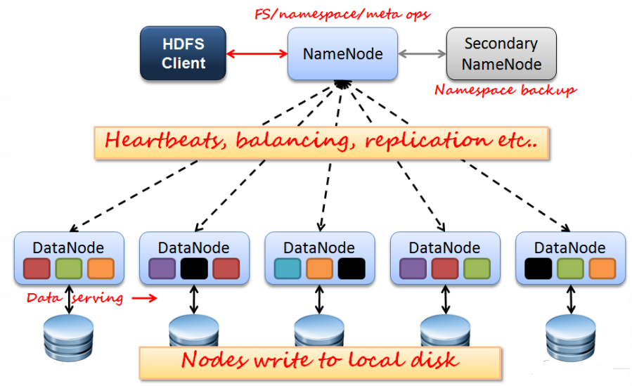
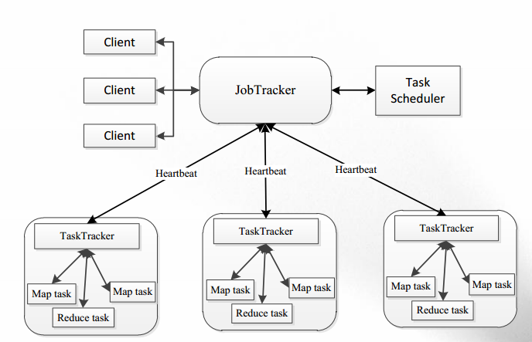
Evolution of Hadoop Core
Why Hadoop 2.0
Notes:
从版本演化，我们可以看到
Hadoop2.0 相比hadoop1.0的优化在两方面
一个是Hadoop hdfs HA
一个是添加yarn 资源调度层
为什么要做这两个 和很好理解。

Slide 7
Evolution of Hadoop Core
Why Hadoop 2.0 ？
Performance bottleneck : JobTracker / NameNode
Single point of failure : JobTracker / NameNode
Not flexible : MapReduce Only
Cost of Operation and maintenance
Data Sharing

Slide 8
Outlines
Evolution of Hadoop Core
YARN:
Why YARN
YARN Architecture
Other Topics
MapReduce
Why MapReduce
MapReduce Architecture
Other Topics
Notes:
上周我们提到过一次hadoop生态系统，这里我们重新详细说一下
上周我们也提过，大数据技术，核心是分布式系统的相关理论。
所以，在说HDFS之前，我们先讨论一些分布式系统的概念
然后就是HDFS 的架构，读写过程，和Shell以及api等

Slide 9
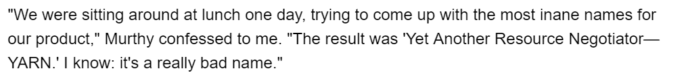

YARN： Yet Another Resource Negotiator
YARN
Notes:
名字的由来

Slide 10
YARN Architecture
Why YARN
Performance bottleneck : JobTracker
Single point of failure : JobTracker
Not flexible : MapReduce Only
Cost of Operation and maintenance
Data Sharing

Slide 11
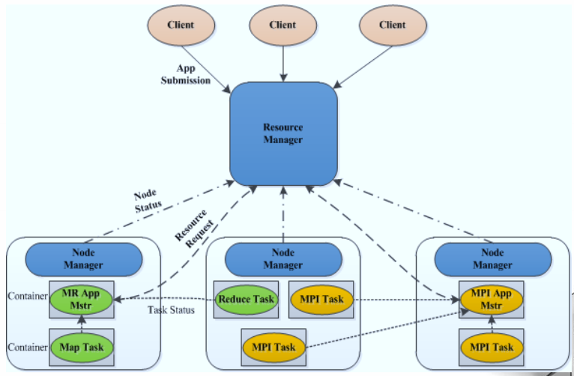
YARN Architecture
YARN
Notes:
YARN 是资源调度器， 两层调度
就好比说，送快递
以前顺丰在中国只有一个网店，上海，负责中国所有市区县镇的快递业务。那你想想，这个运配中心得多大
但更合理的肯定是 全国分几个大的枢纽，到市县还会有下级单位，一级一级的调度。
那你可能会问，这么简单的调度为什么在最开始的时候没想到，原因很简单，因为google的论文里没写。
其实gogle

Slide 12
YARN Architecture ：Terminologies
Resource Manager
Application Manager
Resource Scheduler
Node Manager
Application Master
Container
Notes:
YARN里的哪些术语，也就是他怎么定义各个组件的

Slide 13
YARN Architecture ：Resource Manager
Resource Manager
Application Manager
Resource Scheduler
Client Request
Start/ Monitor App Master
Monitor Node Manager
Resource Scheduler
Notes:
生命周期

Slide 14
YARN Architecture ：Node Manager
Node Manager
Task Managing
Local Resource Scheduling
App Mater Request
Notes:
生命周期

Slide 15
YARN Architecture ：Application Master
Application Master
Start/Monitor App
Apply Resource for Tasks
Allocate Resource for Tasks

Slide 16

YARN Architecture ：Container
Container
Containing :
Task Runtime Environment
Jars
Task Resources
CPU/Memory
Initial Information
Start Command
Parameters
Notes:
生命周期
类似docker

Slide 17
YARN Architecture ：Terminologies
Resource Manager
Node Manager
Application Master
Container

Slide 18
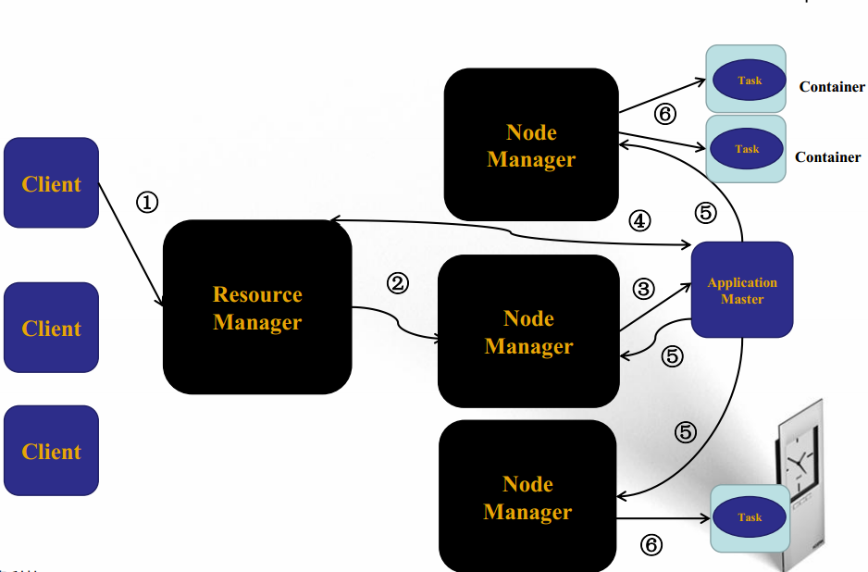
YARN Architecture : Anatomy

Slide 19
Outlines
Evolution of Hadoop Core
YARN:
Why YARN
YARN Architecture
Other Topics
MapReduce
Why MapReduce
MapReduce Architecture
Other Topics

Slide 20
YARN: Fault-Tolerance
Resource Manager
Zookeeper HA
Node Manager
All tasks on this machine fail
Resource Manager inform App Master to restart failure tasks
Application Master
Resource Manager Restart AM
Resource Manager keep the context

Slide 21
YARN: Resources Scheduling
FIFO Scheduling
Capacity Scheduling
Fair Scheduling
Dominant Resource Fairness: Fair Allocation of Multiple Resource Types

Slide 22
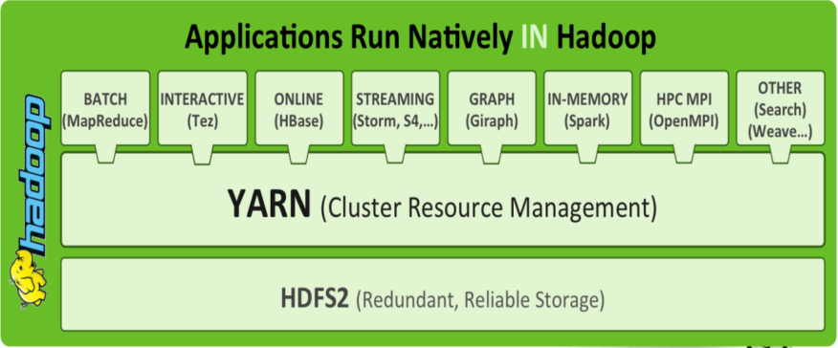
YARN: X on YARN

Slide 23
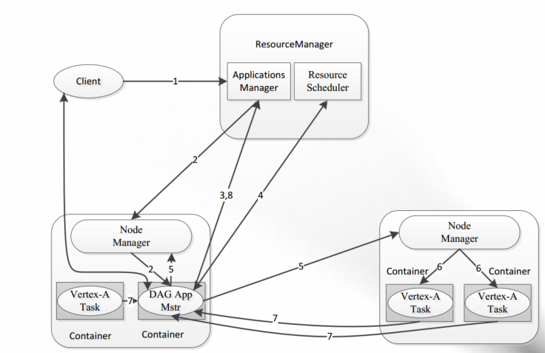
YARN: Tez on YARN

Slide 24
Outlines
Evolution of Hadoop Core
YARN:
Why YARN
YARN Architecture
Other Topics
MapReduce
Why MapReduce
MapReduce Architecture
Other Topics

Slide 25
MapReduce
MapReduce : Simplified Data Processing on Large Clusters, OSDI 2004
MapReduce:
The theory or framework
A paradigm in functional language
A Software in Google
Core of Hadoop 1.0
Core of Hadoop 2.0 (MapReduce on YARN)

Slide 26
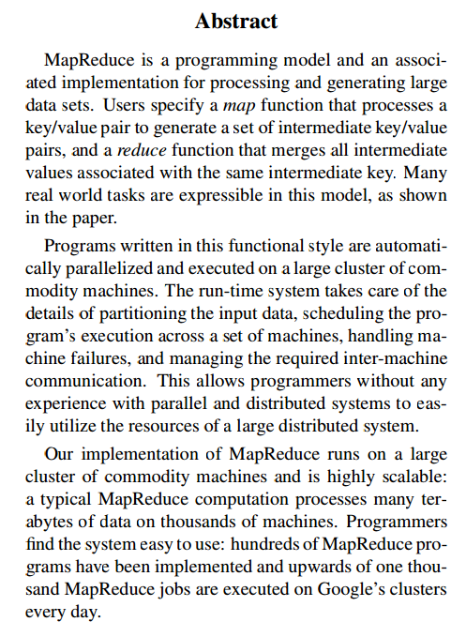
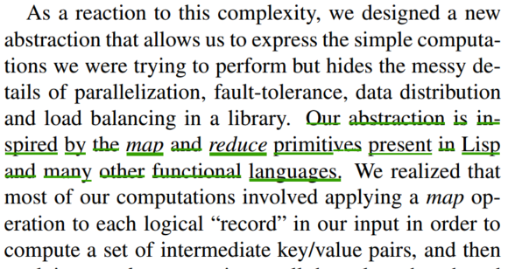
MapReduce: Why
Functional Programming
Lisp

Slide 27
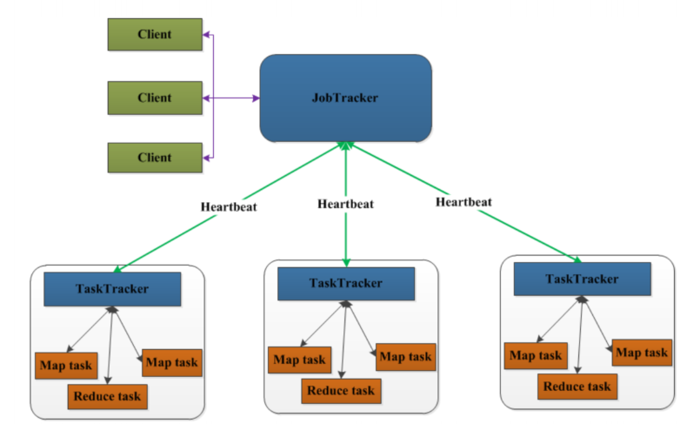
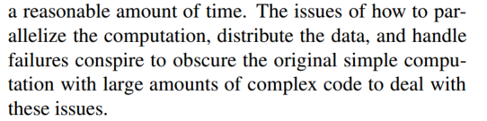
MapReduce Architecture

Slide 28
MapReduce Architecture： 1.0 Terminologies
Job Tracker
Task Trackers
Map Task
Reduce Task

Slide 29
MapReduce Architecture： Job Tracker
Job Tracker
Master
Manage Jobs
Schedule jobs to
Task Trackers
Resource Scheduling

Slide 30
MapReduce Architecture： Task Trackers
Task Trackers
Slaves
Map Tasks
Reduce Tasks
Communicate with
Job Tacker

Slide 31
MapReduce Architecture： Map Task
Map Task
Map Engine
Input <key1,v1>
Output <key2,v2>

Slide 32
MapReduce Architecture： Reduce Task
Reduce Task
Reduce engine
Input <key1 list(value1)>
Output <value2>

Slide 33
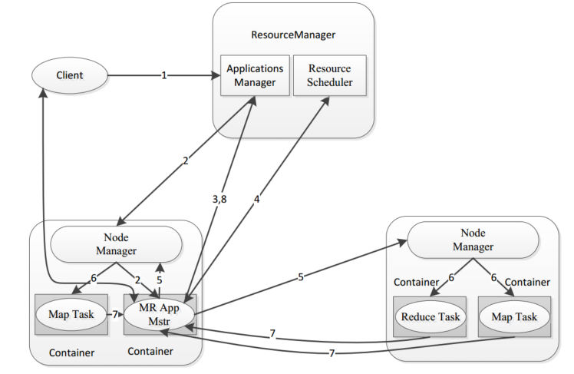
MapReduce Architecture： 2.0 Terminologies
MR App Master
Master
Manage Jobs
Schedule jobs to
Task Trackers
Ask Resource Manager
for Resources.

Slide 34
MapReduce Architecture： MR App Master
MR App Master
Map Task
Reduce Task

Slide 35
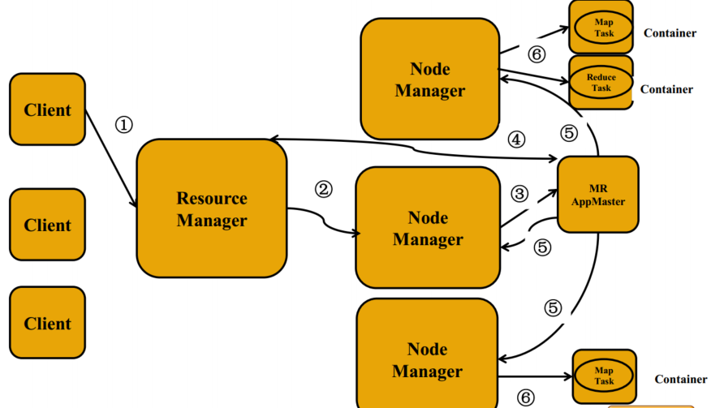
MapReduce ： Anatomy

Slide 36
Outlines
Evolution of Hadoop Core
YARN:
Why YARN
YARN Architecture
Other Topics
MapReduce
Why MapReduce
MapReduce Architecture
Other Topics

Slide 37
MapReduce ： Fault-Tolerance
MRAppMaster Failure
Resource Manager restart
Default twice
Map / Reduce Task Failure
MRAppMaster request Resource and restart
Default 4 times

Slide 38
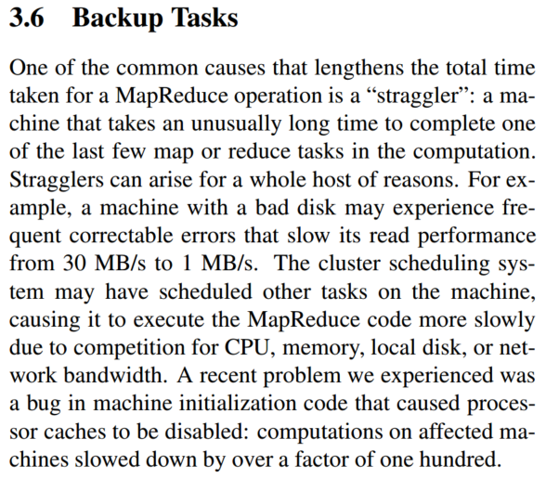
MapReduce ：Backup Tasks
Unusual Straggler
Restart a same Map/Reduce Task
on a different machine.

Slide 39
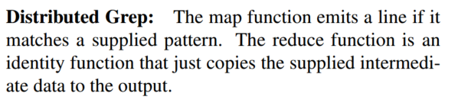
MapReduce ：Applications
Distributed Grep

Slide 40
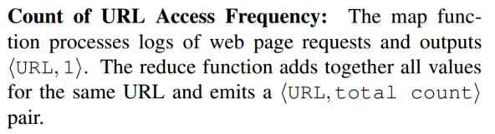
MapReduce ：Applications
Count of URL Access Frequency:

Slide 41
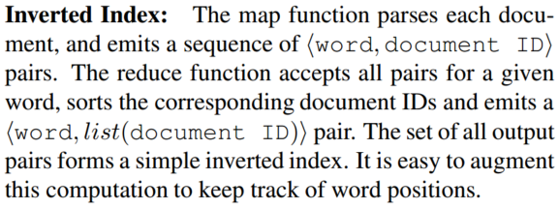
MapReduce ：Applications
Inverted Index:

Slide 42
Outlines
Evolution of Hadoop Core
YARN:
Why YARN
YARN Architecture
Other Topics
MapReduce
Why MapReduce
MapReduce Architecture
Other Topics

Slide 43


