Slide 1
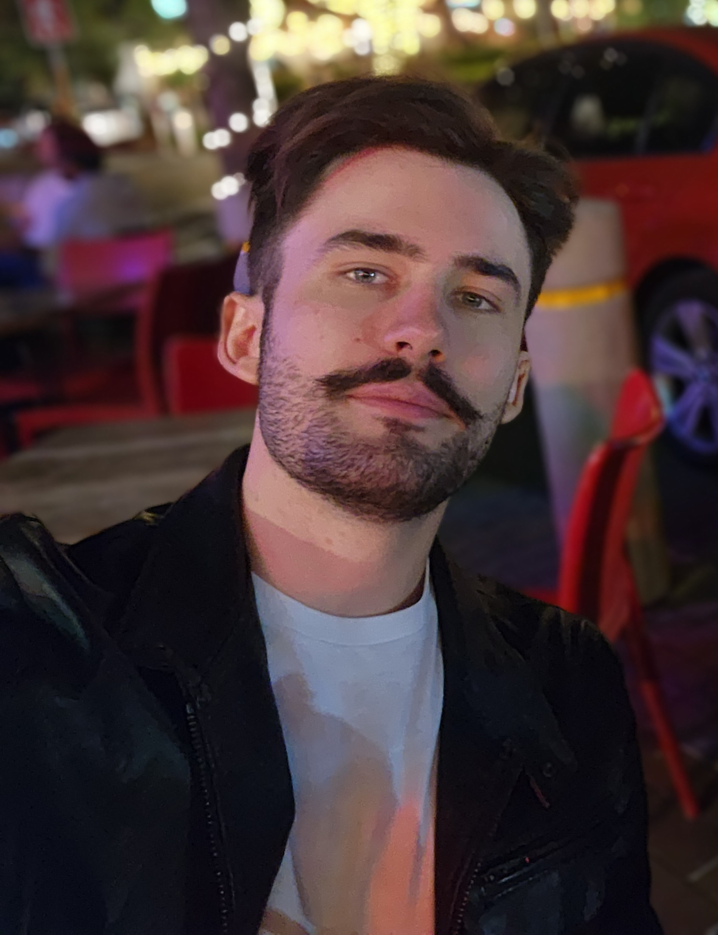
About Me:
Hello, I'm Erin David Cullen, 26 years old, based in Pretoria East.
Business-minded: Grew up in entrepreneurial household, learned real operations from family conversations
Results-focused: From these conversations, I learned to GET THINGS DONE. That's become how I approach problems in technology
Detail-oriented: Focus on accuracy and precision in everything I build
Driven: Push for excellence because if my name is on it, it needs to be right

Slide 2
My Passion for IT: A Lifelong Journey
Why I Chose IT
Curiosity – Took apart my first PC at 6 years old
Growth – From hardware tinkering to scripting & automation
Impact – Built real systems for my family’s business
Turning Point – Realized I needed deeper IT skills to build better, scalable systems
Reason – To combine logic + creativity into practical solutions

Slide 3
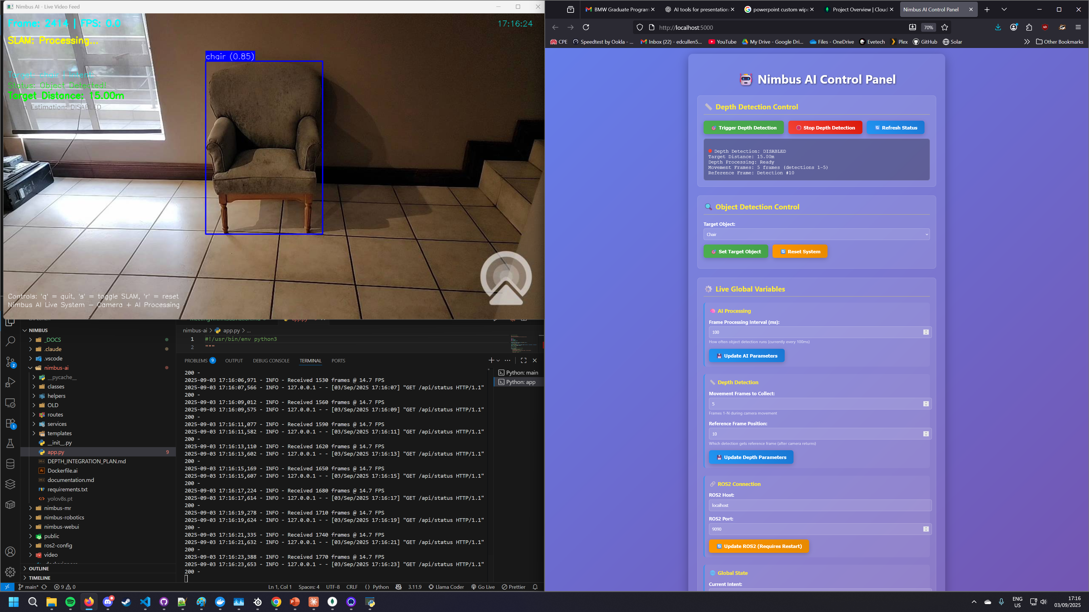

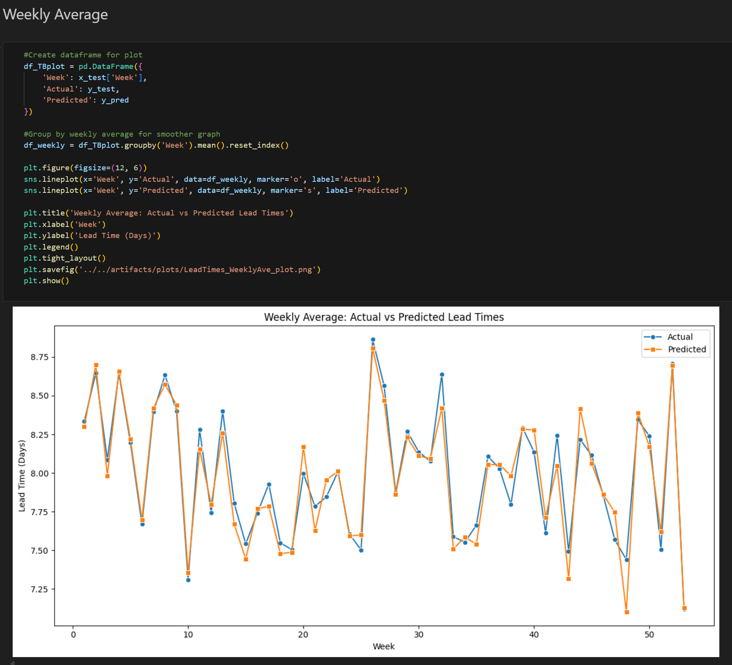
Academic Projects: Applying Technical Expertise
Nimbus
Data
Analysis
Dashboard
Linear
Programming
Solver
(Technical Project Lead)
Real-time drone navigation via natural language commands. NLP converts spoken instructions like "Go to the chair" into drone commands. Integrates YOLOv11 object detection, SLAM for 3D mapping, and PID control algorithms.
(Project Lead)
End-to-end business intelligence using CRISP-DM methodology. Built complete pipeline from data cleaning through statistical modeling to interactive dashboards using R and Power BI.
(Project Lead)
Console-based optimization solver in C# with Primal Simplex and Branch & Bound algorithms. Features full sensitivity analysis and detailed solution documentation.

Slide 4
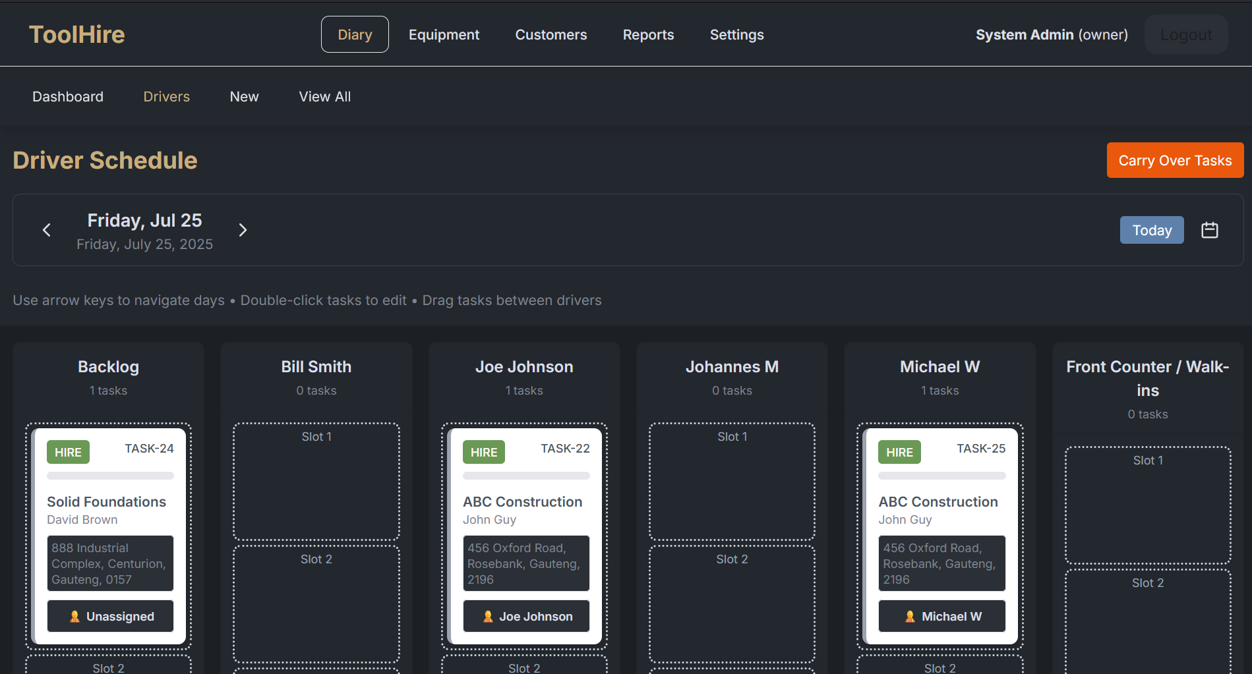
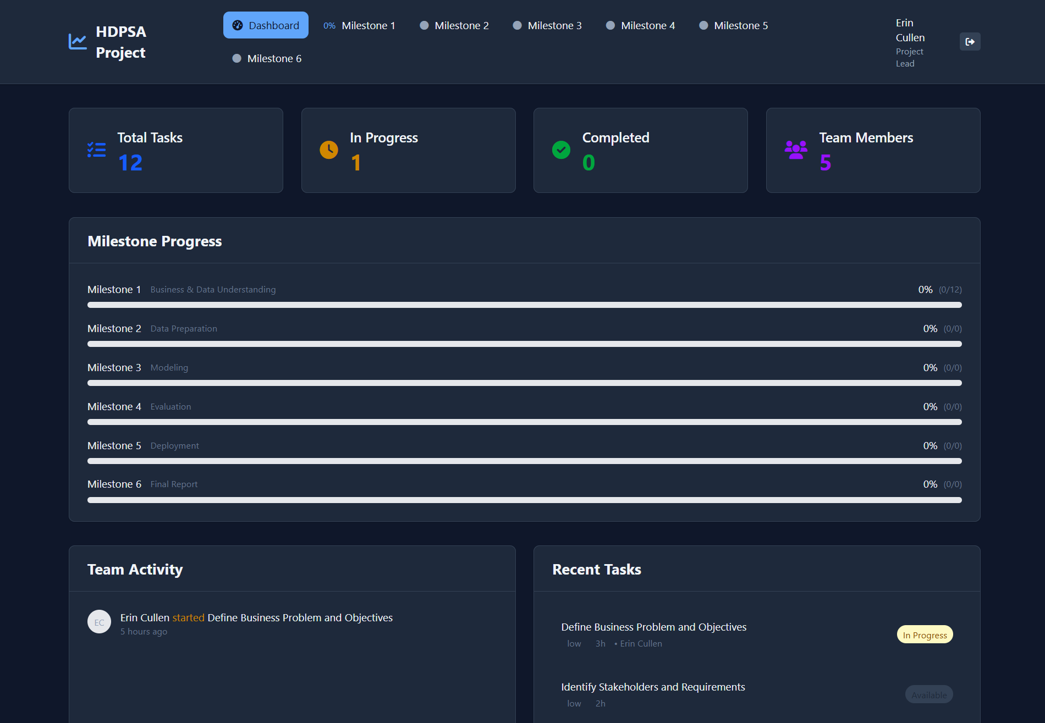
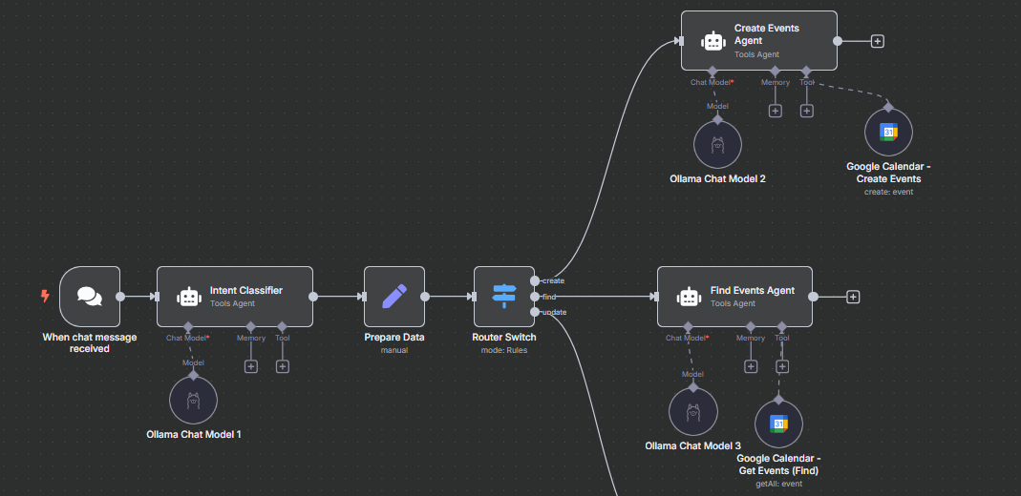
Personal Projects: Driving Innovation
AetherFlow
Task
Management
Personal
AI Assistant
Enterprise equipment hire management system using PostgreSQL, Python backend, and Next.js frontend. Features two-phase booking, automated driver scheduling, and intelligent equipment allocation.
I Developed my own web based task management system that uses an online MongoDB that allows group members to see milestones and tasks live, select tasks to do and update progress on said tasks.
This allows us to see who is doing what, and report on it, make sure that everyone is pulling their weight.
Local AI automation system using N8N workflow automation with Ollama. Handles email management, document summarization, and calendar scheduling while maintaining privacy.

Slide 5


Career Vision in IT: A Roadmap for Growth
Long Term (5-10+ years)
Technical Leadership and Global Impact
Medium Term (3-5 years)
Senior Technical Excellence
Short Term (1-3 years)
Building Technical Foundations
Product Owner or Technical Leadership/Managerial roles. Shape product strategy and technical direction. International growth with potential relocation to Europe. Scaling solutions globally while pushing technical boundaries.
Grow into senior technical roles tackling complex system design challenges and architectural decisions. Continue developing AetherFlow as both a learning platform and business solution.
Build solid foundations in database architecture, scalable API design, and production-level AI/ML systems. Focus on backend development with modern frameworks and distributed systems.

Slide 6
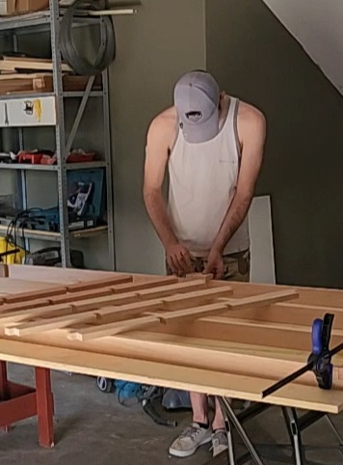
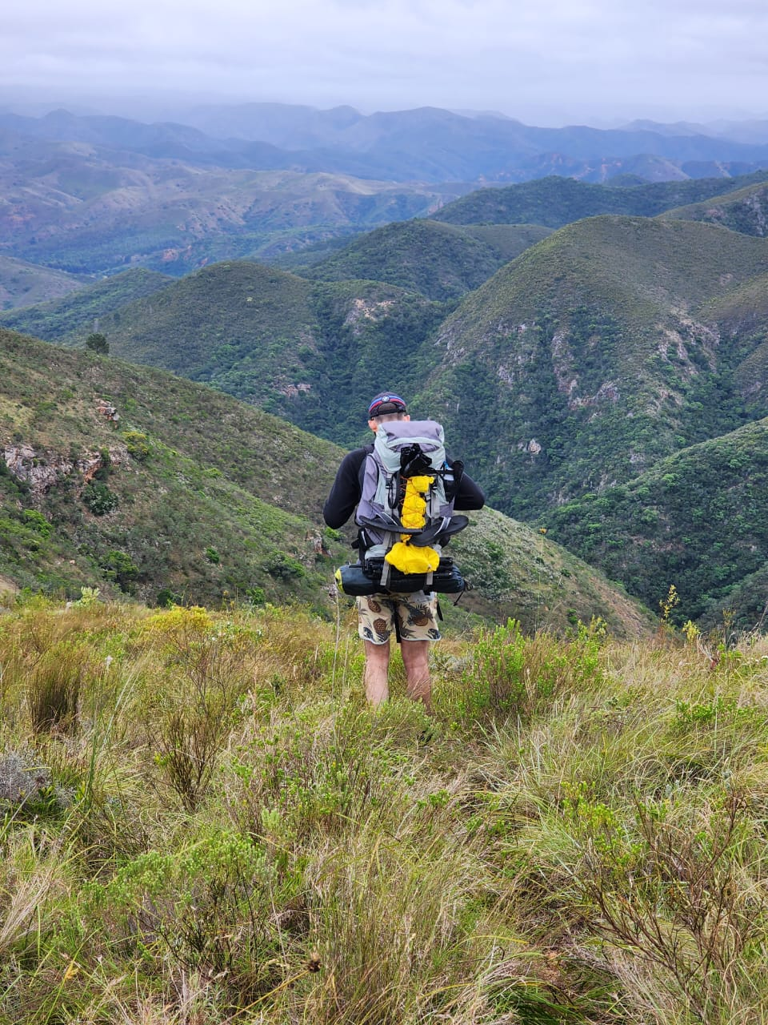
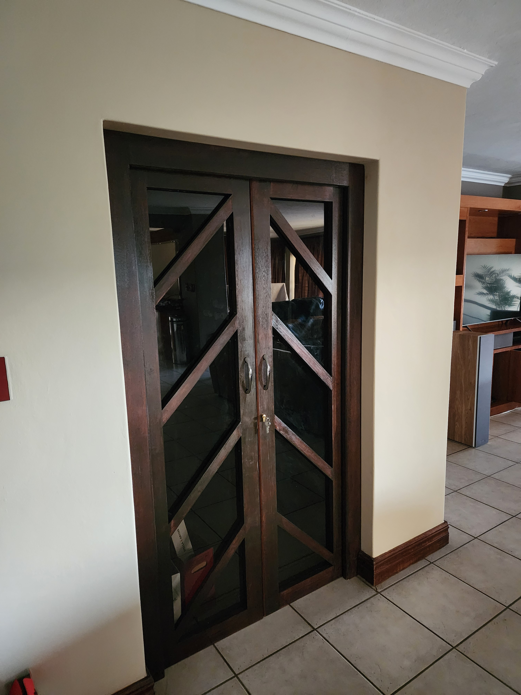
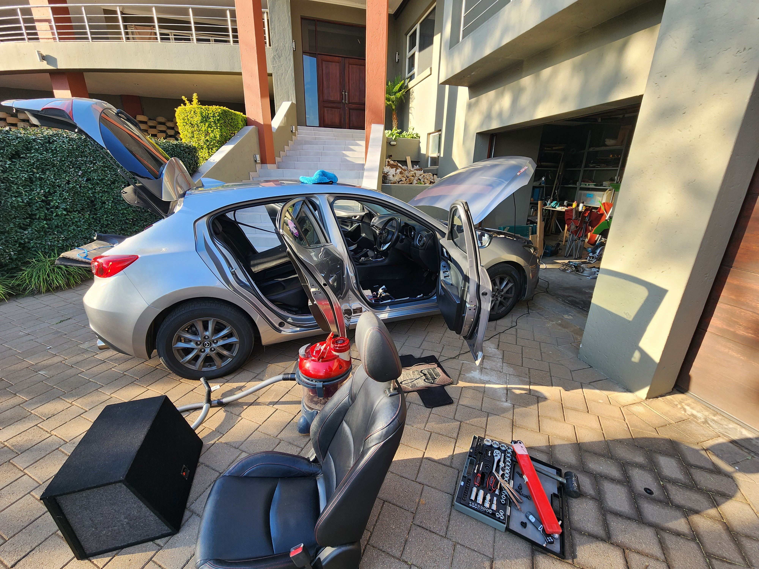
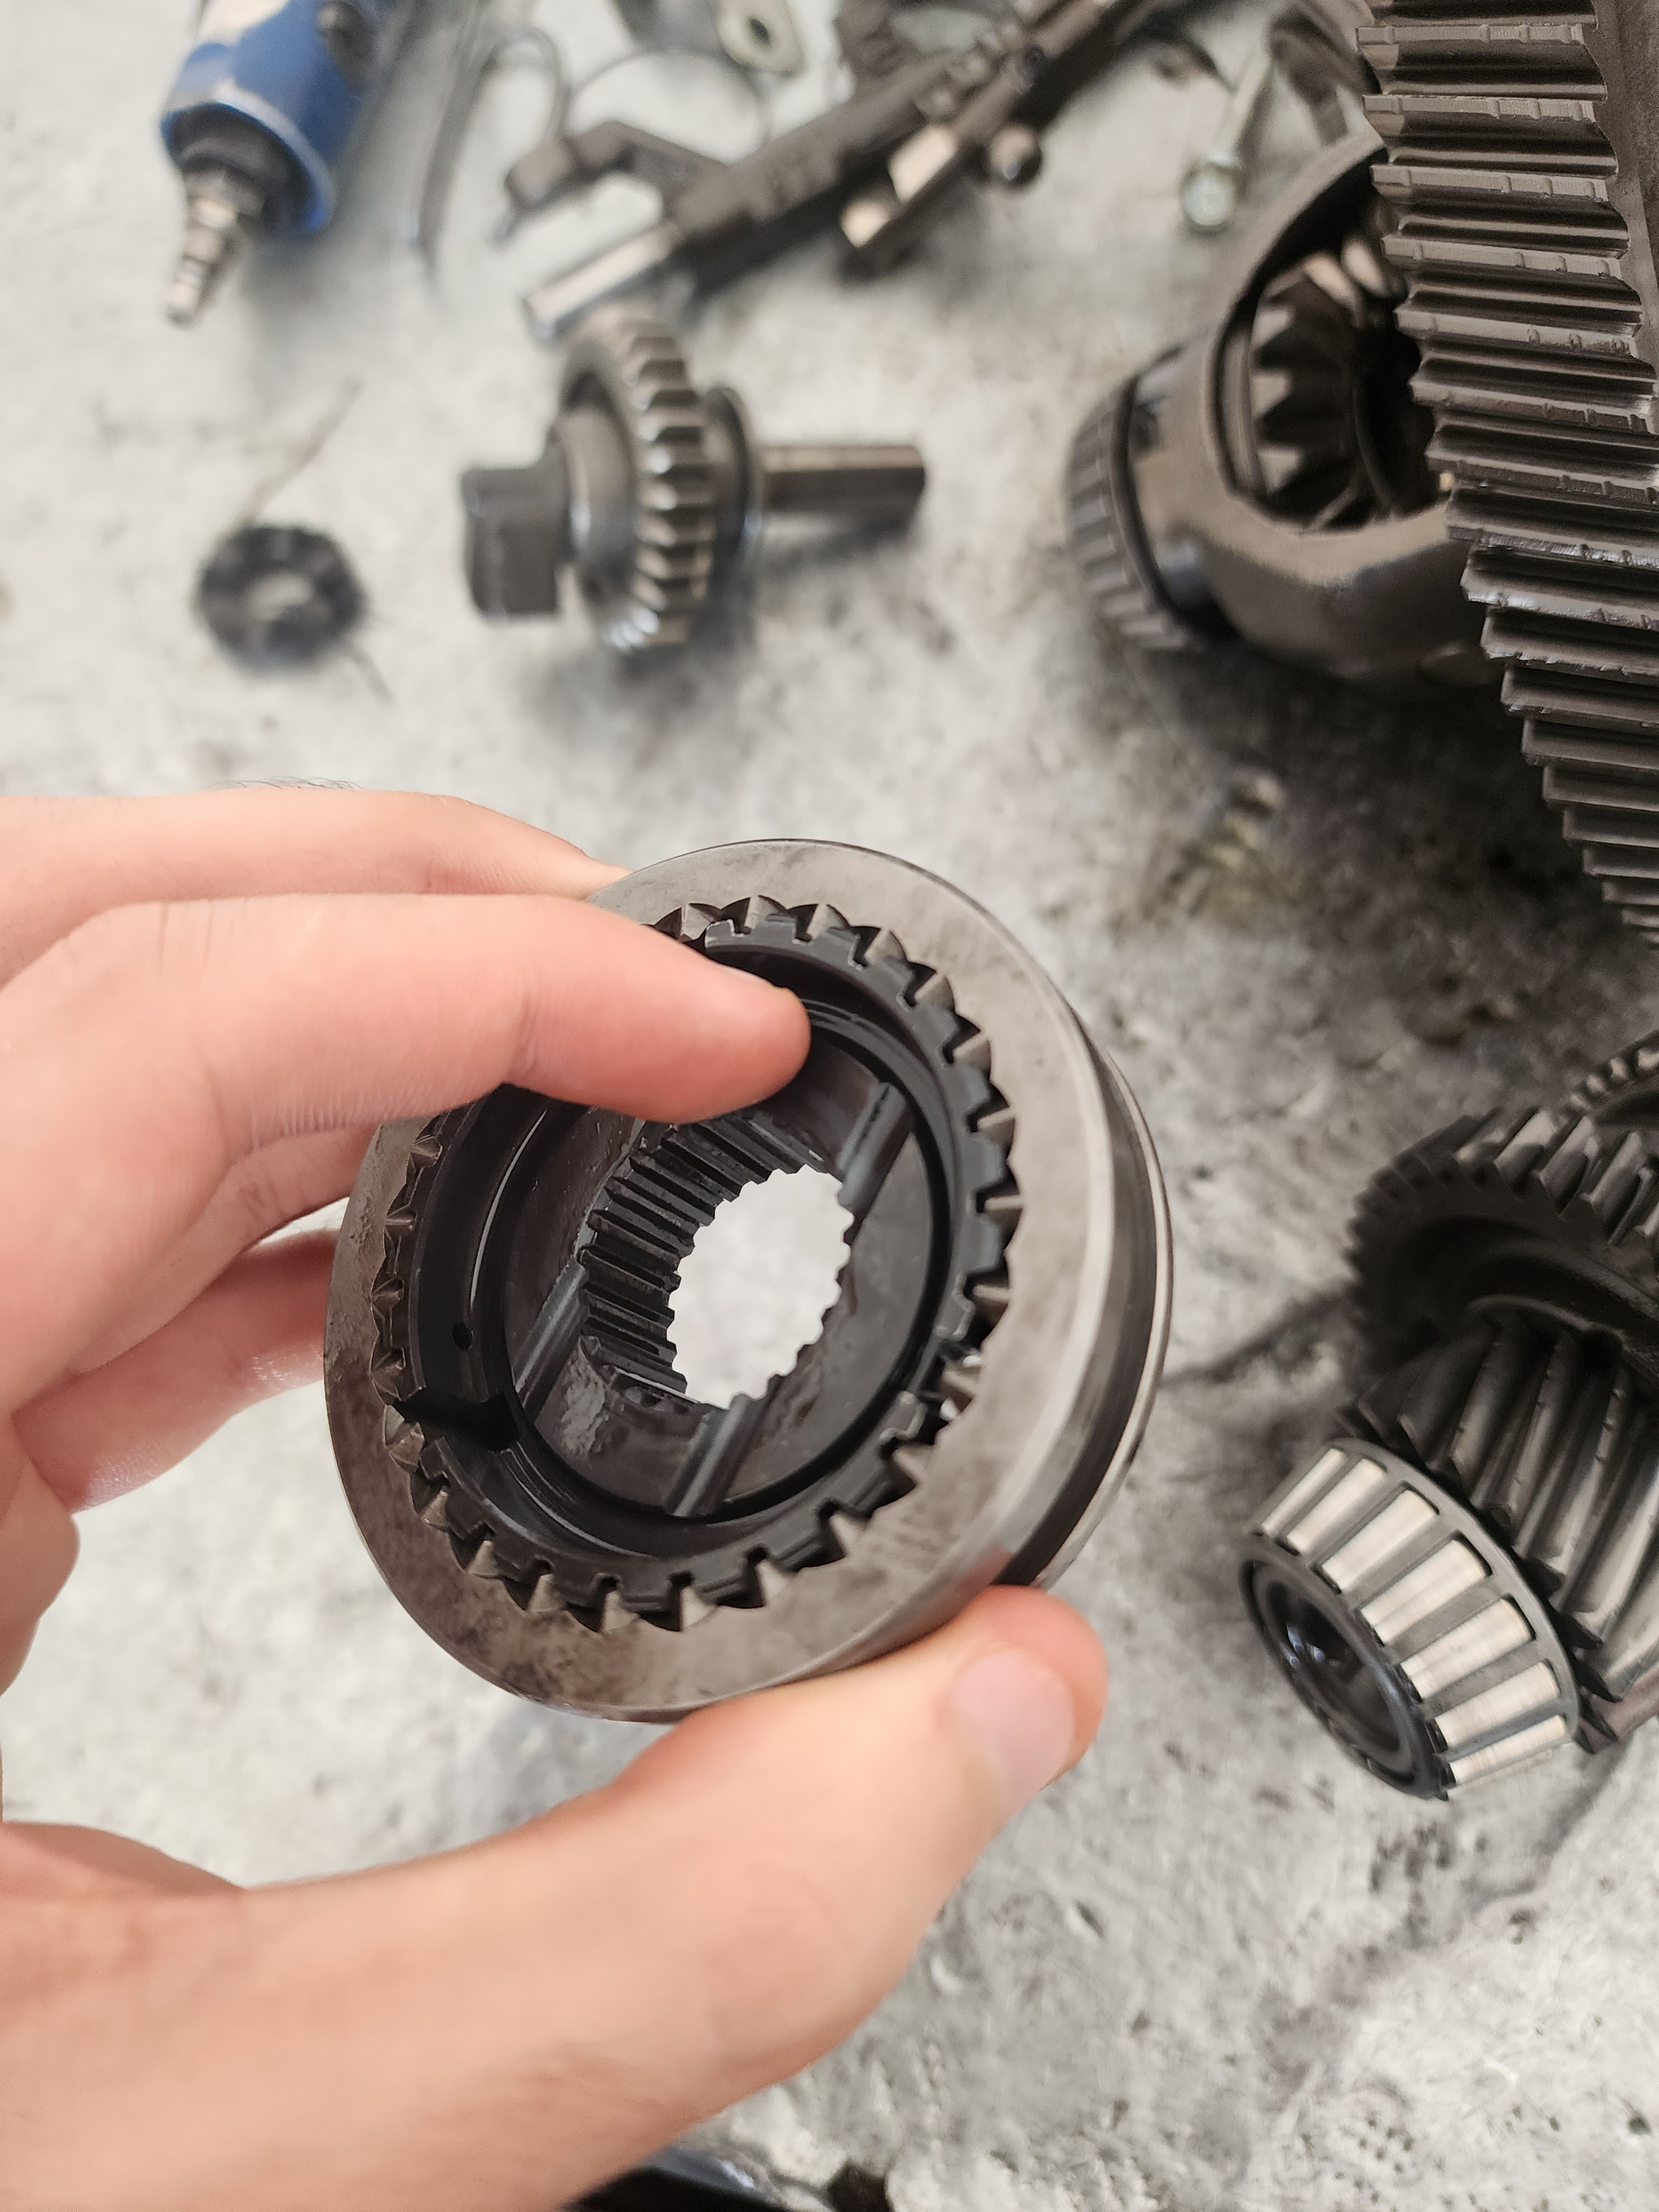
Why BMW + What Drives Me
What makes me different: I am curious by nature and like to get into the details of things. When my car's synchromesh failed, I took apart the gearbox myself because I wanted to understand exactly how it works. That same hands-on curiosity drives how I approach software.
I take ownership of my work. If my name is on it, it needs to be done properly. BMW represents an environment where this level of technical excellence and innovation mindset is valued. I'm interested in contributing to automotive technology that makes a difference.
I think you should care about what your company builds. If I worked in security, I wouldn't be passionate about security. But, I have a genuine affinity for cars -> I understand them, and I'm passionate about them.
I experiment with the latest features in technology, often combining them to explore new possibilities before they become mainstream. I believe staying current with innovation helps me solve problems better.

