Slide 1

Overview Analysis of Suicide Rates in India
Abuzar Khan
10613710
Master of Science Data Analytics.
Dublin Business School
22-05-2023

Slide 2
Introduction
Suicides served a major concern since in previous decade the records were going up and it was a repeating cause for one to lose life, some carefree approach as been around the stigma, as the victims may be underbarrier, it has been an accelerating cause in healthcare and mortality sector.
The emphasis of studying the rates of suicides, there wasn’t much work done to study the suicides, to have some insights to concern to public health sector, to create mental health awareness, Identification of the potential risk areas that needs to b e worked upon, to embark some light on potential interventions and have the policy makers and legislations .
study aims to contribute to the identification of the factors and trends that are making the statistics of the suicide go considerably up, analyzing the trends in the suicide rates of the India over the years through time series analysis.

Slide 3
Background and Context
According to WHO report in 2019 India accounted 16.4% of global suicide deaths, making it one of the leading countries in the terms of suicide rates, afflicted are the age range of 18-45 reported by NCRB(national crime records bureau.).
Social economic factors that were discussed in the literature reviews that were skimmed were Lack of Education, Poverty, loss of a loved one, too much fame or family pressure was observed, lack or mental awareness due to cultural stigma, women being most victims, might revolve around being housewives, whilst males involved with debts etc, Gender Disparity 69% males and women 31%, regional integration is observed.
Maharashtra has showed major increased in the death counts with middle aged people opting the dead, and Tamil Nādu following and children committing suicide in west Bengal is observed.

Slide 4
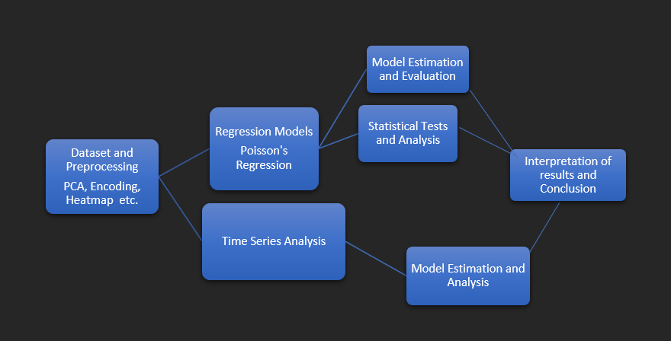
Methodology
Data was acquired from the open data government website NCRB authorities are authorized to collect data from the hospitals and other places for research purpose and allow the researchers to make the utmost use of it through open data gov portal.
Research design including Machine learning revolves around the data set acquiration->preprocessing(PCA, Encoding, Heatmap etc.)->Regression(Models, B-Logistic, Poisson’s Regression) & (Time Series Analysis)->Model Evaluation and interpretation of results.
Using Visualization tools for EDA such as Tableau and PowerBI, using libraries like plotly and sns, seaborn.
Limitations faced were Time was inadequate and data was not upto the standards for the model to give out expected results, but in future that would be worked on, limited number of observational frequencies and limited resources around the subject.

Slide 5
Data Analysis and findings.
Maharashtra has the highest rate of suicide across india in that period of time with 9,01,045 where the stats go around with folks aged 15-29 are more active, with tamil nadu following, majorly married people commit suicides according to the data with 1,125k with educational status of primary passed or no education.
Means adopted were typical hanging , and consumption of pesticides and insecticides, that was inferred from the EDA and visualizations pecularily
Professional profiles that were involved in the higher records were mainly 0ther’s that dint specify and Farmers and Housewives in females were most affected in the decade
Running the Binary Logistic Regression the out put was not that satisfactory but the readinds should that, model tried to fit better but the AIC(Akakie Information Criterion) value was a bit high and which can be tailored with necessary tweaking of hyper parameters. Fisher scoring was 8 in readings which is okay for a model to converge, overall the model was a reasonably good fit for the data, since lower residual deviance compared to null deviance lower AIC value.
ARIMA (Time series model)performed better with a reconsideration Forecasted with estimated number of deaths in next decade is 1.34, with 80% confidence range(-4.462 & -7.153) to higher bound 95%(-7.53 & 10.22818).

Slide 6
Recommendations
Areas of public health sector can be advised to work around the stigma and breaking of stereotypes in India around the male mental health.
Housewives can be heard through various platform and way and means should be formed to mediate the domestic abuse as the rate is alarming in that domain.
Mental health Organizations if they integrate themselves with government body as it would be a building bridge for people to seek help and the government to analyze and have some policy's around it
Education system in India should be reconsidered and much awareness of mental health should be provided from pre-primary level.
Selling of the hazardous chemicals should be regulated and licenses should be revoked upon selling of unauthorized chemicals.
Farmers should be given a priority and subsidy not just financially but mentally programs should be developed.

Slide 7
Conclusion
Self harm and suicides are really a problem that needs a much deeper research and the insights should be called and shown to the public that what menace this has caused.
Some factors that were never included in the research and collection of data should also be taken care of and the media coverage of the nature should reach such factors.
Mainly there should be much awareness among the students and the adolescents that are choosing to end lives in miserable way, researcher believes that because the influence that made researcher adopted to work in this domain, where a 13 year old boy jumps from the bathroom window and ends his life over a haircut (news article linked in the end of the slide)….. This is a question and a challenge to the humanity and we need to take care of it and have prominent solutions around so parents shouldn’t loose their children wives turning into widows and children turning orphans can be reduced considerably
https://timesofindia.indiatimes.com/city/mumbai/unhappy-with-short-hair-cut-13-year-old-boy-leaps-to-death-in-bhayander/articleshow/99280604.cms?from=mdr

Slide 8

Everyone can be a Samaritan!
Thank You!

