Slide 1

Adaptive Importance Sampling
Wei Wang
Supervisor: Dr Simon Cotter

Slide 2
Outline
Importance Sampling
Ensemble Transport Adaptive Importance Sampling (ETAIS)
Comparing Metropolis-Hastings algorithms in a multi-modal example
Data assimilation with Birth & Death ODE
Conclusion

Slide 3

Importance Sampling
Sample $x_{i}$from $ν$
Calculate $ω_{i}=\frac{f(x_{i})}{ν(x_{i})}.$
Store $(x_{i},ω_{i})$ to plot weighted-histogram.

Slide 4
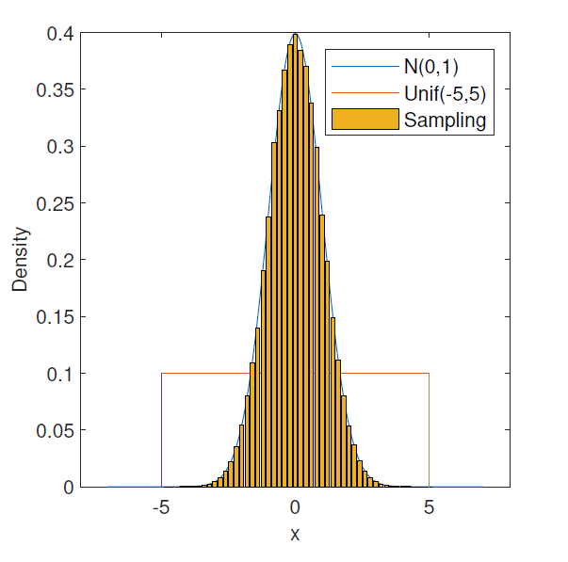
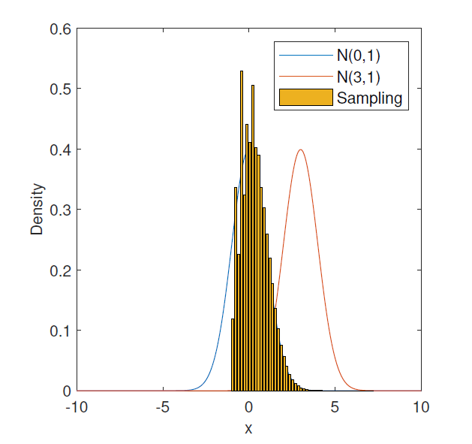


Importance Sampling example: sampling with ${10}^{5}$ samples
Target distribution: standard normal distribution $N(0,1)$
Proposal distribution: $Unif(−5,5)$ and $N(3,1)$

Slide 5
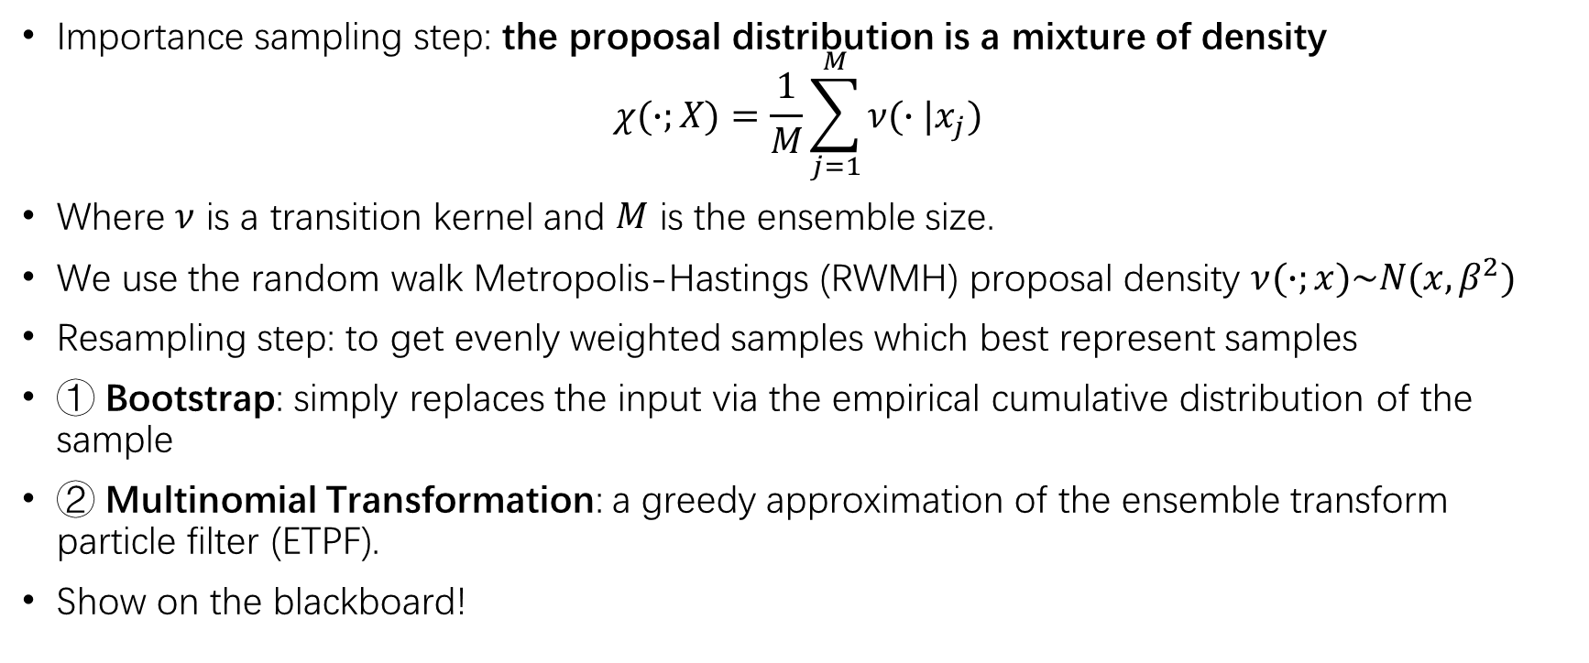
Ensemble Transport Adaptive Importance Sampling (ETAIS)
Importance sampling step: the proposal distribution is a mixture of density
$$χ(∙;X)=\frac{1}{M}\sum_{j=1}^{M}{ν(∙|x_{j})}$$
Where $ν$ is a transition kernel and $M$ is the ensemble size.
We use the random walk Metropolis-Hastings (RWMH) proposal density $ν(∙;x)\sim N(x,β^{2})$
Resampling step: to get evenly weighted samples which best represent samples
① Bootstrap: simply replaces the input via the empirical cumulative distribution of the sample
② Multinomial Transformation: a greedy approximation of the ensemble transform particle filter (ETPF).
Show on the blackboard!

Slide 6
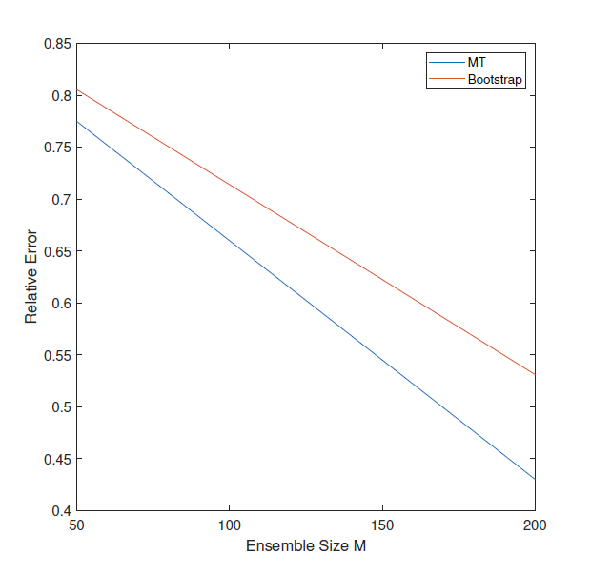
Comparing resampling algorithms
Bootstrap (simple) VS Multinomial transformation (complex)

Slide 7
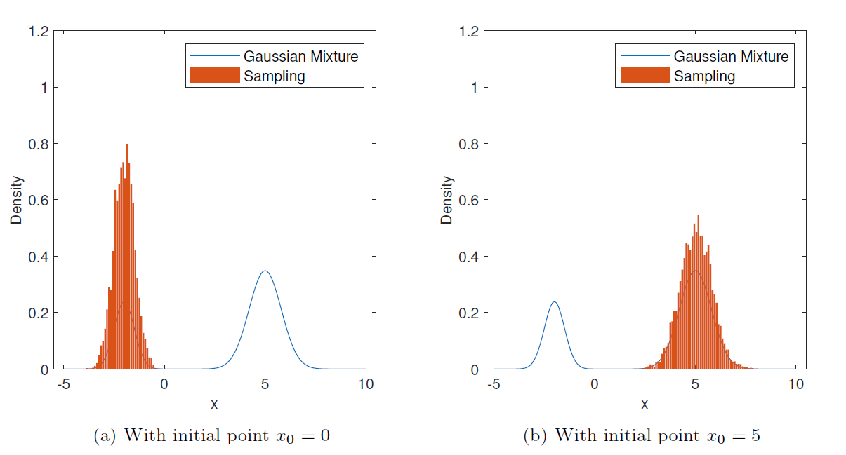

Comparing with Metropolis-Hastings algorithms in a multi-modal example
Target distribution: a Gaussian mixture distribution $π=0.3N(−2,0.5)+0.7N(5,0.8)$
The Metropolis-Hastings Algorithm performs poorly in a multi-modal distribution.(${10}^{4}$ samples)

Slide 8
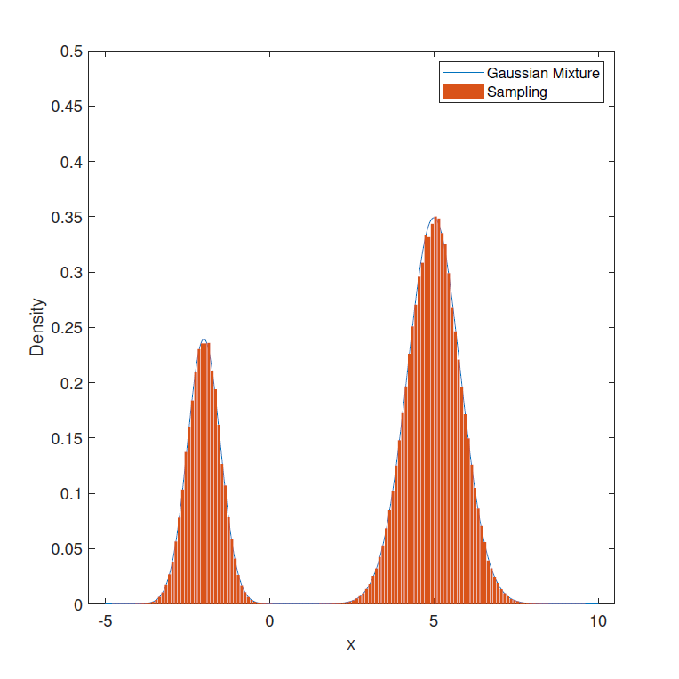
Comparing with Metropolis-Hastings algorithms in a multi-modal example
ETAIS (M=200) will not suffer from
this problem!

Slide 9
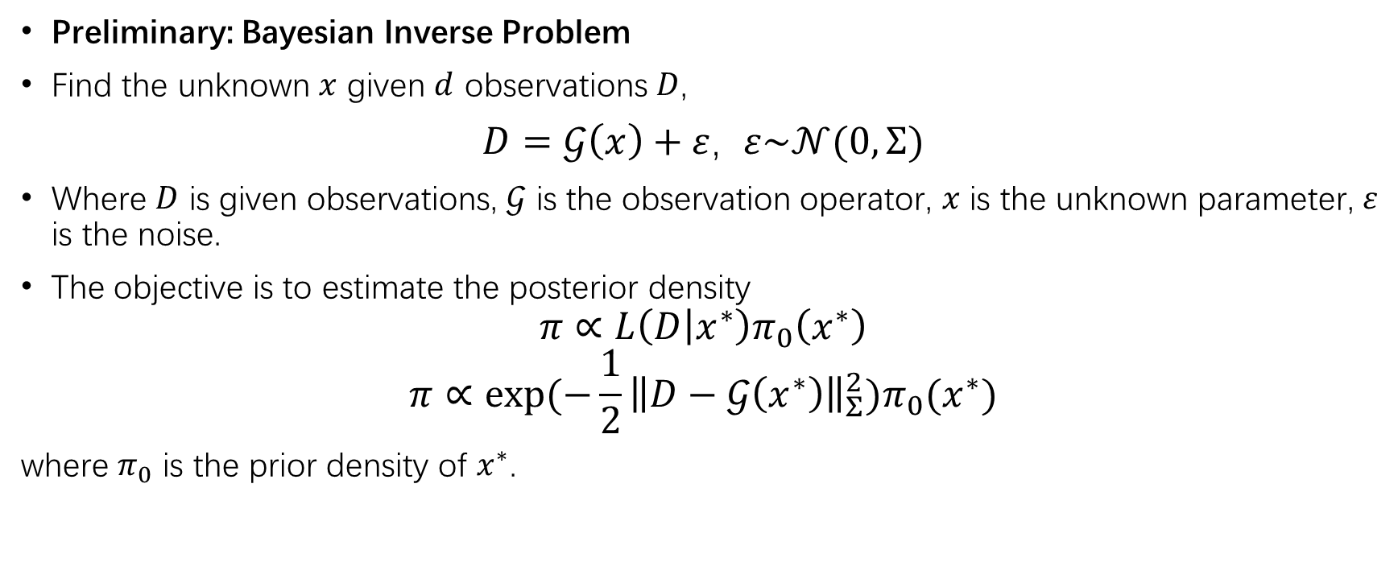
Data assimilation with Birth & Death ODE
Preliminary: Bayesian Inverse Problem
Find the unknown $x$ given $d$ observations $D$,
$D=𝒢\left(x\right)+ε$, $ε\sim 𝒩(0,Σ)$
Where $D$ is given observations, $𝒢$ is the observation operator, $x$ is the unknown parameter, $ε$ is the noise.
The objective is to estimate the posterior density
$$π∝L\left(D | x^{∗}\right)π_{0}\left(x^{∗}\right)$$
$$π∝exp⁡(−\frac{1}{2}{\left\|D−𝒢\left(x^{∗}\right)\right\|}_{Σ}^{2})π_{0}(x^{∗})$$
where $π_{0}$ is the prior density of $x^{∗}$.

Slide 10

The Birth & Death ODE
The population model is
$$\frac{dX}{dt}=K_{b}−K_{d}X$$
where $K_{b}$ is "birth rate" of the population and $K_{d}$ is the "death rate".
The solution is
$X=c$exp$\left(−K_{d}t\right)+\frac{K_{b}}{K_{d}}$

Slide 11
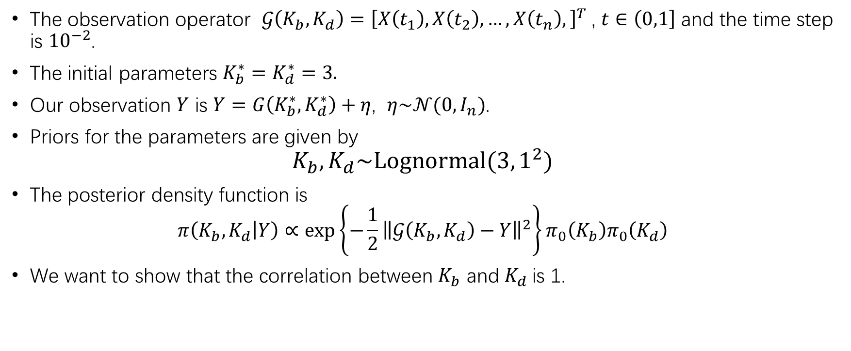
Target distribution
The observation operator $𝒢\left(K_{b},K_{d}\right)={\left[X\left(t_{1}\right),X\left(t_{2}\right),…,X\left(t_{n}\right),\right]}^{T}$, $t∈\left(0,1\right]$ and the time step is ${10}^{−2}$.
The initial parameters $K_{b}^{∗}=K_{d}^{∗}=3.$
Our observation $Y$ is $Y=G\left(K_{b}^{∗},K_{d}^{∗}\right)+η$, $η\sim 𝒩(0,I_{n})$.
Priors for the parameters are given by
$$K_{b},K_{d}\sim \text{Lognormal}(3,1^{2})$$
The posterior density function is
$$π\left(K_{b},K_{d} | Y\right)∝\text{exp}\left\{−\frac{1}{2}{\left\|𝒢\left(K_{b},K_{d}\right)−Y\right\|}^{2}\right\}π_{0}\left(K_{b}\right)π_{0}\left(K_{d}\right)$$
We want to show that the correlation between $K_{b}$ and $K_{d}$is 1.

Slide 12
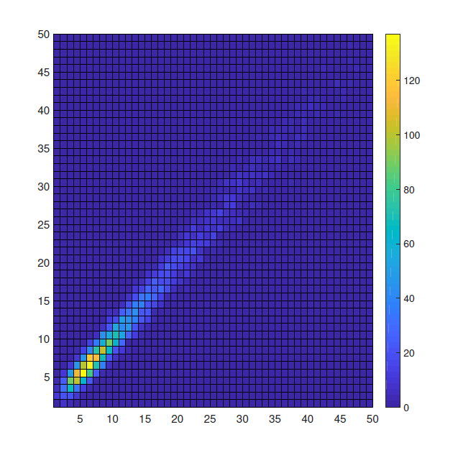
Implementation using ETAIS with Multinomial transformation resampler
Ensemble size M=5000 and iteration time N=50.
It can be seen from the figure that the correlation is 1 and it converges well.

Slide 13
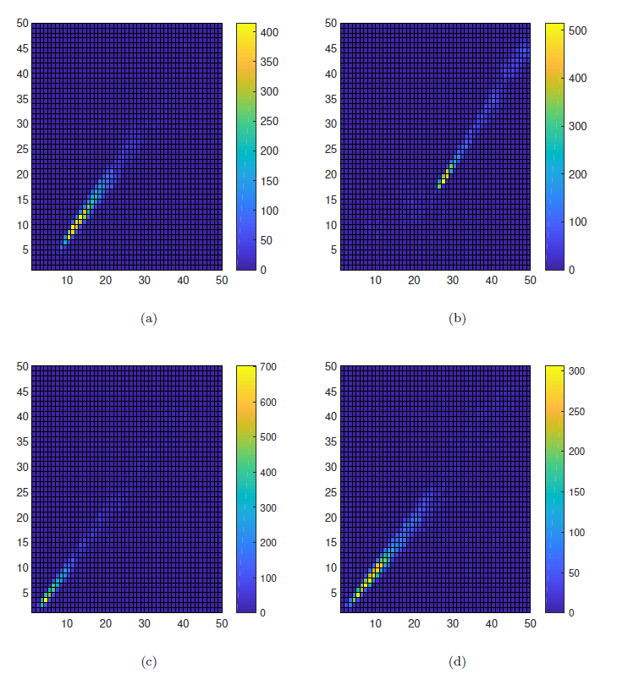
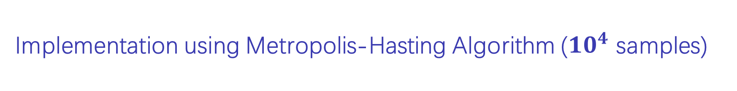
Implementation using Metropolis-Hasting Algorithm (${10}^{4}$ samples)
Some figures are shifted.
The figures are not reproducible, which mean it doesn’t converge well.

Slide 14
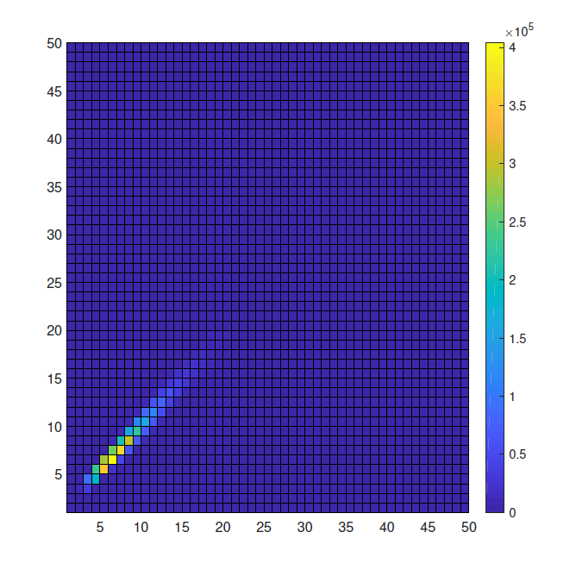
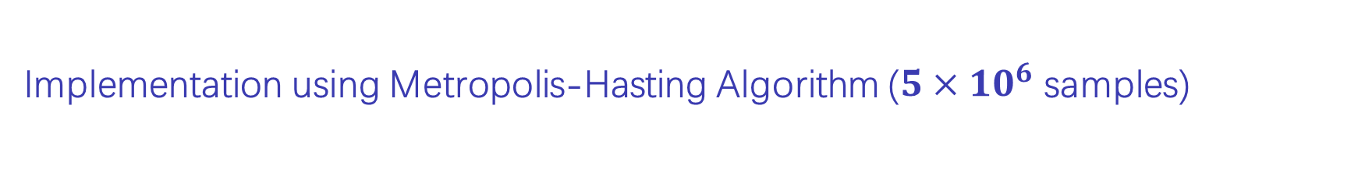
Implementation using Metropolis-Hasting Algorithm (${5×10}^{6}$ samples)
The figure can be reproduced, and it converges.
However, the number of samples is very large!

Slide 15
Conclusion
Importance sampling is a nice sampling method but it must be equipped with appropriate proposal distribution.
We introduce an algorithm ETAIS with a state-of-the-art resampler-Multinomial transformation (MT).
We demonstrate that MT performs better than Bootstrap resampling.
ETAIS performs well in the multi-modal target distribution.
In our numerical example, ETAIS achieves the convergence in a small number of samples.

