Slide 1
Research questions
Does ectoparasite life history, especially time spent on host, influence host specificity?
Does time spent on host affect the relative importance of environmental vs. host covariates with regards to occupancy?

Slide 2
Predictions
Parasites which spend more time on the host (especially fur fleas) will be more host-specific due to increased evolutionary pressure to adapt to a single host
Parasites which spend less time on the host (especially ephemeral parasites such as ticks) will have more variance in occupancy explained by site-level covariates, whereas fur fleas will have more variance explained by host-level covariates

Slide 3
Analysis pt. 1, occupancy model

Slide 4
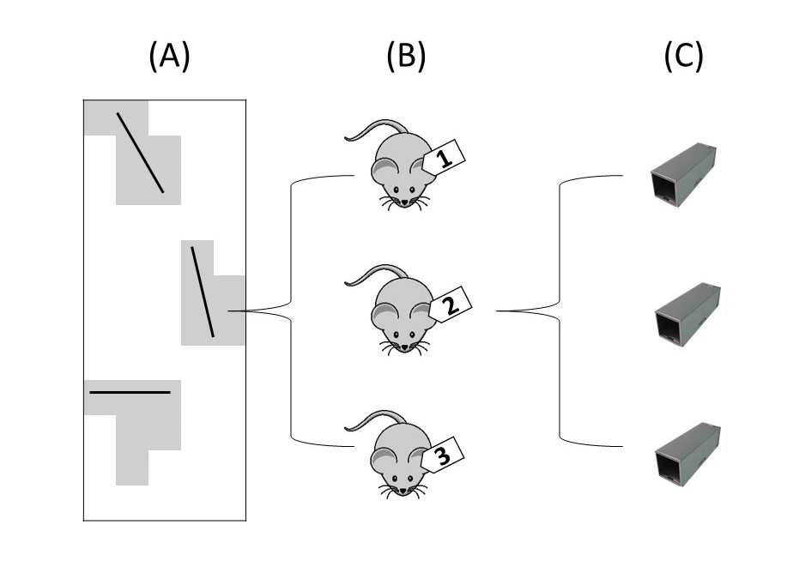
Each geographic site contains a community of small mammal hosts and arthropod ectoparasites

Slide 5
Within a site, ectoparasites may or may not occur on individual mammal hosts

Slide 6
Hosts can be captured multiple times over several days, allowing the model to estimate detection rates

Slide 7
Calculate Bayesian R-squared for levels A & B to compare explanatory power of each level

Slide 8
Analysis pt. 2, Kruskel-Wallis and linear regression
Kruskel-Wallis
Ectos grouped by relative time spent on host (ephemeral parasites, fur fleas, nest fleas, and bot flies)
Variances and sample sizes were unequal, therefore analysis was nonparametric
Bot flies included (for now- there is only 1 species and it doesn’t fit into any other categories)
Regressions performed with Bayesian r-squared values as explanatory variable and number of host species and response

Slide 9
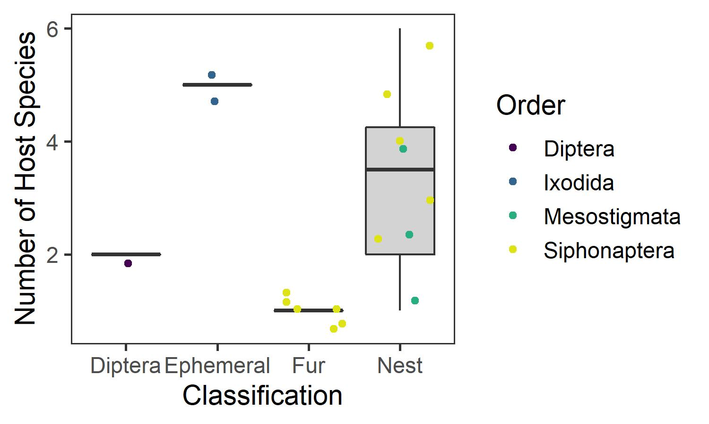
P = 0.011
Eta-sq: 0.630

Slide 10
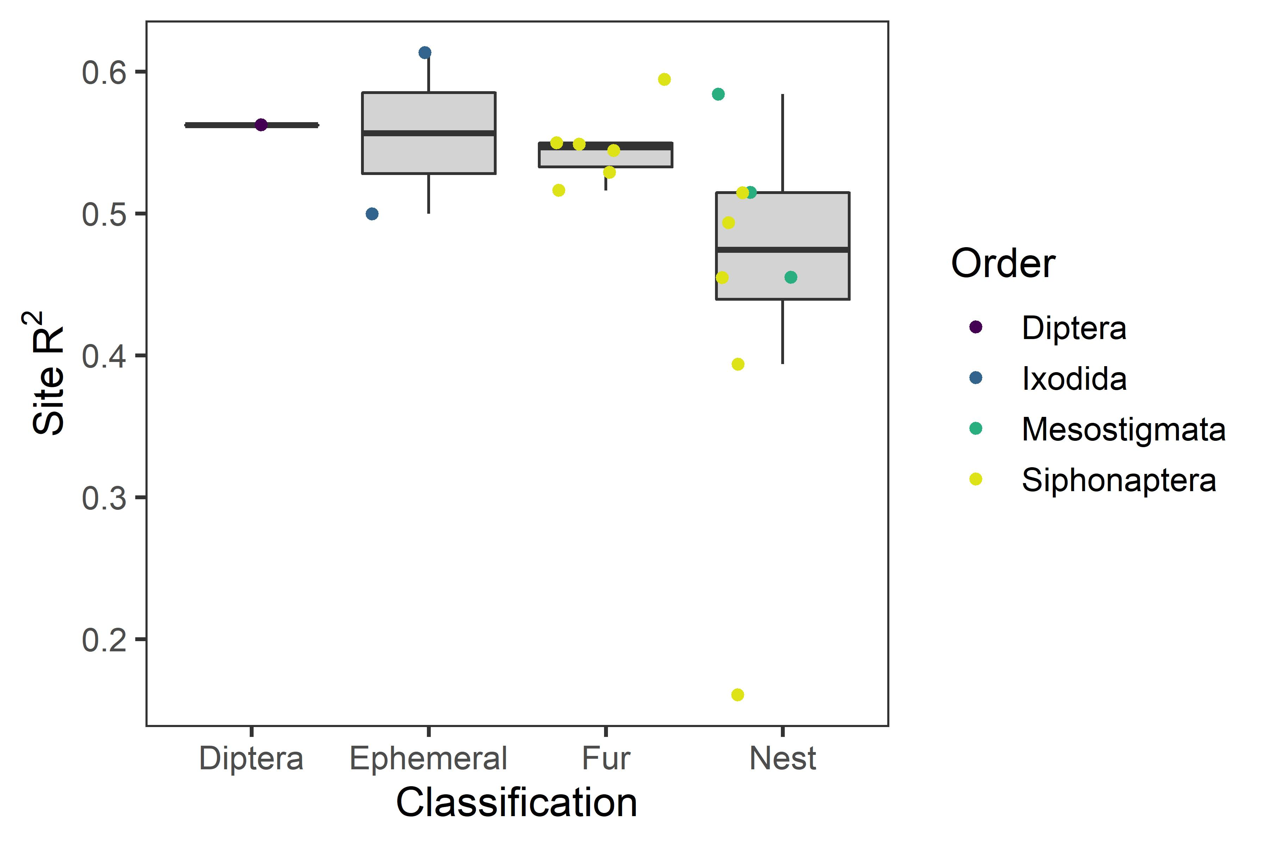
P = 0.074
Eta-sq: 0.303

Slide 11
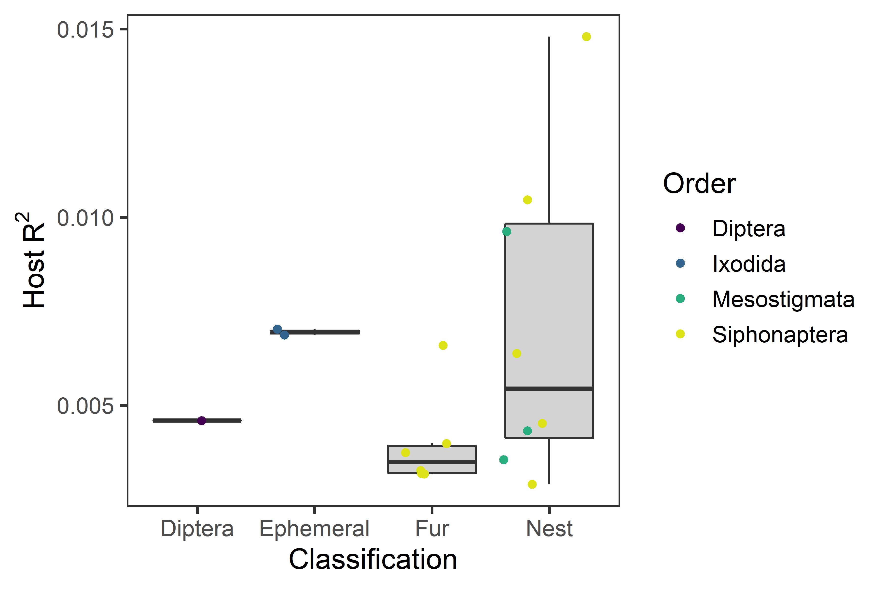
P = 0.193
Eta-sq: 0.133

Slide 12
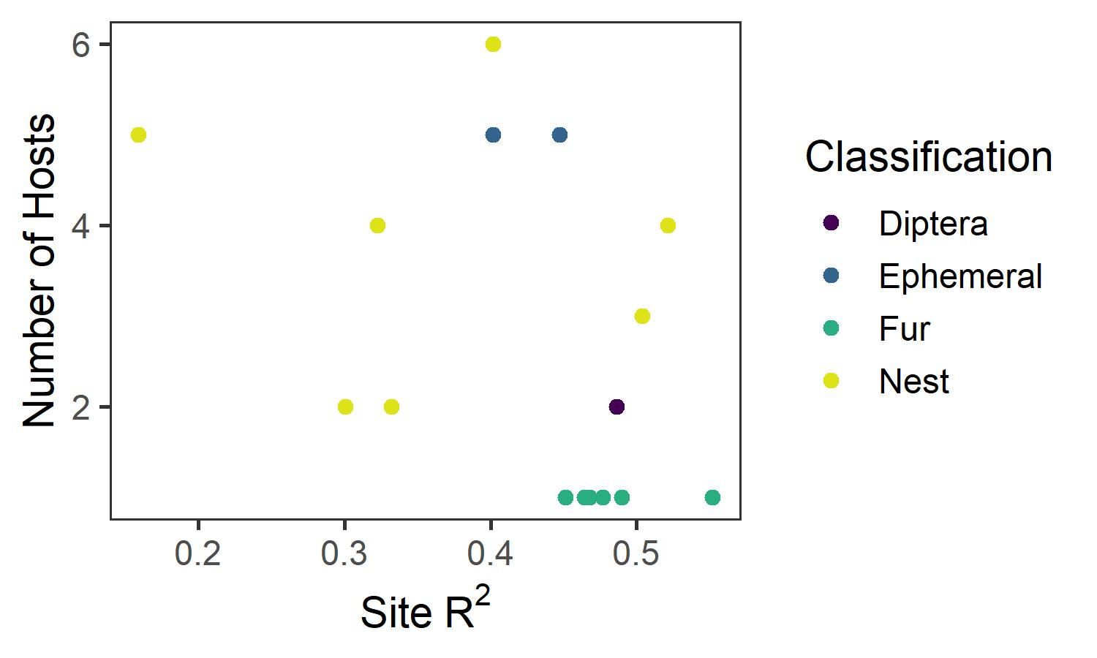
P = 0.195
R-sq: 0.05

Slide 13
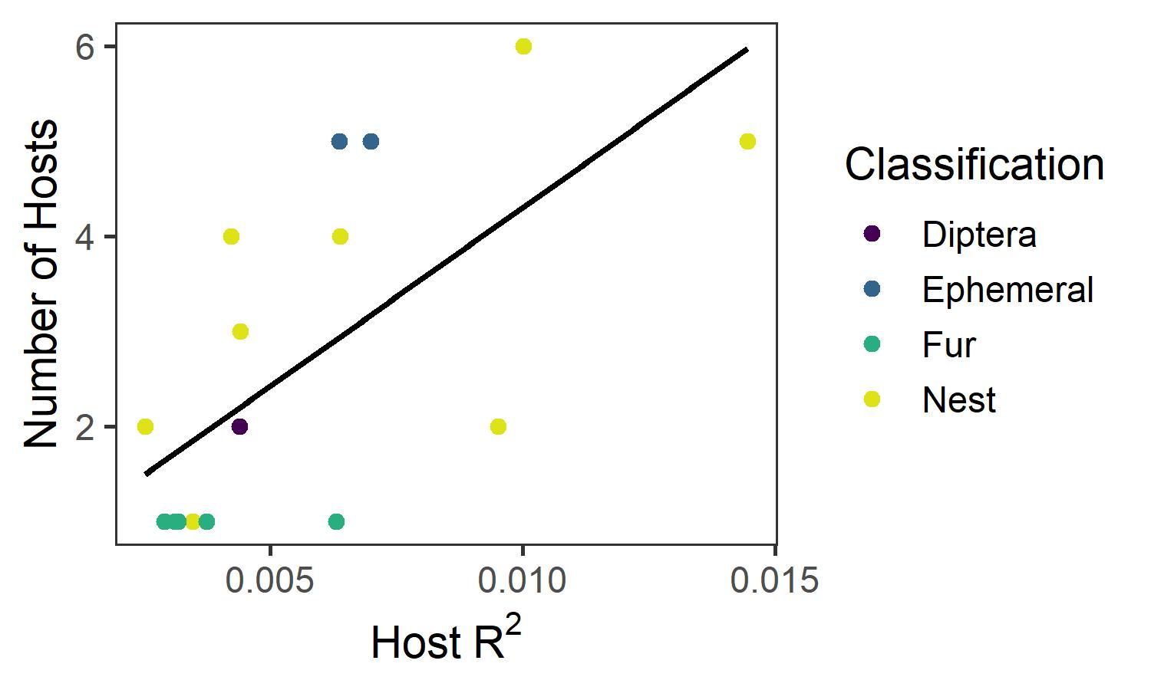
P = 0.003
R-sq: 0.41

Slide 14
Conclusions:
Life history predicts host specificity: fur fleas which spend full life cycle on host are very host specific, ephemeral parasites not host specific, nest parasites variable
Predictive power of host model very low: whether a parasite is on a host individual may be more stochastic
Some evidence that life history affects responses to environmental vs. host covariates, but results are mixed (and sometimes the opposite of what’s expected)

Slide 15
What could be happening:
Life history affects responses to individual covariates more than responses to levels of the model
Mechanisms for preferences might also be different: fur fleas probably follow their host’s habitat preferences; whereas ticks need leaf litter to prevent desiccation of larval stages

Slide 16
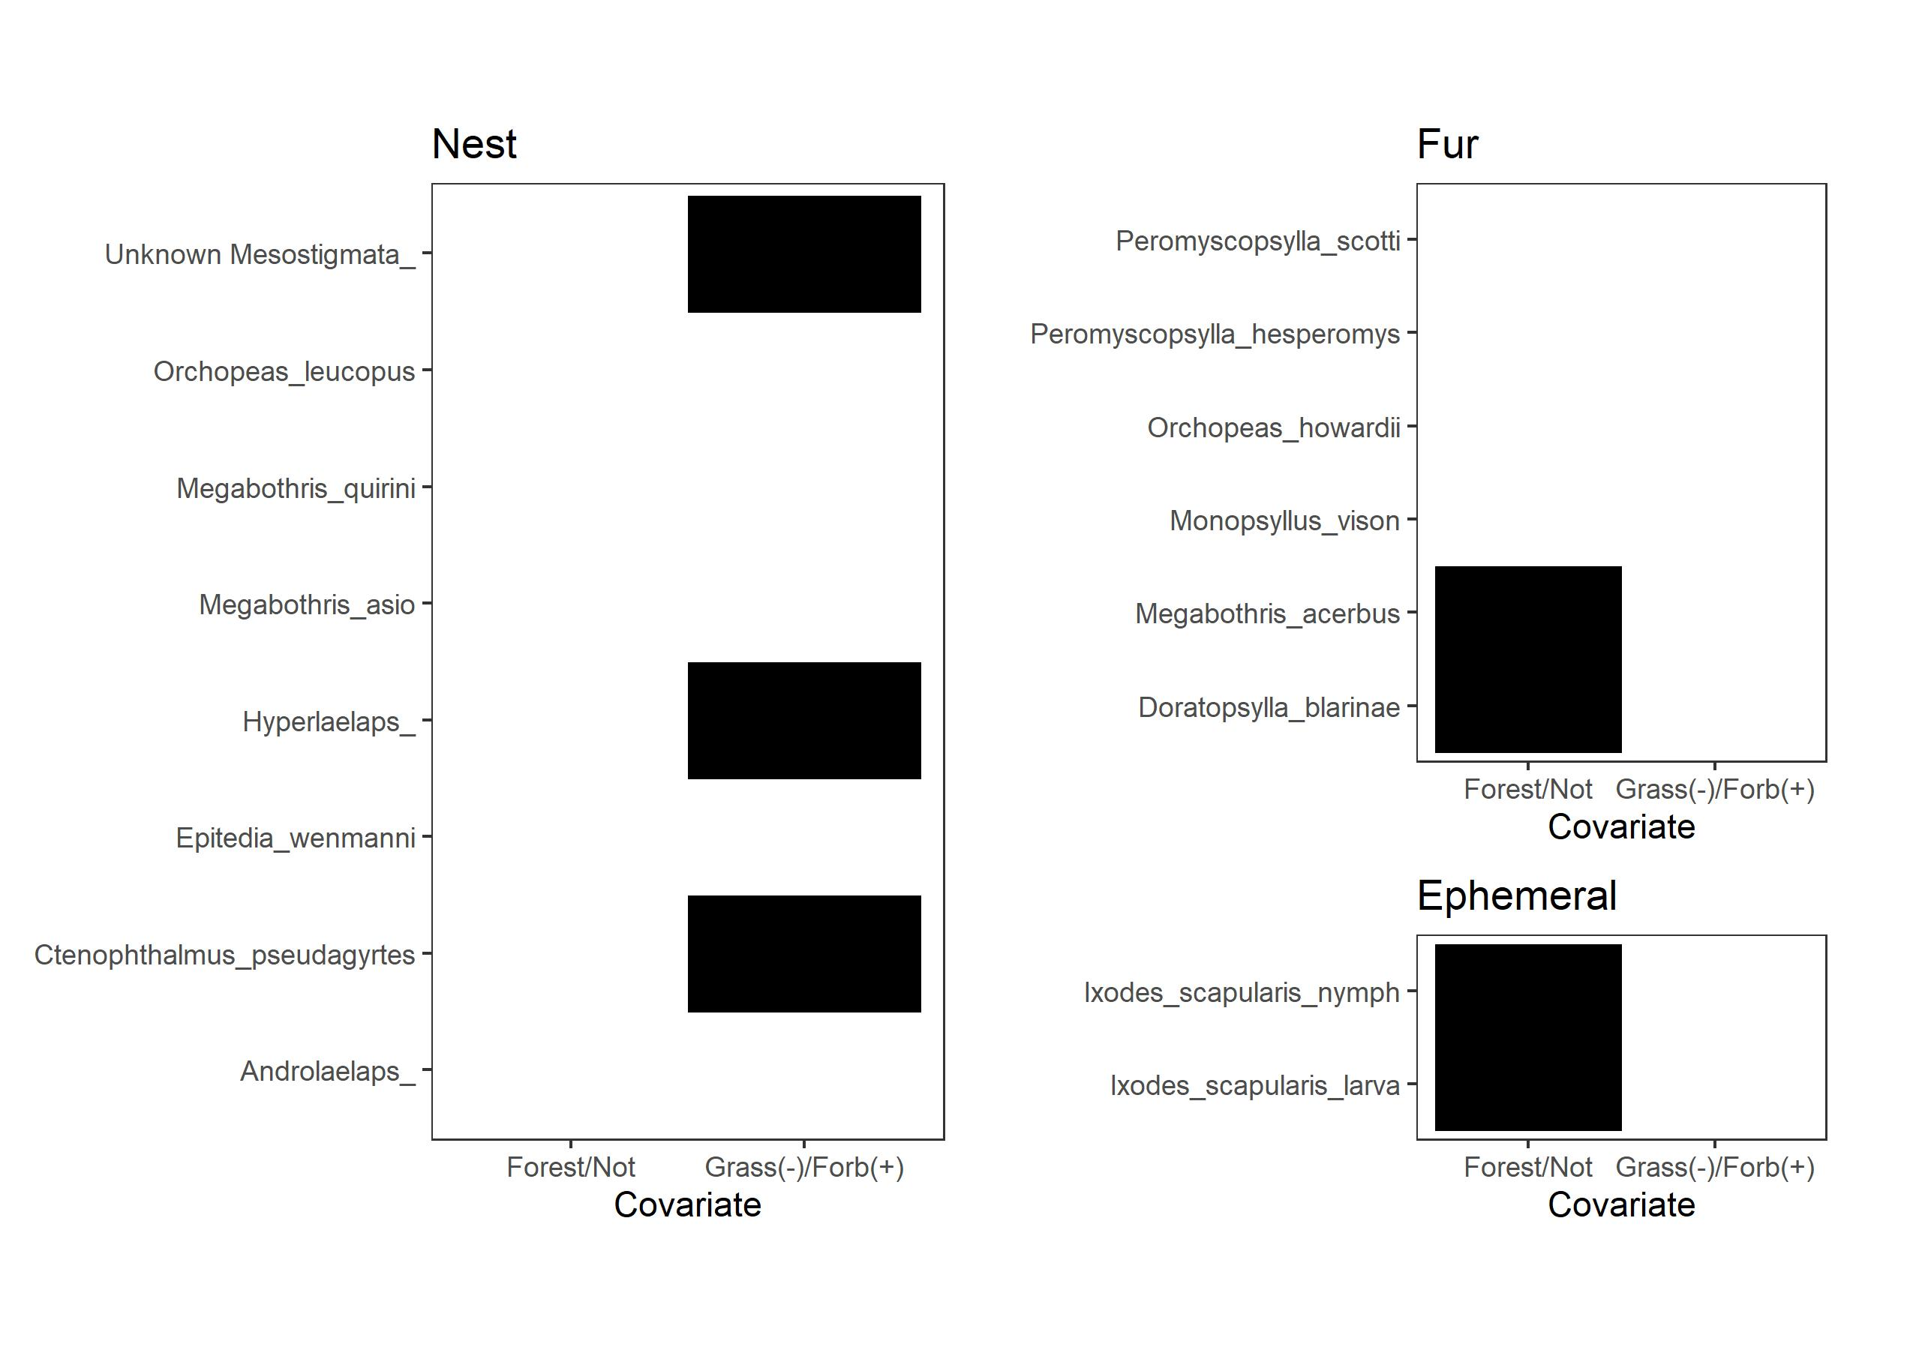

Slide 17
What could be happening:
Host level: bot flies and ephemeral parasites respond to host characteristics other than species identity; fleas do not

Slide 18
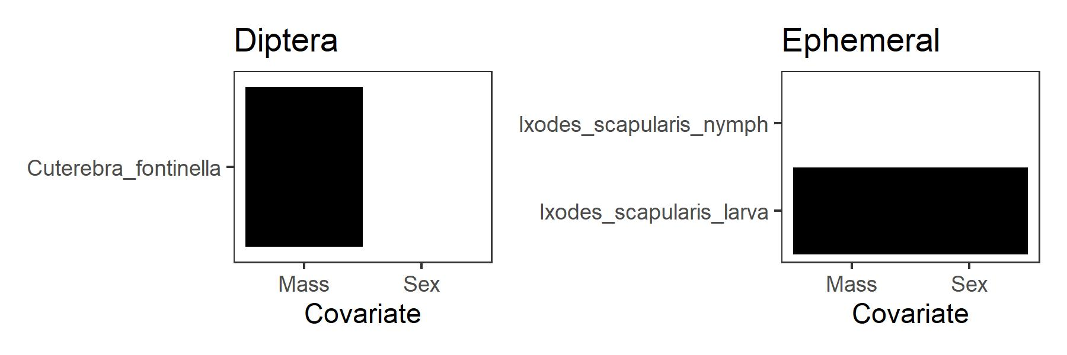

Slide 19
What could be happening:
Host level: bot flies and ephemeral parasites respond to host characteristics other than species identity; fleas do not
Lack of explanatory power could be due to low overall prevalence on hosts (lots of 0’s in the host level of the model)
Response to host species related to parasite abundance?

Slide 20
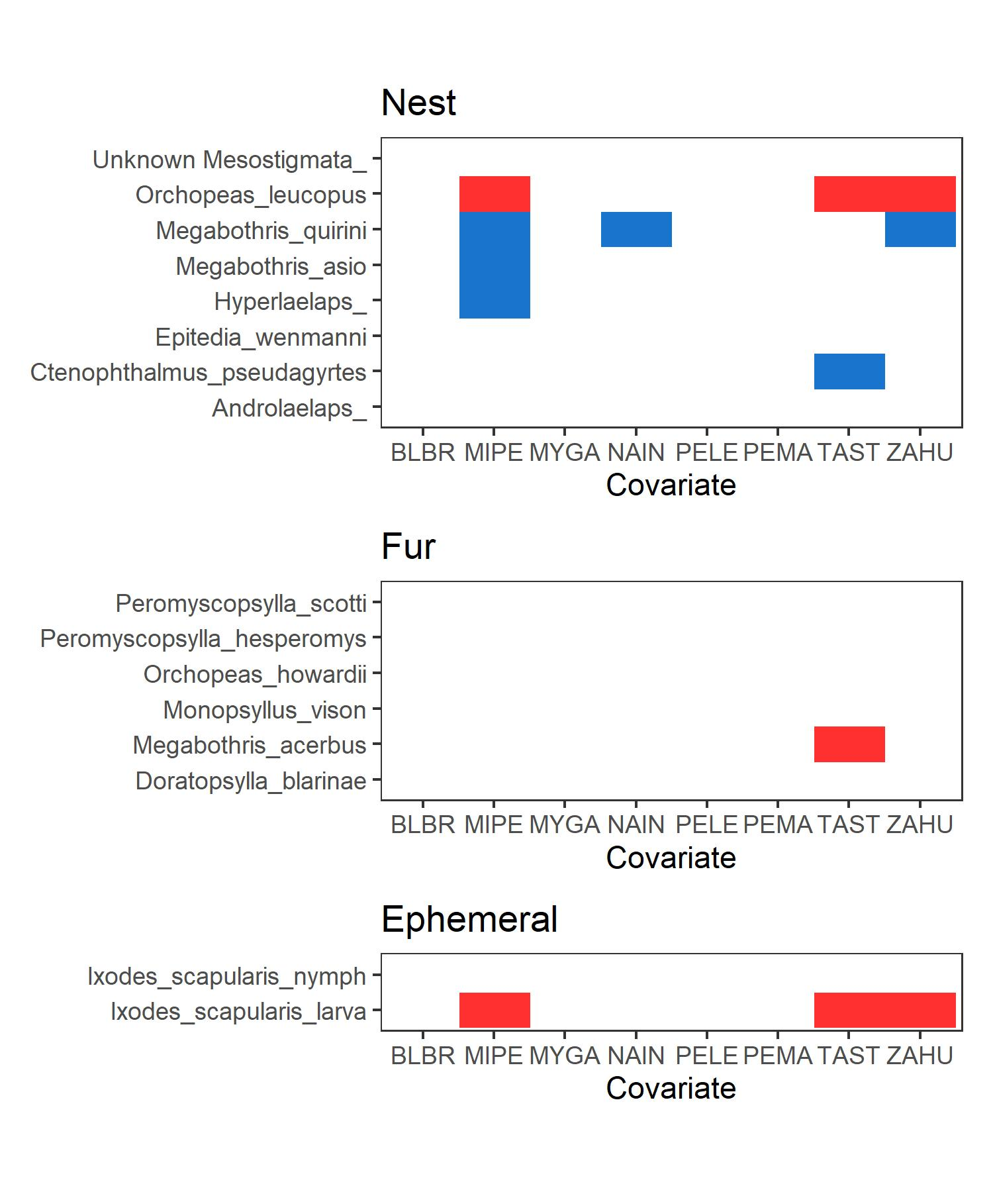

Slide 21
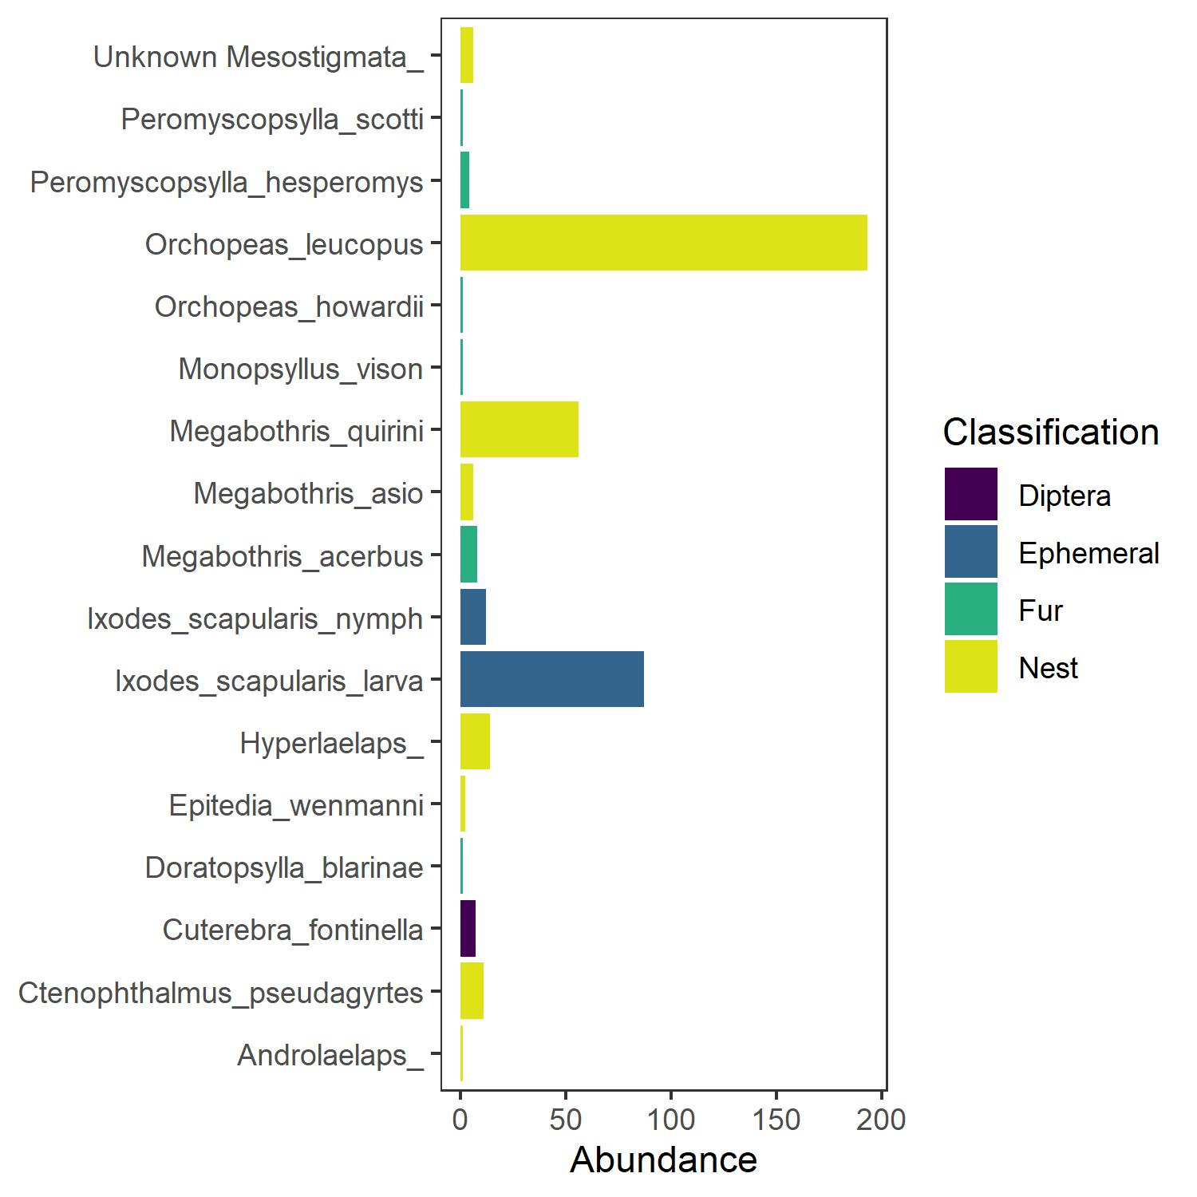
Logistic regression
(Sig. species response ~ Abundance)
P < 0.001

