Slide 1
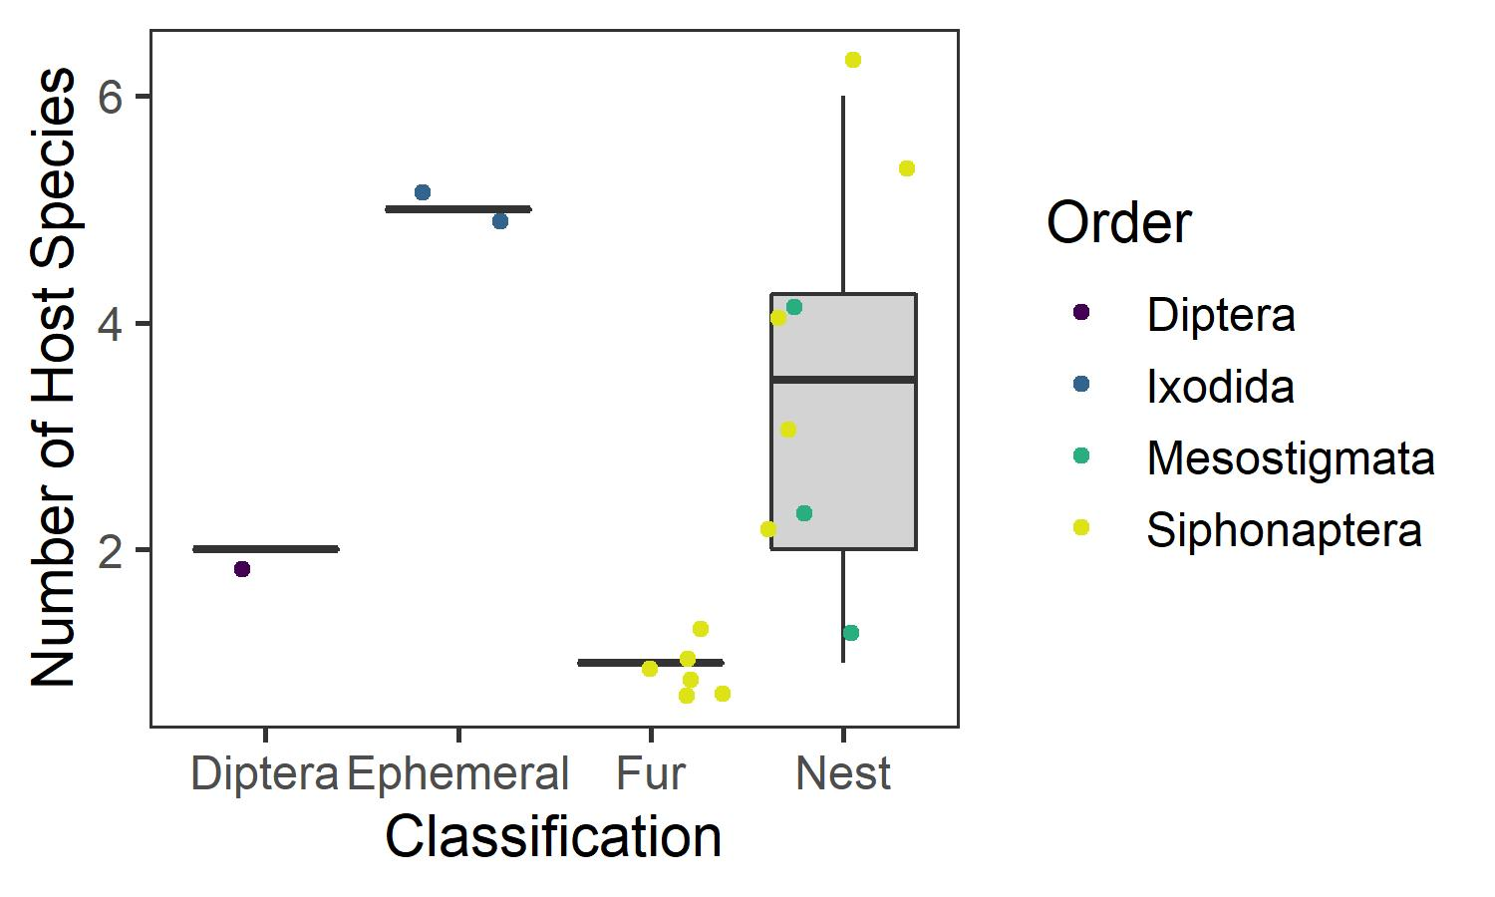
Life history categories vary in host specificity
P = 0.011
η² = 0.630

Slide 2
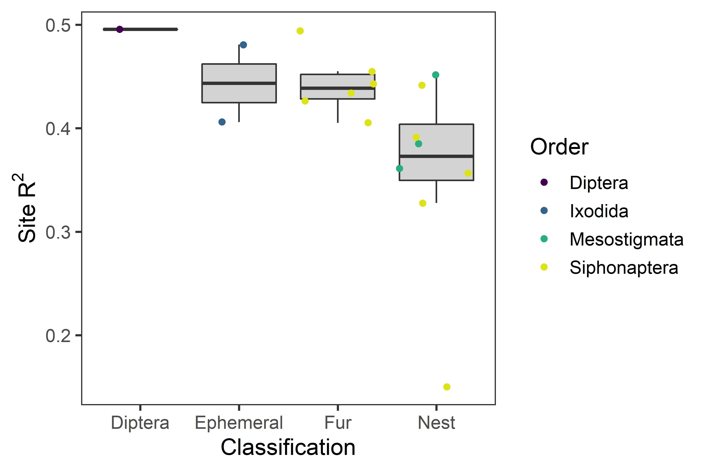
Site-level covariates explain the least variation for nest parasites
P = 0.067
η² = 0.262

Slide 3
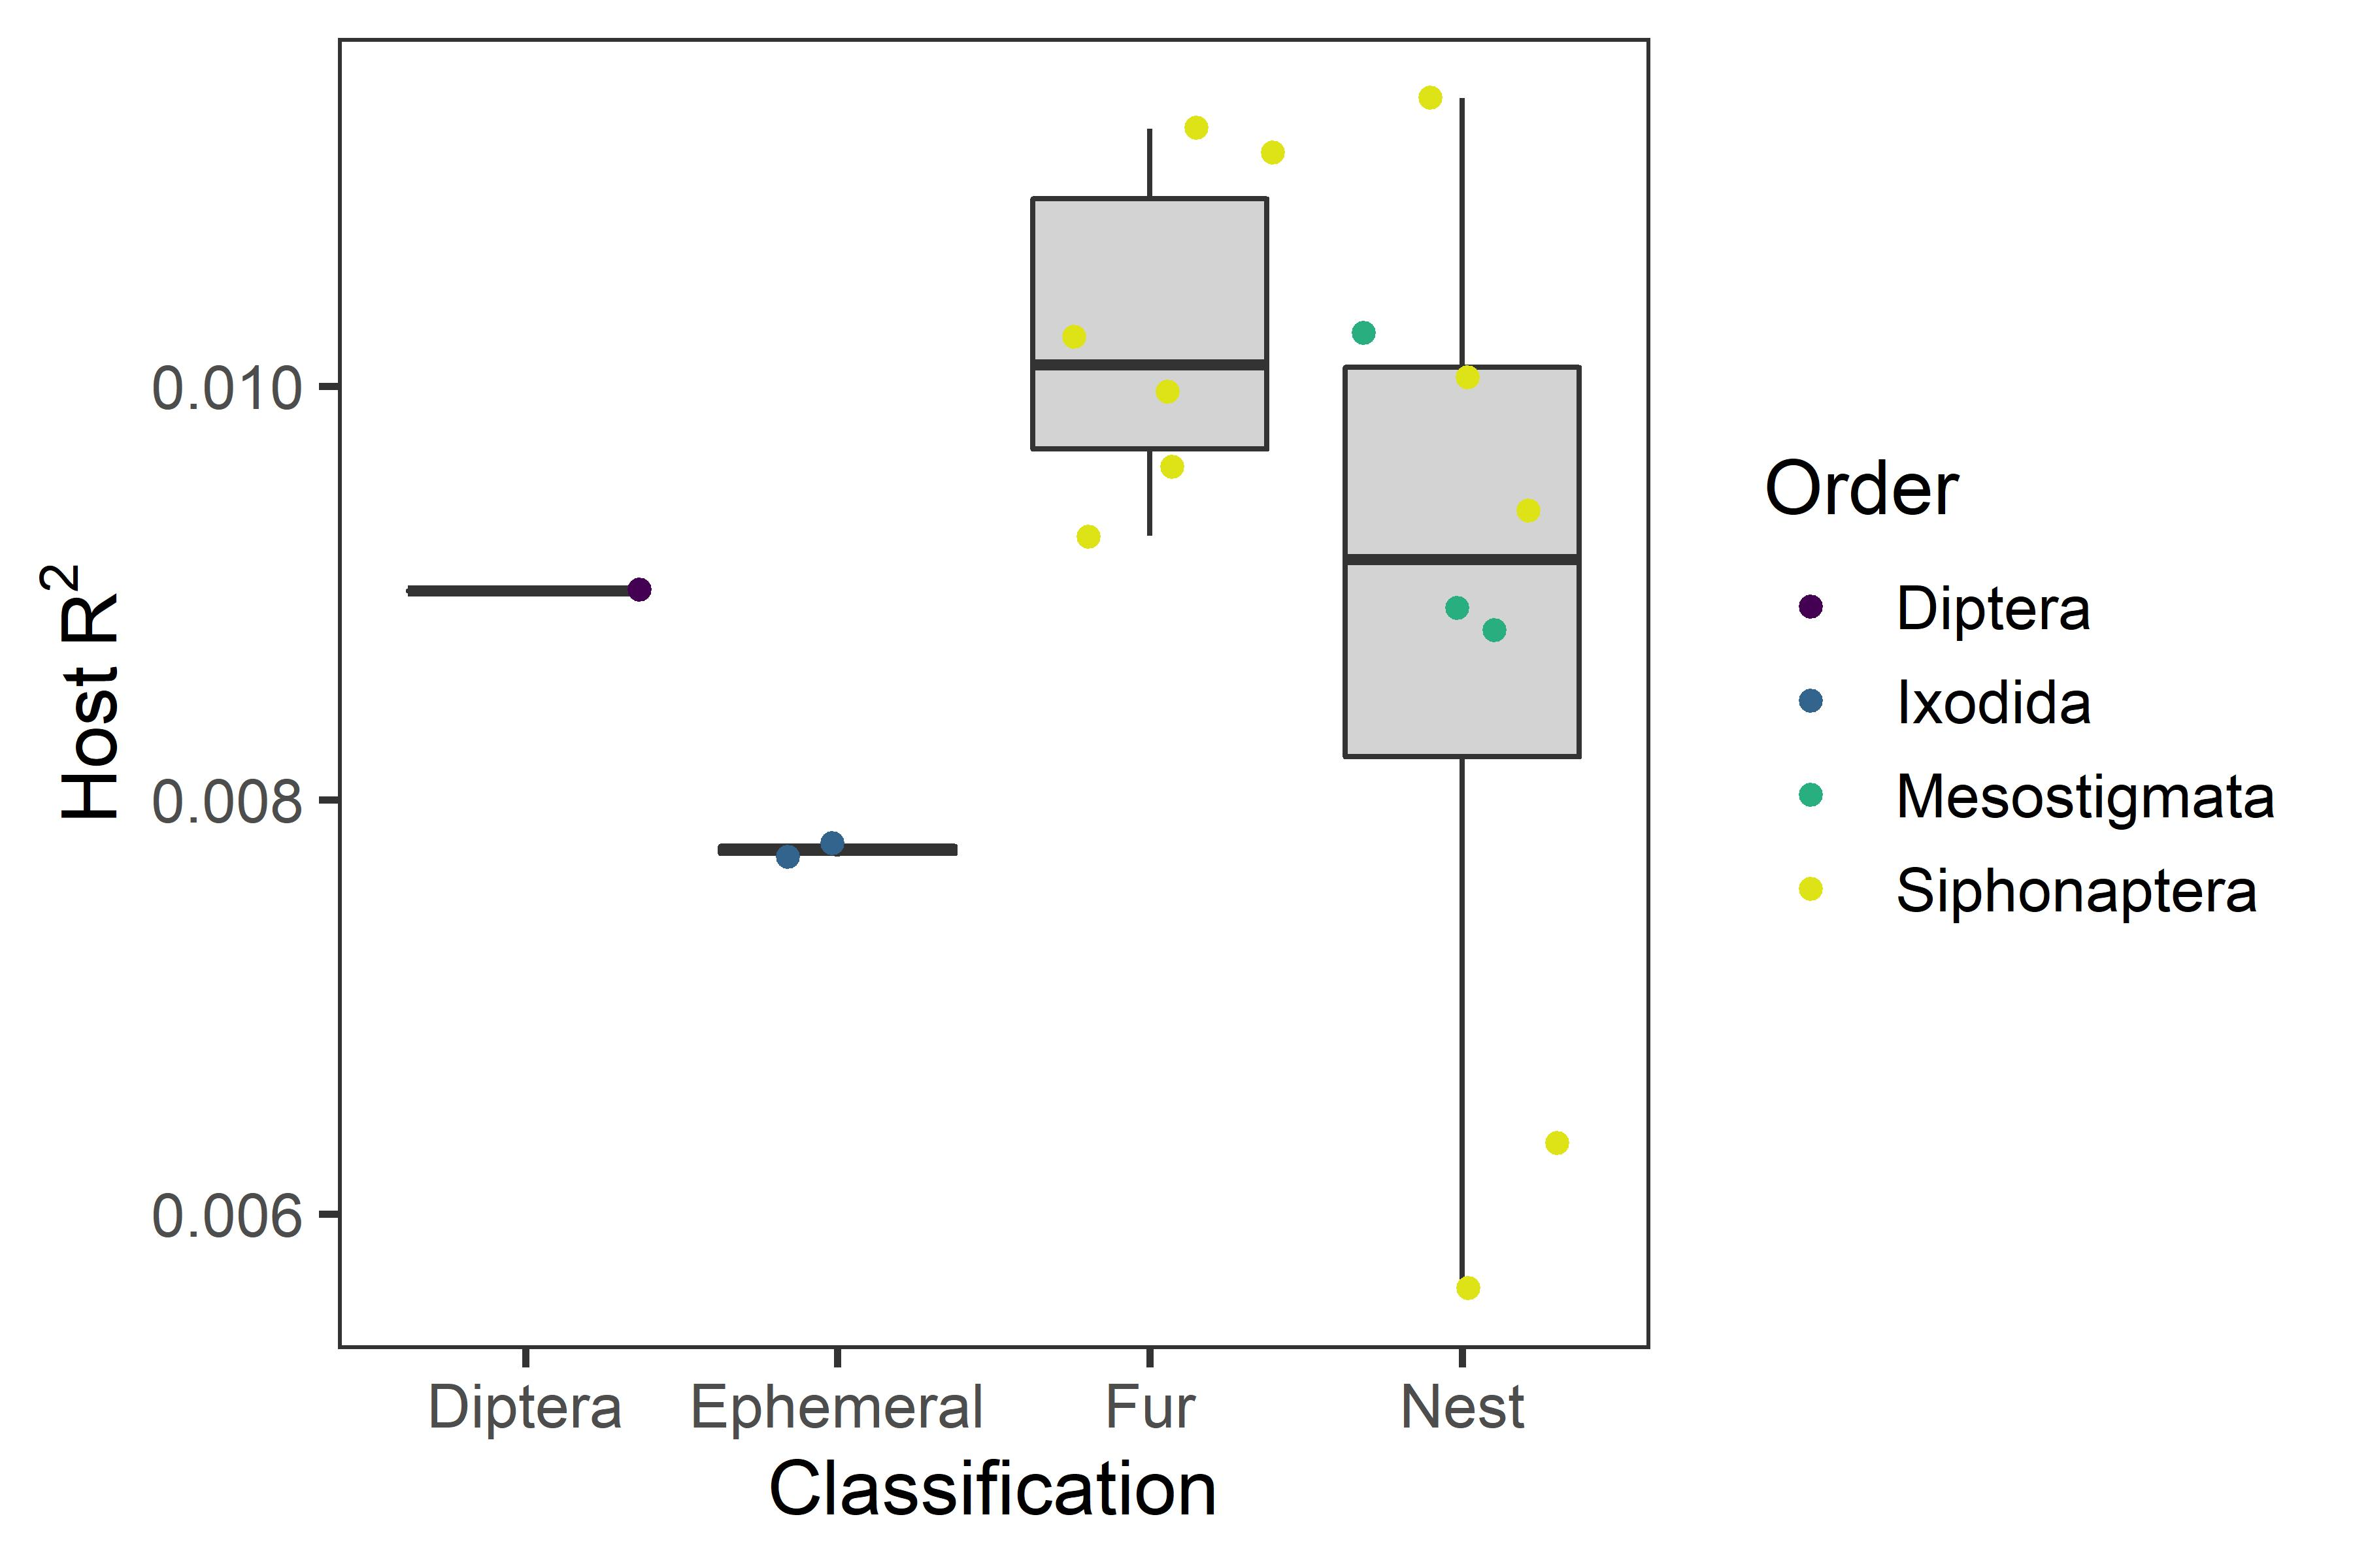
Host-level covariates explain the most variation for fur parasites
P = 0.100
η² = 0.200

Slide 4
Hypotheses review
Ephemeral parasites will have more variation explained by site-level covariates
Nest parasites will have more variation explained by host-level covariates

Slide 5

Hypotheses review
Ephemeral parasites will have more variation explained by site-level covariates
Nest parasites will have more variation explained by host-level covariates

Slide 6
Is everyone just following their primary host around?

Slide 7
Model Selection: Host level
Model | WAIC
Full | 83.86467
Species+Mass | 84.40398
Species+Sex | 85.81873
Species | 89.27891
Intercept | 91.63653
Sex | 92.33064
Mass | 93.88405
Sex+Mass | 94.31164

Slide 8
Get primary host species using protocol from Benton & Cerwonka (1960)
Basically looking at bar charts of # of parasites found on each host species.
I used raw abundance counts & counts adjusted for relative host abundance. Results were qualitatively similar.

Slide 9
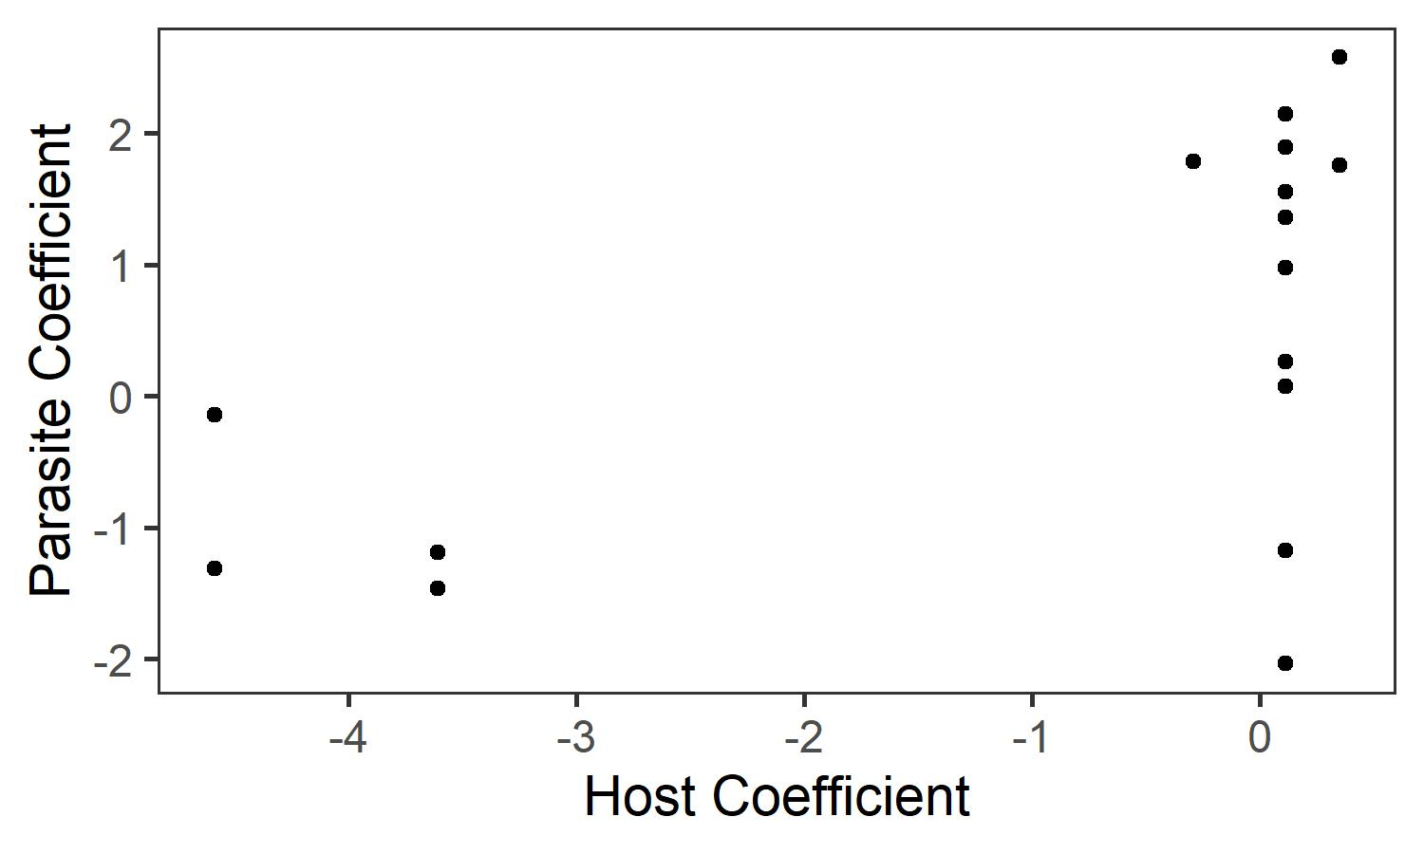
Regression of host and parasite habitat coefficient

Slide 10
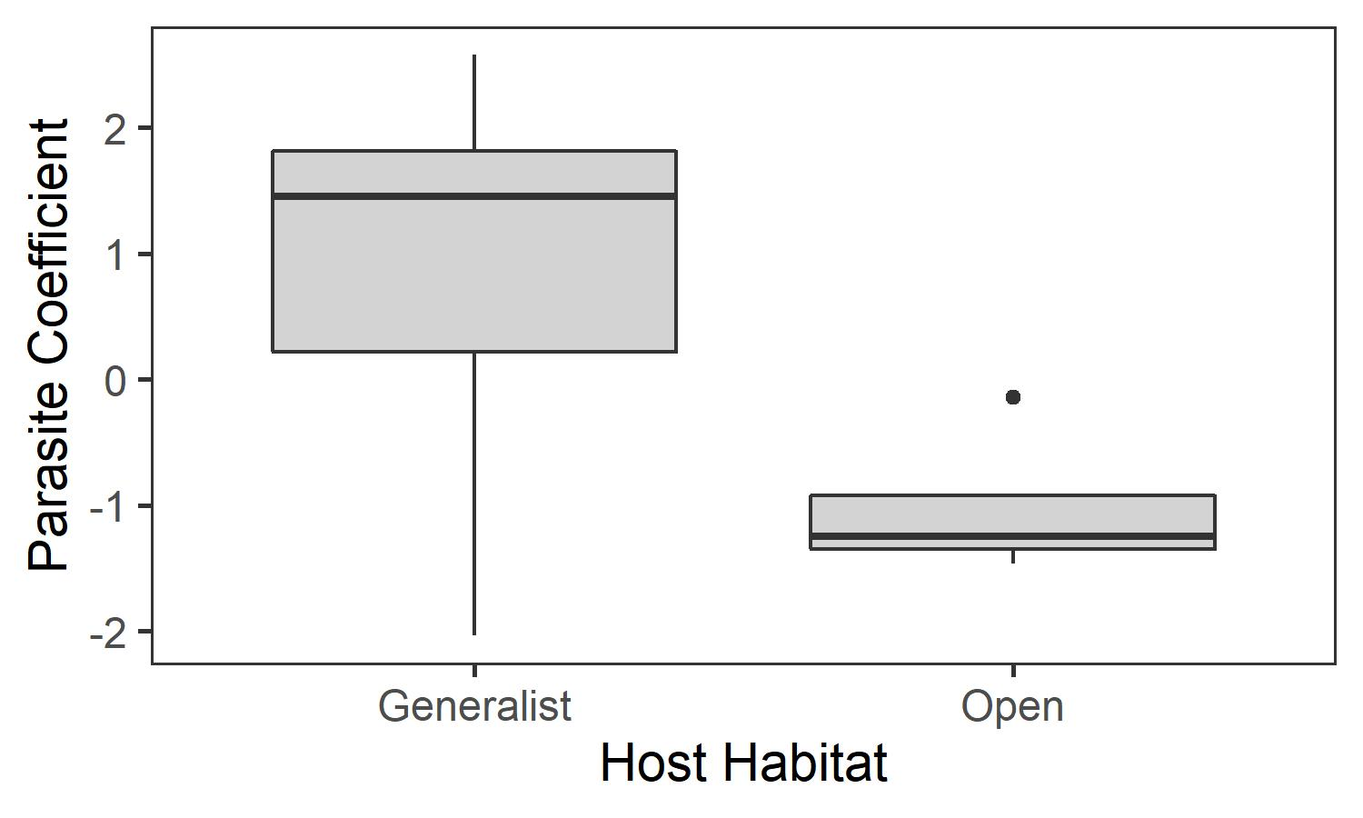
Seems hosts sort categorically by habitat & parasites tend to follow them
t = 3.8918
P = 0.002

Slide 11
Possible ecological explanation
Parasites follow their primary host around, regardless of life history
Life history influences spillover to secondary hosts (e.g. fur fleas do not spill over, nest fleas do sometimes, ephemeral parasites do frequently)

Slide 12
Anecdotal evidence for spillover idea: parasites on Peromyscus leucopus
Parasite | Primary Host | Geographic Site | Primary host present?
Megabothris quirini | Zapus hudsonius | Audubon 2 | No
 |  | Intervale 1 | Yes
 |  | Intervale 2 | Yes
 |  | St. Mike’s 1 | Yes
 |  | St. Mike’s 2 | Yes
Hyperlaelaps | Microtus pennsylvanicus | Jericho 1 | No
Megabothris asio | Microtus pennsylvanicus | St. Mike’s 1 | Yes
Orchopeas howardi | Tamiasciurus hudsonicus | Jericho 1 | Yes

