Slide 1
1, 2.5, 5, 7.5, 10 weekly immigrants
0, 0.015, 0.03, 0.045, 0.06 immigrant prevalence

Slide 2
Most of the completed simulations are here
1, 2.5, 5, 7.5, 10 weekly immigrants
0, 0.015, 0.03, 0.045, 0.06 immigrant prevalence

Slide 3
Most of the completed simulations are here
1, 2.5, 5, 7.5, 10 weekly immigrants
Some are here
0, 0.015, 0.03, 0.045, 0.06 immigrant prevalence

Slide 4
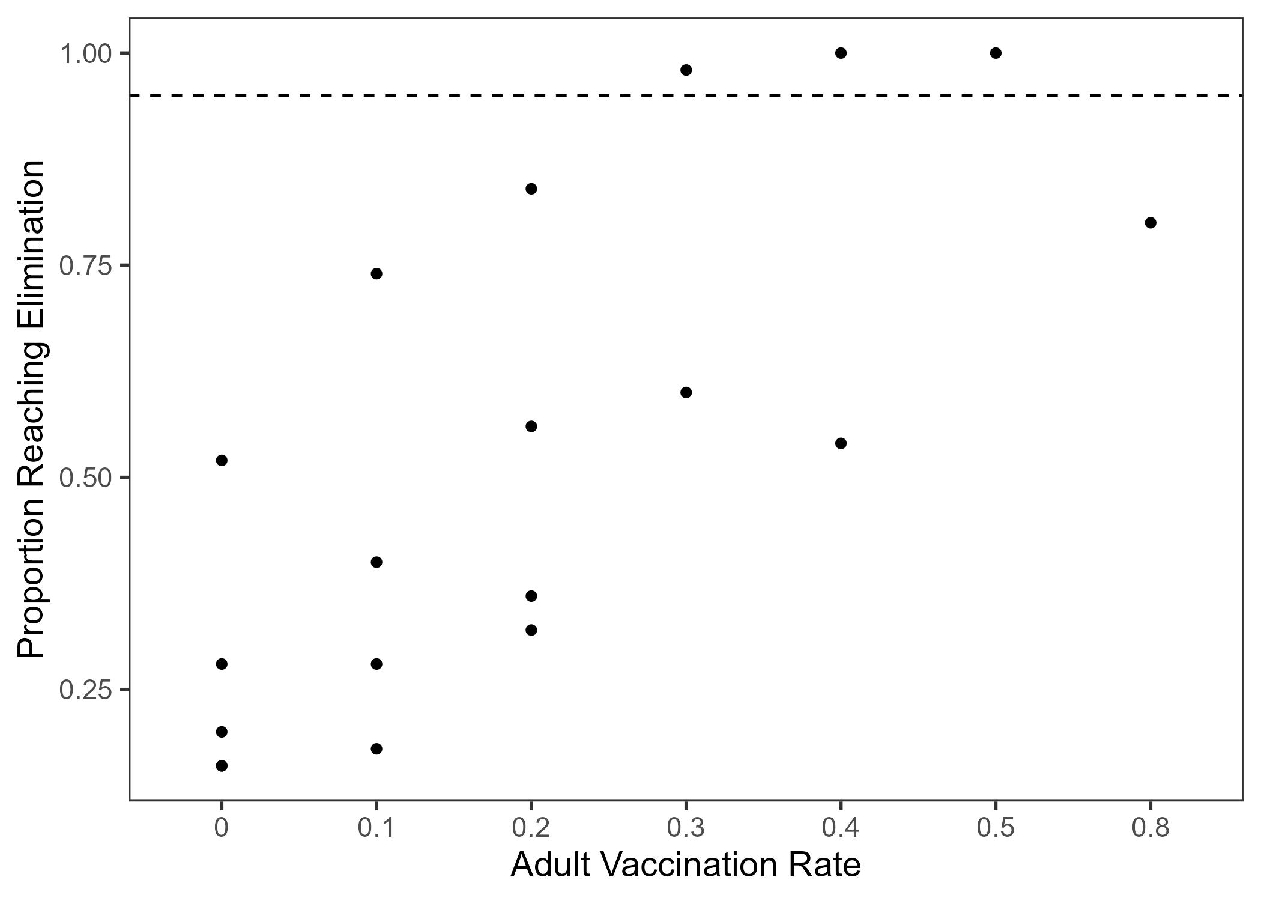

Slide 5
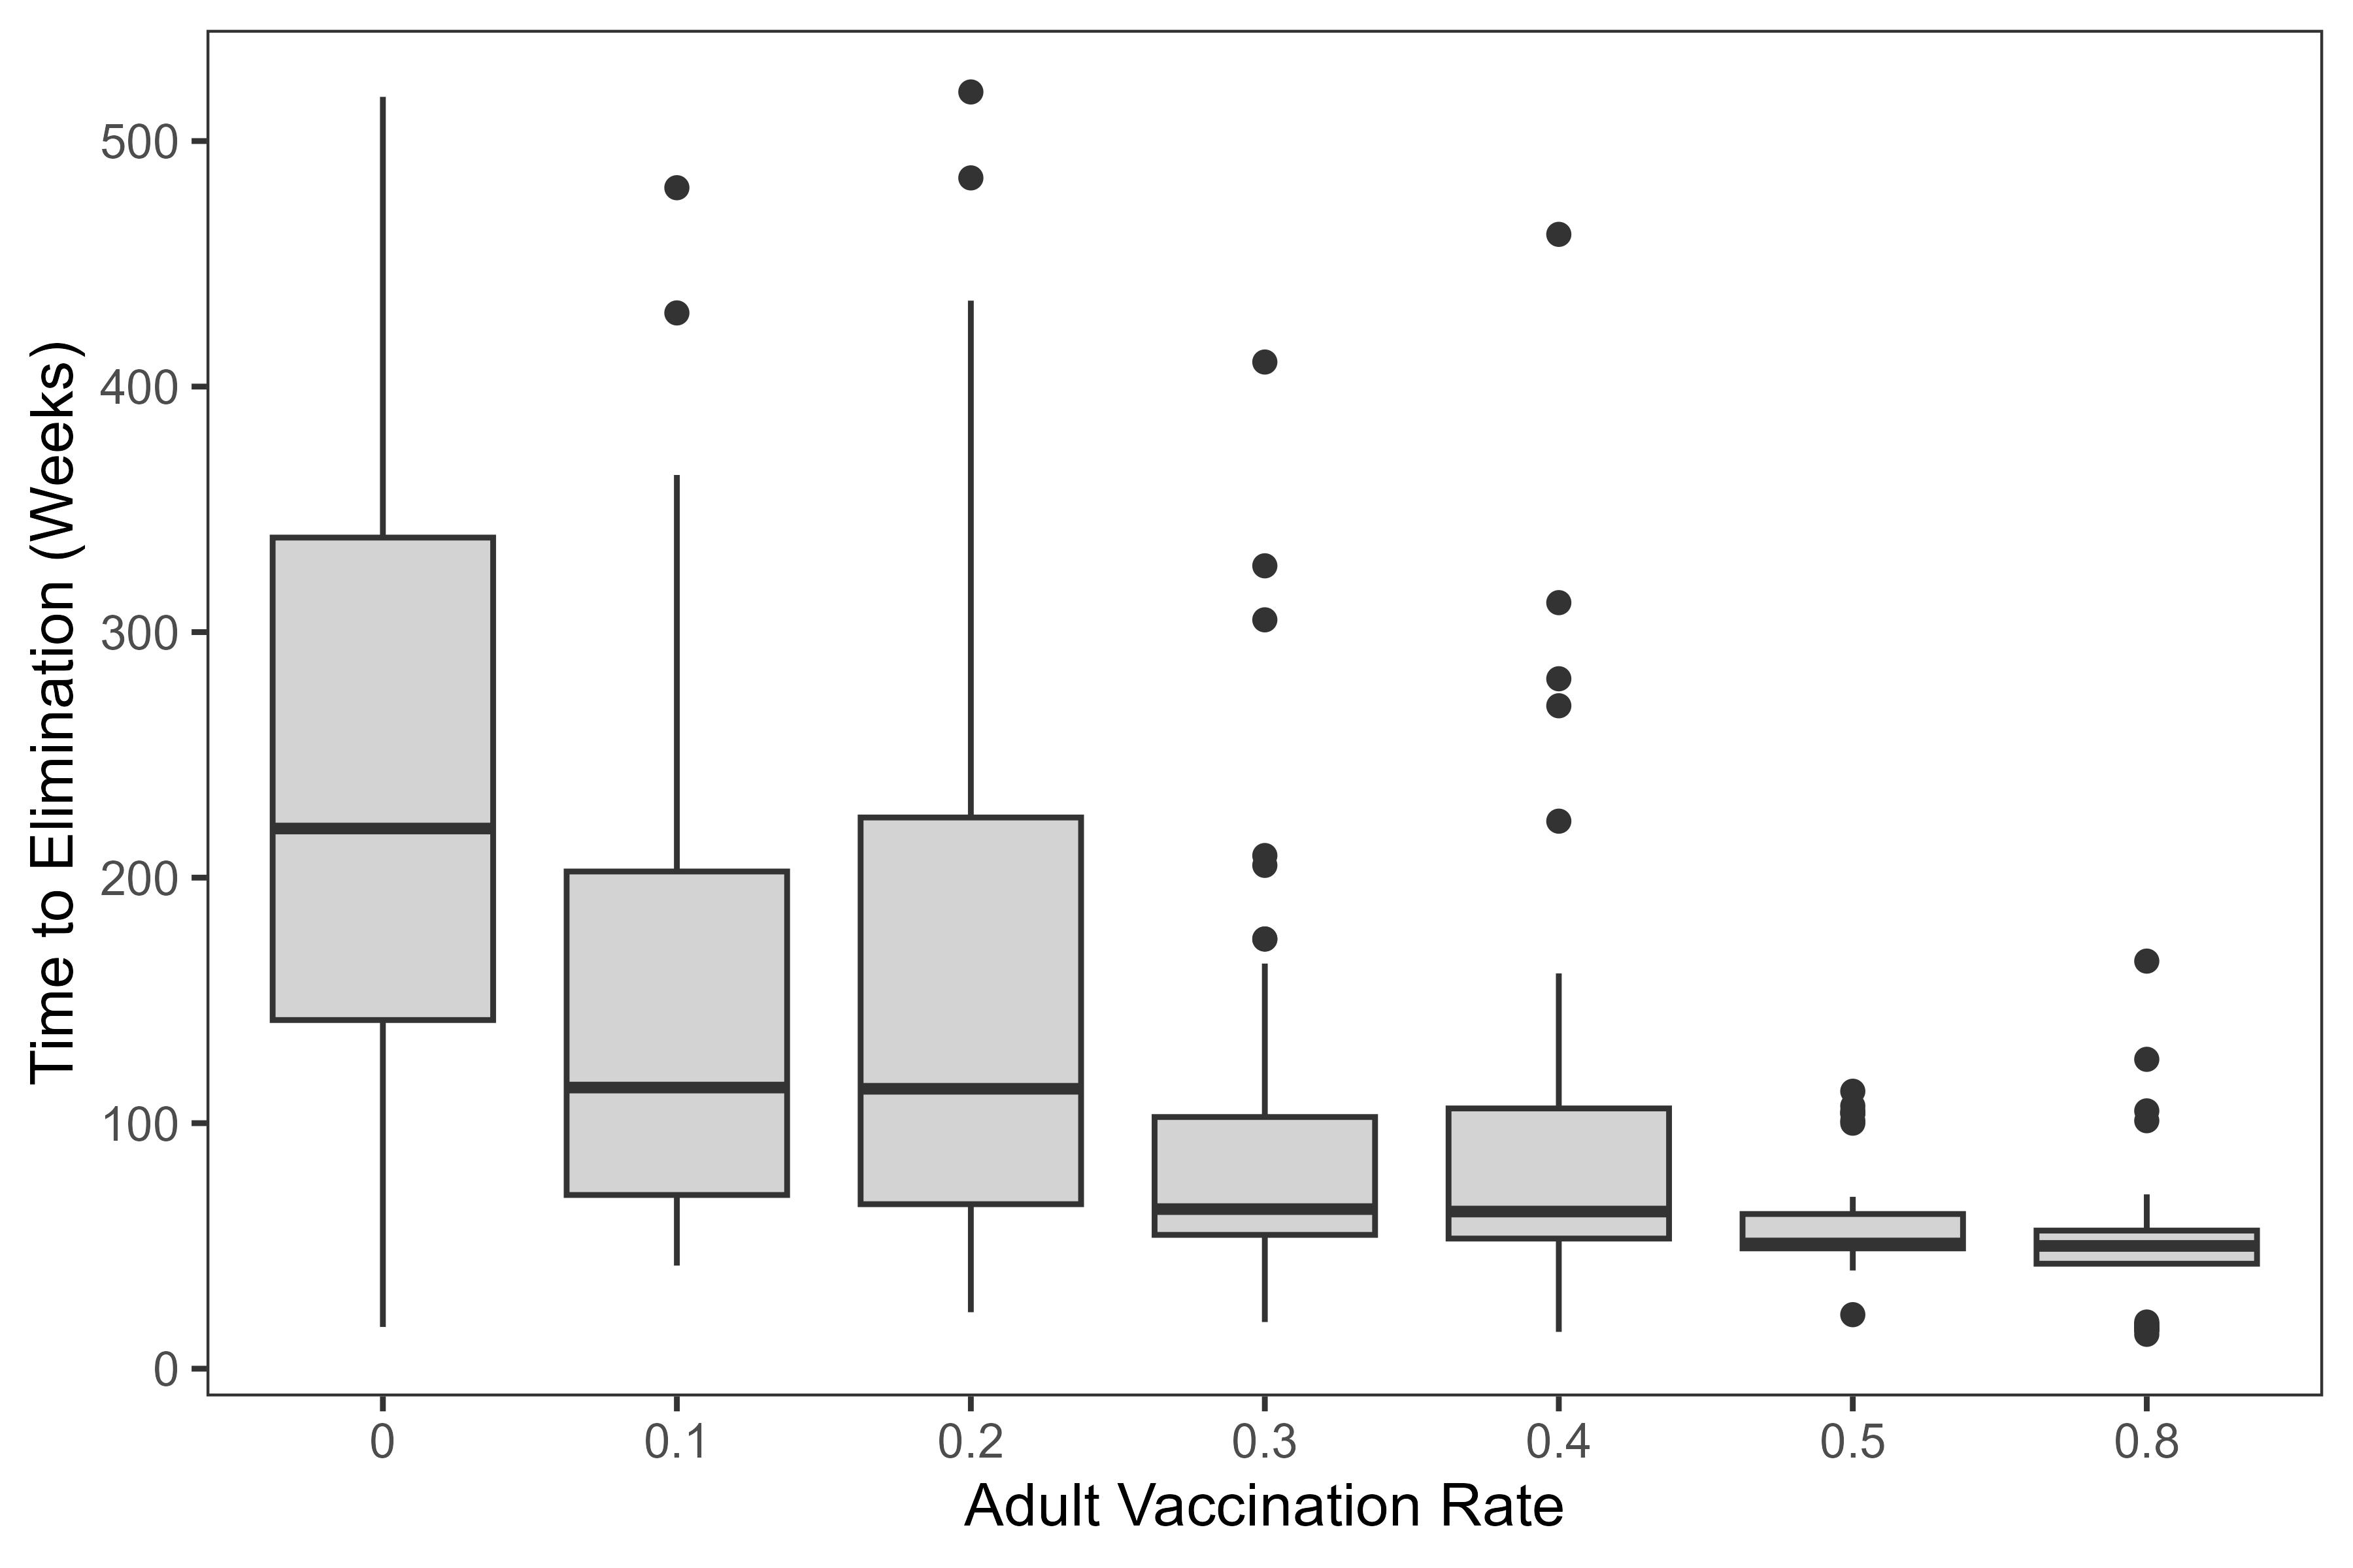

Slide 6
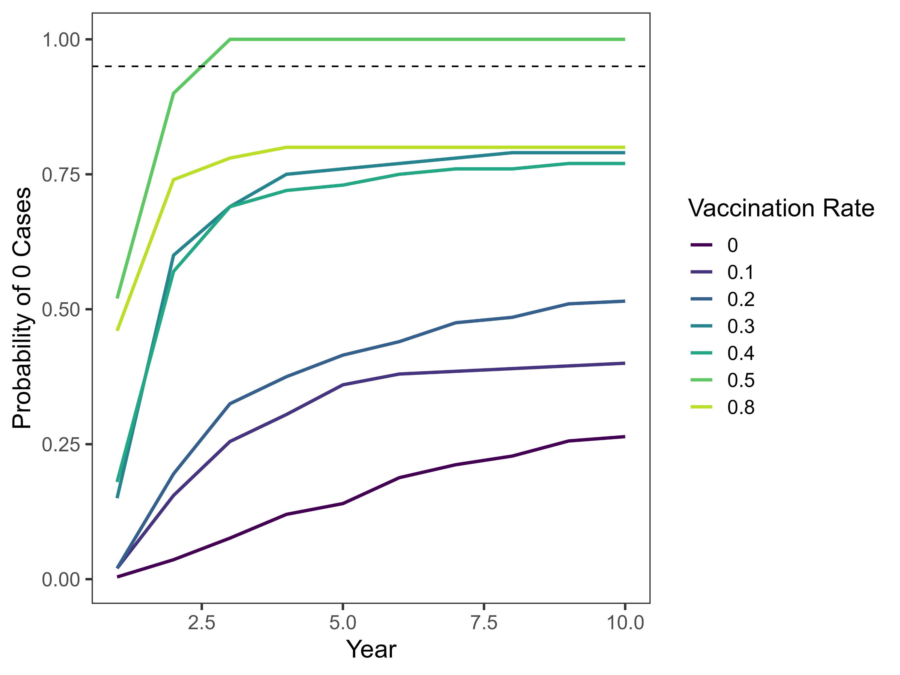

Slide 7
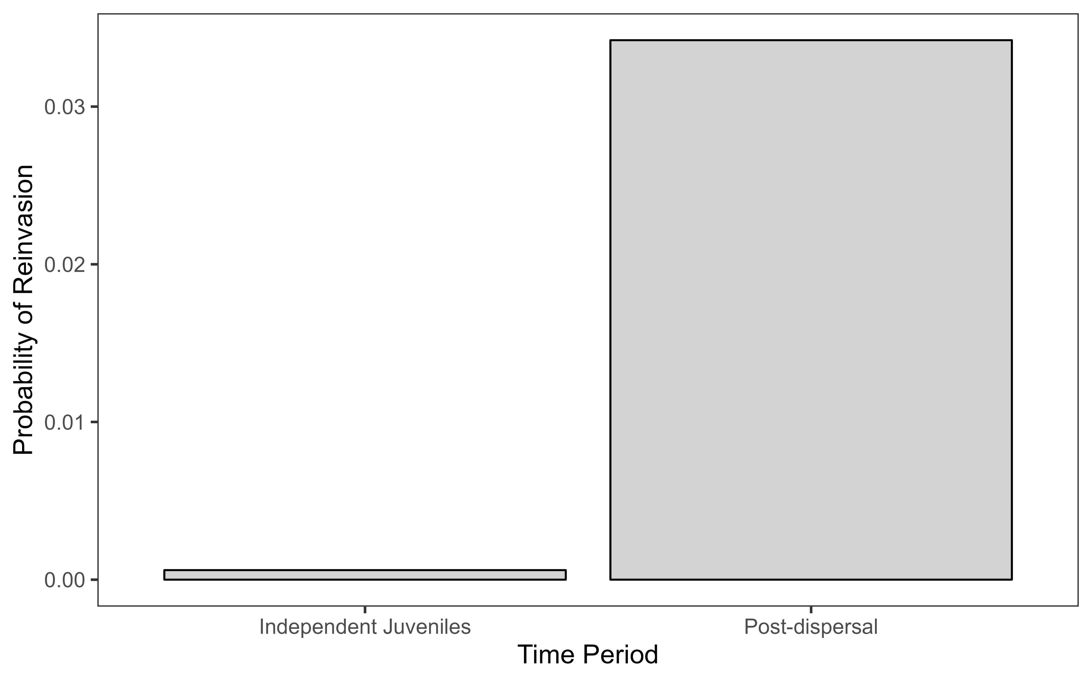

Slide 8
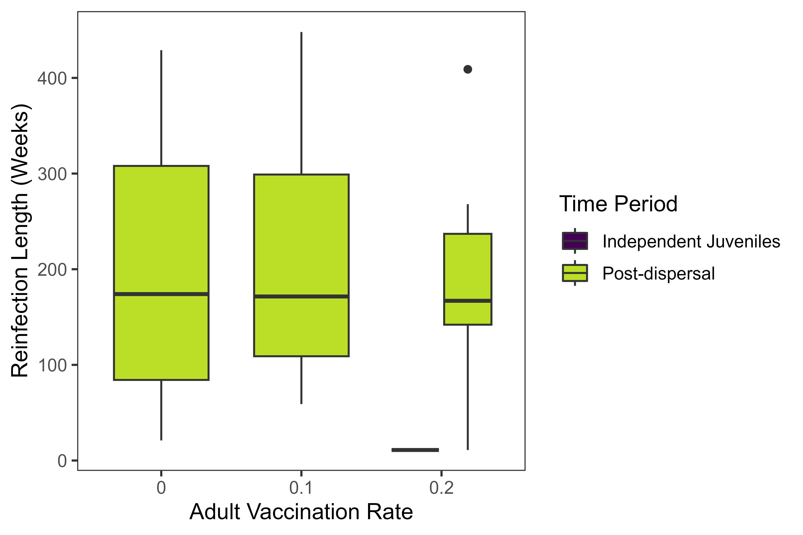

Slide 9
