Slide 1
Do AI coding assistants
make project ideas
more alike?
A monthly study of new GitHub repositories
Samuel Schneider · Spencer Caldwell · Hezeki Webb
Group 4 · EECS 448 · October 27, 2026
Notes:
25 seconds. We ask whether AI coding assistants are making software project ideas more alike. We will measure idea diversity among new public GitHub repositories month by month and test for a change around ChatGPT’s release. Today we explain the design. Our current milestone is setting up the GitHub scraping pipeline and collecting repository IDs. Filtering, summarization and analysis are next steps; we have no diversity estimates to report.

Slide 2
AI could narrow or broaden project ideas
More alike
More varied
Shared models
Similar suggestions
Similar projects
Easier implementation
More people building
More ideas attempted
AI-assisted stories became more similar. We ask whether software does too. [3]
02
Notes:
30 seconds. There are two plausible directions. Shared models might suggest similar solutions and steer developers toward similar projects. Alternatively, easier implementation could let more people pursue ideas they could not previously build. Research on story writing found that AI assistance improved individual evaluations while reducing collective diversity. That motivates our question; it does not establish the same effect in software.

Slide 3
Compare monthly diversity before and after release
23 months before
37 months after
Jan 2021
Dec 2022
Dec 2025
First full month after release [8]
Planned: equal eligible samples
100–200 per month; set after pilot
ChatGPT: November 30, 2022. Copilot was already available. [2, 8]
03
Notes:
35 seconds. The study covers January 2021 through December 2025. December 2022 is the first full month after ChatGPT’s release, leaving 23 months before and 37 after. We keep all 60 months, without a washout exclusion. The final analysis will use the same eligible sample size in every month, expected to be 100 to 200 after checking score stability. Our current collection contains 200 unfiltered candidate IDs per month. Those are not yet 200 eligible projects: we may need more candidates after filtering. Copilot was already available before the boundary, and other tools arrived later.

Slide 4
Each month, turn repositories into one diversity score
For each repository
Recover early files
Filter projects
Collect IDs
Combine vectors
200 candidates
per month
One monthly score
Embed meaning
Summarize ideas
Current work
60 monthly scores → Trend test → Robustness checks
04
Notes:
65 seconds. The structure follows Figure 1 in the writeup. Repeat this process for each month. Collection builds the candidate pool, and is our current milestone. For each repository, recover early files, apply the validated eligibility filter, write an evidence-grounded idea summary, and embed its meaning. Rejected or unavailable candidates will be replaced before fixing the equal-sized eligible samples. Each surviving repository contributes a vector. Combine all vectors from one month into one diversity score; repeat for 60 months. The trend test uses those 60 scores, not individual repositories. Finally rerun the analysis under the three robustness variations. The following slides walk through this same flow.

Slide 5
200 unfiltered candidates per month
60 months covered
12,000 repository IDs
Jan
Feb
Mar
Apr
May
Jun
Jul
Aug
Sep
Oct
Nov
Dec
2021
2022
2023
2024
2025
IDs collected; eligibility has not been assessed.
The final eligible sample may require collecting more candidates.
05
Notes:
45 seconds. The collection contains exactly 12,000 unique repository IDs: 200 for each month from January 2021 through December 2025. Every filled block represents a month with 200 candidate IDs. These are unfiltered candidates, not 12,000 verified software projects. The selection ignores every earlier eligibility decision. We retain IDs, repository names and URLs, not repository clones. This establishes the input to our scraping pipeline. Retrieval and filtering are next, and reaching the final eligible sample size may require additional candidate collection. We have not computed diversity scores or tested the hypothesis.

Slide 6
Next: recover each project's early files
Creation events
Seeded ID order
Historical snapshot
Distinct repository IDs
Within each sampled month
Latest recoverable by day 30
Keep records
If unavailable
Repository ID · commit ID
Decision · evidence · cost
Log the failure.
Take the next candidate.
GH Archive locates creation events; the GitHub API supplies repository contents. [4, 5]
06
Notes:
40 seconds. This is the next retrieval stage. The current deliverable contains IDs and repository names, without cloning repositories. Later, for each candidate, we will seek the latest recoverable snapshot within the first 30 days, using the repository creation timestamp and its currently named default branch. That cannot reconstruct a default branch that was changed or deleted. We will inspect the historical README and file tree, save compact provenance and evidence, and record unavailable material separately from eligibility exclusions. Repository age is held fixed so older projects do not get more time to develop before we describe them.

Slide 7
Next: filter for documented software projects
Rule pass
GLM 5.3 pass
Remove forks, mirrors and profiles
Require source code + English README
Reject short or duplicate READMEs
Keep “project” only
Exclude tutorials, coursework, templates,
non-software and unclear cases
Require a supporting quote. Record each decision and reason.
README minimum: 30 words. Fixed prompt; identity and date redaction.
07
Notes:
40 seconds. This is the proposed filtering stage, not completed validation. Rules will check the documented-project criteria in the writeup, including source files and an English README of at least 30 words. GLM 5.3 is the planned purpose classifier. It must provide evidence for its decision. We need to validate the rubric before applying it to the full sample: a default README alone cannot establish that a repository is an unmodified template, and filenames alone cannot establish an author’s purpose. We will keep unclear evidence distinct from a confident judgment and have reviewers assess decisions before using the sample for inference.

Slide 8
Describe each project before comparing ideas
Early files
Idea statement
Embedding
README + source evidence
Purpose · users · function
Similar meanings sit close
Up to 80 words
Supporting passages required
Unclear purpose: insufficient evidence
Planned: fixed summary prompt; all-MiniLM-L6-v2 embeddings. [9, 10]
08
Notes:
30 seconds. The next stage is planned. We will reduce each eligible repository to at most 80 words describing what it does, who uses it, and its distinguishing function. Every claim must be supported by the early files. If the purpose is unclear, the model should return insufficient evidence. We then use all-MiniLM-L6-v2 to embed the statement and normalize the resulting vector. A fixed model and prompt will be used throughout. Summarization is intended to reduce writing-style differences, but we will test that assumption by embedding cleaned READMEs directly as a robustness check.

Slide 9
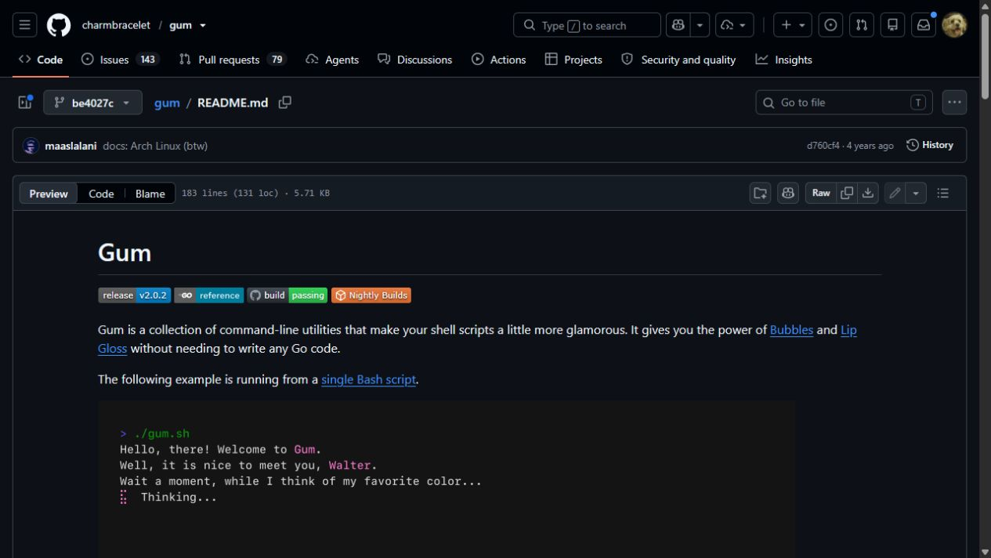
Turn repository details into an idea statement
charmbracelet/gum
Illustrative LLM summary
Gum helps shell-script authors add interactive prompts and styled terminal output without writing Go.
It provides commands for text input, fuzzy selection, progress indicators, and text layout.
Early commit be4027c · demonstration only; summary extraction is planned. [11]
09
Notes:
25 seconds. This is a real historical README from Gum. It describes tools that add interactive prompts and styled output to shell scripts. The short summary preserves the purpose, the intended users and the main functions, while leaving out installation commands and formatting. This example was drafted to demonstrate our planned output; it is not a result from the study sample.
Reference: GPT-6 through Codex drafted the summary from commit be4027ce28f812f905bfd1b5575e198729a6c4cc, within 30 days of repository creation on June 10, 2022. README sections document input, fuzzy filtering, progress, spinners, styling and layout. Gum was chosen for teaching, not randomly sampled. The GitHub interface and remote badges may reflect today; the README text is pinned to the historical commit. Source: https://github.com/charmbracelet/gum/blob/be4027ce28f812f905bfd1b5575e198729a6c4cc/README.md

Slide 10
More varied ideas produce a higher monthly score
Similar ideas
Varied ideas
Lower average distance
Higher average distance
Idea vectors → Compare every pair → Average within the month
Schematic of similarity; not study data or a 2D analysis.
10
Notes:
70 seconds. We now have one normalized embedding for each eligible project. These dots illustrate what semantic similarity means, not an actual two-dimensional embedding plot. If most projects describe similar purposes, their vectors are close in cosine distance and the monthly average is low. A wider range of ideas creates larger pairwise distances and a higher score. We compare every distinct pair and average those distances within the month. Normalizing the vectors means direction represents similarity rather than vector length. We will use the same eligible sample size across months, chosen after checking stability. One month becomes one score, giving the 60 observations for the next graph. The exact formula is in the optional detail slides.

Slide 11
Test whether the diversity trend changes after release
Monthly diversity
Earlier trend continued
Immediate shift
Change in trend
2021
Dec 2022
2025
Estimate the shift and trend change, each with a 95% confidence interval.
Illustration only. Annual patterns are accounted for in the model.
11
Notes:
70 seconds. Each dot now represents one month, rather than one repository. This graph is a schematic of the test, not estimated results. We fit the earlier trend and allow two changes at December 2022: an immediate shift in the score, and a change in its subsequent monthly trend. The dashed line shows the earlier trend continued, which makes the two changes easier to interpret. The illustration shows an immediate drop in diversity followed by a downward trend. It is not a result: the actual estimates could rise, fall, or be indistinguishable from zero. The full regression also includes a repeating yearly pattern. We report 95 percent confidence intervals using Newey-West standard errors with a pre-specified lag of three months, because neighboring months may have correlated deviations. A change around release is an association; it cannot establish that AI caused it. The complete regression is in the optional detail slides.

Slide 12
Validate the filter and the diversity measure
100
candidates
Is “project” classified correctly?
Precision + recall, before vs. after
50
summaries
Does the statement match its source?
Target: 90% faithful summaries
50
idea pairs
Does distance match human judgment?
1–5 ratings; agreement + correlation
Planned: two independent reviewers; revise failed measurements before the full run.
12
Notes:
40 seconds. These are planned checks, not completed evaluations. Two reviewers independently label 100 candidates, balanced between before and after release, to measure the project filter’s precision and recall and whether its errors differ by period. They check 50 summaries against source files, targeting at least 90 percent faithful descriptions. They also rate 50 pairs from unrelated to the same idea. We compare their agreement and the correlation between their ratings and cosine similarity. Failed checks mean revising the measurement before the full run.

Slide 13
Check robustness without claiming causation
Rerun the same model
The question we can answer
Exclude AI-topic projects
Keep one repository per owner
Embed cleaned READMEs
Whether diversity changed
around the release
AI use is unobserved.
Other changes may explain the pattern.
Scope: accessible, documented, English-language projects. Track missing snapshots by month.
13
Notes:
30 seconds. We will rerun the analysis after excluding AI-topic projects, limiting each owner to one repository, and embedding cleaned READMEs instead of summaries. These check topic composition, prolific owners, and summary effects. Even a consistent result describes a change around the release, not proof that AI caused it. We do not observe actual AI use. Accessible, documented English-language repositories are a selected population, and older repositories may be harder to recover. Retrieval failures will be reported by month.

Slide 14
The scraping pipeline is the current milestone
Deliverable
Current status / next target
Lead
Data pipeline
Scraping setup; 200 IDs per month
Samuel
Representation + analysis
Next: summaries, embeddings, scores
Spencer
Summary validation
Planned: source checks
Hezeki
Similarity validation
Planned: human pair ratings
Hezeki
Next: retrieve early files, filter candidates, validate decisions
All three members contribute; leads coordinate each component.
14
Notes:
25 seconds. Our current milestone is setting up the scraping pipeline and collecting 200 repository IDs per month. Filtering and the early-file retrieval needed for it are next steps. Representation and analysis, summary validation, and similarity validation remain planned. Samuel coordinates the data pipeline, Spencer coordinates representation and analysis, and Hezeki coordinates both human-validation tasks. These are coordinating roles; all three members contribute. We will validate eligibility decisions before treating the collection as an analysis sample.

Slide 15
Validate measurement, complete the sample, then test
By Oct 27
Set up scraping; collect IDs
Samuel
Oct 28–Nov 8
Validate filtering; freeze prompts
Spencer
Nov 9–20
Complete samples + human reviews
Spencer
Nov 21–final
Fit trend; rerun; write + present
Hezeki
A reliable answer can be lower, higher, or no clear change.
15
Notes:
30 seconds. By the milestone, the goal is to demonstrate the GitHub scraping setup and the monthly ID collection. Through November 8, we will validate filtering, test the early snapshots, and freeze the summary prompt. By November 20, we plan to complete the eligible monthly samples and human checks; this may require more candidate IDs. The final stage fits the trend model, runs the robustness checks, and prepares the report. A reliable answer could be greater diversity, lower diversity, or no clear change. End of the main presentation. Slides 16 and 17 are optional equation explanations; skip directly to questions if time is short. References follow them.

Slide 16


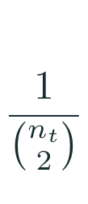

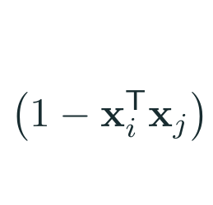
Average idea differences into one monthly score
Monthly idea
diversity
Average across
all pairs
Less similar ideas
contribute more
Compare every
distinct pair
Each x is a unit-length idea vector; n is the number of projects in that month.
16
Notes:
Optional detail, outside the main ten-minute talk. This is the complete pairwise definition of monthly diversity. y_t is the score for month t. There are n_t choose two distinct pairs; the reciprocal averages rather than sums their distances. The sum compares each pair once. With unit-length vectors, the dot product equals cosine similarity, so one minus that value is cosine distance. Less similar project purposes contribute larger distances. In implementation the same quantity can be computed from the mean vector without an explicit pairwise loop, as shown in the writeup. This slide explains the measurement; the previous conceptual slide is enough to follow the main talk.

Slide 17
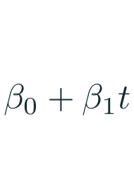

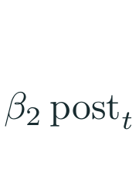
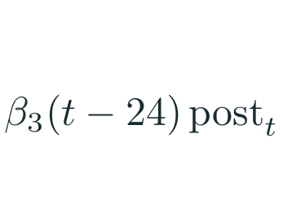
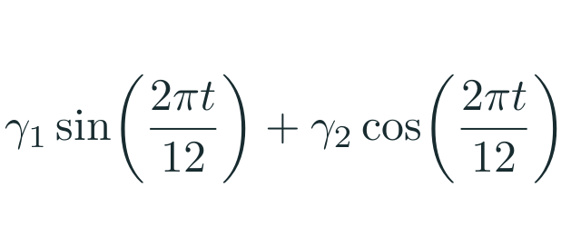

Fit the full model to the 60 monthly scores
Trend before
release
Release-date
shift
Change in
monthly trend
Remaining
variation
Recurring yearly patterns
t = 24 is December 2022; post switches from 0 to 1 at that month.
17
Notes:
Optional detail, outside the main ten-minute talk. The response is the monthly diversity score. The baseline intercept and slope describe the pre-release line; the intercept is its extrapolated value at t equals zero. post is zero through November 2022 and one from December onward. The level-change coefficient shifts the post-release line immediately. The interaction with t minus 24 changes the slope, starting from zero at the boundary, so it does not duplicate the immediate shift. The sine and cosine jointly model a yearly cycle with a fitted phase and amplitude; they are one seasonal adjustment, not separate research questions. Epsilon is the unexplained variation. The two research coefficients are the level and slope changes. We use Newey-West confidence intervals with lag three; this changes uncertainty estimates, not fitted coefficients. The earlier graph communicates these same comparisons without requiring the equation.

Slide 18
References · context and data
[1] Anthropic. 2025. Claude 3.7 Sonnet and Claude Code. (February 24, 2025).
https://www.anthropic.com/news/claude-3-7-sonnet
[2] Thomas Dohmke. 2022. GitHub Copilot is generally available to all developers. (June 21, 2022).
https://github.blog/news-insights/product-news/github-copilot-is-generally-available-to-all-developers/
[3] Anil R. Doshi and Oliver P. Hauser. 2024. Generative AI enhances individual creativity but reduces
the collective diversity of novel content. Science Advances 10, 28, eadn5290. doi:10.1126/sciadv.adn5290
[4] GH Archive. n.d. GH Archive. https://www.gharchive.org/
[5] GitHub. n.d. GitHub event types.
https://docs.github.com/en/rest/using-the-rest-api/github-event-types
18
Notes:
Backup references. Numbering matches milestone.md. These references motivate the study, establish the tool-release context, and document the event source. Full source URLs are provided for audit and follow-up.

Slide 19
References · measurement and inference
[6] James Lopez Bernal, Steven Cummins, and Antonio Gasparrini. 2017. Interrupted time series regression
for the evaluation of public health interventions: a tutorial. Int. J. Epidemiology 46, 1, 348–355. doi:10.1093/ije/dyw098
[7] Whitney K. Newey and Kenneth D. West. 1987. A Simple, Positive Semi-Definite, Heteroskedasticity and
Autocorrelation Consistent Covariance Matrix. Econometrica 55, 3, 703–708. doi:10.2307/1913610
[8] OpenAI. 2022. Introducing ChatGPT. (November 30, 2022).
https://openai.com/index/chatgpt/
[9] Nils Reimers and Iryna Gurevych. 2019. Sentence-BERT: Sentence Embeddings using Siamese BERT-Networks.
In EMNLP-IJCNLP. Association for Computational Linguistics, 3982–3992. doi:10.18653/v1/D19-1410
[10] Sentence Transformers. n.d. all-MiniLM-L6-v2. Hugging Face model card.
https://huggingface.co/sentence-transformers/all-MiniLM-L6-v2
[11] Charmbracelet. 2022. Gum. Historical README, commit be4027c. Retrieved October 26, 2026.
https://github.com/charmbracelet/gum/blob/be4027ce28f812f905bfd1b5575e198729a6c4cc/README.md
19
Notes:
Backup references. These sources support the interrupted time-series approach, dependence-adjusted standard errors, the release boundary and the representation method.

