Slide 1
CT/2026/SEM I/01
CaseTriage
AI-Powered Legal Backlog Optimisation Engine
Transforming overwhelmed court systems through intelligent, explainable, and fully automated case prioritisation — built for speed, fairness, and judicial accountability.

Slide 2
THE PROBLEM
The Triage Bottleneck
Overwhelming Volume
Manual Delays
Courts are paralysed by thousands of unreviewed, backlogged dockets — with no intelligent system to separate urgent filings from routine ones.
Human sorting is prohibitively slow. Critical legal interventions are deferred for weeks — sometimes months — waiting for a clerk's review.
Inconsistent Triage
Blind Allocation
Manual review is vulnerable to fatigue, cognitive bias, and inconsistent criteria — leading to unpredictable outcomes for litigants.
Administrators lack macro-level visibility into which case types are flooding their courts, making strategic staffing nearly impossible.

Slide 3

THE SOLUTION
Introducing CaseTriage
CaseTriage is an end-to-end automation engine that ingests raw legal filings, scores them with ML, routes them by jurisdiction, and surfaces the most relevant precedents — all without human intervention.
Automated Routing
Instant Precedent Fetch
Detects geographic markers in filings and routes cases to US, India, or International backlogs automatically.
Queries a vector database in real time to surface the closest historical legal precedent for every new case.
Zero-Touch Ingestion
Algorithmic Prioritisation
A Python Watchdog daemon continuously monitors local file systems and auto-ingests raw case files the moment they arrive.
Instantly assigns a mathematically grounded Priority Score (1–100) using a trained ML regression model.

Slide 4

TECHNICAL ARCHITECTURE
Full-Stack Orchestration Pipeline
Python Watchdog
Recharts Analytics
FastAPI + Uvicorn
React + TypeScript
Each layer is independently deployable and communicates via a strict REST contract — enabling horizontal scaling of any single component without disrupting the pipeline.

Slide 5
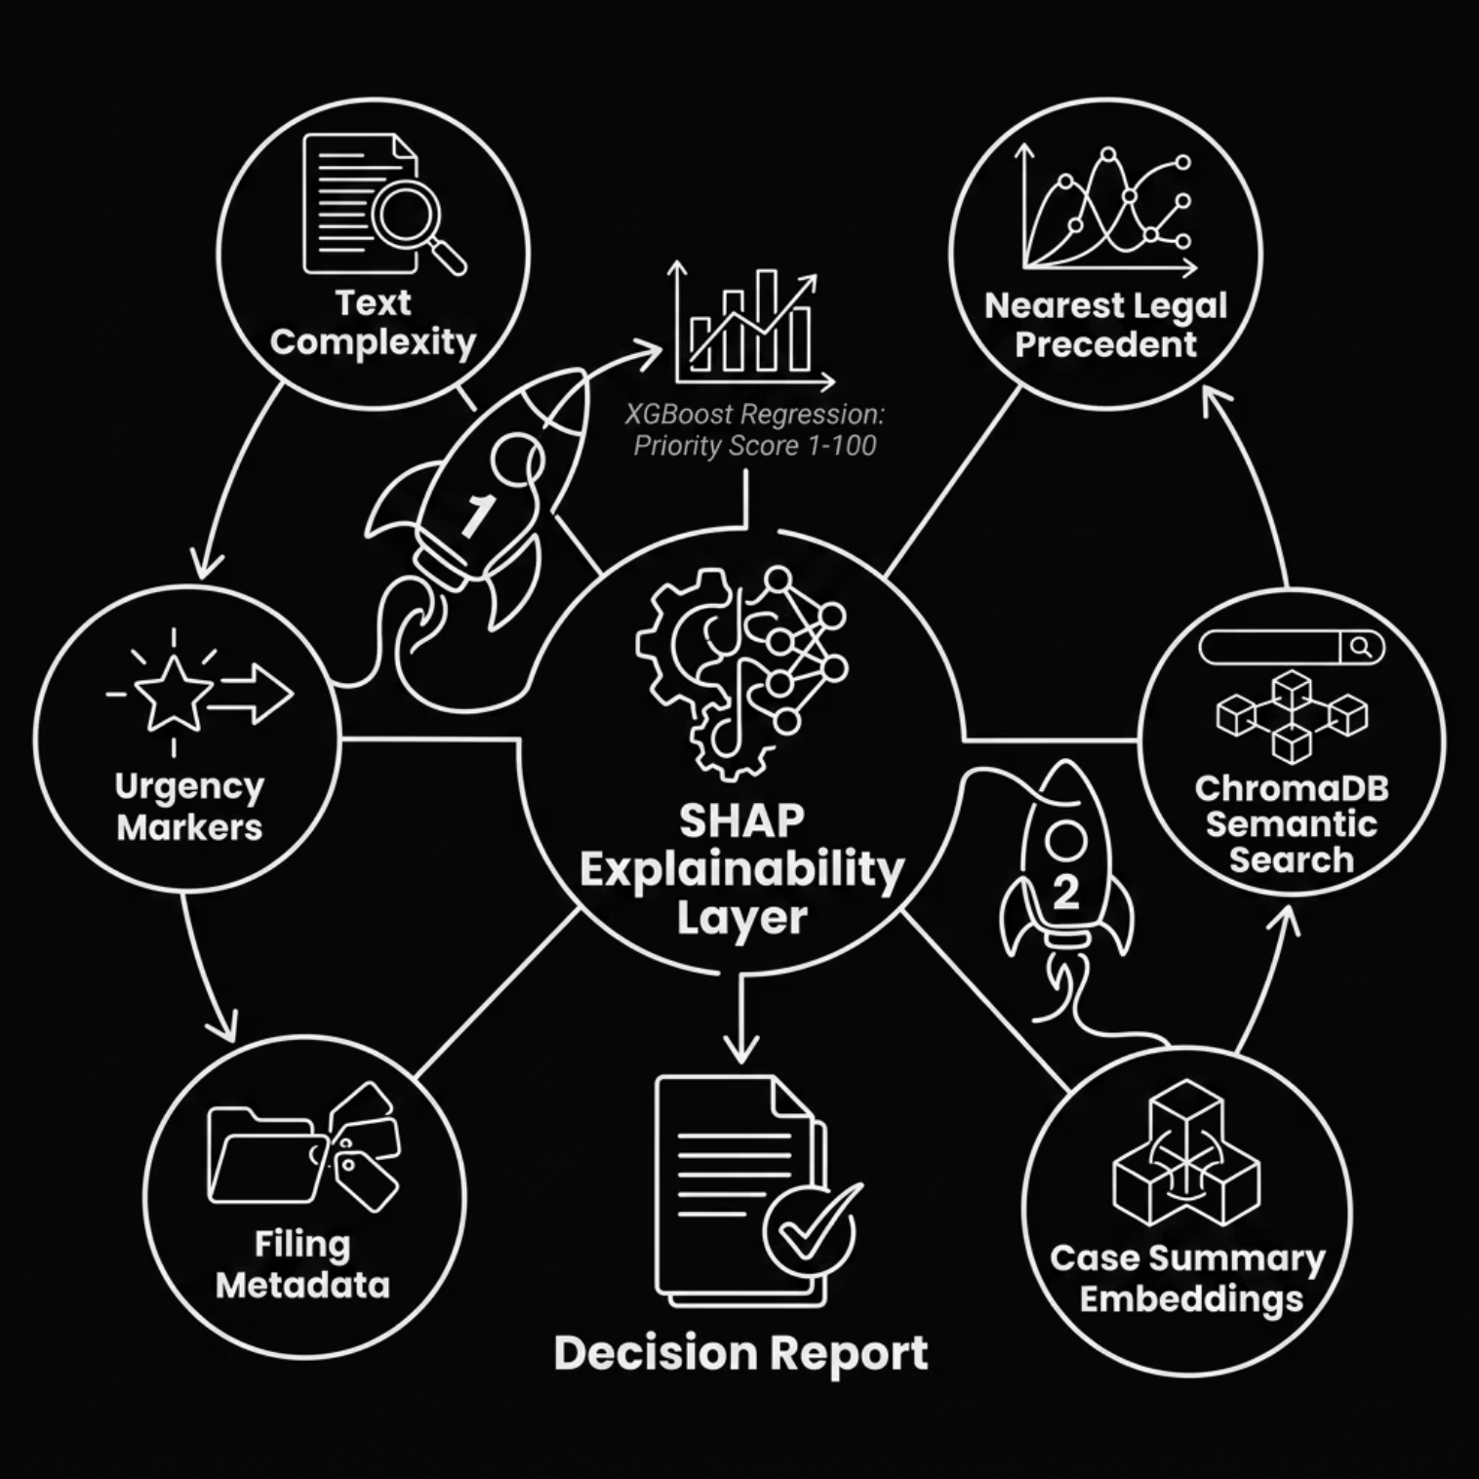

THE DUAL-ENGINE AI
Explainable Intelligence
1
2
Priority Regression
Semantic Search via ChromaDB
An XGBoost model evaluates text complexity, legal urgency markers, and filing metadata to produce a calibrated 1–100 Priority Score.
Case summaries are embedded into high-dimensional vector space. ChromaDB retrieves the nearest historical precedent by semantic similarity.
3
4
SHAP Explainability
Cold-Start Bootstrapping
SHapley Additive exPlanations mathematically dissect every score — showing exactly which features drove the AI's decision.
A dynamic heuristic rule-engine generates synthetic training labels, eliminating the cold-start problem from day one.

Slide 6
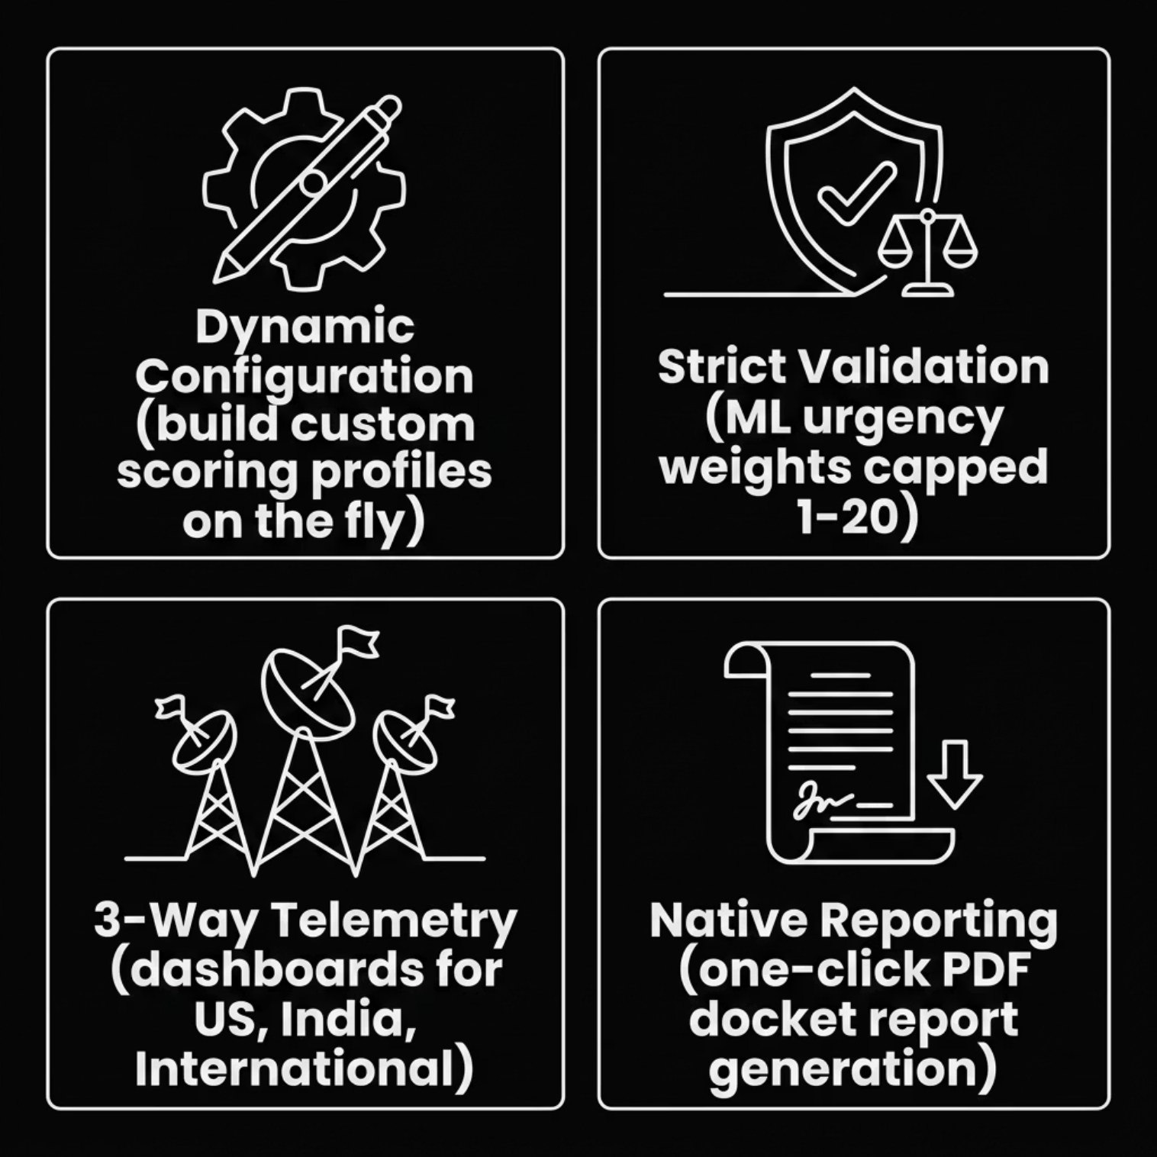
DYNAMIC SYSTEM CONTROL
Administrator Configuration & UI
Dynamic Configuration
Strict Validation
End-to-end security architecture ensures ML urgency weights are hard-capped between 1 and 20, preventing runaway prioritisation.
Admins build and stack custom scoring profiles on the fly — no engineering deployment required.
3-Way Telemetry
Native Reporting
Interactive dashboards partition system health by US, India, and International queues — simultaneously and in real time.
One-click generation of structured, formatted PDF docket reports for administrative record-keeping.

Slide 7

EXPECTED OUTCOMES & IMPACT
Modernising the Justice System
⚡ Millisecond Triage
🔍 Judicial Trust via SHAP
Cases are scored and ranked in milliseconds — eliminating the weeks-long backlog that delays critical judicial interventions.
Full explainability ensures judges and administrators understand every AI decision. Humans remain the final authority.
📊 Data-Driven Staffing
🗂️ Reduced Clerk Workload
Live regional analytics allow court administrators to surgically deploy judges to jurisdictions experiencing sudden case spikes.
Automated precedent pre-fetching eliminates hours of manual legal research per filing — freeing clerks for higher-value tasks.
CaseTriage is not a replacement for judicial judgment — it is a force multiplier that ensures no urgent case is ever buried under administrative delay.

