Slide 1

Plant Breaker – Hands-On OT Red Teaming
Lab overview • Red-team techniques • MITRE ATT&CK mapping • Defender practices
Training environment only — isolated Docker lab with fictional assets and credentials.
Safety
Resilience
Performance
OTSecPro

Slide 2
01 / Workshop Purpose & Instructor Intro
OT Security Workshop
Sanjay Hiremath
Learning outcome
Understand how an OT red-team path moves across Purdue levels and how defenders convert each step into high-confidence evidence and response priorities.
Security Engineer @ ASTRA Cybersecurity
AI / IT / OT Security
Focus: OT/ICS visibility, passive fingerprinting, protocol analysis, SOC evidence pipelines and IEC 62443-oriented assessments.
Plant model
Adversary path
Defender view
Purdue levels, zones, conduits, process impact
Foothold, pivot, discovery, control access
Network, endpoint, HMI and process evidence
Workshop stance
Plant context first. Tools second. Evidence always.
Based on the uploaded Meridian Nuclear Generating Station lab guide; all systems are fictional and training-only.
Safety | Resilience | Performance
OTSecPro Training Lab

Slide 3
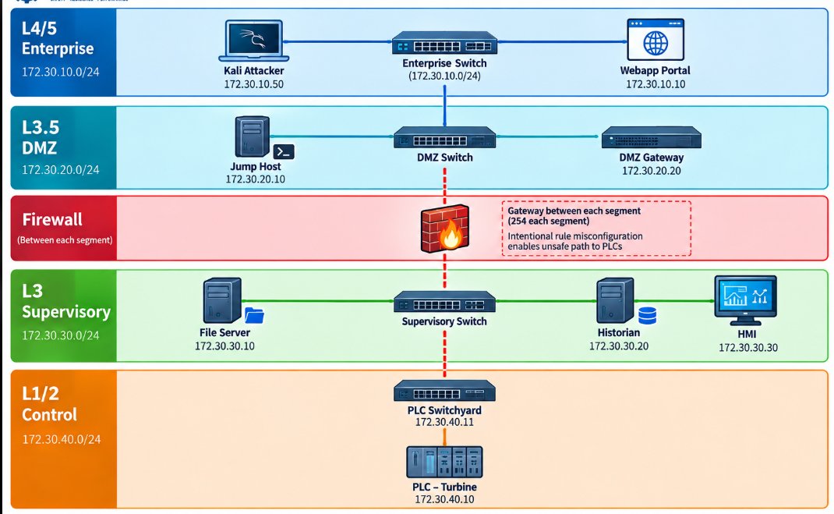
02 / Lab Scenario and Purdue Topology
OT Security Workshop
Safety | Resilience | Performance

Slide 4
03 / Red-Team Techniques Used in the OT Plant Lab
OT Security Workshop
Technique chain shown at workshop level: no executable commands, all actions remain inside the isolated Docker plant lab.
1
Initial foothold
2
Privilege & credential exposure
3
Persistence technique
Enterprise-facing web weakness provides the first entry point into the lab network.
Weak local privilege boundary exposes jump-host access material for the next segment.
Recurring execution keeps access alive after interruption; in the lab this is represented by scheduled relaunch behavior such as cron.
4
Pivot across Purdue levels
5
OT discovery & collection
6
Sustained process impact
Controlled proxy/tunnel behavior demonstrates movement from Enterprise to DMZ and toward Supervisory assets.
Asset inventory and process-state observation identify PLCs, HMI, historian and polling relationships.
Repeated control-state changes simulate persistent disruption that can prevent operator recovery until cleaned up.
Persistence is covered twice: maintaining access on the IT/DMZ side, and sustaining unsafe process effects on the OT side until blue-team response resets the lab.
Safety | Resilience | Performance
OTSecPro Training Lab

Slide 5
04 / MITRE ATT&CK for ICS Mapping
OT Security Workshop
Tactic
ATT&CK point
Lab mapping
Initial Access
T0819 Exploit Public-Facing Application
Vulnerable web portal establishes first foothold.
Execution
T0807 Command-Line Interface / T0853 Scripting
Shell and script activity are used only inside the training environment.
Persistence
T1053.003 Scheduled Task/Job: Cron
Recurring job/payload behavior demonstrates how access can survive interruptions.
Lateral Movement
T0866 Remote Services / T0884 Connection Proxy
SSH, jump host and proxy path show movement across Purdue segments.
Discovery / Collection
T0811 Repositories / T0801 Monitor Process State
Inventory and process-state data guide target selection.
Impair Process Control
TA0106 + T0806 Brute Force I/O / T0836 Modify Parameter
Repeated control changes and parameter manipulation simulate sustained process disruption.
Impact
T0813 Denial of Control / T0814 Denial of Service / T0815 Denial of View
Operator/process disruption patterns are discussed and validated with evidence.
Mapping combines ATT&CK for ICS with Enterprise persistence where the lab action occurs on a Linux IT/DMZ host.
Safety | Resilience | Performance
OTSecPro Training Lab

Slide 6
05 / Blue-Team Practices for the Lab
OT Security Workshop
Evidence sources
Persistence checks
OT anomaly themes
Response practice
Web/app logs and request payloads
Auth/sudo logs and host process events
Zeek connections and Suricata alerts
HMI/API state and PLC protocol records
Review crontab additions and file changes
Detect recurring unusual binaries or scripts
Monitor reverse connections after cleanup
Validate no scheduled relaunch remains
Unauthorized Modbus source to PLCs
Rapid coil/register write bursts
Breaker flicker and alarm floods
Unexpected source crossing conduits
Confirm with at least two evidence types
Scope by Purdue level and asset role
Prioritize safety-relevant functions
Reset lab state and document lessons
Blue-team objective: detect both access persistence and persistent process manipulation before it becomes sustained plant impact.
Defender goal: convert every red-team step into a repeatable detection, investigation and response playbook.
Safety | Resilience | Performance
OTSecPro Training Lab

Slide 7
06 / Blue-Team Detection Map
OT Security Workshop
Map every red-team stage to evidence sources, high-signal detections and defender action.
Stage | Likely evidence | Detection logic | Blue-team action
Web foothold | Web/app logs, child process events | Shell metacharacters, abnormal command execution from web service | Block input path, preserve logs, confirm host scope
Privileged access | sudo/auth logs, sensitive file access | Unexpected interpreter use, credential material exposure | Rotate lab credentials, review privilege boundary
Pivot / tunnel | Zeek flows, host processes, unusual TLS ports | New tunnel process, routing changes, unexpected cross-zone reachability | Contain pivot host, validate conduits, capture flows
Supervisory access | FTP logs, file access, inventory reads | Backdoor-like login pattern, suspicious asset inventory access | Isolate file server, verify inventory exposure
PLC impact / persistence | Modbus records, HMI alarms, PLC state changes | Unauthorized Modbus source, rapid coil/register writes, breaker oscillation | Prioritize safety state, restore process, document ATT&CK mapping
Workshop rule: alert only after evidence validation — avoid false correlation by requiring plant context + network/host/process signal.
Safety | Resilience | Performance
OTSecPro Training Lab

Slide 8
07 / Closing Takeaways
OT Security Workshop
The workshop is not about running tools; it is about understanding trust boundaries and proving what happened.
1
Model the plant first
3
Map to ATT&CK
Know assets, roles, conduits and safety-relevant functions before testing.
Use ATT&CK for ICS to standardize communication and reporting.
2
Trace the attack path
4
Defend with evidence
Show how a weak enterprise entry can become OT control-path exposure.
Correlate logs, flows, alerts, endpoint events, HMI state and process behavior.
Thank You
Safety | Resilience | Performance
OTSecPro Training Lab

