Slide 1
E-COMMERCE WEBSITE USING DJANGO

Slide 2
INTRODUCTION
Our ecommerce website project, titled Ecommerce website, leverages the robust capabilities of Django, a high-level Python web framework, to deliver a seamless and convenient online shopping experience for customers across various demographics. In the face of the exponential growth of online retail, it's no longer enough for businesses to simply have an online presence. To truly thrive, they need platforms equipped with powerful functionalities that meet the ever-changing demands of modern consumers. This is where Django shines.

Slide 3
Importance of Email Authentication for Security
and User Verification:
1.User Verification
2. Protection Against Unauthorized Access
3. Enhanced Data Privacy

Slide 4
Description of the Implementation Process, Including Technologies Used
User Registration
2. Email Verification
3. Verification Link/Code

Slide 5
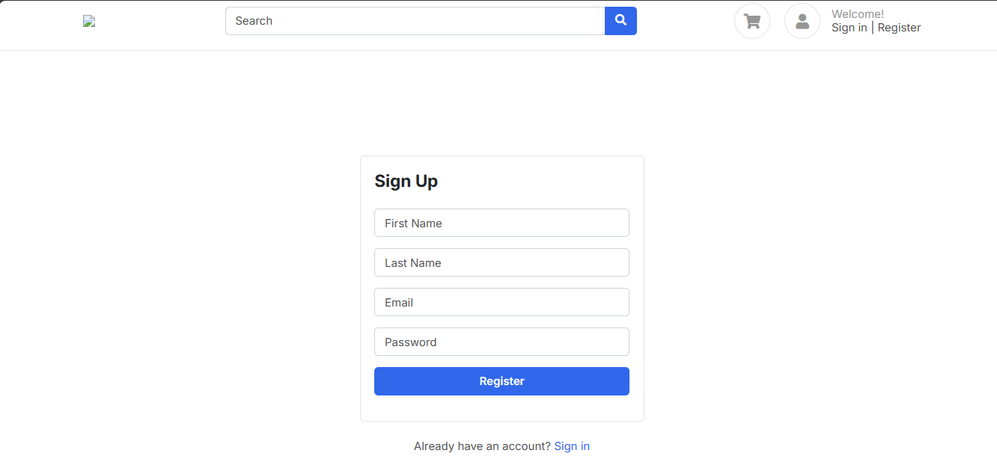
SignUp Page/Register

Slide 6
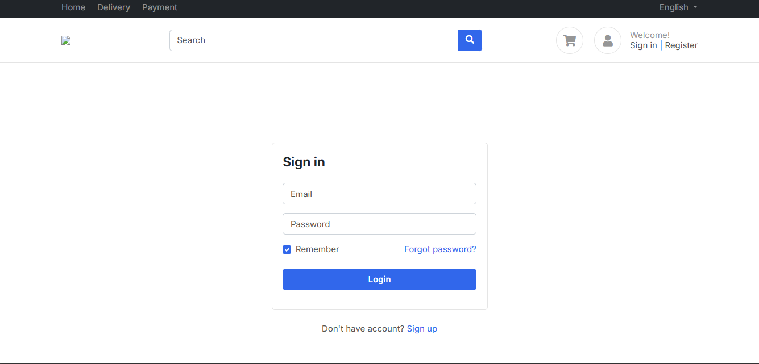
Login Page/SignIn

Slide 7
Purpose of the Admin Side in Managing Products, Orders, Users, and Other Aspects of the Ecommerce Platform:
1. Product Management: Administrators can add, edit, and delete products from the platform, including updating product descriptions, images, prices, and inventory levels.
2. Order Processing: Administrators have access to real-time order management tools, allowing them to view, process, and fulfill orders efficiently.
3. User Management: The admin panel enables administrators to manage user accounts, including creating new accounts, modifying user profiles, resetting passwords, and deactivating or suspending accounts
4. Content Management: Administrators can update website content, including static pages, banners, promotional offers, and news updates, directly from the admin panel.

Slide 8
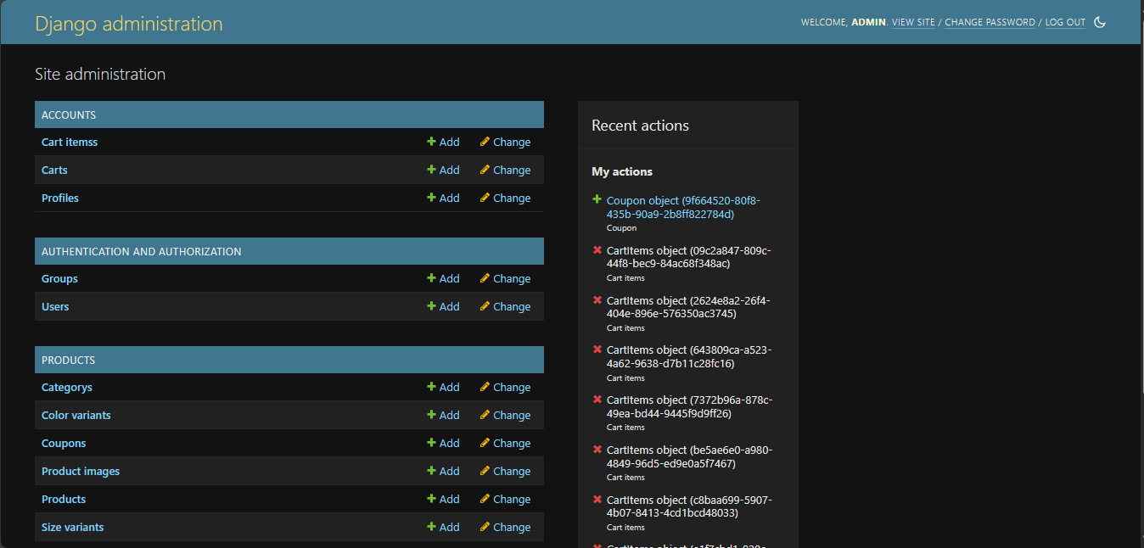
ADMIN PANEL

Slide 9
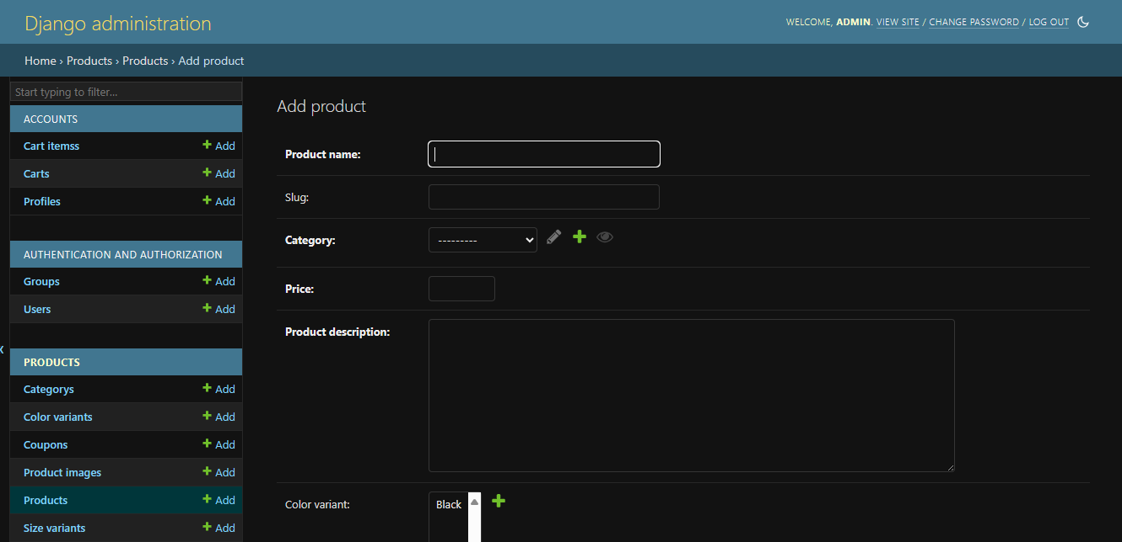
Admin can add products

Slide 10
Price Changes on Different Sizes
1.Customer Personalization
2. Competitive Advantage
3. Inventory management

Slide 11
Add to Cart Functionality
1. Ease of Product Selection
2. Flexibility and Convenience
3. Comparison and Consideration

Slide 12
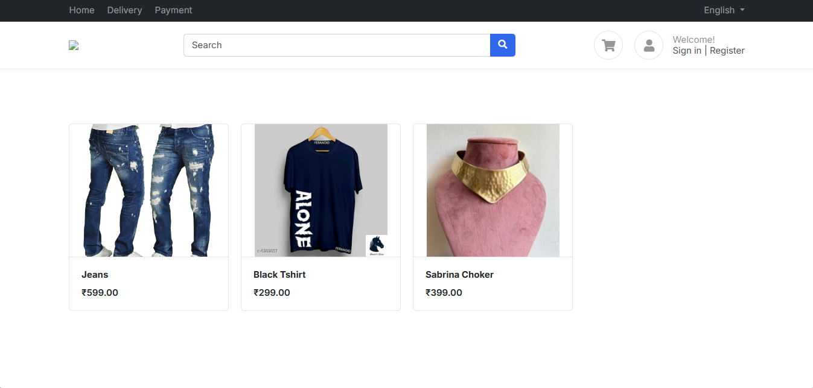
PAGE INTERFACES
Home Page

Slide 13
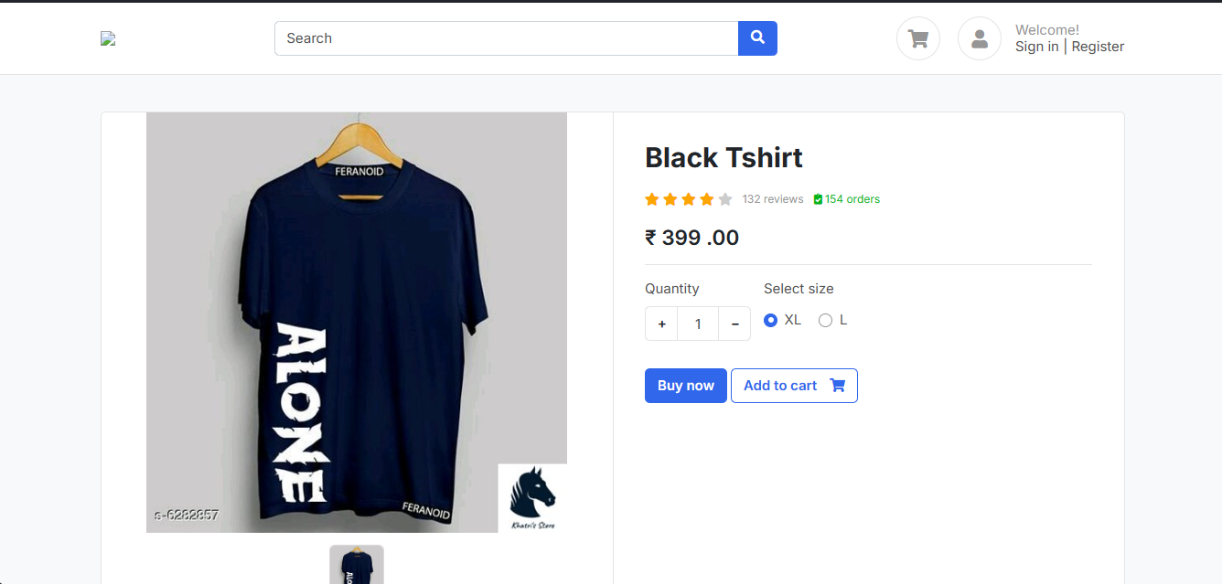
Product Interface

Slide 14
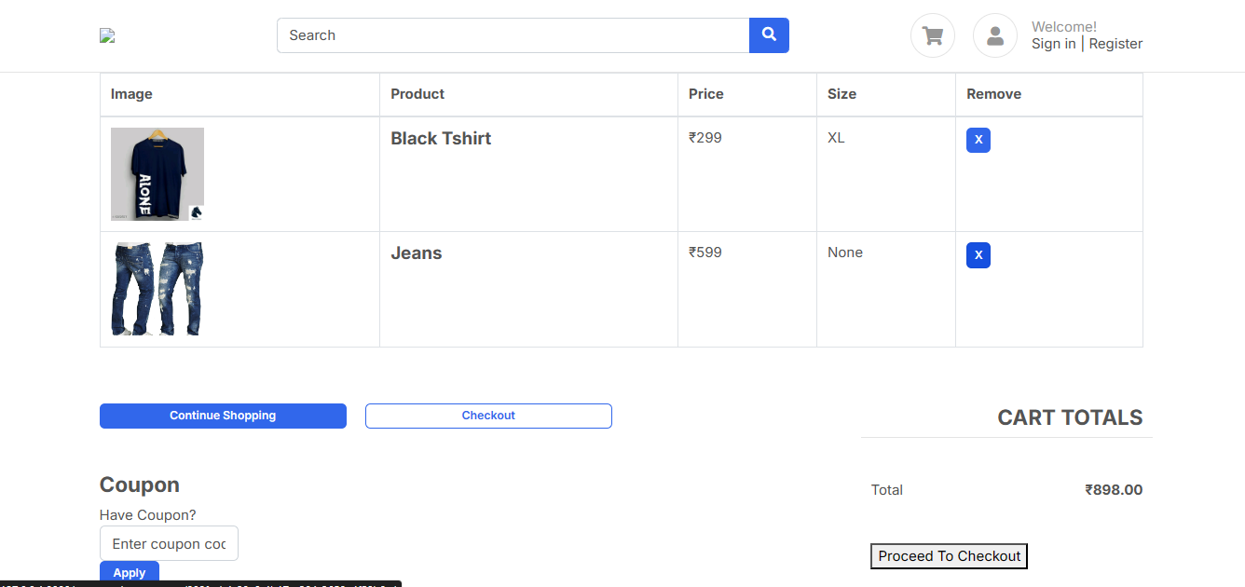
Cart Interface

Slide 15
TECHNOLOGIES USED
DJANGO
PYTHON
JIRA
HTML/CSS/JAVASCRIPT

Slide 16
THANK YOU!

