Slide 1

Healthcare Analytics For
Doctor Visits TIRTC
VASANTHAN K
AICTE Student ID: STU67e7ac832ee361743236227

Slide 2

PROBLEM STATEMENT
Healthcare providers need to understand the factors influencing patients’ doctor visits to better analyze healthcare utilization patterns. This project aims to analyze healthcare data using Python to identify patterns in doctor visits based on demographic and health-related factors such as age, gender, illness, and income. Through data cleaning, exploratory data analysis, and visualizations, the project seeks to examine visit distributions, compare average visits across different groups, and understand the relationship between patients’ characteristics and their healthcare-seeking behaviour.

Slide 3
Project Description
Healthcare Analytics for Doctor Visits is a data analysis project developed using Python to explore patient healthcare utilization patterns. The project involves data preprocessing, cleaning, exploratory data analysis (EDA), and data visualization to examine doctor visits and identify trends across patient groups. Using Python libraries such as Pandas, NumPy, Matplotlib, and Seaborn, the analysis aims to extract meaningful insights from healthcare data and understand how patient characteristics relate to doctor visit frequency.

Slide 4

WHO ARE THE END USERS?
Healthcare Administrators – To understand patient visit patterns and support resource planning.
Doctors and Medical Professionals – To gain insights into patients’ healthcare-seeking behaviour.
Hospital and Clinic Management – To improve service planning based on healthcare utilization trends.
Public Health Researchers – To study factors influencing doctor visits across different patient groups.
Government Health Departments – To support healthcare policy and public health planning.
Data Analysts – To analyze healthcare data and identify meaningful trends and patterns.

Slide 5
Technology Used
Python
Jupyter Notebook
Pandas
NumPy
Matplotlib
Seaborn

Slide 6
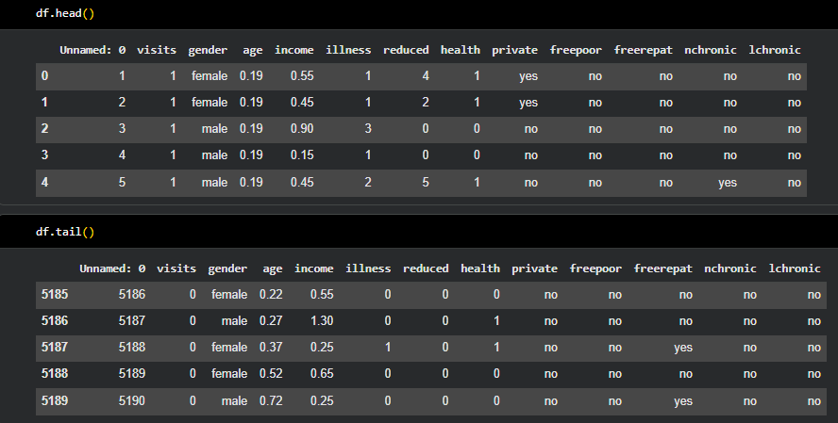
RESULTS
Github Link

Slide 7
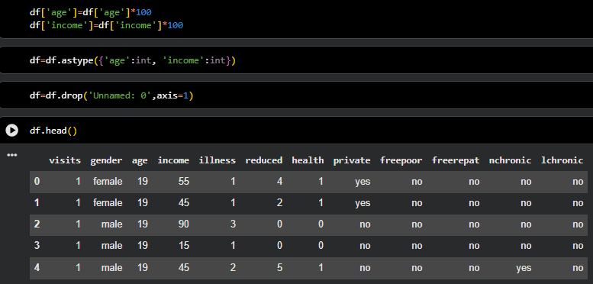
RESULTS

Slide 8
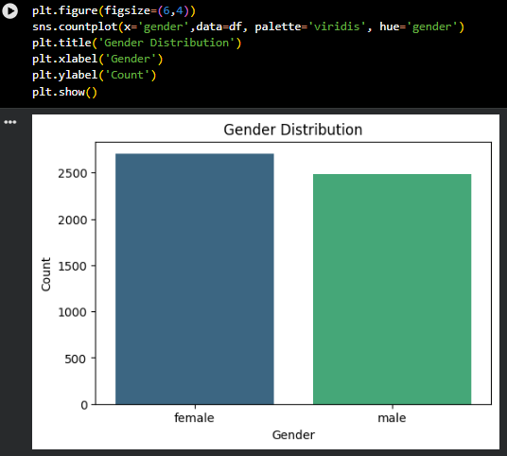
RESULTS

Slide 9
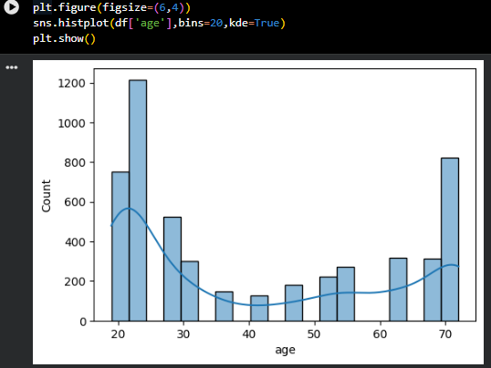
RESULTS

Slide 10
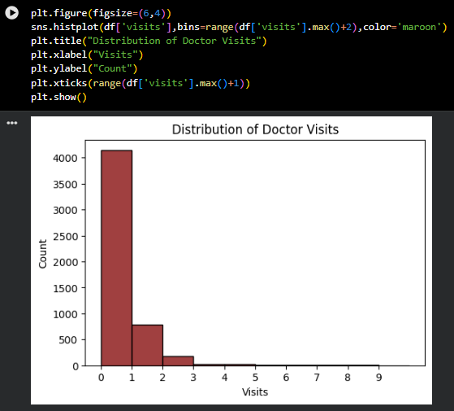
RESULTS

Slide 11
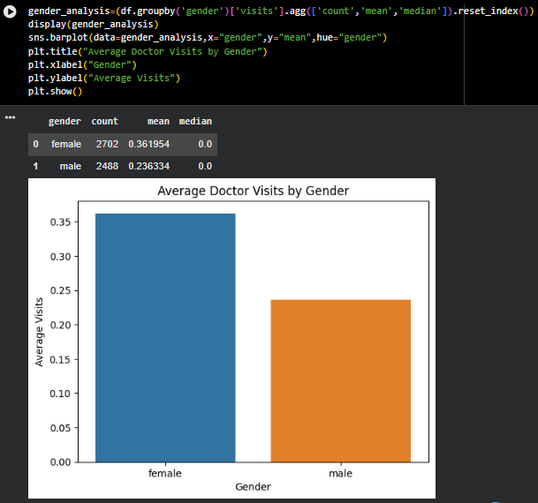
RESULTS

Slide 12
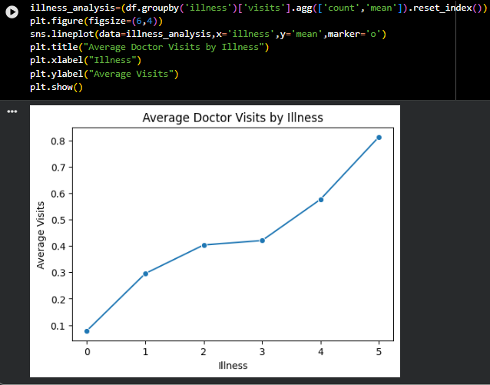
RESULTS

Slide 13
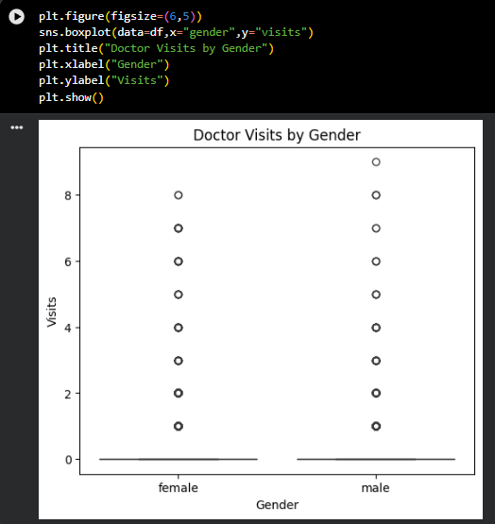
RESULTS

Slide 14
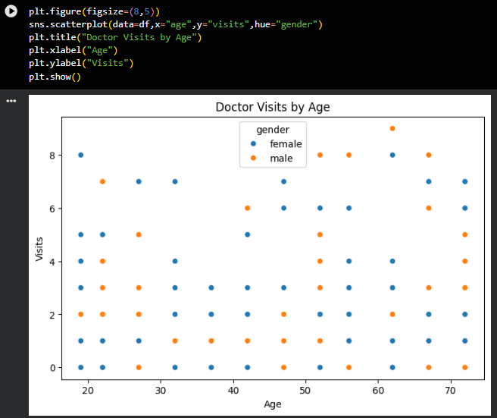
RESULTS

Slide 15
Thank you
Github Link: https://github.com/Beastboy77777/Healthcare-Analytics-For-Doctor-Visits
.
.

