Slide 1
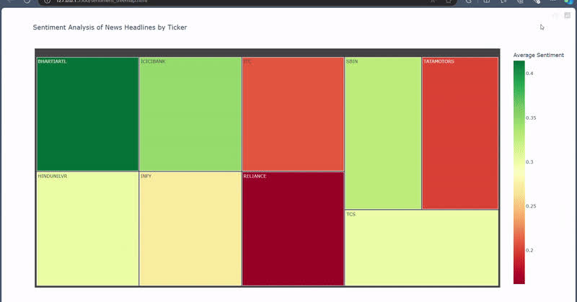

CYBER SURGE
SENTIMENT ANALYSIS FOR STOCKS
We have built an AI-based sentiment analysis tool that analyzes stock market news and provides sentiment scores (bullish, bearish, neutral) to help investors make informed decisions.
METHODOLOGY:
Data collection - Yahoo Finance
Sentiment Analysis model - VADER
Data Visualization - Treemap plotting
OUTCOME:
The treemap helps visualize the stock trends based on the proportion and impact of sentiments across sectors.

Slide 2



CYBER SURGE
ENHANCED SECURITY
Our Sentiment Analysis for Stock Market project integrates Layer 1 security, ensuring the foundational protection of our data pipelines and stock sentiment predictions.
SECURE & SAFE
Key Aspects of Layer 1 Security:
Data Integrity: Ensures the accuracy and completeness of sentiment data during transmission, preventing tampering or corruption.
Protected Infrastructure: Safeguards the network and hardware used in the analysis from external threats, minimizing risks of cyber attacks or data breaches.
Implements encryption for gathering and processing sentiment data from multiple sources like social media, news outlets, and financial reports.
TRUSTED
With Layer 1 security, the accuracy of stock sentiment outcomes remains uncompromised, providing trustworthy insights for stock predictions.

Slide 3
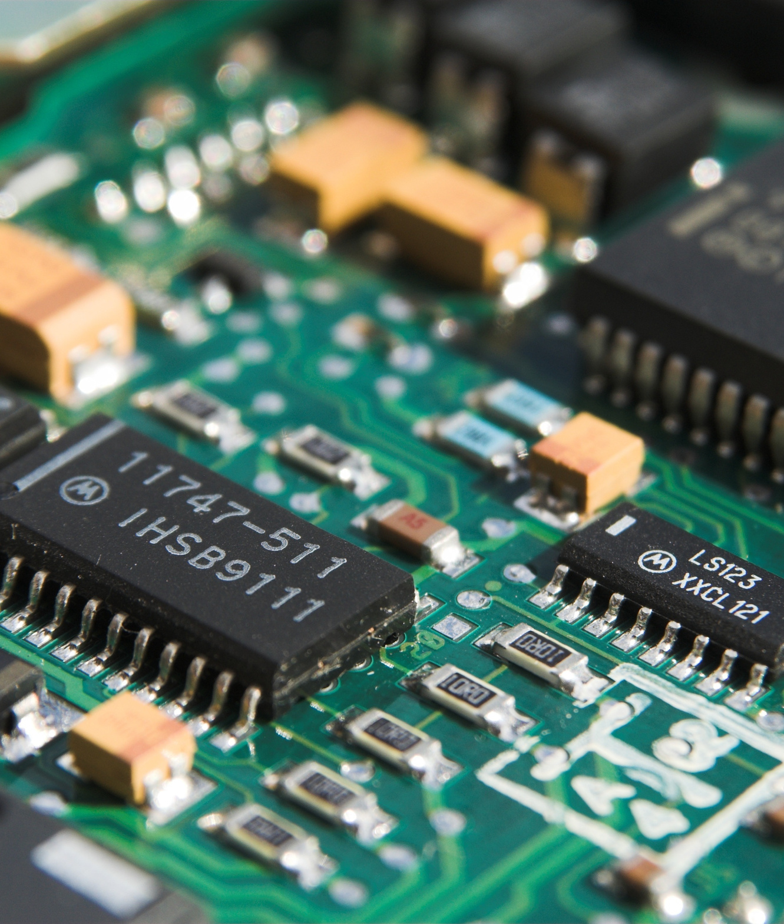
CYBER SURGE
INTEGRATING HARDWARE COMPONENTS
In addition to our sentiment analysis framework, our project leverages hardware components like ESP32 and NFC Tag 216 to enhance data security and real-time processing.
KEY HARDWARE COMPONENTS:
ESP32: When the market triggers, the esp32 gives response whether the market is bullish, bearish or neutral.
NFC Tag 216: It provides us a secure physical wallet.

