Slide 1
Overview
PDB
CLASSIFY
Others
Query
CIF
Pure_RNA
RNA sequences
+RNA MSA
+Template
Protenix
Pred Structure
Flow Matching

Slide 2
Data screening
PDB
CLASSIFY
Others
Query
CIF
Pure_RNA
+RNA MSA
RNA sequences
+Template
Protenix
Pred Structure
Flow Matching

Slide 3
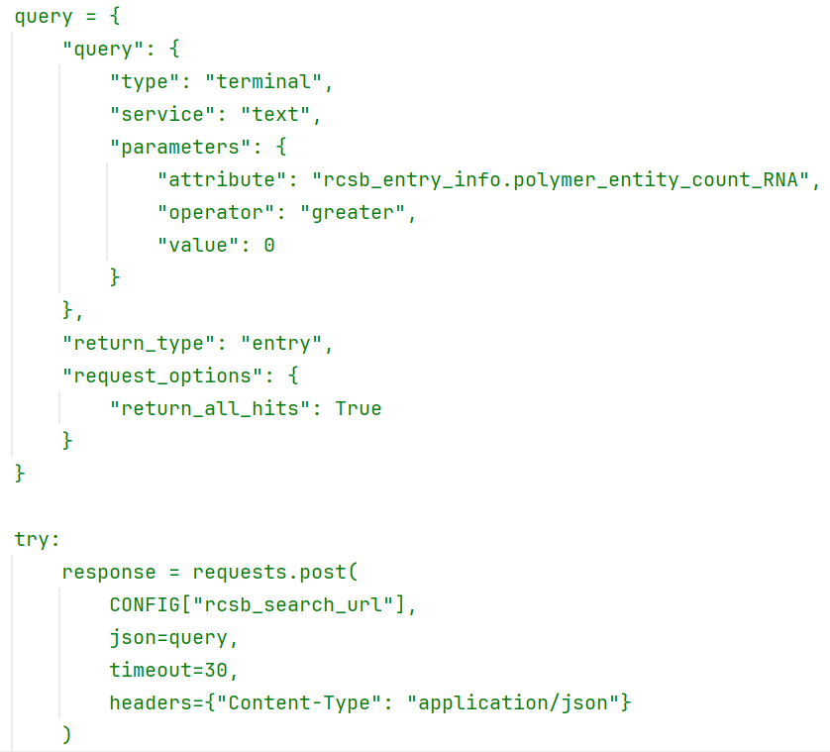
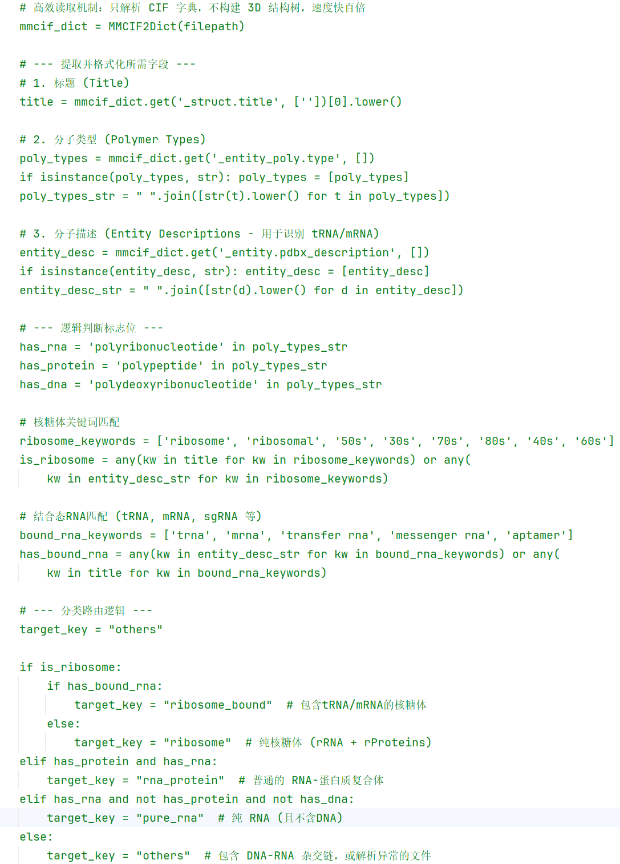
Data screening
PDB
CLASSIFY
Others
Query
CIF
Pure_RNA
Notes:
9428 其实纯RNA是1979个

Slide 4
Decoys生成
PDB
CLASSIFY
Others
Query
CIF
Pure_RNA
+RNA MSA
RNA sequences
+Template
Protenix
Pred Structure
Flow Matching

Slide 5
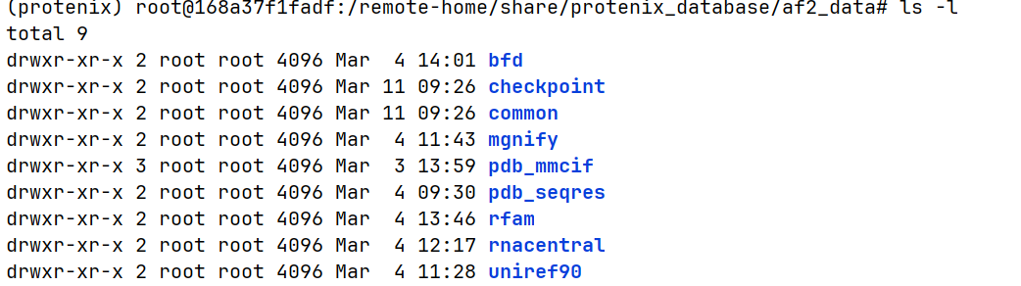
Decoys生成
RNA sequences
Pure_RNA
Protenix
Pred Structure
+RNA MSA
+Template
Protenix
CUTLASS、kalign、hmmer……
Notes:
加一下

Slide 6
Flow Matching
PDB
CLASSIFY
Others
Query
CIF
Pure_RNA
RNA sequences
+RNA MSA
+Template
Protenix
Pred Structure
Flow Matching

Slide 7
Todo
More Data (NAKB)
Decoys生成

