Slide 1


Overview
PDB
CLASSIFY
Others
Query
CIF
Pure_RNA
RNA sequences
+RNA MSA
+Template
Protenix
Pred Structure
Flow Matching

Slide 2
Data screening
PDB
CLASSIFY
Others
Query
CIF
Pure_RNA
+RNA MSA
RNA sequences
+Template
Protenix
Pred Structure
Flow Matching

Slide 3
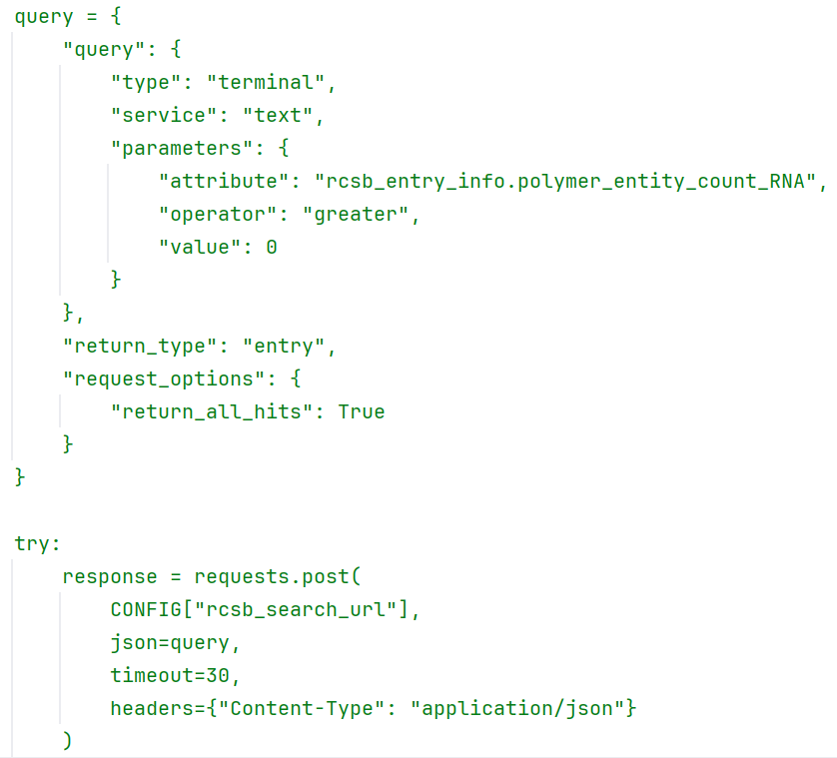
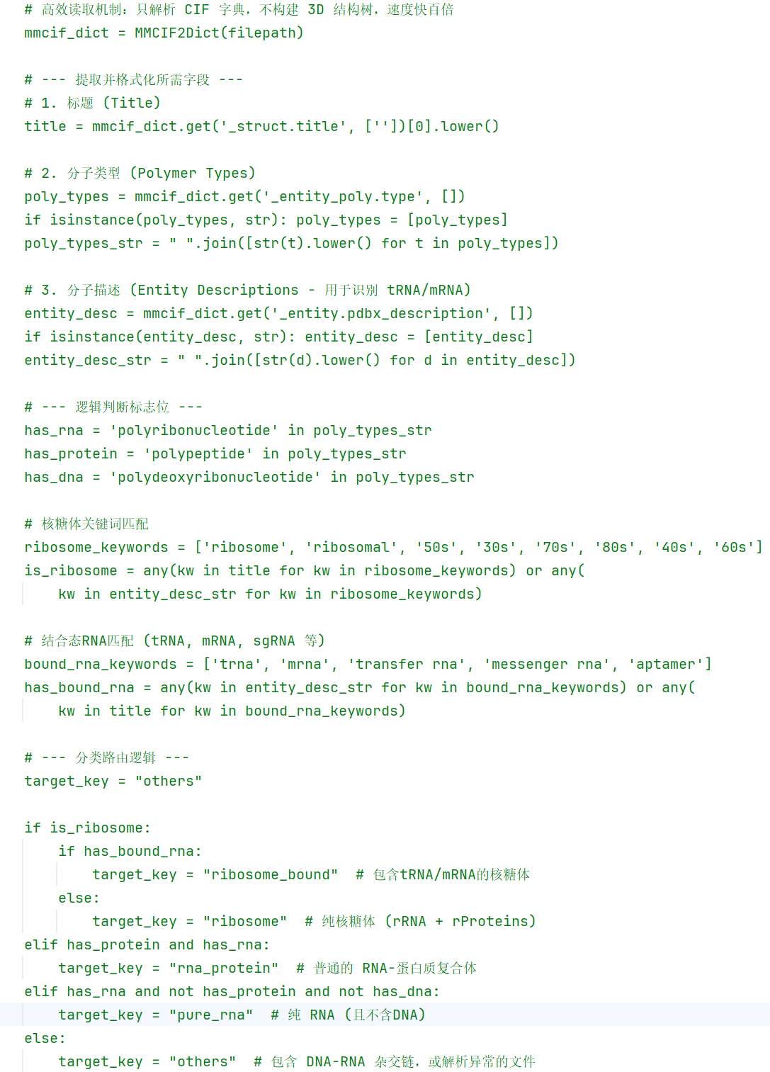
Data screening
PDB
CLASSIFY
Others
Query
CIF
Pure_RNA

Slide 4
Decoys生成
PDB
CLASSIFY
Others
Query
CIF
Pure_RNA
+RNA MSA
RNA sequences
+Template
Protenix
Pred Structure
Flow Matching

Slide 5
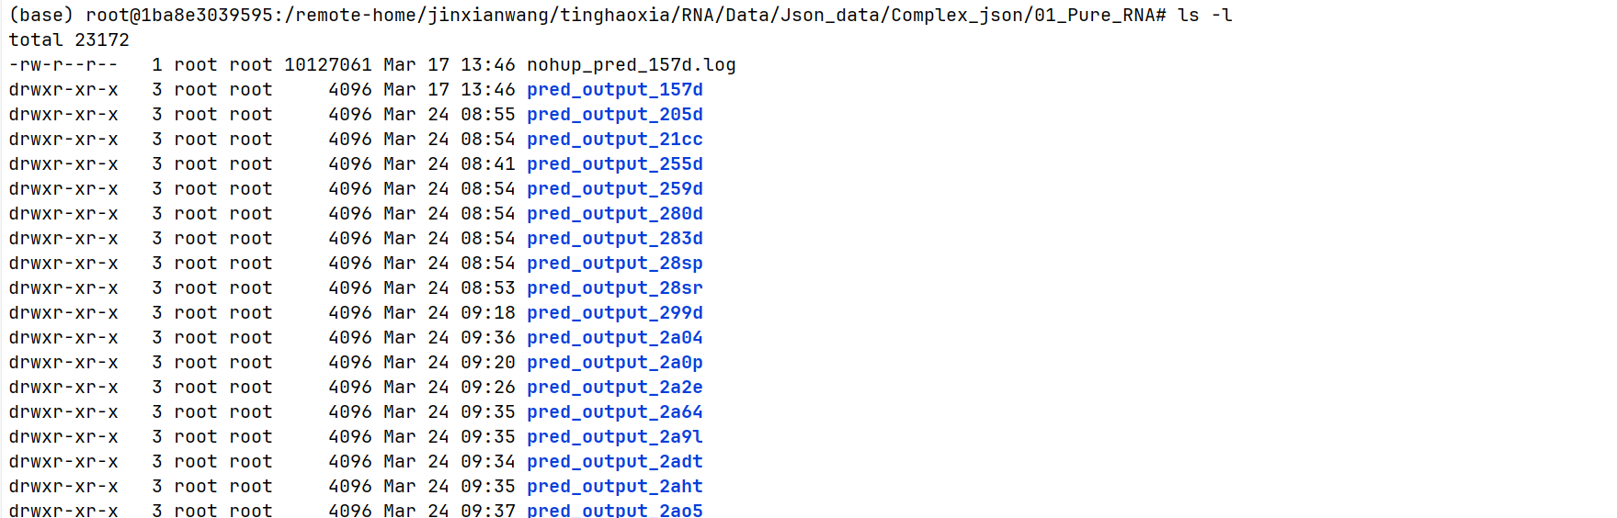

Decoys生成
RNA sequences
Pure_RNA
Protenix
Pred Structure
+RNA MSA
+Template

Slide 6
Todo
  More Data
  模型搭建

