Slide 1
Overview
PDB
CLASSIFY
Others
Query
CIF
Pure_RNA
RNA sequences
+RNA MSA
+Template
Protenix
Pred Structure
Flow Matching

Slide 2
Data screening
PDB
CLASSIFY
Others
Query
CIF
Pure_RNA
+RNA MSA
RNA sequences
+Template
Protenix
Pred Structure
Flow Matching

Slide 3
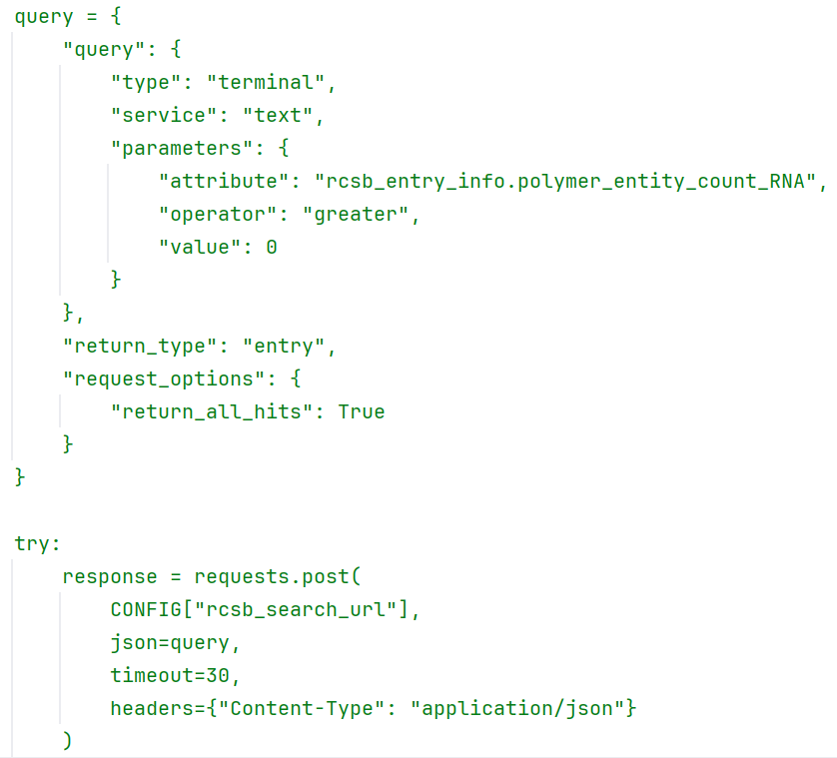
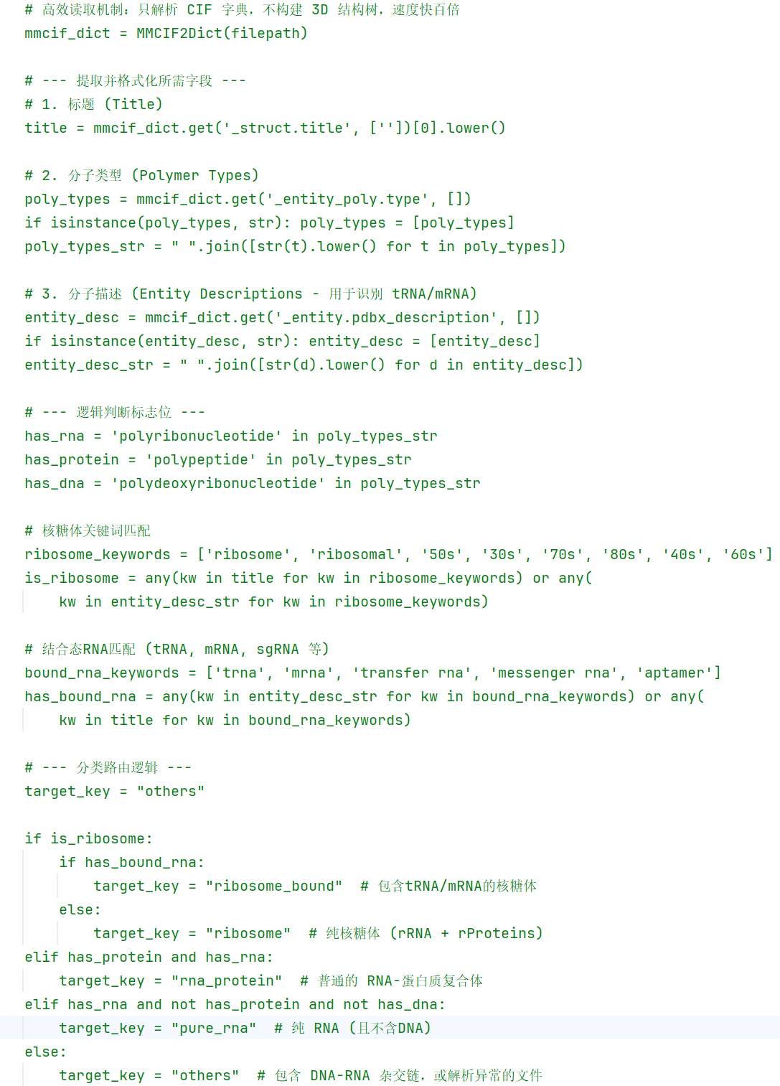
Data screening
PDB
CLASSIFY
Others
Query
CIF
Pure_RNA

Slide 4
Decoys生成
PDB
CLASSIFY
Others
Query
CIF
Pure_RNA
+RNA MSA
RNA sequences
+Template
Protenix
Pred Structure
Flow Matching

Slide 5
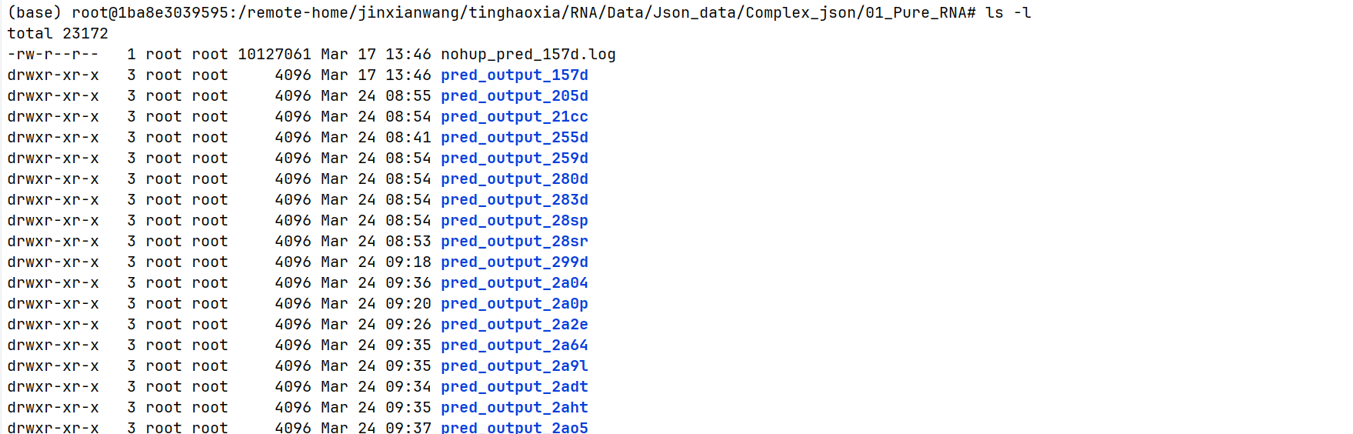
Decoys生成
RNA sequences
Pure_RNA
Protenix
Pred Structure
+RNA MSA
+Template

Slide 6
Decoys生成
seed1
seed2
RNA sequences
Pure_RNA
Protenix
+RNA MSA
+Template
seed3
seed4

Slide 7
Train.py
logger
trainer
trainer.fit
.yaml
callbacks
--config
--debug
--no_logger
run(config: dict)
model
PDB
datamodule
.pt

Slide 8
Todo
  修改模型
  加快训练速度

