Slide 1


others
Seed 42
Seed 43
.cif
pure(1979)
polymer_entity_count_RNA > 0
Seed 44
Seed 45
.pt
'pos': pos_tensor,
'pos_pred': pos_pred_tensor,
'atomic_numbers': z_tensor,
'sequence': sequence,
'edge_index': edge_index,
'pdb_id': pdb_id,
'seed': seed,
'pred_filename': pred_cif,
'alignment_ratio': alignment_ratio
Notes:
搜索到9443个，下载到服务器9439个，四个下载失败；9438是all_rna_structures.csv的数据；分类日志9428是旧数据；1979个pure+4373个RNA蛋白质复合物+1385个核糖体+1601Ribosome_Bound+101Failed=9439

Slide 2
k(num_atoms,num_head,head_dim)
q(num_atoms,num_head,head_dim)
v(num_atoms,num_head,head_dim*4)
nn.Linear
nn.Linear
nn.Linear
x(num_atoms,hidden_channels)
layernorm
nn.Linear
*num_layers
nn.SiLu
nn.Linear
x(num_atoms,hidden_channels)
t(num_atoms,1)
x(num_atoms,hidden_channels)
vec(num_atoms,3,hidden_channels)
neighbor_embedding
x(num_atoms,hidden_channels)
embedding
z(num_atoms)
Notes:
Num_workers

Slide 3
BaseDataModule(pl.LightningDataModule)
DataLoader[train/val/test]
EuclideanDataset(Dataset)
pos (num_atoms,3)
atomic_numbers(num_atoms)
smiles(str)
edge_index(2,num_edges)
[chirals]
mol
node_attr(num_atoms,node_attr_dim)
edge_attr(num_edges,edge_attr_dim)
.pt
**self.dataloader_args
BaseFlow(BaseModel(LightningModule))
z, pos, bond_index
node_attr, edge_attr,batch
max_batch_size
num_samples
n_timesteps
device
s_churn
t_min
t_max
std
sampler_type
atomic_numbers
smiles_changed
edge_index
chiral[]
node_attr
edge_attr
loss(v_t,u_t)
smiles
data
x₀
t
x_t
u_t
_{V_t}
representation_model
output_model
EquivariantVectorOutput(OutputModel(nn.Module))
(num_atoms,)
z
(2,num_edges)
embedding
edge_index
NeighborEmbedding
t
(num_atoms,)
(num_atoms,hidden_channels)
(num_atoms,hidden_channels)
z
x
x
EquivariantMultiHeadAttention
GatedEquivariantBlock
(2,num_edges)
GatedEquivariantBlock
(num_edges,)
edge_index
(num_atoms,hidden_channels)
mask
*8
(num_edges,3)
x
edge_vec
(num_atoms,3,hidden_channels)
dx
dvec
v_t
(num_edges,1)
(num_atoms,3,hidden_channels)
(num_atoms,3)
masked_edge_weight
distance_expansion
vec
vec
pos
(num_edges,3)
(num_edges,)
(num_edges,num_rbf)
(num_edges,3)
(num_atoms,)
edge_vec
edge_weight
edge_attr
edge_vec
z
(2,num_edges)
edge_index
(num_edges,)
(num_atoms,3)
edge_weight
pos
(num_edges,num_rbf)
batch
edge_attr
Notes:
等变图注意力层

Slide 4
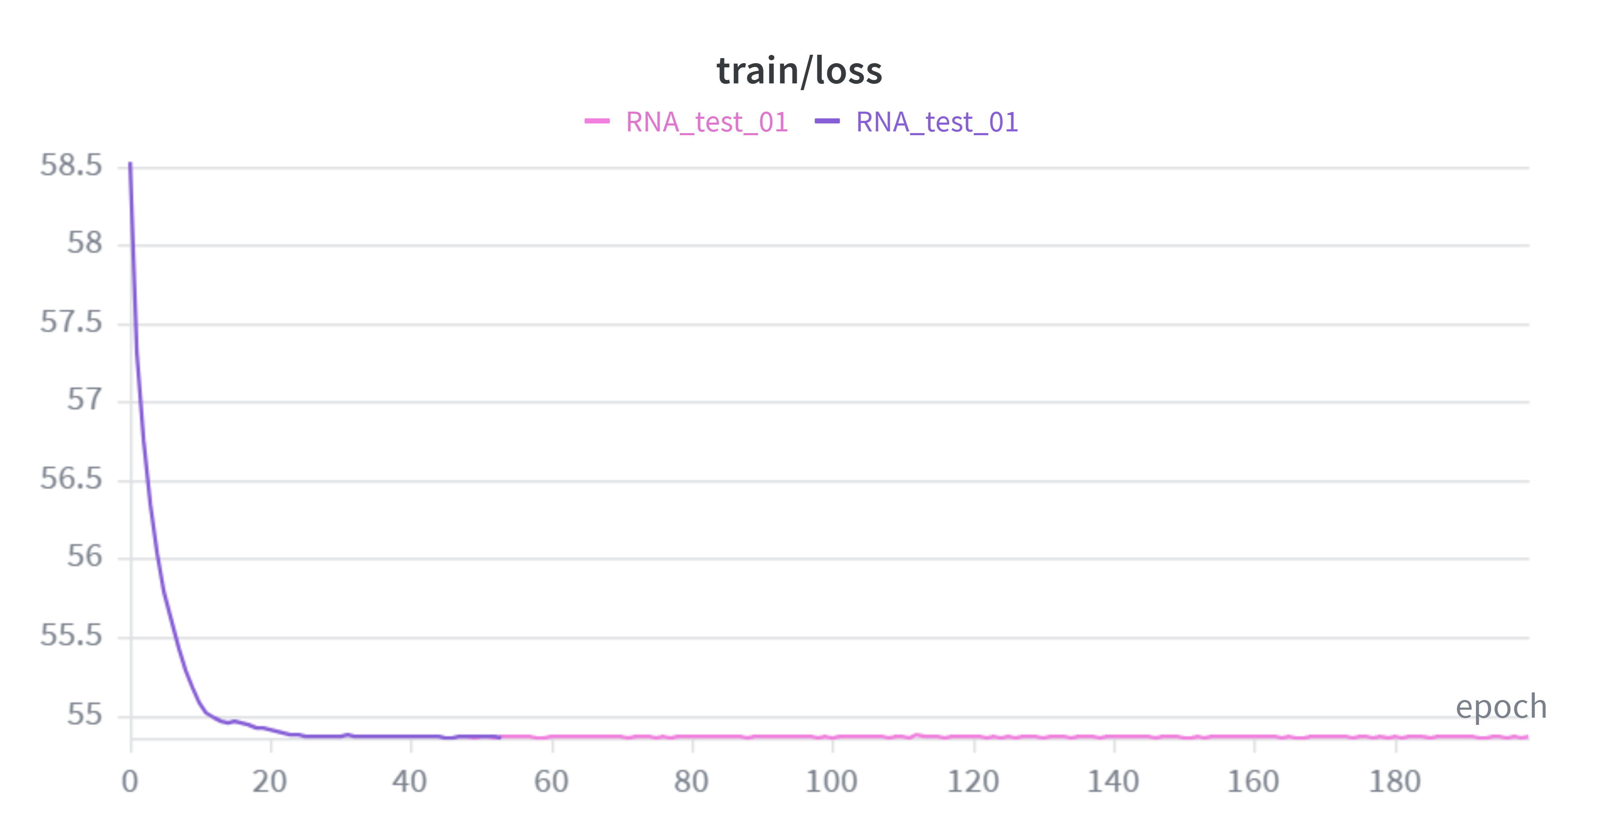
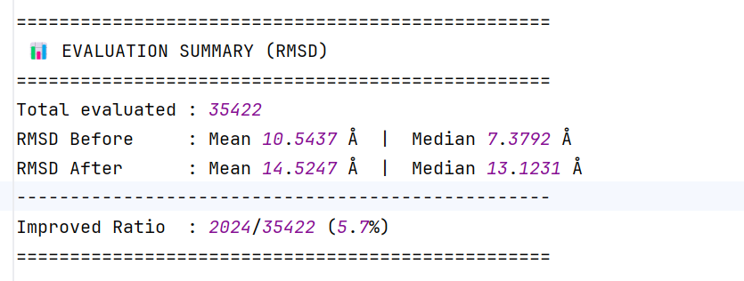
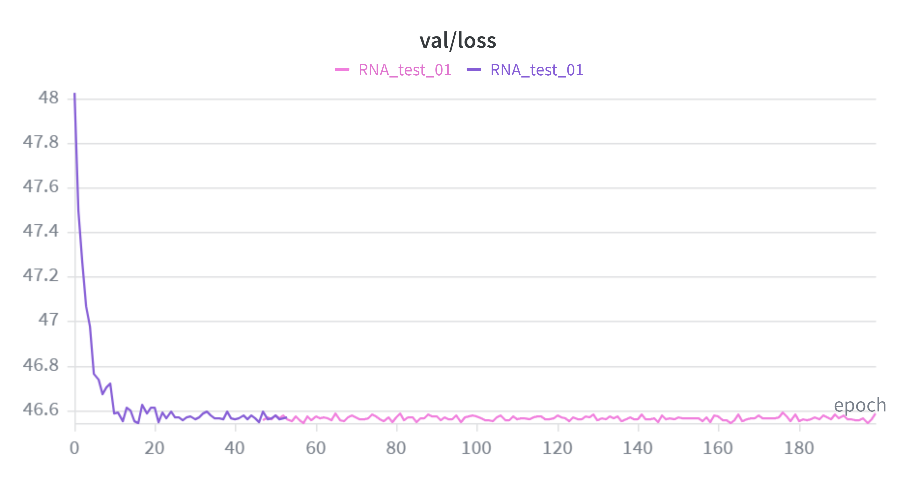
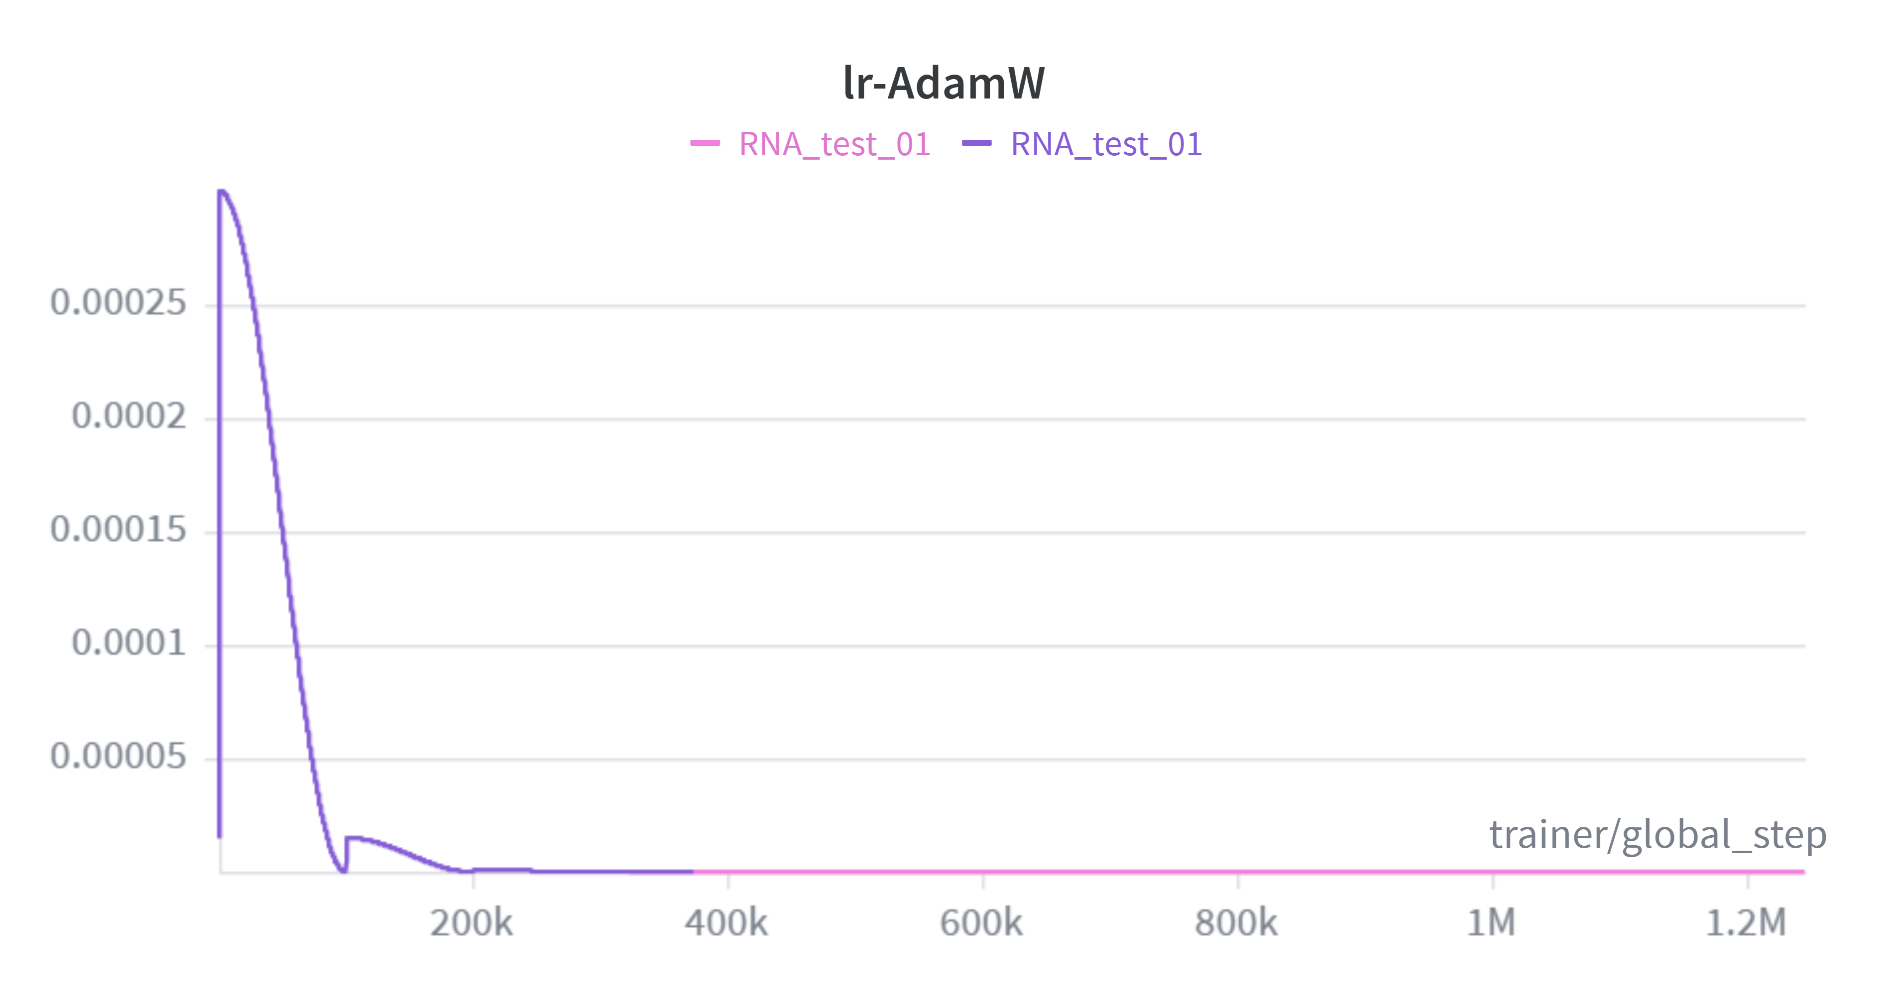
Notes:
带预热的余弦退火重启

Slide 5
Reasons？
1.学习率过低？
2.模型容量不够？

Slide 6
ToDo
lr
Notes:
大幅缩减总训练步数

