Slide 1
Escape Room
QUEST
CODEBREAKERS team presents
IRONHACK, Data Analytics Bootcamp WEEK 1

Slide 2
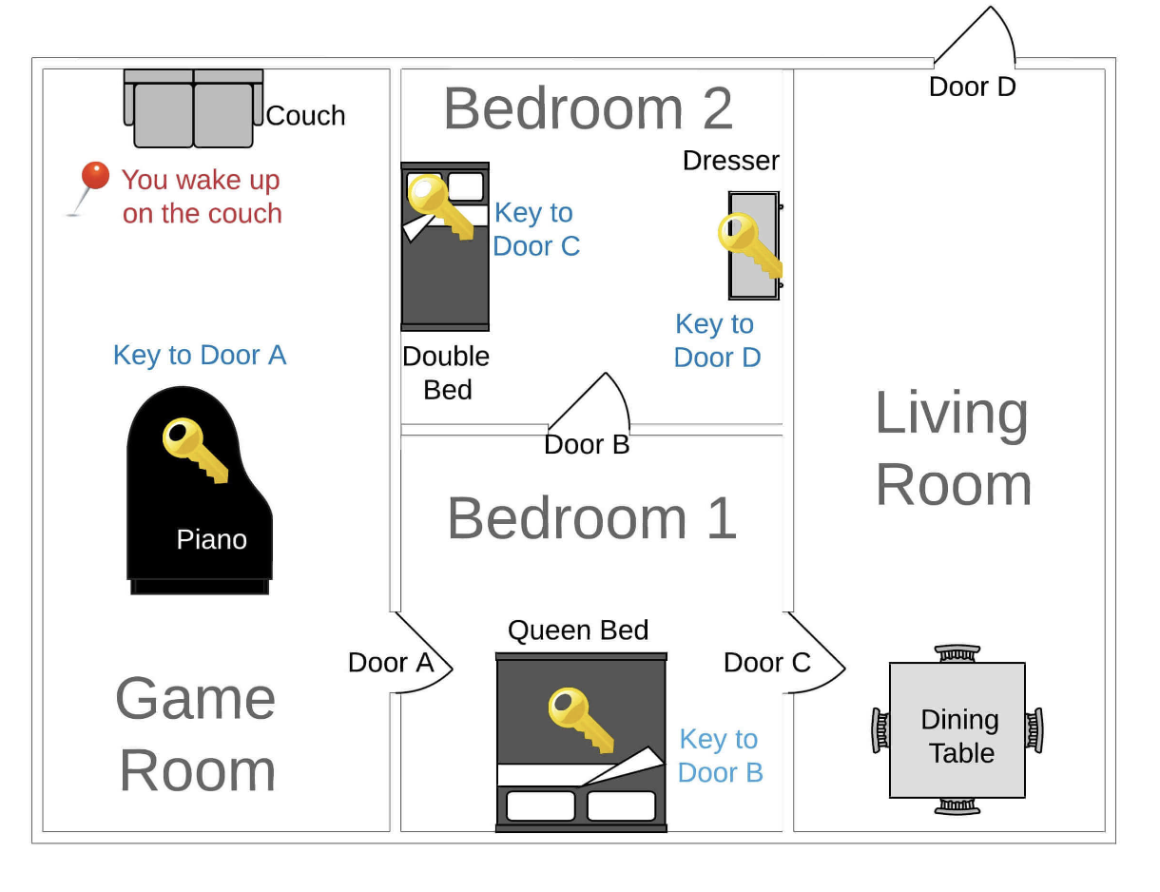
Quest Brief
Code a text-based game, ‘Escape Room’, utilizing Python skills learned in the bootcamp
Implement Python code, enhance it and test the game to ensure robustness.
Each room presents unique challenges. The goal is to escape from the starting room (Game Room) to the end (Outside).

Slide 3
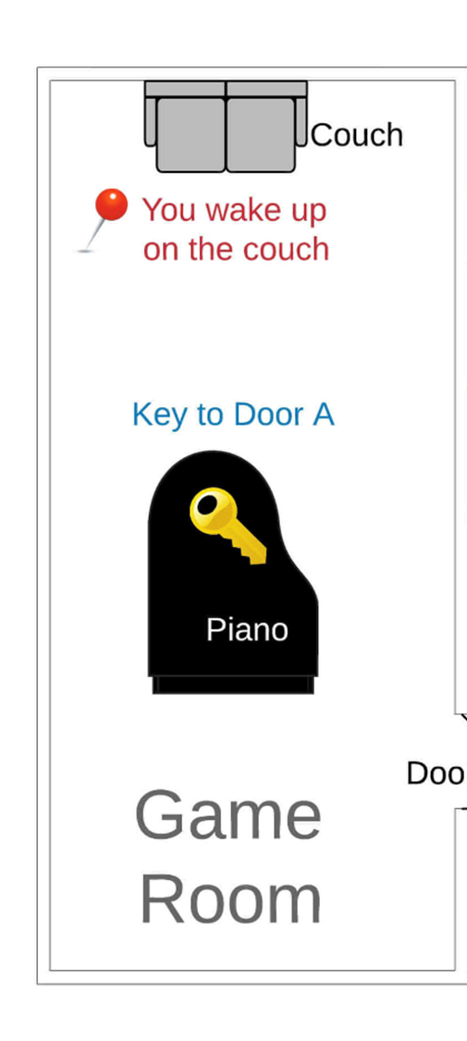
How is the game’s structure organized? Which functions do you have and how are they imported?
The rooms, items and paths are defined using nested lists and dictionaries.
For and if/else functions are used for control flow and interactions with user
In the sample code only the game room was defined and was directly connected with the outside

Slide 4
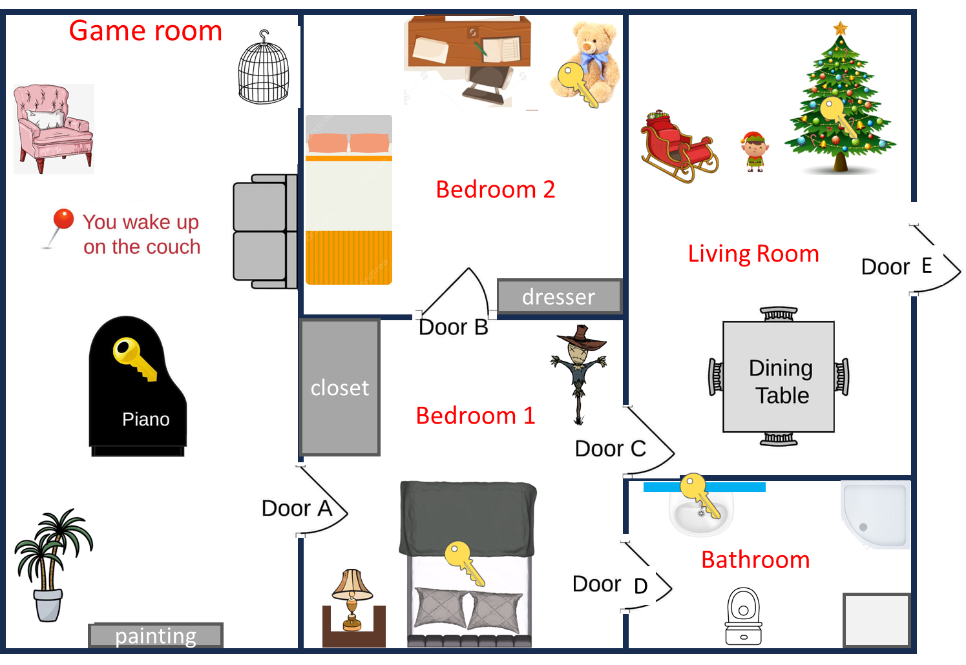
Which features did you add to the game?
Addition of new rooms and items in them.
Definition of relations between new objects, rooms and paths between them.

Slide 5

Which features did you add to the game?
Simplified the user interaction with the game:
Made the messages displayed to user more user-friendly
User can choose just numbers (0,1..) to make action
User can either ‘examine’ an object, ‘solve a puzzle’ or ‘go back’ to a room that was already visited

Slide 6
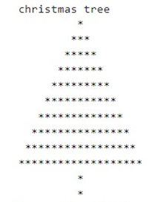
Which features did you add to the game?
For ‘go back’ option: ‘history’ parameter was added for tracking the rooms that were visited. A new go_back() function was defined.
Add ‘solve the puzzle’ function to answer a riddle and get a clue where the key is
Include sounds when the key is found, after answer to a puzzle or when you finish the game.
Print a christmas tree when it is examined

Slide 7
Technical challenge
What was the most important technical challenge you faced?
How did you overcome that challenge?

Slide 8
Big mistake
What was the biggest mistake you made during this project?
What did you learn from it?

Slide 9
THANK YOU!
CODEBREAKERS team
IRONHACK, Data Analytics Bootcamp WEEK 1

