Slide 1


PYTHON INTERMEDIATE (online) Final project
Personal Expense Tracker
We use tech to connect human potential and
opportunity with dignity & humility
Beatrice Osayi
beatriceosayi1@gmail.com

Slide 2
Agenda
Project Idea
Process / Flowchart
Result/Outcome
Limitations
Future steps

Slide 3

Project idea
Problem: As expenses vary depending on activities in the month, calculating costs can be challenging.
Solution: Personal Finance Manager to give better control over finances.

Slide 4
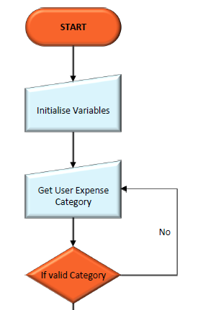
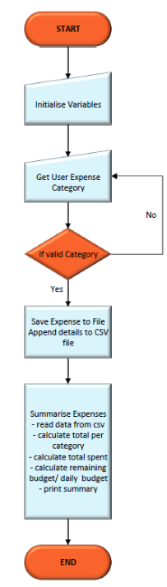
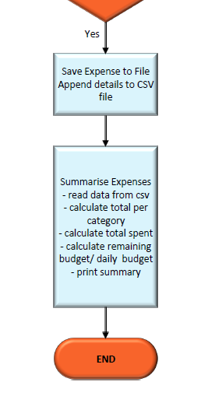
Process/ Flowchart

Slide 5
Functionality of the application
The program prompts the user to input the expense, amount and category. Key features include:
Expense Input
Smart categorization
Budget control
Insightful Analysis
Goal setting

Slide 6
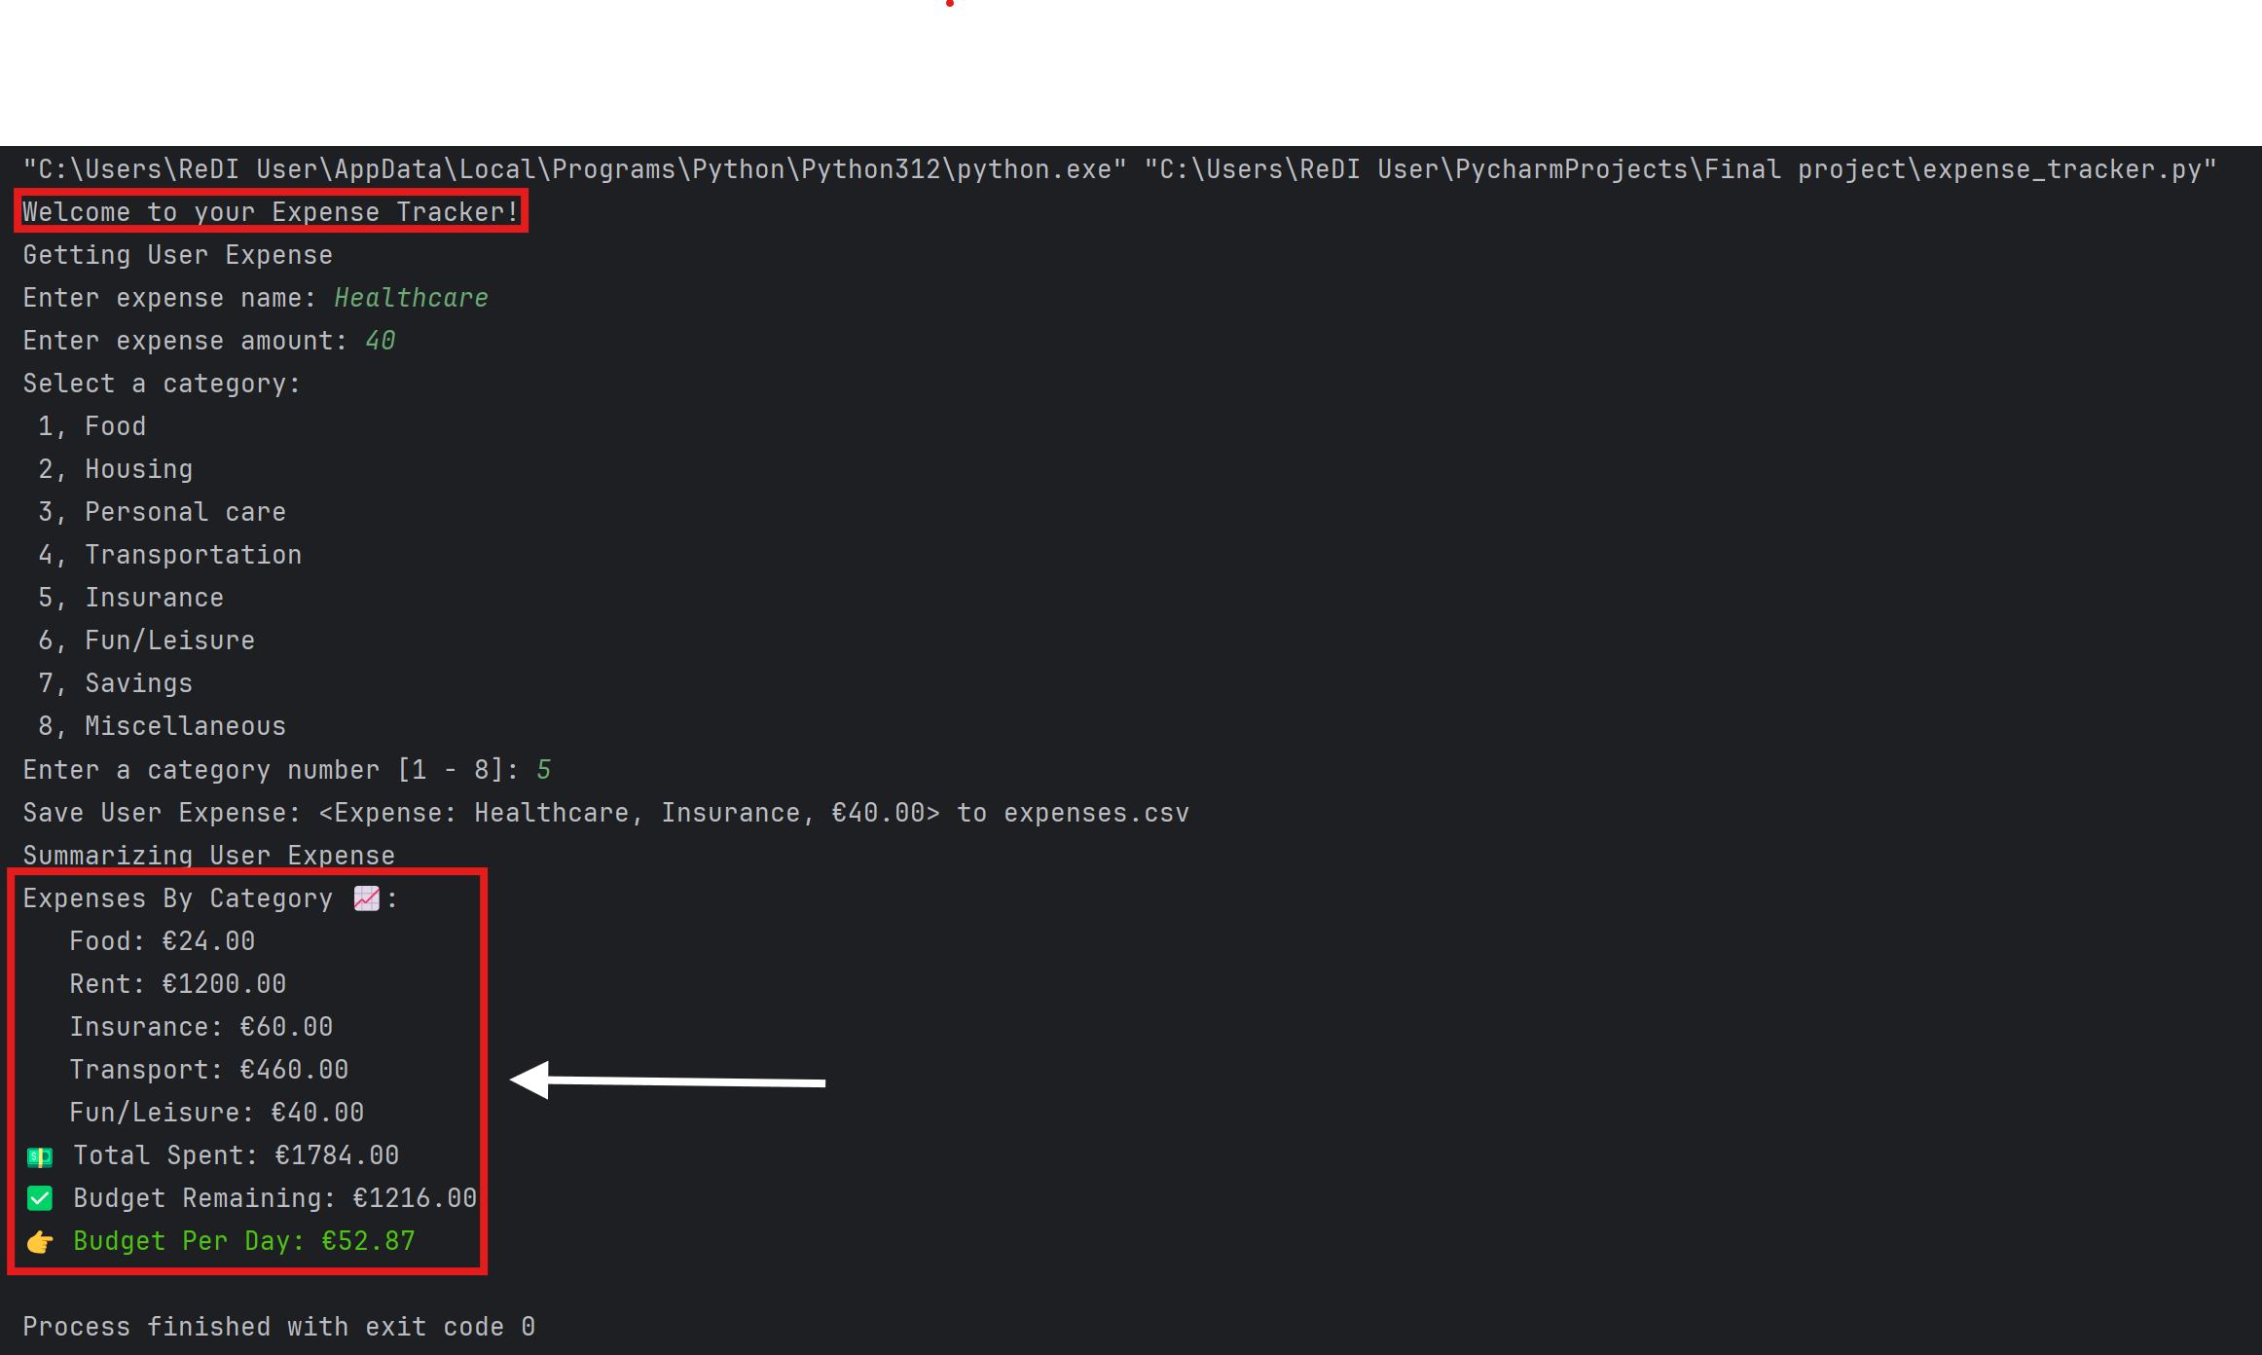
Result/Outcome
Outcome

Slide 7

Limitations
Time constraint
Seemingly complex due to limited knowledge
Solution quality and interpretation

Slide 8

Future steps
GUI to be created
Integration with bank app
Expansion of financial categories
Integration of in app alerts for budget monitoring

Slide 9

THANK YOU TO ALL THE TEACHERS!

