Slide 1
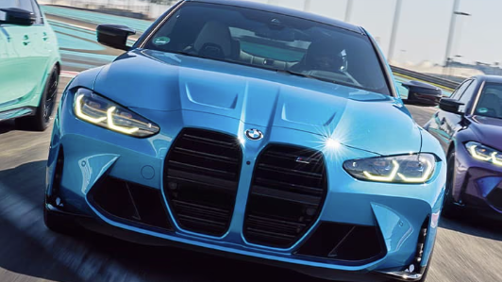
D214: Data Analytics Graduate Capstone -NKM2 — NKM2 Task 3: Presentation of Findings Beatrice Mwangi College of Information Technology, Western Governors University D214: Data Analytics Graduate Capstone Dr. Daniel Smith November 11, 2025
Predicting if the vehicle’s features influenced the sales volume for BMW vehicles between 2010 and 2024
Executive Summary and Implications

Slide 2
Statement of the problem and the hypothesis
Executive Summary and Implications
Statement of the Problem
Can we utilize the random forest regressor machine learning model to predict the features that influenced the BMW sales volumes between 2010 and 2024 across various regions?
For this analysis, the following null and alternative hypotheses were utilized.
Null hypothesis
The sales volume for various BMW vehicles is not significantly influenced by the vehicle’s features, such as the model, color, fuel_type, transmission, Engine_Size_L, Mileage_KM, and Price_USD, in the various regions from 2010 to 2024.
Alternate Hypothesis
The sales volume for various BMW vehicles is significantly influenced by the vehicle’s features, such as the model, color, fuel_type, transmission, Engine_Size_L, Mileage_KM, and Price_USD, in the various regions from 2010 to 2024.

Slide 3
Data analysis process
The data was extracted from the Kaggle.com website, available at this link: https://www.kaggle.com/datasets/ahmadrazakashif/bmw-worldwide-sales-records-20102024. and downloaded to a CSV file. The data was loaded from the CSV file into a python dataframe called ‘BMW_df’. After loading the data, I checked for data types, missing values, duplicated data, trimmed and cleaned the white spaces, and dropped the features that I will not use for analysis. In exploring the data, I examined the data's shape, the correlation between features, and visualized it to assess the distribution. To prepare the data for processing, I converted the categorical data to numeric data using dummy encoding. For the binary column, I dropped the first column to prevent multicollinearity; however, for the non-binary columns, no first column was dropped. I also standardized the numerical columns through scaling and normalization to enable data analysis. Feature selection was performed using SelectKBest, which involves selecting the top 15 features based on a statistical test to improve model performance and reduce overfitting. The data was split into X_train, X_test, y_train, and y_test, with a test size of 20%, to separate the training data used to build the model from the testing data used to evaluate the model's performance. This will ensure the model is trained and validated on distinct datasets, preventing overfitting and generalizing well to new data. The Random Forest Regressor model was initialized and fitted to the training dataset. The initial model was evaluated using the metrics R² score, MSE, RMSE, and MAE. Based on the initial R² score of –0.1797, the high MSE of 9,636,368, RMSE of 3,104, and MAE of 2,624, the results indicate that there is no correlation between the vehicle features and the sales volume. RandomizedSearchCV was used to optimize the model. The final model used the values below for the hyperparameters: max_depth=10, max_features = 'log2', min_samples_leaf=4,n_estimators=400, random_state=42, and bootstrap = True. The final model was evaluated using the metrics R² score, MSE, RMSE, and MAE. The final model improved slightly after optimization, with an R² Score of – 0.0036, a high MSE of 8200764.15, an RMSE of 2863.70, and an MAE of 2479.33. The results indicate that there is no correlation between the vehicle features and the sales volume. I then created a feature importance visualization to display the impact of each feature on sales volumes.

Slide 4
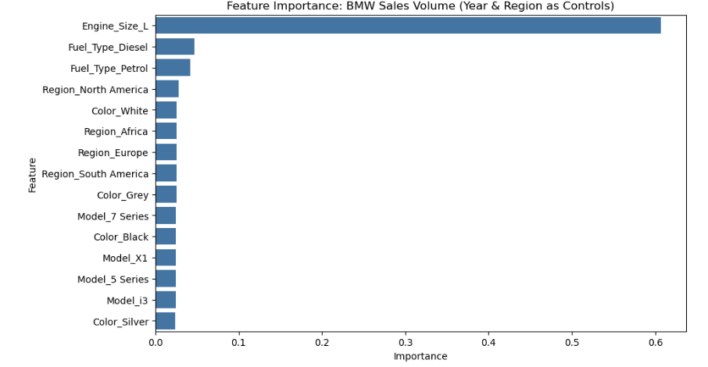
Findings
Feature importance visualization
When creating a feature importance visualization, the visual indicates that Engine_Size_L has a minimal influence on the sales volume. All other features do not appear to have any influence on sales volume.
The final model was evaluated using the metrics R² score, Mean Squared Error (MSE), Root Mean Squared Error (RMSE) and Mean Absolute Error (MAE).
The final model improved slightly after optimization, with an R² Score of
-0.0036, a high MSE of 8200764.15, an RMSE of 2863.70, and an MAE of 2479.33. The results indicate that there is no correlation between the vehicle features and the sales volume, thereby supporting the null hypothesis.

Slide 5
Limitations of the technique and tool used
For this analysis, I chose to use a Python tool to perform a random forest regression analysis on the BMW Sales volume between 2010 and 2024 dataset. The Limitation of the random forest regressor machine learning model is that the model is computationally expensive, which makes it slow for large datasets. The Limitation of the Python tool is that it can be inefficient in analyzing large datasets. While tuning the model performance, the limitations of the technique and the tool were encountered.

Slide 6
Summary of the proposed action
One limitation of the data analysis is that the dataset only contains the features of a vehicle, and no other variables, such as customer demographics and economic conditions, that may impact sales volume. Additionally, the vehicle's features have little or no impact on influencing buying decisions on their own.
The recommendation to the executive of the BMW company is that the vehicle features alone have no impact on determining the sales volume of various vehicles from 2010 to 2024 in different regions, and they may need to consider the economic conditions and customer demographics in determining how to increase the sales volumes.

Slide 7
Benefits of the study
The primary objective of this data analysis is to determine whether the features of vehicles affect the sales volume using the random forest regressor model, based on the BMW dataset from 2010 to 2024. The features model, color, fuel_type, transmission, Engine_Size_L, Mileage_KM, Price_USD, in the various regions with Year as a control variable, were evaluated to determine if they had a significant influence on sales volume. The results indicate poor model performance, characterized by a negative R² value, a large RMSE, and a high MSE score. The model suggests that vehicle features have little to no impact on sales volume. The model hence supports the null hypothesis, “the sales volume for the various BMW vehicles is not significantly influenced by the various factors such as the model, color, fuel_type, transmission, Engine_Size_L, Mileage_KM, Price_USD in the various regions from the year 2010 to the year 2024.”. What this means is that the vehicle features on their own cannot be used as a strategy to increase sales volume.

