Slide 1
K-Means Clustering
Comparison between a sequential and parallel implementation
Beatrice Paoli
Firenze – 12/1/2023

Slide 2
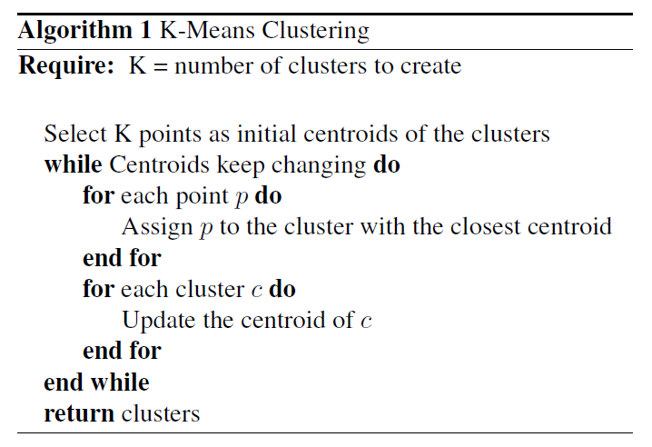
K-Means Clustering
Comparison between a sequential and parallel version
Firenze – 12/1/2023
The Algorithm
K-Means Clustering
The K-means algorithm is a parametrized clustering technique that allows to partition a dataset of points or observations into K clusters.
The algorithm is composed by few steps, with two main phases alternated between each other: the Assignment phase and the Update phase

Slide 3
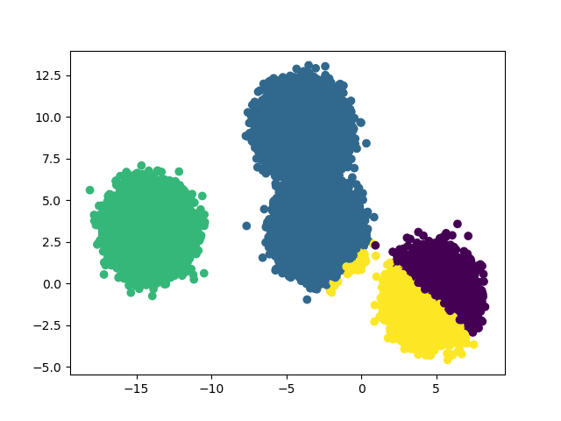
K-Means Clustering
Comparison between a sequential and parallel version
Firenze – 12/1/2023
The Algorithm
K-Means Clustering
The algorithm converges after few steps to a local minimum, depending on the choice of the initial centroids.
In the implementation, the starting centroids are chosen randomly from the dataset in input. Therefore, different runs of the algorithm on the same dataset can yield different results.

Slide 4
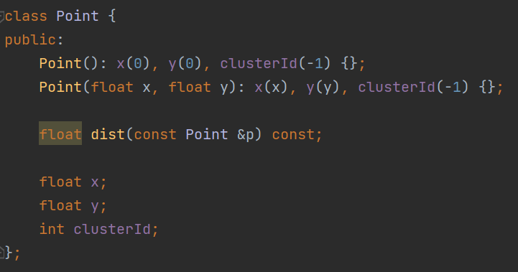
K-Means Clustering
Comparison between a sequential and parallel version
Firenze – 12/1/2023
Implementation
Classes: Point
The AoS (Array of Structure) approach was used.

Slide 5
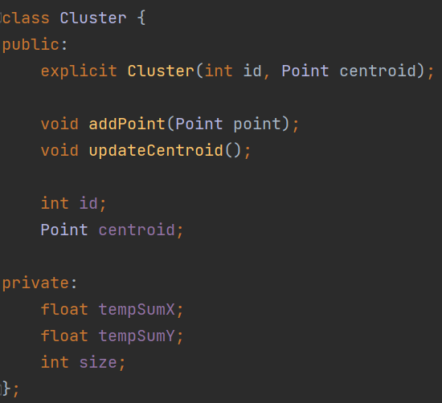
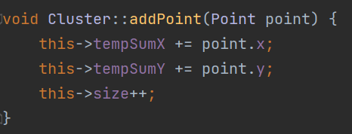
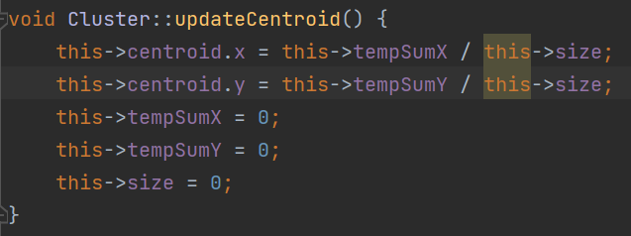
K-Means Clustering
Comparison between a sequential and parallel version
Firenze – 12/1/2023
Implementation
Classes: Cluster
The AoS (Array of Structure) approach was used.

Slide 6
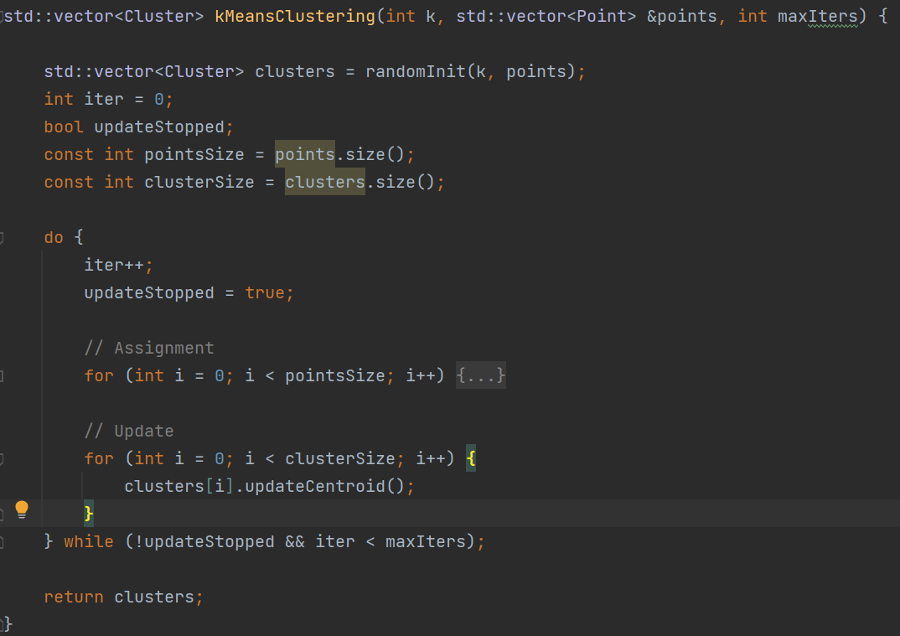
K-Means Clustering
Comparison between a sequential and parallel version
Firenze – 12/1/2023
Implementation
Function

Slide 7
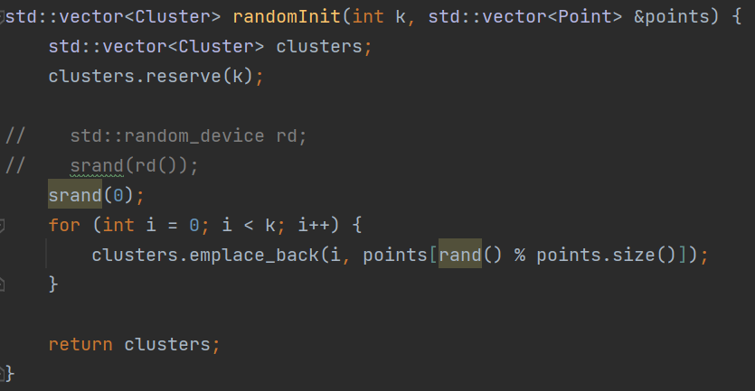
K-Means Clustering
Comparison between a sequential and parallel version
Firenze – 12/1/2023
Implementation
Initialization

Slide 8
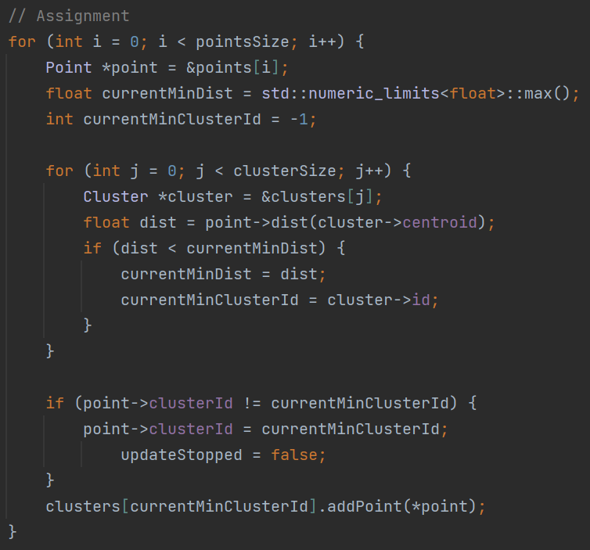
K-Means Clustering
Comparison between a sequential and parallel version
Firenze – 12/1/2023
Implementation
Assignment Step

Slide 9
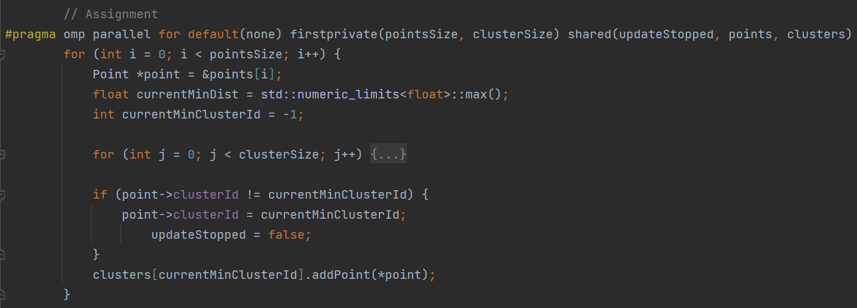
K-Means Clustering
Comparison between a sequential and parallel version
Firenze – 12/1/2023
Parallelization with OpenMP
Assignment Step Parallelization
To achieve parallelization, it was necessary to use only a few pragma statements.
The assignment step is embarrassingly parallel since the search and assignment of each point to a cluster is independent from one another. So, a #pragma omp parallel for statement was used on the points loop to use threads to parallelize the computation.
Since the workload for each thread is similar the default static scheduler is used.

Slide 10
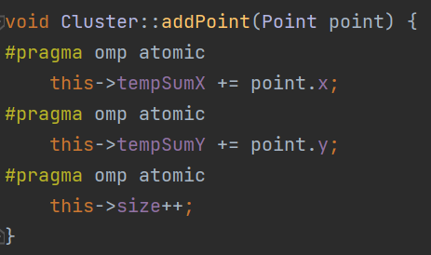
K-Means Clustering
Comparison between a sequential and parallel version
Firenze – 12/1/2023
Parallelization with OpenMP
Assignment Step Parallelization
However, each thread accesses the shared clusters to call addPoint() and update the internal cluster variable. Without any synchronization mechanism, this introduces a race condition on the algorithm that leads to incorrect results.
The method addPoint() only performs three sums over the variables tempSumX, tempSumY and size, so three #pragma omp atomic were used to ensure the correct update of the variables and avoid the race condition.

Slide 11

K-Means Clustering
Comparison between a sequential and parallel version
Firenze – 12/1/2023
Speedup Analysis
Definition
In order to compare the performance of a sequential algorithm with its parallel version we can use the concept of speedup.
Speedup is measured as the ratio between the execution time of the sequential algorithm and the parallel one.
Ideally, we should look for perfect speedup or even linear speedup, meaning S should be equal or similar to the number of processors used to perform the parallel algorithm.

Slide 12
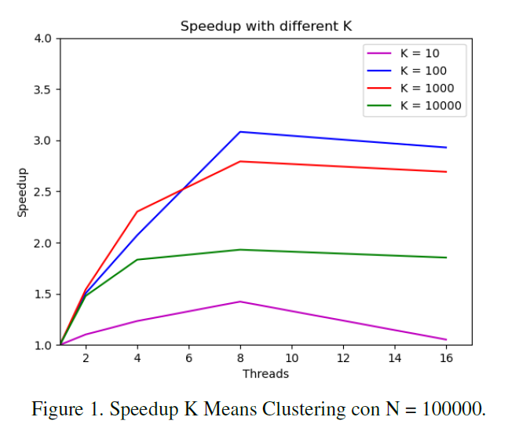
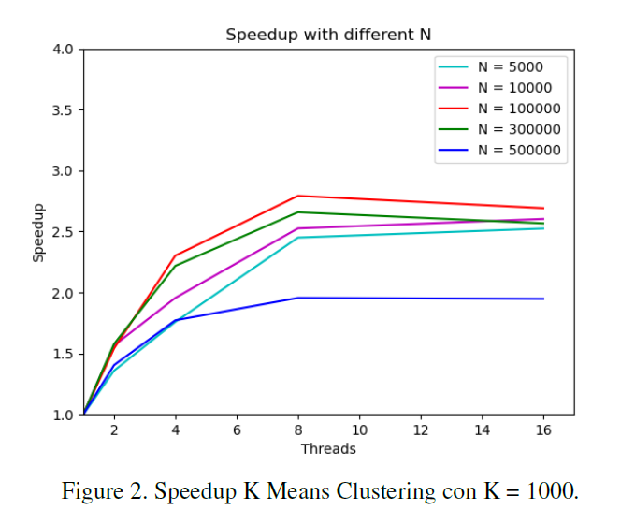
K-Means Clustering
Comparison between a sequential and parallel version
Firenze – 12/1/2023
Speedup Analysis
Speedup results with different K and N
The experiments were performed on a Intel Core i7-1165G7 with 8 logical cores.
Since the algorithm has the hyperparameter K for the number of clusters, different experiments were performed with varying K and fixed N (number of points), and viceversa.

Slide 13
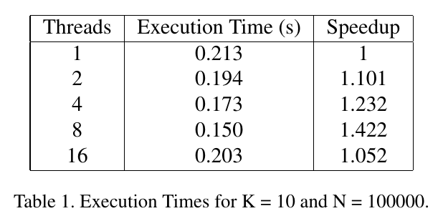
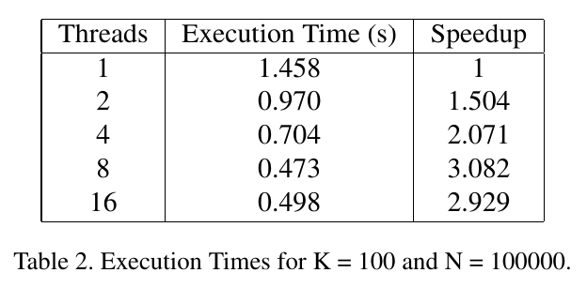
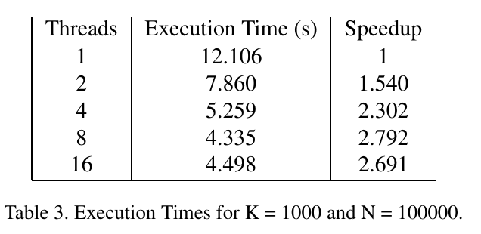
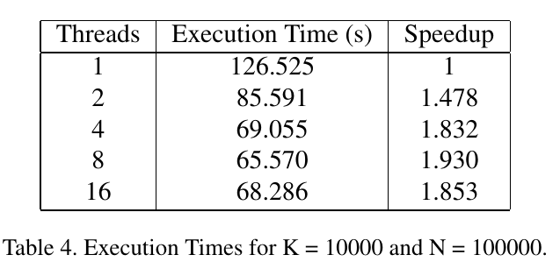
K-Means Clustering
Comparison between a sequential and parallel version
Firenze – 12/1/2023
Speedup Analysis
Execution Times

Slide 14
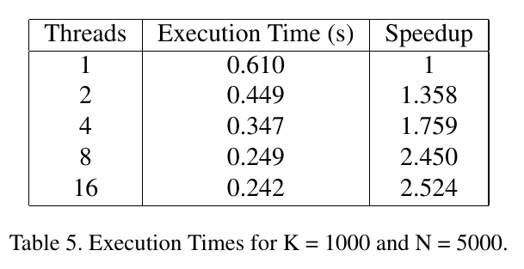
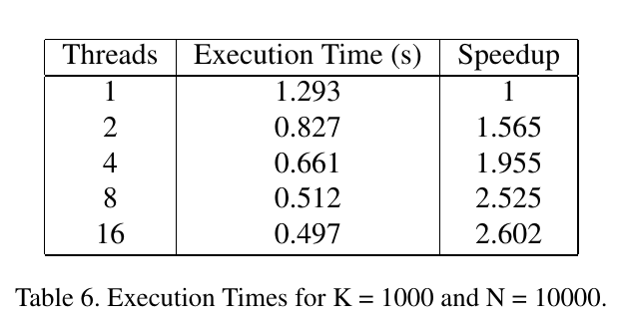
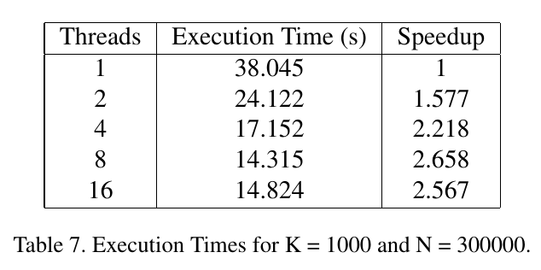
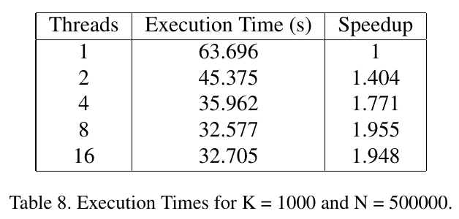
K-Means Clustering
Comparison between a sequential and parallel version
Firenze – 12/1/2023
Speedup Analysis
Execution Times

