Slide 1
Kernel Image Processing
Comparison between a sequential and parallel implementation
Beatrice Paoli
Firenze – 12/1/2023

Slide 2
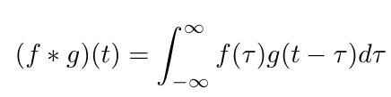
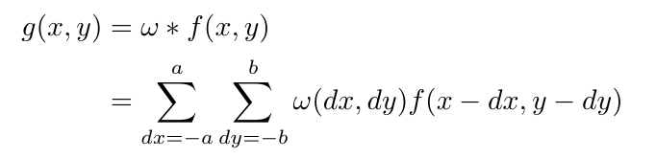
Kernel Image Processing
Comparison between a sequential and parallel version
Firenze – 12/1/2023
Introduction
Kernel Convolution
Kernel Convolution is a basic operation used in image processing to enhance or extract useful information from an image (for example, for blurring, sharpening or perform edge detection).
In general, in the continous domain, it is the integral of the product between the first and the second function translated by a certain value.
In image processing, a different definition for discreet and bidimensional values is used.

Slide 3
Kernel Image Processing
Comparison between a sequential and parallel version
Firenze – 12/1/2023
Introduction
Kernel Convolution

Slide 4
Kernel Image Processing
Comparison between a sequential and parallel version
Firenze – 12/1/2023
Introduction
Kernel Convolution
The output g of the convolution will have a smaller size than the input: if f has size WxH and ω has size nxn the output will have size (W - n + 1)x(H - n + 1) because the pixels on the edges contribute less on the convolution.
To solve this problem, we need to apply a padding to the input image borders in order to preserve the output size. There are multiple type of paddings that can be used to add these pixels:
Constant pixels: a constant pre-defined value for the pixels is used (like 0).
Pixel replication: the border pixel is replicated for the padding.
Pixel reflection: the padding pixels mirror the image from the edge.
Pixel wrapping: the padding pixels are taken from the opposite edge, as to wrap the image.

Slide 5

Kernel Image Processing
Comparison between a sequential and parallel version
Firenze – 12/1/2023
Implementation
Image loading and Gaussian kernel
The implementation is done in Python and uses Pillow and numpy.
The application first loads the image and converts it into a numpy array of shape (height, width, channels).
After that, a gaussian kernel to use for the convolution is generated: given a width and a standard deviation, a matrix is generated with each value computed as:
The convolution with this type of kernel is used to blur the input image.

Slide 6
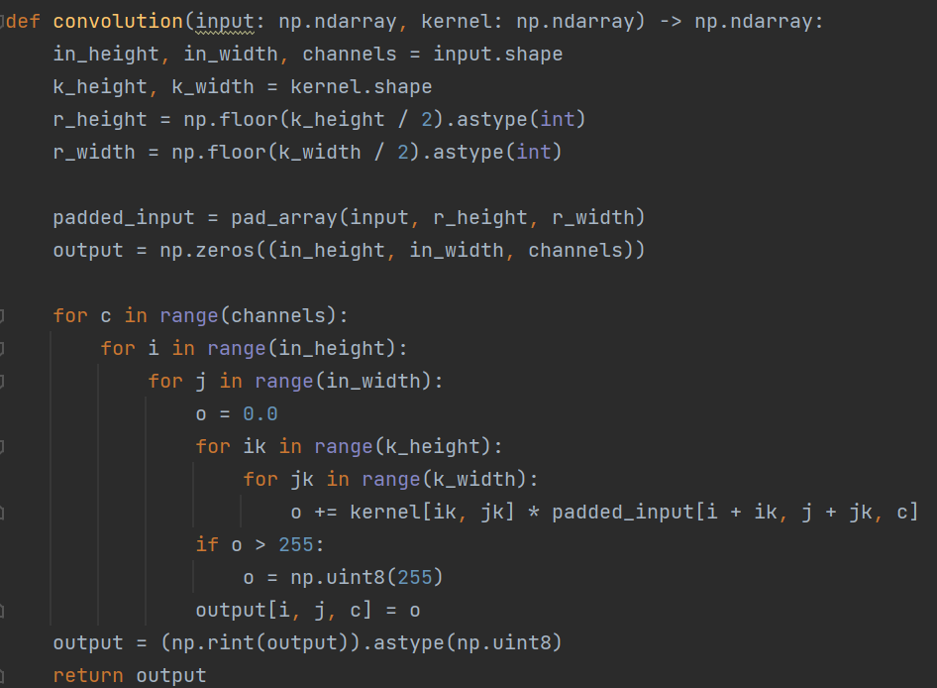
Kernel Image Processing
Comparison between a sequential and parallel version
Firenze – 12/1/2023
Implementation
Sequential Convolution

Slide 7
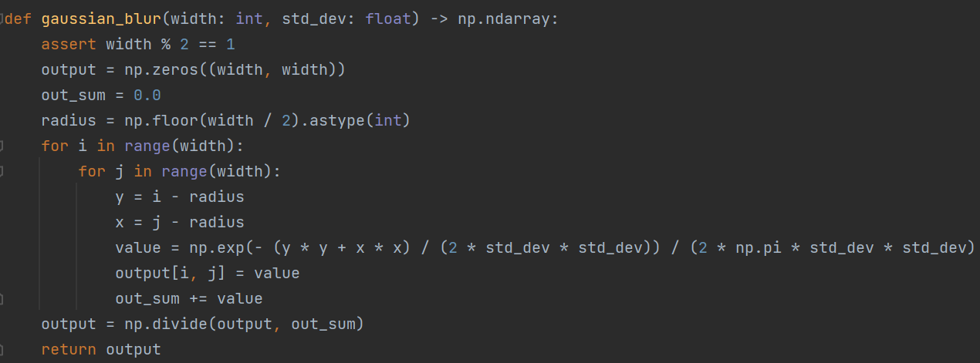
Kernel Image Processing
Comparison between a sequential and parallel version
Firenze – 12/1/2023
Implementation
Gaussian Kernel

Slide 8
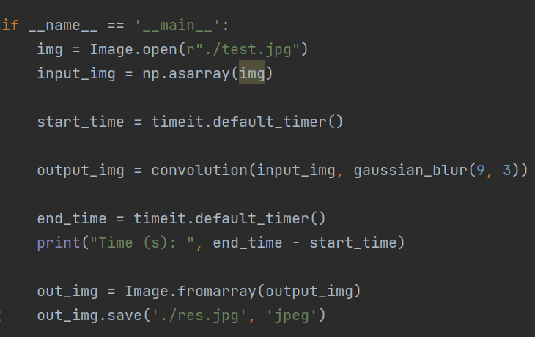
Kernel Image Processing
Comparison between a sequential and parallel version
Firenze – 12/1/2023
Implementation
Main

Slide 9
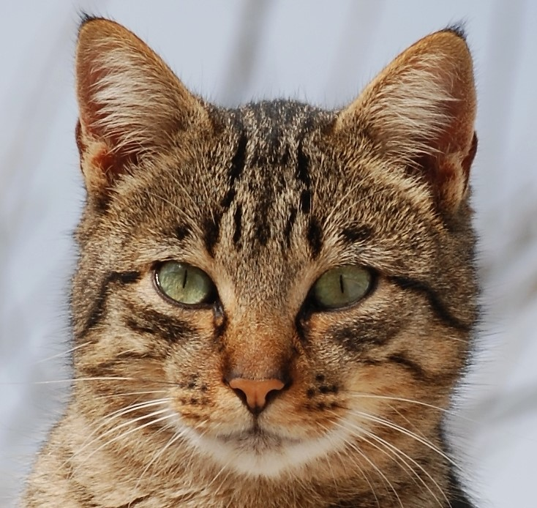

Kernel Image Processing
Comparison between a sequential and parallel version
Firenze – 12/1/2023
Result
Blur

Slide 10
Kernel Image Processing
Comparison between a sequential and parallel version
Firenze – 12/1/2023
Parallelization with Joblib
Steps
Joblib is a high-level library that allows to parallelize computation through the use of a backend library (multiprocessing or loki) by spawning processes instead of threads.
The kernel convolution algorithm is an embarassingly parallel problem: the computation of each output pixel is independent from one another, and the input image and kernel are only read, no synchronization is needed.
However, it isn't convenient to have each pixel computed independently because of the drastic increase in overhead for process management. Therefore, the image is split in sub-images, and each process computes the output for a single slice.
Another problem: each process needs the input image (a numpy array), a large object that needs to be copied every time and slows down the process instantiation. To avoid this, we can use the joblib.dump() and joblib.load() functions to save and reload the numpy array efficiently.

Slide 11
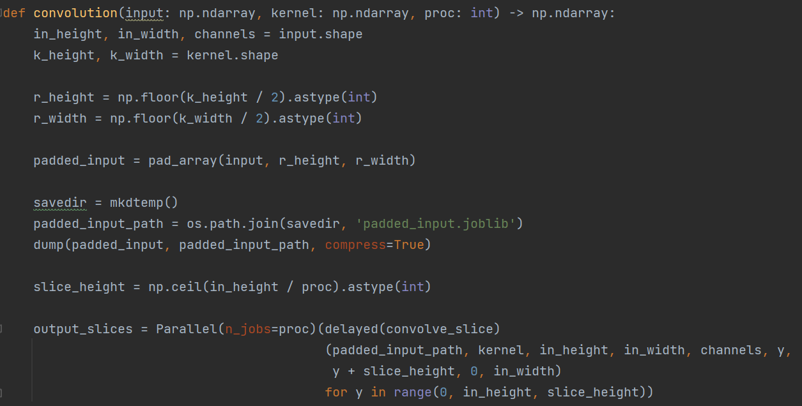
Kernel Image Processing
Comparison between a sequential and parallel version
Firenze – 12/1/2023
Parallelization with Joblib
Code

Slide 12
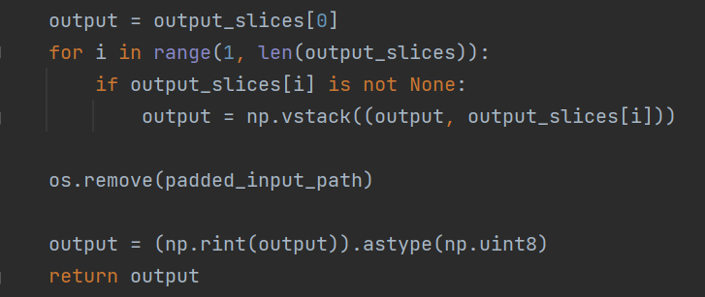
Kernel Image Processing
Comparison between a sequential and parallel version
Firenze – 12/1/2023
Parallelization with Joblib
Code

Slide 13
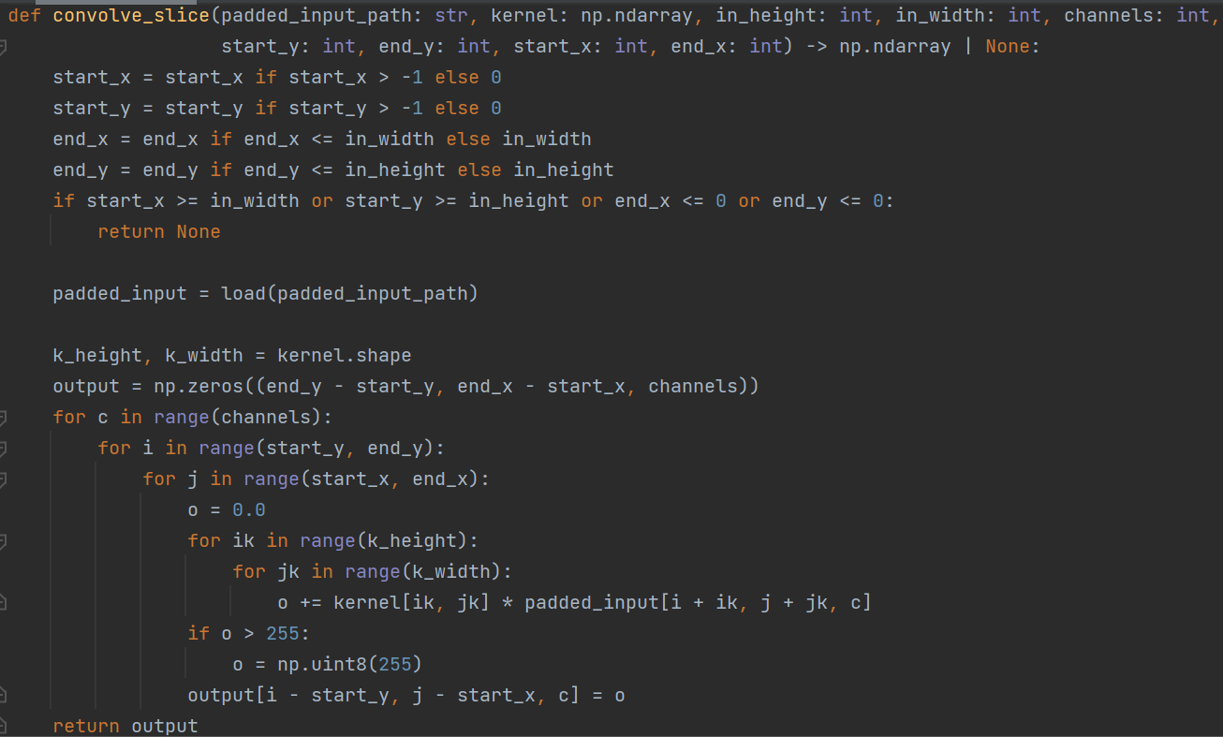
Kernel Image Processing
Comparison between a sequential and parallel version
Firenze – 12/1/2023
Parallelization with Joblib
Code

Slide 14

Kernel Image Processing
Comparison between a sequential and parallel version
Firenze – 12/1/2023
Speedup Analysis
Definition
In order to compare the performance of a sequential algorithm with its parallel version we can use the concept of speedup.
Speedup is measured as the ratio between the execution time of the sequential algorithm and the parallel one.
Ideally, we should look for perfect speedup or even linear speedup, meaning S should be equal or similar to the number of processors used to perform the parallel algorithm.

Slide 15
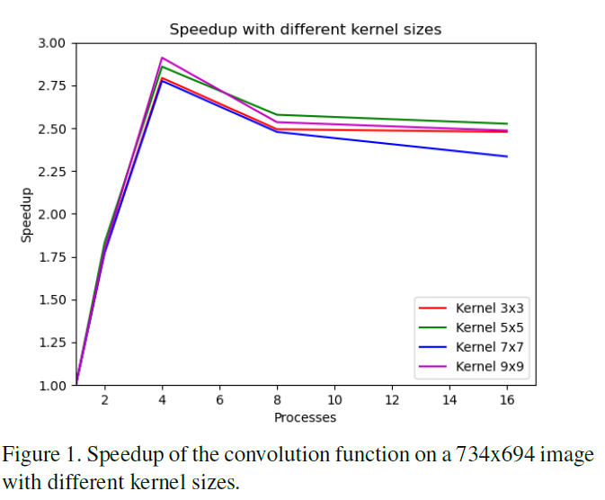
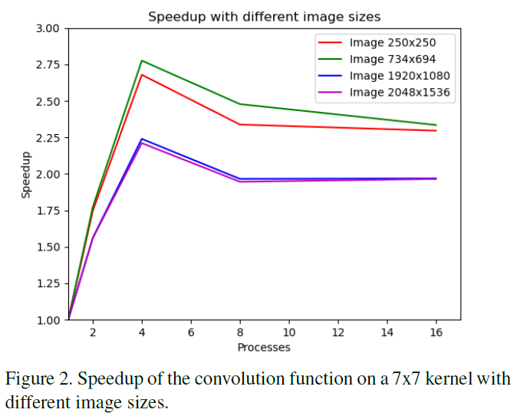
Kernel Image Processing
Comparison between a sequential and parallel version
Firenze – 12/1/2023
Speedup Analysis
Speedup results with different K and N
The experiments were performed on a Intel Core i7-1165G7 with 4 physical cores 8 logical cores.
To evaluate the application performance, different images and kernel sizes were used.

Slide 16
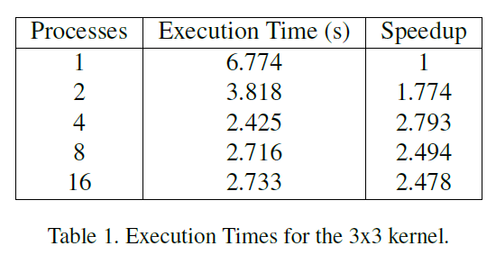
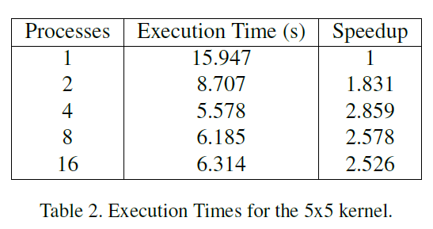
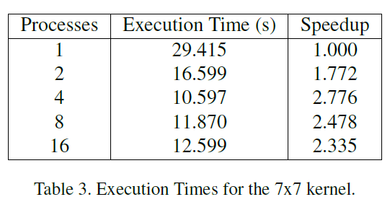
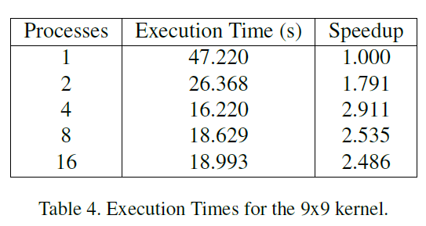
Kernel Image Processing
Comparison between a sequential and parallel version
Firenze – 12/1/2023
Speedup Analysis
Execution Times

Slide 17
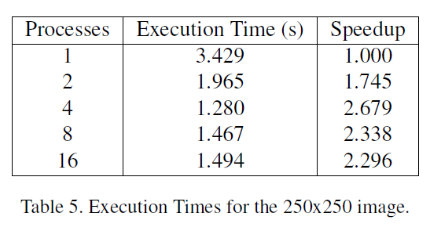
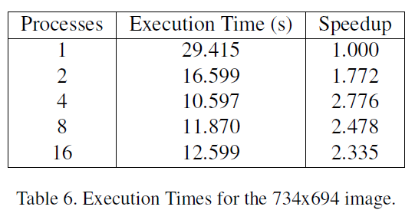
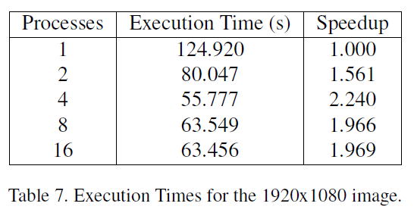
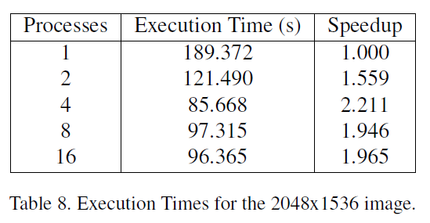
Kernel Image Processing
Comparison between a sequential and parallel version
Firenze – 12/1/2023
Speedup Analysis
Execution Times

