Slide 1
Local Binary Pattern
Comparison between a sequential and parallel implementation
Beatrice Paoli
Firenze – 2/2/2023

Slide 2
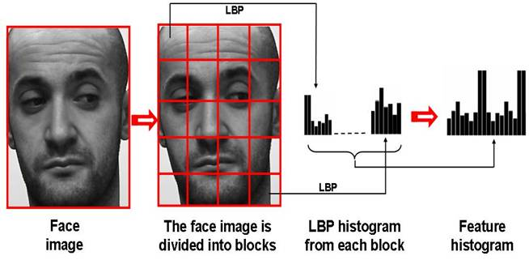
Local Binary Pattern
Comparison between a sequential and parallel version
Firenze – 2/2/2023
Introduction
Local Binary Pattern
Local Binary Pattern (LBP) is a simple and efficient texture descriptor that labels each pixel of a grayscale image with a binary number based on the neighboring pixels in order to create a local representation of the texture.
The histogram obtained from the occurrences of these labels can be used as a texture descriptor.

Slide 3
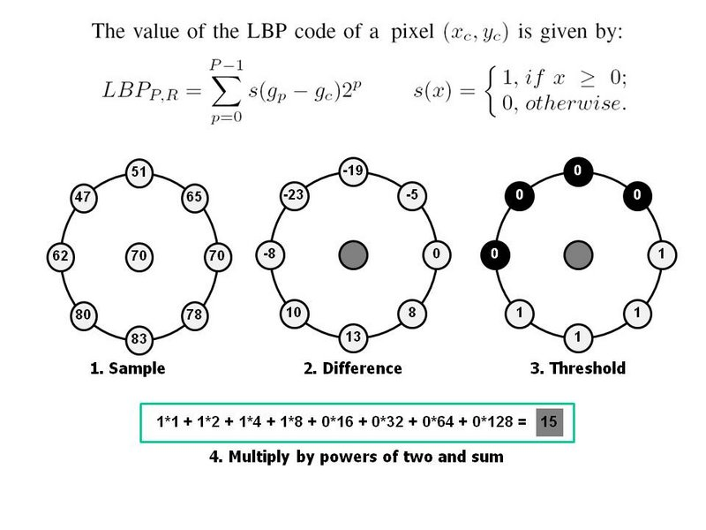
Local Binary Pattern
Comparison between a sequential and parallel version
Firenze – 2/2/2023
Introduction
Local Binary Pattern

Slide 4
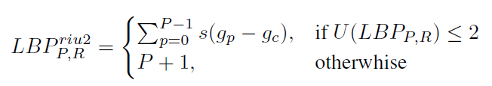
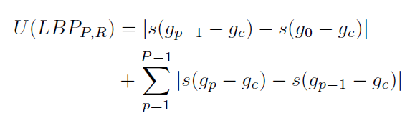
Local Binary Pattern
Comparison between a sequential and parallel version
Firenze – 2/2/2023
Introduction
Local Binary Pattern – Uniform Patterns
A circular neighbourhood of pixels is said to have a uniform pattern if there are few spatial transitions.
More formally, we define the function U that calculates the number of spatial transitions (bitwise 0/1 changes) in the neighbourhood pattern. Only patterns with a value of U of at most 2 are considered uniform.

Slide 5
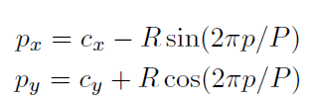
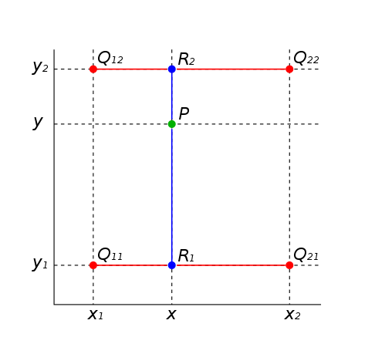


Local Binary Pattern
Comparison between a sequential and parallel version
Firenze – 2/2/2023
Introduction
Bilinear Interpolation
If cx and cy are the coordinates of the center pixel, the coordinates of each neighbour pixel p can be computed as
If these coordinates don't end into the center of a pixel, the grayscale value is bilinearly interpolated.
If only one of the coordinates needs to be interpolated:

Slide 6
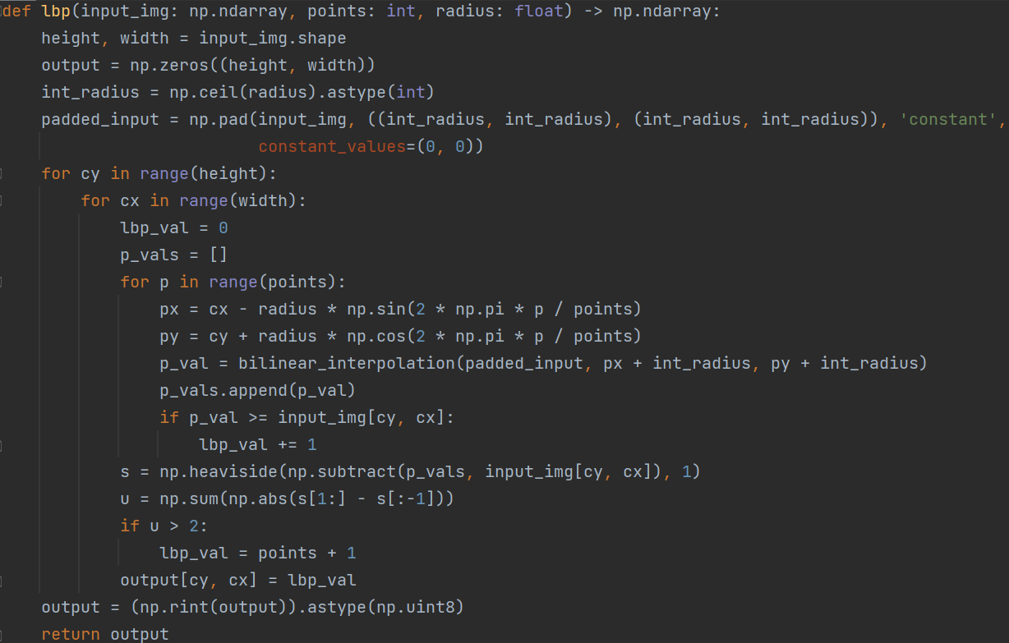
Local Binary Pattern
Comparison between a sequential and parallel version
Firenze – 2/2/2023
Implementation
Sequential LBP

Slide 7
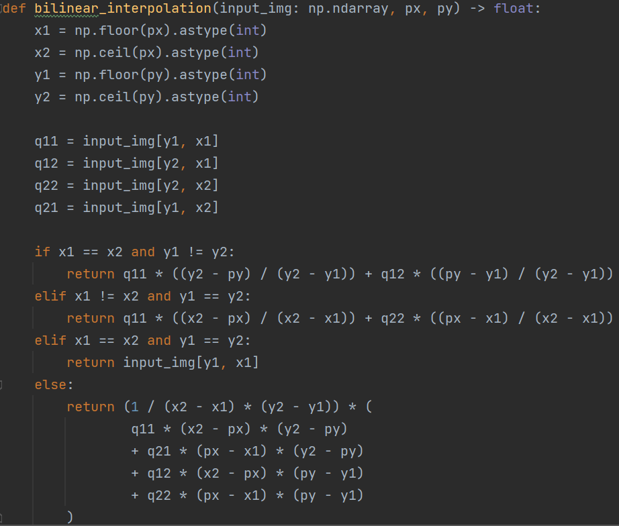
Local Binary Pattern
Comparison between a sequential and parallel version
Firenze – 2/2/2023
Implementation
Interpolation

Slide 8
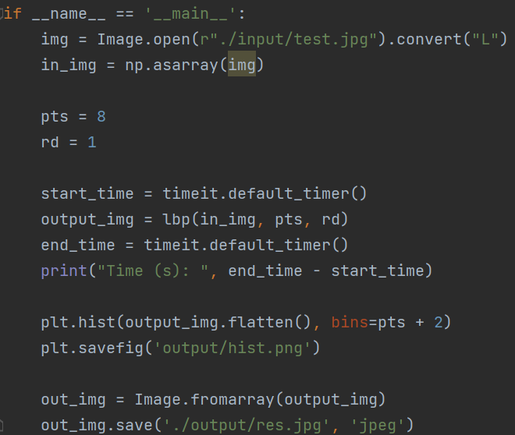
Local Binary Pattern
Comparison between a sequential and parallel version
Firenze – 2/2/2023
Implementation
Main

Slide 9
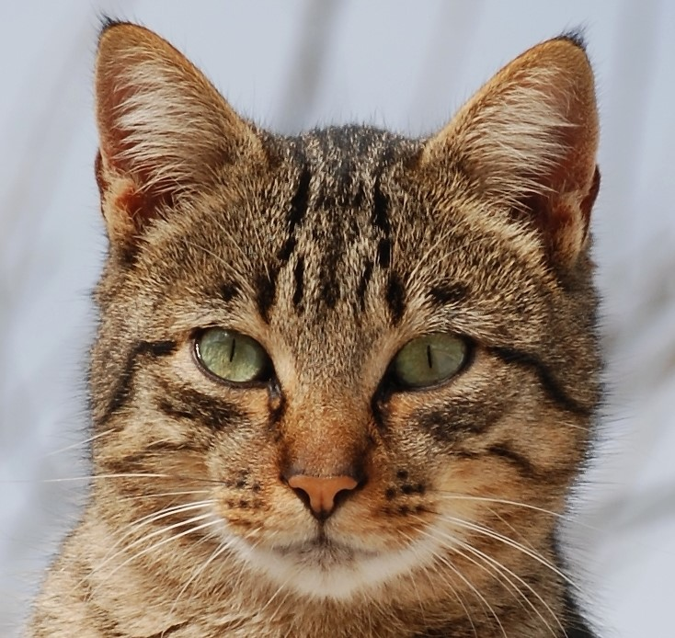
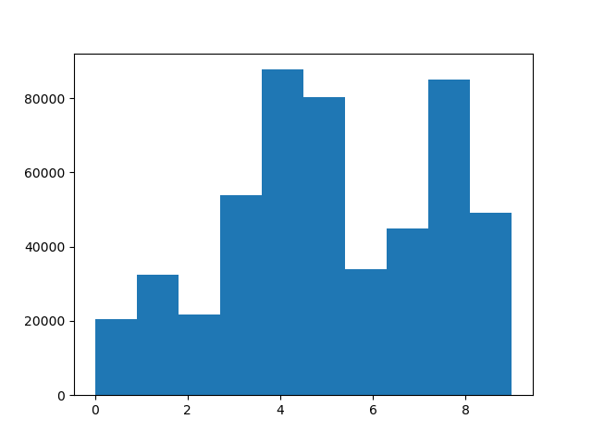
Local Binary Pattern
Comparison between a sequential and parallel version
Firenze – 2/2/2023
Result
Histogram

Slide 10
Local Binary Pattern
Comparison between a sequential and parallel version
Firenze – 2/2/2023
Parallelization with Joblib
Steps
Joblib is a high-level library that allows to parallelize computation through the use of a backend library (multiprocessing or loki) by spawning processes instead of threads.
The LBP algorithm is an embarassingly parallel problem: the computation of each output pixel is independent from one another, and the input image is only read, no synchronization is needed.
However, it isn't convenient to have each pixel computed independently because of the drastic increase in overhead for process management. Therefore, the image is split in sub-images, and each process computes the output for a single slice.
Another problem: each process needs the input image (a numpy array), a large object that needs to be copied every time and slows down the process instantiation. To avoid this, we can use the joblib.dump() and joblib.load() functions to save and reload the numpy array efficiently.

Slide 11
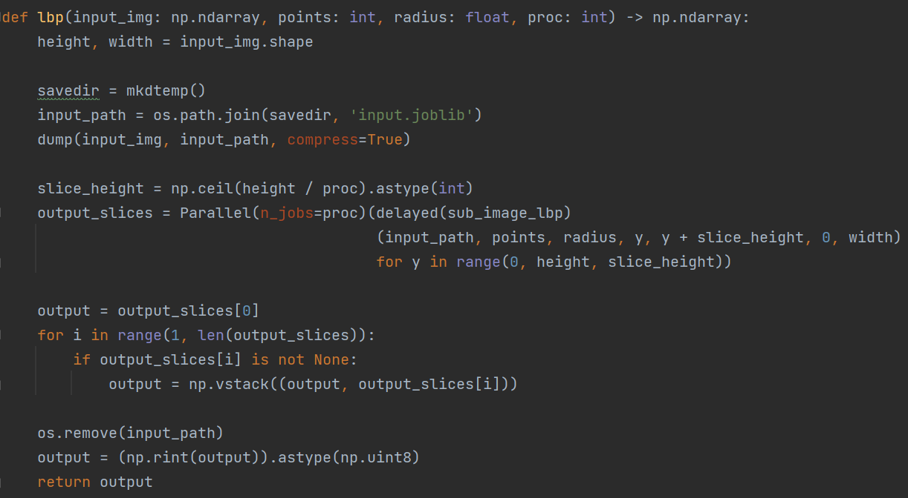
Local Binary Pattern
Comparison between a sequential and parallel version
Firenze – 2/2/2023
Parallelization with Joblib
Code

Slide 12
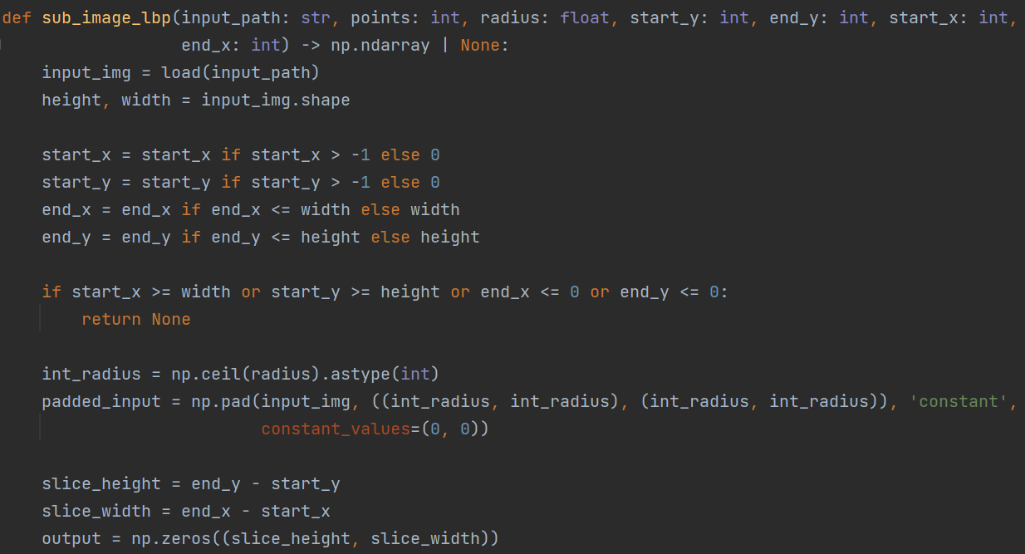
Local Binary Pattern
Comparison between a sequential and parallel version
Firenze – 2/2/2023
Parallelization with Joblib
Code

Slide 13
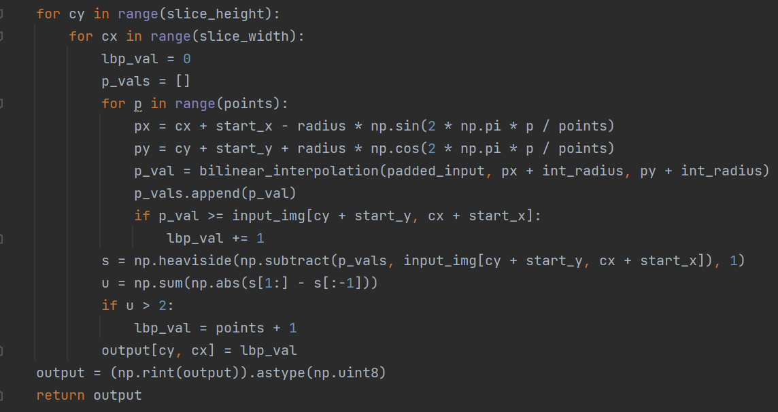
Local Binary Pattern
Comparison between a sequential and parallel version
Firenze – 2/2/2023
Parallelization with Joblib
Code

Slide 14

Local Binary Pattern
Comparison between a sequential and parallel version
Firenze – 2/2/2023
Speedup Analysis
Definition
In order to compare the performance of a sequential algorithm with its parallel version we can use the concept of speedup.
Speedup is measured as the ratio between the execution time of the sequential algorithm and the parallel one.
Ideally, we should look for perfect speedup or even linear speedup, meaning S should be equal or similar to the number of processors used to perform the parallel algorithm.

Slide 15
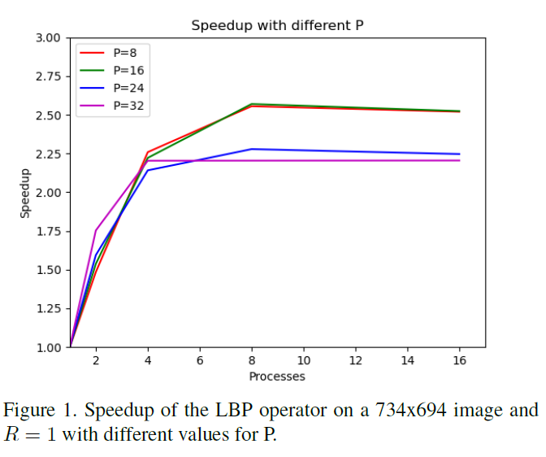
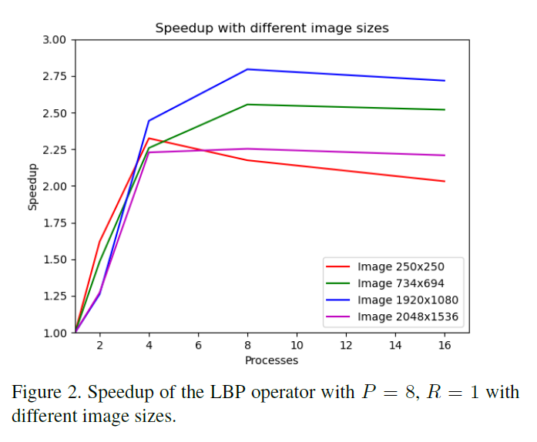
Local Binary Pattern
Comparison between a sequential and parallel version
Firenze – 2/2/2023
Speedup Analysis
Speedup results with different K and N
The experiments were performed on a Intel Core i7-1165G7 with 4 physical cores 8 logical cores.
To evaluate the application performance, different images and values for the parameter P were used.

Slide 16
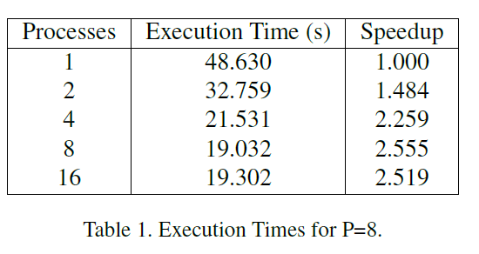
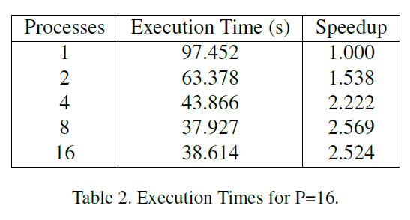
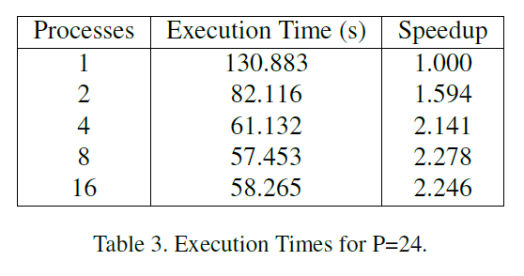
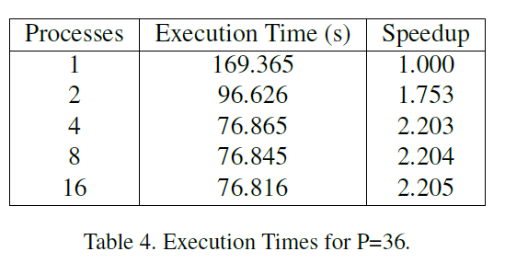
Local Binary Pattern
Comparison between a sequential and parallel version
Firenze – 2/2/2023
Speedup Analysis
Execution Times

Slide 17
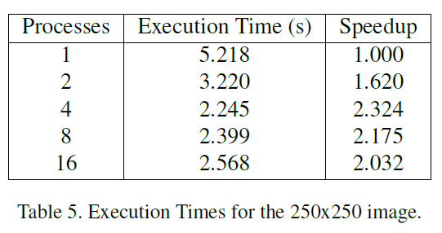
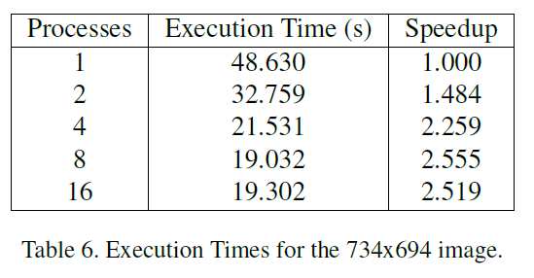
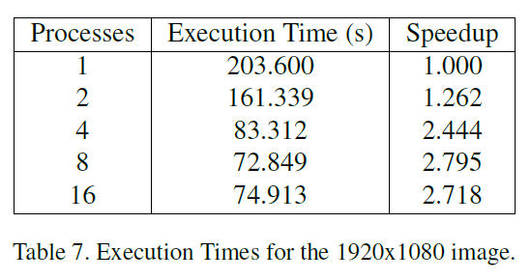
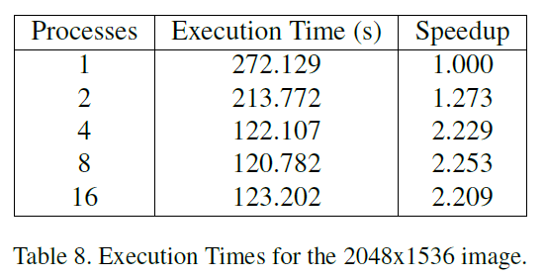
Local Binary Pattern
Comparison between a sequential and parallel version
Firenze – 2/2/2023
Speedup Analysis
Execution Times

Slide 18
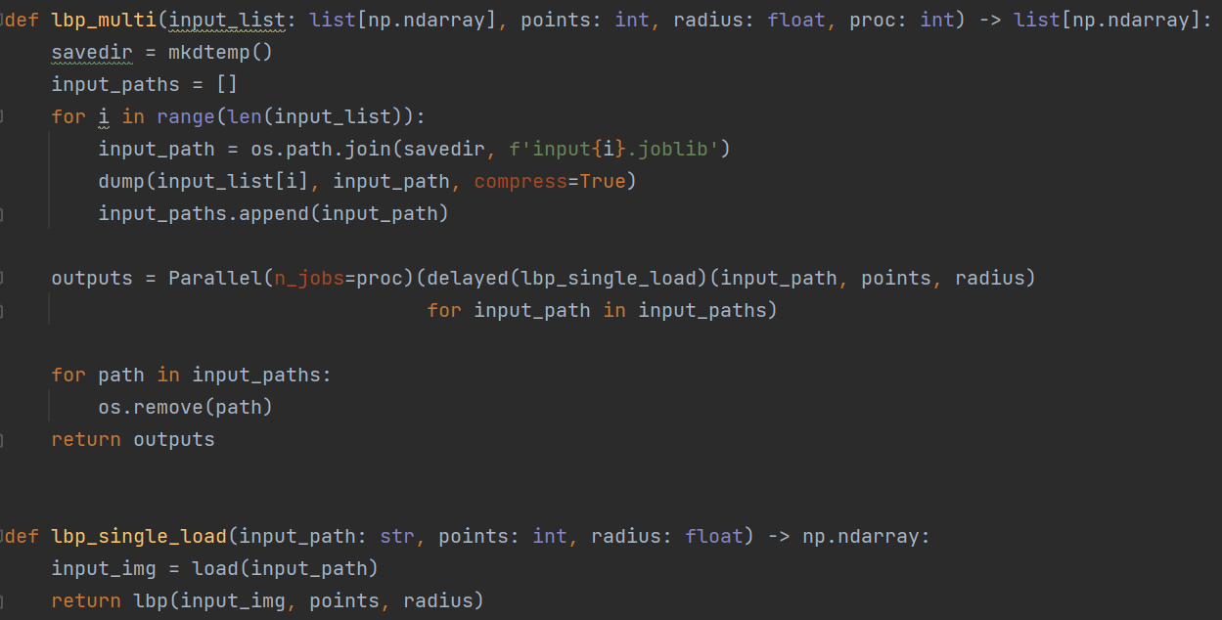
Local Binary Pattern
Comparison between a sequential and parallel version
Firenze – 2/2/2023
Parallelization with Joblib
Code

Slide 19
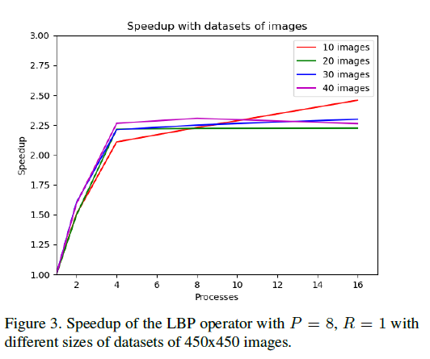
Local Binary Pattern
Comparison between a sequential and parallel version
Firenze – 2/2/2023
Speedup Analysis
Speedup results with different datasets

Slide 20
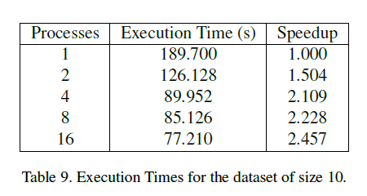
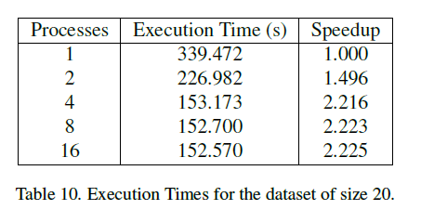
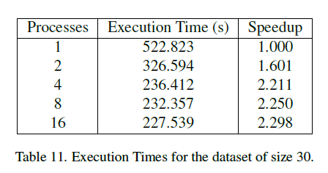
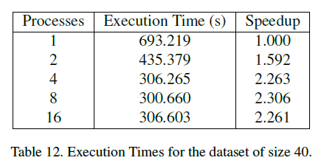
Local Binary Pattern
Comparison between a sequential and parallel version
Firenze – 2/2/2023
Speedup Analysis
Execution Times

