Slide 1
Project 2
By: Beatriz Rodriguez

Slide 2
OBJECTIVE:
The objective of this project is to create a visual representations of suicide rates in 40 different countries over 19 years.

Slide 3


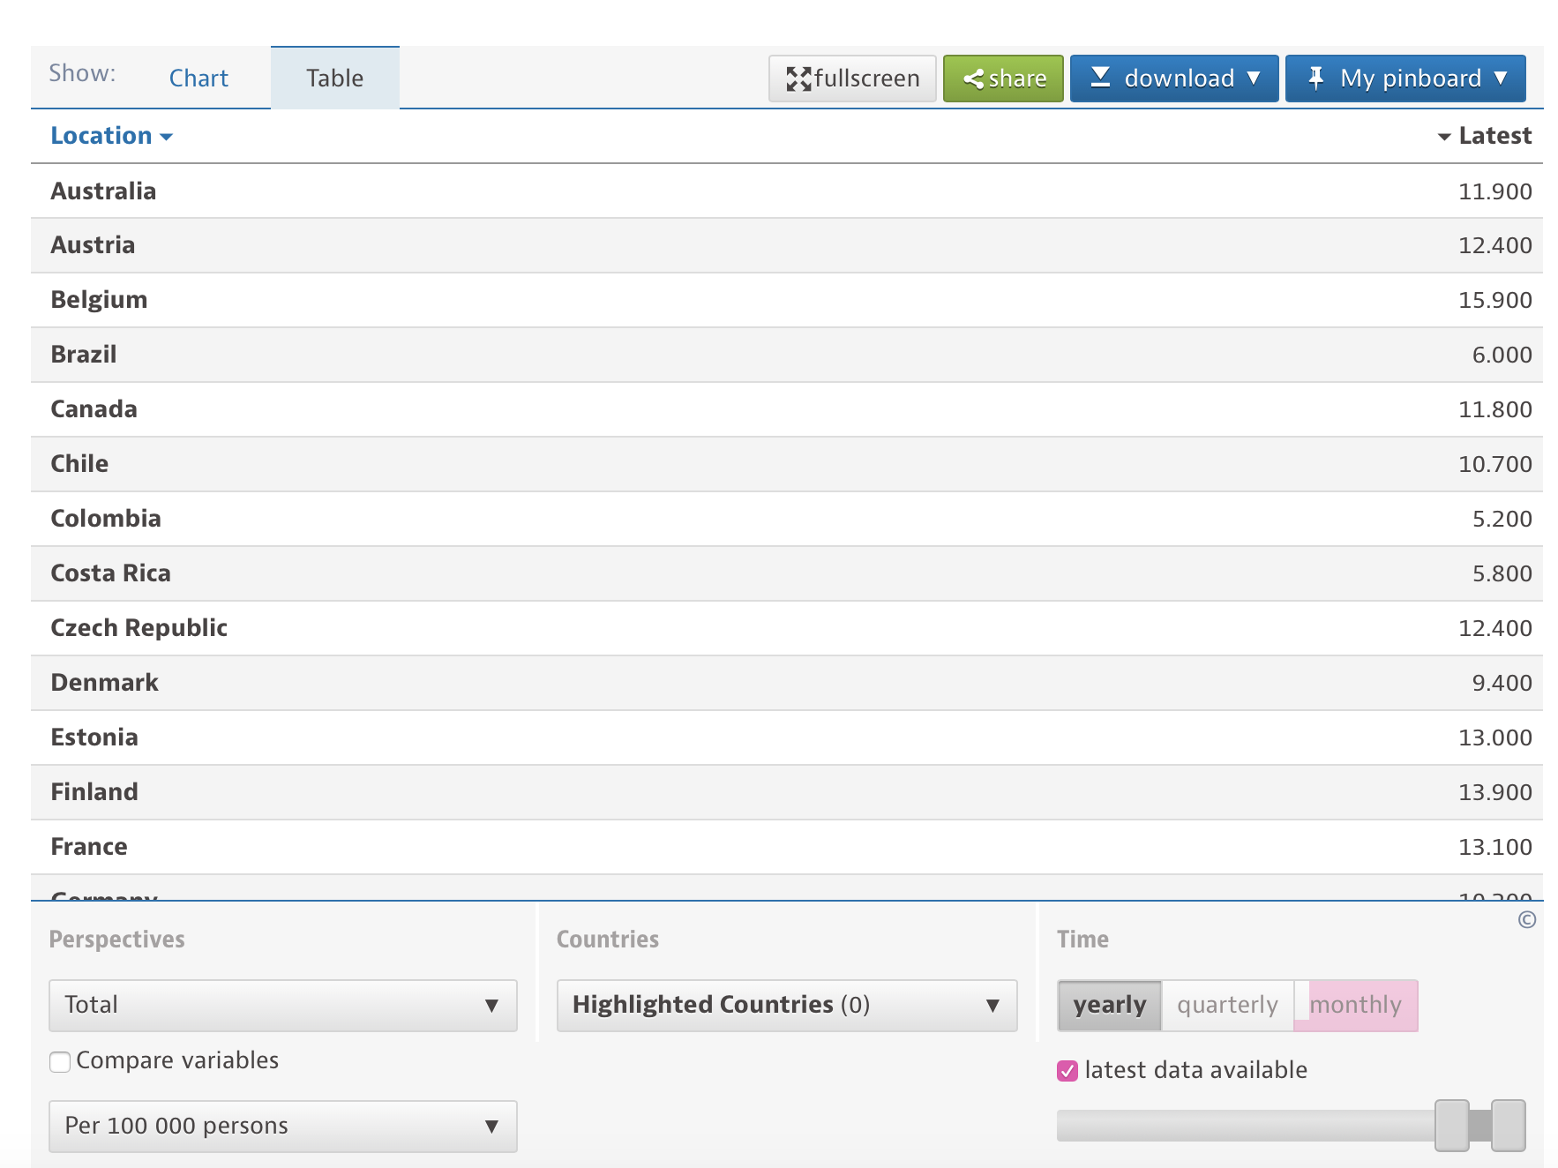
DATA SOURCE:
OECD Data - Suicide Rates
https://data.oecd.org/healthstat/suicide-rates.htm

Slide 4
DATA CLEAN UP AND DATABASE:
Used Python pandas on Jupyter notebook to clean up raw data.
Create database with SQLite Browser.
Export Jupyter notebook table onto new database.

Slide 5
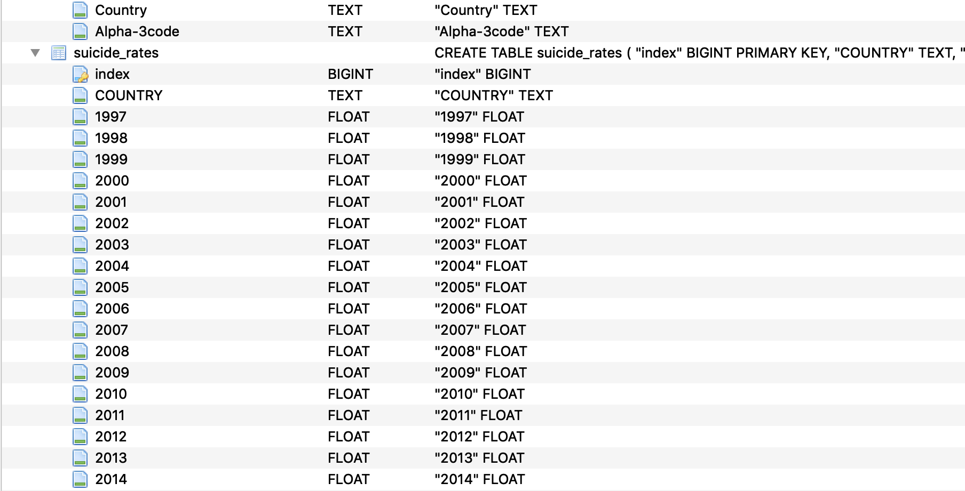

Slide 6
LANGUAGES:
Python - Programming Language
Flask
Pandas
Javascript - Programming Language
D3 - Data-Driven Documents
D3.GeoJSON - projection format
Plotly – Graphing framework
CSS - Style Sheet Language
Bootstrap
d3Style
HTML - Mark up language

Slide 7
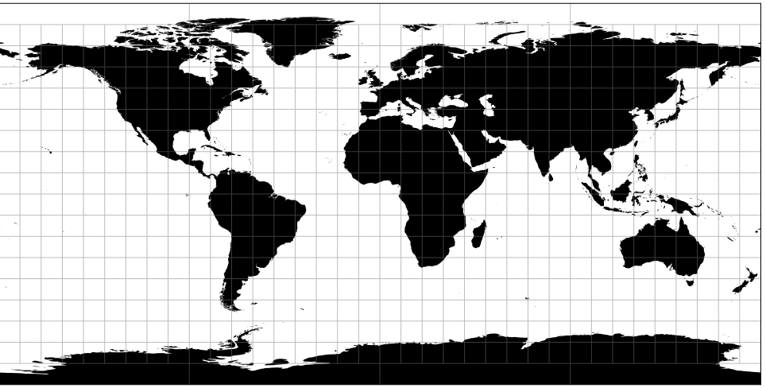
D3 – projection:
(d3.geoEquirectangular)

Slide 8
OTHER TECHNOLOGIES
USED:
Heroku – Platform used to run application

Slide 9
https://suicide-rates-project.herokuapp.com

