Slide 1


Coordinated Ambulance Location and Dispatching among Different Service Providers
Beatriz A. García Ramos, M.Sc.
Roger Z. Ríos Mercado, Ph.D.
Yasmín A. Ríos Solís, Ph.D.

Slide 2
Agenda
Introduction
Problem description
Solution Methods
Experiments
Future work

Slide 3


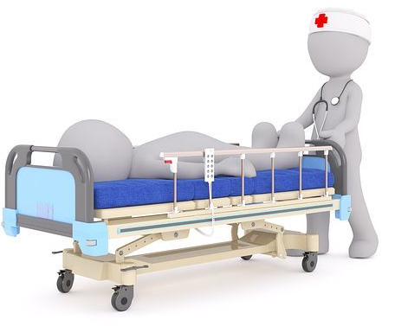
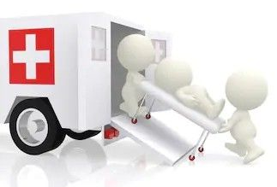

Emergency Medical Service (EMS) System

Slide 4

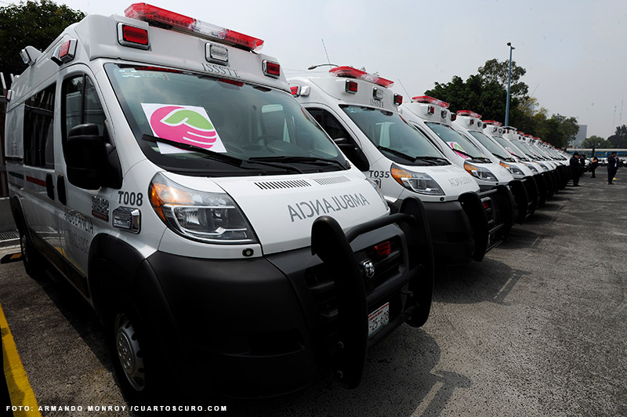

Motivation
World Health Organization (WHO) established there should be four ambulances per 100 thousand inhabitants.
More than 232 ambulances are needed for Nuevo León, approximately.
5,784,442 inhabitants in Nuevo León (2020).

Slide 5
Objective
Our objective is the implementation of models and algorithms that provide a solution to the problem in order to locate the available ambulances in an optimal way and create optimal dispatch policies to determine the ambulances that must be sent to the different emergency calls that enter the system, providing the best service to patients.

Slide 6
Hypothesis
The ambulance location and dispatch problem for a medical emergency system where there is uncertainty about the system demand, can be represented by a stochastic programming model, whose objective function is maximize the number of incoming calls to be covered in an adequate time to ensure the survival of patients.

Slide 7

Problem features
Potential sites. Set $L.$
Potential sites. Set 𝐿.
Demand points. Set $I.$
Demand points. Set 𝐼.
Ambulance types. Set $K.$
Ambulance types. Set 𝐾.

Slide 8

Problem features
Potential sites. Set $L.$
Potential sites. Set 𝐿.
Demand points. Set $I.$
Demand points. Set 𝐼.
Ambulance types. Set $K.$
Ambulance types. Set 𝐾.

Slide 9

Problem features
Potential sites. Set $L.$
Potential sites. Set 𝐿.
Demand points. Set $I.$
Demand points. Set 𝐼.
Ambulance types. Set $K.$
Ambulance types. Set 𝐾.

Slide 10


Problem features
Potential sites. Set $L.$
Potential sites. Set 𝐿.
Demand points. Set $I.$
Demand points. Set 𝐼.
Ambulance types. Set $K.$
Ambulance types. Set 𝐾.
Advanced Life Support (ALS)
Basic Life Support (BLS)

Slide 11
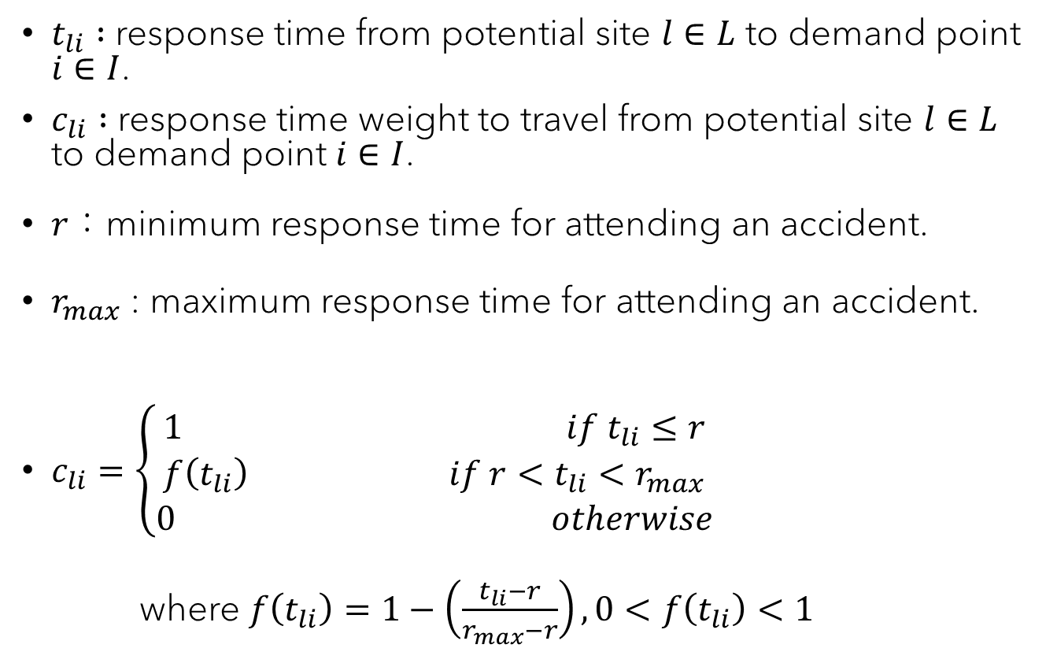
Problem features
$t_{li} :$ response time from potential site $l∈L$ to demand point $i∈I$.
$c_{li} :$ response time weight to travel from potential site $l∈L$ to demand point $i∈I$.
$r$ : minimum response time for attending an accident.
$r_{max}$ : maximum response time for attending an accident.
$c_{li}=\left\{\begin{aligned}1 if t_{li}≤r \\ f\left(t_{li}\right) if r<t_{li}<r_{max} \\ 0 otherwise\end{aligned}\right.$
where $f\left(t_{li}\right)=1−\left(\frac{t_{li}−r}{r_{max}−r}\right), 0<f\left(t_{li}\right)<1$

Slide 12





Problem features
$t_{li} :$ response time from potential site $l∈L$ to demand point $i∈I$.
$c_{li} :$ response time weight to travel from potential site $l∈L$ to demand point $i∈I$.
$r$ : minimum response time for attending an accident.
$r_{max}$ : maximum response time for attending an accident.
$c_{li}=\left\{\begin{aligned}1 if t_{li}≤r \\ f\left(t_{li}\right) if r<t_{li}<r_{max} \\ 0 otherwise\end{aligned}\right.$
where $f\left(t_{li}\right)=1−\left(\frac{t_{li}−r}{r_{max}−r}\right), 0<f\left(t_{li}\right)<1$
$$r_{max}$$
$$r$$
$$f\left(t_{li}\right)$$
$$i$$

Slide 13



Coverage types
Full coverage:
$Full$: Every ambulances was deployed to cover an accident and all have $c_{li}=1 ∀ y_{lvi}^{s}$.
Suppose we have an accident that needs 2 ambulances type BLS and 1 ambulance type ALS.
$$r_{max}$$
$$r$$

Slide 14

Coverage types
Full coverage:
$Full$: Every ambulances was deployed to cover an accident and all have $c_{li}=1 ∀ y_{lvi}^{s}$.
Partial coverage:
$Partial 1$: All ambulances were deployed to cover an accident but at leat one of them has$0<c_{li}<1.$
Suppose we have an accident that needs 2 ambulances type BLS and 1 ambulance type ALS.
$$r_{max}$$
$$r$$

Slide 15
Coverage types
Full coverage:
$Full$: Every ambulances was deployed to cover an accident and all have $c_{li}=1 ∀ y_{lvi}^{s}$.
Partial coverage:
$Partial 1$: All ambulances were deployed to cover an accident but at leat one of them has$0<c_{li}<1.$
Suppose we have an accident that needs 2 ambulances type BLS and 1 ambulance type ALS.
$$r_{max}$$
$$r$$

Slide 16
Coverage types
Full coverage:
$Full$: Every ambulances was deployed to cover an accident and all have $c_{li}=1 ∀ y_{lvi}^{s}$.
Partial coverage:
$Partial 1$: All ambulances were deployed to cover an accident but at leat one of them has$0<c_{li}<1.$
Suppose we have an accident that needs 2 ambulances type BLS and 1 ambulance type ALS.
$$r_{max}$$
$$r$$

Slide 17
Coverage types
Full coverage:
$Full$: Every ambulances was deployed to cover an accident and all have $c_{li}=1 ∀ y_{lvi}^{s}$.
Partial coverage:
$Partial 1$: All ambulances were deployed to cover an accident but at leat one of them has$0<c_{li}<1.$
Suppose we have an accident that needs 2 ambulances type BLS and 1 ambulance type ALS.
$$r_{max}$$
$$r$$

Slide 18
Coverage types
Full coverage:
$Full$: Every ambulances was deployed to cover an accident and all have $c_{li}=1 ∀ y_{lvi}^{s}$.
Partial coverage:
$Partial 1$: All ambulances were deployed to cover an accident but at leat one of them has$0<c_{li}<1.$
Suppose we have an accident that needs 2 ambulances type BLS and 1 ambulance type ALS.
$$r_{max}$$
$$r$$

Slide 19


Coverage types
Full coverage:
$Full$: Every ambulances was deployed to cover an accident and all have $c_{li}=1 ∀ y_{lvi}^{s}$.
Partial coverage:
$Partial 1$: All ambulances were deployed to cover an accident but at leat one of them has$0<c_{li}<1.$
$Partial 2:$ Not all ambulances were deployed to cover an accident but all of them have $c_{li}=1 ∀ y_{lvi}^{s}.$
$Partial 3:$ Not all ambulances were deployed to cover an accident and at least one of them has$0<c_{li}<1.$
Null coverage:
$Null:$No ambulance was deployed.
Full coverage:
$Full$: Every ambulances was deployed to cover an accident and all have $c_{li}=1 ∀ y_{lvi}^{s}$.
Partial coverage:
$Partial 1$: All ambulances were deployed to cover an accident but at leat one of them has$0<c_{li}<1.$
$Partial 2:$ Not all ambulances were deployed to cover an accident but all of them have $c_{li}=1 ∀ y_{lvi}^{s}.$
Suppose we have an accident that needs 2 ambulances type BLS and 1 ambulance type ALS.
$$r_{max}$$
$$r$$

Slide 20
Coverage types
Full coverage:
$Full$: Every ambulances was deployed to cover an accident and all have $c_{li}=1 ∀ y_{lvi}^{s}$.
Partial coverage:
$Partial 1$: All ambulances were deployed to cover an accident but at leat one of them has$0<c_{li}<1.$
$Partial 2:$ Not all ambulances were deployed to cover an accident but all of them have $c_{li}=1 ∀ y_{lvi}^{s}.$
$Partial 3:$ Not all ambulances were deployed to cover an accident and at least one of them has$0<c_{li}<1.$
Null coverage:
$Null:$No ambulance was deployed.
Full coverage:
$Full$: Every ambulances was deployed to cover an accident and all have $c_{li}=1 ∀ y_{lvi}^{s}$.
Partial coverage:
$Partial 1$: All ambulances were deployed to cover an accident but at leat one of them has$0<c_{li}<1.$
$Partial 2:$ Not all ambulances were deployed to cover an accident but all of them have $c_{li}=1 ∀ y_{lvi}^{s}.$
Suppose we have an accident that needs 2 ambulances type BLS and 1 ambulance type ALS.
$$r_{max}$$
$$r$$

Slide 21
Coverage types
Full coverage:
$Full$: Every ambulances was deployed to cover an accident and all have $c_{li}=1 ∀ y_{lvi}^{s}$.
Partial coverage:
$Partial 1$: All ambulances were deployed to cover an accident but at leat one of them has$0<c_{li}<1.$
$Partial 2:$ Not all ambulances were deployed to cover an accident but all of them have $c_{li}=1 ∀ y_{lvi}^{s}.$
$Partial 3:$ Not all ambulances were deployed to cover an accident and at least one of them has$0<c_{li}<1.$
Null coverage:
$Null:$No ambulance was deployed.
Full coverage:
$Full$: Every ambulances was deployed to cover an accident and all have $c_{li}=1 ∀ y_{lvi}^{s}$.
Partial coverage:
$Partial 1$: All ambulances were deployed to cover an accident but at leat one of them has$0<c_{li}<1.$
$Partial 2:$ Not all ambulances were deployed to cover an accident but all of them have $c_{li}=1 ∀ y_{lvi}^{s}.$
Suppose we have an accident that needs 2 ambulances type BLS and 1 ambulance type ALS.
$$r_{max}$$
$$r$$

Slide 22
Coverage types
Full coverage:
$Full$: Every ambulances was deployed to cover an accident and all have $c_{li}=1 ∀ y_{lvi}^{s}$.
Partial coverage:
$Partial 1$: All ambulances were deployed to cover an accident but at leat one of them has$0<c_{li}<1.$
$Partial 2:$ Not all ambulances were deployed to cover an accident but all of them have $c_{li}=1 ∀ y_{lvi}^{s}.$
$Partial 3:$ Not all ambulances were deployed to cover an accident and at least one of them has$0<c_{li}<1.$
Null coverage:
$Null:$No ambulance was deployed.
Full coverage:
$Full$: Every ambulances was deployed to cover an accident and all have $c_{li}=1 ∀ y_{lvi}^{s}$.
Partial coverage:
$Partial 1$: All ambulances were deployed to cover an accident but at leat one of them has$0<c_{li}<1.$
$Partial 2:$ Not all ambulances were deployed to cover an accident but all of them have $c_{li}=1 ∀ y_{lvi}^{s}.$
Suppose we have an accident that needs 2 ambulances type BLS and 1 ambulance type ALS.
$$r_{max}$$
$$r$$

Slide 23

Coverage types
Full coverage:
$Full$: Every ambulances was deployed to cover an accident and all have $c_{li}=1 ∀ y_{lvi}^{s}$.
Partial coverage:
$Partial 1$: All ambulances were deployed to cover an accident but at leat one of them has$0<c_{li}<1.$
$Partial 2:$ Not all ambulances were deployed to cover an accident but all of them have $c_{li}=1 ∀ y_{lvi}^{s}.$
$Partial 3:$ Not all ambulances were deployed to cover an accident and at least one of them has$0<c_{li}<1.$
Suppose we have an accident that needs 2 ambulances type BLS and 1 ambulance type ALS.
$$r_{max}$$
$$r$$

Slide 24
Coverage types
Full coverage:
$Full$: Every ambulances was deployed to cover an accident and all have $c_{li}=1 ∀ y_{lvi}^{s}$.
Partial coverage:
$Partial 1$: All ambulances were deployed to cover an accident but at leat one of them has$0<c_{li}<1.$
$Partial 2:$ Not all ambulances were deployed to cover an accident but all of them have $c_{li}=1 ∀ y_{lvi}^{s}.$
$Partial 3:$ Not all ambulances were deployed to cover an accident and at least one of them has$0<c_{li}<1.$
Suppose we have an accident that needs 2 ambulances type BLS and 1 ambulance type ALS.
$$r_{max}$$
$$r$$

Slide 25
Coverage types
Full coverage:
$Full$: Every ambulances was deployed to cover an accident and all have $c_{li}=1 ∀ y_{lvi}^{s}$.
Partial coverage:
$Partial 1$: All ambulances were deployed to cover an accident but at leat one of them has$0<c_{li}<1.$
$Partial 2:$ Not all ambulances were deployed to cover an accident but all of them have $c_{li}=1 ∀ y_{lvi}^{s}.$
$Partial 3:$ Not all ambulances were deployed to cover an accident and at least one of them has$0<c_{li}<1.$
Suppose we have an accident that needs 2 ambulances type BLS and 1 ambulance type ALS.
$$r_{max}$$
$$r$$

Slide 26
Coverage types
Full coverage:
$Full$: Every ambulances was deployed to cover an accident and all have $c_{li}=1 ∀ y_{lvi}^{s}$.
Partial coverage:
$Partial 1$: All ambulances were deployed to cover an accident but at leat one of them has$0<c_{li}<1.$
$Partial 2:$ Not all ambulances were deployed to cover an accident but all of them have $c_{li}=1 ∀ y_{lvi}^{s}.$
$Partial 3:$ Not all ambulances were deployed to cover an accident and at least one of them has$0<c_{li}<1.$
Suppose we have an accident that needs 2 ambulances type BLS and 1 ambulance type ALS.
$$r_{max}$$
$$r$$

Slide 27
Coverage types
Full coverage:
$Full$: Every ambulances was deployed to cover an accident and all have $c_{li}=1 ∀ y_{lvi}^{s}$.
Partial coverage:
$Partial 1$: All ambulances were deployed to cover an accident but at leat one of them has$0<c_{li}<1.$
$Partial 2:$ Not all ambulances were deployed to cover an accident but all of them have $c_{li}=1 ∀ y_{lvi}^{s}.$
$Partial 3:$ Not all ambulances were deployed to cover an accident and at least one of them has$0<c_{li}<1.$
Suppose we have an accident that needs 2 ambulances type BLS and 1 ambulance type ALS.
$$r_{max}$$
$$r$$

Slide 28
Coverage types
Full coverage:
$Full$: Every ambulances was deployed to cover an accident and all have $c_{li}=1 ∀ y_{lvi}^{s}$.
Partial coverage:
$Partial 1$: All ambulances were deployed to cover an accident but at leat one of them has$0<c_{li}<1.$
$Partial 2:$ Not all ambulances were deployed to cover an accident but all of them have $c_{li}=1 ∀ y_{lvi}^{s}.$
$Partial 3:$ Not all ambulances were deployed to cover an accident and at least one of them has$0<c_{li}<1.$
Suppose we have an accident that needs 2 ambulances type BLS and 1 ambulance type ALS.
$$r_{max}$$
$$r$$

Slide 29
Coverage types
Full coverage:
$Full$: Every ambulances was deployed to cover an accident and all have $c_{li}=1 ∀ y_{lvi}^{s}$.
Partial coverage:
$Partial 1$: All ambulances were deployed to cover an accident but at leat one of them has$0<c_{li}<1.$
$Partial 2:$ Not all ambulances were deployed to cover an accident but all of them have $c_{li}=1 ∀ y_{lvi}^{s}.$
$Partial 3:$ Not all ambulances were deployed to cover an accident and at least one of them has$0<c_{li}<1.$
Suppose we have an accident that needs 2 ambulances type BLS and 1 ambulance type ALS.
$$r_{max}$$
$$r$$

Slide 30
Coverage types
Full coverage:
$Full$: Every ambulances was deployed to cover an accident and all have $c_{li}=1 ∀ y_{lvi}^{s}$.
Partial coverage:
$Partial 1$: All ambulances were deployed to cover an accident but at leat one of them has$0<c_{li}<1.$
$Partial 2:$ Not all ambulances were deployed to cover an accident but all of them have $c_{li}=1 ∀ y_{lvi}^{s}.$
$Partial 3:$ Not all ambulances were deployed to cover an accident and at least one of them has$0<c_{li}<1.$
Null coverage:
$Null:$No ambulance was deployed.
Suppose we have an accident that needs 2 ambulances type BLS and 1 ambulance type ALS.
$$r_{max}$$
$$r$$

Slide 31

Scenario-Based Ambulance Location and Dispatching (SBALD) Model
Sets and parameters
$I$ : Set of demand points
$L :$ Set of potential sites
$K$ : Set of ambulance types
$t_{li}$ : travel time from potential site $l∈L$ to demand point $i∈I$
$n_{k}$ : total number of ambulances in the system of type $k∈K$

Slide 32

SBALD Model
Sets and parameters
$S$ : Set of scenarios; tuples of accidents at demand points $i∈I$ that need ambulances of type $k_{1}∈K,$ and ambulances of type $k_{2}∈K$.
$a_{ik}^{s}$ : number of ambulances needed of type $k∈K$ at demand point $i∈I$ in scenario $s∈S$.
Scenario’s example:
For $I=\left\{1, 2, 3\right\}, K=\{1, 2\}$ and $S=\left\{1, 2\right\}$ we have
$$S=\left\{\begin{aligned}\left\{\left(0, 1\right), \left(3, 0\right), \left(2 1\right)\right\}, \\ \left\{\left(0, 0\right), \left(1, 1\right), \left(1, 2\right)\right\}\end{aligned}\right\}$$

Slide 33
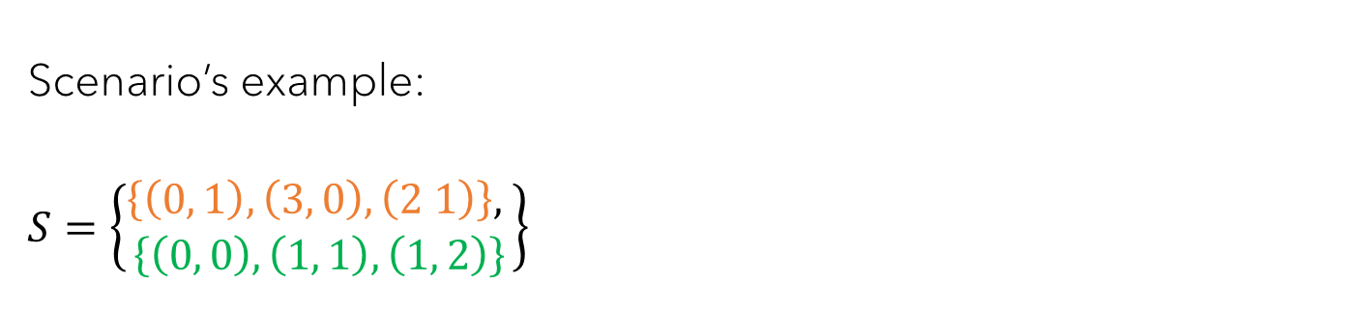
SBALD Model
Sets and parameters
Scenario’s example:
$S=\left\{\begin{aligned}\left\{\left(0, 1\right), \left(3, 0\right), \left(2 1\right)\right\}, \\ \left\{\left(0, 0\right), \left(1, 1\right), \left(1, 2\right)\right\}\end{aligned}\right\}$
3
2
1

Slide 34
SBALD Model Objective and assumptions
Maximize the expected value of accident coverage.
Same probability for all scenarios.
ALS ambulances can service non-severity accidents but not vice versa.

Slide 35

Variables
Location variables
$x_{lk}$ = number of ambulances type $k∈K$ located at potential site $l∈L$.
Dispatch variables
$y_{lki}^{s}$ = $1$ if an ambulance type $k∈K$ from potential site $l∈L$is dispatched for an accident at demand point $i∈I$ in scenario $s∈S$; $0$ otherwise.

Slide 36
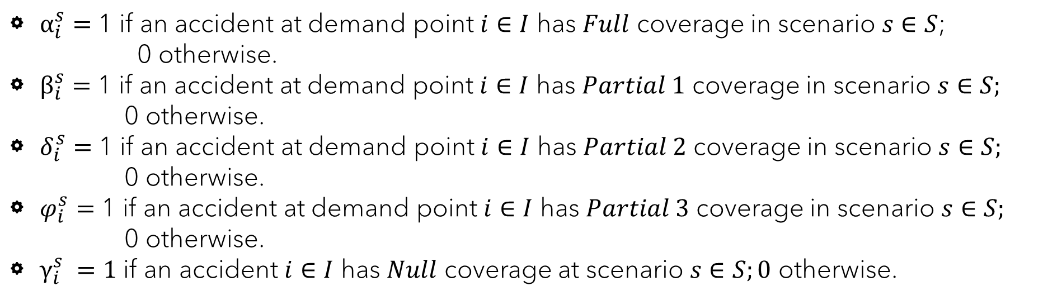
Variables
Coverage variables
$α_{i}^{s}=$ 1 if an accident at demand point $i∈I$ has $Full$ coverage in scenario $s∈S$; 0 otherwise.
$β_{i}^{s}=$ 1 if an accident at demand point $i∈I$ has $Partial 1$ coverage in scenario $s∈S;$ 0 otherwise.
$δ_{i}^{s}=$ 1 if an accident at demand point $i∈I$ has $Partial 2$ coverage in scenario $s∈S;$ 0 otherwise.
$φ_{i}^{s}=$ 1 if an accident at demand point $i∈I$ has $Partial 3$ coverage in scenario $s∈S;$ 0 otherwise.
$γ_{i}^{s} =1$ if an accident $i∈I$ has $Null$ coverage at scenario $s∈S;0$ otherwise.

Slide 37

Sets and parameters
$w_{α}:$ benefit from covering as $Full$ an accident.
$w_{β}:$ benefit from covering as $Partial 1$coverage an accident
$w_{δ}:$ benefit from covering as $Partial 2$coverage an accident
$w_{φ}:$ benefit from covering as $Partial 3$ coverage an accident
$p:$ penalty from not covering an accident, where $p=\frac{\max\left(c_{li}\right)}{|S|}+ε$

Slide 38
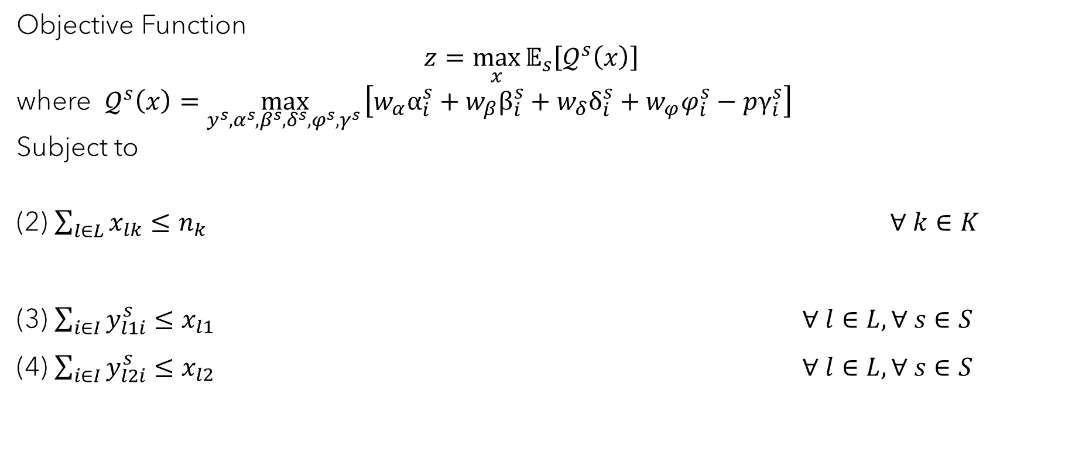
SBALD Model
Objective Function
$$z=\max_{x}{𝔼_{s}\left[𝒬^{s}\left(x\right)\right]}$$
where $𝒬^{s}\left(x\right)=\max_{y^{s}, α^{s}, β^{s}, δ^{s}, φ^{s}, γ^{s} }\left[w_{α}α_{i}^{s}+w_{β}β_{i}^{s}+w_{δ}δ_{i}^{s}+w_{φ}φ_{i}^{s}−pγ_{i}^{s}\right]$
Subject to
(2) $\sum_{l∈L}{x_{lk}}≤n_{k}$ $∀ k∈K$
(3) $\sum_{i∈I}{y_{l1i}^{s}}≤x_{l1}$ $∀ l∈L, ∀ s∈S$
(4) $\sum_{i∈I}{y_{l2i}^{s}}≤x_{l2}$ $∀ l∈L, ∀ s∈S$

Slide 39
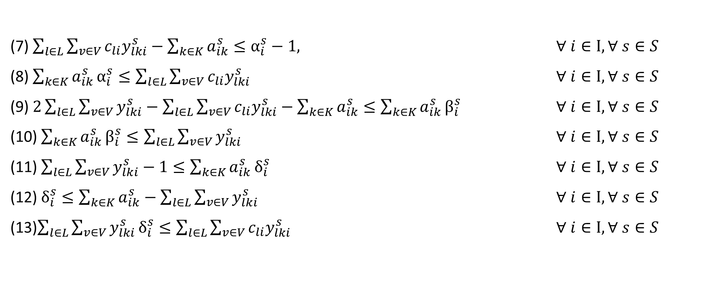
SBALD Model
(7) $\sum_{l∈L}{\sum_{v∈V}{c_{li}y_{lki}^{s}}}−\sum_{k∈K}{a_{ik}^{s}}≤α_{i}^{s}−1,$ $∀ i∈I, ∀ s∈S$
(8) $\sum_{k∈K}{a_{ik}^{s}}α_{i}^{s}≤\sum_{l∈L}{\sum_{v∈V}{c_{li}y_{lki}^{s}}}$ $∀ i∈I, ∀ s∈S$
(9) $2\sum_{l∈L}{\sum_{v∈V}{y_{lki}^{s}}}−\sum_{l∈L}{\sum_{v∈V}{c_{li}y_{lki}^{s}}}−\sum_{k∈K}{a_{ik}^{s}}≤\sum_{k∈K}{a_{ik}^{s}}β_{i}^{s}$ $∀ i∈I, ∀ s∈S$
(10) $\sum_{k∈K}{a_{ik}^{s}}β_{i}^{s}≤\sum_{l∈L}{\sum_{v∈V}{y_{lki}^{s}}}$ $∀ i∈I, ∀ s∈S$
(11) $\sum_{l∈L}{\sum_{v∈V}{y_{lki}^{s}}}−1≤\sum_{k∈K}{a_{ik}^{s}}δ_{i}^{s}$ $∀ i∈I, ∀ s∈S$
(12) $δ_{i}^{s}≤\sum_{k∈K}{a_{ik}^{s}}−\sum_{l∈L}{\sum_{v∈V}{y_{lki}^{s}}}$ $∀ i∈I, ∀ s∈S$
(13)$\sum_{l∈L}{\sum_{v∈V}{y_{lki}^{s}}}δ_{i}^{s}≤\sum_{l∈L}{\sum_{v∈V}{c_{li}y_{lki}^{s}}}$ $∀ i∈I, ∀ s∈S$

Slide 40
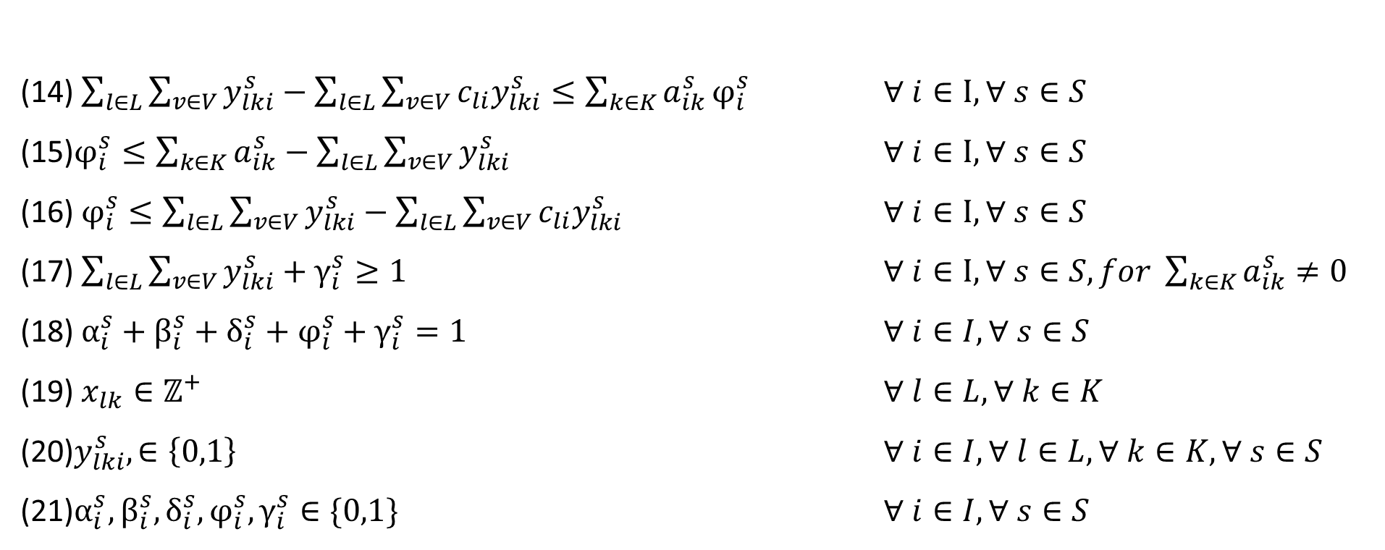
SBALD Model
(14) $\sum_{l∈L}{\sum_{v∈V}{y_{lki}^{s}}}−\sum_{l∈L}{\sum_{v∈V}{c_{li}y_{lki}^{s}}}≤\sum_{k∈K}{a_{ik}^{s}}φ_{i}^{s}$ $∀ i∈I, ∀ s∈S$
(15)$φ_{i}^{s}≤\sum_{k∈K}{a_{ik}^{s}}−\sum_{l∈L}{\sum_{v∈V}{y_{lki}^{s}}}$ $∀ i∈I, ∀ s∈S$
(16) $φ_{i}^{s}≤\sum_{l∈L}{\sum_{v∈V}{y_{lki}^{s}}}−\sum_{l∈L}{\sum_{v∈V}{c_{li}y_{lki}^{s}}}$ $∀ i∈I, ∀ s∈S$
(17) $\sum_{l∈L}{\sum_{v∈V}{y_{lki}^{s}}}+γ_{i}^{s}≥1$ $∀ i∈I, ∀ s∈S, for \sum_{k∈K}{a_{ik}^{s}}≠0$
(18) $α_{i}^{s}+β_{i}^{s}+δ_{i}^{s}+φ_{i}^{s}+γ_{i}^{s}=1$ $∀ i∈I,∀ s∈S$
(19) $x_{lk}∈ℤ^{+}$ $∀ l∈L, ∀ k∈K$
(20)$y_{lki}^{s}, ∈\left\{0,1\right\}$ $∀ i∈I, ∀ l∈L,∀ k∈K, ∀ s∈S$
(21)$α_{i}^{s}, β_{i}^{s}, δ_{i}^{s}, φ_{i}^{s}, γ_{i}^{s}∈\{0,1\}$ $∀ i∈I,∀ s∈S$

Slide 41
How to solve it?
Encoding the model in Gurobi Optimizer we obtain
I size | L size | S size | time | gap %
20 | 40 | 30 | 14.08276 | 0.119898
20 | 40 | 40 | 15.44143 | 0.134527
20 | 50 | 30 | 9.108832 | 0.162228
20 | 50 | 40 | 10.95055 | 0
20 | 70 | 30 | 16.38052 | 0
20 | 70 | 40 | 13.98547 | 0.109351
20 | 85 | 30 | 18.95625 | 0.144219
20 | 85 | 40 | 40.54161 | 0.109737
20 | 100 | 30 | 40.98202 | 0.14476
20 | 100 | 40 | 22.77708 | 0.215225
50 | 40 | 30 | 10.95833 | 0
50 | 40 | 40 | 13.34403 | 0
50 | 50 | 30 | 32.9247 | 3.612618
50 | 50 | 40 | 32.57972 | 1.124508
50 | 70 | 30 | 45.82508 | 0.026204
50 | 70 | 40 | 78.09327 | 0
50 | 85 | 30 | 47.3683 | 0.058805
50 | 85 | 40 | 60.03771 | 0
50 | 100 | 30 | 147.1494 | 0
50 | 100 | 40 | 99.44417 | 0.022079
80 | 40 | 30 | 22.71431 | 0.009784
80 | 40 | 40 | 25.75802 | 0.017439
80 | 50 | 30 | 69.27808 | 0
80 | 50 | 40 | 101.6029 | 0
80 | 70 | 30 | 140.2352 | 0.054784
I size | L size | S size | time | gap %
80 | 70 | 40 | 151.7835 | 0
80 | 85 | 30 | 253.9653 | 0
80 | 85 | 40 | 371.1847 | 0.019577
80 | 100 | 30 | 657.8192 | 0.001108
80 | 100 | 40 | 1678.983 | 0
95 | 40 | 30 | 47.82319 | 1.11E-11
95 | 40 | 40 | 82.71881 | 4.39E-12
95 | 50 | 30 | 75.85917 | 1.73E-11
95 | 50 | 40 | 88.41378 | 0
95 | 70 | 30 | 122.377 | 0.084173
95 | 70 | 40 | 296.5843 | 0.004894
95 | 85 | 30 | 203.9559 | 0.241781
95 | 85 | 40 | 165.0583 | 0
95 | 100 | 30 | 861.1579 | 0
95 | 100 | 40 | 1785.907 | 0
100 | 40 | 30 | 32.62382 | 0.002948
100 | 40 | 40 | 41.29161 | 0.001646
100 | 50 | 30 | 119.62 | 0.221352
100 | 50 | 40 | 72.95243 | 0.005889
100 | 70 | 30 | 166.298 | 0.016562
100 | 70 | 40 | 224.9268 | 0.005974
100 | 85 | 30 | 167.3487 | 0.244427
100 | 85 | 40 | 409.5405 | 0.009204
100 | 100 | 30 | 360.045 | 0.001983
100 | 100 | 40 | 152.2143 | 0.016128

Slide 42
How to solve it?
Encoding the model in Gurobi Optimizer we obtain
I size | L size | S size | time | gap %
20 | 40 | 30 | 14.08276 | 0.119898
20 | 40 | 40 | 15.44143 | 0.134527
20 | 50 | 30 | 9.108832 | 0.162228
20 | 50 | 40 | 10.95055 | 0
20 | 70 | 30 | 16.38052 | 0
20 | 70 | 40 | 13.98547 | 0.109351
20 | 85 | 30 | 18.95625 | 0.144219
20 | 85 | 40 | 40.54161 | 0.109737
20 | 100 | 30 | 40.98202 | 0.14476
20 | 100 | 40 | 22.77708 | 0.215225
50 | 40 | 30 | 10.95833 | 0
50 | 40 | 40 | 13.34403 | 0
50 | 50 | 30 | 32.9247 | 3.612618
50 | 50 | 40 | 32.57972 | 1.124508
50 | 70 | 30 | 45.82508 | 0.026204
50 | 70 | 40 | 78.09327 | 0
50 | 85 | 30 | 47.3683 | 0.058805
50 | 85 | 40 | 60.03771 | 0
50 | 100 | 30 | 147.1494 | 0
50 | 100 | 40 | 99.44417 | 0.022079
80 | 40 | 30 | 22.71431 | 0.009784
80 | 40 | 40 | 25.75802 | 0.017439
80 | 50 | 30 | 69.27808 | 0
80 | 50 | 40 | 101.6029 | 0
80 | 70 | 30 | 140.2352 | 0.054784
I size | L size | S size | time | gap %
80 | 70 | 40 | 151.7835 | 0
80 | 85 | 30 | 253.9653 | 0
80 | 85 | 40 | 371.1847 | 0.019577
80 | 100 | 30 | 657.8192 | 0.001108
80 | 100 | 40 | 1678.983 | 0
95 | 40 | 30 | 47.82319 | 1.11E-11
95 | 40 | 40 | 82.71881 | 4.39E-12
95 | 50 | 30 | 75.85917 | 1.73E-11
95 | 50 | 40 | 88.41378 | 0
95 | 70 | 30 | 122.377 | 0.084173
95 | 70 | 40 | 296.5843 | 0.004894
95 | 85 | 30 | 203.9559 | 0.241781
95 | 85 | 40 | 165.0583 | 0
95 | 100 | 30 | 861.1579 | 0
95 | 100 | 40 | 1785.907 | 0
100 | 40 | 30 | 32.62382 | 0.002948
100 | 40 | 40 | 41.29161 | 0.001646
100 | 50 | 30 | 119.62 | 0.221352
100 | 50 | 40 | 72.95243 | 0.005889
100 | 70 | 30 | 166.298 | 0.016562
100 | 70 | 40 | 224.9268 | 0.005974
100 | 85 | 30 | 167.3487 | 0.244427
100 | 85 | 40 | 409.5405 | 0.009204
100 | 100 | 30 | 360.045 | 0.001983
100 | 100 | 40 | 152.2143 | 0.016128

Slide 43
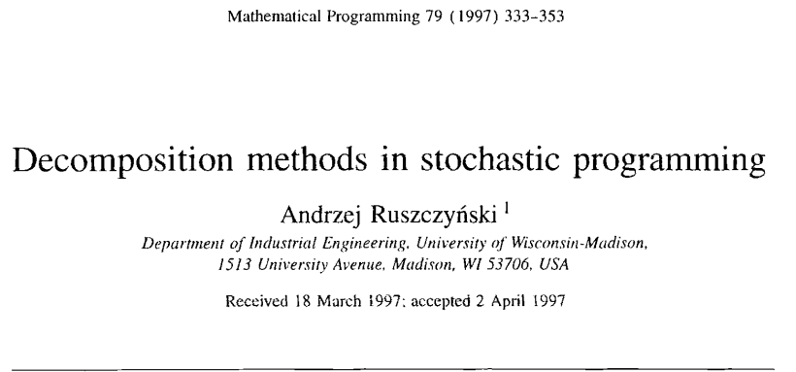

Solution Methods

Slide 44


Solution Methods

Slide 45

Solution Methods

Slide 46

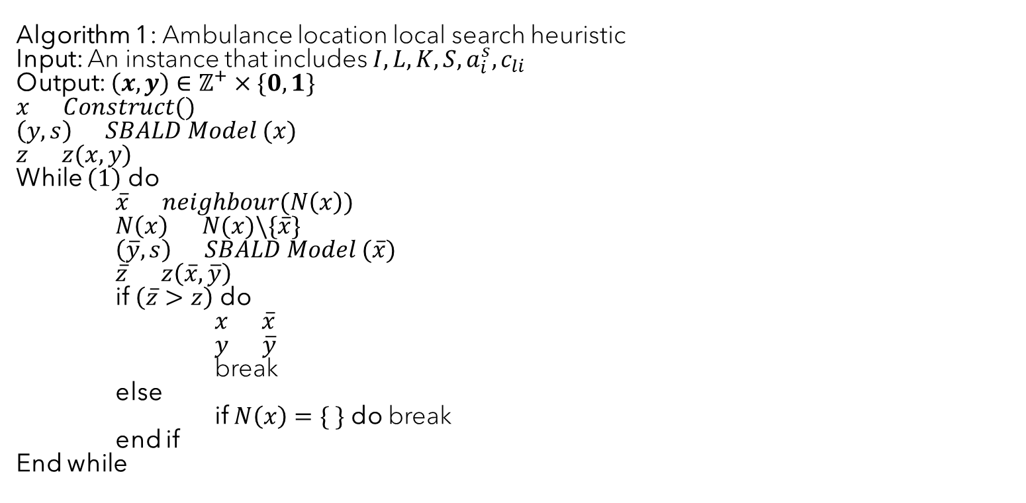
What are we doing?
Local search for ambulance location evaluating solutions for a scenario sampling method at the model’s second stage.
Algorithm 1: Ambulance location local search heuristic
Input: An instance that includes $I, L, K, S, a_{i}^{s}, c_{li}$
Output: $\left(x,y\right)∈ℤ^{+}×\{0,1\}$
$x Construct()$
$\left(y,s\right) SBALD Model (x)$
$z z(x,y)$
While $\left(1\right)$ do
$\overline{x} neighbour(N\left(x\right))$
$N\left(x\right) N(x)\backslash \{\overline{x}\}$
$\left(\overline{y}, s\right) SBALD Model (\overline{x})$
$\overline{z} z\left(\overline{x}, \overline{y}\right)$
if $\left(\overline{z}>z\right)$ do
$x \overline{x}$
$y \overline{y}$
break
else
if $N\left(x\right)=\{ \}$ do break
end if
End while

Slide 47


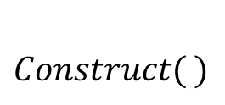
What are we doing?
$Construct( )$

Slide 48

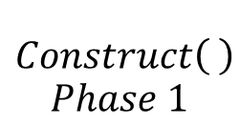
What are we doing?
$Construct\left( \right)$ $$Phase 1$$
48

Slide 49
What are we doing?
$Construct\left( \right)$ $$Phase 1$$
49

Slide 50
What are we doing?
$Construct\left( \right)$ $$Phase 1$$
50

Slide 51
What are we doing?
$Construct\left( \right)$ $$Phase 1$$
51

Slide 52
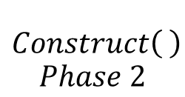
What are we doing?
$Construct\left( \right)$ $$Phase 2$$
52

Slide 53

What are we doing?
$neighbour(N(x))$
53

Slide 54
What are we doing?
$neighbour(N(x))$
54

Slide 55
What are we doing?
$neighbour(N(x))$
55

Slide 56
What are we doing?
$neighbour(N(x))$
56

Slide 57
What are we doing?
$neighbour(N(x))$
57

Slide 58
What are we doing?
$neighbour(N(x))$
58

Slide 59
What are we doing?
$neighbour(N(x))$
59

Slide 60

Experiments
$$I=\left\{1,…,95\right\}, L=\left\{1,…,100\right\}, S=\{1,…,40\}$$

Slide 61

Experiments
$$I=\left\{1,…,300\right\}, L=\left\{1,…,50\right\}, S=\{1,…,100\}$$

Slide 62

Experiments
$$I=\left\{1,…,1000\right\}, L=\left\{1,…,85\right\}, S=\{1,…,100\}$$

Slide 63

Future work
$neighbour(N(x))$
63

Slide 64
Thank you

