Slide 1
IS 331 Database Design, Management and Applications
Dr. Art Hendela
DAY 3: Conceptual Design (I)
Requirement Analysis
Conceptual Design
Logical Design
Physical Design
Implementation
Maintenance

Slide 2
Learning Objectives
Define the following terms: Model, Conceptual Model, Data Model, ER Model, mini-world
Define and understand three key constructs of ER Model: Entity, Attribute, and Relationship.
Differentiate between entity and entity class, relationship and relationship class
Define identifier
Define composite, multi-valued and derived attribute

Slide 3
Learning Objectives (II)
Master the notations for entity, relationship and attribute in the original ER model AND the Crow’s foot model
Be able to identify the three constructs of ER Model given a specific mini-world setting
Be able to generate basic ER Models given a description of the mini-world

Slide 4
Agenda
Conceptual Model: Definition
ER Model
Basic Constructs
Entity: Definition, examples and notation
Relationship: Definition, examples and notation
Attributes: Definition, examples, notation, and more
Basic ER Modeling: How to do it
The Bookstore Case
The NCAA Case

Slide 5
Remember Database Development Lifecycle?
Requirement Analysis
produces
Requirement
Specification
Conceptual Design
produces
Conceptual
Model
DBMS Independent
Logical Design
DBMS Dependent
Physical Design
Implementation
Maintenance

Slide 6
Road Map for Conceptual Design
Basics
EER Modeling
Conceptual Design
Three advanced types of Entity
Entity
Super/subtypes
Basic ER Modeling
ER Model
Attributes
Basics
Relationship
ER Modeling
Cardinality and Participation

Slide 7

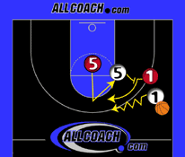

Conceptual Model
Basic modeling concepts
What is a model?
A Model is a description or analogy used to visualize something that cannot be observed
Example:

Slide 8


Data Model
A data model is a plan, or blueprint, for a database design
It describes the data that need to be captured by a database on a conceptual level
Focuses on what to capture, not how to capture it
Analogy: compact camera vs. SLR professional camera
A data model is more generalized and abstract than a database design – and therefore a lot easier to change!

Slide 9
Conceptual Model vs the Data Model
What is a conceptual model again?
Conceptual: semantic, meaning
Conceptual / data model represents a global view of the data.
Conceptual model serves as basis for identification of the major data objects, avoiding details
Analogy: Think about blueprint for architects
It describes how a building should look like
It identifies major objects: How many bedrooms? How many levels? What does it look like on a sunny day?
It avoids details: Size of the dining room? Carpet or tiles? Concrete or wood?
It is sufficient to be used as a tool of communication
But not so detailed such that a change would require complete rebuild of the system!

Slide 10
Conceptual Model, Cont.
What do we model in conceptual design?
The mini-world: Some part of the real world about which information will be stored in the database
Example:
For a bank, customer info., account info., etc.
For a bookstore, book info., customer info. etc
For a university?
Mini-world is the scope of our modeling

Slide 11
ER Modeling
Entity-Relationship model is a set of concepts and graphical symbols that can be used to create conceptual schemas.
The most popular and de facto conceptual model in database design
ER Modeling views a database as a collection of entities and relationships among them
WARNING: ER model is NOT equal to conceptual model, it is only one of the many conceptual modeling methods!

Slide 12
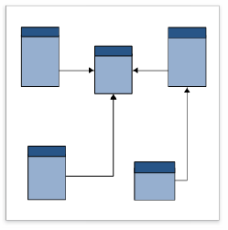
ER Modeling
Requirement
Specification
(English)
ER Modeling
ER Diagram (ERD) or ER Schema
ERD serves as a design tool, planning tool & documentation for the designers!!
ERD serves as a communication tool between the designers and the users!!

Slide 13
ER Modeling: A Tale of TOO MANY versions…
Versions
Original E-R model — Peter Chen (1976)
Extended E-R model — Extensions to the Chen model
Information Engineering (IE) — James Martin (1990); it uses “crow’s foot” notation, is easier to understand and we will use it
IDEF1X — A national standard developed by the National Institute of Standards and Technology [see Appendix C]
Unified Modeling Language (UML) — The Object Management Group; it supports object-oriented methodology [see Appendix D]

Slide 14
ER Modeling: A Tale of TOO MANY versions…
Our Plan
We will use two versions: The original version and the Crow’s foot version.
The original version is the most intuitive and the easiest to learn, but drawing it for your homework could be a painful experience
The Crow’s foot, on the other hand, is easier to draw using Visio, but not ideal for beginner’s learning purpose

Slide 15
ER Modeling: Basic Constructs
Entity
The mini-world is made up of entities
Entity is an object in the mini-world about which the organization wants to collect data
Relationships
Relationship exists among entities, associating them together
Attributes
Entity and relationship can have attributes*
*: In the original ER model, relationship could have attributes

Slide 16
ER Modeling: A Case Study
You are to design a database for the Highlander Bookstore. Below is the description of the “mini-world”:
The bookstore sells books and software to students. Each student has a student ID, name (First and Last), address, and phone number(s). A book has its title, ISBN, author, publisher, number of copies in stock and price. Software has its name, price, and required platforms (Windows or Mac)
When a student makes a purchase, he(she) may get a discount. The nature of the discount, copies of book purchased as well as the actual purchase price should be stored in your database.
The bookstore hires employees. An employee has his employee ID, name, address, and phone number. If an employee is also a student, he can make purchases at the bookstore.

Slide 17
ER Modeling: Entity
Entity
The mini-world is made up of entities
Entity is an object in the mini-world about which the organization wants to collect data
Entities in bookstore database ?
“Modern Database”, 6th edition
James Brown (a fictitious student)
Windows 7, professional version
Richard Slaten (a fictitious employee)

Slide 18
ER Modeling: Entity Class
Entity Class
A collection of entities that share common properties.
Entity classes in bookstore database
Book
Student
Software
Employee
We model entity classes, not entities!!
However, people often use the term “entity” to refer to both entity type and entity instance

Slide 19
ER Modeling: Entity
Notation:
In bookstore database (original version):
ENTITIY NAME
ENTITIY NAME
Original version
Crow’s foot
BOOK
STUDENT
SOFTWARE
EMPLOYEE
WARNING: Throughout the class, we will use the term “entity” to refer to “entity class”, but you should remember that we are modeling entity classes ALL THE TIME!

Slide 20
ER Modeling: Entity
Naming Conventions
Singular noun
Try to be specific and concise
No two entities should share the same name
More in the book

Slide 21
ER Modeling: Relationship
Definition
An association among the instances of one or more entity classes that is of interest to the organization
Notice that a relationship is among entity instances, not entity classes
Relationships in bookstore database
James Brown purchased “modern databases”

Slide 22
ER Modeling: Relationship
Relationship Class
A collection of relationships that share common properties.
Relationship Class in bookstore database
Students buy books
Students buy software
We model relationship types, not relationships
However, people often use the term “relationship” to refer to both relationship type and relationship instance

Slide 23
ER Modeling: Relationship
Notation
In bookstore database (original version):
Relationship name
Relationship name
Crow’s foot
Original version
purchases
WARNING: Throughout the class, we will use the term “relationship” to refer to “relationship class”, but you should remember that we are modeling relationship classes ALL THE TIME!

Slide 24
ER Modeling: Attributes
Definition
A property or characteristic of an entity type or relationship classes
Notice that attribute is associated with classes, not instances
Attributes examples in bookstore database
What attributes does the entity class “student” have?
Name, ID, address, phone numbers
What attributes does the relationship class “purchase” have?
Date, discount type, purchase price, number of copies purchased

Slide 25
ER Modeling: Attributes
Attributes have domains
The domain is the attribute's set of possible values.
The domain of the attribute "Grade Point Average" is a real number between 0.0 and 4.0
The domain of the attribute “Sex" contains Male and Female --- however…
The domain of the attribute “birth date” in a customer database?

Slide 26
ER Modeling: Attributes
Notation (original style):
Notation (Visio / crow’s foot style):
Attribute
ENTITY
ENTITY
Identifier
Other Attributes

Slide 27
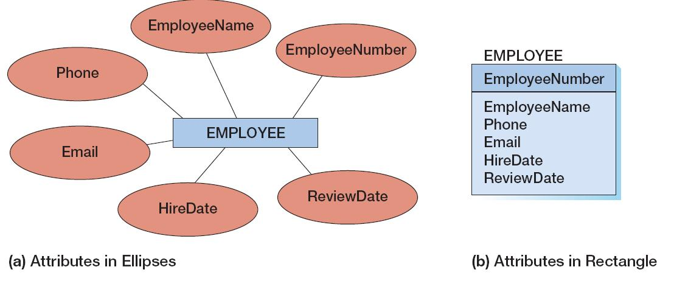
ER Modeling: Attributes
We will use style “b” for homework assignments

Slide 28
Attributes: Identifiers
Identifiers are attributes that name, or identify, entity instances.
Identifier could contain one or MORE attributes
For the STUDENT entity class?
Composite identifiers are identifiers that consist of two or more attributes
Sneak Preview: Identifiers in data models become ? in database designs

Slide 29
ER Modeling: Identifiers
Practice:
There are many classrooms in this building. Each room has a room number which is uniquely assigned.
Each room has a capacity limit, a status (tech. or non-tech. room), and a equipment list.
Interestingly, no two tech. room have the same capacity limit, and no two non-tech room have the same capacity limit either.

Slide 30
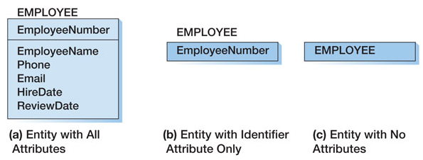
Attributes: Identifiers
Depending on the size of our ER model, we might display the entity set name and ALL of the attributes, or the entity set name and the identifier, or just the entity set name:

Slide 31
Attributes: Special Types
Simple vs. composite attributes
A Simple Attribute cannot be further divided into more attributes.
Sex, Age, etc.
A composite attribute is a logical grouping of simple attributes.
E.g., a name is composed of a first name and a last name
Any other example?
STUDENT
First name
Student ID
name
STUDENT
First Name
Last Name
Last name
Notice that only the lowest level of composite attributes are included in the crow’s foot notation!

Slide 32
Attributes: Special Types
Single valued vs. multi-valued attributes
A Single-Valued Attribute can have only a single value.
Example: Age is a single valued attribute of the entity person, because a person can have only one age.
A Multi-Valued Attribute can have many values.
Assume that an employee can have more than one phone number (Office and cell)
Phone
Employee
The notation for multi-valued attribute is too complicated in Visio / Crow’s foot. We will discuss it later

Slide 33
Attributes: Special Types
Multi-valued vs. composite
A multi-value attribute has multiple values for the same attribute
A composite attribute has multiple attributes, but each has a single value!
Phone Number
9736524454 9345235724 8424144633
Address
Street | City | State
Main | Union | NJ
multi-value
composite

Slide 34
Attributes: Special Types
Stored vs. derived attributes
A Derived Attribute does not physically exist within the database, but is derived (computed) by an algorithm or computation.
Total sale amount for a purchase = purchase price * number of copies purchased
Total sale
price
purchase
# of copies
The notation for derived attribute is simple: it is NOT included!

Slide 35
ER Modeling: Recap
Three constructs:
Entity:
Relationship:
Attributes:
Multi-value
Derived
Key (identifier)

Slide 36
Performing ER Modeling: Basic Procedure
Get the description of the mini-world through requirement analysis
identify entities from the description
identify relationships among the entities
identify attributes for the entities and relationships
identify key (identifier) for each entity
Draw the ERD

Slide 37
Performing ER Modeling: Rules
No duplicated entity or relationship names
Use specific names for relationships, avoid words like “has”, “is”, etc.
Each statement in the requirement specification should be located somewhere in the ER diagram.
Each ER diagram construct should be located somewhere in the requirement specification.
“No more, no less.”: too much assume makes an ass out of u and me!
Conceptual design often reveals inconsistencies and ambiguities in the requirement specification, which must be first resolved.

Slide 38
Performing ER Modeling: Tips and Tricks
Identify entities: entities are often nouns in the description
The bookstore sells books and software to students. Each student has a student ID, name (First and Last), address, and phone number(s). A book has its title, ISBN, author, publisher, number of copies in stock and price. Software has its name, price, and required platforms (Windows or Mac)
When a student makes a purchase, he(she) may get a discount. The nature of the discount, copies of book purchased as well as the actual purchase price should be stored in your database.
The bookstore hires employees. An employee has his employee ID, name, address, and phone number. If an employee is also a student, he can make purchases at the bookstore.

Slide 39
Performing ER Modeling: Tips and Tricks
Identify entities: which nouns are entities?
The ones that are of interest to the users
If a noun “belongs” to another (A has B), then it is more likely to be an attribute. (B is likely to be an attribute of A)
Books HAVE title, ISBN, author, publisher, number of copies in stock and price software HAS name, price, and required platforms Students HAS student ID, name (First and Last), address, and phone number Employees HAVE employee ID, name, address, and phone number
bookstore discount Purchase HAS nature of the discount, copies of book purchased, actual purchase price

Slide 40
Performing ER Modeling: Tips and Tricks
Identify entities: which nouns are entities?
It is clear that the first four are entities, their attributes are also found
Bookstore: It is the USER, or ORGANIZATION, which we are modeling, therefore, it is NOT an entity
Books HAVE title, ISBN, author, publisher, number of copies in stock and price software HAS name, price, and required platforms Students HAS student ID, name (First and Last), address, and phone number Employees HAVE employee ID, name, address, and phone number
bookstore discount Purchase HAS nature of the discount, copies of book purchased , actual purchase price

Slide 41
Performing ER Modeling: Tips and Tricks
Identify entities: which nouns are entities?
Discount: Do we have enough information (attributes) to make it an entity? – It does not make sense to design an entity with no attributes
Purchase: pay EXTREME attention here. Purchase could be a verb.
discount Purchase HAS nature of the discount, copies of book purchased, actual purchase price

Slide 42
Performing ER Modeling: Tips and Tricks
Identify relationships: Verbs
Purchase: Is it better as a relationship or an entity?
It ties students to books and software, therefore, it is better as a relationship
It has nature of the discount, actual purchase price as attributes
Is: Obviously a relationship here
Purchase HAS nature of the discount, copies of book purchased , actual purchase price
an employee is also a student

Slide 43
Performing ER Modeling: Tips and Tricks
WARNING: The above tricks are used to aid you in your design. Do NOT follow strictly!
Example: If A has B, B might also be modeled as an entity – refer to the exercise at the end of this lecture
After you extract the nouns and verbs, analyze carefully the assumptions in the mini-world to determine how to correctly model it

Slide 44
Performing ER Modeling
EID
LNAME
Finally…
ENAME
EMPLOYEE
ADDRESS
FNAME
PHONE
MAY BE
Total
SID
LNAME
SNAME
STUDENT
ADDRESS
FNAME
PURCHASES
ISBN
PHONE
TITLE
BOOK
PURCHASES
AUTHOR
Total
QTY
QTY
PUBLISHER
DISCOUNT_TYPE
PRICE
PRICE
STOCK
NAME
DISCOUNT_TYPE
PRICE
PLATFORM
SOFTWARE
PRICE

Slide 45
Performing ER Modeling: Are we done?
No we’re not.
There are two relationships with the same name and practically the same attributes. Is that good?
How do we specify the relationships to a greater detail? Cardinality, Degree, etc..
We will solve these issues in the next two classes

Slide 46
Performing ER Modeling: Exercise
You are designing a database for the registrar’s office that captures students’ grade information for courses. For each student, you need to capture his / her UCID, Name (including Last name and First name), Sex, Age, Major, Admission date, and Class (derived from the admission date).
For each course, you need to store the (unique) course number, course title, credit, department offering the course, time of the course, and classroom.
Some courses have other courses as prerequisite, and this relationship needs to be captured, too.
You also need to store the final grade a student gets for each course he / she took before and the semester he/she took it.

Slide 47
Performing ER Modeling: Exercise
Entities?
Student, Course, Takes
Relationships?
A student takes a course
A course is the prerequisite of another course
Attributes:
STUDENT: UCID, Name (composite attribute including Last name and First name), Sex, Age, Major, Admission date, and Class (derived attribute).
COURSE: Number, Title, Department, Credit, Time, Room
TAKES: Grade, Semester

Slide 48
Performing ER Modeling: Exercise
UCID
Sex
STUDENT
Age
FName
Name
LName
Major
Admission Date
Grade
TAKES
Class
Semester
Number
COURSE
Title
Dept.
IS PREREQUISITE
Credit
Time
Room

Slide 49
Why didn’t we use Crow’s Foot?
In Crow’s Foot notation, relationship cannot have attributes!
Logically, the original version is more natural (relationships could have attributes that describe them)
Logistically, Crow’s foot is better for later “translation” of the data model into relational model (tables).
In the next class, we will see how Crow’s Foot model solves the relationship-with-attributes problem.

Slide 50
Performing ER Modeling: Exercise
Lessons:
Many relationships are “hidden”, don’t just only look at the words. Really get to the MEANING of the words. (conceptual!)
Relationships may or may NOT have attributes dependent on the rules in the mini-world
Entities MUST have attributes
All entities should have identifier
A relationship does not have an identifier

