Slide 1
IS 331 Database Design, Management and Applications
Dr. Art Hendela
DAY 4: Conceptual Design (II)
Requirement Analysis
Conceptual Design
Logical Design
Physical Design
Implementation
Maintenance

Slide 2
Learning Objectives
Define and understand the following terms:
Weak Entity, Associative Entity, Recursive Entity, Cardinality, Participation, Degree
Know the three types of maximum cardinalities and correctly identify them given a scenario
Identify mandatory and optional participations
Identify weak entities and identifying relationships
Generate ER Models with cardinality of relationships given a description of the mini-world
Become familiar with the original notational system
Use the Crow’s foot notational system to conduct ER Modeling

Slide 3
Overview
More on Relationship
Degree of relationship
Cardinality of relationship
Participants of a relationship
Recursive relationship
More on entity
Weak entity: Definition, examples and notation
Associative entity: Definition, examples and notation

Slide 4
Road Map For Conceptual Design
Basics
Conceptual Design
EER Modeling
Two advanced types of Entity
Entity
Super/subtypes
Basic ER Modeling
ER Model
Attributes
Basics
Relationship
ER Modeling
Cardinality and Participation

Slide 5
More on Relationship
We only covered basics about relationship last time
Relationship details are the most difficult part of ER modeling
We need to determine:
Cardinality of a relationship
Total or partial participation
Degree of a relationship
Notes:
2. Total Participation: (FROM http://www.ques10.com/p/3849/explain-the-terms-total-participation-and-partial-/)
i. The participation of an entity set E in a relationship set R is said to be total if every entity in E participates in at least one relationship in R.
ii. Consider two entities EMPLOYEE and DEPARTMENT related with the help of relationship WORKS_FOR.
iii. If a company policy states that every employee must work for a department, then an employee entity can exist only if it participates in at least one WORKS_FOR relationship instance. Thus, the participation of EMPLOYEE in WORKS_FOR is called total participation, meaning that every entity in the total set of employee entities must be related to a department entity via WORKS_FOR.
iv. Total participation is also called existence dependency.
v. Total participation is displayed as a double line in ER diagram connecting the participating entity type to the relationship
3. Partial Participation:
i. If only some entities in entity set E participates in relationships in R, the participation of entity set E in relationship set R is said to be partial.
ii. Consider two entities EMPLOYEE and DEPARTMENT related with the help of relationship MANAGES.
iii. Here, not all employees are expected to manage a department, so the participation of EMPLOYEE in the MANAGES relationship type is partial.
iv. This means that some or part of the set of employee entities are related to some department entity via MANAGES, but not necessarily all.

Slide 6
What is Missing?
Original ER:
STUDENT
TAKES
COURSE
Crow’s Foot:
STUDENT
COURSE
Takes
The mini-world tells us about the entities, etc. that we need. That’s the qualitative story
Now we need to capture quantitative information
How many courses COULD a student take? (Max)
How many courses MUST a student take? (Min)
How many students COULD a course have? (Max)
How many students MUST a course have? (Min)

Slide 7
Introducing Cardinality
Definition
A cardinal number is a number used in counting, such as 1, 2, 3, ....
In ER modeling, “cardinality” refers to the number of entity instances that can be involved in a relationship
Maximum cardinality is the maximum number of entity instances that can participate in a relationship
Minimum cardinality is the minimum number of entity instances that must participate in a relationship.
Notes:
Think of an entity instances as a row in an Excel sheet.
If you have two different Excel sheets, how many rows in the one sheet (Entity or table) are related to how many rows in the other sheet.

Slide 8
Three Numbers To Know About Crow’s Foot Notation
Using Crow’s Foot notation makes it easier to understand the relationship cardinalities. This is what we will use for our assignments
I will also show you how to use the original Chen notation from Peter Chen’s 1976 paper called “The Entity-Relationship Model-Towards a Unified View of Data”
0
1
m

Slide 9
Maximum Cardinality: How many instances CAN be involved?
I have introduced to you the ONLY three numbers we could have in cardinality
Imagine TWO entity classes and a relationship between them
How many different types of maximum cardinality are possible?
0 – 1?
1 – 0?
1 – 1?
1 – m ?
m – 1?
M – m ?

Slide 10
Maximum Cardinality: One to One Relationship
One-to-one relationship
Example
An employee may be a student: Each employee may be a student.
A student may be a employee
Here, only one instance could participate the relationship
Notations
1 :
EMPLOYEE
1
STUDENT
MAY BE
EMPLOYEE
STUDENT
MAY BE

Slide 11
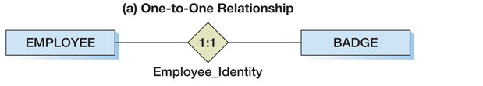
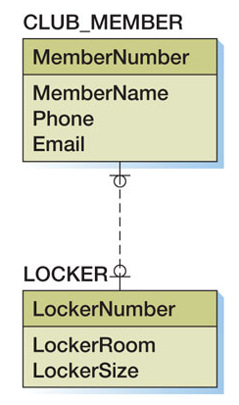
Maximum Cardinality: One to One Relationship
Book Example
Ignore the circles (0) – those are minimal cardinalities, we will cover them later

Slide 12
Maximum Cardinality: One to Many Relationship
One-to-Many (or Many-to-one) relationship
Example
A basketball team has (is composed of) many players
A player, however, can only play for one team
Notation
N
TEAM
1 :
PLAYER
is composed of
TEAM
PLAYER
is composed of

Slide 13
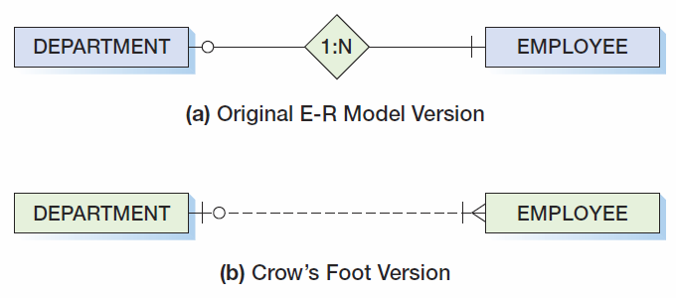
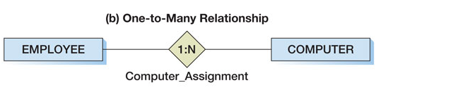
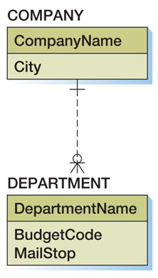
Maximum Cardinality: One to Many Relationship
Textbook Examples:
Ignore the circle (0) and 1 in the middle – those are minimal cardinalities, we will cover them later

Slide 14
One to Many Relationships
Be Careful Choosing Sides
Unlike 1-1 or m-n, a 1-m (one to many) relationship is not symmetric. Which side you put the 1 and the side you put the “many” makes a difference.
The entity on the one side of the relationship is called the parent entity or just the parent
The entity on the many side of the relationship is called the child entity or just the child

Slide 15
One to Many Relationship:
Be Careful Choosing Sides
How To Decide Which is 1 and Which is m?
Read the sentence to check the validity
1 employee is assigned many computers
Step 1: Read the left-side number
If the sentence is right, you are right!
Step 2: Read the left-side entity
Step 3: Read the relationship
Step 4: Read the right-side number
Step 5: Read the right-side entity

Slide 16
One to Many Relationship:
Be Careful Choosing Sides
HOWEVER – REMEMBER, THERE ARE TWO SENTENCES!
Don’t forget the indication from the reverse side!
1 computer can be assigned to how many employees?

Slide 17
One to Many Relationship:
Be Careful Choosing Sides
Practice: which of the following has the right cardinality?
STUDENT
CAR
CUSTOMER
BOOK
EMPLOYEE
MANAGER
ROOM
HOUSE
Notes:
The first three are correct.
In a hierarchical management organization, one employee has multiple reporting lines, hence more than one manager.

Slide 18
Maximum Cardinality: Many to Many Relationship
Many-to-Many relationship
Example
A student may purchase many books
A book may be purchased by many students (The mini-world definition of the “book” entity is all copies of the same publication)
Notation
STUDENT
n :
m
BOOK
PURCHASES
STUDENT
BOOK

Slide 19
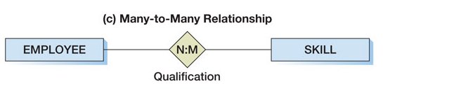
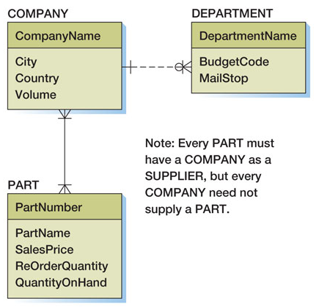
Maximum Cardinality: Many to Many Relationship
Book Example:
This diagram to the right is incorrect. As drawn, the caption should be that “Every Company must supply at least one part.”
What tells me that the description is in correct?

Slide 20
Cardinality of a Relationship
EID
LNAME
Adding cardinality to the bookstore database
ENAME
EMPLOYEE
ADDRESS
FNAME
1
PHONE
MAY BE
Total
SID
LNAME
1
SNAME
m
STUDENT
ADDRESS
FNAME
PURCHASE
ISBN
m
PHONE
m
TITLE
BOOK
PURCHASE
AUTHOR
Total
QTY
QTY
PUBLISHER
DISCOUNT_TYPE
PRICE
PRICE
STOCK
NAME
DISCOUNT_TYPE
PRICE
m
PLATFORM
SOFTWARE
PRICE

Slide 21
Minimum Cardinality: How many instances MUST be involved?
The maximum cardinality only describes the maximum number of entities/entity sets that can be involved in a relationship.
In other words, it tells us what COULD happen
We need a methodology to also describe the minimum cardinality in a relationship
In other words, what MUST happen?

Slide 22

Minimum Cardinality
Minimum cardinality is the minimum number of entity instances that must participate in a relationship.
Minimums are generally stated as either zero or one
What does zero indicate?
Does the employee HAVE to have a computer?
Does a computer HAVE to be assigned to an employee?
Notes:
The zero indicates that the relation is optional.

Slide 23
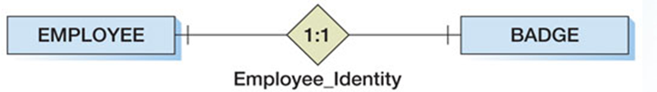
Minimum Cardinality
What does one indicate?
Does the employee HAVE to have a badge?
Does a badge HAVE to be assigned to an employee?

Slide 24
Participation
Minimum cardinality of zero [0] indicates optional participation of an entity instance in a relationship
Minimum cardinality of one [1] indicates mandatory or required participation of an entity instance in a relationship.

Slide 25
Minimum Cardinality Notation
The notation for minimum cardinality in the original version is similar to the Crow’s Foot notation:
The number is put on the side of the entity set in question
0
1

Slide 26
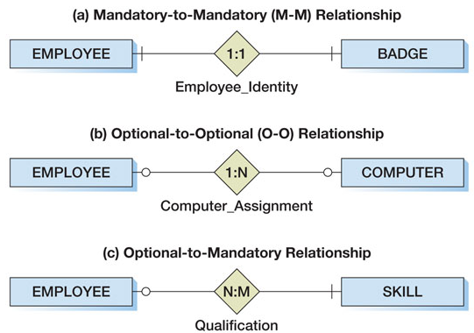
Minimum Cardinality Notation
Examples: (notice the side the numbers are
on!)
Maximum Cardinality
Minimum Cardinality

Slide 27
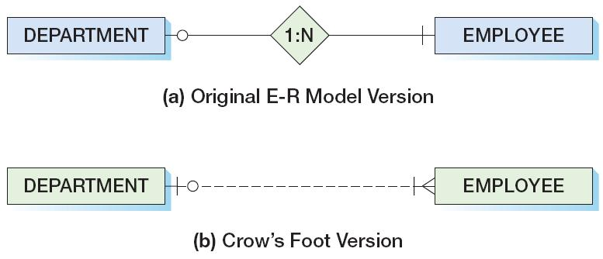
Minimum Cardinality Notation
The notation for minimum cardinality in Crow’s foot version:
Just remember: maximum on the outside, minimum on the inside!
A DEPARTMENT must have at least one, and possibly many employees, while an EMPLOYEE may be associated with no DEPARTMENT or possibly with ONE Department.

Slide 28
The Three Types of Minimum Cardinality

Slide 29
How to Read Minimum Cardinality
1 Department
Hires
At least 1
Employee
1 Department
Hires
At least 1
Employee

Slide 30
How to Read Minimum Cardinality
1 Employee
Works at
At least 0
Department
1 Employee
Works at
At least 0
Department

Slide 31
Cardinality Exercise
At NJIT, a professor could teach many courses. A course could be taught by many professors (and naturally by at least one!). However, a professor does not have to teach a course – he might be a research professor
Model the professor – course relationship

Slide 32
Cardinality Exercise
Step 1: Put it in two sentences
1 professor could teach min? – max? courses
1 course could be taught by min? – max? professor
Step 2: work from left → right, translate the first sentence into numbers
PROFESSOR
COURSE
Step 3: work from right → left, translate the second sentence into numbers

Slide 33
Cardinality Exercise
DORMITORY
0
1:N
STUDENT
READ this ER

Slide 34
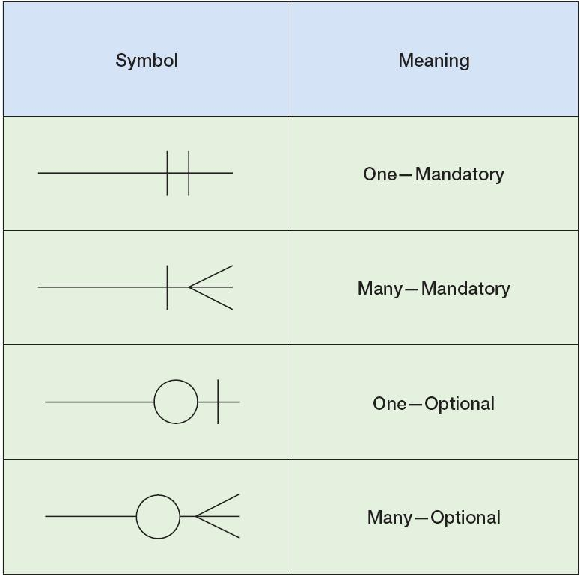
Crow’s Foot Notation (read from left to right)
Alternate Version
(min:max) = (1:1)
(min:max) = (1:m)
(min:max) = (0:1)
(min:max) = (0:m)

Slide 35
Degree of a Relationship
The DEGREE of the entity types is the number of participants involved in a relationship. Think of how many tables are in a particular relationship
The CARDINALITY of the relationship is the number of entity instances involved in a relationship. Think of how many rows in one table are connected to how many rows in another table

Slide 36
Degree of a Relationship
Unary Relationship: Only one entity class is involved
A unary relationship is also known as a recursive relationship
How to determine the cardinality of such relationships?
TEAM
COURSE
PLAYS AGAINST
IS PREREQUISITE

Slide 37
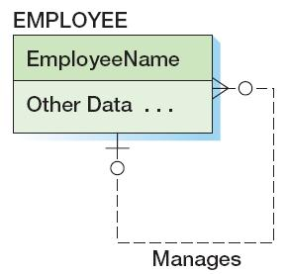
1:N Recursive Relationships
An employee can manage many other employees, but some employees do not manage any other employees.
But an employee can be managed by at most one other employee, and some employees (the boss!) are not managed by any other employee.
an employee manages 0 – m employees
an employee is managed by 0 – 1 employees

Slide 38
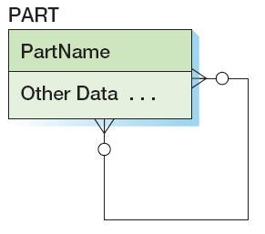
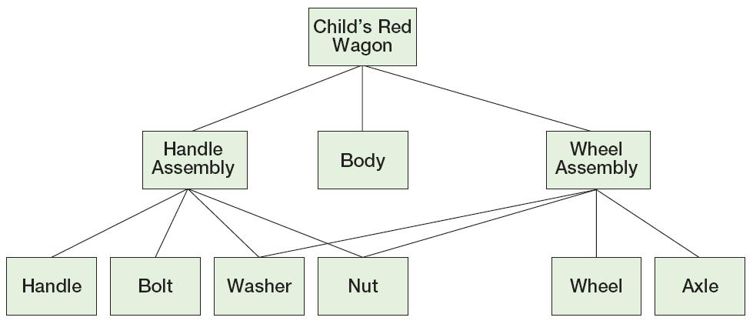
N:M Recursive Relationship
This Bill of Materials is common in manufacturing applications. The Child’s Red Wagon consists of three parts: a Handle Assembly, a Body, and a Wheel Assembly. And the Handle Assembly and the Wheel Assembly each consist of ‘many’ other parts (some of which are common to both).
Each part may consist of ‘many’ other parts, or none at all.
And each part may be used in ‘many’ other parts, or perhaps none.

Slide 39
Degree of a relationship
Binary Relationship: Two entity types
Most common type
EMPLOYEE
MAY BE
STUDENT
STUDENT
PURCHASE
BOOK

Slide 40
Degree of a Relationship
Ternary Relationship: Three entity types
Assume we add this sentence to the bookstore case:
“A student made a purchase of a book under the help of one employee”
Now, a purchase action involves three entities: student, employee, and book
STUDENT
PURCHASE
BOOK
EMPLOYEE

Slide 41
Where are we?
Basics
Conceptual Design
EER Modeling
Two advanced types of Entity
Entity
Super/subtypes
Basic ER Modeling
ER Model
Attributes
Basics
Relationship
ER Modeling
Cardinality and Participation

Slide 42
More on Entities
We have gone over the basics about entities
We will now learn three new types of entities:
Weak entity: An entity that cannot exist without another entity
Associative Entity: A special type of relationship

Slide 43
Weak Entity
Definition: an entity whose existence in the database depends on other entities
The entity that a weak entity depends on is called its owner
Example from the bookstore case:
We now assume that we have a new entity called “dependent.” This new entity holds dependents of the students
In the database, a dependent should not exist without a corresponding student: if the student data is deleted, then the dependent data must be deleted too

Slide 44
Weak Entity Examples
Find the primary keys for the following entity pairs:
Class: Section
Building: Room
Painting: Print
Movie: DVD
What do they share in common?
Notes:
The item on the right side of the “:” cannot exist without the existence of the item on the left side of the “:”.
It is impossible to have a section of a class before the class is defined.
That’s the same with rooms in a building.

Slide 45
ID – Dependent Entity
An ID-dependent entity is a child entity whose identifier includes the identifier of the parent entity.
The ID-dependent entity is a logical extension or sub-unit of the parent:
BUILDING : APARTMENT (Building 369, Apt 4)
PAINTING : PRINT
What is the minimum cardinality from the ID-dependent entity to the parent?
Notes:
The answer is 1.

Slide 46
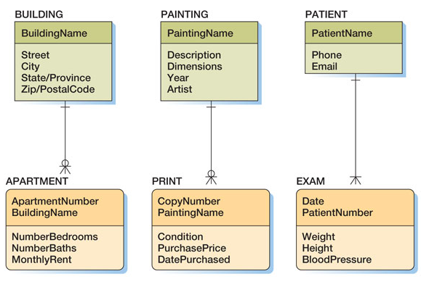
ID–Dependent Entity Notation
A solid line indicates an identifying relationship
notice the edges of the rectangle are rounded to denote the weak entity

Slide 47
ID–Dependent vs. Weak Entities
An ID-dependent entity, by definition, is a weak entity
The relationship between ID-dependent entity and its parent is called an identifying relationship, and uses a solid line in Crow’s foot notation
All the “normal” relationships we studied before are called “non-identifying relationships” and use dashed lines in Crow’s foot notation

Slide 48
ID-Dependent Relationships The Arch type/Instance Pattern
The archtype/instance pattern occurs when the ID-dependent child entity is the physical manifestation (instance) of an abstract or logical parent:
PAINTING : PRINT
CLASS : SECTION
YACHT_DESIGN : YACHT
HOUSE_MODEL : HOUSE

Slide 49
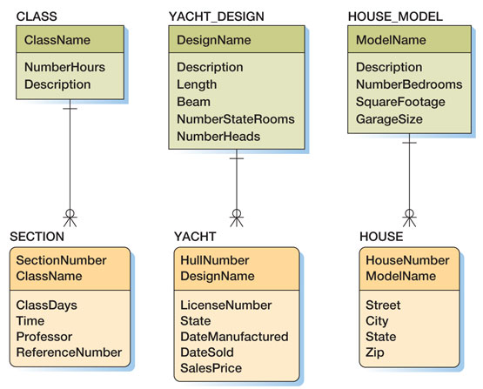
ID-Dependent Relationships The Arch type/Instance Pattern
Note that these are true ID-dependent relationships - the identifier of the parent appears as part of the composite identifier of the ID-dependent child.

Slide 50
QUESTION
1) Is an ID-dependent entity is always a weak entity?
2) However, is a weak entity always ID-dependent?
Any counter-example?
An ID-Dependent entity is always weak
Weak Entities are not always ID-dependent

Slide 51
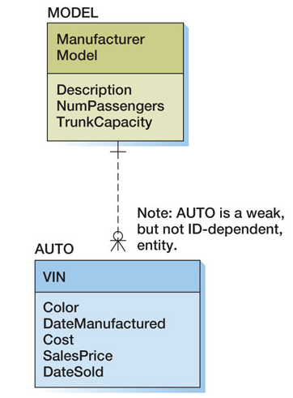
Non-ID-Dependent Weak Entity
A dashed line indicates a nonidentifying relationship

Slide 52
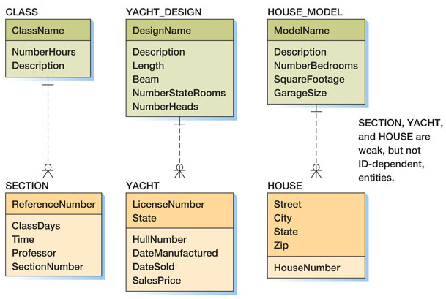
ID-Dependent Relationships The Arch Type/Instance Pattern
Note the use of weak, but not ID-dependent children.

Slide 53
Some More Information
The non ID-dependent, non-identifying type of weak entity adds a lot of confusion to your modeling task
Logically, they are not too different from other “normal” entities
Therefore, when you model weak entities, just focus on the ID-dependent ones

Slide 54
Associative Entity
An entity type that associates the instance of one or more entity types and contains attributes that are peculiar to the relationship between those entity instances
English, please?
Very simple: Just understand it as relationships which have attributes. Known as an intersection table
Notation

Slide 55
Associative Entity
EID
LNAME
EMPLOYEE
ENAME
FNAME
ADDRESS
Example
PHONE
MAY BE
SID
LNAME
Total
SNAME
STUDENT
ADDRESS
FNAME
PURCHASE
PHONE
ISBN
TITLE
BOOK
PURCHASE
AUTHOR
Total
QTY
QTY
PUBLISHER
DISCOUNT_TYPE
PRICE
PRICE
STOCK
NAME
DISCOUNT_TYPE
PRICE
PLATFORM
SOFTWARE
PRICE

Slide 56
Other thoughts
The textbook calls this “the association pattern”
This pattern is how the Crow’s foot model solves the “relationship with attributes” problem

Slide 57
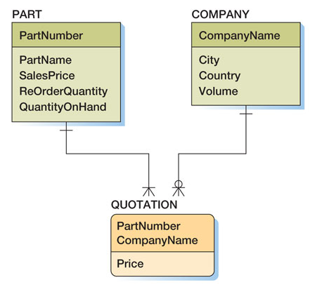
Translating Associative Entity into Crow’s Foot Model
Breaks the m:n relationship into two 1:m relationships
All attributes belong to the “associative entity” in the middle
PRICE
COMPANY
M : N
PART
QUOTES

Slide 58
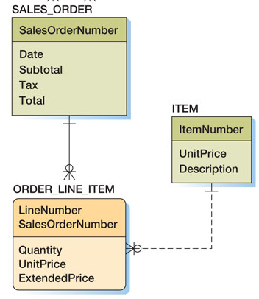
More Associative Entity Examples
The Classical “Line-Item Pattern”:
CONTAINS
ORDER
M : N
ITEM
UPrice
Quantity
EPrice

Slide 59
REVIEW
We covered:
More on relationships
Degree of relationship
Cardinality of relationship
Participants of a relationship
Recursive relationship
More on entities
Weak entity: Definition, examples and notation
Associative entity: Definition, examples and notation
Next week, we will:
Put everything together by doing an ER Modeling Exercise
And use VISIO to do it!

