Slide 1
IS 331 Database Design, Management and Applications
Dr. Art Hendela
DAY 5: Conceptual Design (III)
Requirement Analysis
Conceptual Design
Logical Design
Physical Design
Implementation
Maintenance

Slide 2
Learning Objectives
Understand the concepts of subtype, supertype, inheritance, discriminator
Identify sub/supertypes and represent them using appropriate notations
Identify different types of inheritance
Generate EER Models which might have inheritance relationships

Slide 3
Overview
Enhanced Entity Relationship Modeling (EER)
Supertype and subtype
Examples
Definition
Notation
Completeness and disjointness
How to perform EER modeling

Slide 4
Where are we?
Basics
Conceptual Design
EER Modeling
Two advanced types of Entity
Entity
Super/subtypes
Basic ER Modeling
ER Model
Attributes
Basics
Relationship
ER Modeling
Cardinality and Participation

Slide 5
EER – Why do we need it?
ER Model has limited power
Real world business is getting more and more complicated
For example, in the bookstore case, we have to relationships that are exactly the same. Seems redundant
EER – Enhance ER is used to extend ER’s power
Major difference: EER = ER + subtype/supertype
This is a simplified view. There is more to EER
We will focus on subtype/supertype in this class

Slide 6
The Extended ERD– Why?
STUDENT (StudentID, Lname, Fname, SocSec#, Home Address, City,State, ZipCode, Phone, EmailAddy, NameOfHighSchool, SAT Score, HighSchoolGPA, HonorsCollege, GRE Score, UndergraduateSchool, GPAfromUndergraduateSchool, YearOfBachelorsDegree, EnrolledGraduateProgram)
READ THE ABOVE TABLE. PAY ATTENTION TO THE TYPE OF STUDENT EACH ATTRIBUTE DESCRIBES
Courtesy of Dr. J. Scher

Slide 7
The Extended ERD– Why?
STUDENT (StudentID, Lname, Fname, SocSec#, Home Address, City,State, ZipCode, Phone, EmailAddy, NameOfHighSchool, SAT Score, HighSchoolGPA, HonorsCollege, GRE Score, UndergraduateDegreeSchool, GPAfromUndergraduateDegreeSchool, YearOfBachelorsDegree, EnrolledGraduateProgram)
Who would have the yellow attributes? Who would have the red ones?
Who would have the blue ones?
Courtesy of Dr. J. Scher

Slide 8
If we create one STUDENT table…
STUDENT (StudentID, Lname, Fname, SocSec#, Home Address, City,State, ZipCode, Phone, EmailAddy, NameOfHighSchool, SAT Score, HighSchoolGPA, HonorsCollege, GRE Score, UndergraduateSchool, GPAfromUndergraduateSchool, YearOfBachelorsDegree, EnrolledGraduateProgram)

Slide 9
EER – subtype/supertype
Subtype/supertype is used to model entities that share some common properties
If you’ve learned JAVA before, it is very similar to the concept of subclass and superclass. Both are based on the principle of “inheritance”
Subtype entity is a special case of a supertype entity:
STUDENT : UNDERGRADUATE or GRADUATE
The supertype contains all common attributes, while the subtypes contain specific attributes
The supertype may have a discriminator attribute that indicates the subtype.

Slide 10
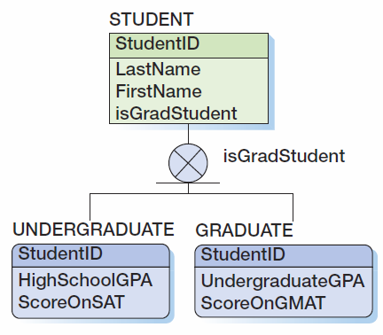
The STUDENT Case, With Supertype / Subtype
An exclusive subtype
(denoted by an X in the circle)
means that the supertype
can only take on precisely
one subtype.
The discriminator

Slide 11
Discriminators
A discriminator is an optional attribute that determines which subtype is appropriate.
The discriminator will appear as an attribute name and will also be placed adjacent to the subtype symbol

Slide 12
Notations
Supertype is ALWAYS above all of its subtypes
A circle and a line (like a ball on the ground) is used to link supertype to subtypes
If subtypes are exclusive, one supertype relates to at most one subtype. Put an “X” in the circle
If subtypes are inclusive, one supertype can relate to one or more subtypes.

Slide 13
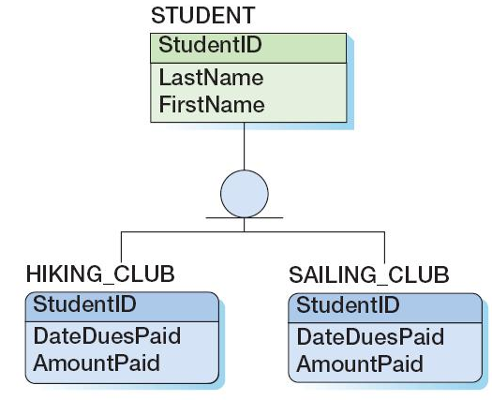
INCLUSIVE SUBTYPE

Slide 14
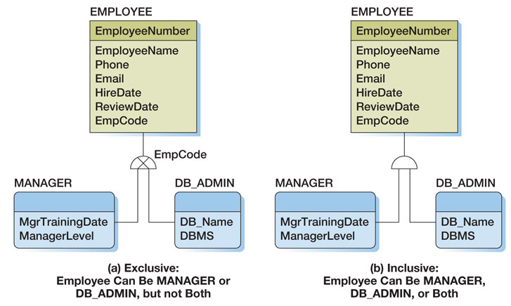
Question…
Can an inclusive relationship have a discriminator?

Slide 15
Inheritance
Inheritance means that the entities in the subtypes "inherit" the attributes of the supertype entity class
UNDERGRADUATEs and GRADUATEs inherit the attributes of STUDENT.
These attributes are common to both undergrads and grads.
Inheritance is a key concept for the object oriented paradigm

Slide 16
Performing EER Modeling Complete Procedure
Get the description of the mini-world through requirement analysis
Identify entities from the description
Identify relationships among the entities
Identify attributes for the entities and relationships
Identify key (identifier) for each entity
Identify weak entities
Fill in cardinality for all relationships
Label participation status (mandatory or optional)
Identify potential super/subclasses
Draw the ERD

Slide 17
Getting Requirements
The first step of the ER Modeling process is the toughest!
If you are lucky, you get to interview the clients and understand how their world works
This is the case for the scenario you are about to work on
If you are unlucky, you can only infer everything from reports and forms
That is the case for the highline university case covered in the next class

Slide 18
Visio and Data Modeling
Three reasons why VISIO is NOT a data modeling tool
Data Model leaves out details about attribute data types (conceptual design!)
Data Model does NOT have primary keys! (only identifiers)
Data Model does NOT have foreign keys! (only relationships)

Slide 19
Why use VISIO?
Three reasons we are using VISIO for data modeling
Leading software in modeling
The non-data modeling features make later logical design easier
Much better than drawing on paper!

