Slide 1
IS 331 Database Design, Management and Applications
Dr. Art Hendela
DAY 6: Conceptual Design (IV)
Requirement Analysis
Conceptual Design
Logical Design
Physical Design
Implementation
Maintenance

Slide 2
Learning Objectives
Be able to develop a complete EER Model based on:
A requirement document
or
A set of forms and reports

Slide 3
Review
We have conducted simple EER modeling based on requirement document
Today, we will learn:
How to conduct EER modeling with forms and reports
How to conduct more advanced EER modeling with a complicated case

Slide 4
Highline University
The Highline University [HU] database will track such entities as:
Colleges
Departments
Faculty
Students
We have gathered a set of HU reports that will be the source documents for a data model

Slide 5
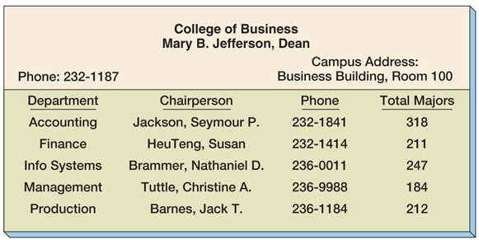
The College Report

Slide 6
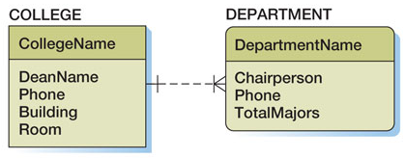
Data Model from the College Report
This is a weak, but not ID-dependent, 1:N relationship

Slide 7
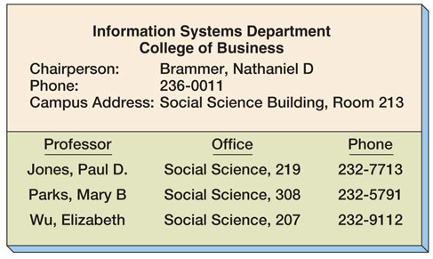
The Department Report

Slide 8
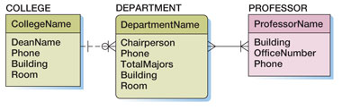
The DEPARTMENT / PROFESSOR Relationship Alternate Model 1: Using an N:M Relationship
This is an N:M relationship

Slide 9
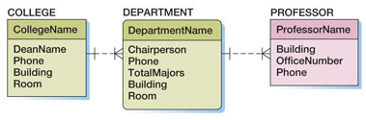
The DEPARTMENT / PROFESSOR Relationship Alternate Model 2: Using a 1:N Relationship
This is a 1:N relationship

Slide 10
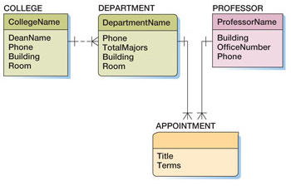
The DEPARTMENT / PROFESSOR Relationship Alternate Model 3: Using an Association Pattern
This is an association pattern

Slide 11
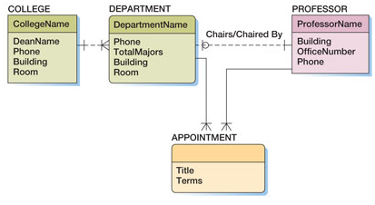
The DEPARTMENT / PROFESSOR Relationship Alternate Model 4 Using a Association Pattern and a 1:N Relationship
This is a 1:1 relationship
This is an association pattern

Slide 12
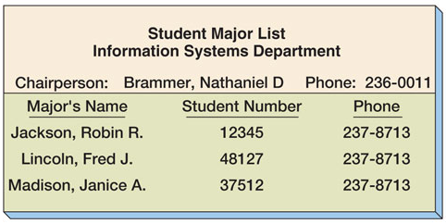
The Department Major Report

Slide 13
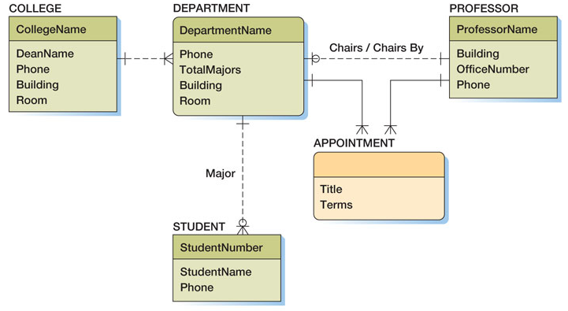
Data Model with STUDENT Entity

Slide 14
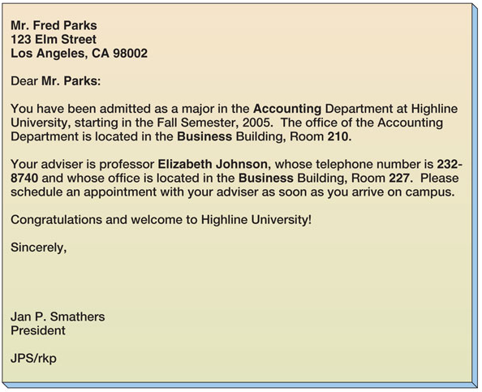
The Student Acceptance Letter

Slide 15
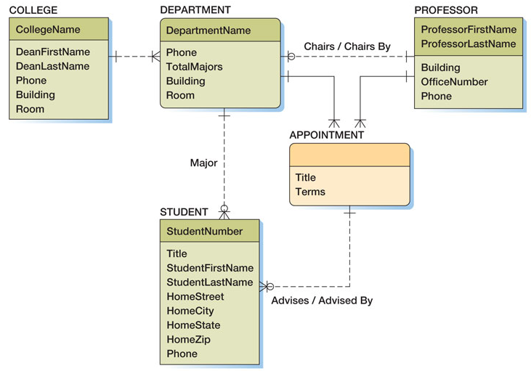
Data Model with Advises Relationship

Slide 16
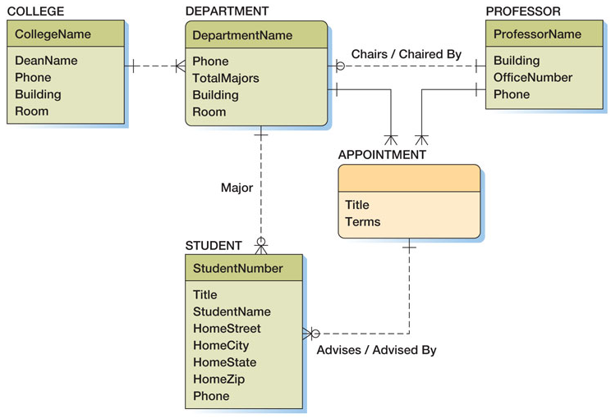
Final Highline University Data Model

