Slide 1
IS 331 Database Design, Management and Applications
Dr. Art Hendela
Database Systems – An Intro

Slide 2
A SNEAK PREVIEW (a.k.a. “Learning Objectives”)
In today’s class, we will know:
What is the big deal with database systems?
Why did Oracle and SQL Server succeed?
How to create a database using MS Access?
You need to:
Define database
Define relationship, primary and foreign key, and metadata
List the three components of a database (page 13)
List the components of a database system (page 15, 16)
Differentiate between database and DBMS
Know the benefits of a DBMS
Know the phases of a database system lifecycle and activities associated with each phase
Be able to create a database using MS Access

Slide 3
Refresh Your Memory…
The purpose of a database is to help people track things of interest to them.
Data is stored in tables, which have rows and columns.
A flatfile database has a single table
A relational database will have multiple table.
Each table stores data about a different thing (entity)
Each row in a table stores data about an entity, i.e., an occurrence or instance of the thing of interest.
Each Column is an attribute that describes the entity

Slide 4
Refresh Your Memory…
For a database to be better than a file processing system, it needs to:
Eliminate or limit redundancy by using only one table for one entity
Address the isolated data storage problem of one program interfering with another. DO this by establishing links between data files (tables) and defining security
Address the data / structural dependence issue by design a mechanism to enable self-contained data description. Keep track of how the data is stored so programs do not over read the end of a data record. Numeric data must remain numeric.

Slide 5
Database Defined
“Self-Describing” means that there are metadata that describes the database itself. A system table keeps track of things like how many bytes a field uses and the name of the field.
A database is a self-describing collection of integrated tables.
“Integrated” means that there are data that describes
The relationships among tables

Slide 6
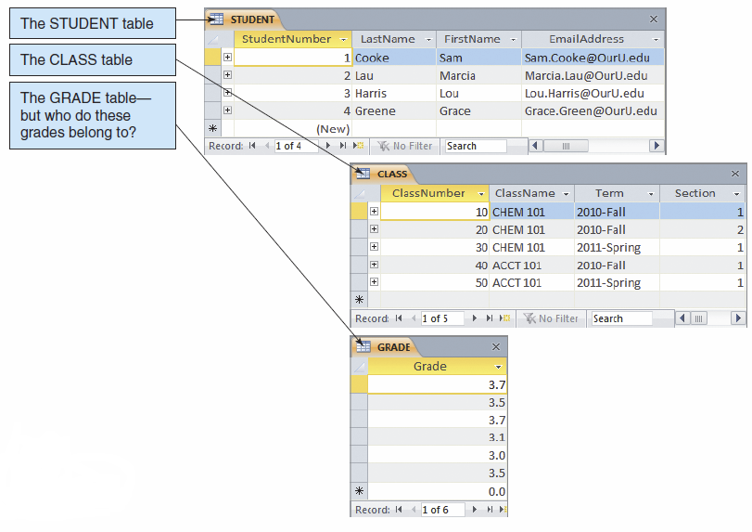
Without Relationships

Slide 7
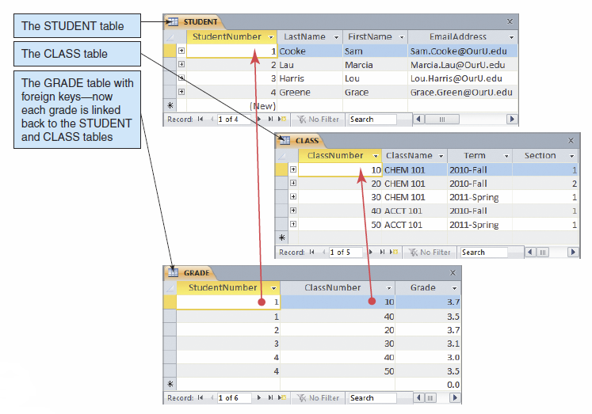
With Relationships

Slide 8
Relationship Defined
A RELATIONSHIP is an association between entities in different entity sets.
There is a RELATIONSHIP between entities (students) in the STUDENT entity set and entities (grades) in the GRADES entity set, namely each student is associated with several grades
A relationship is implemented through primary key – foreign key pairs (more on this later)
Relationship links tables together, solving the isolated data problem

Slide 9
Keys - Revisited
A primary key is a column or group of columns that identifies a unique row in a table
Student Number is the key of the STUDENT table
A foreign key is a non-key column or field in one table that links to a primary key in another table
By definition, a foreign key involves TWO tables
Student Number in the GRADE table

Slide 10
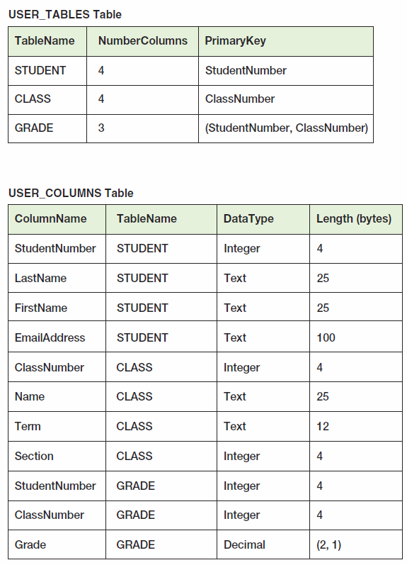
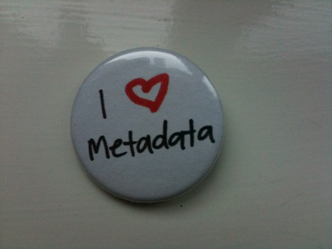
Meta Data – Data About Data
This is a table
But it stores
information about
other tables

Slide 11
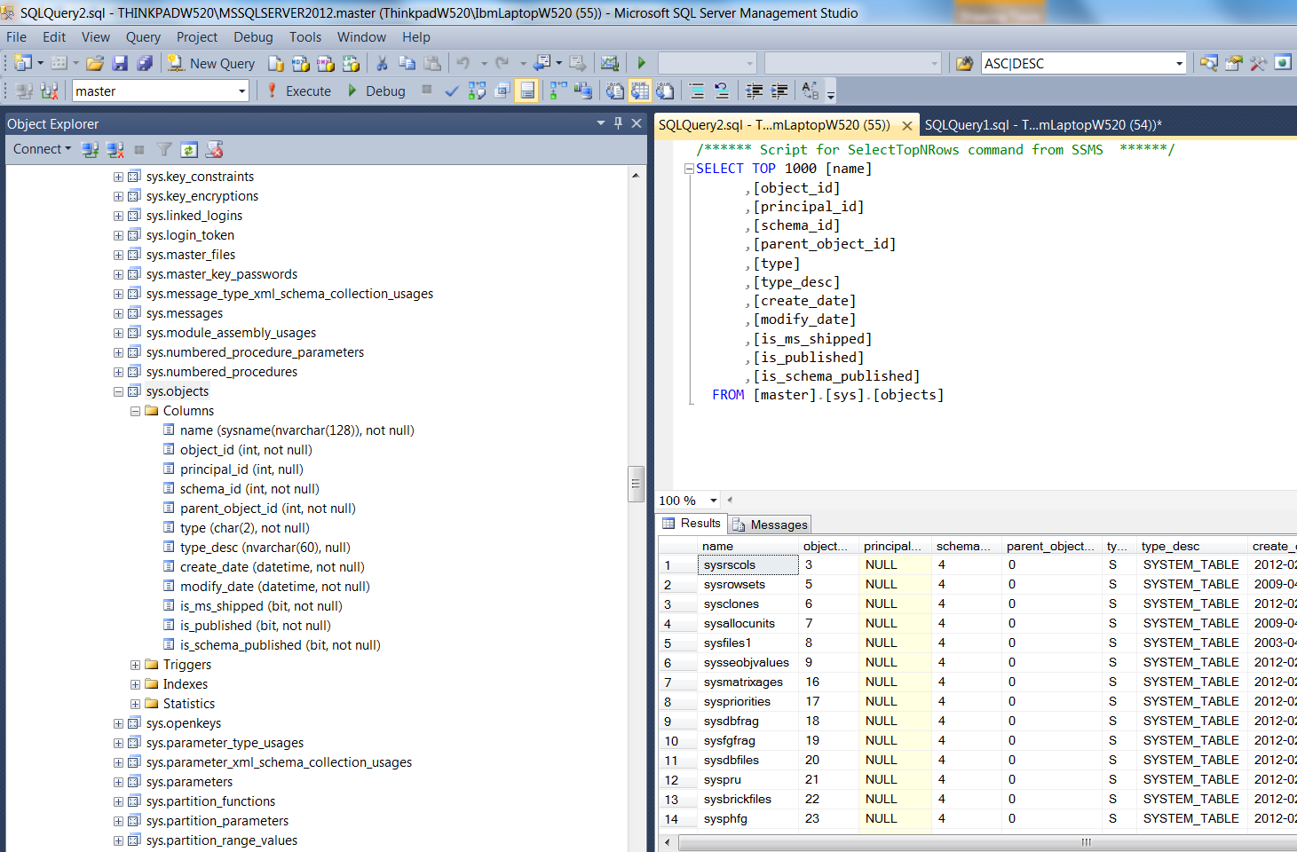
Meta Data in SQL Server

Slide 12
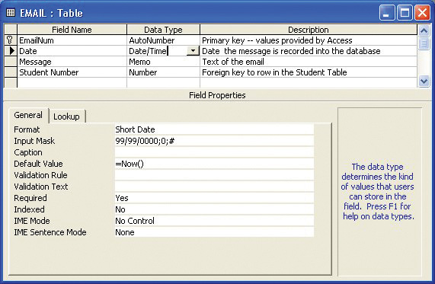
Meta Data in Access

Slide 13
Why Meta Data?
What do we do if we need to make changes to the format or structure of the database?
Split up the “address” field?
Add an “age” column?
NO APPLICATION needs to be involved!
Customer ID | Customer Name | Customer Address | Phone
c1 | Bill Letterman | 10 Henry Street,Union | 7324525256
c2 | Ronald Bieber | 7 Brown Ave, Edgewater | 7329376392
c3 | Patty Lawrence | 23 Bridge Ave, Bridgewater | 9732525235
c4 | Joe Ridings | 34 Baybridge, Brooklyn | 9173452524

Slide 14
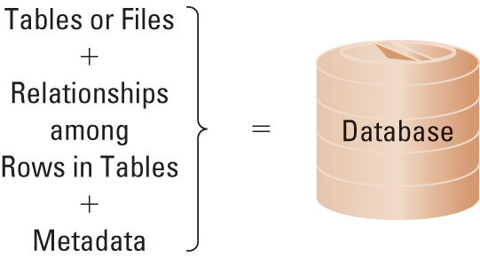
Database: Summary

Slide 15
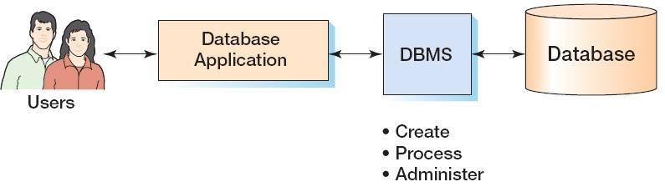
Database != Database System
The DBMS and the database are two different things:
A DBMS is a software program
A database is a collection of tables, relationships, and metadata

Slide 16
Database != Database System
Database: An organized collection of logically related data
Database Management Systems (DBMS): A software package to facilitate the creation and maintenance of a database.
Database system: a computerized record-keeping system, containing database and DBMS as well as some other components.
Four components: Users, Software, Hardware, Data
What do we build: Database, DBMS, or database system?

Slide 17
Database != Database System
Users
End users
Software
interact
Application Programs
Application Programmers
develop
“What” to get
DBMS
Database Administrators
maintain
Data
“How” to get
Database Designers
design
Database

Slide 18
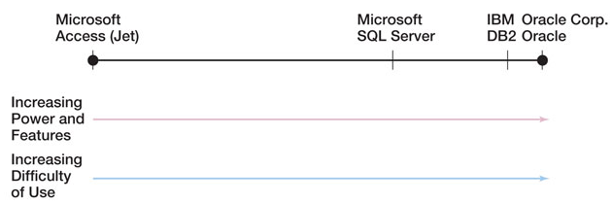
Oracle, DB2, SQL Server, etc…
These are popular DBMS systems
For your future career, I strongly recommend that you become familiar with at least one of the above
“Oracle is #1 in worldwide RDBMS software revenue share. It
holds more revenue share than its seven closest competitors combined, and grew at 18.0 percent, exceeding both the industry average (16.3 percent) and the growth rates of its closest competitors.” *
(*) Source: Market Share: All Software Markets, Worldwide 2011 - March 29, 2012

Slide 19
Why is Oracle Successful?
What are some of the benefits of a DBMS?
Security: can define who access what to a very detailed level
E.g.: Sales can only view customers without a signing date, i.e., “leads”
Integrity: can define specific integrity constraints on attributes values
E.g.: the value of customer age must be integer, positive, and less than 150
Performance: Ad-hoc query = no more waiting!

Slide 20
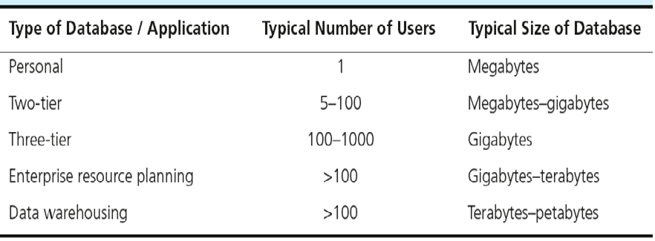
Database Types
“Enterprise Systems” is a better characterization

Slide 21
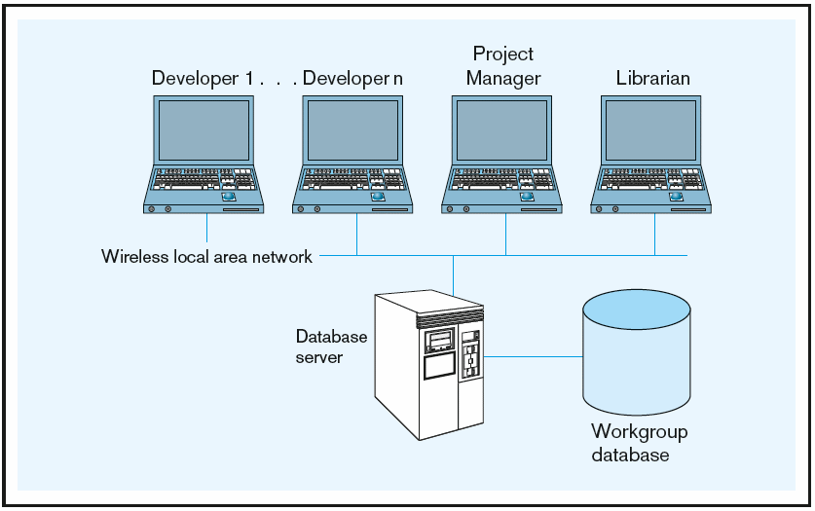
Two Tier
Typical Structure of an internal / back-office database

Slide 22
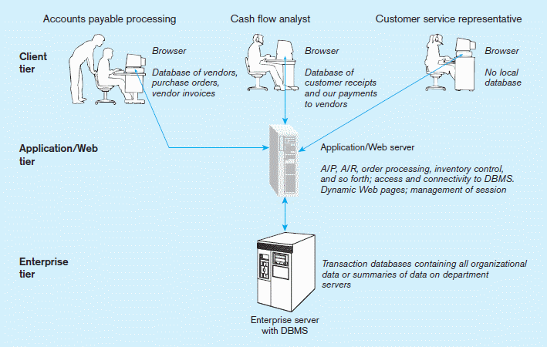
Three Tier
Typical Structure of an external / front-office database

Slide 23
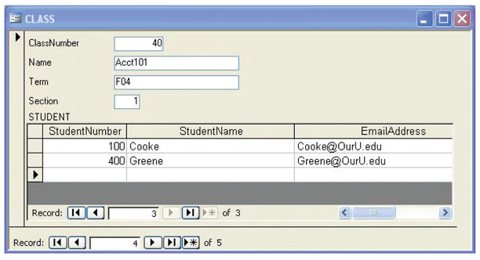
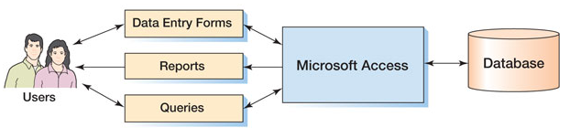
Components of a Database System: Microsoft Access

Slide 24
Microsoft Access
Microsoft Access is a low-end product intended for individual users and small workgroups
MS Access tries to hide much of the underlying database technology from the user
A good strategy for beginners, but not for database professionals
MS Access is discussed in detail in Appendix A (See Moodle board for link)

Slide 25
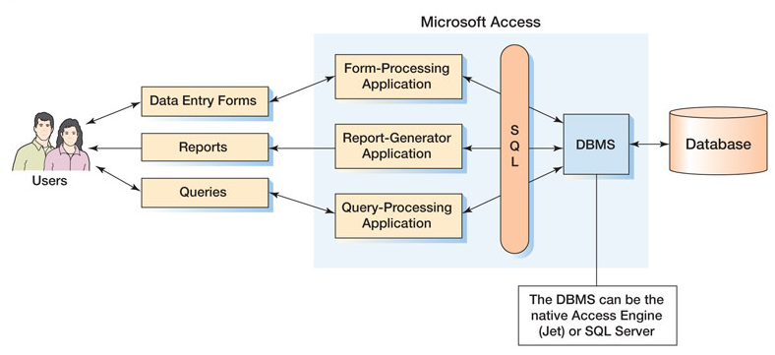
MS Access in Detail

Slide 26
Systems Development Life Cycle
Purpose: preliminary understanding
Deliverable: request for study
Planning
Planning
Conceptual Design
Logical Design
Physical Design
Implementation
Database activity:
enterprise modeling and early conceptual data modeling
Maintenance

Slide 27
Systems Development Life Cycle
Purpose: thorough requirements analysis and structuring
Deliverable: functional system specifications
Planning
Conceptual Design
Analysis
Logical Design
Physical Design
Database activity: thorough and integrated conceptual data modeling (ER Model)
Implementation
Maintenance

Slide 28
Systems Development Life Cycle
Purpose: information requirements elicitation and structure
Deliverable: detailed design specifications
Planning
Conceptual Design
Logical Design
Logical Design
Physical Design
Database activity–
logical database design (relational model)
Implementation
Maintenance

Slide 29
Systems Development Life Cycle
Purpose: develop technology and organizational specifications
Deliverable: program/data structures, technology purchases, organization redesigns
Planning
Conceptual Design
Logical Design
Physical Design
Physical Design
Database activity:
physical database design (define database to DBMS, physical data organization, database processing programs)
Implementation
Maintenance

Slide 30
Systems Development Life Cycle
Purpose: programming, testing, training, installation, documenting
Deliverable: operational programs, documentation, training materials
Planning
Conceptual Design
Logical Design
Physical Design
Database activity–
database implementation, including coded programs, documentation, installation and conversion
Implementation
Implementation
Maintenance

Slide 31
Systems Development Life Cycle
Planning
Purpose–monitor, repair, enhance
Deliverable–periodic audits
Conceptual Design
Logical Design
Physical Design
Database activity–
database maintenance, performance analysis and tuning, error corrections
Implementation
Maintenance
Maintenance

Slide 32
Textbook Topics vs. Lifecycle Model
Planning
Conceptual Design
Logical Design
DB Redesign
Physical Design
Implementation
From Existing Data
Maintenance
New Systems Development

