Slide 1
IS 331 Database Design, Management and Applications
Dr. Art Hendela
File Processing Systems

Slide 2
THIS WEEK’s Learning Objectives
In today’s class, we will know:
Why is Excel NOT a database system?
What problems occur with flat file systems?
You need to:
Define a File Processing System
Define data anomaly
Define data dependence & functional dependence
Give examples of a file processing system’s update, deletion and insertion anomaly
List the limitations of a file processing system
Understand the root cause of file processing system’s problems
Isolated data storage
Lack of self-contained data description

Slide 3
Review of Last Week
What did we do last week?
Data, information, knowledge
From manual file systems to flat file databases
Entity, attribute, primary key

Slide 4
After Flat File Databases…
The advantage of a flat file database system?
Easy to generate, easy to maintain
Fast – no overhead
The disadvantages?
Functionality
Scope

Slide 5
File Processing Systems
File Processing System: A collection of application programs that perform services for the end-users such as producing reports.
Early attempts computerized the manual filing approach
Developed in C, COBOL or other languages
Each program managed its own data
Overseen by Data Processing (DP) staff

Slide 6



Introducing “NJIA”
New Jersey Investment Advisors
Founded in 1970, employee owned investment advisor
Registered with SEC
Provides services to corporate and public pension funds, endowments, foundations and high net-worth individuals
Clients

Slide 7
Sam the Sales Manager
Sam works in the field, introducing NJIA’s 19 different mutual funds to potential clients (leads)
Sam needs to store information about:
The funds: fund id and fund name, date created, current share price, investment minimum, annual returns
Leads: name, phone number, note to self

Slide 8
Oliver the Operations Guy
Oliver maintains the clients’ contact database, making sure it is up to date and accurate
Oliver needs to store information about:
Clients: ID, name, address, phone number
Client History: ID, signing date, value (a 5-point scale that measures how valuable a customer is to the firm)

Slide 9
Claire the Client Manager
Claire’s main job is to handle customer complaints and generate quarterly reports for customers
Claire needs to use information about:
Customers: ID, name, address, phone number
Customer Portfolio: ID, fund ID, quarter, original value, current value

Slide 10
Help building a file processing system
Sam
The funds: fund id and fund name, date created, current share price, investment minimum, annual returns
Leads: name, phone number, note to self
Oliver
Clients: ID, name, address, phone number
Client History: ID, signing date, value (a 5-point scale that measures how valuable a customer is to the firm)
Claire
Customers: ID, name, address, phone number
Customer Portfolio: ID, fund ID, quarter, original value, current value

Slide 11
Sales Files
Sam
Fund table
Lead table
Fund ID | Fund Name | Date | Share Price | Minimum | Return
1 | Core Growth | 12/6/1986 | 41.26 | 5000 | 13%
2 | Emerging India | 4/26/2011 | 2.5 | 2000 | -8%
3 | Emerging Small Cap | 10/1/2007 | 1.8 | 1000 | 4%
4 | Heritage Growth | 4/21/1990 | 12.42 | 4000 | 2%
5 | Large Cap | 2/3/1989 | 24.21 | 2000 | 6%
Customer Name | Address | Phone | Note
Bill | 10 Henry St | 9173452524 | Loves Golf
Patty | 23 Bridge Ave | 7329376392 | Risk Averse
Bob | 4 Duke Blvd | 9732525235 | Retire By 40
Ron | 7 Brown Ave | 7324525256 | Son going to College

Slide 12
Operations Files
Oliver
Customer Table
History Table
Customer ID | Last Name | First Name | Address | City | State | Phone
001 | Letterman | William | 10 Henry Street | Union | NJ | 7324525256
002 | Bieber | Ronald | 7 Brown Ave | Edgewater | NJ | 7329376392
003 | Lawrence | Patricia | 23 Bridge Ave | Bridgewater | NJ | 9732525235
004 | Ridings | Joe | 34 Baybridge | Brooklyn | NY | 9173452524
Customer ID | Signing_Date | Value
001 | 2/19/1996 | 5
002 | 3/2/2000 | 3
003 | 7/3/2001 | 2
004 | 4/3/2004 | 4

Slide 13
Client Relation Files
Customer Table
History Table
Customer ID | Customer Name | Customer Address | Phone
c1 | Bill Letterman | 10 Henry Street,Union | 7324525256
c2 | Ronald Bieber | 7 Brown Ave, Edgewater | 7329376392
c3 | Patty Lawrence | 23 Bridge Ave, Bridgewater | 9732525235
c4 | Joe Ridings | 34 Baybridge, Brooklyn | 9173452524
Customer ID | Fund ID | Quarter | Original Value | Current Value
c1 | 1 | 2011_1 | 3000 | 3420
c1 | 1 | 2011_2 | 3420 | 3650
c1 | 3 | 2011_1 | 45002 | 46032
c1 | 3 | 2011_2 | 46032 | 47423
c2 | 2 | 2012_1 | 2300 | 2542
c2 | 2 | 2012_2 | 2542 | 2325
c3 | 3 | 2004_1 | 5400 | 5760
c3 | 3 | 2004_2 | 5760 | 5504
c3 | 3 | 2004_3 | 5504 | 5636
c3 | 3 | 2004_4 | 5636 | 4532
c4 | 1 | 2012_1 | 20504 | 22035
c4 | 4 | 2011_4 | 3023 | 3220
c4 | 4 | 2012_1 | 3220 | 3500
c4 | 4 | 2012_2 | 3500 | 3650

Slide 14
Physical Implementation
A Personal SnapDB Database
A File System Written in C++ For Queries
No Access to Non- Operation Personnel
An Excel Workbook with Macros as query tools

Slide 15
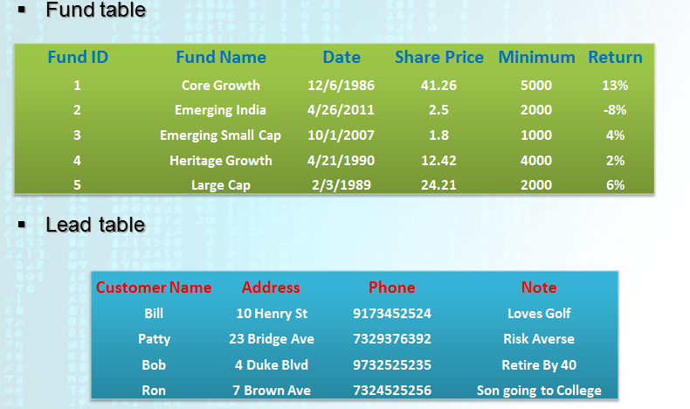
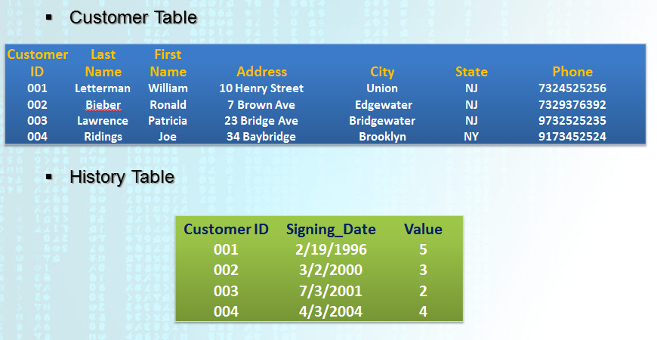
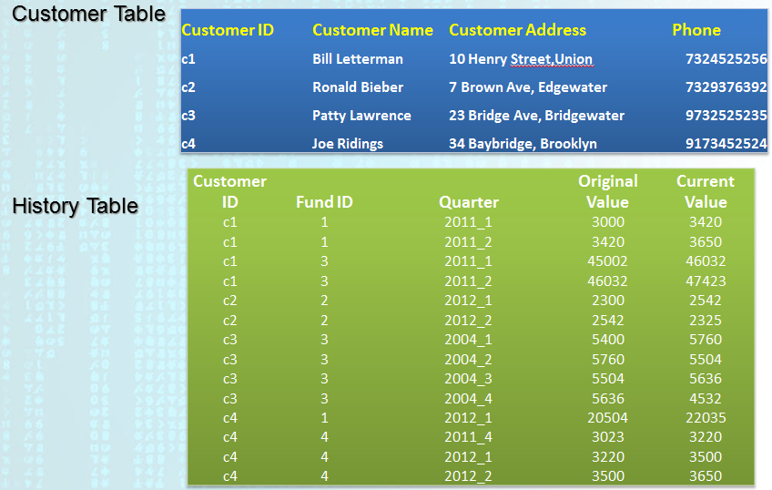
What Are The Problems?

Slide 16
File Processing System Limitations
Redundancy: Why is it bad?
How many versions of “customer” table do we have?
What happens if Bill Letterman calls Claire, telling her that he has just moved?
What happens if Sam adds a new lead to his table?
Who should we trust if we are to build a quarterly report?
Customer ID | Customer Name | Customer Address | Phone
c1 | Bill Letterman | 10 Henry Street,Union | 7324525256
c2 | Ronald Bieber | 7 Brown Ave, Edgewater | 7329376392
c3 | Patty Lawrence | 23 Bridge Ave, Bridgewater | 9732525235
c4 | Joe Ridings | 34 Baybridge, Brooklyn | 9173452524
Customer ID | Last Name | First Name | Address | City | State | Phone
001 | Letterman | William | 10 Henry Street | Union | NJ | 7324525256
002 | Bieber | Ronald | 7 Brown Ave | Edgewater | NJ | 7329376392
003 | Lawrence | Patricia | 23 Bridge Ave | Bridgewater | NJ | 9732525235
004 | Ridings | Joe | 34 Baybridge | Brooklyn | NY | 9173452524

Slide 17
File Processing System Limitations
Redundancy: Why is it bad?
Wasteful Space
Update Inefficiency
Inconsistency: Data Anomalies
Update Anomaly: happens when the same attribute in different tables fails to be updated simultaneously
Insertion Anomaly: happens when a new record is added to one table without adding relevant data in other tables
Deletion Anomaly: happens when a record is deleted in one table without deleting all records in other tables that are related to it

Slide 18
File Processing System Limitations
Access to Data
Claire needs to know more about her clients, she wants to know their history…
The CEO wants a report that shows whether the “value” rating for customers are consistent with their portfolio info…
Customer ID | Signing_Date | Value
001 | 2/19/1996 | 5
002 | 3/2/2000 | 3
003 | 7/3/2001 | 2
004 | 4/3/2004 | 4
Customer ID | Fund ID | Quarter | Original Value | Current Value
c1 | 1 | 2011_1 | 3000 | 3420
c1 | 1 | 2011_2 | 3420 | 3650
c1 | 3 | 2011_1 | 45002 | 46032
c1 | 3 | 2011_2 | 46032 | 47423
c2 | 2 | 2012_1 | 2300 | 2542
c2 | 2 | 2012_2 | 2542 | 2325

Slide 19
File Processing System Limitations
(Tough one) Lack of Data Independence
If we split up the “address” field into city and state, all related programs have to change accordingly
Data Dependence: change of data characteristics requires change of the file descriptions in all programs that access the file
Data dependence exists because the application programs have to describe “how” to read/write data
Data dependence makes it hard to change a file once it is created

Slide 20
File Processing System Limitations
Lack of Structural Independence
If we add a new field “customer age”, all related programs have to change accordingly
Structural Dependence: change of file structure requires change of the file descriptions in all programs that access the file
Structural dependence also exists because the application programs have to describe “how” to read/write data

Slide 21
The Cause of Data & Structural Dependence
To change data format, I need to change…
App 1
Read first string,
assign its value
to the variable
“Customer ID”
c1 1 2011_1 3000 3420
c1 1 2011_2 3420 3650
c1 3 2011_1 45002 46032
c1 3 2011_2 46032 47423
c2 2 2012_1 2300 2542
c2 2 2012_2 2542 2325
c3 3 2004_1 5400 5760
App 2
Read second string,
assign its value
to the variable
“Fund ID”
App 3
The Files Alone In a File Processing System
Do Not Carry Description of Data

Slide 22
Other Considerations
Long development times
What if we need a new query?
Excessive Program Maintenance
Weak Recovery and Security Features

Slide 23
File Processing System Summary
A system that is out of date
Problems arise because of
Isolated data file storage
limited sharing
redundancy (duplication)
data anomalies caused by lack of integration among files
Data description is imbedded in the application programs
data dependency
structural dependency

