Slide 1
IS 331 Database Design, Management and Applications
By Art Hendela/ Mark Chiusano
INTRODUCTION

Slide 2
A SNEAK PREVIEW (a.k.a. “Learning Objectives”)
In today’s class, we will discuss:
Who am I ?
Who are you ?
What are we going to do ?

Slide 3
Let’s get to know each other
One of my research interest is in self generative systems utilizing advanced database methods
I have a degree in Physics from Rutgers
Created and worked on patented technologies
Very experienced with database software and technology
Have run my own research & development private consulting company for 41 years.
And I am here to share with you my experiences in the field of database design and more
What about you? Who are you?

Slide 4
Your Turn
Introduce yourself in Canvas
This is your chance to share with us your background, your experiences in database and any concerns you might have
Tell me if there are particular topics that you want to learn

Slide 5
MY STYLE
It is my duty to:
Combine my years of experience and the knowledge from many textbooks, translate them into PowerPoint slides, and post them online
Be accessible to you during my office hours, through Canvas, and by email.
Listen to your concerns and feedback, and make adjustments

Slide 6
YOUR JOB
It is your job to:
LOG ON TO Canvas REGULARLY
I would recommend at least three times per week
SPEND 9 – 12 HOURS PER WEEK
SUBMIT HOMEWORK ON TIME
Do not be late on assignments!!! Lateness is unacceptable. Not only do you not get the assignment credit, you lower your participation score.
CHEATING IS NOT TOLERATED!
Any student found cheating on any exam or homework/project assignment receives an automatic F in the assignment and is referred to the Dean of Students.

Slide 7
HOW TO GET THE MOST OUT OF THIS COURSE? (or: How do I get an “A” / “B” / pass, etc…)
Work HARD!
Use the resources on Canvas
Form a good rhythm…
Try to set up regular time to study for this course.
Divide your weekly study time into two or more sessions.
AND – do NOT be afraid to reach out to me

Slide 8
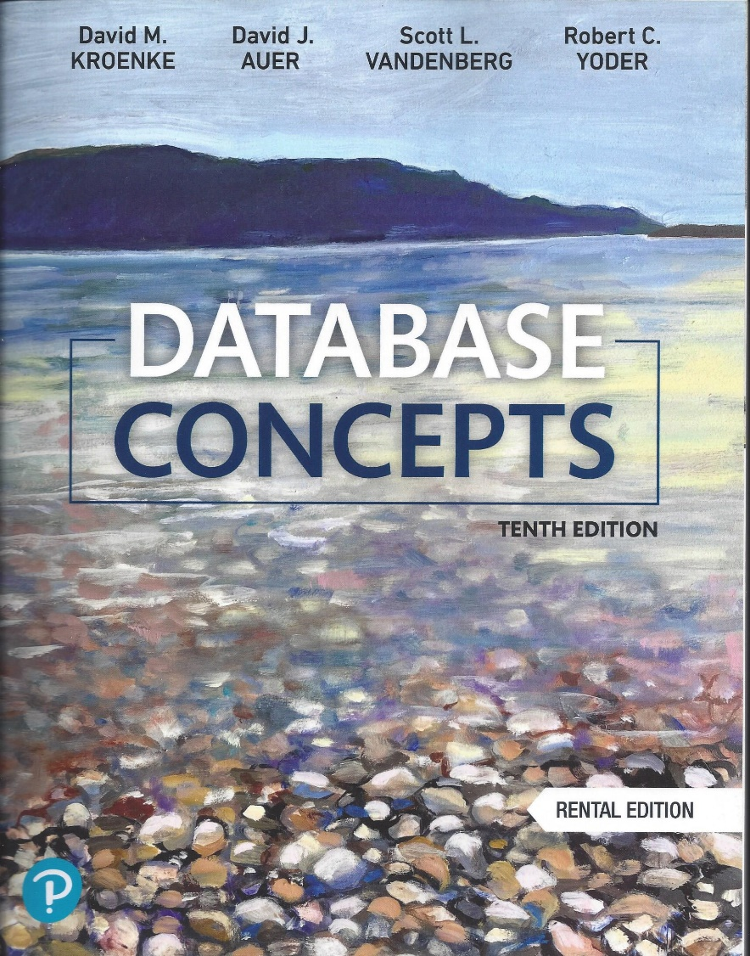
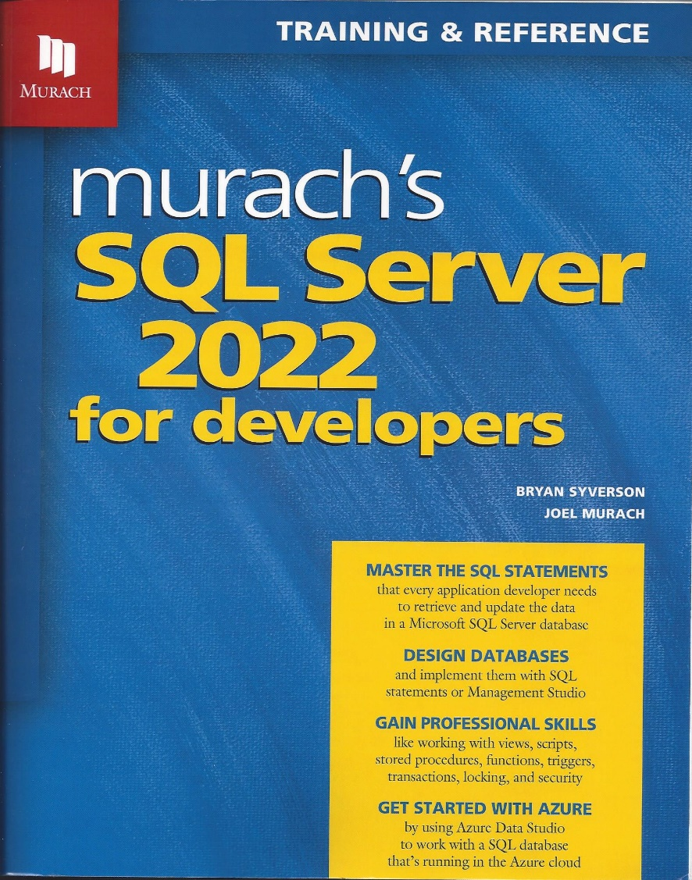
WHAT ARE THE TEXTBOOKS FOR THIS COURSE?

Slide 9
HOW WILL THE COURSE GRADE BE DETERMINED?
There are four components to your grade:
Midterm Exam - 29%
Final Examination 29%
Conceptual Assignments, DBMS Projects 30%
Class Participation and Attendance 12% - – If you miss an assignment this grade goes down

Slide 10
WHAT KIND OF PROGRAMMING / HANDS-ON ACTIVITIES WILL WE HAVE ?
You will be exposed to some of the most popular database tools available in today’s market, including:
Excel (a spreadsheet)
Microsoft Access (world’s leading desktop RDBMS), particularly its Graphical Query-By-Example, which allows us to generate SQL from a graphical query design
SQL Server
Oracle
Other commercial database products as time permits

Slide 11
HOWEVER…
This is NOT just a class about SQL or DBMS
The hands-on experience with SQL is in the second half of the semester.
There are many poorly designed databases which are the reason for slow web site queries and sub-optimal system performance
The goal is to help you become a strong database Designer and Developer

Slide 12
WHY ARE WE HERE?
There are many technologies out there today, we do not create one course for each of them. Why database then? Why not ERP (Enterprise Resource Planning), CRM (Customer Relationship Management), SCM (Supply Chain Management), etc.
What can you do with database knowledge and SQL Server or Oracle on your resume?

Slide 13
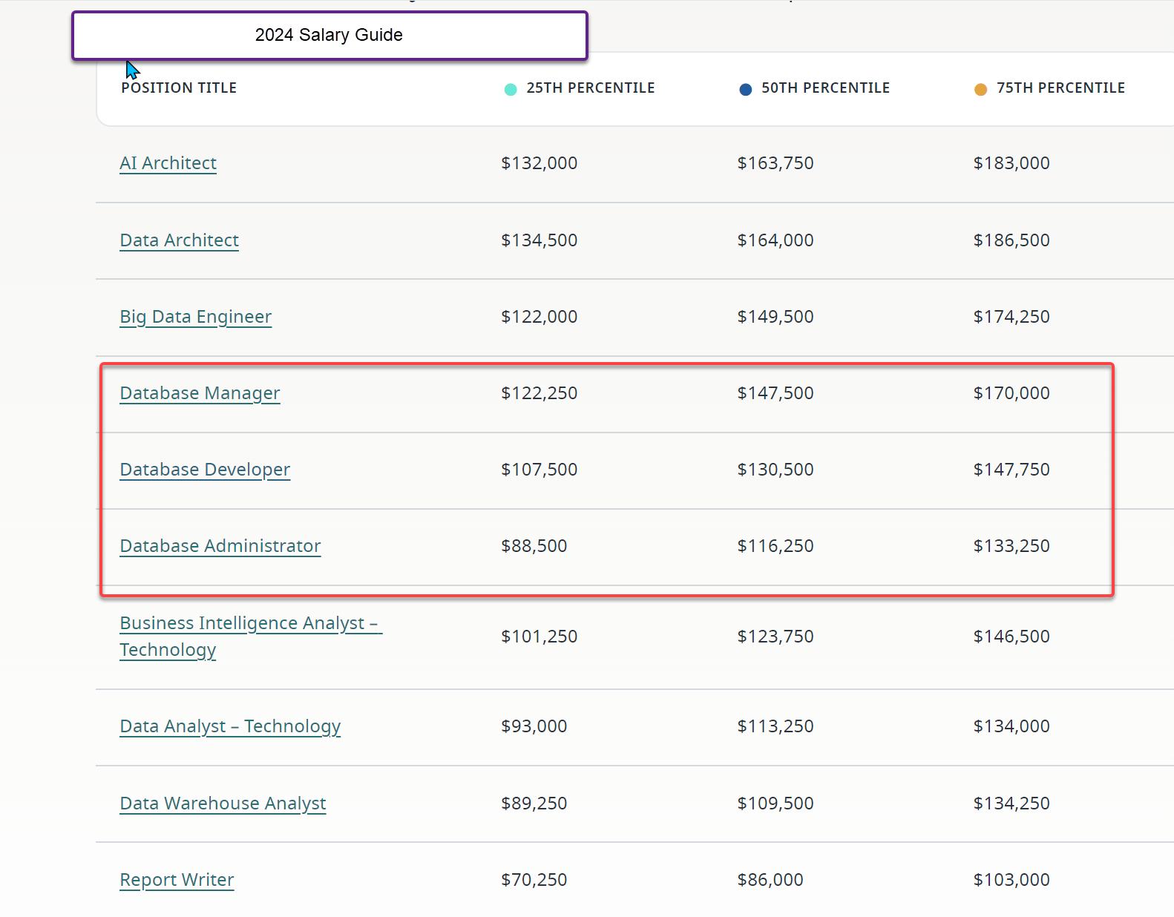
Some Career Options This Course Opens For You
After this class, you will be ready for these career tracks
Source: Robert Half Technology 2024 IT Salary Guides

Slide 14
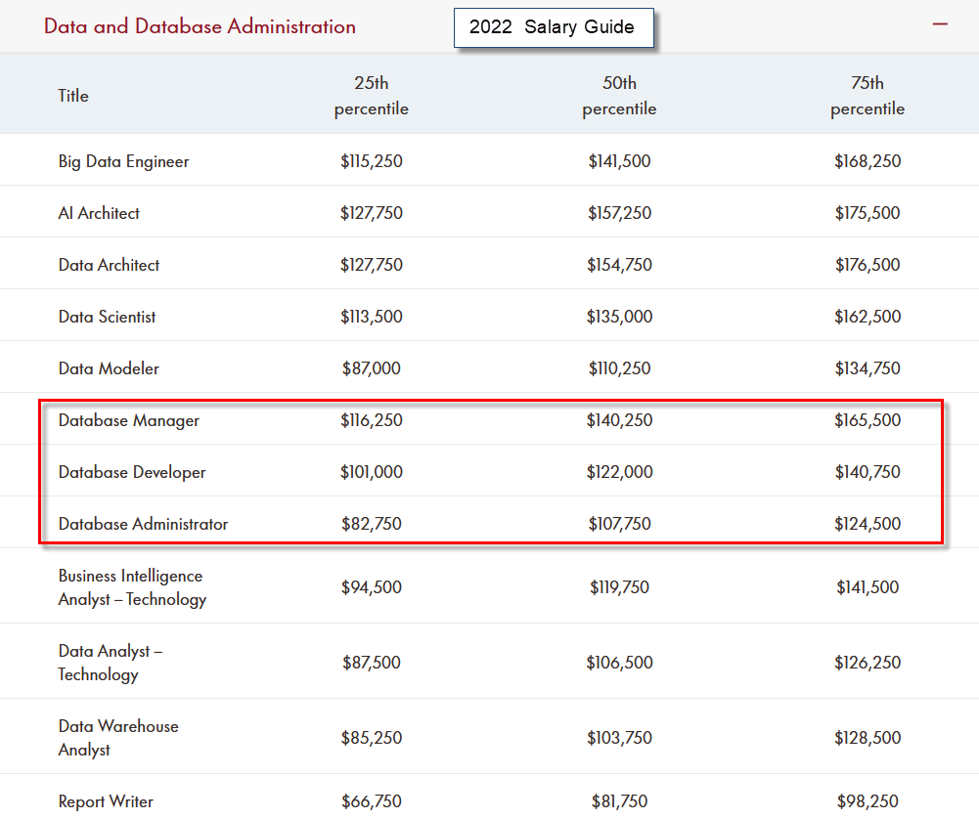
Some Career Options This Course Opens For You
After this class, you will be ready for these career tracks
Source: Robert Half Technology 2022 IT Salary Guides

Slide 15
A SNEAK PREVIEW
In this part, we will:
Define data, information & knowledge and differentiate them
Understand the limitations of a manual file system
Define the following terms:
Table
Entity
Column (Attribute)
Row (Instance)
Primary Key

Slide 16
Let us begin with…
Data: What is it?
Set of discrete, objective facts about events
Are these data?
Your GPA
Your Facebook profile
Your video blog

Slide 17
Information
Information: the reason we build databases
Put data into a meaningful context
Process data by summing, ordering, averaging, grouping, comparing, or other similar operations
Example?

Slide 18
Knowledge
Knowledge: the ultimate goal
Data further refined
Information based on the expertise of the subject
What is the context of the data that gives it meaning to be able to use it to make a decision?

Slide 19
Put them altogether…
The Number 4.0
Information
4.0 GPA
Knowledge
Hire the person with the highest grade point average
Data

Slide 20
Put them altogether…
A. Berger
M. Jones
T. Martin
J. Smith
Shoes
Scarves
Jewelry
Groceries
A. Berger is most
likely to buy new
product
John Smith
Taurus
Database Queries
?
50,000
234
wireless
Amex Gold
Ted Martin
Anna Berger
50,000
46,800
29,200
75,500
MoU
Qty
Income
Education
B.A.
T. Martin is profitable
customer and is likely
to switch carriers
shoes
Data
Information
Knowledge &
Customer Insight
In this class, we will learn: how to store data how to produce information using the data
Some of the images above come from a presentation given by:
®

Slide 21

A Brief History of Data
BEFORE COMPUTERS…
What’s the catch?
Let’s assume that you have a file cabinet storing your everyday receipts (confession: I am not that organized!)
Can you:
Quickly locate all purchases you made last Friday?
Quickly sum up total expense for last week?

Slide 22
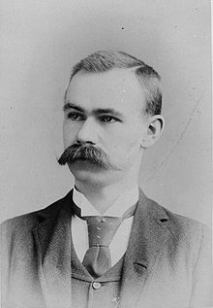
A Brief History of Data
Data management, the early days (1960’s – late 1970’s)
Flat File Database
Chao’s note: Herman Hollerith has a legendary life, and the story about how he came up with the idea of punched card, the earliest form of a flat file database, is interesting
Herman Hollerith

Slide 23
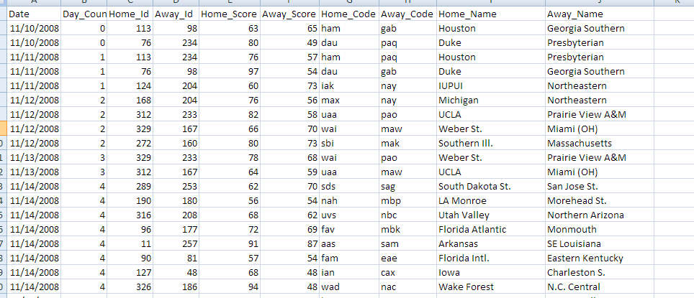
Flat File Database
As its name suggests, the flat file database stores information on a flat file (think txt or even Excel if it helps you to understand)
Although simple, flat file databases set up the “norm” for how to store data
And is a perfect tool for us to learn some terminology!
A flat file database example, showing NCAA game records

Slide 24
Let’s Build a Stock Database
A TABLE is a two-dimensional structure used to store data in flat file (and many other forms of) databases
A table usually captures information about a group of similar objects – entities
What are the entities we are trying to capture in the stock flat file database?

Slide 25
Let’s Build a Stock Database
What information should I capture for each stock?
ATTRIBUTES: A list of characteristics that collectively describe the entity
Also known as “columns”, or “fields”, depending on your discipline

Slide 26
Let’s Build a Stock Database
We record the table and attributes in the following format:
TABLE_NAME (Attribute 1, Attribute 2, …)
For the stock database:
Symbol The stock symbol that you chose
Date The date of the stock data
Open Open Price
High The highest daily price
Low The lowest price during the day
Close The closing price for the day
PivotPoint The average of the High, Low, and Close prices
Volume The number of shares traded during the day.
CompanyName(Symbol, Date, Open, High, Low, Close, PivotPoint, Volume)

Slide 27
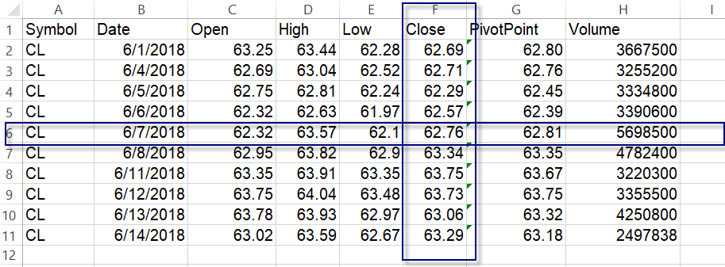
Let’s Build a Stock Database
Attribute: Column
Tuple: Row
The Intersection between a column and a row is called a cell

Slide 28
Let’s Build a Stock Database
ROWS: each row in the table stores information about a unique object / entity
Also known as an “instance” of this entity type
Can two rows be redundant?
Can some values from some attributes be missing for a row?
How can we uniquely identify a row in a table?
Chao’s Note: No two rows can be redundant, but some cells could have null value, i.e., no value

Slide 29
Let’s Build a Stock Database
Primary Key: The “unique identifier” of a row in a database
It could be one attribute or multiple attributes
What is the primary key of the table “stock”?
Stock(Symbol, Date, Open, High, Low, Close, PivotPoint, Volume)
Note: The answer is: Symbol + Date

Slide 30
Looking Back…
We now know the typical data structure used to store data:
Table
Attribute
Row
Primary Key
However, we are still limited to ONE table and ONE file

Slide 31
Looking Forward…
In the next class, we will discuss the next stage of data management – the file processing systems

Slide 32
Assignment 2
You will need to use Excel, to create a flat file database.
Explanations of how to use this tool are posted in Canvas*

