Slide 1
IS 331 Database Design, Management and Applications
Dr. Art Hendela
DAY 8: Logical Design (II)
Requirement Analysis
Conceptual Design
Logical Design
Physical Design
Implementation
Maintenance

Slide 2
Preview
Translate an ERD into a relational model
Link conceptual design with logical design
NOTE: You are not required to memorize all the steps.
Follow the steps through three or four cases and it will become instinctive

Slide 3
Overview
How to transform the following types of EERDs into relations:
Regular Entity types (Step 1)
Multi-value attributes (Step 2)
ID-Dependent Entity types (Step 3)
Binary m:n relationship types (Step 4)
Binary 1:m relationship types (Step 5)
Binary 1:1 relationship types (Step 6)
N-ary relationship types (Step 7)
Super/sub types (Step 8)

Slide 4
Road Map for Logical Design
Data Structure
Understand Relational Model
Data Integrity
Translate ER Into Relational Model
Data Manipulation
Logical Design
How to Translate?
Normalization

Slide 5
Textbook Chapter 6
We will use a modified methodology from the book’s coverage
I believe the slides offer a simpler learning process
We will skip more complicated or detailed topics such as normalization and datatypes until later

Slide 6
From Conceptual to Logical
What do we have?
EER Diagram
Entities
Relationships
Attributes
Super/sub types
What do we want?
Relations
Attributes
Keys

Slide 7
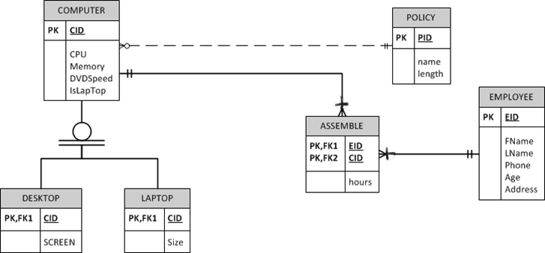
The TCI Example
Let’s turn it into a relational model!

Slide 8
ER to Relational: Step 1
Regular entity classes
Create one table for each entity type
Create the corresponding attribute in the table for each simple attribute in the entity
Only include simple attributes such as address. Do not include composite attributes such as Street, State, Zip that are subdivisions of Address Add only “Address”
Do Not include derived attributes
Do Not include multi-value attributes
Make the identifier of the entity the primary key for the table

Slide 9
ER to Relational: Step1
EMPLOYEE (EID, Fname, Lname, Phone, Age, Address)

Slide 10
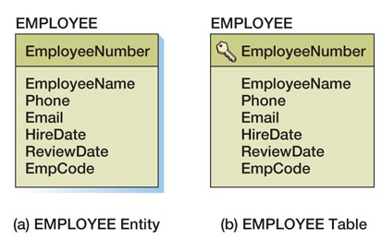
Book Notation vs. Our Notation
The Book:
The Class (for homework and exams):
EMPLOYEE (EmployeeNumber, Ename, Phone, Email, HireDate, Rdat, EmpCode)
Benefit:
No more VISIO homework for relational modeling
Avoid confusion with the data model

Slide 11
ER to Relational: Step2
Multi-value attributes:
Create a table for EACH multi-value attribute
This table should contain two attributes:
The primary key of the entity
The attribute that is multi-valued
Primary key of this table: Two attributes together
Foreign key in this table: primary key of the entity
This is what the book calls “multi-valued attribute pattern” in Chapter 6, page 265-267

Slide 12
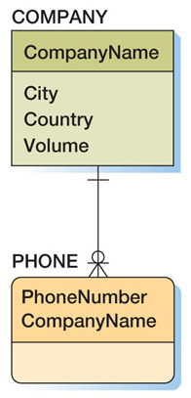
ER to Relational: Step2
Multi-value attributes

Slide 13
ER to Relational : Step2
Employee( EMP#, name, salary)
Emp_phone(EMP#, phone)
Employee_phone
Emp#
Phone
S1
S1
S1
S1
S2
S2
S3
S4
S4
623-4342
612-3221
534-5352
453-3523
612-3221
231-3242
343-2234
625-3424
532-2623
EMP#
NAME
SALARY
S1
S2
S3
S4
S5
Smith
Jones
Blake
Clark
Adams
20
10
30
20
30
Employee

Slide 14
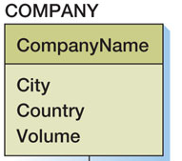
ER to Relational: Step2
Multi-value attributes Exercise:
Contacts
COMPANY (Cname, City, Country, Volume)
COMPANY_CONTACT (Cname, Contact)
FOREIGN KEY Cname REFERENCES COMPANY

Slide 15
ER to Relational: Step3
ID Dependent entity
Create a table for EACH weak entity type
Add to the table one attribute for each simple attribute in the corresponding ID-Dependent entity
Include the primary key of each owner entity type. These are foreign keys
The primary key of the table is:
The primary key of the owner table
The primary key + partial key otherwise

Slide 16

ER to Relational: Step3
ASSEMBLE (EID, CID, Hours)
FOREIGN KEY EID REFERENCES EMPLOYEE;
FOREIGN KEY CID REFERENCES COMPUTER;

Slide 17
ER to Relational: Step3
ASSEMBLE (EID, CID, Hours)
FOREIGN KEY EID REFERENCES EMPLOYEE;
FOREIGN KEY CID REFERENCES COMPUTER;

Slide 18
ER to Relational: Step3
More Examples
FIRST
EMP#
M
MI
NAME
EMPLOYEE
1
EMP_DEP
DEPENDENT
LAST
SALARY
DNAME
GENDER
PHONE
Employee( EMP#, first, mi, last, salary)
Dependent(EMP#, Dname, Gender)
FOREIGN KEY EMP# REFERENCES EMPLOYEE

Slide 19
ER to Relational: Step4
Binary m:n relationships
Create a table for each binary m:n relationship
Make the Primary keys the primary keys of the participating entity types
Make the Foreign keys the primary keys of the participating entity types
Include all other attributes of this relationship
if the relationship has attributes, it is associative entity and should have been taken care of by the previous step
If it slipped through, it will be captured here!
If the relationship has no attributes, the created table has only two keys, and is called an intersection table.

Slide 20
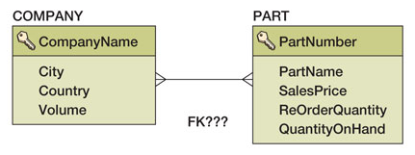
ER to Relational: Step4
COMPANY (Cname, City, Country, Volume)
PART (Pnumber, PartName, SalesPrice, ReOrder, QOnHand)
Insert the Company_part table in between the COMPANY and PART tables, defined below
COMPANY_PART(Cname, Pnumber)
FOREIGN KEY Cname REFERENCES COMPANY
FOREIGN KEY Pnumber REFERENCES PART

Slide 21
ER to Relational: Step 5
Binary 1:m relationships
Create a foreign key in the table on the “many” side
Referencing the table on the “one” side
Do NOT need to introduce a separate table
To memorize: The foreign key “Migrates” to the Many side.

Slide 22
ER to Relational: Step 5
WHO has the foreign key? POLICY or COMPUTER?
COMPUTER (CID, CPU, Memory, DVD, isLaptop, PID)
FOREIGN KEY PID REFERENCES POLICY

Slide 23
ER to Relational: Step 5
More examples
Employee (Emp#, First, MI, Last, Salary, Dept#)
Foreign key: Dept# references Department;
Project (J#, Jname, City, Manager#)
Foreign key: Manager# references Employee;
DEPARTMENT
1
WORK_IN
M
EMPLOYEE
1
PROJ_MANAGE
M
EMPLOYEE
PROJECT

Slide 24
ER to Relational : Step6
Binary 1:1 relationships
Similar to 1:m: There are NO new tables
In 1:m, key migrates to the many side
In 1:1, which side does the foreign key go?
Often, the foreign key goes to the total participation side
DEPARTMENT
1
MANAGE
1
EMPLOYEE
Notes:
1. Introduction:
i. The participation constraint specifies if an entity’s existence depends on its being related to any other entity via the relationship type.
ii. This constraint specifies the minimum number of relationship instances that each entity can participate in, and is sometimes called the minimum cardinality constraint.
2. Total Participation:
i. The participation of an entity set E in a relationship set R is said to be total if every entity in E participates in at least one relationship in R.
ii. Consider two entities EMPLOYEE and DEPARTMENT related with the help of relationship WORKS_FOR.
iii. If a company policy states that every employee must work for a department, then an employee entity can exist only if it participates in at least one WORKS_FOR relationship instance. Thus, the participation of EMPLOYEE in WORKS_FOR is called total participation, meaning that every entity in the total set of employee entities must be related to a department entity via WORKS_FOR.
iv. Total participation is also called existence dependency.
v. Total participation is displayed as a double line in ER diagram connecting the participating entity type to the relationship
3. Partial Participation:
i. If only some entities in entity set E participates in relationships in R, the participation of entity set E in relationship set R is said to be partial.
ii. Consider two entities EMPLOYEE and DEPARTMENT related with the help of relationship MANAGES.
iii. Here, not all employees are expected to manage a department, so the participation of EMPLOYEE in the MANAGES relationship type is partial.
iv. Thismeans that some or part of the set of employee entities are related to some department entity via MANAGES, but not necessarily all.

Slide 25
ER to Relational: Step7
N-ary relationships
Each n-ary (n>2) relationship type maps into a table.
The primary key of this new table is the combination of the primary keys of the participating entity types.
These keys are also foreign keys.
Attributes of the relationship type maps to attributes of the table. This is similar to those of regular entity types
Very similar to m:n relationships

Slide 26
ER to Relational: Step7
S#
N-ary relationships
SNAME
J#
SUPPLIER
STATUS
JNAME
M
CITY
CITY
TOTQTY
TOTQTY
M
SPJ
PROJECT
QTY
SPJ(S#, P#, J#, QTY)
Foreign key (S#) References Supplier,
Foreign key (P#) References Part,
Foreign key (J#) References Project;
P#
M
PNAME
PART
COLOR
WEIGHT

Slide 27
ER to Relational: Step 8
Super/sub types
The super type maps into a base table.
Each subtype maps into another base table.
The primary key is the same as the primary key of its super type.
This is also a foreign key.
Treat attributes that belongs to the sub type as usual.
The primary key of the root entity propagates down the hierarchy of entity types

Slide 28
ER to Relational: Step 8
COMPUTER (CID, CPU, Memory, DVD, isLaptop, PID)
FOREIGN KEY PID REFERENCES POLICY
DESKTOP (CID, Screen)
FOREIGN KEY CID REFERENCES COMPUTER
LAPTOP (CID, Size)
FOREIGN KEY CID REFERENCES COMPUTER

Slide 29
ER to Relational: Step 8
Employee(Emp#, First, MI, Last, Salary, Dept#)
Programmer (Emp#, Language)
FOREIGN KEY Emp# REFERENECES Employee;
SYS_Prog (Emp#, OS)
FOREIGN KEY(Emp#) REFERENECES Programmer;
APP_Prog (Emp#, Web_Based)
FOREIGN KEY(Emp#) REFERENECES Programmer;
EMPLOYEE
LANGUAGE
PROGRAMMER
APP_PROG
SYS_PROG
WEB_BASED
OS

Slide 30
Another Case
DEPT#
DNAME
S#
DEPARTMENT
CITY
SNAME
1
1
J#
SUPPLIER
STATUS
MANAGE
WORK_IN
JNAME
M
M
CITY
CITY
TOTQTY
TOTQTY
FIRST
EMP#
1
M
MI
NAME
M
SPJ
SP
EMPLOYEE
PROJ_MANAGE
PROJECT
LAST
SALARY
1
1
M
QTY
QTY
PHONE
P#
M
PNAME
LANGUAGE
PROGRAMMER
M
EMP_DEP
PART
COLOR
M
M
WEIGHT
M
Container
Component
CITY
APP_PROG
SYS_PROG
DEPENDENT
TOTQTY
CONTAIN
WEB_BASED
OS
DNAME
GENDER
QTY

Slide 31
Solution for This Case
Department(Dept#, Dname, City, Manager#) FOREIGN KEY (Manager#) REFERENCES Employee;
Employee(Emp#, First, MI, Last, Salary, Dept#) FOREIGN KEY (Dept#) REFERENCES Department;
Supplier(S#, Sname, City, Status);
Part(P#, Pname, Color, Weight, City);
Project(J#, Jname, City, Manager#) FOREIGN KEY (Manager#) REFERENCES Employee;
Proj_Work(Emp#, J#) FOREIGN KEY (Emp#) REFERENCES Employee, FOREIGN KEY (J#) REFERENCES Project;

Slide 32
Solution for This Case
SP(S#, P#, QTY)
FOREIGN KEY (S#) REFERENCES Supplier,
FOREIGN KEY (P#) REFERENCES Part;
Contain(Cont_P#, Comp_P#, QTY)
FOREIGN KEY (Cont_P#) REFERENCES Part,
FOREIGN KEY (Comp_P#) REFERENCES Part;
SPJ(S#, P#, J#, QTY)
FOREIGN KEY (S#) REFERENCES Supplier,
FOREIGN KEY (P#) REFERENCES Part,
FOREIGN KEY (J#) REFERENCES Project;
Dependent(Emp#, Dname#, Gender)
FOREIGN KEY (Emp#) REFERENCES Employee;

Slide 33
Solution for This Case
Emp_Phone (Emp#, Phone)
FOREIGN KEY (Emp#) REFERENCES Employee;
Programmer (Emp#, Language)
FOREIGN KEY (Emp#) REFERENCES Employee;
SYS_Prog (Emp#, OS)
FOREIGN KEY (Emp#) REFERENCES Programmer;
APP_Prog (Emp#, Web_Based)
FOREIGN KEY (Emp#) REFERENCES Programmer;
Totally 14 relations.

