Slide 1
Wafer Module

Slide 2
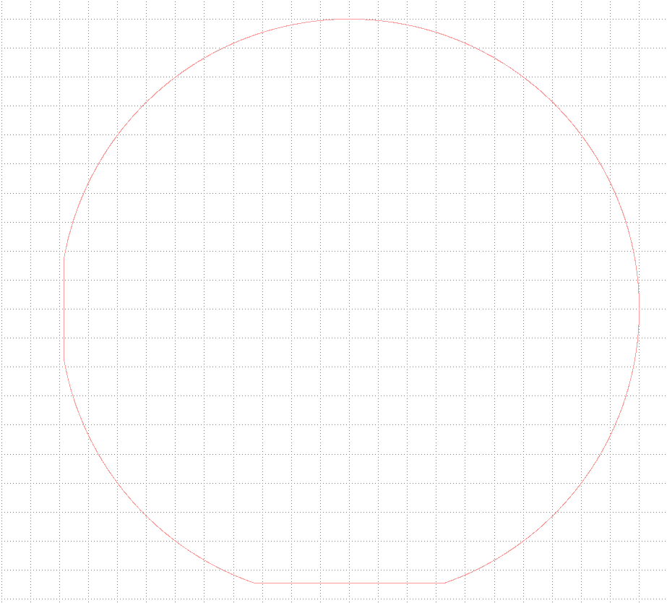
Class Wafer4
Class to draw a 4 inch wafer
WaferCell = lib.new_cell("WAFER")
Wafer=Wafer4(0,0,0,WaferLayer) #set (x,y,rotation,layer)
WaferCell.add(Wafer.drawWafer4())
10 cm
18 mm
32.5 mm

Slide 3
Alignment Module

Slide 4
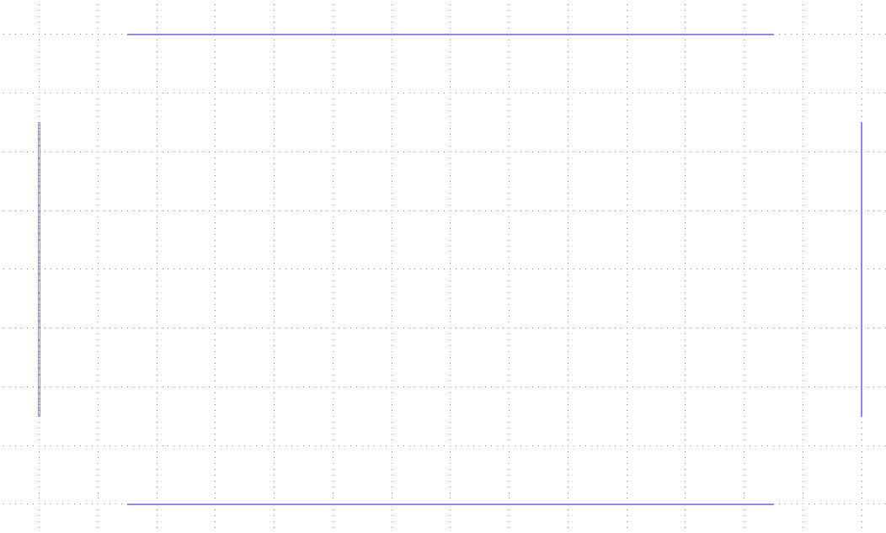
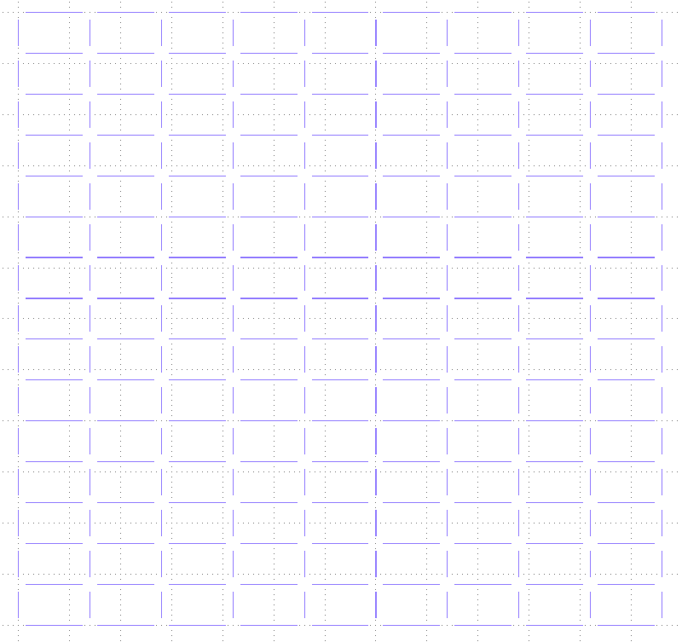
Class AlignmentLines
ChipSizeX
AlignmentLineWidth
Class to draw all the alignment lines
AlignmentLines=AlignmentLines(0,0,0,AlignmentLayer)
AlignmentLines.setParameters(AlignmentLineWidth,AlignmentLineOffset, ChipSizeX, ChipSizeY)
AlignmentLineCell.add(AlignmentLines.drawArray(NbRow,NbColumn,ChipSizeX,ChipSizeY))
ChipSizeY
AlignmentLineOffset
Each line can be drawn individually using the method drawx and drawy. The method drawArray allows to make a complete array
NbRow : Number of Row
NbColumn : Number of Column

Slide 5
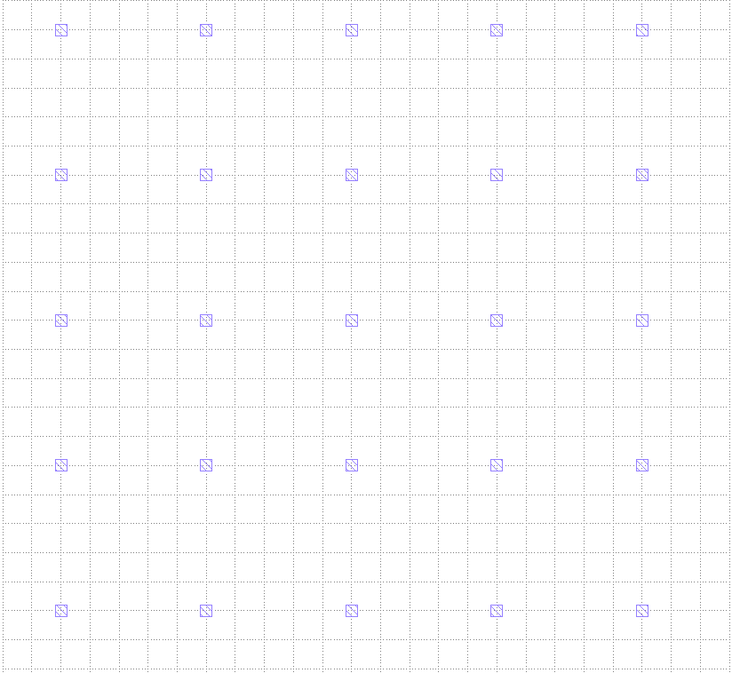
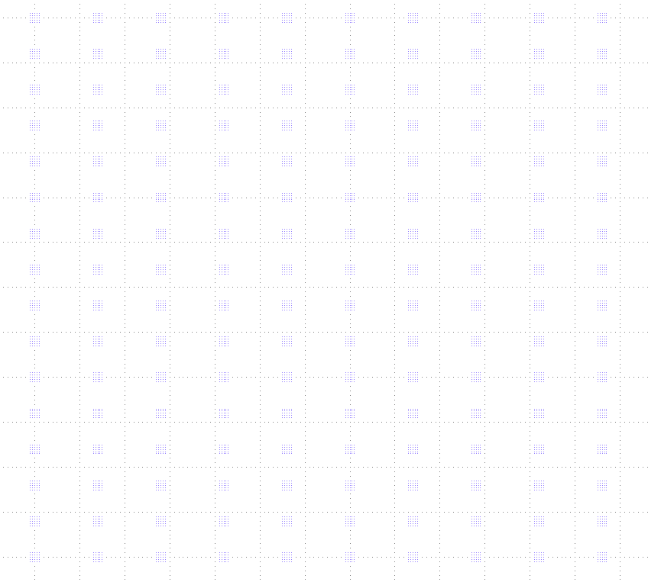
Class AlignmentMarkers
Array spacing
Class to draw all the alignment markers
MarkerSize
AlignmentLines=AlignmentLines(0,0,0,AlignmentLayer)
AlignmentLines.setParameters(AlignmentLineWidth,AlignmentLineOffset, ChipSizeX, ChipSizeY)
AlignmentLineCell.add(AlignmentLines.drawArray(NbRow,NbColumn,ChipSizeX,ChipSizeY))
Each set of markers can be drawn individually using the method draw. The drawAarray method however allows to draw the markers over the entire wafer based on the size of the Chip in x and y and the number of rows and columns.
MarkerArraySize=5 (number of squares)

Slide 6

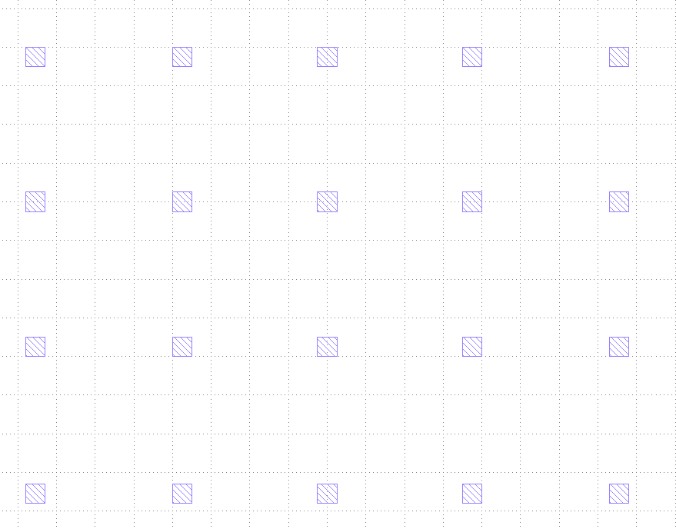
Class AlignmentGrid
Class to draw all the alignment grid used for the ebeam exposure. It consists of markers that are incrementally spaced from the center.
AlignmentGrid=AlignmentGrid(0,0,0,AlignmentLayer)
AlignmentGrid.setParameters(MarkerSize, MarkerDistance, OffSet, ArraySize)
AlignmentGridCell.add(AlignmentGrid.draw())
Parameter definition:
MarkerSize : size of each marker
MarkerDistance : distance from the center marker
Offset : added offset to each marker
Array size : size of the array (i.e 5 makes an array of 5 by 5)
MarkerDistance
MarkerDistance+Offset
Center
MarkerDistance
MarkerDistance+Offset
MarkerDistance+2*Offset

Slide 7
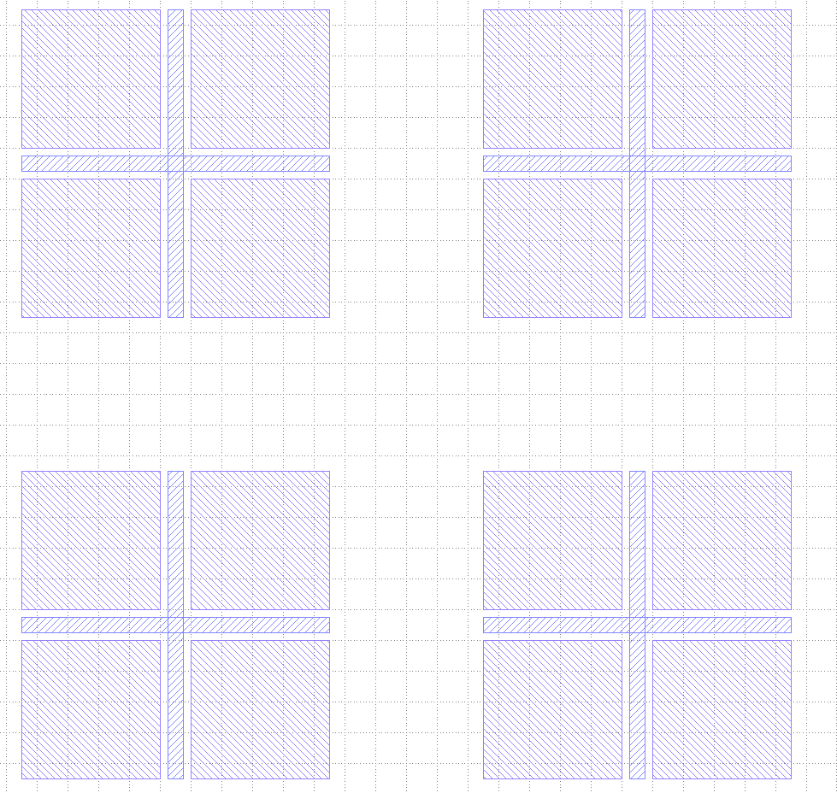
Class AlignmentCross
Class to draw all the alignment cross used to measure the misalignment of the MLA relative to the markers
SquareSize
AlingmentOffset=AlignmentCross(0, 0, 0, AlignmentLayer,GroundPlaneLayer)
AlingmentOffset.setParameters(SquareSize, Spacing, CrossWidth)
AlignmentCrossCell.add(AlingmentOffset.draw())
CrossWidth
Spacing

Slide 8
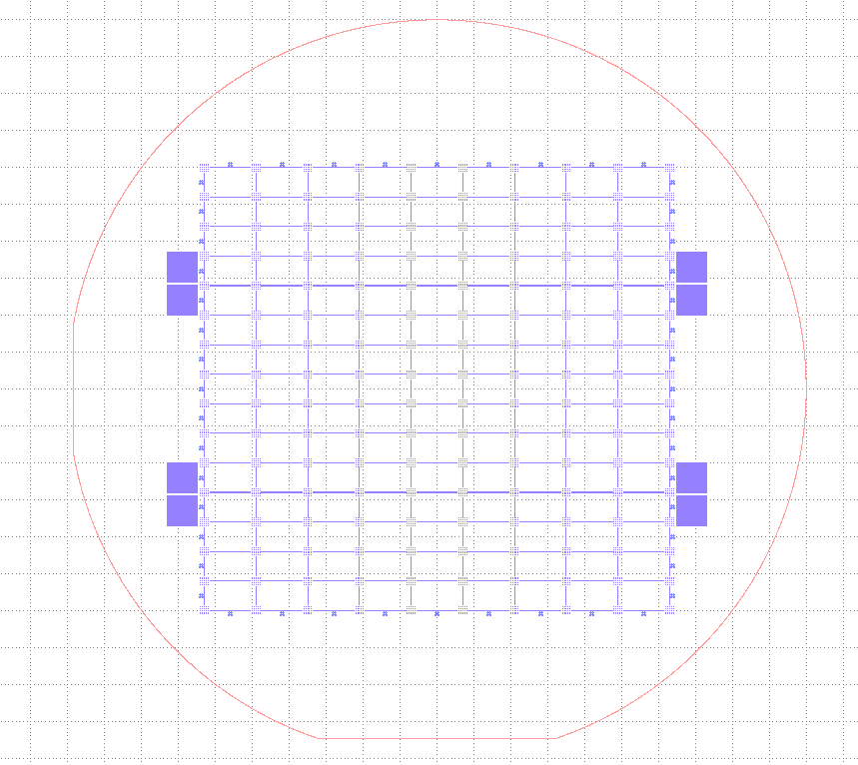
Alignement Overview

Slide 9
Utility.PopulateWafer
Utility.PopulateWafer(ChipList, WaferCell, ChipSizeX, ChipSizeY)
ChipList[0][0]
Takes as an input :
ChipList : a list containing the cells that should appear on the wafer.
WaferCell : The cell of the whole wafer
ChipSizeX : dimensions of a chip in X
ChipSizeY : dimensions of a chip in y
ChipList[3][1]
ChipList[14][8]

Slide 10
Termination Module

Slide 11
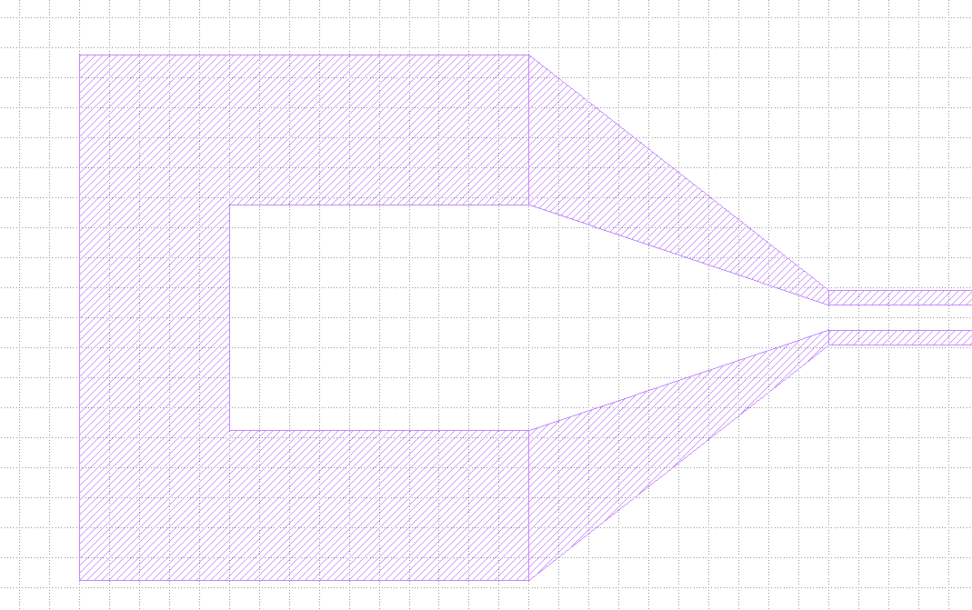
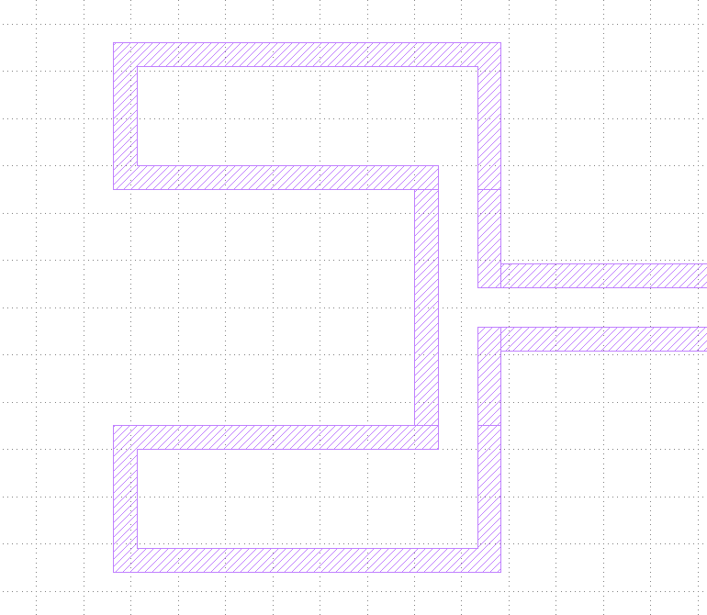
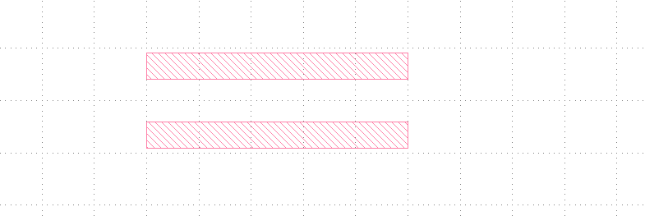
What is a Termination
A termination is any circuit element that can easily be attached to the circuit with only two points (the start in red and the end in blue). The termination is drawn with reference to the red point. The following circuit element will then be draw with reference to the blue point. For example :
The method to draw the termination : CPWGuide.drawTermination(Termination, Direction, layer, Reversed=False)
Termination : Type of termination with its parameters in a library i.e : {"CPWPad":[PadWidth,OffsetPadEtch,PadLength,ImpMatchLength]}
Direction : “+x”, “-x”, “+y”, “-y”
Layer : the layer in which to draw the termination
Reversed : Default is false, but for certain termination, it is possible to reversed the position of the red and blue dots.
At any point, the starting point (red) of a termination can be changed by using the CPWGuide method Self.SetPoint(coord_x, coord_y) or Self. RelSetPoint(delta_x, delta_y). The first method allows to define a point anywhere whereas the second method to simply change the relative position of the point.

Slide 12
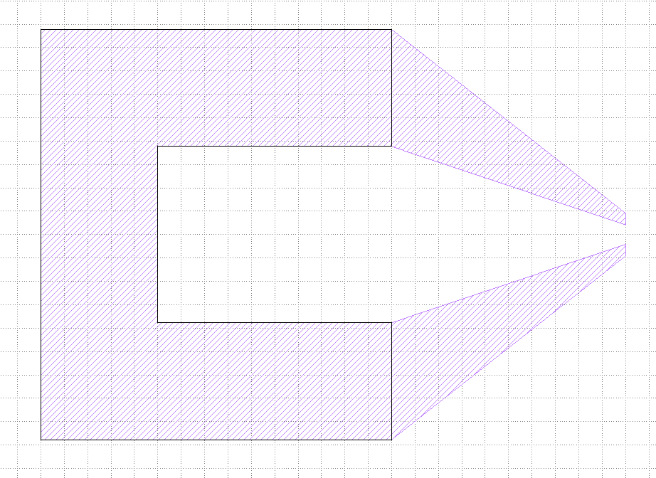
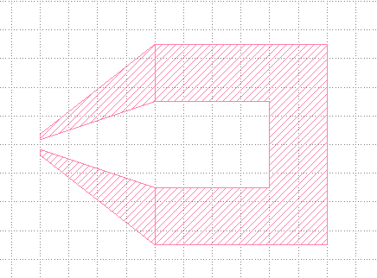
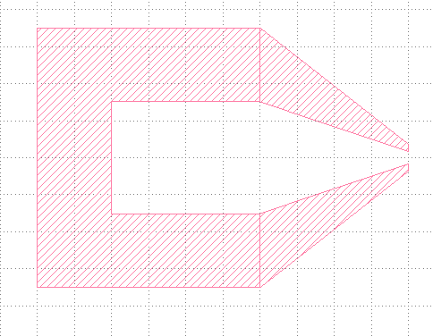
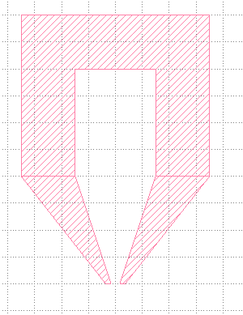
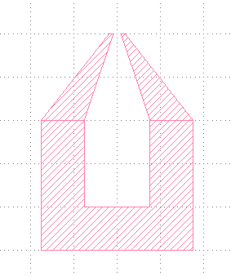
Class CPWPad
ImpMatchLength
+x
-x
PadLength
PadWdith
SlotWidth
StripWidth
+y
-y
OffsetPadEtch

Slide 13
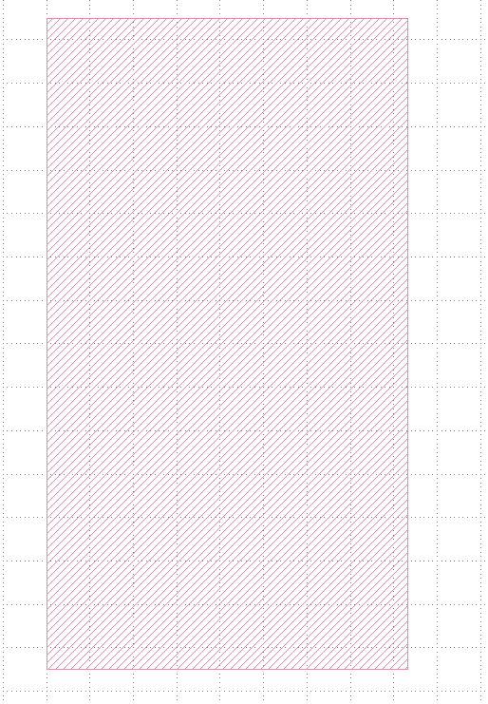
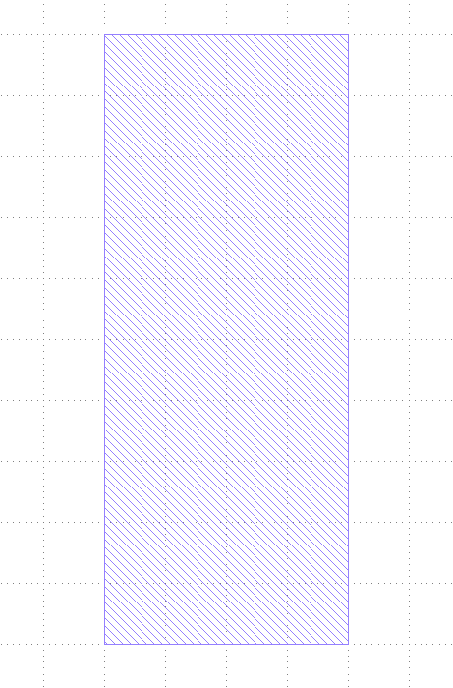
Class CPWOpening
+x
-x
OpeningLength
+y
-y
OpeningWidth
For the y, the red point is adjusted when used with termination

Slide 14
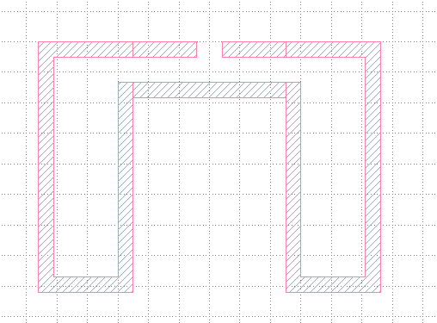
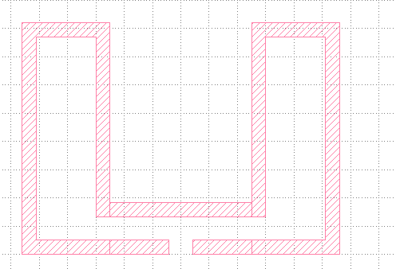
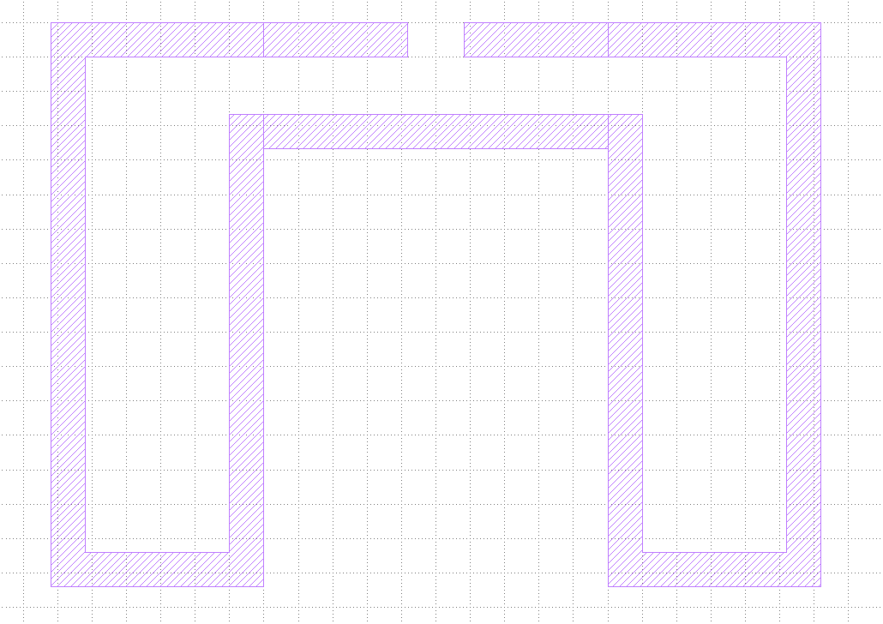
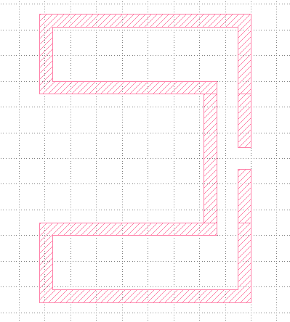
Class CPWQubitCoupling
+x
-x
StripWidth
SlotWidth
+y
-y
SideConductorWidth
SideLength
CentralConductorWidth
For the y, the red point is adjusted when used with termination

Slide 15
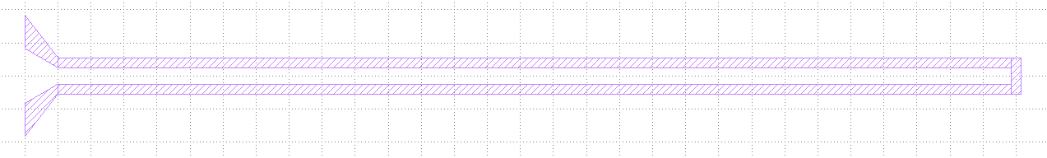
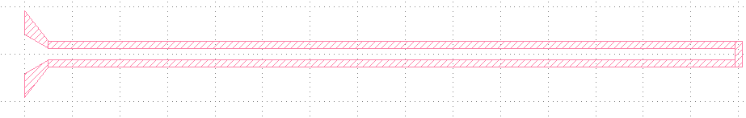

Class CPWQubitDriveLine
TaperedLength
FinSlotWidth
StraightLength
InitStripWidth
FinStripWidth
InitSlotWidth
+x
-x
+y
-y

Slide 16
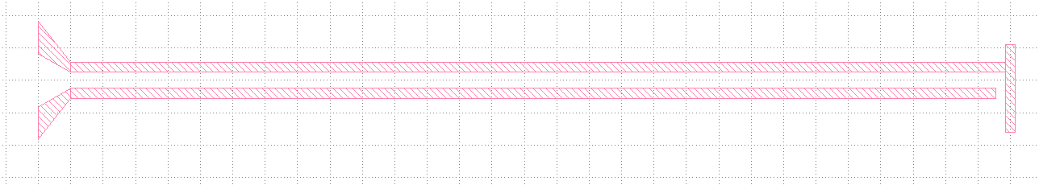
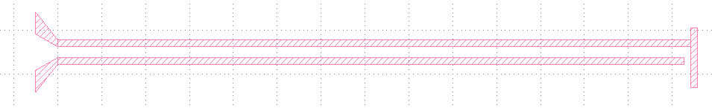
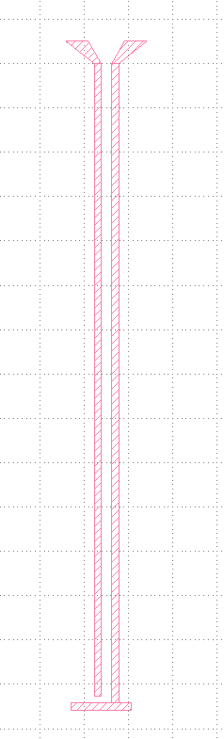
Class CPWFluxLine
TaperedLength
FinSlotWidth
OpeningOffset
StraightLength
InitStripWidth
FinStripWidth
OpeningLength
Gap
InitSlotWidth
+x
-x
+y
-y

Slide 17
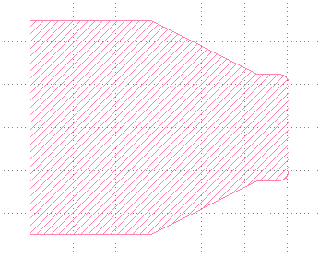
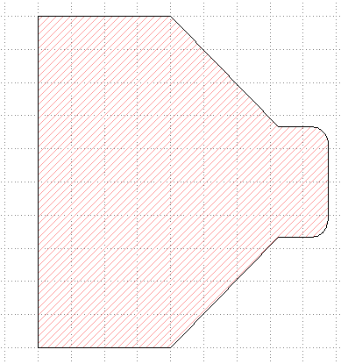
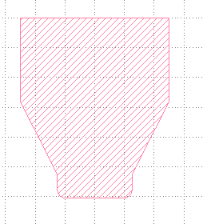
Class TPatch
+x
-x
PartialHeight
+y
-y
TotalWidth
TopWidth
TopHeight
TotalHeight

Slide 18
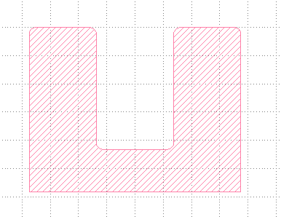
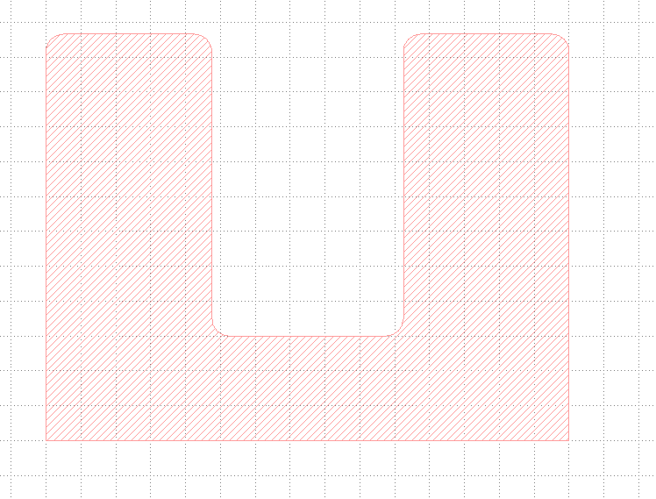
Class UPatch
+x
-x
SideWidth
RadiusCorner
+y
-y
SideHeight
BottomHeight
TotalWidth

Slide 19
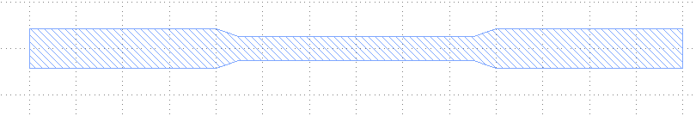
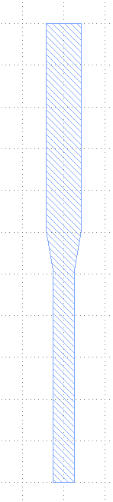

Class DoubleAngleJunction
+x
-x
DoubleAngleJunction.drawHorizontalJunction()
+y
-y
RestrictedLength
SmallWidth
LargeWidth
TotalLength
DoubleAngleJunction.drawVerticalJunction()
LargeWidth
+x
-x
RestrictedLength
SmallWidth
+y
-y
Notes:
22

Slide 20
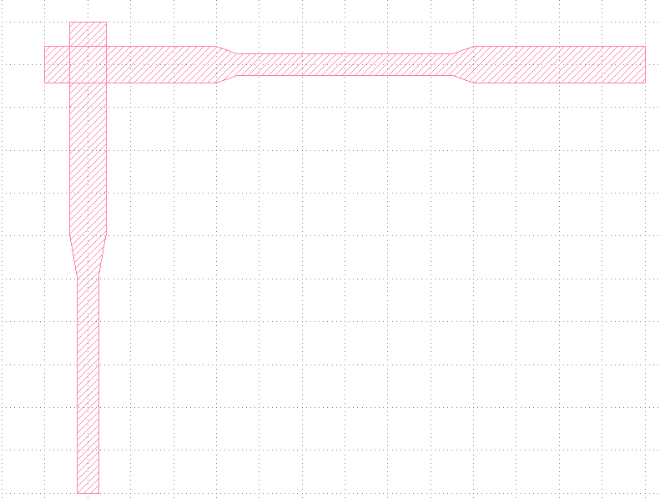
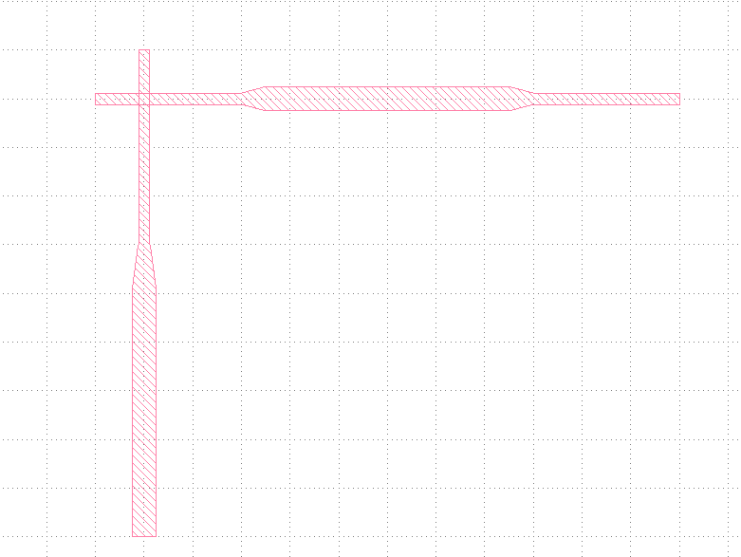
Class DoubleAngleJunction
DoubleAngleJunction.drawJunction(LeftJunctionX, DisplacementY)
0
180
LeftJunctionX
DisplacementY
90
-90

Slide 21
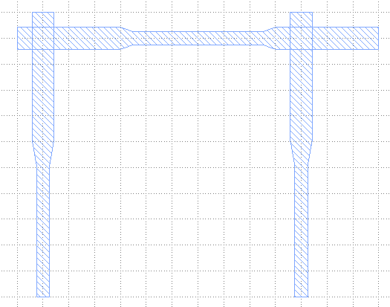
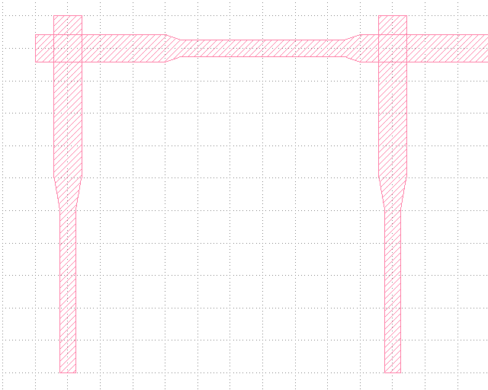
Class DoubleAngleJunction
DoubleAngleJunction.drawSQUID(LeftJunctionX,RightJunctionX,DisplacementY)
LeftJunctionX
RightJunctionX
0
180
DisplacementY
90
-90
Notes:
gglllll
23

Slide 22
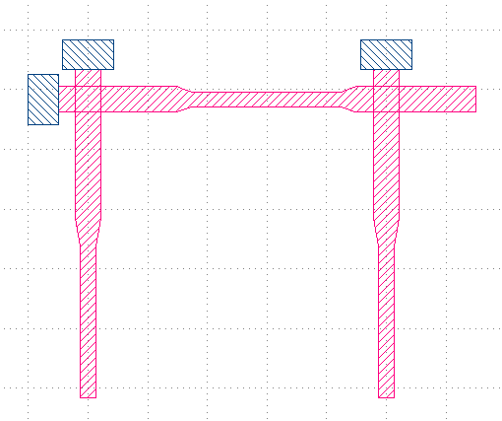
Class DoubleAngleJunction
DoubleAngleJunction.drawJunctionSet(LeftJunctionX,RightJunctionX,DisplacementY,LayerUnderCut)
0
180
LeftJunctionX
RightJunctionX
DisplacementY
90
-90
Notes:
gglllll
25

Slide 23
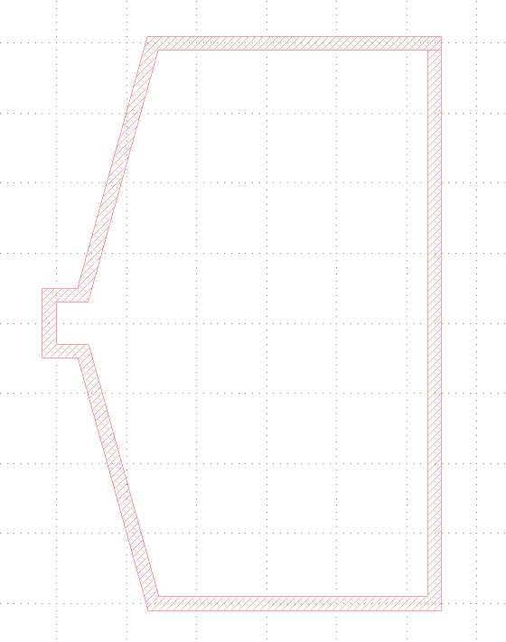
Class TestPad
+x
-x
SlotWidth
ConstrictionWidth
+y
-y
ConstrictionHeight
Height
TaperedWidth
Width

Slide 24
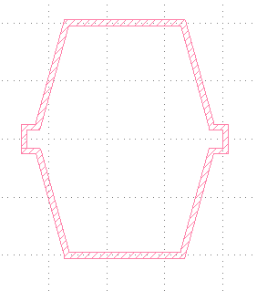
Class TwoSideTestPadCell
+x
-x
SlotWidth
Height
ConstrictionWidth
ConstrictionHeight
TaperedWidth
draw(self,EBL=False)
EBL can be set to true to reverse the PAD and expose it directly at the ebeam
Width

Slide 25
CPWGuide Module

Slide 26
Why the CPW module :
The CPW module allows to connect the different terminations and objects presented in the termination module and respective object modules. The CPW module works by first defining a coplanar wave guide with its parameters :
CPW=CPWGuide(0, 0, 0, Layer)
CPW.setParameters(StripWidth,SlotWidth)
Once defined, therminations can be added with the method: CPWGuide.drawTermination(Termination, Direction, layer, Reversed=False)
Objects can be added by using the ConnectObject module : CPWGuide.ConnectObject(Object,Direction)
This terminations are combined with straight CPW added with the method : CPWGuide.drawStraight(Length, Direction)
And turns with CPWGuide.drawTurn(radius, angle,direction)
There are two additional methods to define new blue points:
Self.SetPoint(coord_x, coord_y)
Defines a new reference point in absolute unit to draw a new waveguide
Self. RelSetPoint(delta_x, delta_y)
Shifts the reference point by delta_x and delta_y

Slide 27
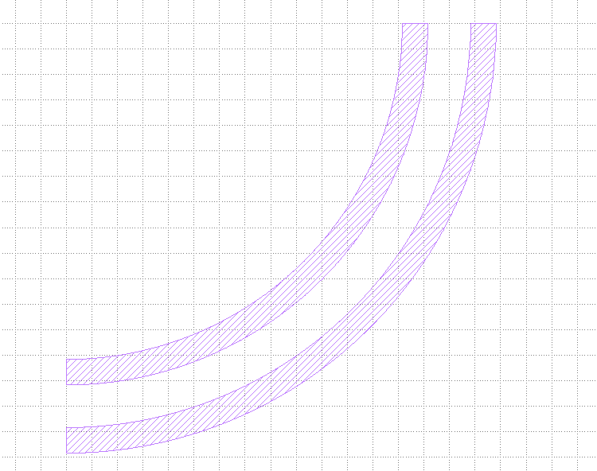
Class CPWGuide
Self.drawStraight(Length, Direction)
Length
Direction either : “+x”, “-x”, “+y”, “-y”
SlotWidth
StripWidth
SlotWidth
Self. drawTurn(radius, angle,direction)
Direction either : “+x”, “-x”, “+y”, “-y”
Radius
Angle either
: “r”, “rr”, “l”, “ll”
Where the letter r means a turn to the right and l a 90 degree turn to the left. The double letter means a 180 degree turn
Self.drawTurn(150,"l","+x")

Slide 28
CPWGuide.drawTermination(Termination, Direction, Layer, Reversed=False)
Reversed=True
{"CPWPad":[PadWidth,OffsetPadEtch,PadLength,ImpMatchLength]}
+y
+x
"CPWOpening":[OpeningWidth, OpeningLength]
Reversed=True
"CPWQubitCoupling":[CentralConductorWidth,SideConductorWidth,SideLength]

Slide 29
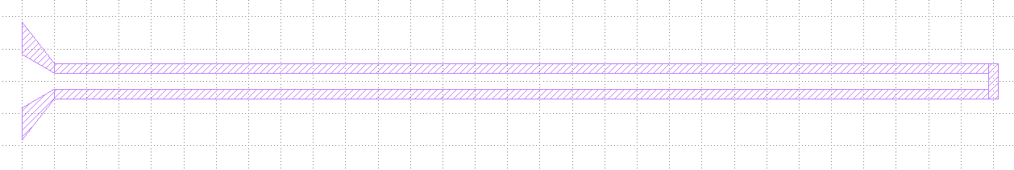
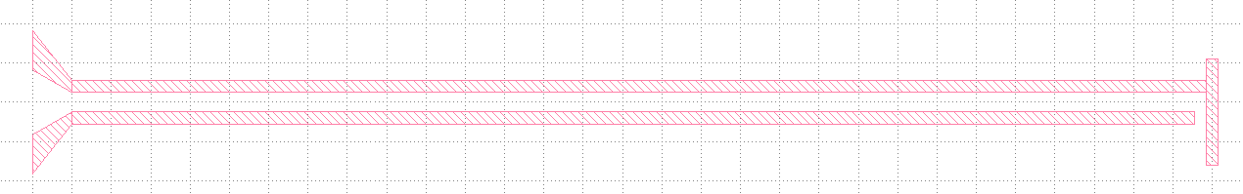
CPWGuide.drawTermination(Termination, Direction, Layer, Reversed=False)
"CPWQubitDriveLine":[FinStripWidth,FinSlotWidth,TaperedLength,StraightLength]
Reversed=True
"CPWFluxLine":[FinStripWidth, FinSlotWidth, TaperedLength, StraightLength, Gap, OpeningLength, OpeningOffset]
Reversed=True

Slide 30
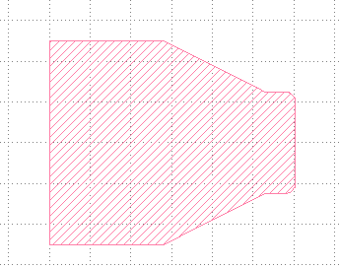
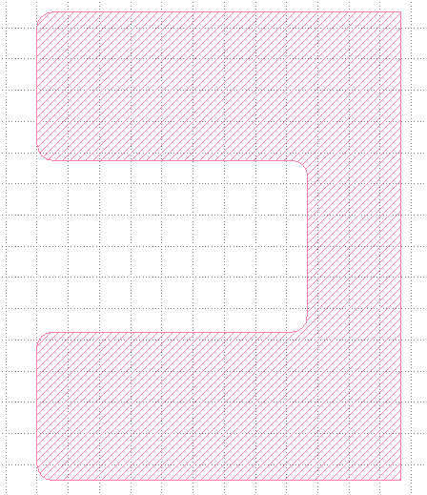
CPWGuide.drawTermination(Termination, Direction, Layer, Reversed=False)
+x
"TPatch":[TotalWidth,PartialHeight,TopWidth,RadiusCorner,TotalHeight,TopHeight]
+y
Reversed=True
"UPatch":[SideWidth, BottomHeight, RadiusCorner, SideHeight, TotalWidth,Overlap]
+x
+y
Reversed=True

Slide 31
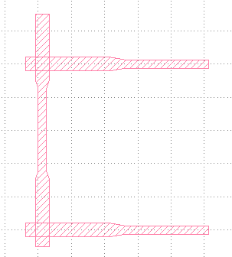
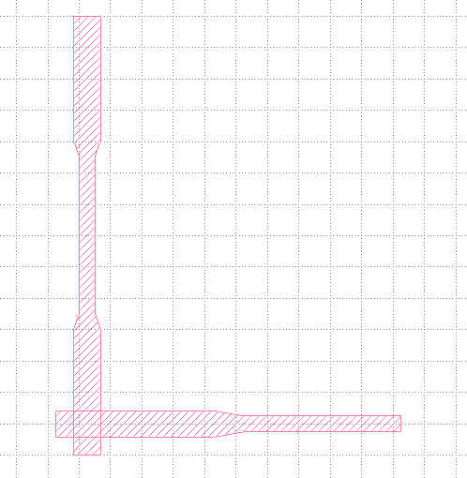
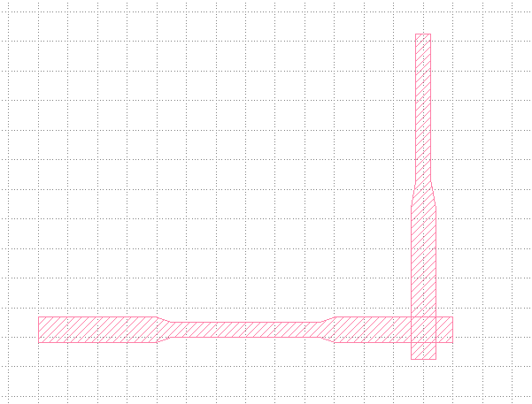
CPWGuide.drawTermination(Termination, Direction, Layer, Reversed=False)
+y
"SQUIDDoubleAngle":[SmallWidth,LargeWidth,RestrictedLength,TotalLength,LeftJunctionX,RightJunctionX,DisplacementY]
Reversed=True
+x
"JunctionDoubleAngle":[SmallWidth,LargeWidth,RestrictedLength,TotalLength,LeftJunctionX,DisplacementY]
+x
+y

Slide 32
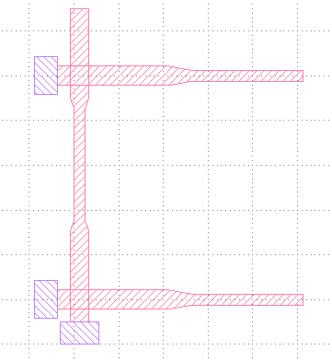
CPWGuide.drawTermination(Termination, Direction, Layer, Reversed=False)
"SQUIDDoubleAngleJunctionUnderCut":[SmallWidth,LargeWidth,RestrictedLength,TotalLength,LeftJunctionX,RightJunctionX,DisplacementY,UndercutLayer]
+y
+x
"TestPad":[Height,Width,ConstrictionWidth,ConstrictionHeight,TaperedWidth]

Slide 33
CPWGuide.drawTermination(Termination, Direction,layer)
"TestPad":[Height,Width,ConstrictionWidth,ConstrictionHeight,TaperedWidth]

Slide 34
Junction example :
+x
+x
+x
Start
-x Reversed=True
-x,Reversed=True
-x,Reversed=True
Start

Slide 35
Qubit Module

Slide 36
Why the QUBIT module :
The Qubit module contains different types of qubit (object) that can be connected to a CPW using the CPWGuide.ConnectObject(Object,Direction)
method.

Slide 37

Xmon :
EndCoordinateTop
Qubit=Xmon(0,0,0,3)
Qubit.setParameters(StripWidth, SlotWidth, CrossLength)
CrossLength
Design=Qubit.draw()
EndCoordinateLeft
StripWidth
Each blue point can be change offset its position by using the method : RelSetPoint(self,Direction,delta_x,delta_y)
The direction “+x”, “-x”, “+y”, “-y” correspond respectively to the right, left, top and bottom
EndCoordinateRight
SlotWidth
EndCoordinateBottom

Slide 38
XmonTermination :
"TPatch":[TotalWidth,PartialHeight,TopWidth,RadiusCorner,TotalHeight,TopHeight]
"UPatch":[SideWidth, BottomHeight, RadiusCorner, SideHeight, TotalWidth,Overlap]

Slide 39
XmonTermination :
"SQUIDDoubleAngle":[SmallWidth,LargeWidth,RestrictedLength,TotalLength,LeftJunctionX,RightJunctionX,DisplacementY]
Reversed=True
"JunctionDoubleAngle":[SmallWidth,LargeWidth,RestrictedLength,TotalLength,LeftJunctionX,DisplacementY]

Slide 40
XmonTermination :
"SQUIDDoubleAngleJunctionUnderCut":[SmallWidth,LargeWidth,RestrictedLength,TotalLength,LeftJunctionX,RightJunctionX,DisplacementY,UndercutLayer]

