Slide 1
Texas Inmates Demographics
Predicting Age and Probability of Parole of inmates
Beauty Kabore

Slide 2
Background
Crime is serious problem which impacts us all
~132 people die from a firearm-related injury every day
Leading cause of death
#1 cause of death among children & teens in the US
Other losses
Costs the US tens of billions of dollars every year
Threatens our collective sense of safety and security
Individuals who are apprehended for violating the law can be sentenced to prison when deemed guilty by court processes.
Offfences include murder, rape, sexual assault, and robbery. Their sentences range from a certain number of years to Life, Death or Life Without Parole (LWOP).

Slide 3
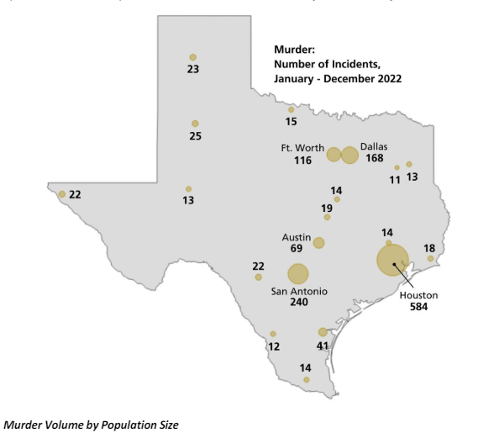
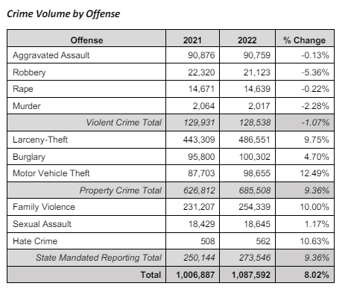
Crime in Texas
America has the high crime rates and Texas is no exception.

Slide 4
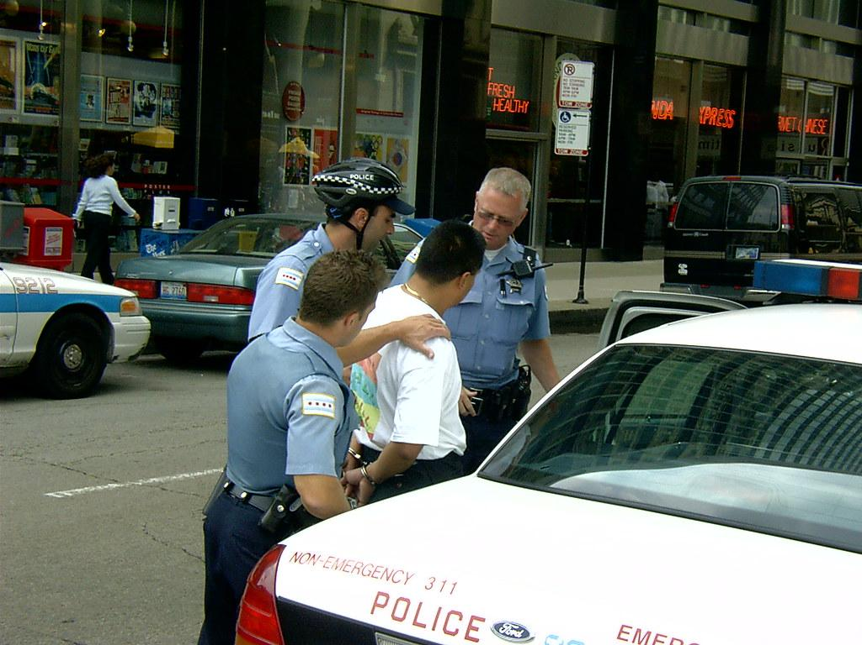
Research Question
Research aims to identify what factors if any impacts whether an inmate will be granted parole or not
To build a model that can predict the age and probability of parole for inmates
Predicting age of inmates.
Predicting Parole decision
Gain better understanding of the relationship and trends between variables to aid decision making.

Slide 5
A Closer Look at the Data

Slide 6
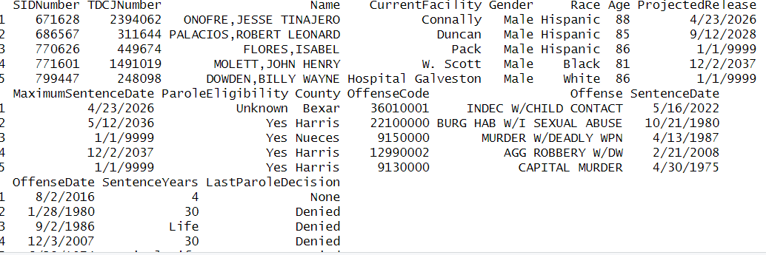
Dataset
The on-hand inmate population dataset (https://catalog.data.gov/dataset/high-value-dataset-december-2023 ) is published by the city of Austin. This downloaded data comprises on hand inmate population with relevant demographic, offense, and parole information. Data period is 6 months (June - December 2023). Dataset consists of 129,513 rows with 17 variables
Analysis based on several factors:
Age
Gender
Race
Parole Eligibility
Last Parole Decision
Offence

Slide 7
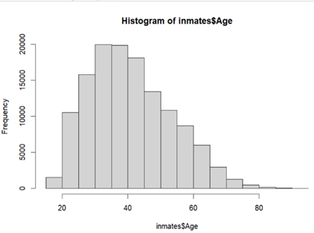
Exploratory Data Analysis
Dataset consists of 129,513 rows with 17 variables.
The youngest inmate is 17 years and the oldest is 92 years.
Mean of age is 41 years.

Slide 8
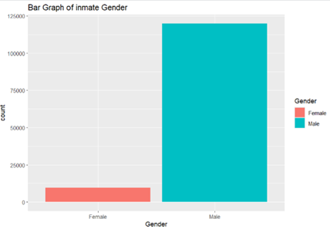
Majority of inmates are Male
Although males make up about 49.6% of the Texas population, they made up 93% of the inmates’ population

Slide 9
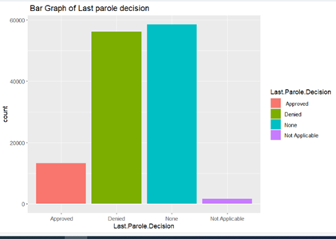
Most Parole requests are denied

Slide 10
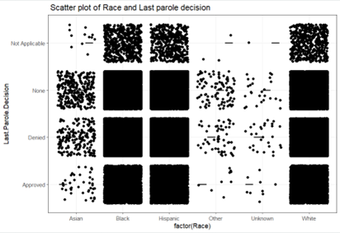
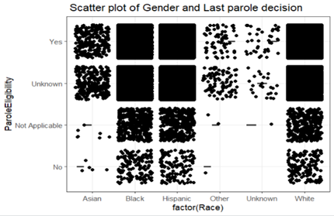
Disparities between race

Slide 11

Supervised Models
Linear Model & Decision Tree

Slide 12
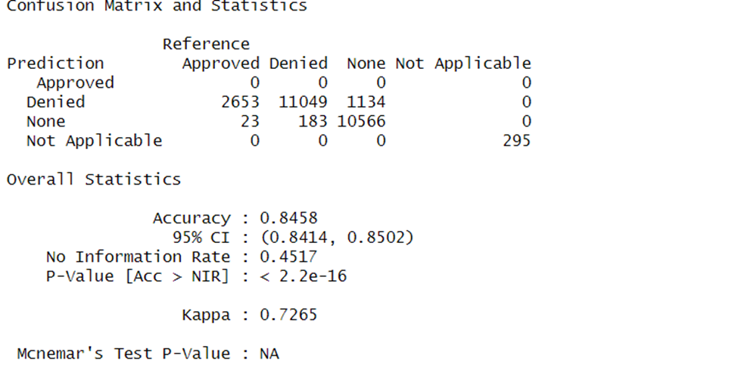
Model #1: Decision Tree
Predicting Parole Decision using Gender, Race, and Parole Eligibility
Model is inefficient at predicting Last Parole Decisions that were Approved - only 10% of the 129,513 dataset is Approved

Slide 13
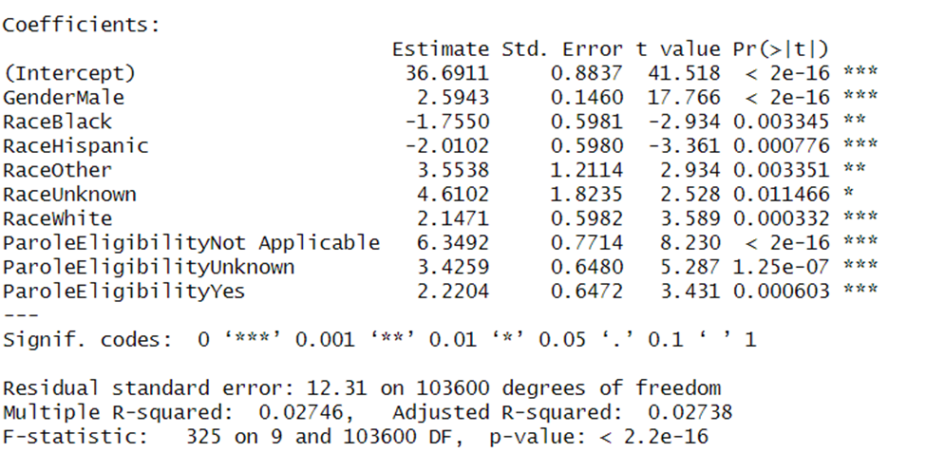
Model #2: Linear Model
Predicting Age using Gender, Race, and Parole Eligibility
The model predicted the inmates’ age with an average error of 12. The correlation of 0.2 indicates there is no significant relationship between Gender, Race, Parole Eligibility and Age of inmates.

Slide 14
Summary of Learning
EDA important to understand dataset
Consider desired outcome
Select model after above two
Techniques for dealing with categorical data
Bias in data ( biased to other gender categories like transgendered because only Male and Female gender categorizations were recorded)

Slide 15
References
Executive Order on Safe, Secure, and Trustworthy Artificial Intelligence
UCR Publications — FBI
https://www.dps.texas.gov/sites/default/files/documents/crimereports/22/2022cit.pdf

Slide 16
THANK YOU!

