Slide 1

Live CCTV Footage Analysis for Abnormal Activity Detection
Utilizing Multiple Instance Learning and Advanced Detection Modules
Zeroth Review Meeting
Pranshul Atri(CH.EN.U4CYS21057)
Vijay M Varma (CH.EN.U4CYS21092)
Department of COMPUTER SCIENCE AND ENGINEERING
Under the Guidance of
Dr. K. Deepak
Assistant Professor
Department of Computer Science and Engineering (Cyber Security)
Date of Review: 12-07-2024

Slide 2
Content
Problem Identification
Problem Statement
Significane of the Project
Visuals
Technology Stack
Objectives and Scope
Reference
Flow Chart
Dataset
Gantt Chart
2/15

Slide 3
Problem Identification
Increasing need for real-time monitoring and safety in public spaces.
Limitations of existing CCTV systems in proactive crime detection.
Rising incidents of public disorder and criminal activities.
Challenges in manual surveillance and response time.
3/15

Slide 4
Problem Statement
Development of a real-time surveillance system to detect and alert authorities of abnormal activities.
Integration of multiple detection modules (e.g., safety vest and helmet detection, overcrowding detection).
Implementation of a scalable and efficient solution for live CCTV footage analysis
4/15

Slide 5
Significance of the Project
Importance in Society
Enhanced Safety: The project aims to increase public safety by providing real-time monitoring and alerts for abnormal activities, ensuring quick response times from authorities.
Prevention of Crimes: By detecting potential crimes early, the system can help prevent incidents from escalating, thus protecting individuals and property.
Improved Traffic Management: Modules like safety vest and helmet detection and overcrowding detection contribute to better traffic management and compliance with safety regulations.
Stakeholders
Law Enforcement Agencies: Police and other security agencies can benefit from real-time alerts and detailed reports on suspicious activities, aiding in quicker and more informed decision-making.
City Administration: Municipal bodies responsible for public safety and urban management can use the system to monitor and manage public spaces more effectively.
Businesses and Institutions: Organizations can utilize the system to enhance the security of their premises, protecting employees, customers, and assets.
General Public: Citizens benefit from a safer environment and the assurance that authorities are equipped with tools to handle potential threats efficiently.
Applications
Public Safety Monitoring: Continuous surveillance and analysis of public areas to detect and respond to crimes and unsafe situations.
Traffic Safety Enforcement: Monitoring compliance with traffic safety regulations, such as the wearing of helmets and safety vests.
Crowd Management: Detecting and managing overcrowding situations in public spaces, events, and transportation hubs to prevent accidents and ensure orderly conduct.
Event Security: Enhancing security at public events by providing real-time monitoring and alerts for suspicious activities.
Industrial Safety: Ensuring compliance with safety protocols in industrial settings by detecting the presence of required safety gear.
5/15

Slide 6
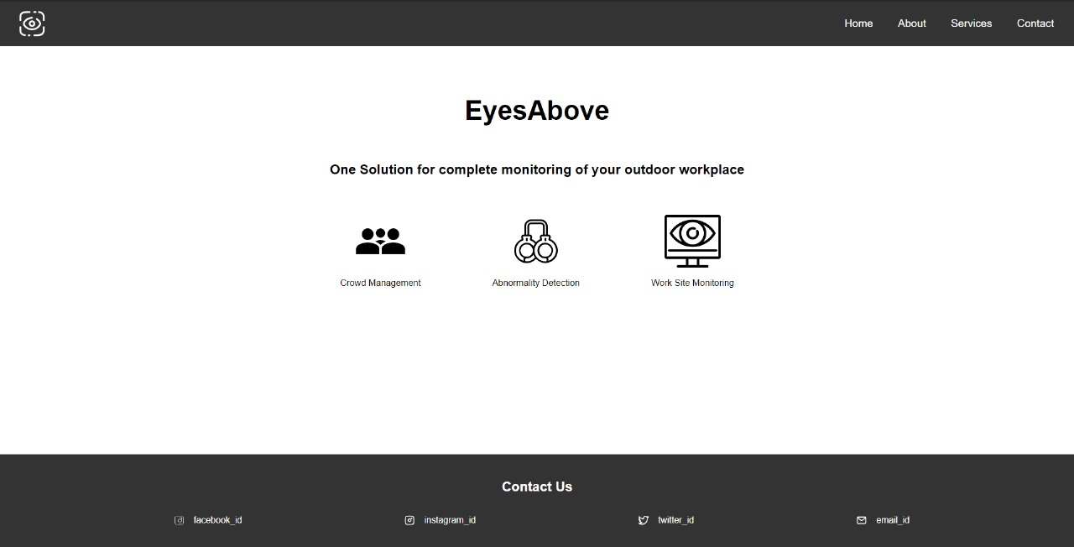
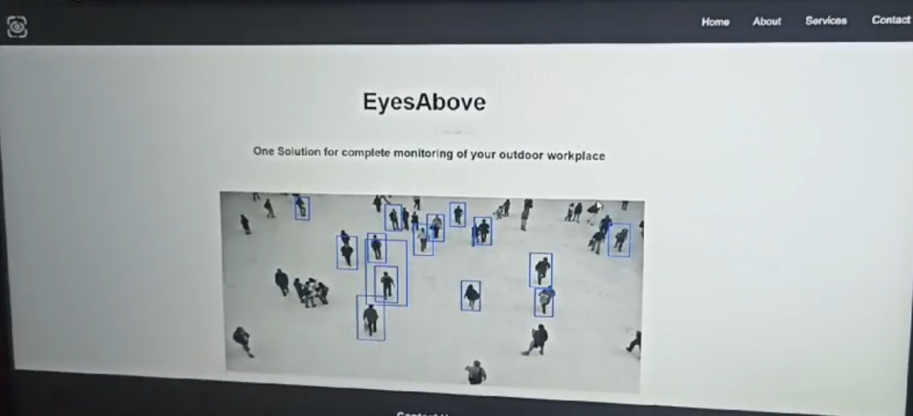
Visuals
6/15

Slide 7
Technology Stack
Frontend:
HTML/CSS: For structuring and styling the user interface.
JavaScript: For interactive elements and client-side logic.
Bootstrap or similar frameworks: For responsive design and UI components.
Backend:
Python: For developing machine learning models, data processing, and backend logic.
TensorFlow or PyTorch: For building and training deep learning models.
OpenCV: For image and video processing tasks, including object detection and tracking.
Flask or Django: For developing APIs to integrate different modules and handle real-time data.
DevOps:
GitHub or GitLab: For version control and collaboration on codebase.
6/15

Slide 8
Objectives and Scope
Objective:
To develop a comprehensive surveillance system for detecting abnormal activities and generating real-time alerts.
Scope:
Abnormal Activity Detection using unsupervised learning
Automated worforce monitoring
Overcrowding Detection
Object Tracking
Integration and Real-time Alert System
7/15

Slide 9
References
1. Integrating Prediction and Reconstruction for Anomaly Detection, Tang, Y., Zhao, L., Zhang, S., Gong, C., Li, G. and Yang, J., 2020. Integrating prediction and reconstruction for anomaly detection. Pattern Recognition Letters, 129, pp.123-130.
2. Abnormal Event Detection in Videos using Spatiotemporal Autoencoder, Chong, Y.S. and Tay, Y.H., 2017. Abnormal event detection in videos using spatiotemporal autoencoder. In Advances in Neural Networks-ISNN 2017: 14th International Symposium, ISNN 2017, Sapporo, Hakodate, and Muroran, Hokkaido, Japan, June 21–26, 2017, Proceedings, Part II 14 (pp. 189-196). Springer International Publishing.
3. Two-stream deep spatial-temporal auto-encoder for surveillance video abnormal event detection, Li, T., Chen, X., Zhu, F., Zhang, Z. and Yan, H., 2021. Two-stream deep spatial-temporal auto-encoder for surveillance video abnormal event detection. Neurocomputing, 439, pp.256-270.
4. Residual spatiotemporal autoencoder for unsupervised video anomaly detection, Deepak, K., Chandrakala, S. and Mohan, C.K., 2021. Residual spatiotemporal autoencoder for unsupervised video anomaly detection. Signal, Image and Video Processing, 15(1), pp.215-222.
14/15

Slide 10
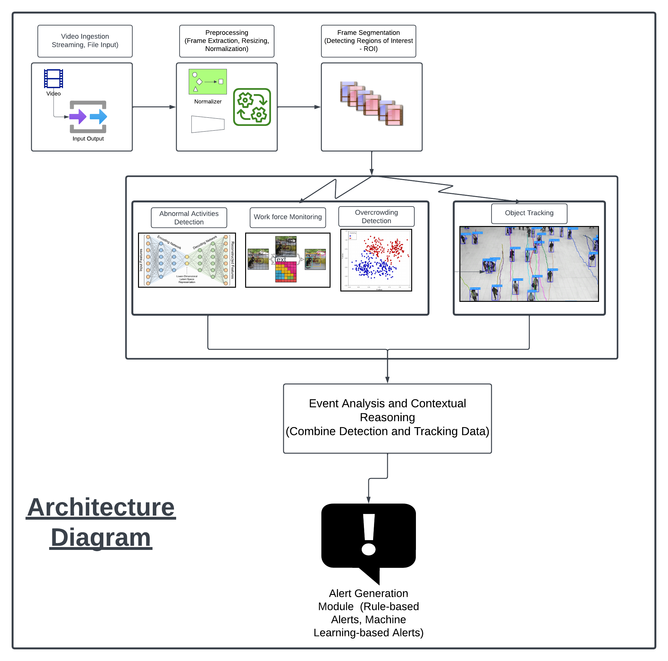
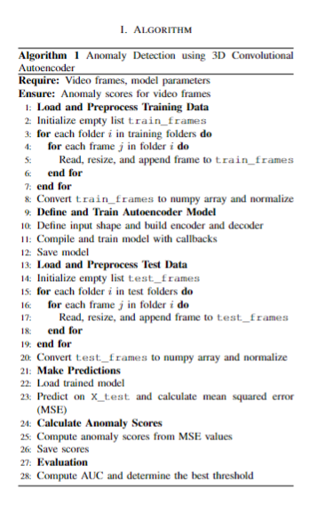
Flow Chart
10/15

Slide 11
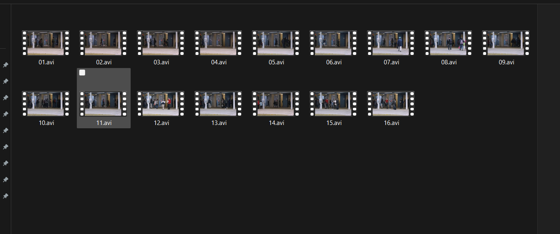
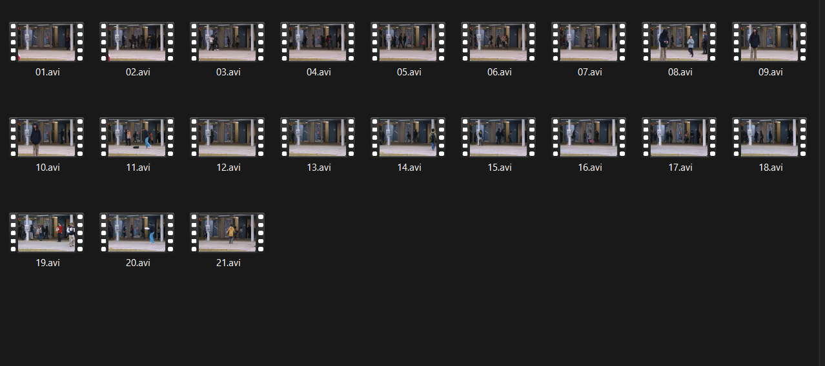
Dataset
We have planned to work on a few different datasets:
1. UCSD Anomaly Detection Dataset
1.1 Ped 1 (34 training video samples and 36 testing video samples)
1.2 Ped 2 (16 training video samples and 12 testing video samples)
2. Avenue Dataset (16 training video samples and 21 testing vide samples)
11/15

Slide 12
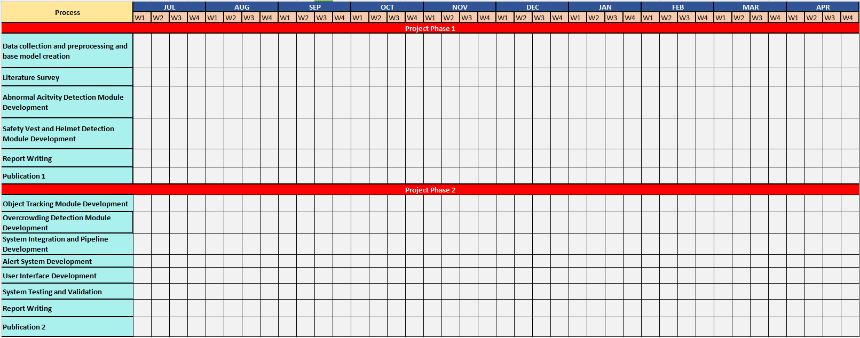
Gantt Chart
12/15

Slide 13
Thank you
Name: Pranshul Atri
Roll Number: CH.EN.U4CYS21057
Department: CSE-CYS
Phone: 9311099144
Email:
Name: Vijay M Varma
Roll Number: CH.EN.U4CYS21092
Department: CSE-CYS
Phone:
Email:
15/15

