Slide 1
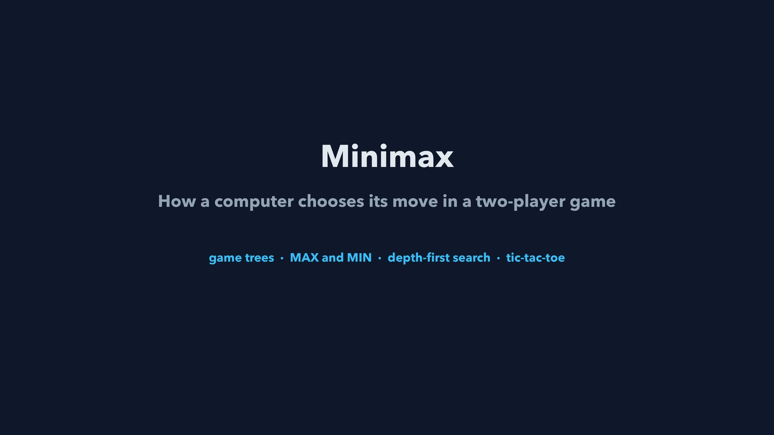
Notes:
Step 1 of 78
Minimax
How a computer chooses its move in a two-player game
game trees • MAX and MIN • depth-first search • tic-tac-toe

Slide 2
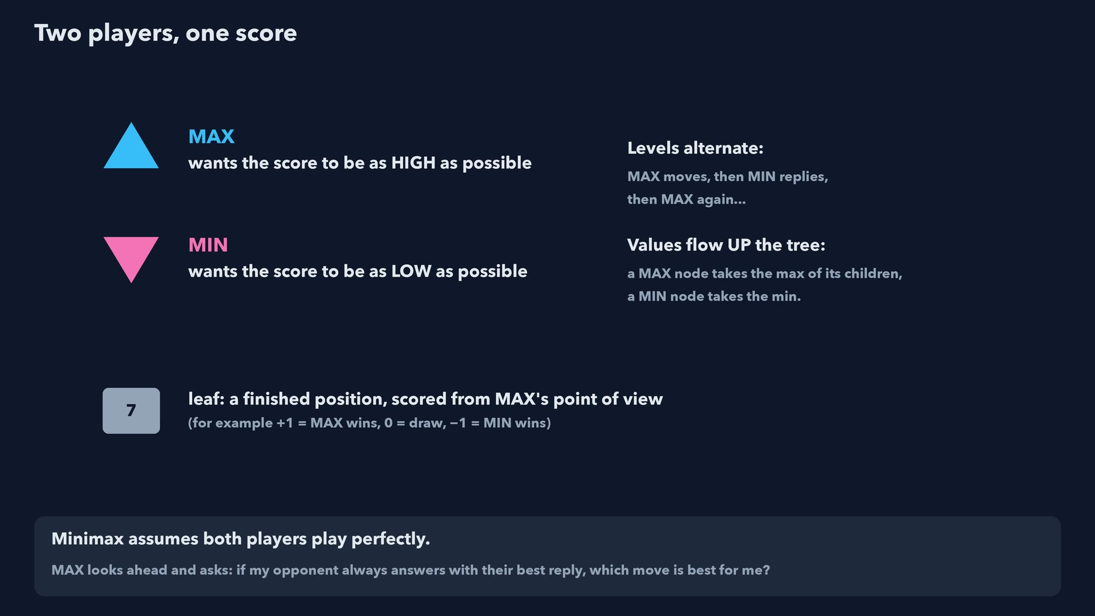
Notes:
Step 2 of 78
Minimax assumes both players play perfectly.
MAX looks ahead and asks: if my opponent always answers with their best reply, which move is best for me?

Slide 3
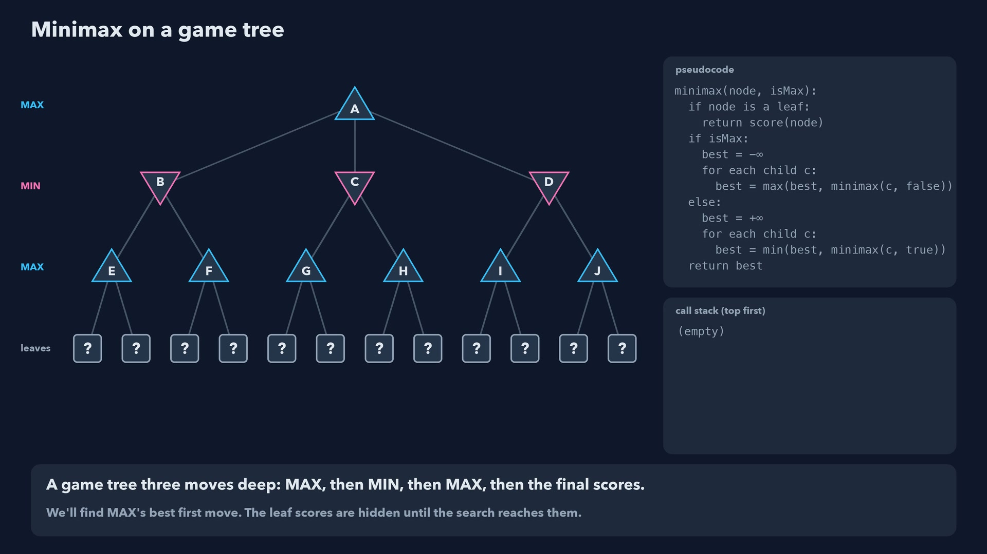
Notes:
Step 3 of 78
A game tree three moves deep: MAX, then MIN, then MAX, then the final scores.
We'll find MAX's best first move. The leaf scores are hidden until the search reaches them.

Slide 4
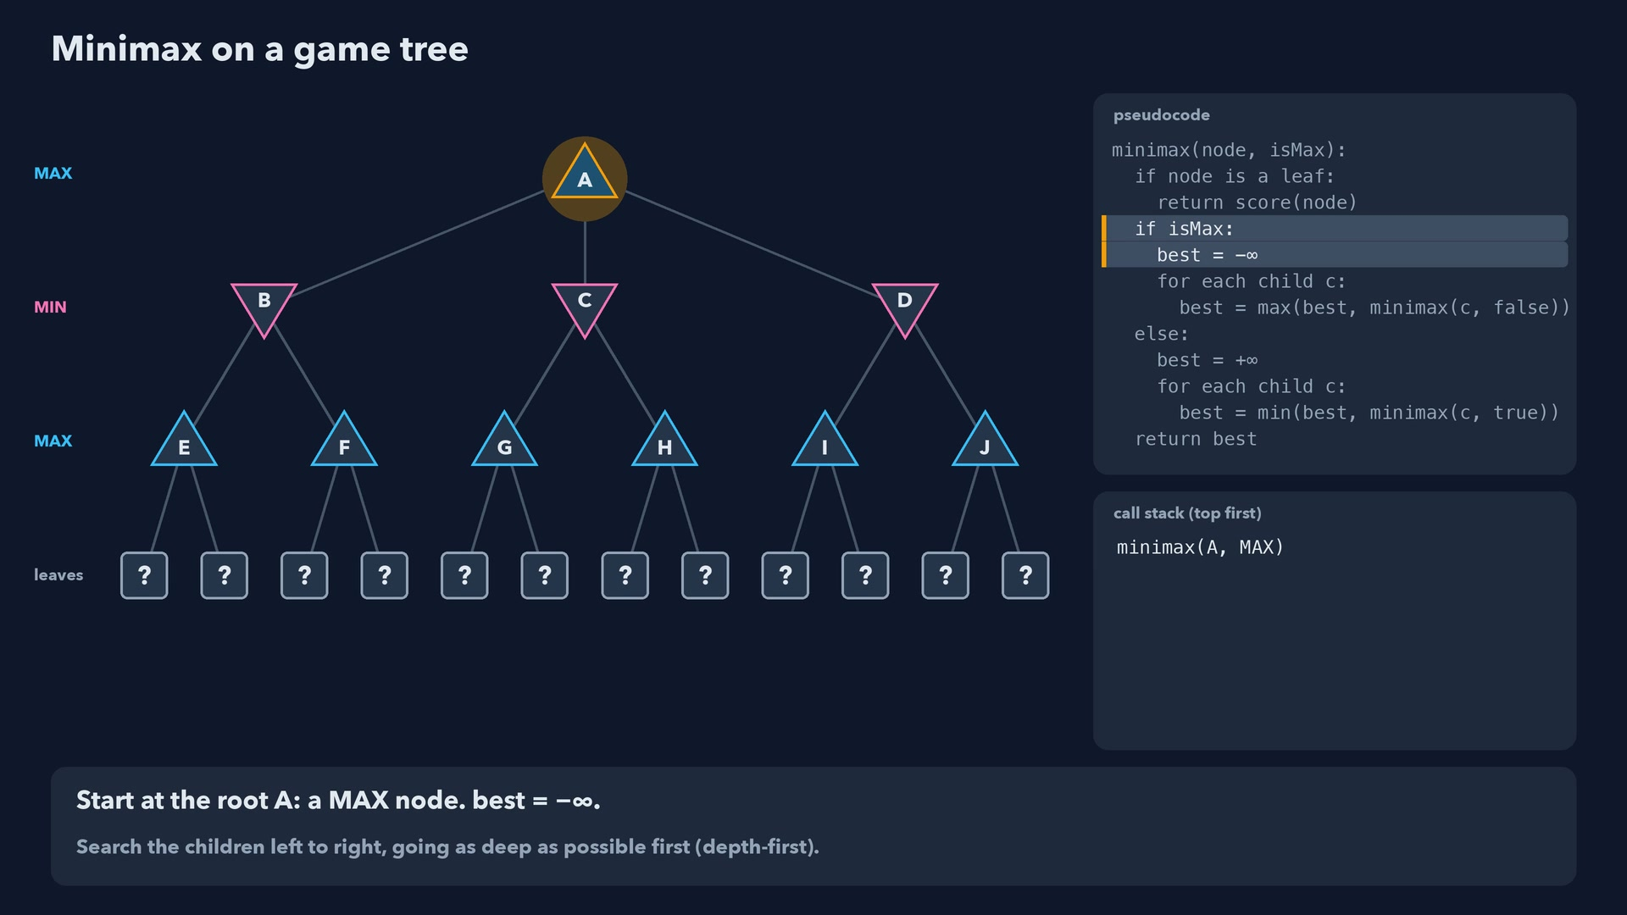
Notes:
Step 4 of 78
Start at the root A: a MAX node. best = -∞.
Search the children left to right, going as deep as possible first (depth-first).

Slide 5
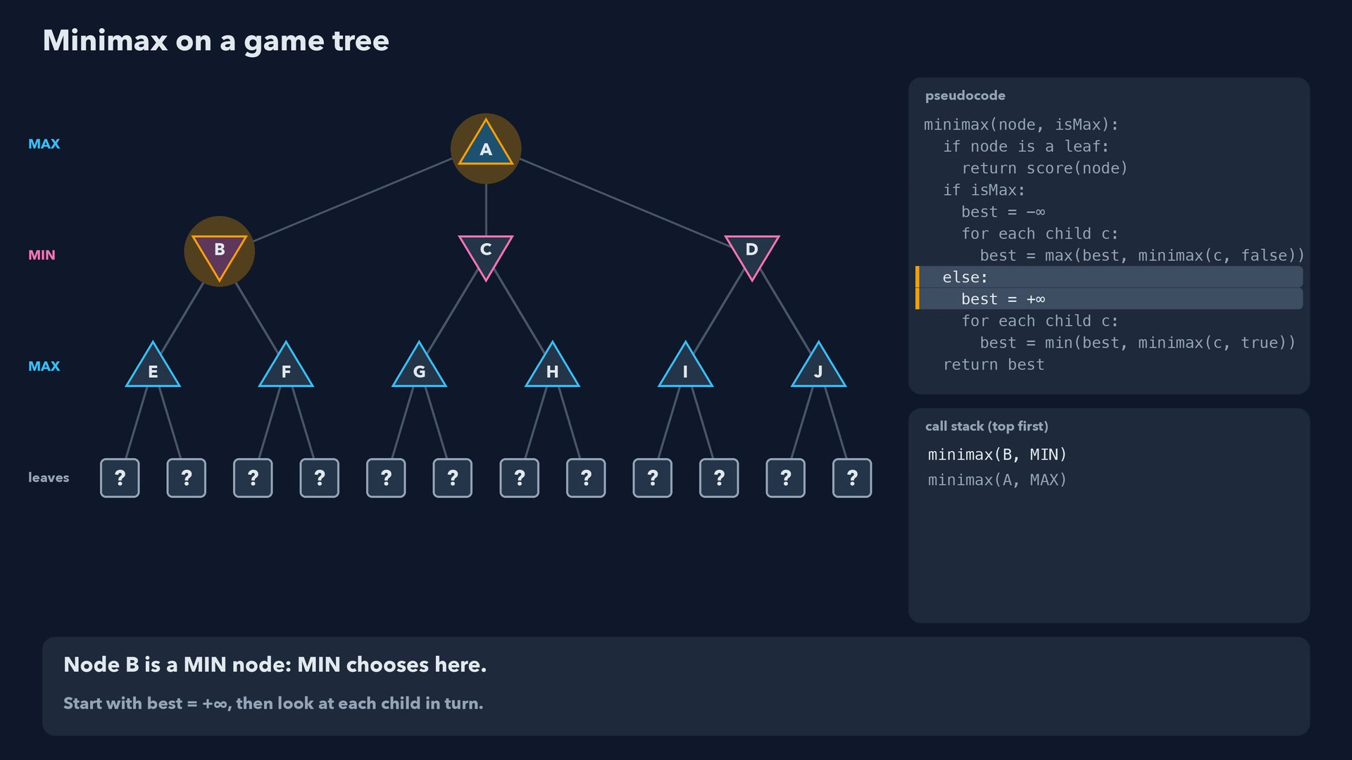
Notes:
Step 5 of 78
Node B is a MIN node: MIN chooses here.
Start with best = +∞, then look at each child in turn.

Slide 6
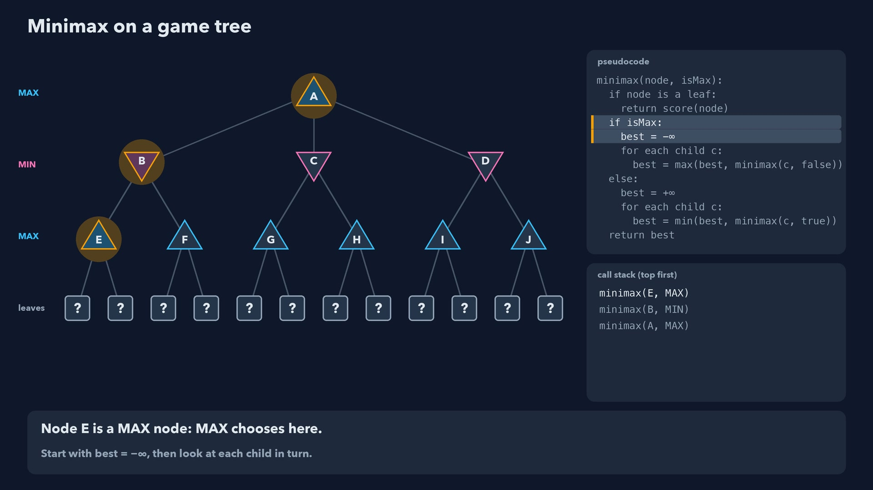
Notes:
Step 6 of 78
Node E is a MAX node: MAX chooses here.
Start with best = -∞, then look at each child in turn.

Slide 7
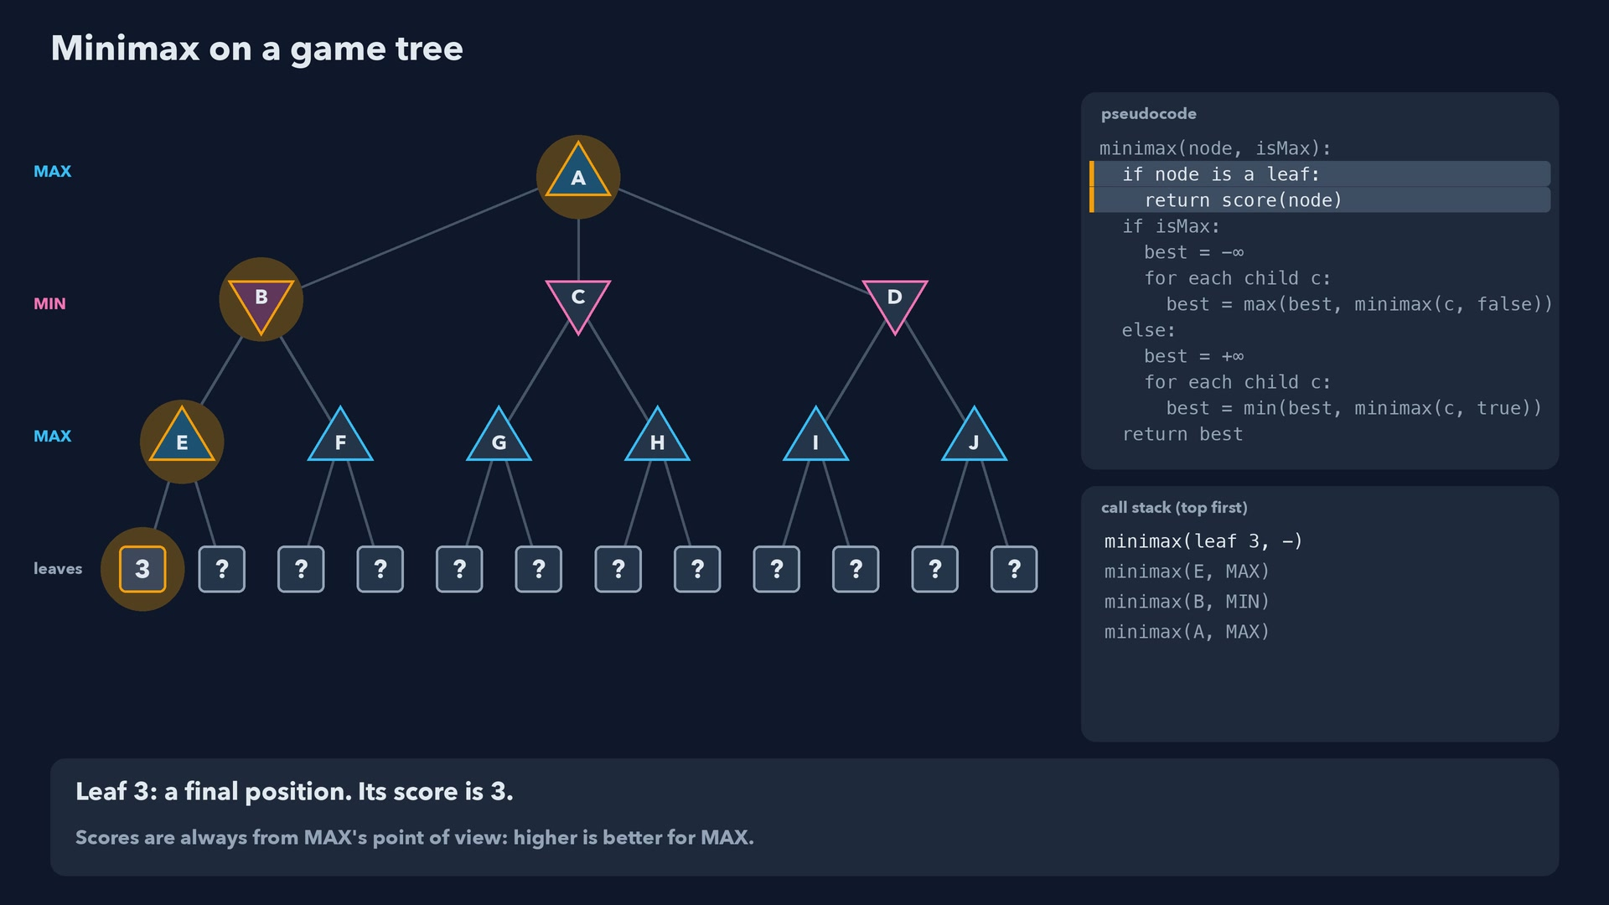
Notes:
Step 7 of 78
Leaf 3: a final position. Its score is 3.
Scores are always from MAX's point of view: higher is better for MAX.

Slide 8
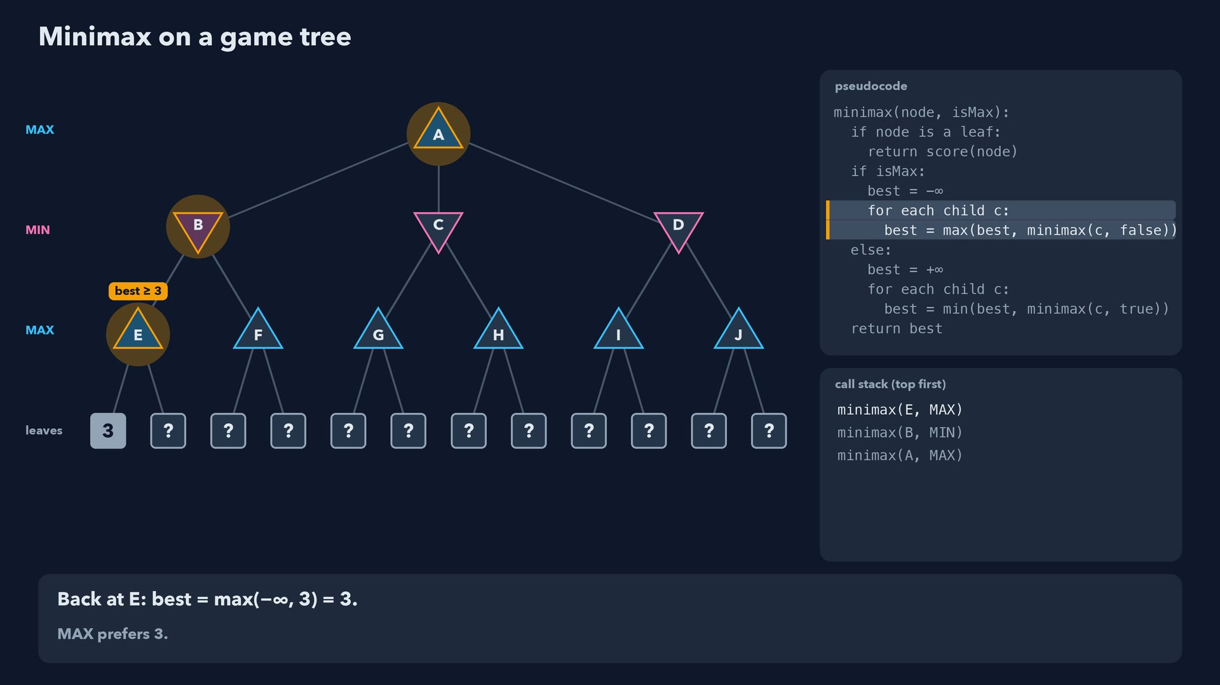
Notes:
Step 8 of 78
Back at E: best = max(-∞, 3) = 3.
MAX prefers 3.

Slide 9
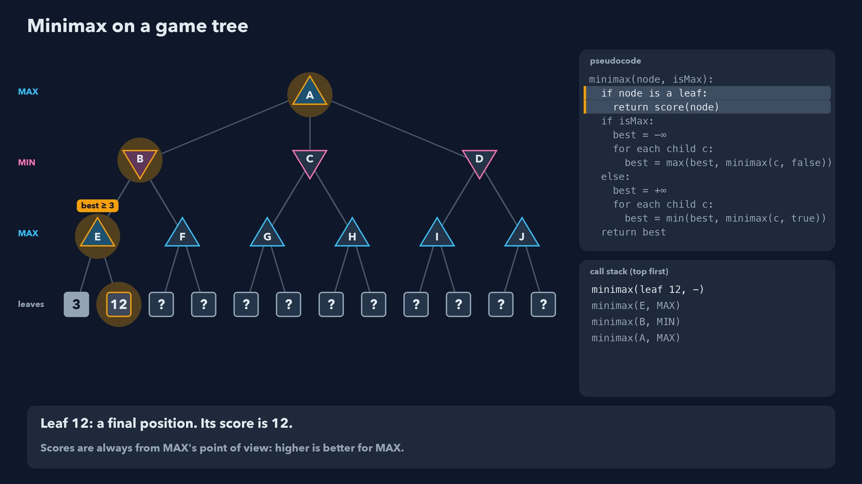
Notes:
Step 9 of 78
Leaf 12: a final position. Its score is 12.
Scores are always from MAX's point of view: higher is better for MAX.

Slide 10
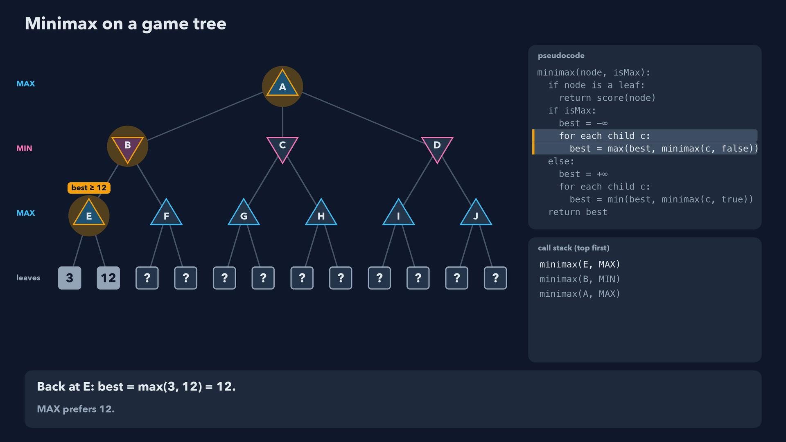
Notes:
Step 10 of 78
Back at E: best = max(3, 12) = 12.
MAX prefers 12.

Slide 11
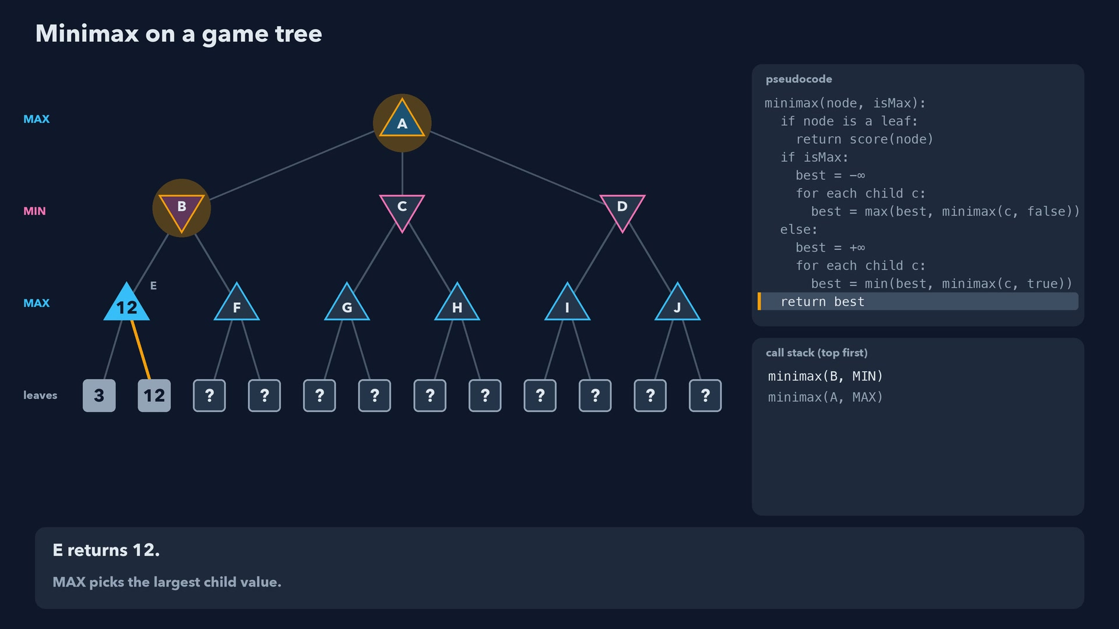
Notes:
Step 11 of 78
E returns 12.
MAX picks the largest child value.

Slide 12
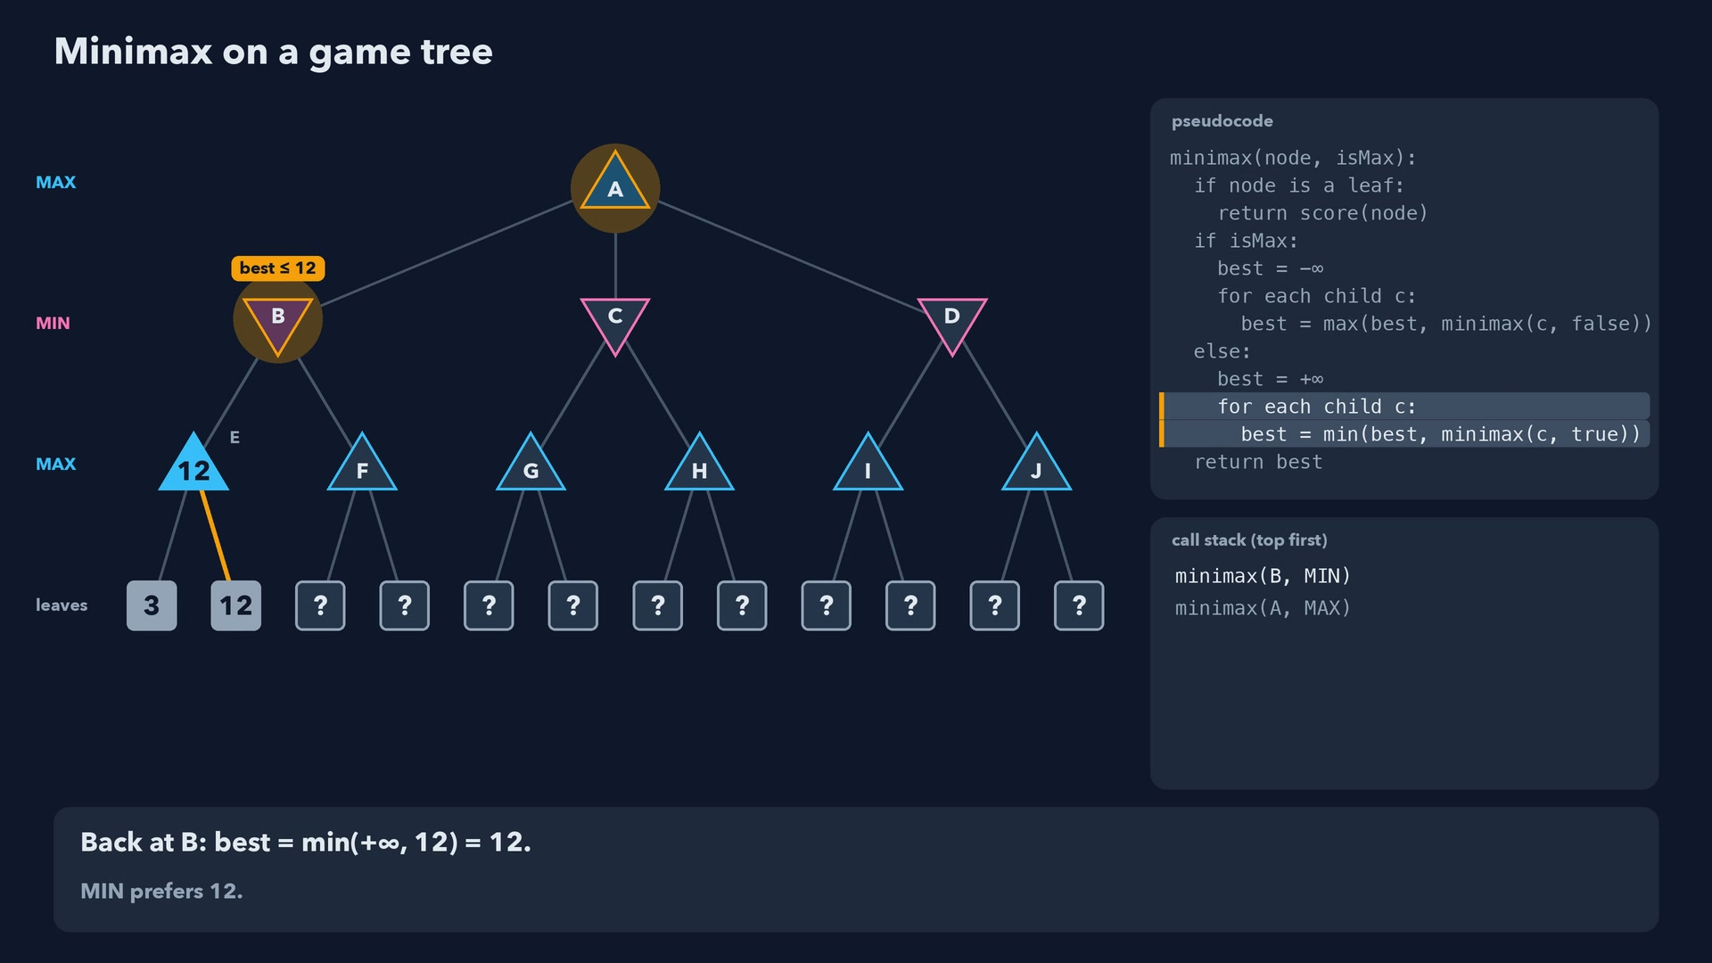
Notes:
Step 12 of 78
Back at B: best = min(+∞, 12) = 12.
MIN prefers 12.

Slide 13
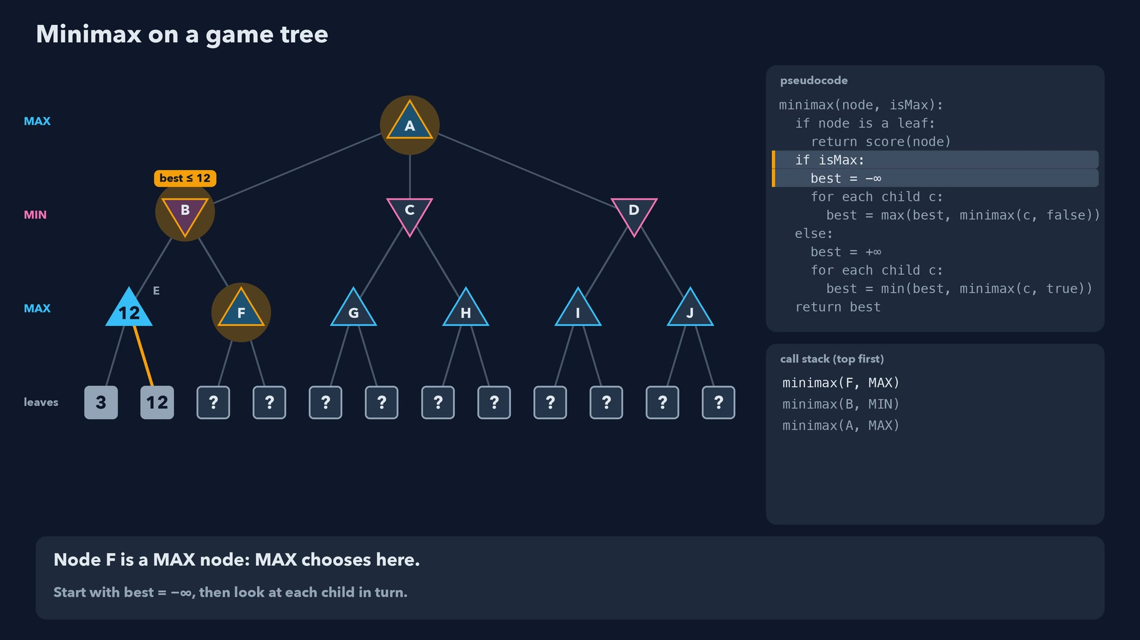
Notes:
Step 13 of 78
Node F is a MAX node: MAX chooses here.
Start with best = -∞, then look at each child in turn.

Slide 14
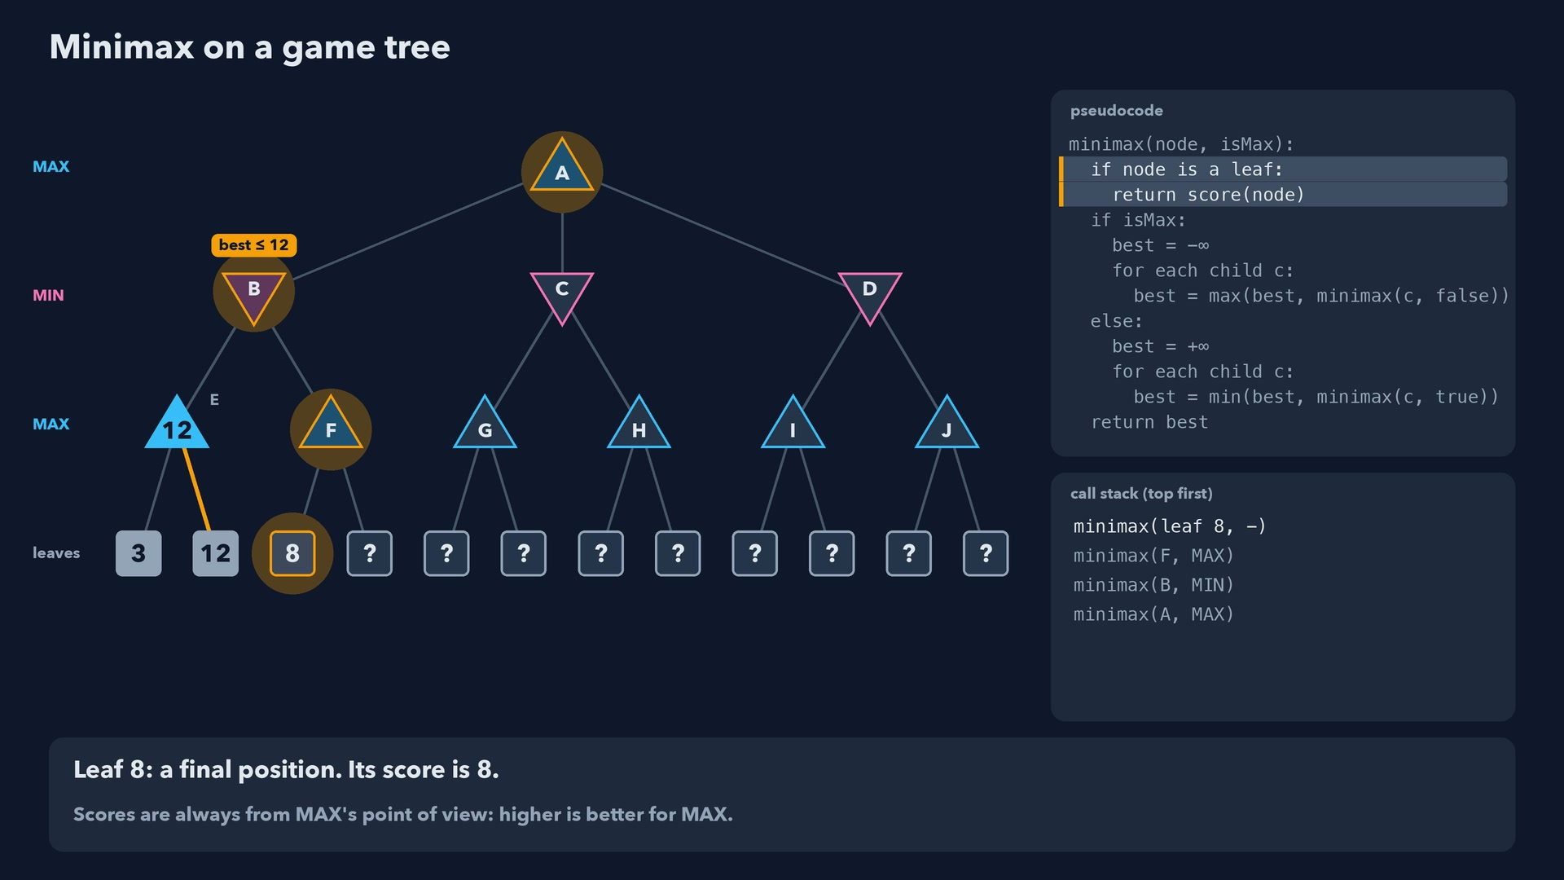
Notes:
Step 14 of 78
Leaf 8: a final position. Its score is 8.
Scores are always from MAX's point of view: higher is better for MAX.

Slide 15
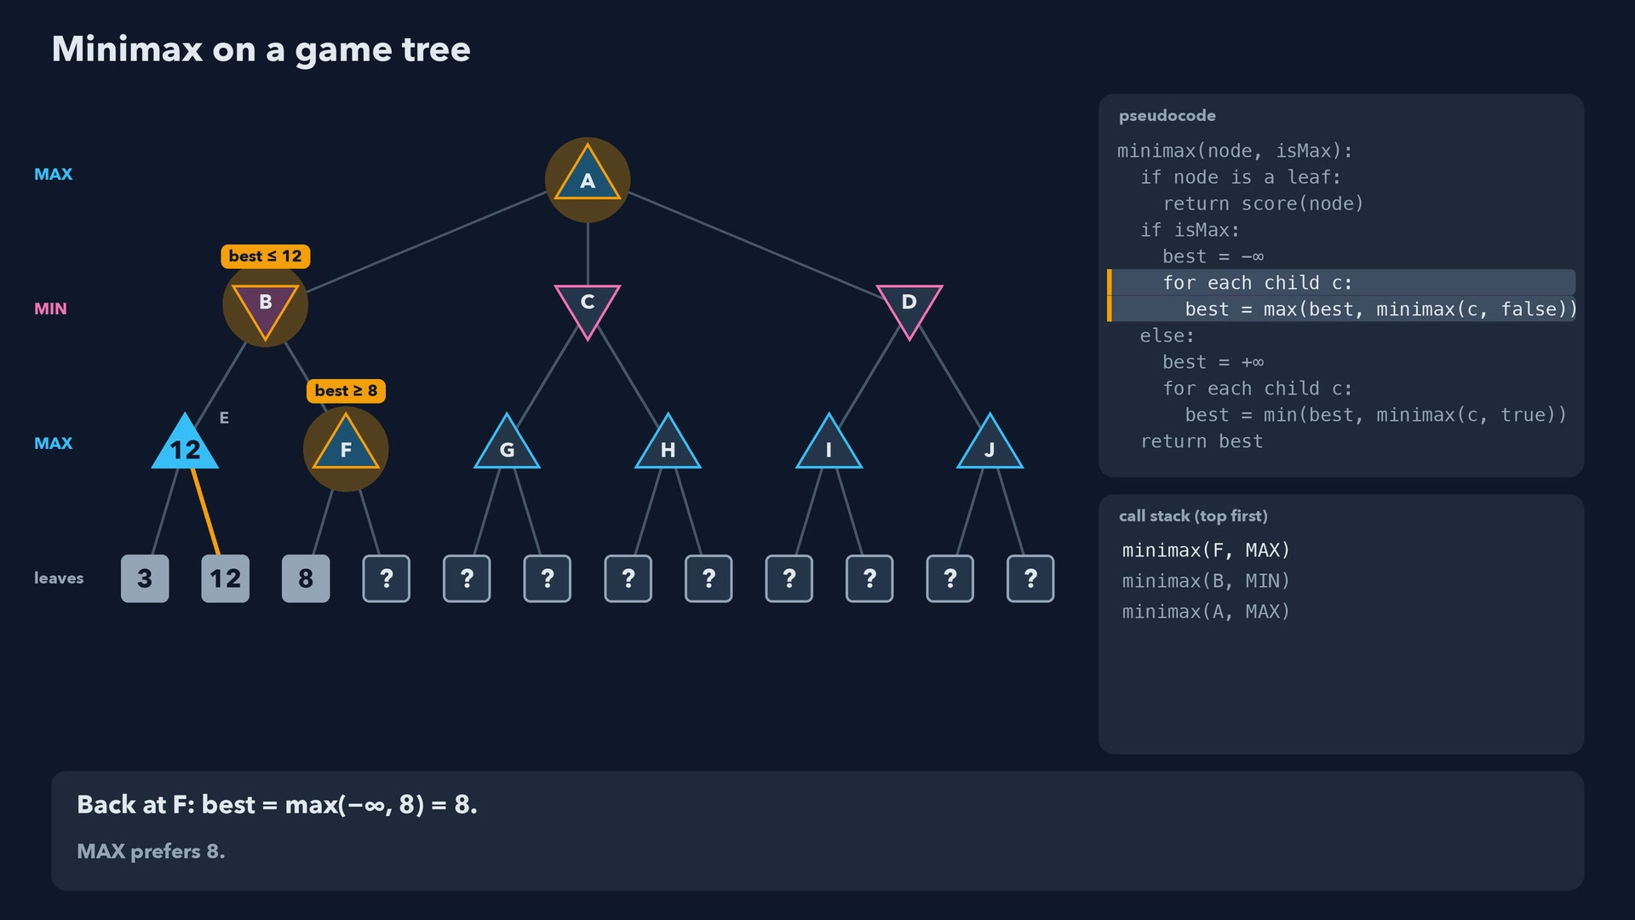
Notes:
Step 15 of 78
Back at F: best = max(-∞, 8) = 8.
MAX prefers 8.

Slide 16
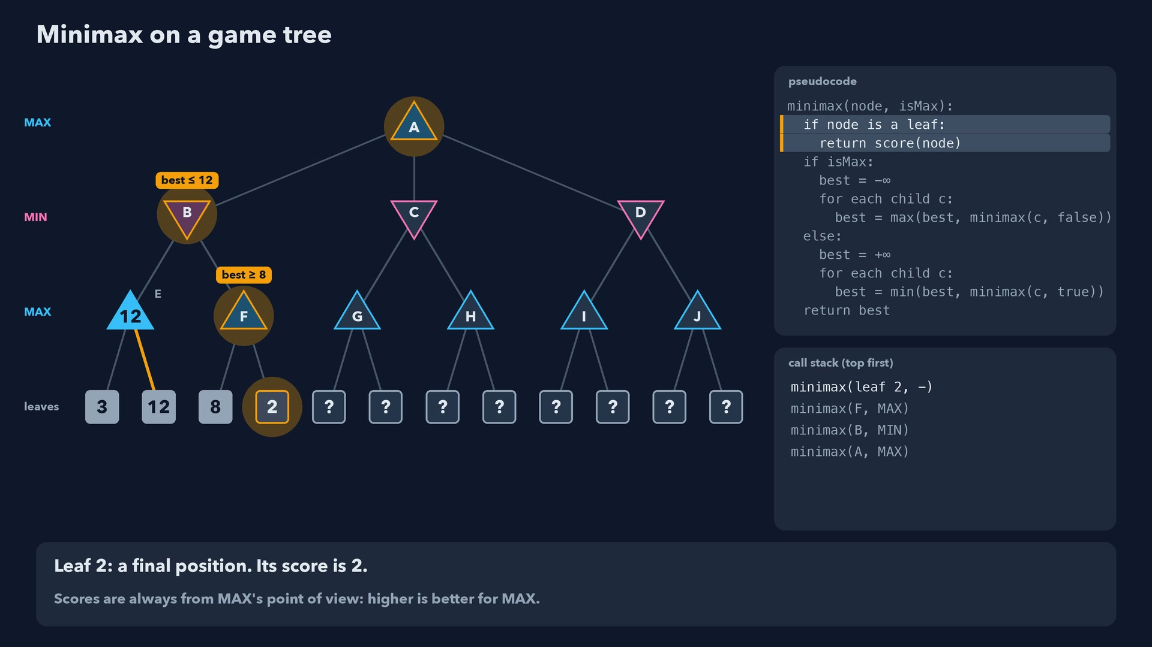
Notes:
Step 16 of 78
Leaf 2: a final position. Its score is 2.
Scores are always from MAX's point of view: higher is better for MAX.

Slide 17
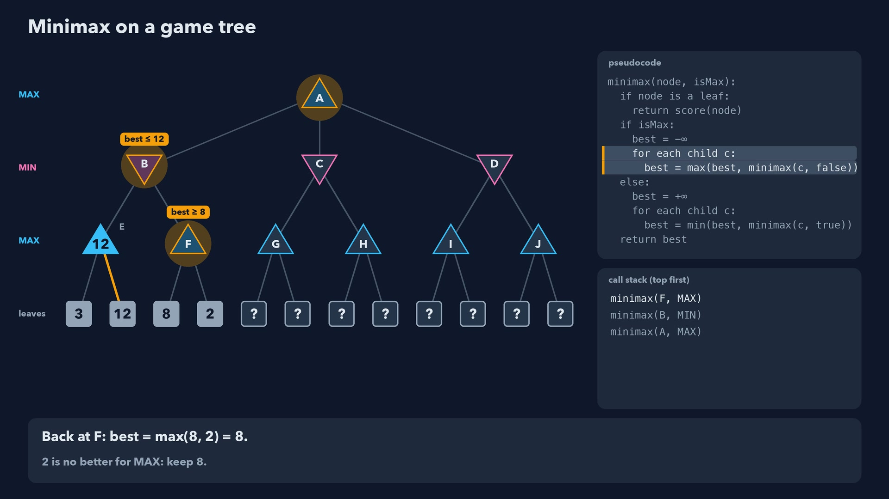
Notes:
Step 17 of 78
Back at F: best = max(8, 2) = 8.
2 is no better for MAX: keep 8.

Slide 18
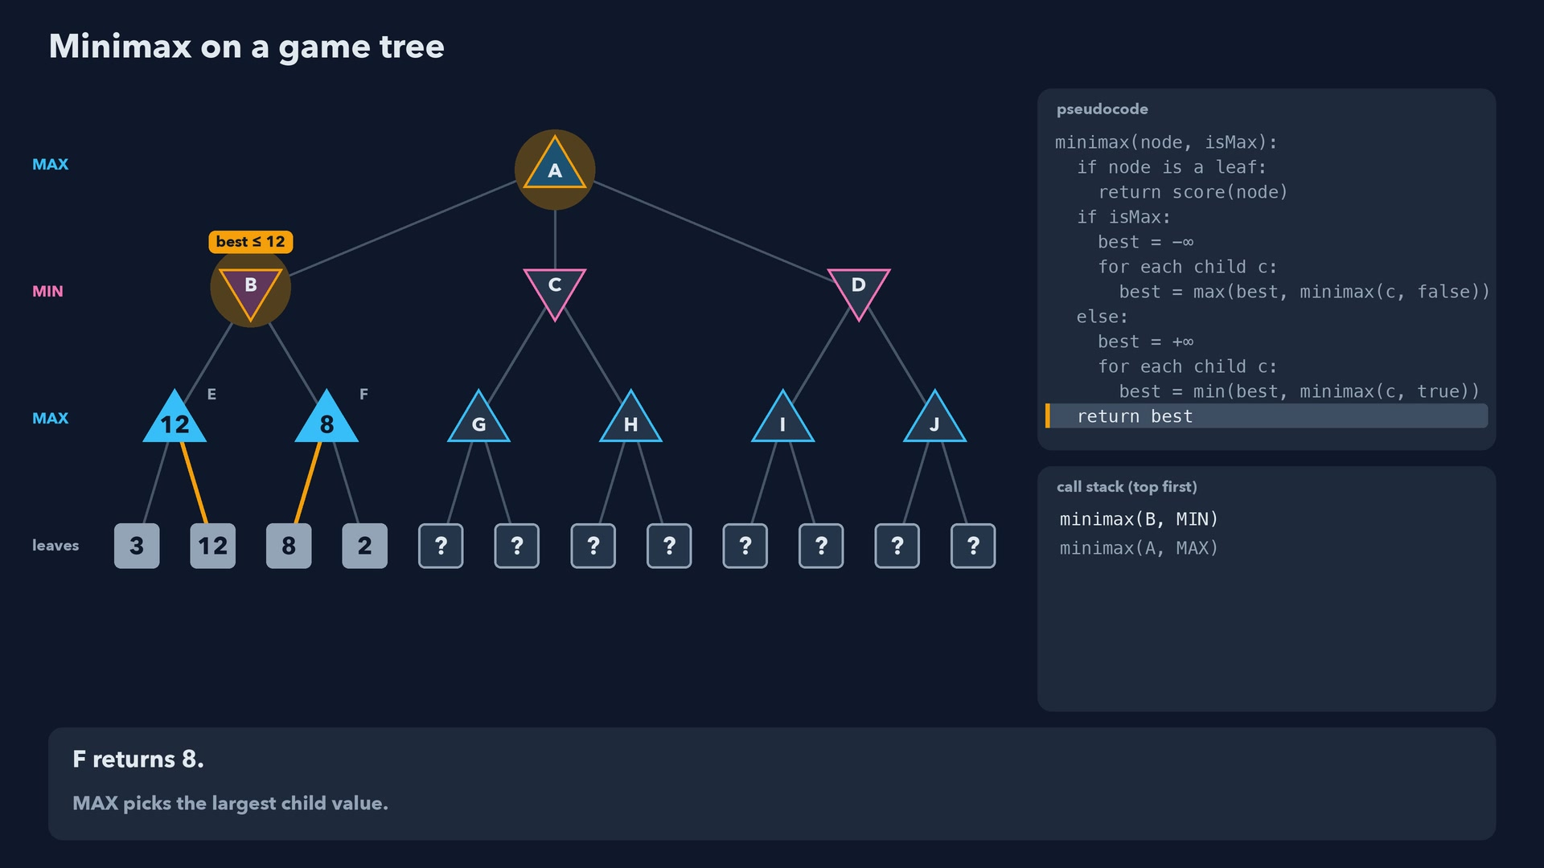
Notes:
Step 18 of 78
F returns 8.
MAX picks the largest child value.

Slide 19
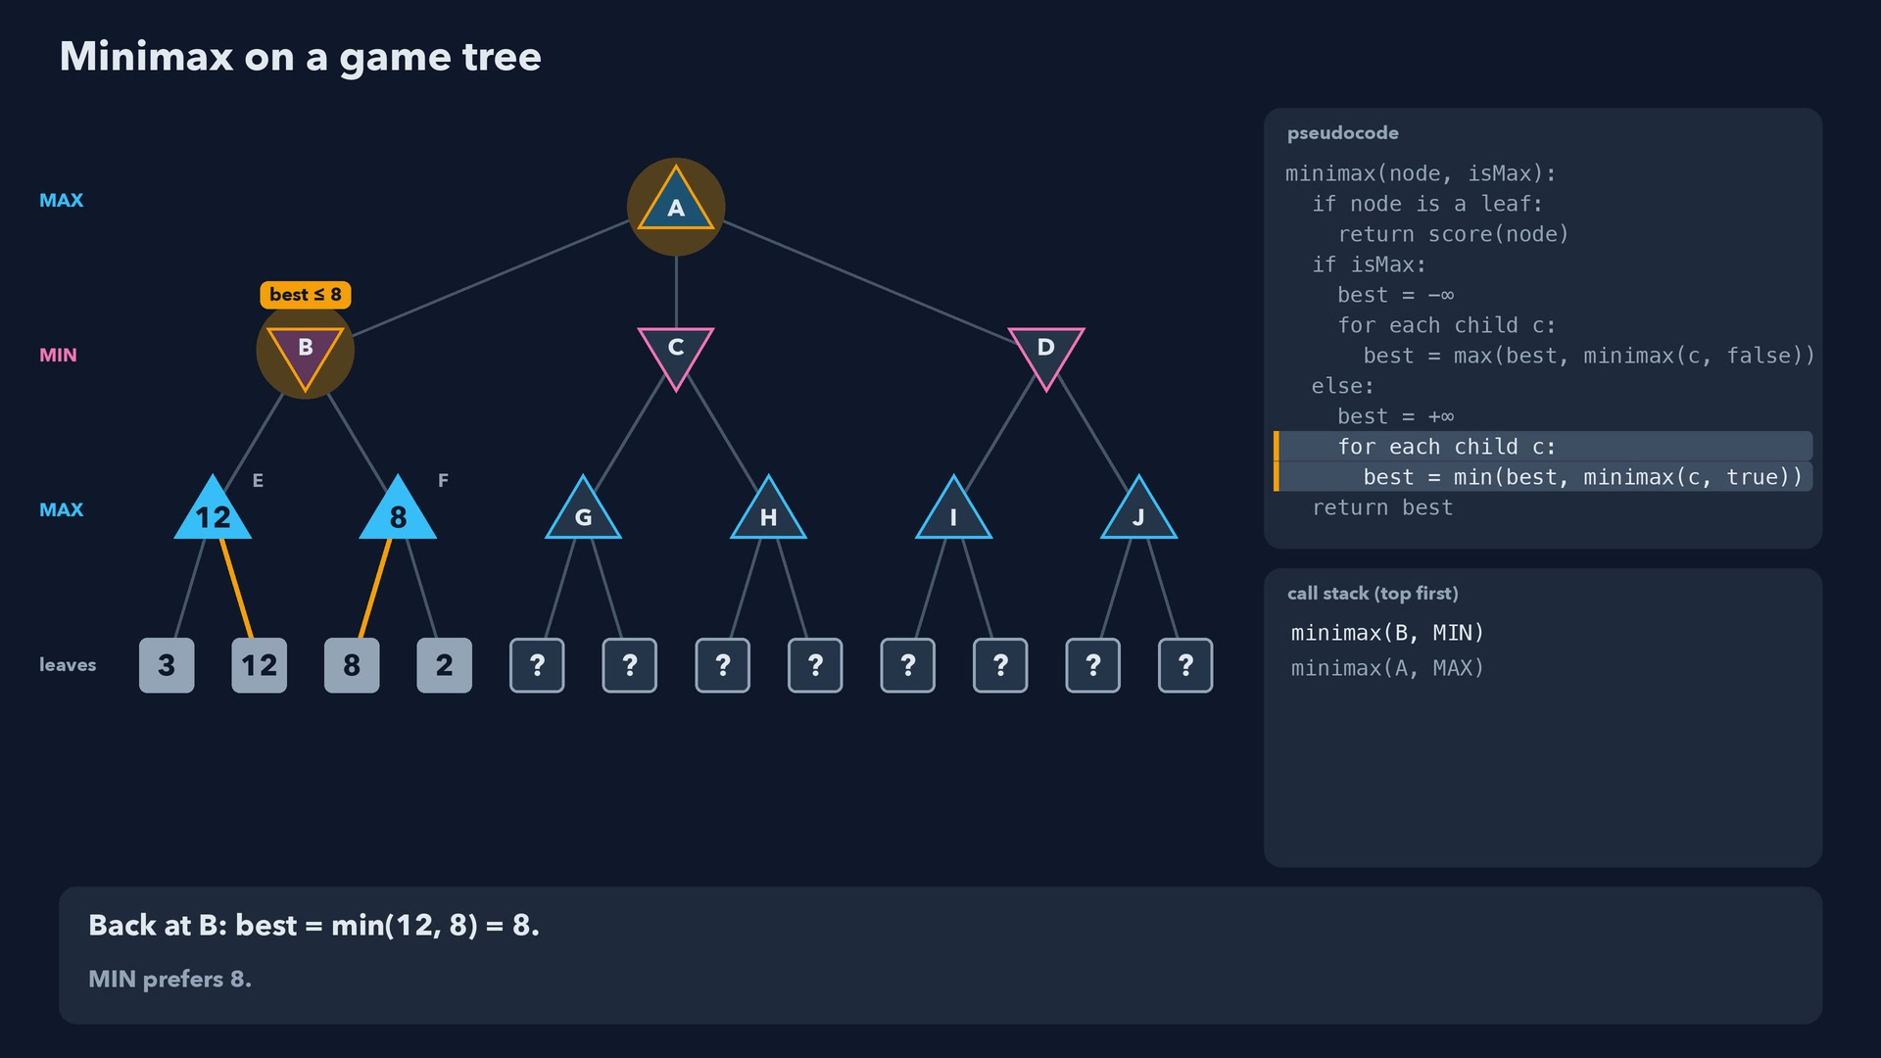
Notes:
Step 19 of 78
Back at B: best = min(12, 8) = 8.
MIN prefers 8.

Slide 20
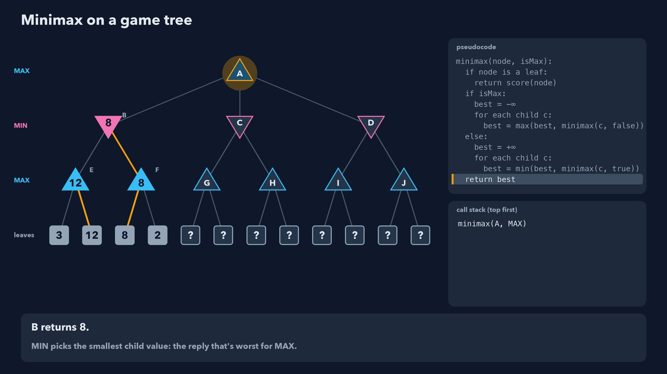
Notes:
Step 20 of 78
B returns 8.
MIN picks the smallest child value: the reply that's worst for MAX.

Slide 21
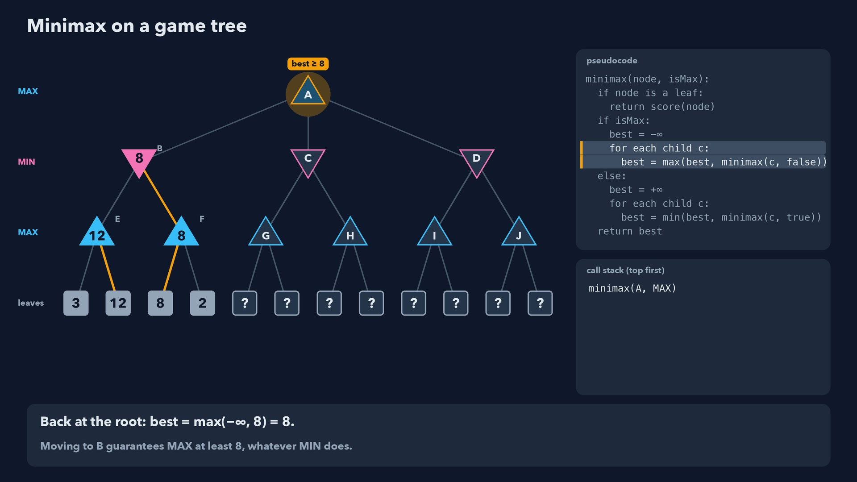
Notes:
Step 21 of 78
Back at the root: best = max(-∞, 8) = 8.
Moving to B guarantees MAX at least 8, whatever MIN does.

Slide 22
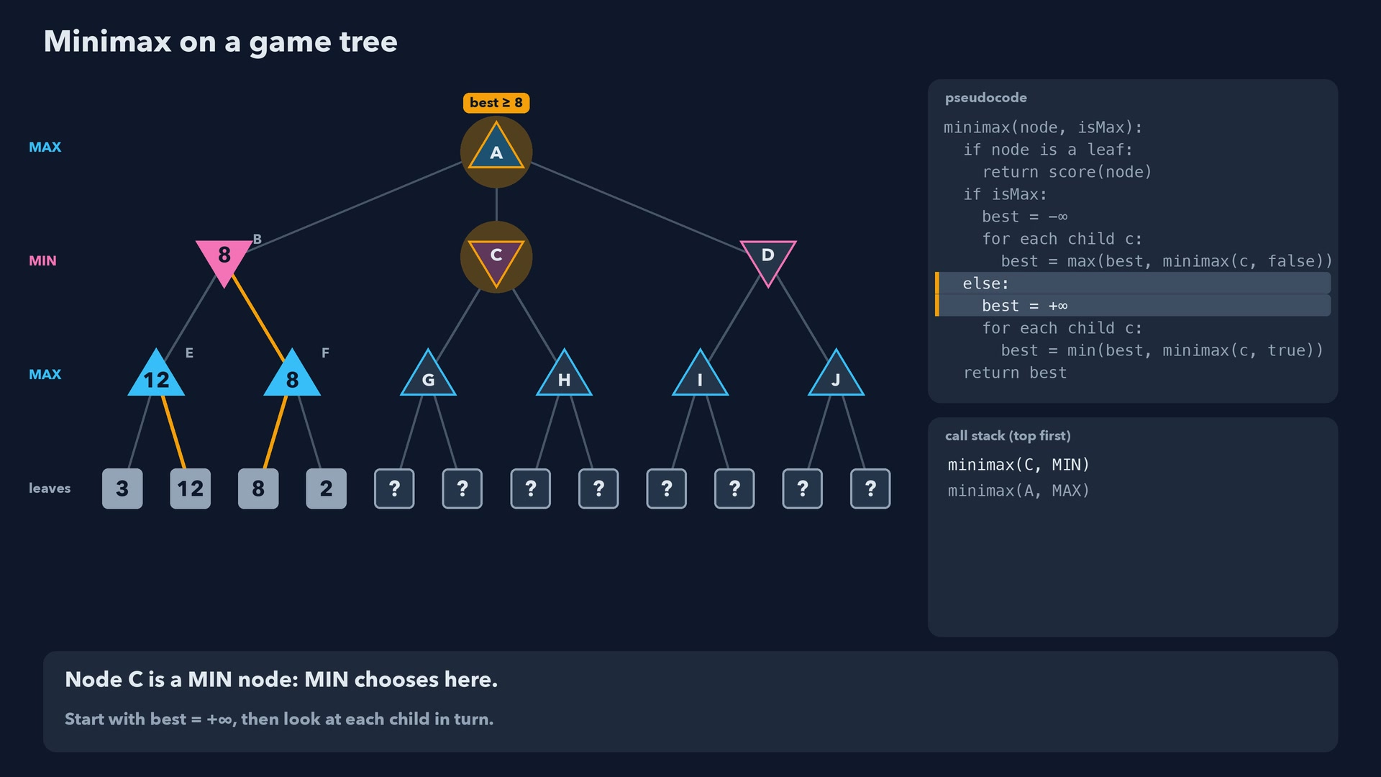
Notes:
Step 22 of 78
Node C is a MIN node: MIN chooses here.
Start with best = +∞, then look at each child in turn.

Slide 23
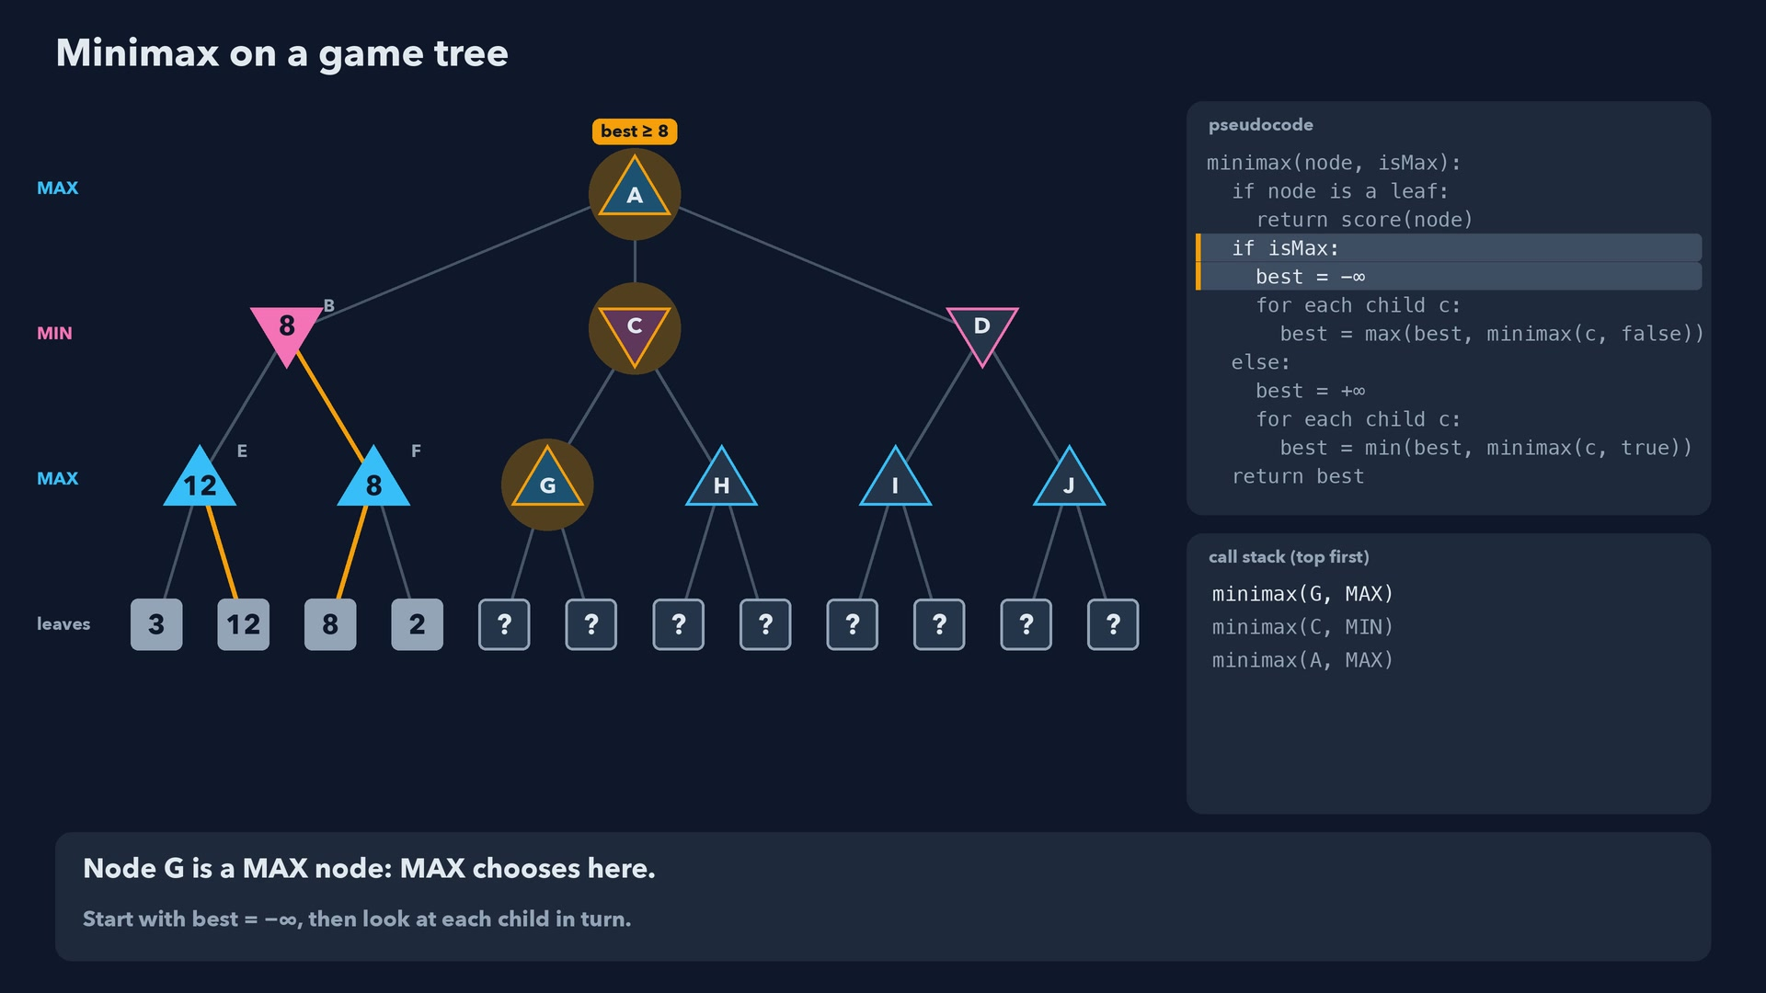
Notes:
Step 23 of 78
Node G is a MAX node: MAX chooses here.
Start with best = -∞, then look at each child in turn.

Slide 24
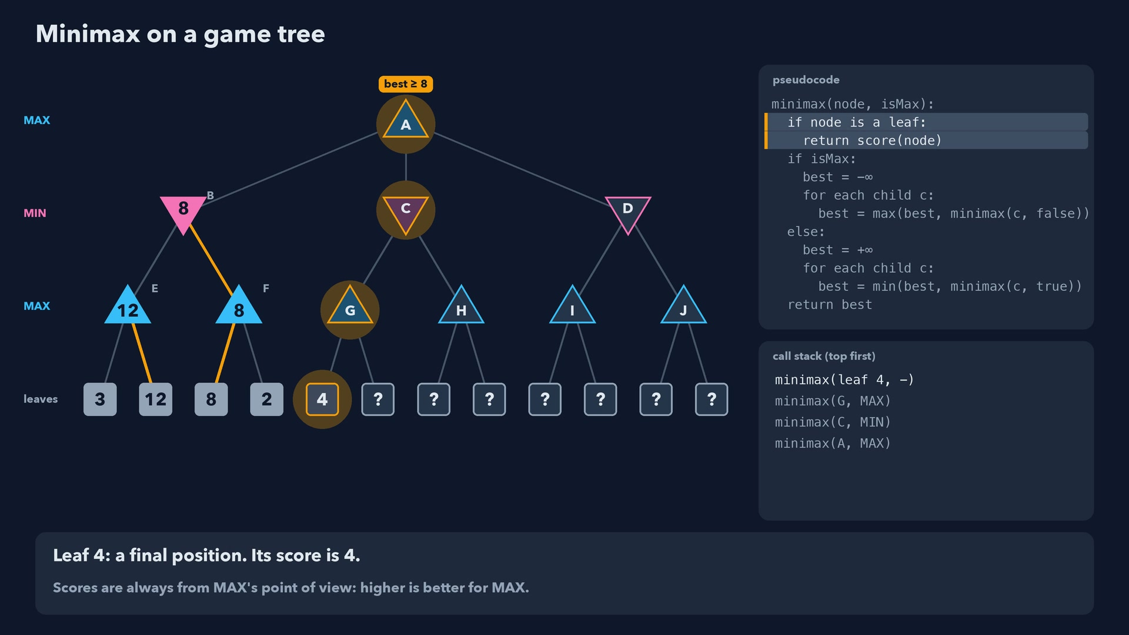
Notes:
Step 24 of 78
Leaf 4: a final position. Its score is 4.
Scores are always from MAX's point of view: higher is better for MAX.

Slide 25
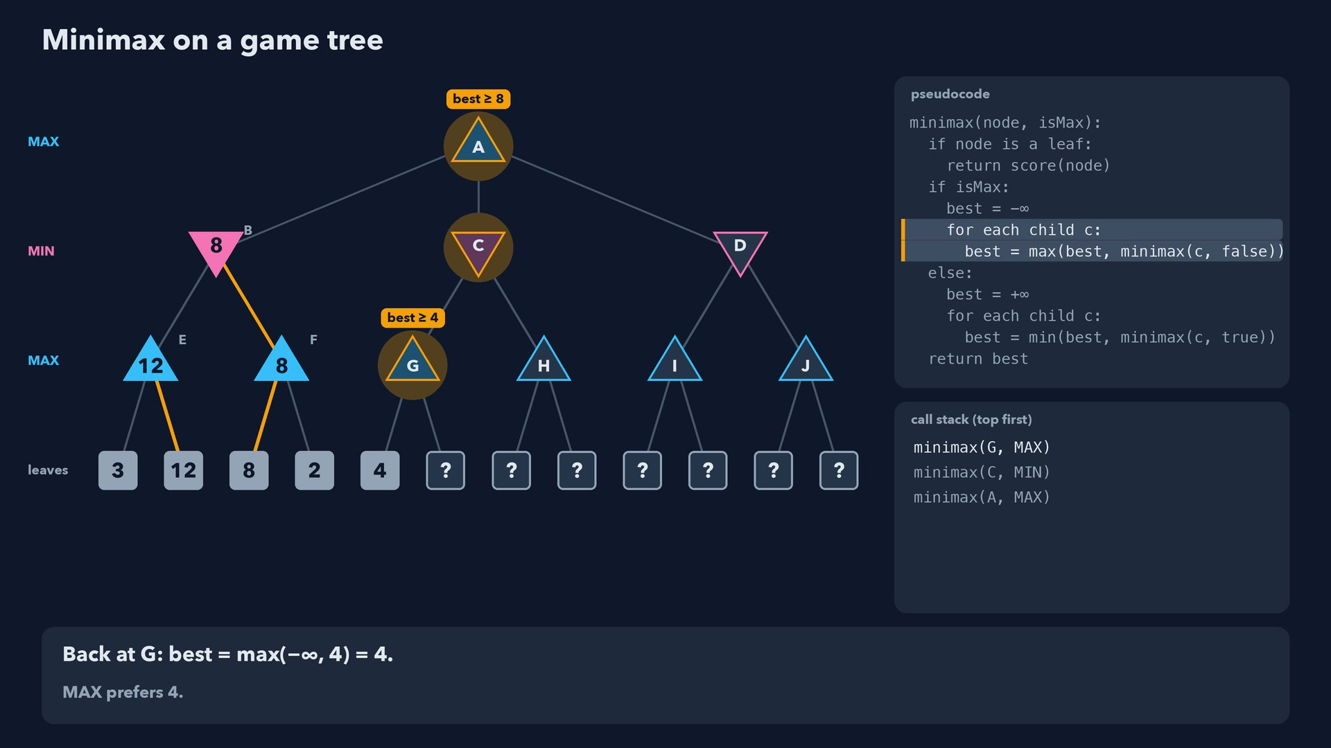
Notes:
Step 25 of 78
Back at G: best = max(-∞, 4) = 4.
MAX prefers 4.

Slide 26
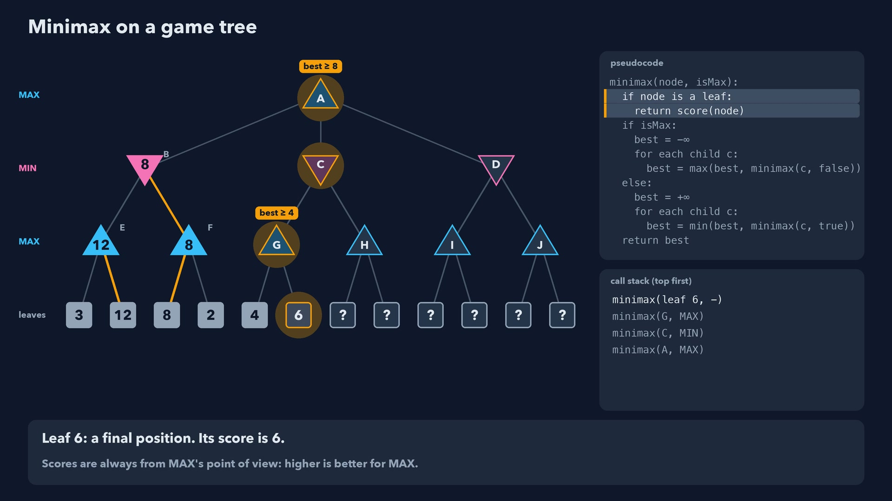
Notes:
Step 26 of 78
Leaf 6: a final position. Its score is 6.
Scores are always from MAX's point of view: higher is better for MAX.

Slide 27
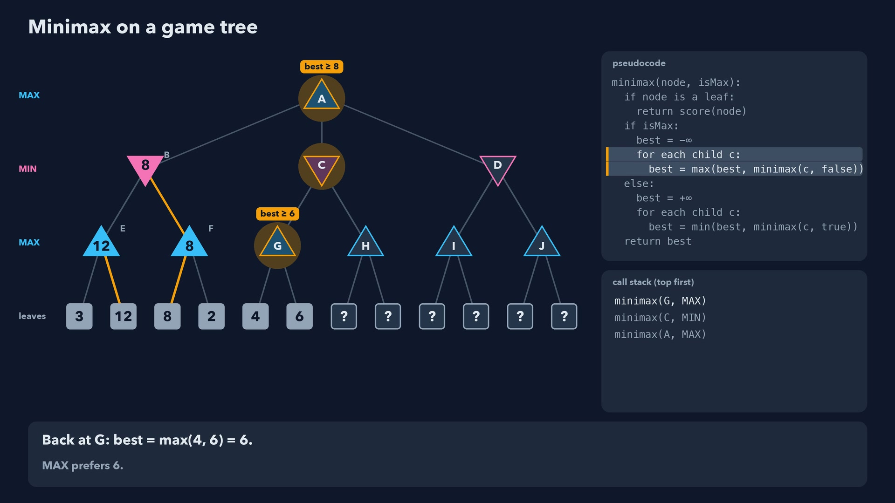
Notes:
Step 27 of 78
Back at G: best = max(4, 6) = 6.
MAX prefers 6.

Slide 28
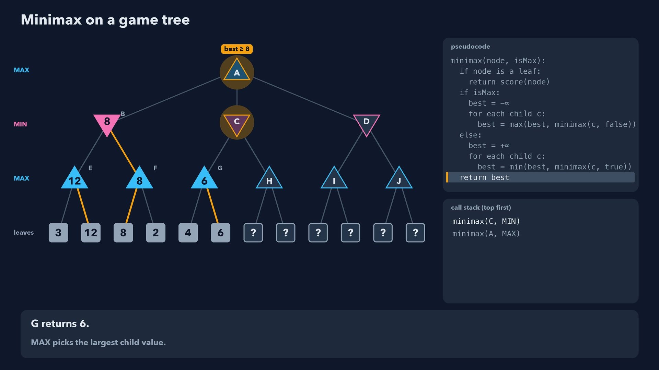
Notes:
Step 28 of 78
G returns 6.
MAX picks the largest child value.

Slide 29
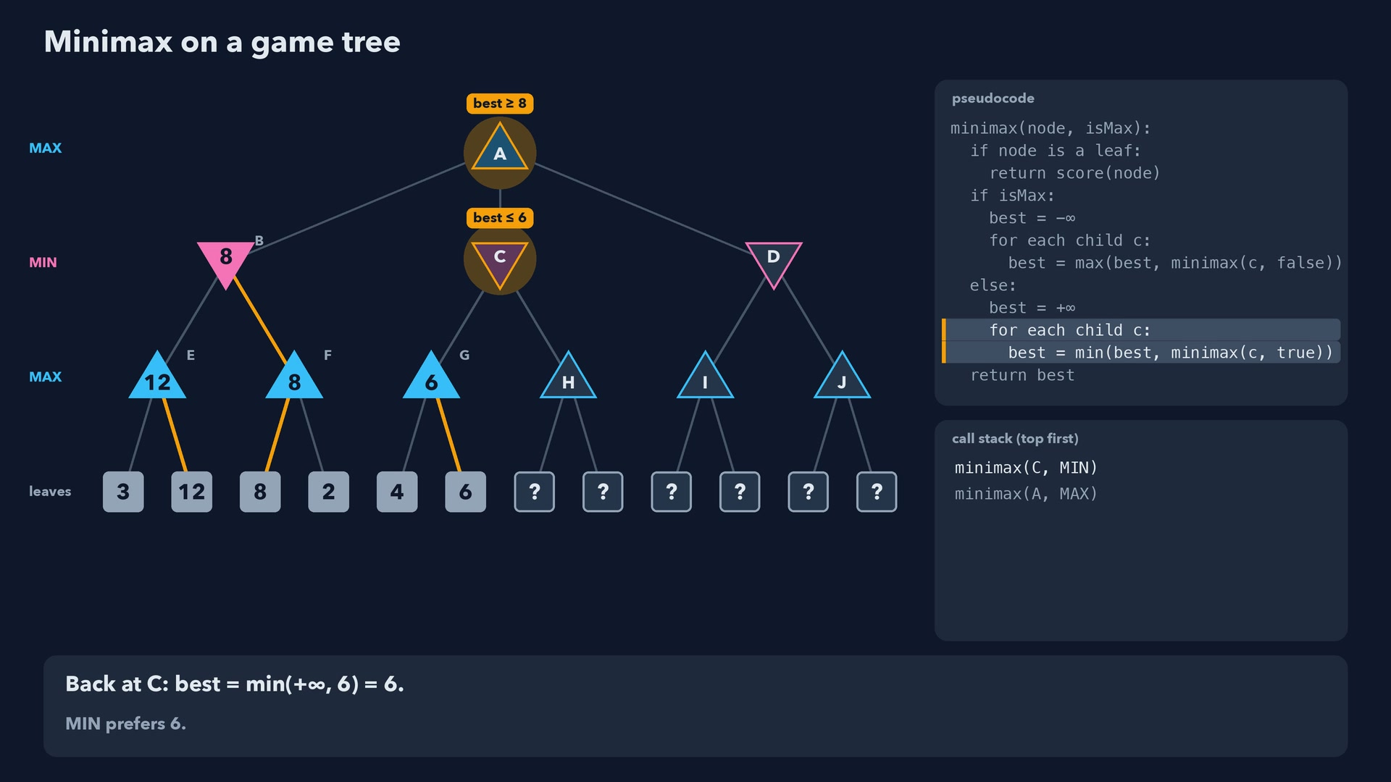
Notes:
Step 29 of 78
Back at C: best = min(+∞, 6) = 6.
MIN prefers 6.

Slide 30
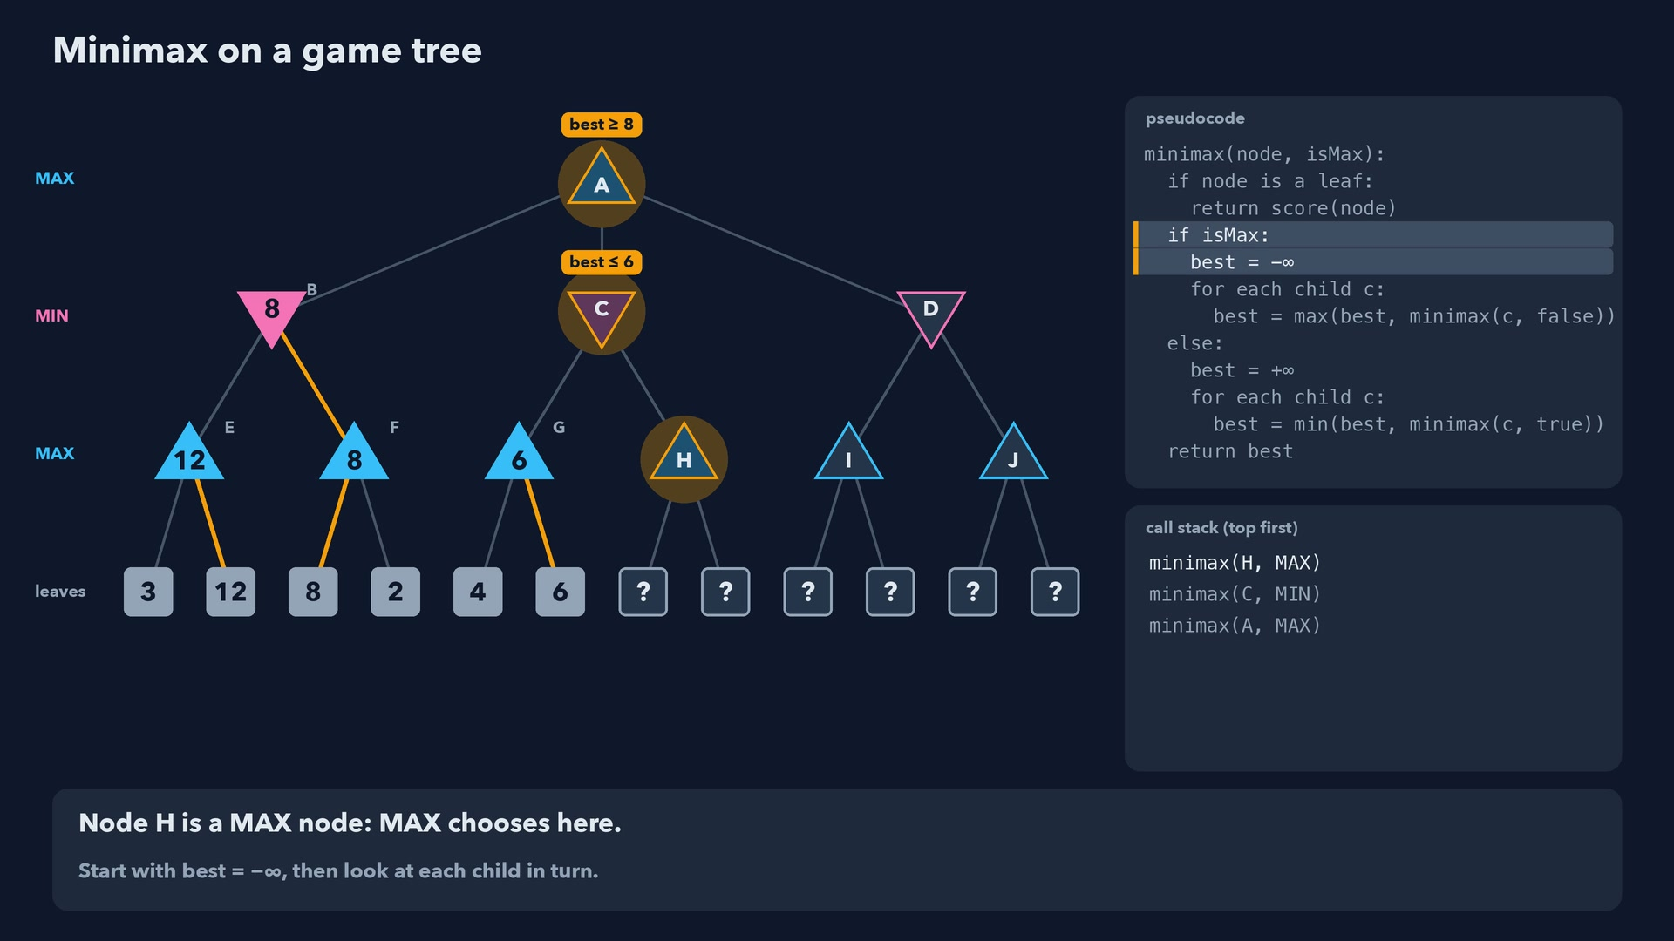
Notes:
Step 30 of 78
Node H is a MAX node: MAX chooses here.
Start with best = -∞, then look at each child in turn.

Slide 31
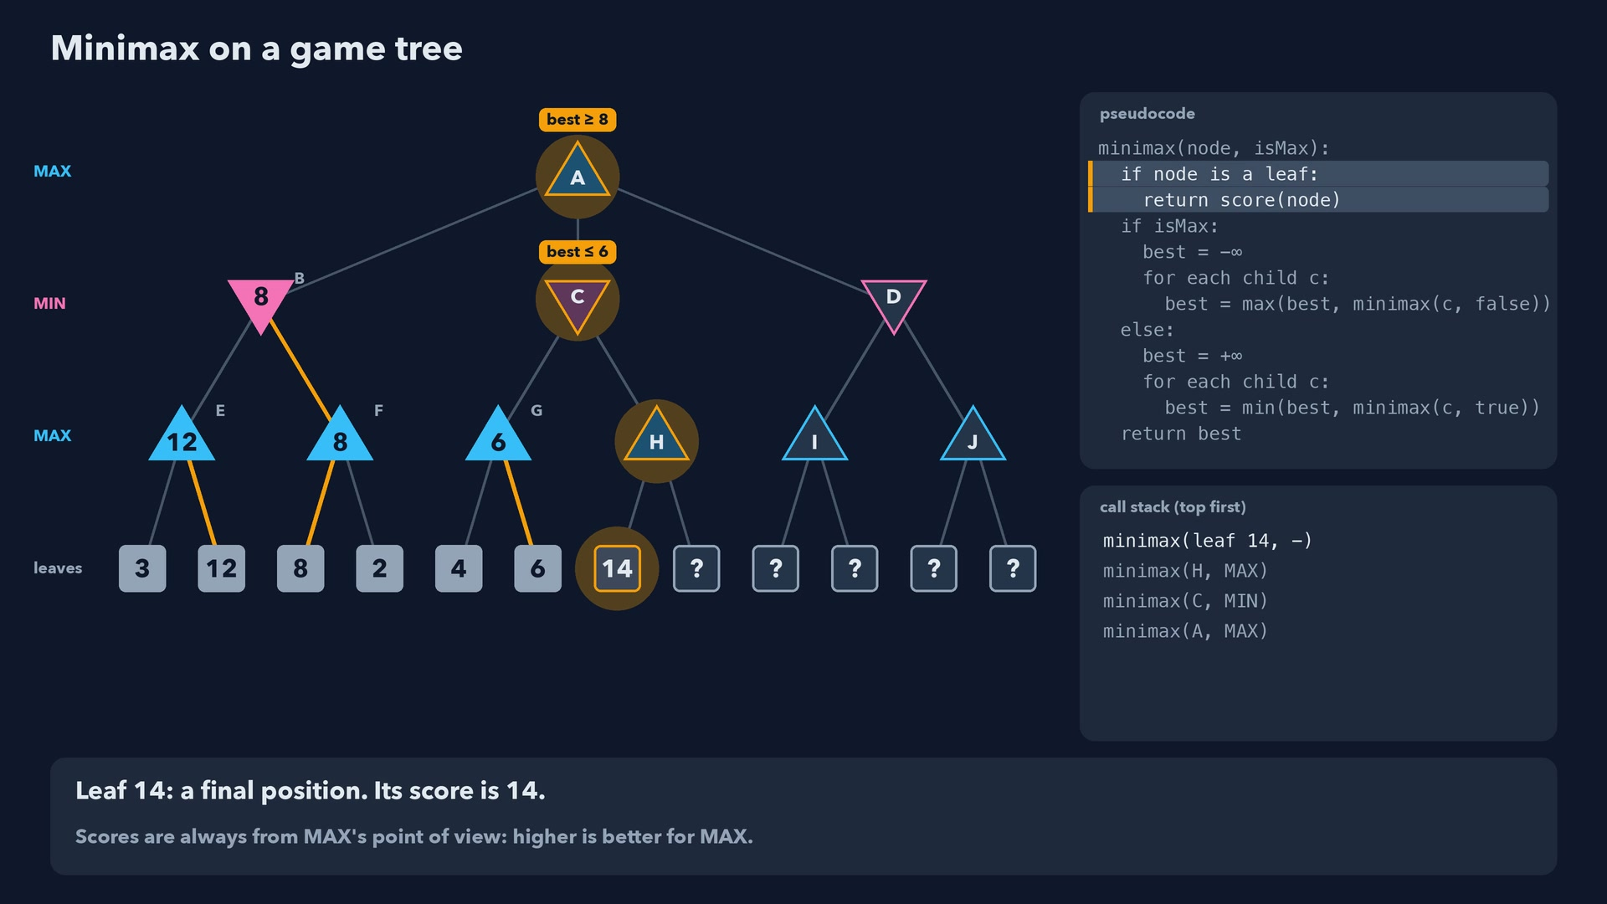
Notes:
Step 31 of 78
Leaf 14: a final position. Its score is 14.
Scores are always from MAX's point of view: higher is better for MAX.

Slide 32
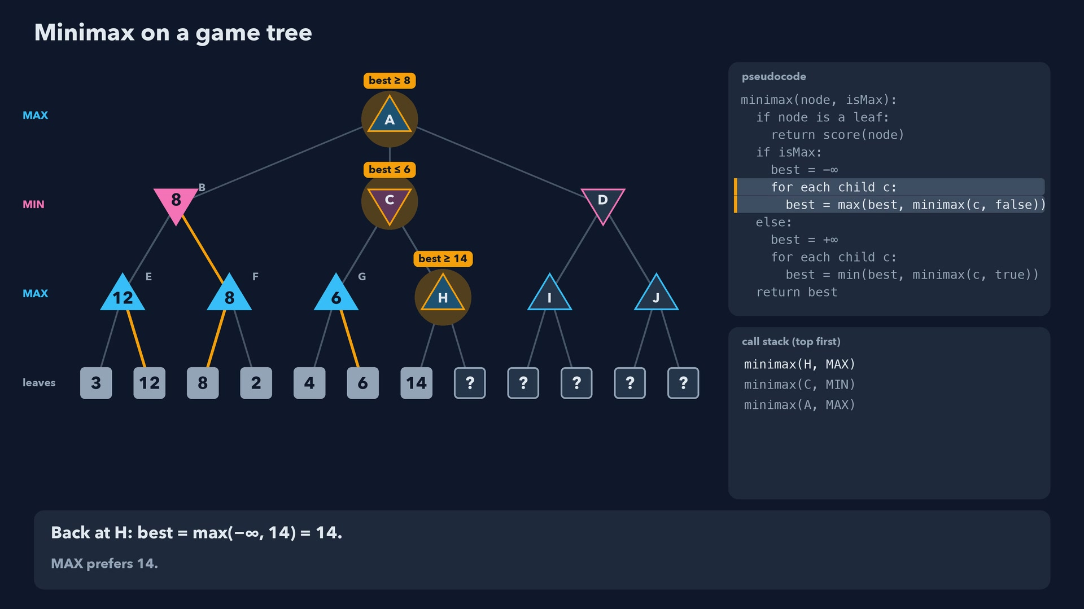
Notes:
Step 32 of 78
Back at H: best = max(-∞, 14) = 14.
MAX prefers 14.

Slide 33
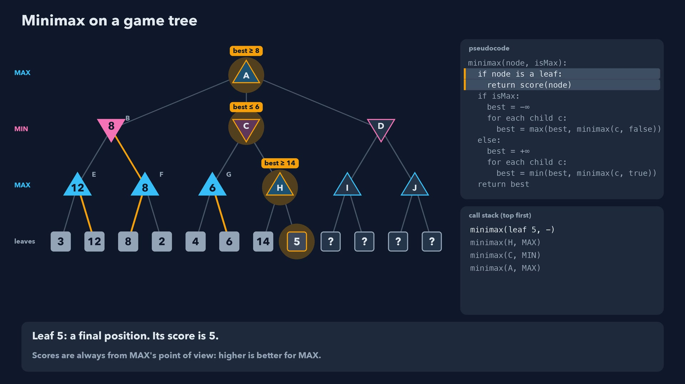
Notes:
Step 33 of 78
Leaf 5: a final position. Its score is 5.
Scores are always from MAX's point of view: higher is better for MAX.

Slide 34
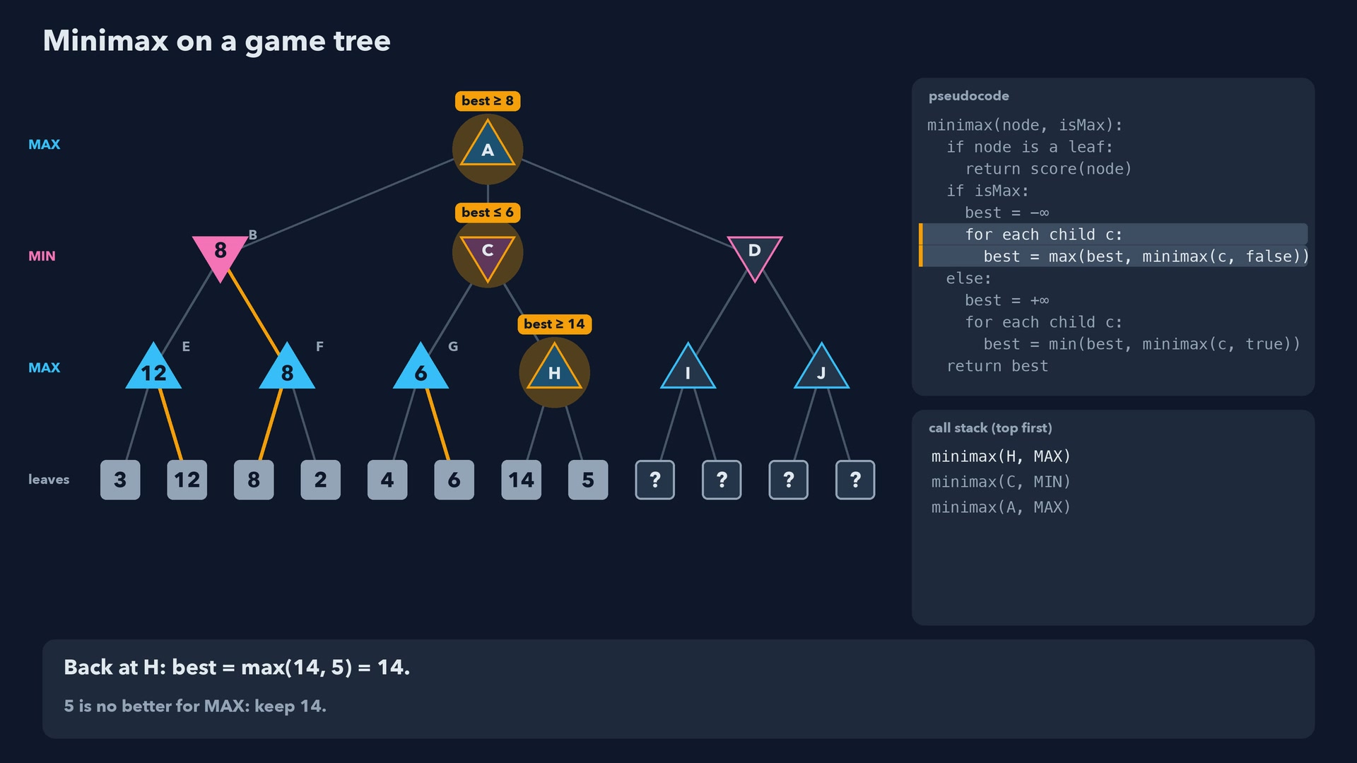
Notes:
Step 34 of 78
Back at H: best = max(14, 5) = 14.
5 is no better for MAX: keep 14.

Slide 35
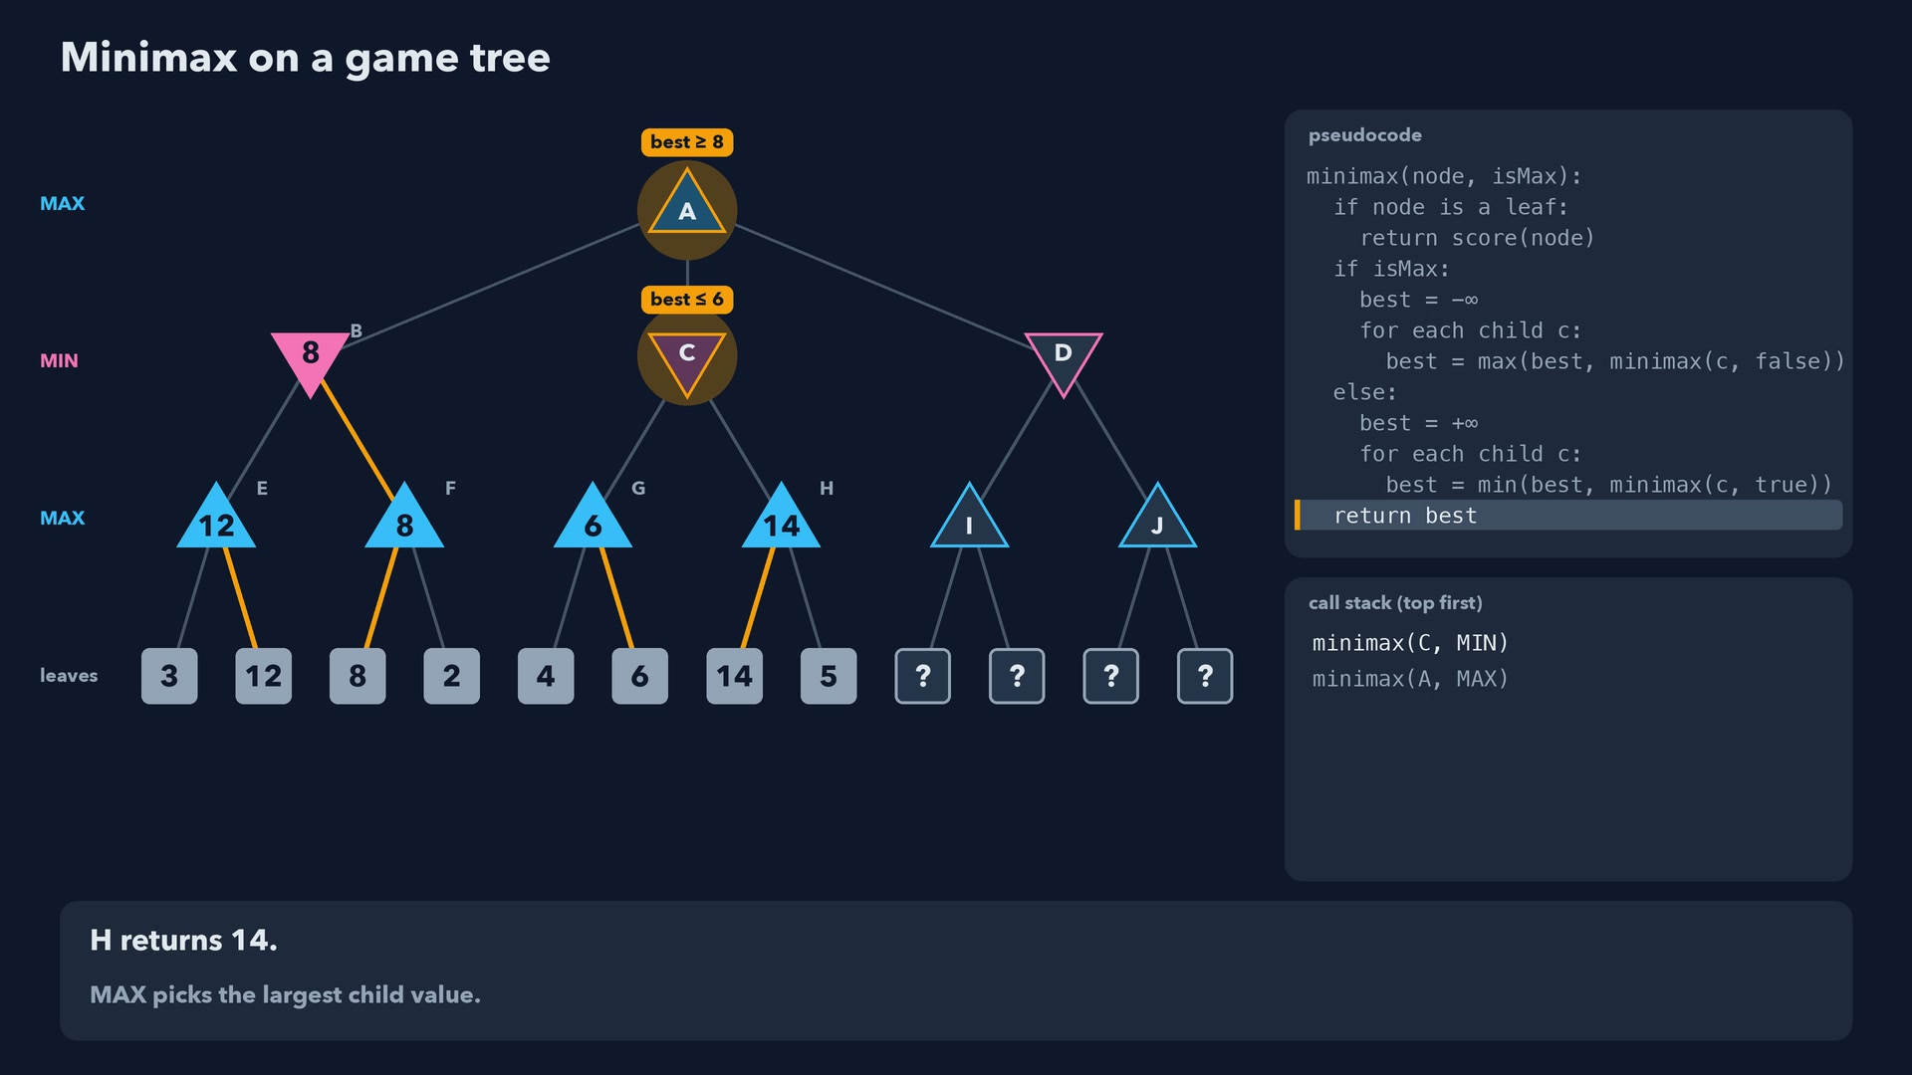
Notes:
Step 35 of 78
H returns 14.
MAX picks the largest child value.

Slide 36
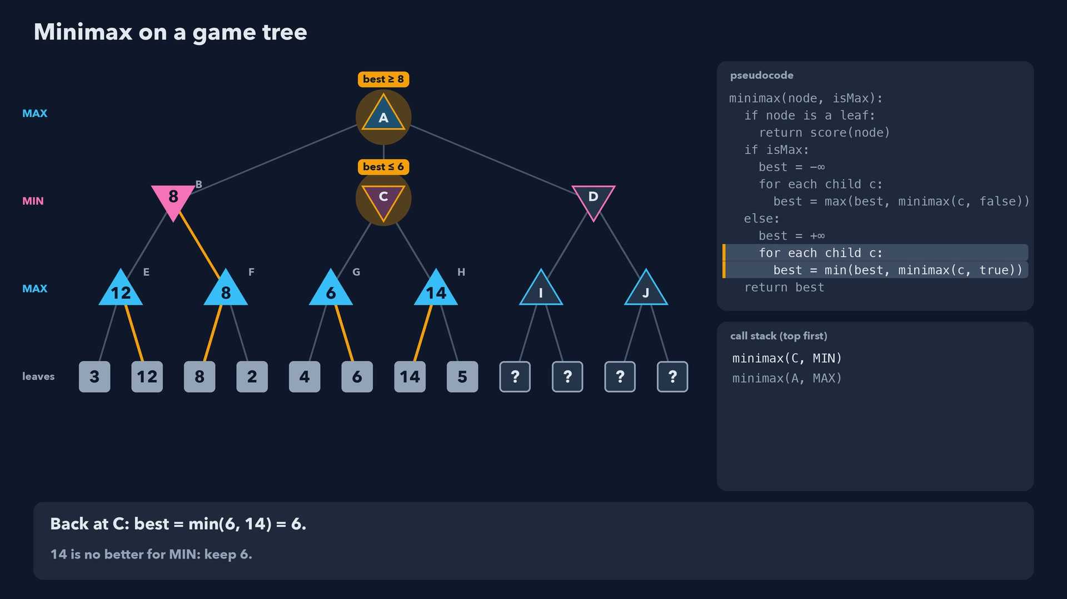
Notes:
Step 36 of 78
Back at C: best = min(6, 14) = 6.
14 is no better for MIN: keep 6.

Slide 37
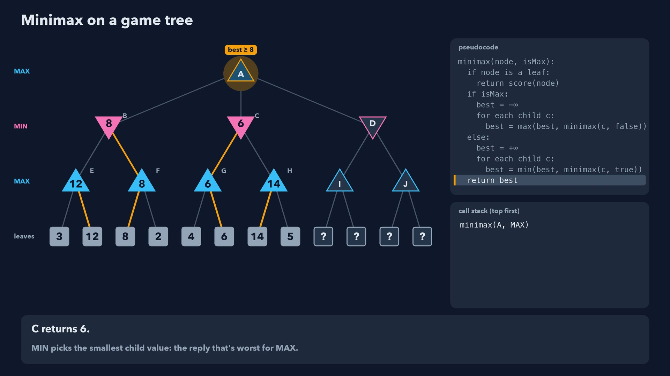
Notes:
Step 37 of 78
C returns 6.
MIN picks the smallest child value: the reply that's worst for MAX.

Slide 38
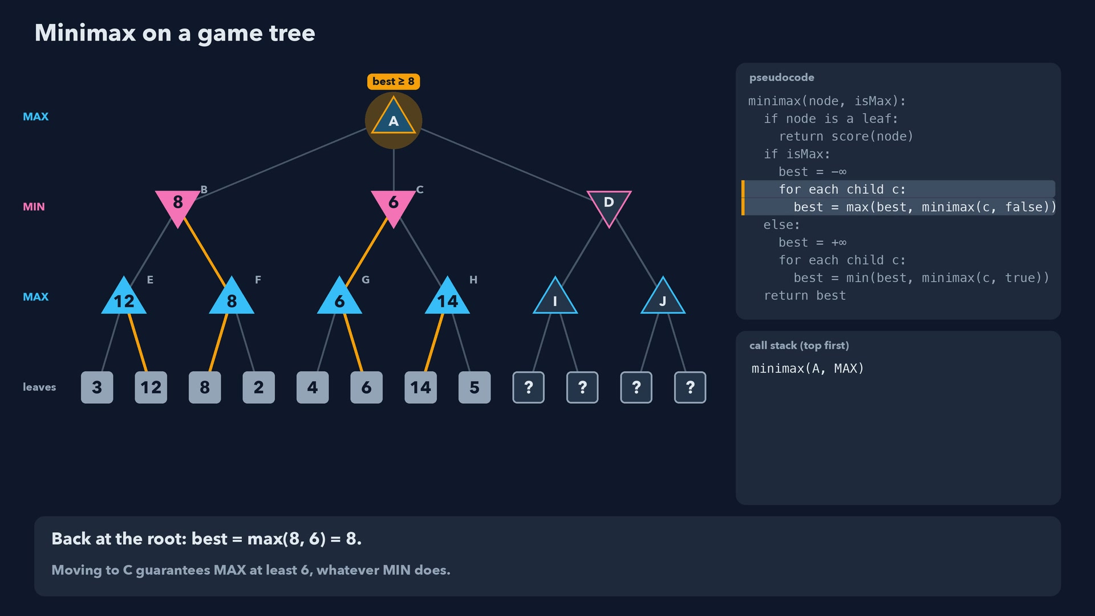
Notes:
Step 38 of 78
Back at the root: best = max(8, 6) = 8.
Moving to C guarantees MAX at least 6, whatever MIN does.

Slide 39
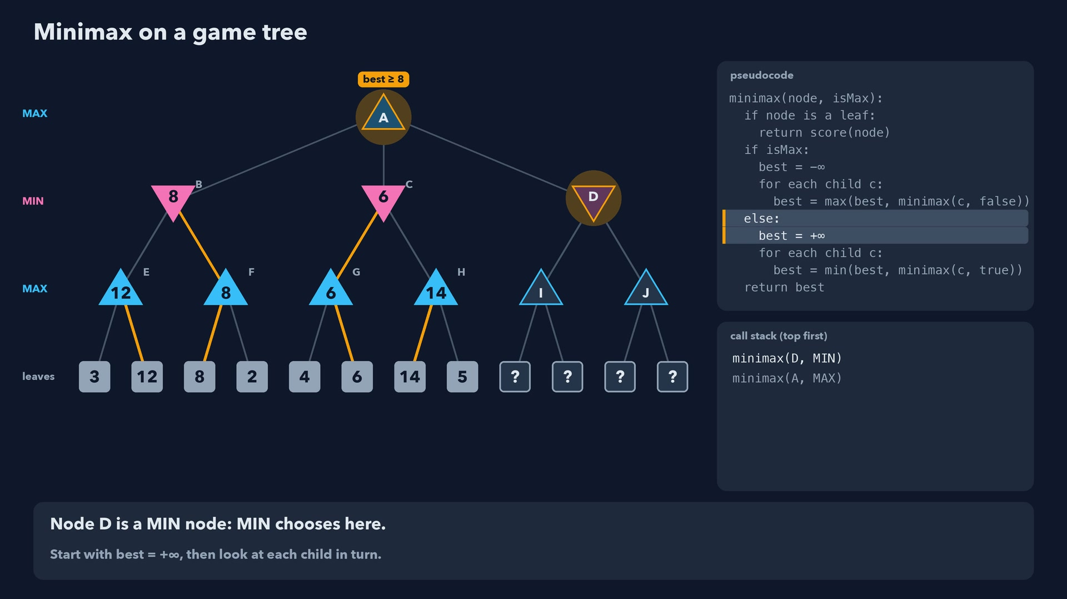
Notes:
Step 39 of 78
Node D is a MIN node: MIN chooses here.
Start with best = +∞, then look at each child in turn.

Slide 40
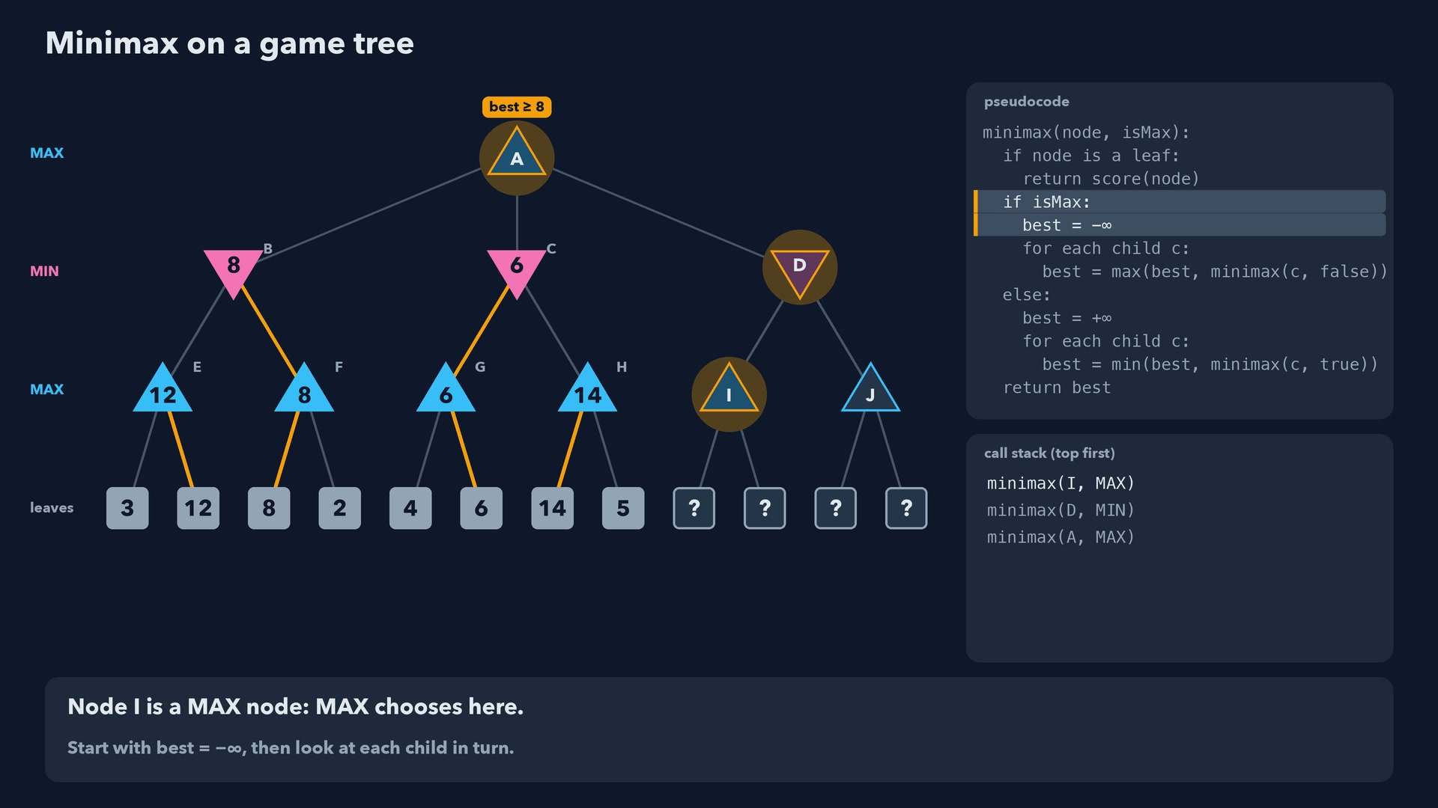
Notes:
Step 40 of 78
Node I is a MAX node: MAX chooses here.
Start with best = -∞, then look at each child in turn.

Slide 41
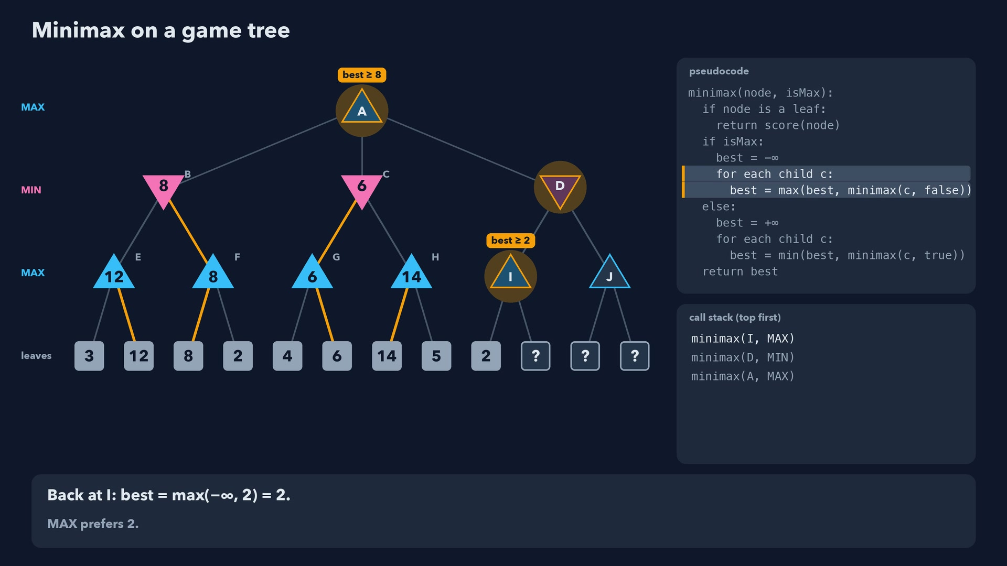
Notes:
Step 41 of 78
Back at I: best = max(-∞, 2) = 2.
MAX prefers 2.

Slide 42
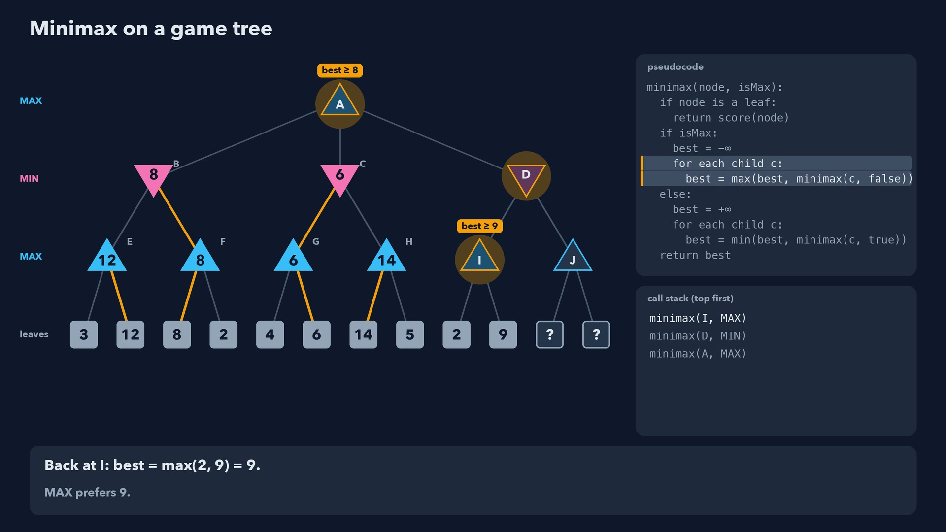
Notes:
Step 42 of 78
Back at I: best = max(2, 9) = 9.
MAX prefers 9.

Slide 43
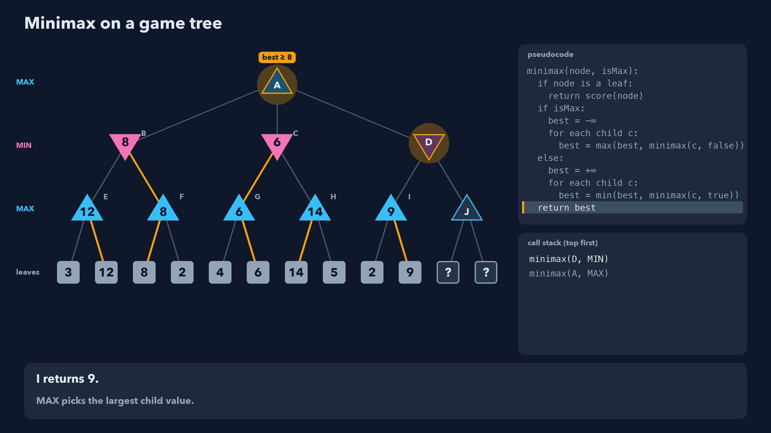
Notes:
Step 43 of 78
I returns 9.
MAX picks the largest child value.

Slide 44
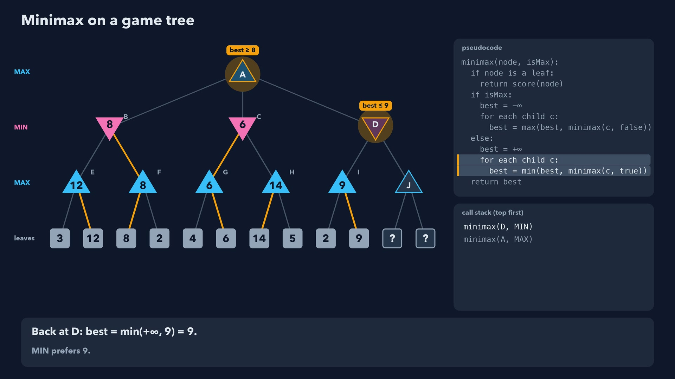
Notes:
Step 44 of 78
Back at D: best = min(+∞, 9) = 9.
MIN prefers 9.

Slide 45
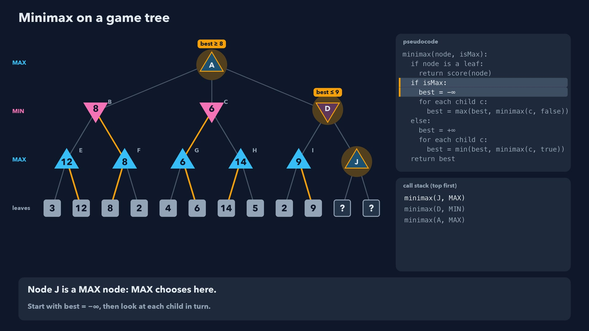
Notes:
Step 45 of 78
Node J is a MAX node: MAX chooses here.
Start with best = -∞, then look at each child in turn.

Slide 46
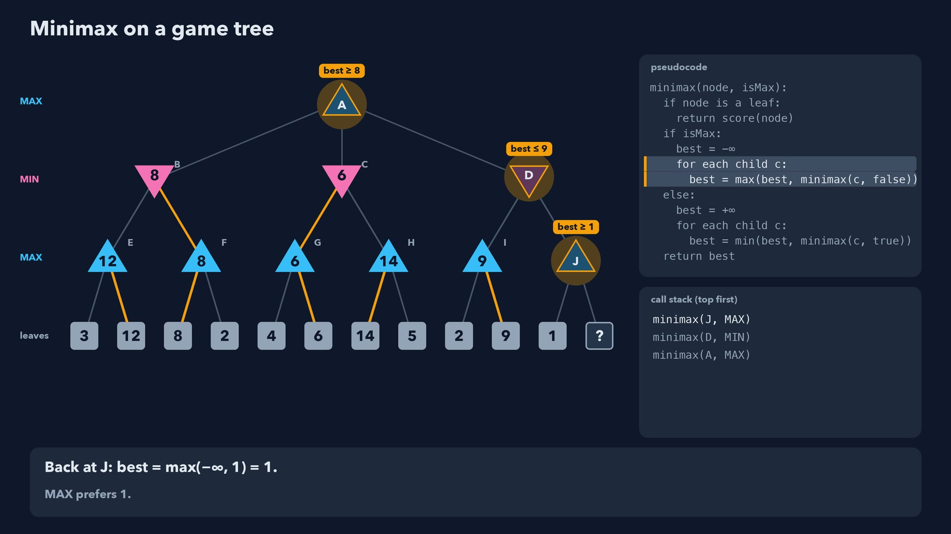
Notes:
Step 46 of 78
Back at J: best = max(-∞, 1) = 1.
MAX prefers 1.

Slide 47
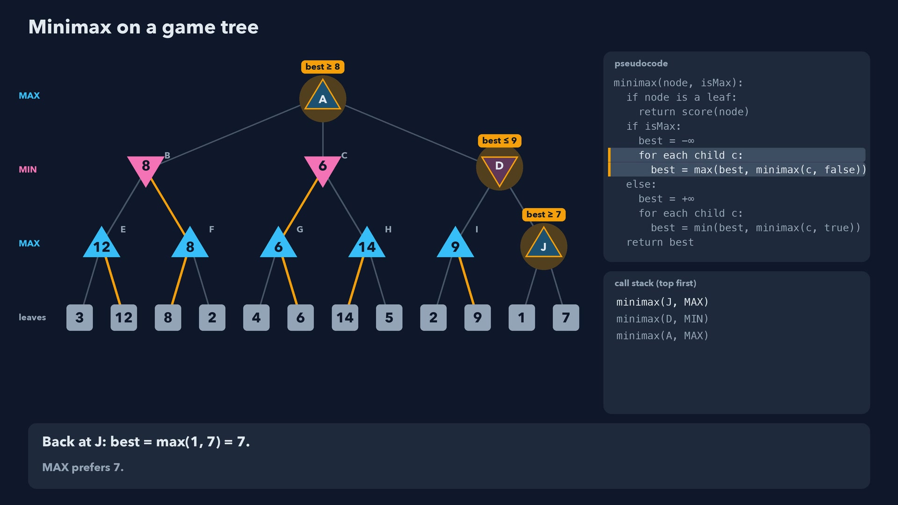
Notes:
Step 47 of 78
Back at J: best = max(1, 7) = 7.
MAX prefers 7.

Slide 48
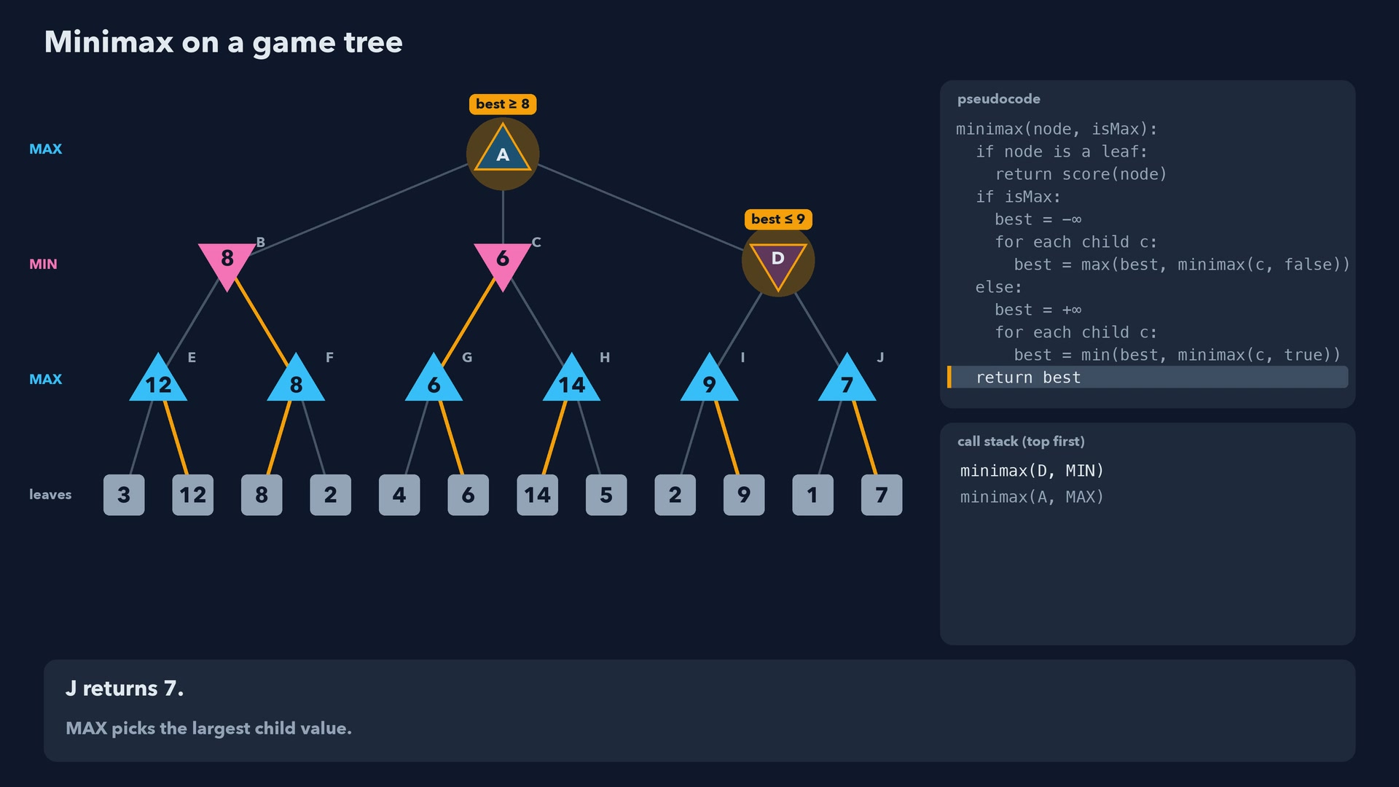
Notes:
Step 48 of 78
J returns 7.
MAX picks the largest child value.

Slide 49
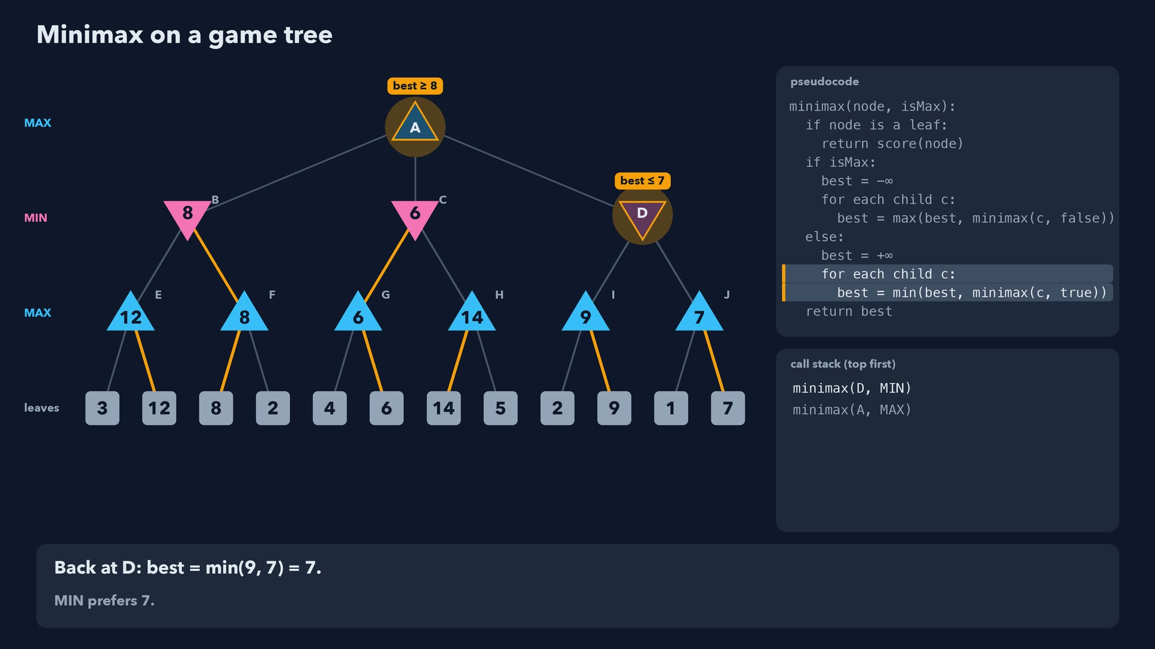
Notes:
Step 49 of 78
Back at D: best = min(9, 7) = 7.
MIN prefers 7.

Slide 50
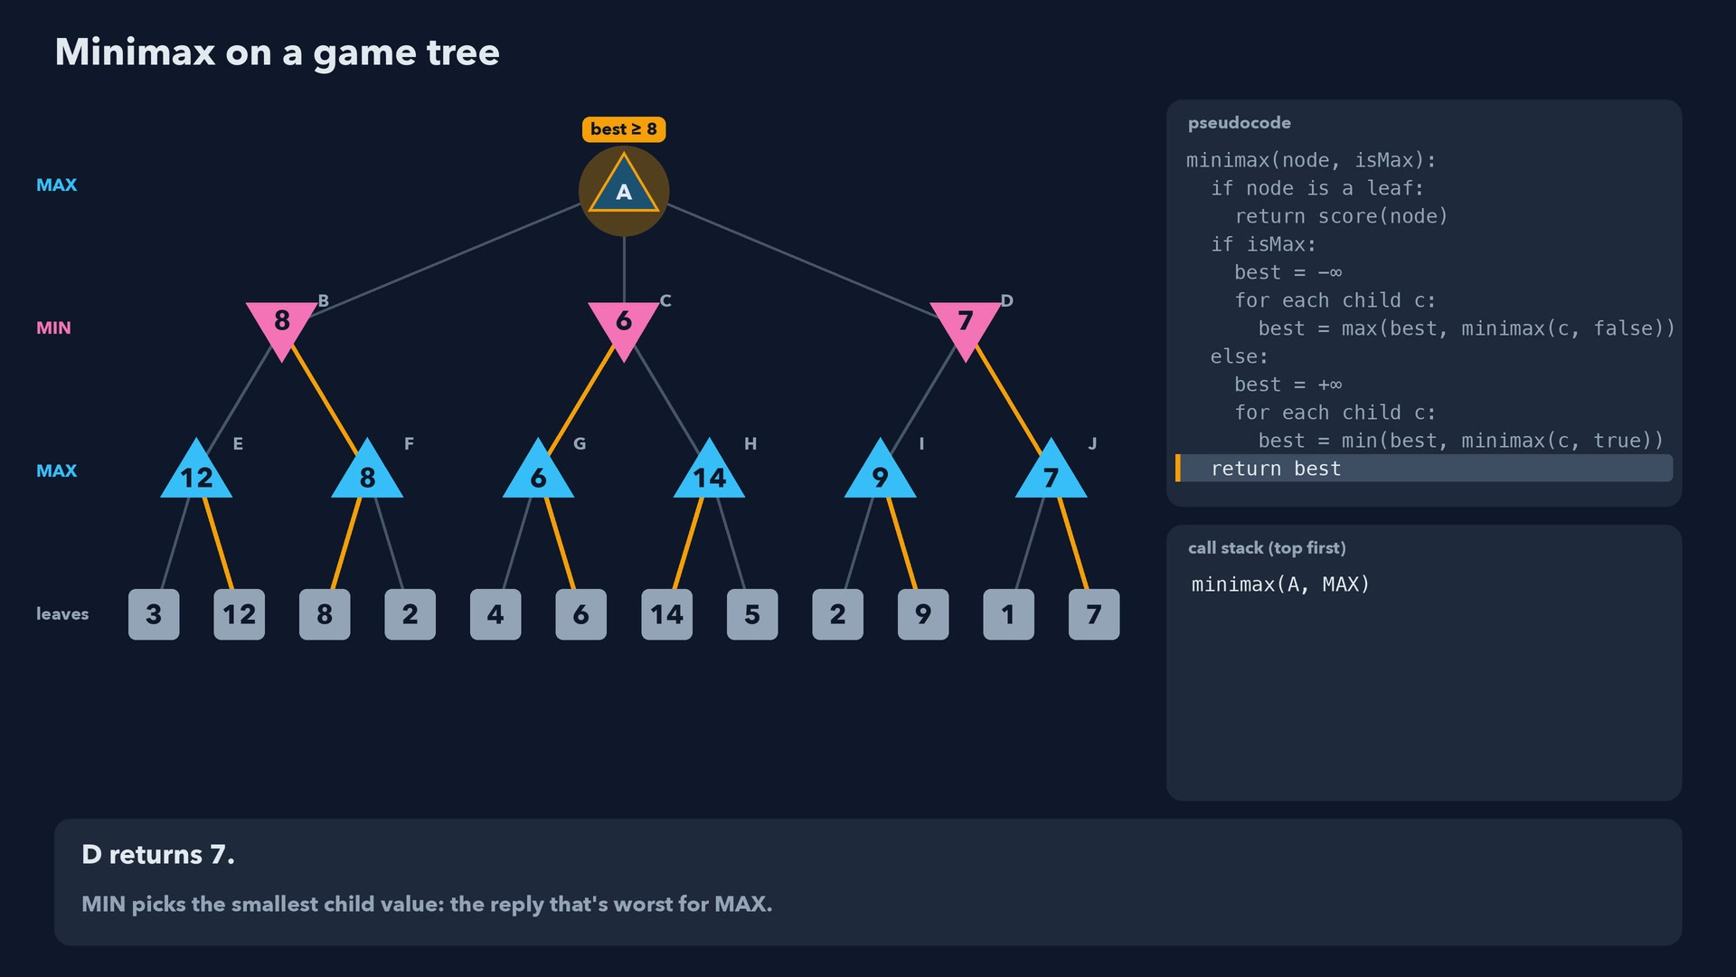
Notes:
Step 50 of 78
D returns 7.
MIN picks the smallest child value: the reply that's worst for MAX.

Slide 51

Notes:
Step 51 of 78
Back at the root: best = max(8, 7) = 8.
Moving to D guarantees MAX at least 7, whatever MIN does.

Slide 52

Notes:
Step 52 of 78
The root's value is 8: MAX should move to B.
MIN could never force a lower score from there, and no other move guarantees more.

Slide 53

Notes:
Step 53 of 78
The green path is the best play for both sides: A > B > F > leaf 8.
Notice MAX doesn't aim for the 14: MIN would never allow it. The guaranteed 8 is the best MAX can do.

Slide 54

Notes:
Step 54 of 78
Preview, alpha-beta pruning: node H and its 2 leaves never need to be examined.
After G = 6, MIN at C can already hold MAX to 6 or less, worse than the 8 from B. H can't change that.

Slide 55

Notes:
Step 55 of 78
X to move. Three empty squares, so three possible moves.
O threatens the diagonal top-right to bottom-left. Which move should X play?

Slide 56

Notes:
Step 56 of 78
O (MIN) to move here: try each possible reply.

Slide 57

Notes:
Step 57 of 78
X (MAX) to move here: try each possible reply.

Slide 58

Notes:
Step 58 of 78
Game over: X wins: +1.
Terminal positions are scored directly.

Slide 59

Notes:
Step 59 of 78
X (MAX) picks the best option for itself: value 1.
O picks the lowest score, X the highest.

Slide 60

Notes:
Step 60 of 78
X (MAX) to move here: try each possible reply.

Slide 61

Notes:
Step 61 of 78
Game over: X wins: +1.
Terminal positions are scored directly.

Slide 62

Notes:
Step 62 of 78
X (MAX) picks the best option for itself: value 1.
O picks the lowest score, X the highest.

Slide 63

Notes:
Step 63 of 78
O (MIN) picks the best option for itself: value 1.
O picks the lowest score, X the highest.

Slide 64

Notes:
Step 64 of 78
O (MIN) to move here: try each possible reply.

Slide 65

Notes:
Step 65 of 78
Game over: O wins: -1.
Terminal positions are scored directly.

Slide 66

Notes:
Step 66 of 78
X (MAX) to move here: try each possible reply.

Slide 67

Notes:
Step 67 of 78
Game over: X wins: +1.
Terminal positions are scored directly.

Slide 68

Notes:
Step 68 of 78
X (MAX) picks the best option for itself: value 1.
O picks the lowest score, X the highest.

Slide 69

Notes:
Step 69 of 78
O (MIN) picks the best option for itself: value -1.
O picks the lowest score, X the highest.

Slide 70

Notes:
Step 70 of 78
O (MIN) to move here: try each possible reply.

Slide 71

Notes:
Step 71 of 78
Game over: O wins: -1.
Terminal positions are scored directly.

Slide 72

Notes:
Step 72 of 78
X (MAX) to move here: try each possible reply.

Slide 73

Notes:
Step 73 of 78
Game over: X wins: +1.
Terminal positions are scored directly.

Slide 74

Notes:
Step 74 of 78
X (MAX) picks the best option for itself: value 1.
O picks the lowest score, X the highest.

Slide 75

Notes:
Step 75 of 78
O (MIN) picks the best option for itself: value -1.
O picks the lowest score, X the highest.

Slide 76

Notes:
Step 76 of 78
X plays middle-center: value +1, a guaranteed win.
It blocks O's diagonal and creates two X threats at once, so O can't block both. The other two moves lose.

Slide 77

Notes:
Step 77 of 78
Games like chess and Connect 4 are far too big to search to the end.
So programs stop at a depth limit, estimate unfinished positions with a heuristic, and use alpha-beta to skip work. The pseudocode adds a depth counter: a finished game still gets its true score, but a position at the depth limit gets an estimate. Each extra move multiplies the work by b, and with good move order alpha-beta searches about twice as deep in the same time.

Slide 78

Notes:
Step 78 of 78
Minimax assumes a perfect opponent. A full search finds the best guaranteed outcome; a depth-limited search finds the best outcome according to its estimates.
Next step: alpha-beta pruning, which finds the same move while looking at fewer positions.

