Slide 1
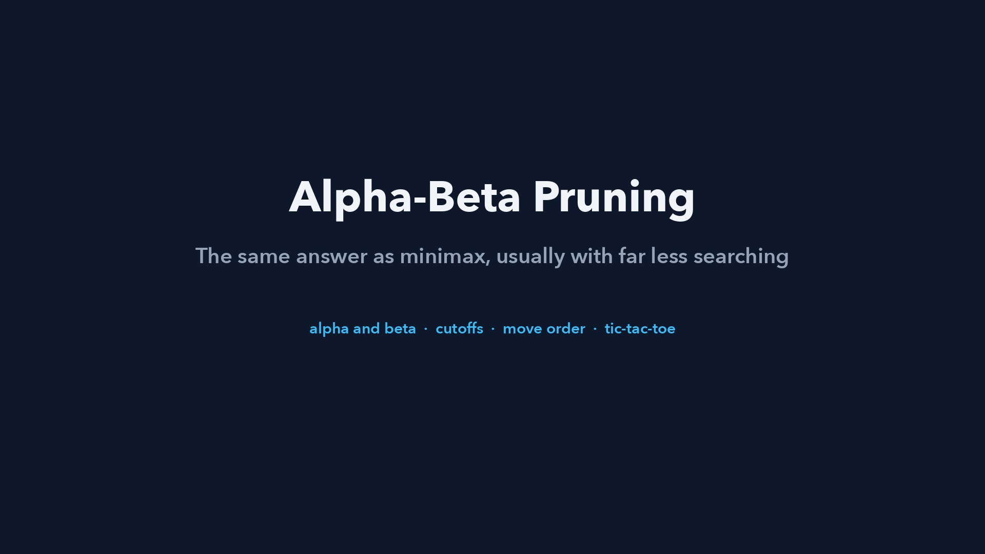
Notes:
Step 1 of 58
Alpha-Beta Pruning
The same answer as minimax, usually with far less searching. alpha and beta • cutoffs • move order • tic-tac-toe

Slide 2
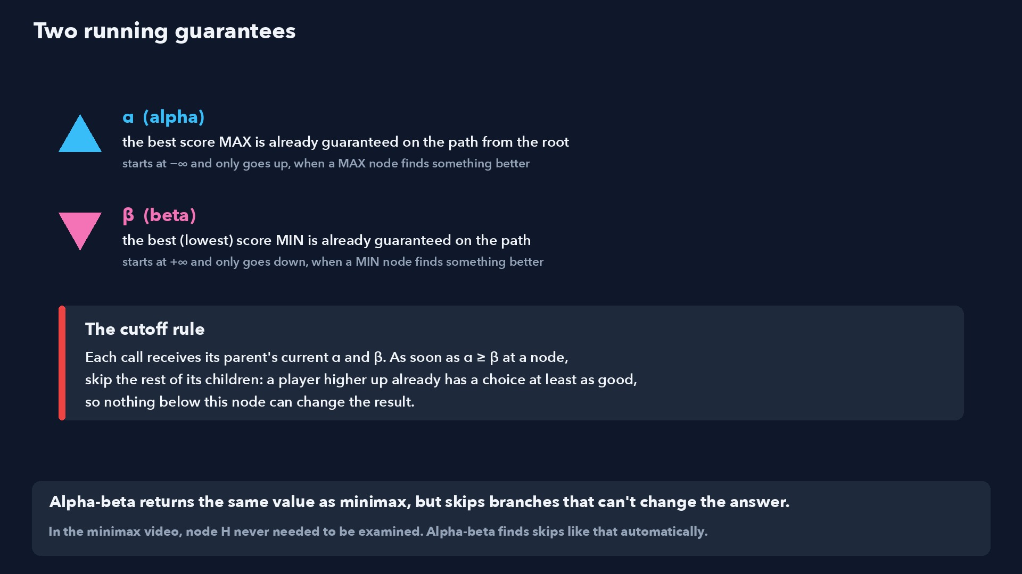
Notes:
Step 2 of 58
Alpha-beta returns the same value as minimax, but skips branches that can't change the answer.
In the minimax video, node H never needed to be examined. Alpha-beta finds skips like that automatically.

Slide 3
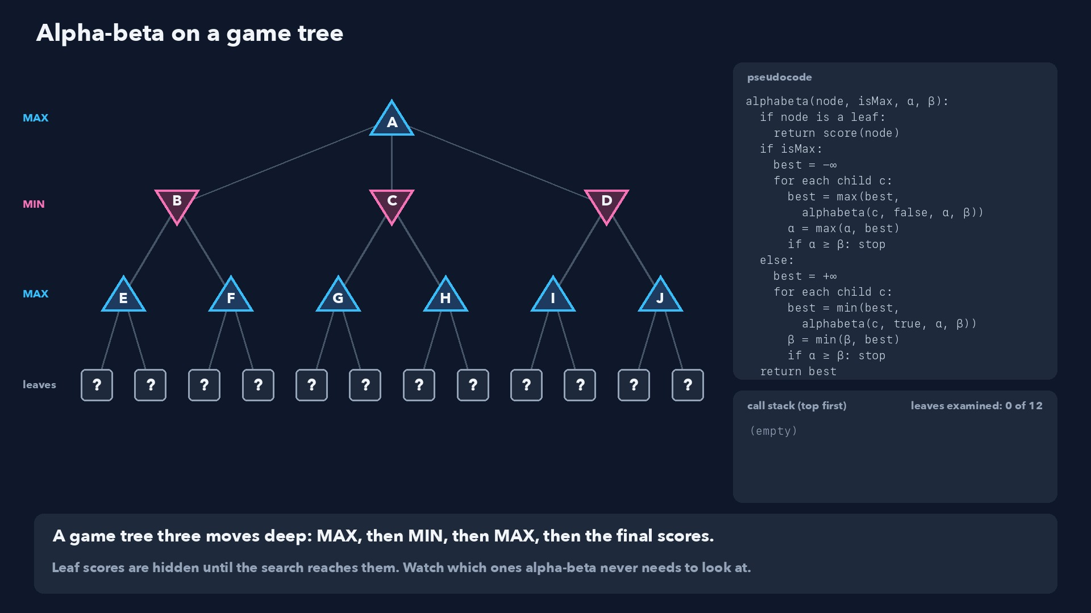
Notes:
Step 3 of 58
A game tree three moves deep: MAX, then MIN, then MAX, then the final scores.
Leaf scores are hidden until the search reaches them. Watch which ones alpha-beta never needs to look at.

Slide 4
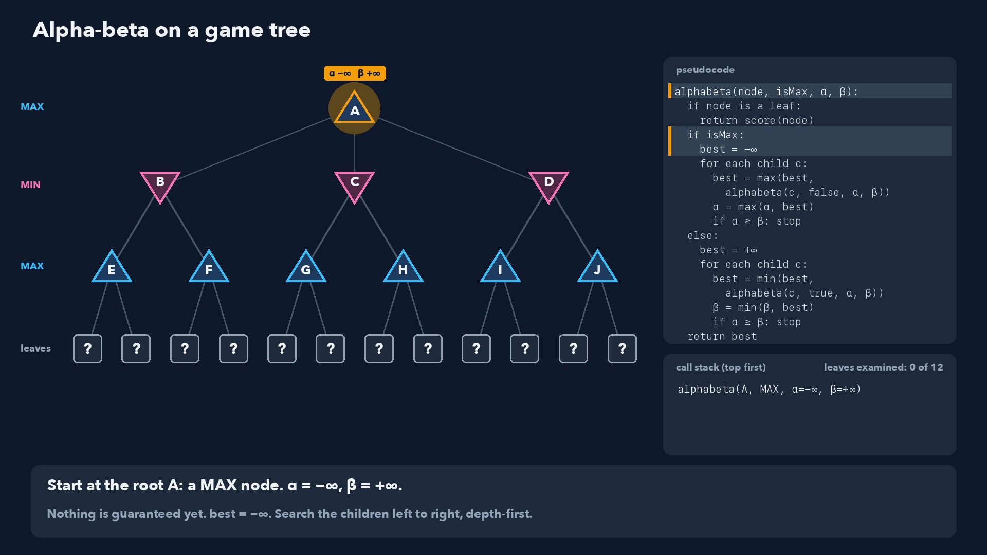
Notes:
Step 4 of 58
Start at the root A: a MAX node. α = −∞, β = +∞.
Nothing is guaranteed yet. best = −∞. Search the children left to right, depth-first.

Slide 5
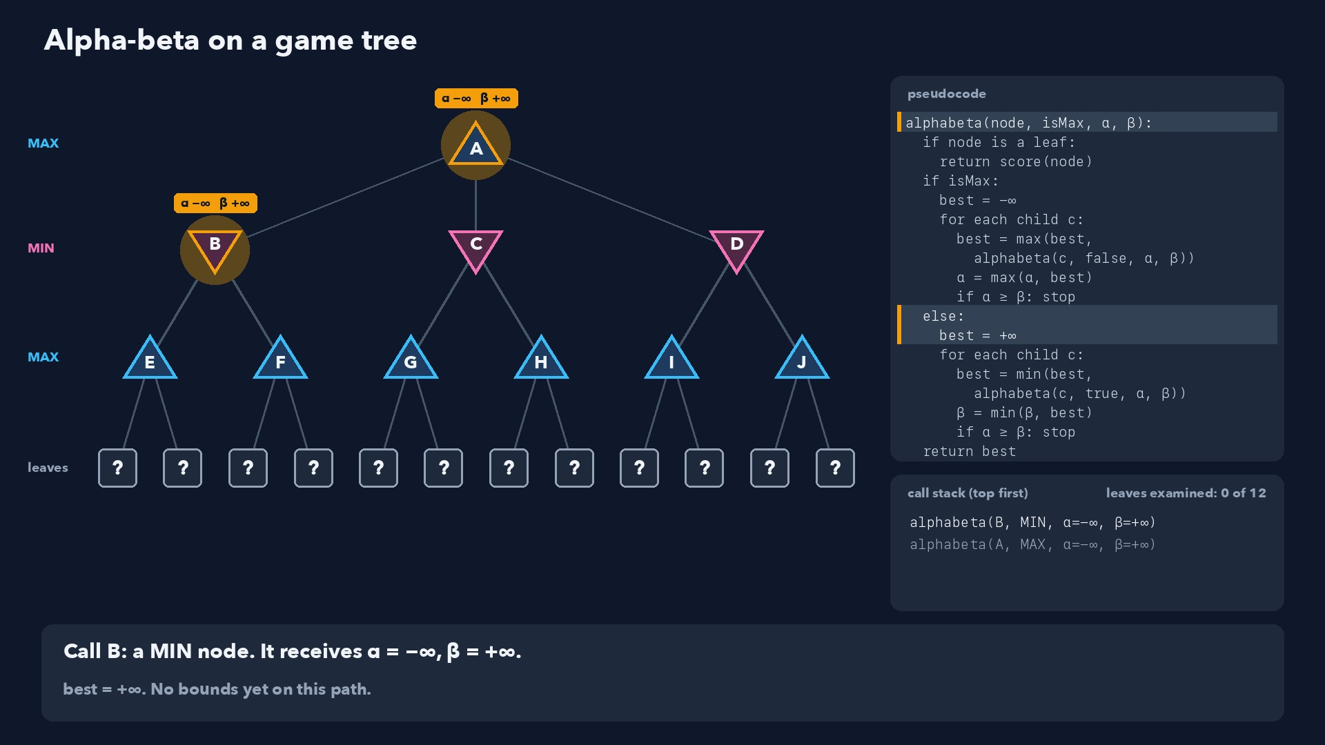
Notes:
Step 5 of 58
Call B: a MIN node. It receives α = −∞, β = +∞.
best = +∞. No bounds yet on this path.

Slide 6
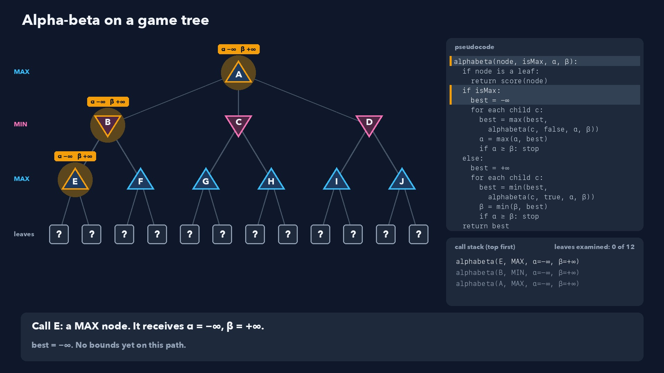
Notes:
Step 6 of 58
Call E: a MAX node. It receives α = −∞, β = +∞.
best = −∞. No bounds yet on this path.

Slide 7
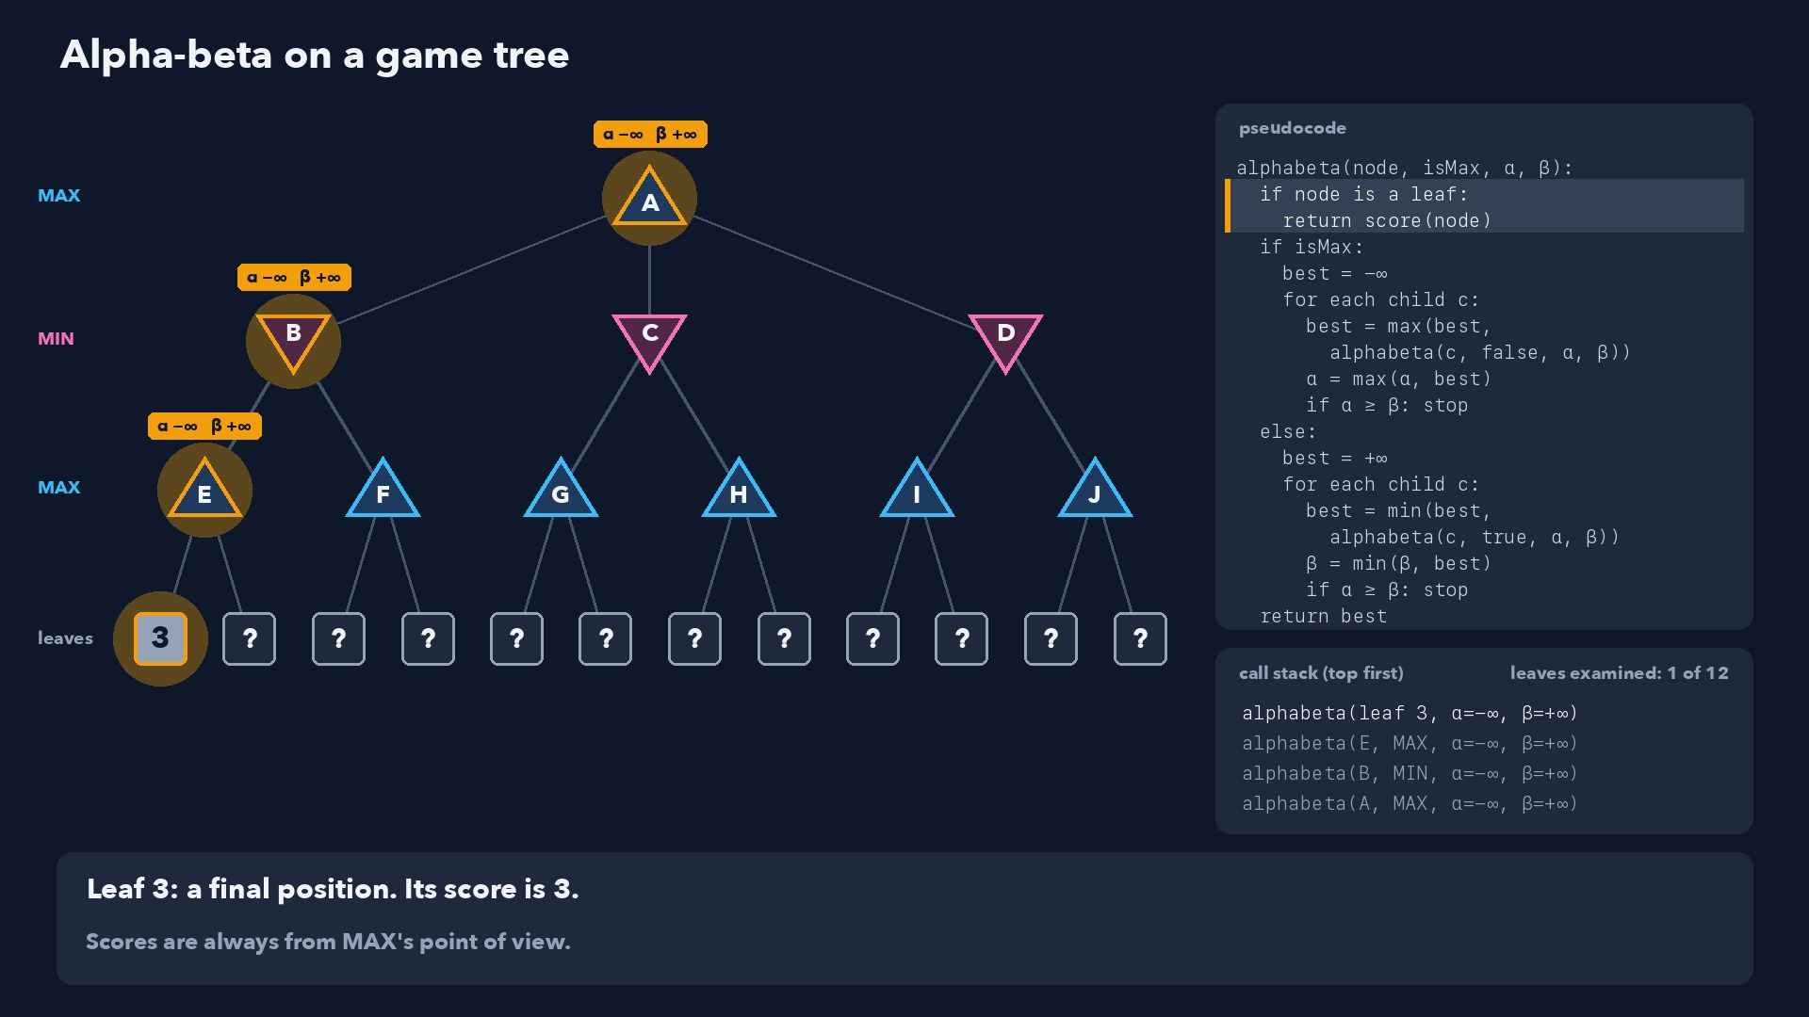
Notes:
Step 7 of 58
Leaf 3: a final position. Its score is 3.
Scores are always from MAX's point of view.

Slide 8
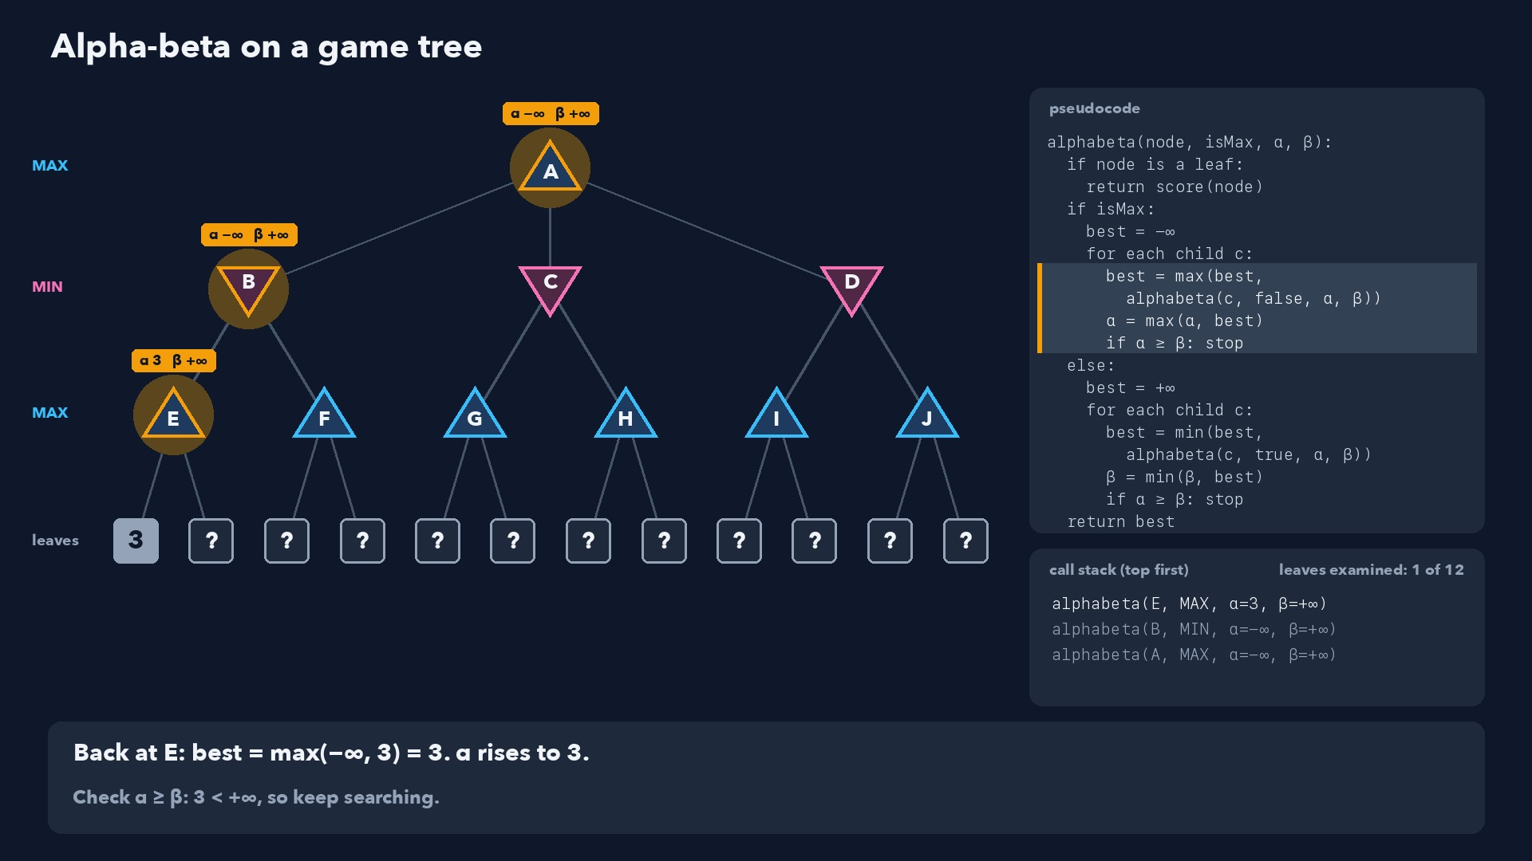
Notes:
Step 8 of 58
Back at E: best = max(−∞, 3) = 3. α rises to 3.
Check α ≥ β: 3 < +∞, so keep searching.

Slide 9
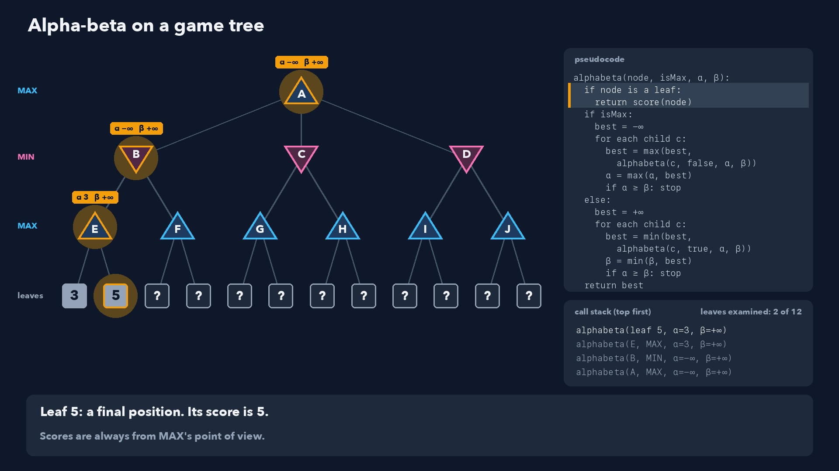
Notes:
Step 9 of 58
Leaf 5: a final position. Its score is 5.
Scores are always from MAX's point of view.

Slide 10
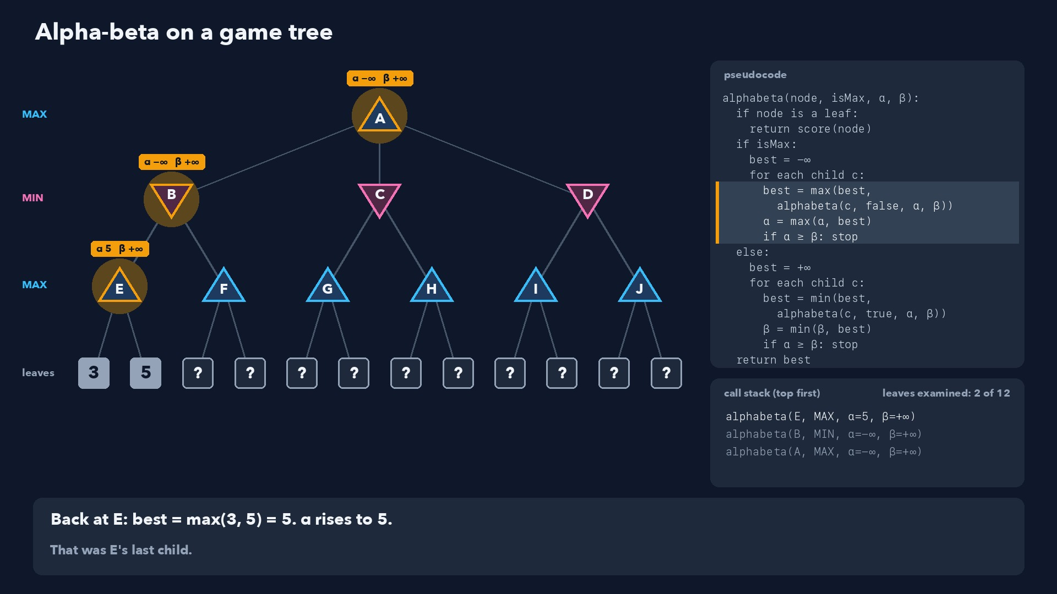
Notes:
Step 10 of 58
Back at E: best = max(3, 5) = 5. α rises to 5.
That was E's last child.

Slide 11
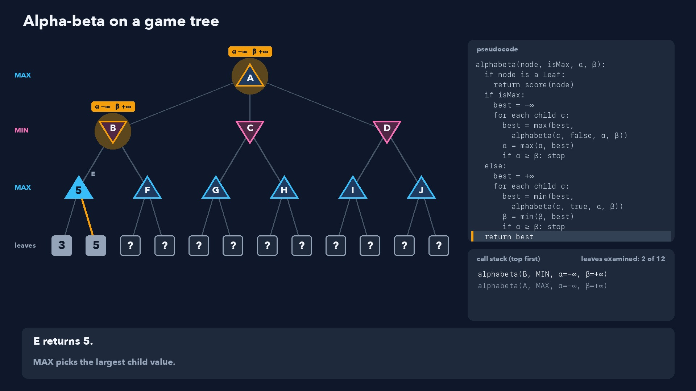
Notes:
Step 11 of 58
E returns 5.
MAX picks the largest child value.

Slide 12
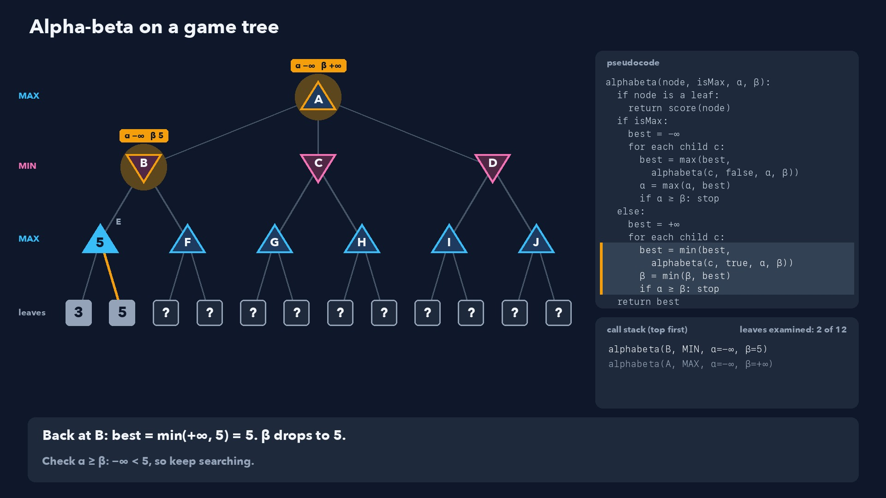
Notes:
Step 12 of 58
Back at B: best = min(+∞, 5) = 5. β drops to 5.
Check α ≥ β: −∞ < 5, so keep searching.

Slide 13
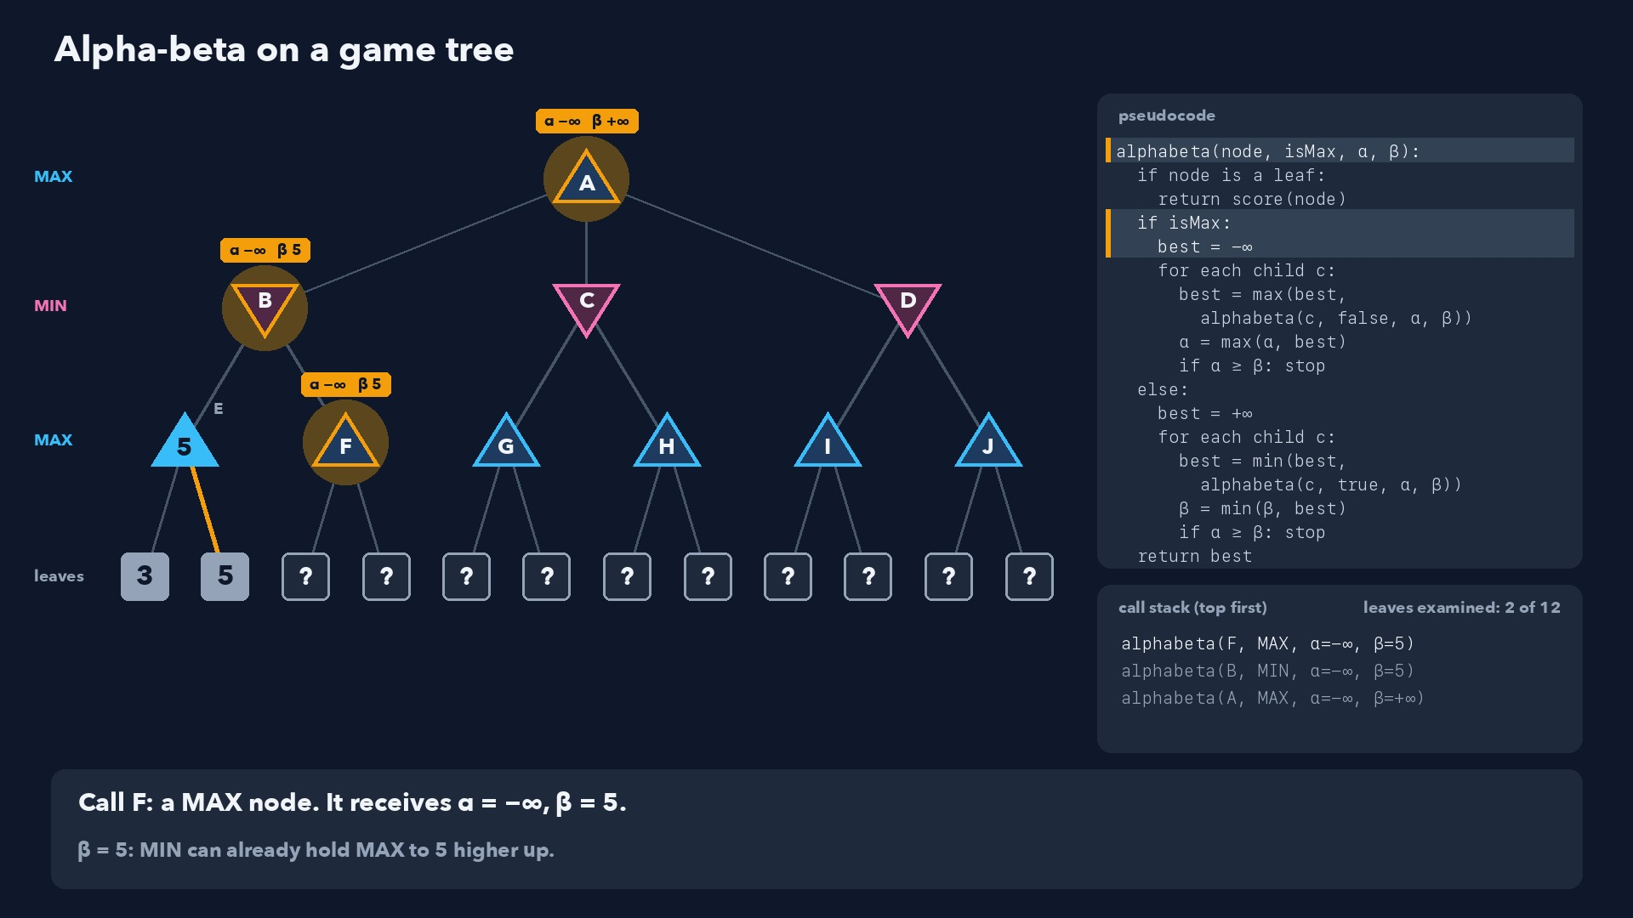
Notes:
Step 13 of 58
Call F: a MAX node. It receives α = −∞, β = 5.
β = 5: MIN can already hold MAX to 5 higher up.

Slide 14
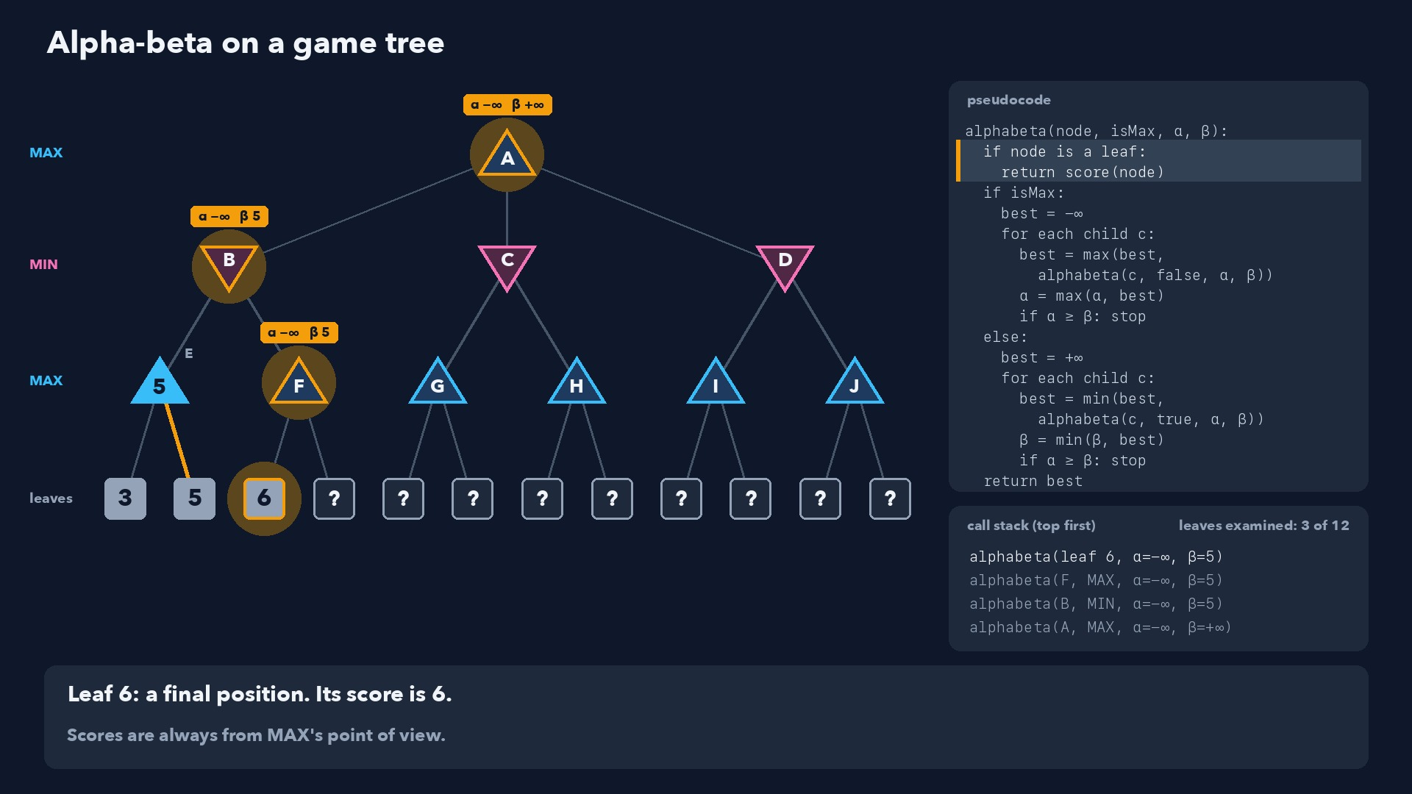
Notes:
Step 14 of 58
Leaf 6: a final position. Its score is 6.
Scores are always from MAX's point of view.

Slide 15
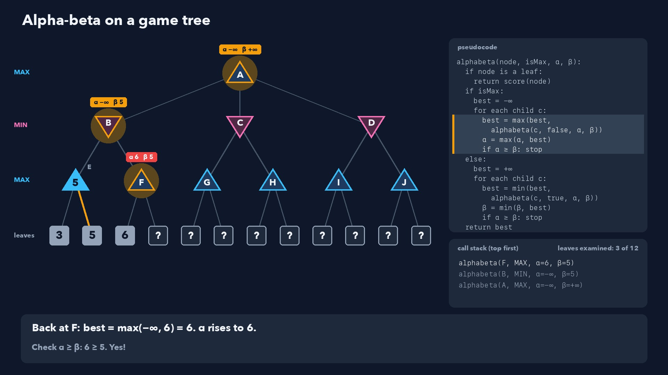
Notes:
Step 15 of 58
Back at F: best = max(−∞, 6) = 6. α rises to 6.
Check α ≥ β: 6 ≥ 5. Yes!

Slide 16
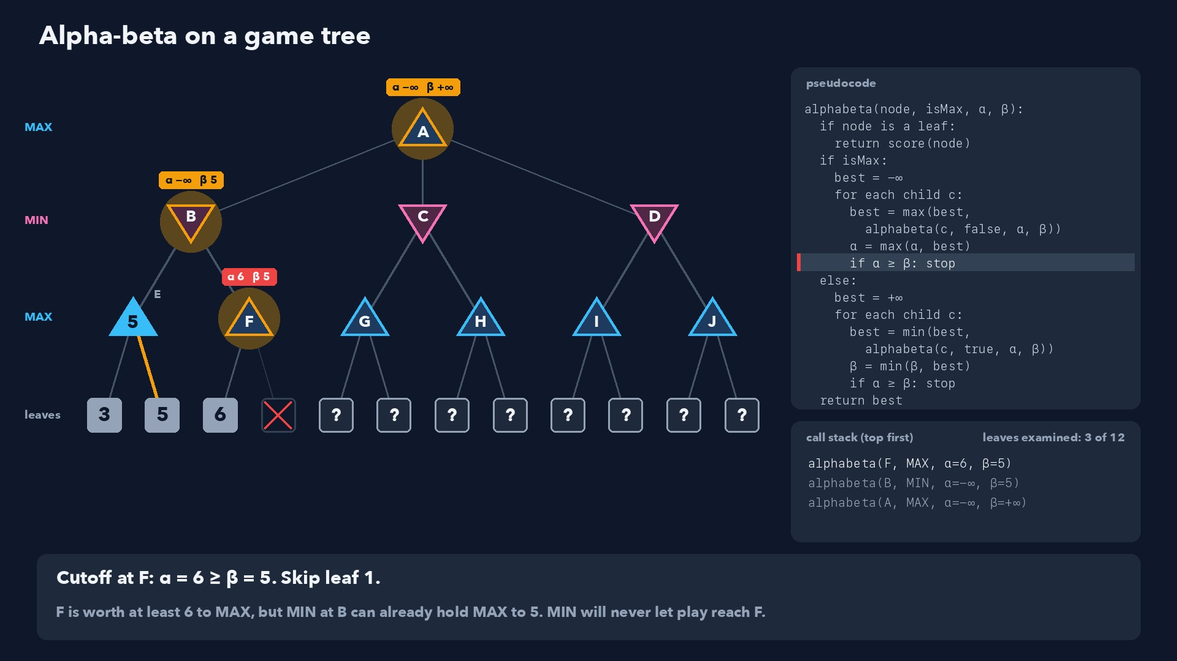
Notes:
Step 16 of 58
Cutoff at F: α = 6 ≥ β = 5. Skip leaf 1.
F is worth at least 6 to MAX, but MIN at B can already hold MAX to 5. MIN will never let play reach F.

Slide 17
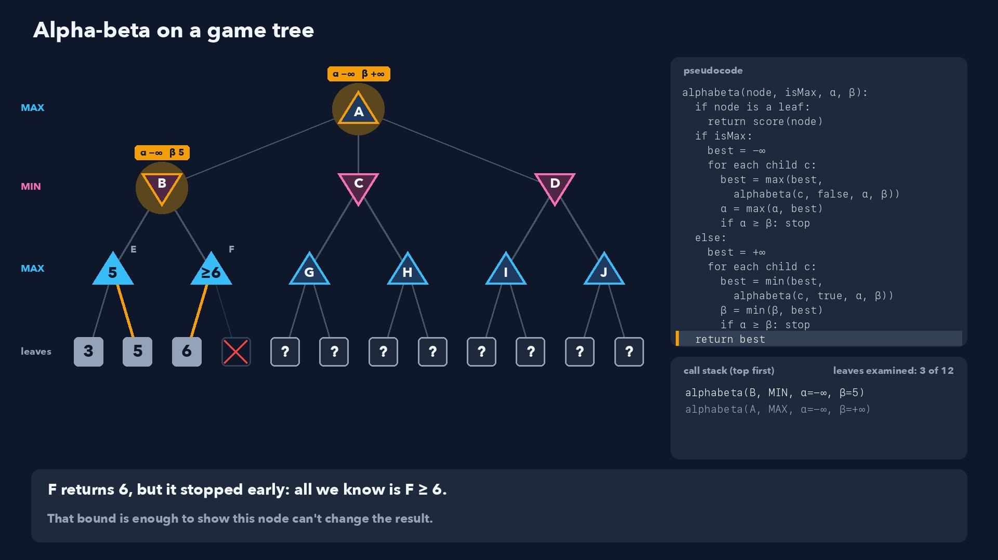
Notes:
Step 17 of 58
F returns 6, but it stopped early: all we know is F ≥ 6.
That bound is enough to show this node can't change the result.

Slide 18
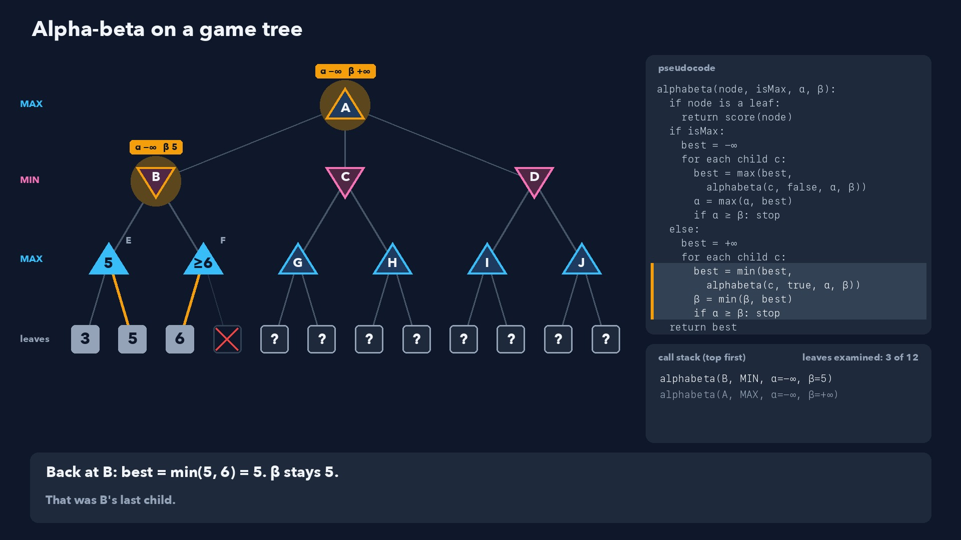
Notes:
Step 18 of 58
Back at B: best = min(5, 6) = 5. β stays 5.
That was B's last child.

Slide 19
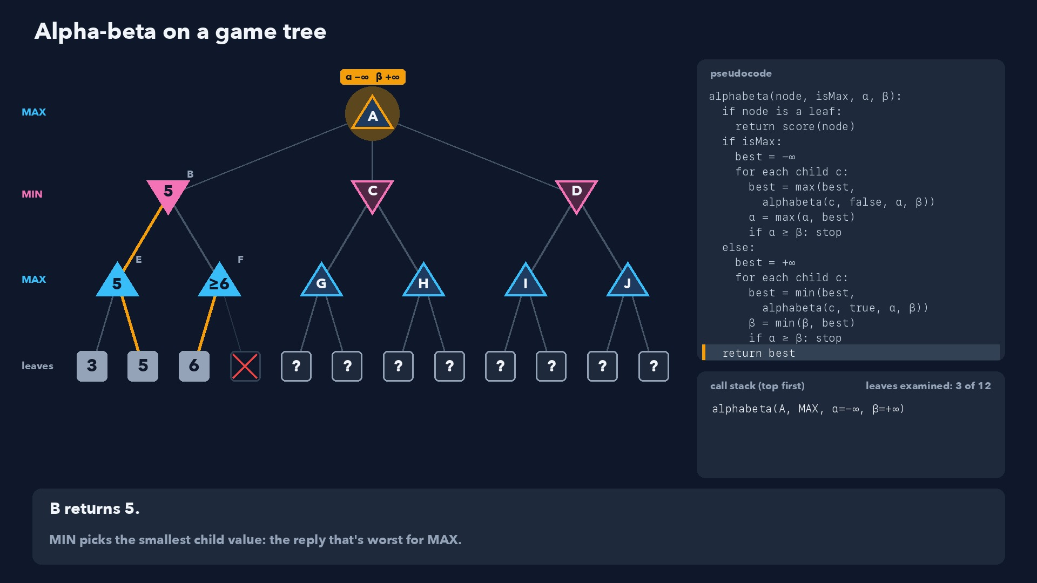
Notes:
Step 19 of 58
B returns 5.
MIN picks the smallest child value: the reply that's worst for MAX.

Slide 20
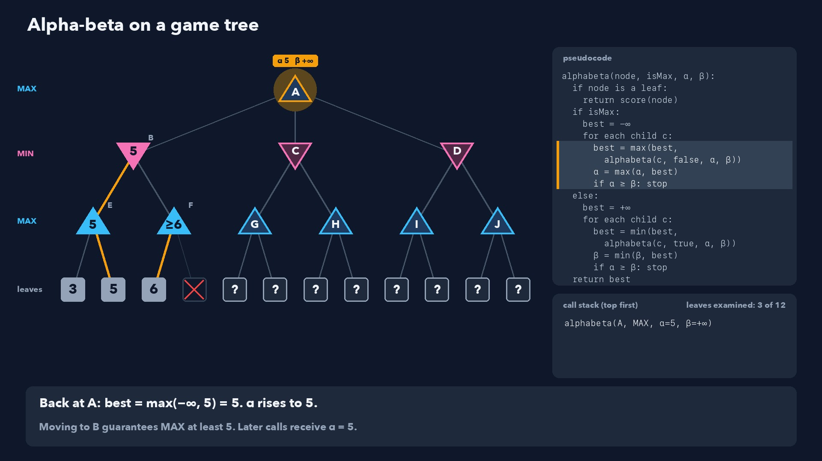
Notes:
Step 20 of 58
Back at A: best = max(−∞, 5) = 5. α rises to 5.
Moving to B guarantees MAX at least 5. Later calls receive α = 5.

Slide 21
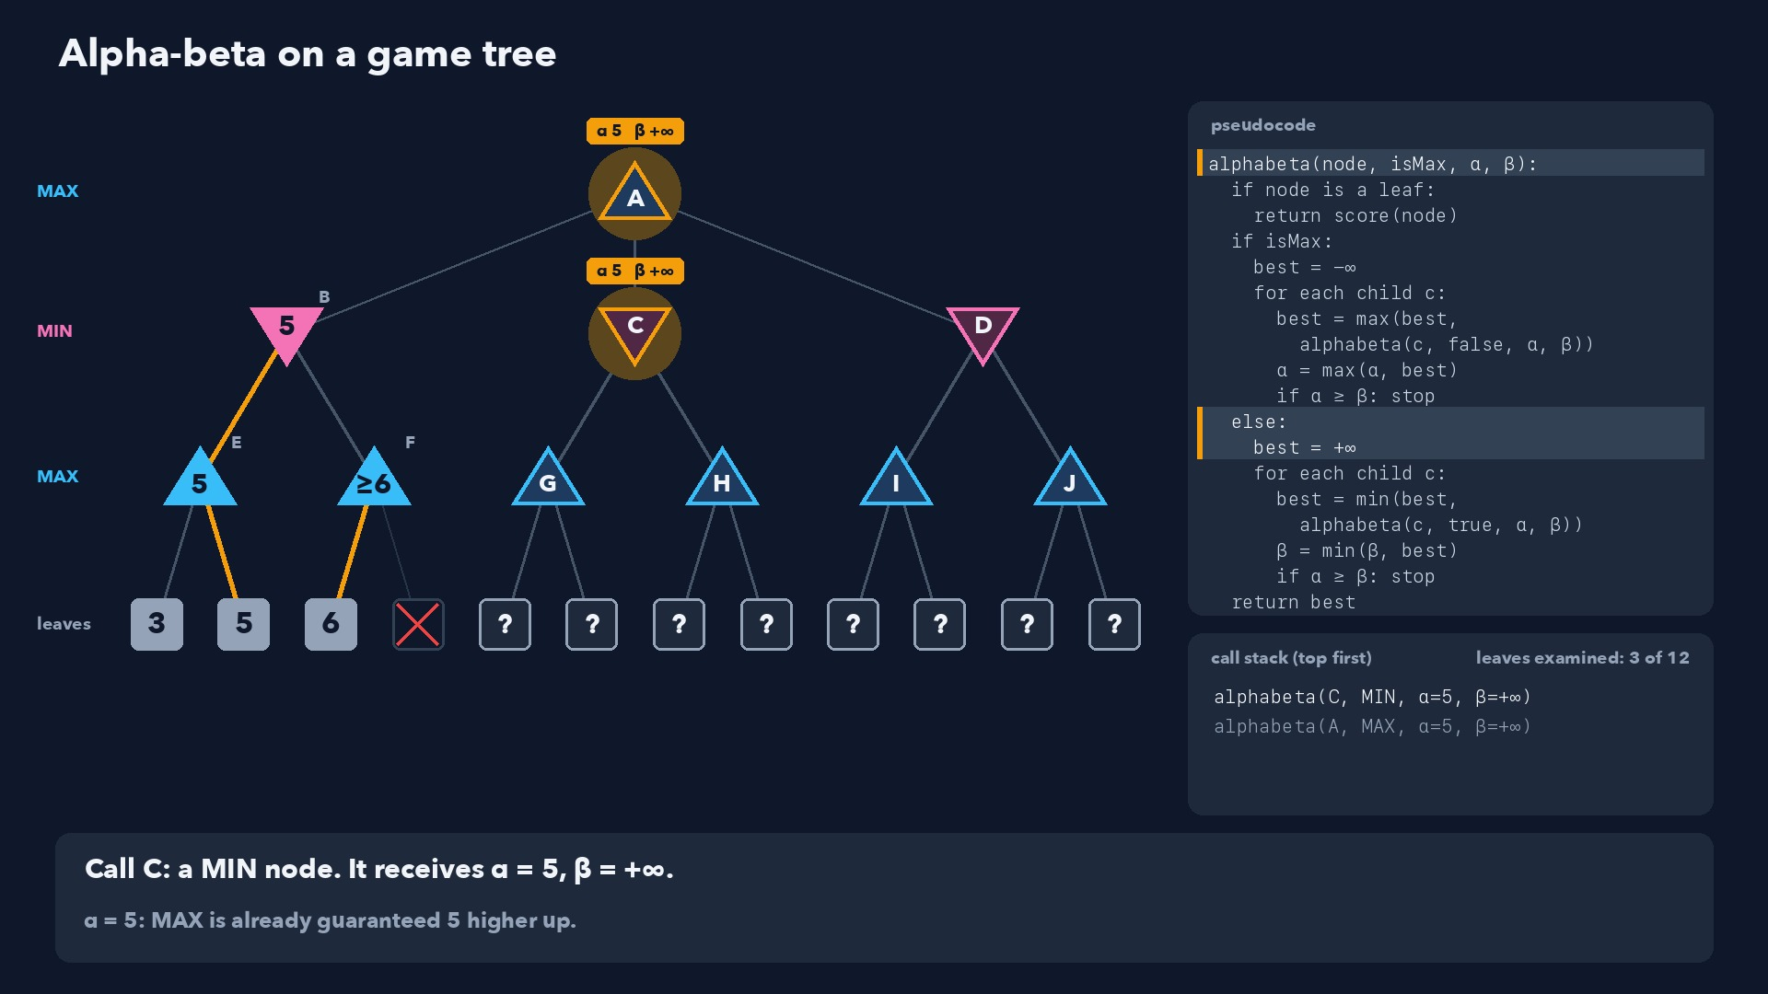
Notes:
Step 21 of 58
Call C: a MIN node. It receives α = 5, β = +∞.
α = 5: MAX is already guaranteed 5 higher up.

Slide 22
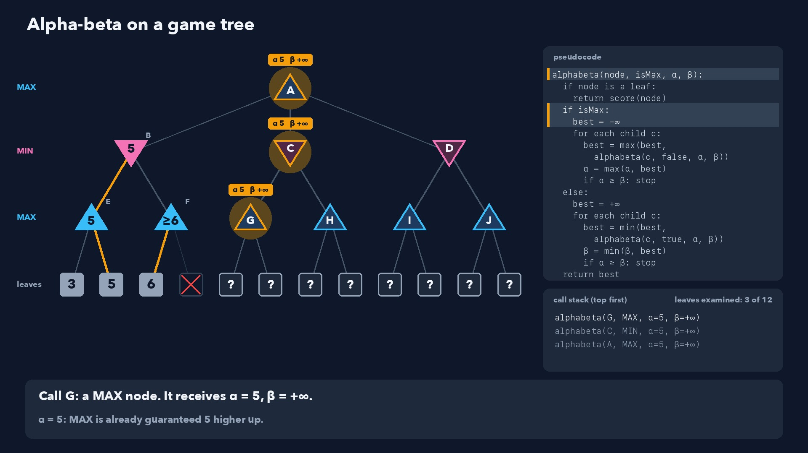
Notes:
Step 22 of 58
Call G: a MAX node. It receives α = 5, β = +∞.
α = 5: MAX is already guaranteed 5 higher up.

Slide 23
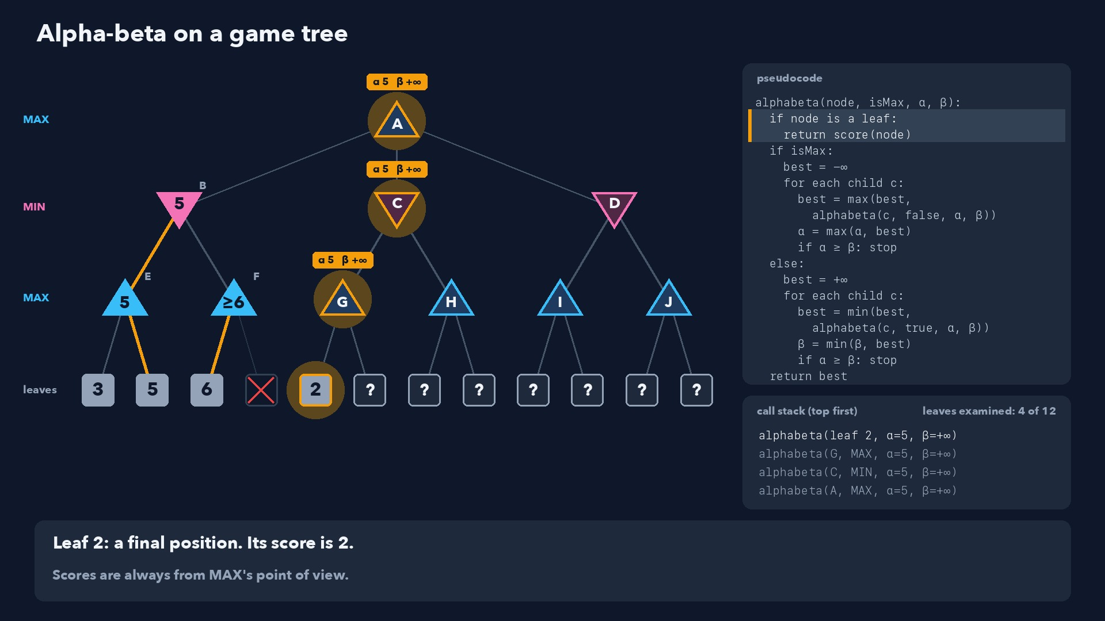
Notes:
Step 23 of 58
Leaf 2: a final position. Its score is 2.
Scores are always from MAX's point of view.

Slide 24
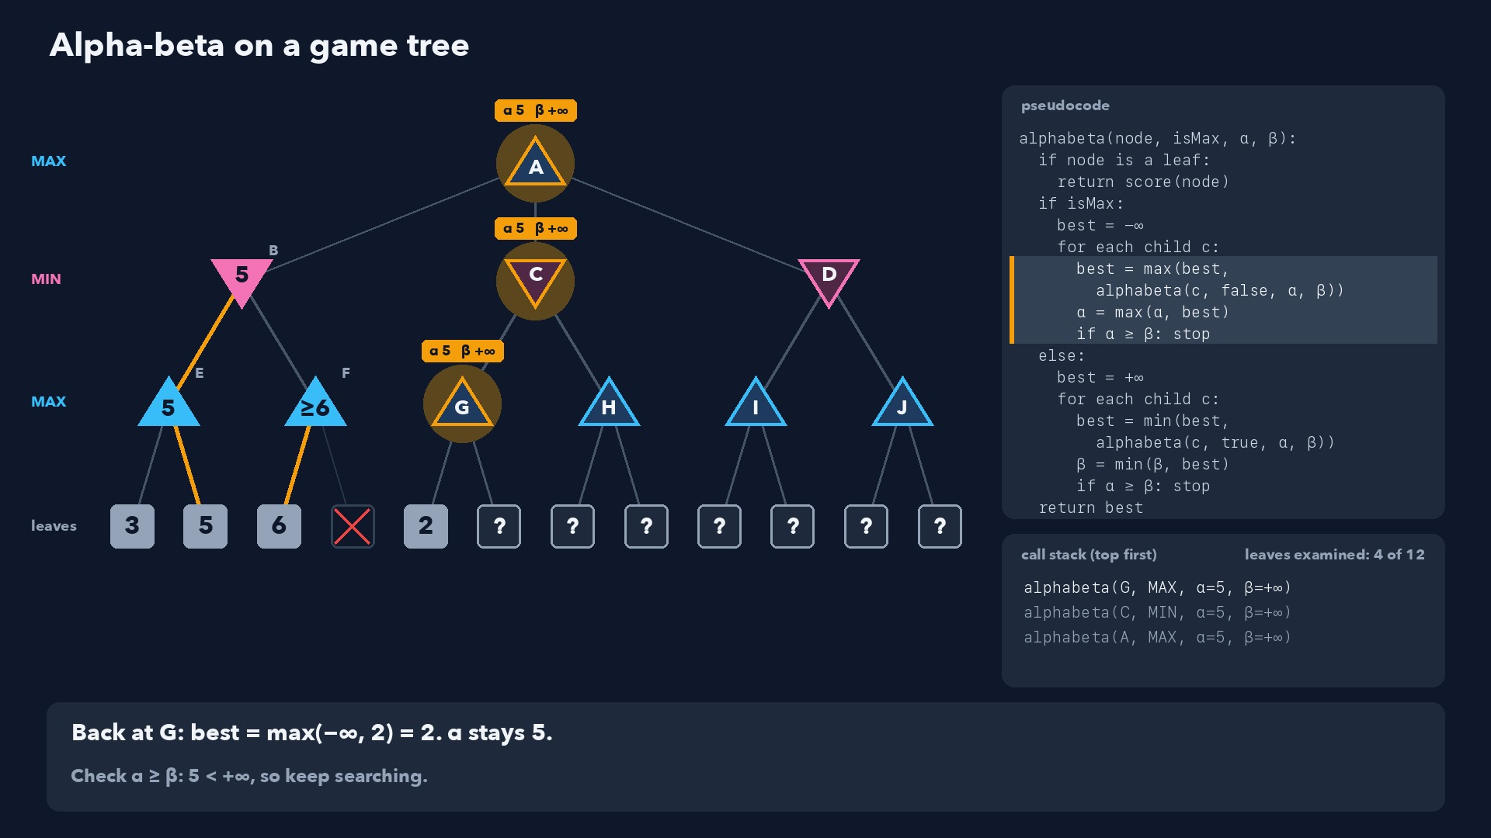
Notes:
Step 24 of 58
Back at G: best = max(−∞, 2) = 2. α stays 5.
Check α ≥ β: 5 < +∞, so keep searching.

Slide 25
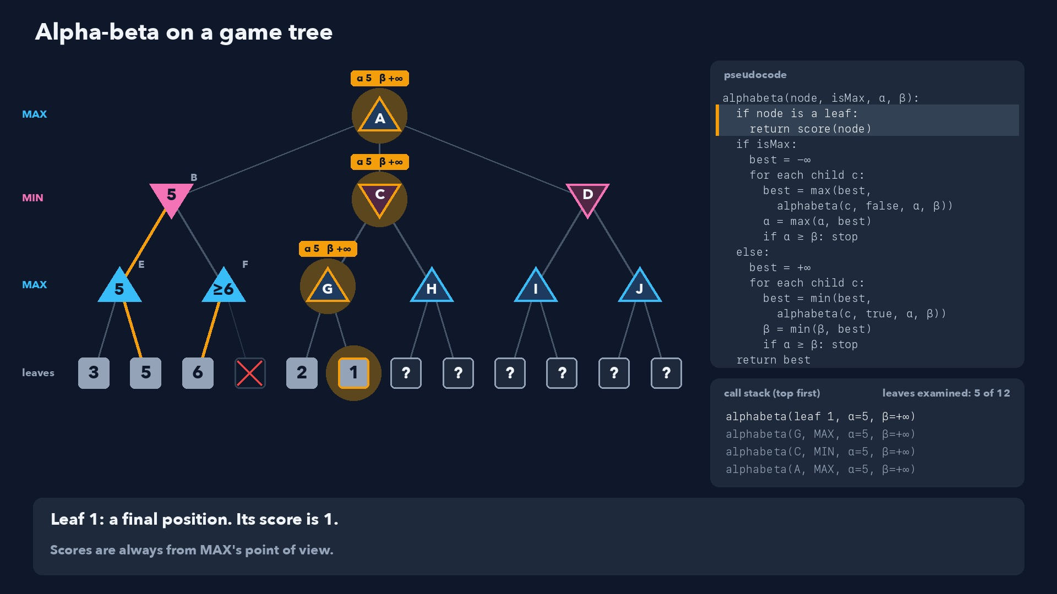
Notes:
Step 25 of 58
Leaf 1: a final position. Its score is 1.
Scores are always from MAX's point of view.

Slide 26
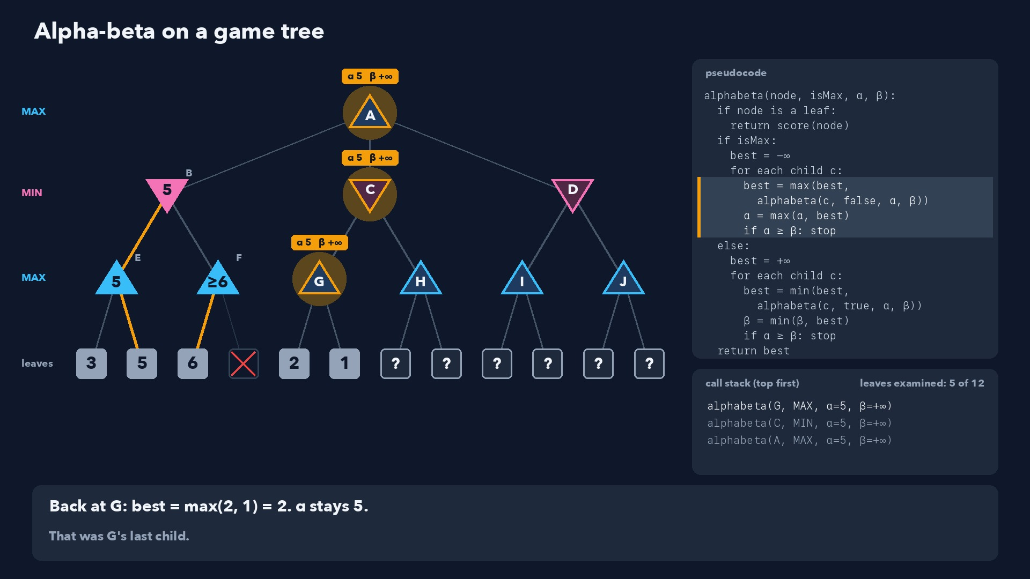
Notes:
Step 26 of 58
Back at G: best = max(2, 1) = 2. α stays 5.
That was G's last child.

Slide 27
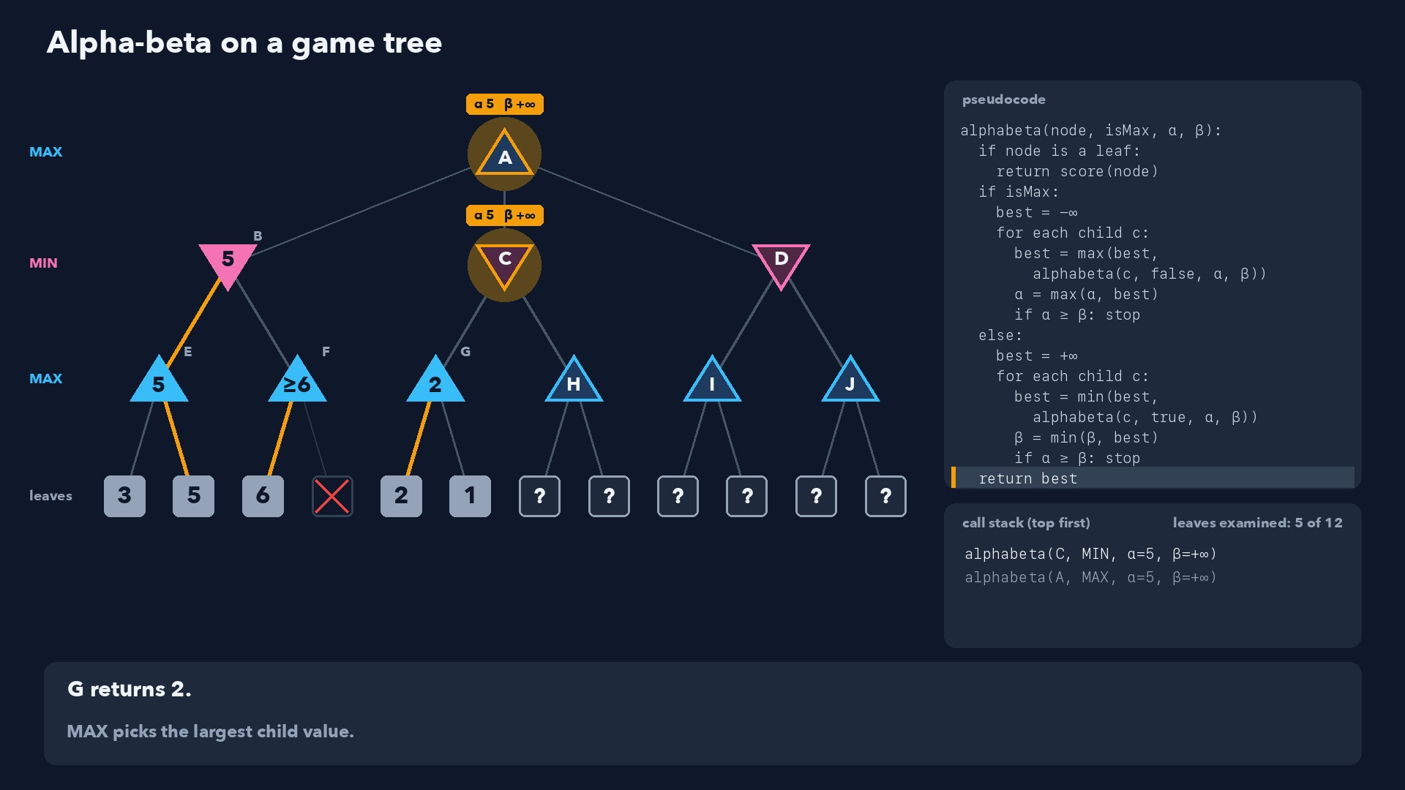
Notes:
Step 27 of 58
G returns 2.
MAX picks the largest child value.

Slide 28
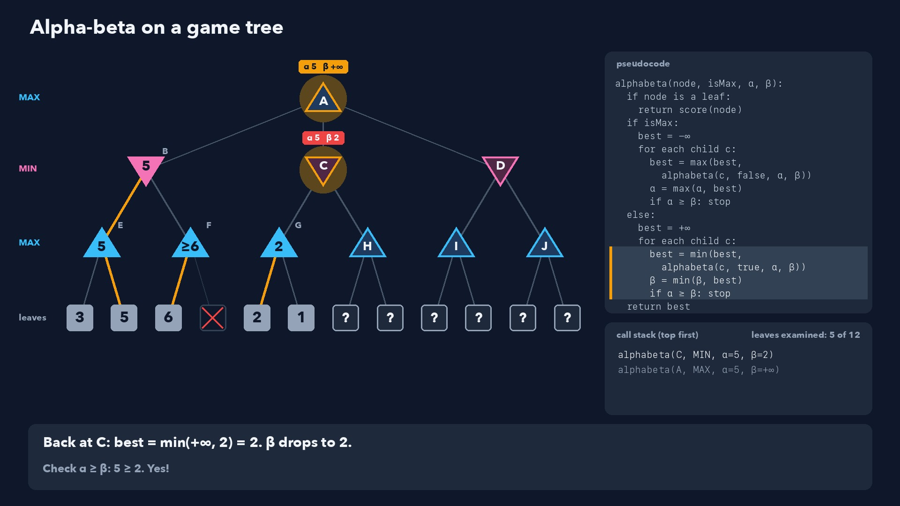
Notes:
Step 28 of 58
Back at C: best = min(+∞, 2) = 2. β drops to 2.
Check α ≥ β: 5 ≥ 2. Yes!

Slide 29
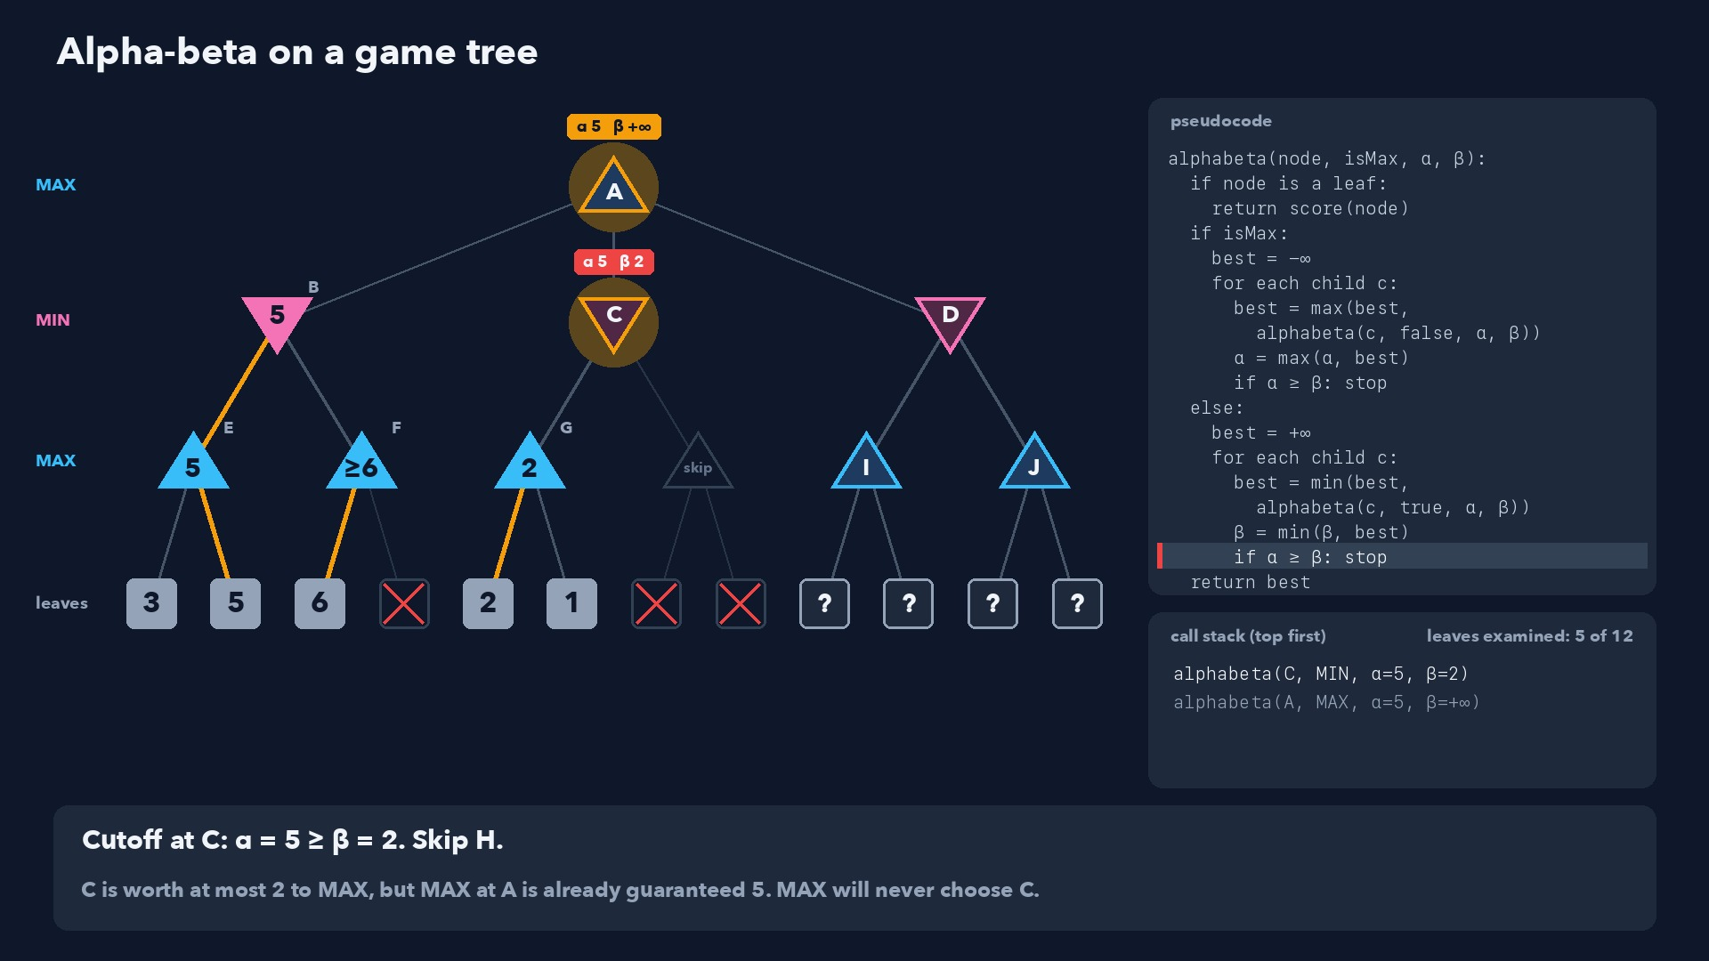
Notes:
Step 29 of 58
Cutoff at C: α = 5 ≥ β = 2. Skip H.
C is worth at most 2 to MAX, but MAX at A is already guaranteed 5. MAX will never choose C.

Slide 30
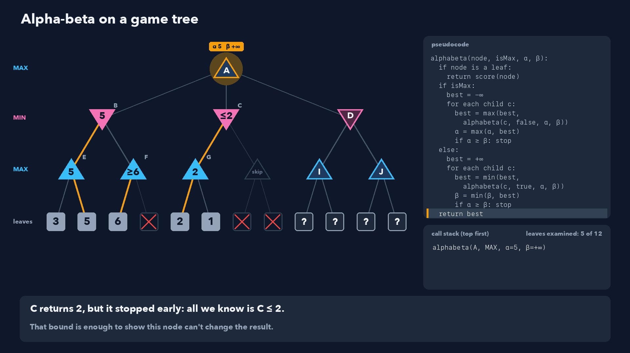
Notes:
Step 30 of 58
C returns 2, but it stopped early: all we know is C ≤ 2.
That bound is enough to show this node can't change the result.

Slide 31
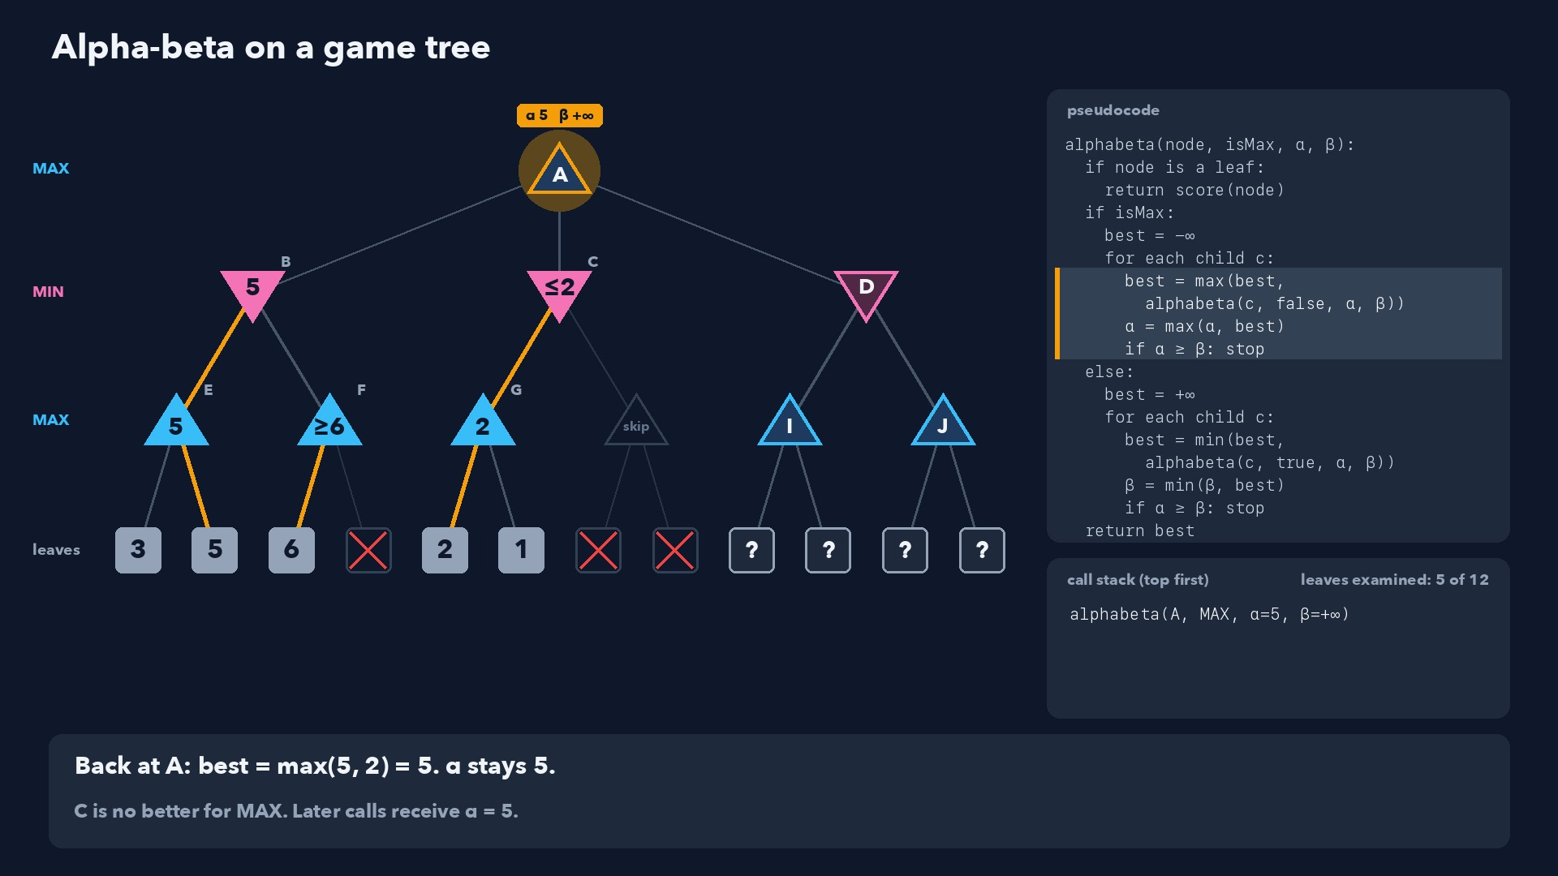
Notes:
Step 31 of 58
Back at A: best = max(5, 2) = 5. α stays 5.
C is no better for MAX. Later calls receive α = 5.

Slide 32
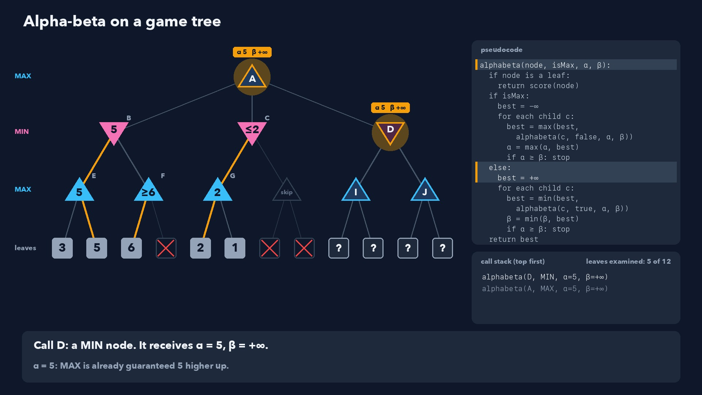
Notes:
Step 32 of 58
Call D: a MIN node. It receives α = 5, β = +∞.
α = 5: MAX is already guaranteed 5 higher up.

Slide 33
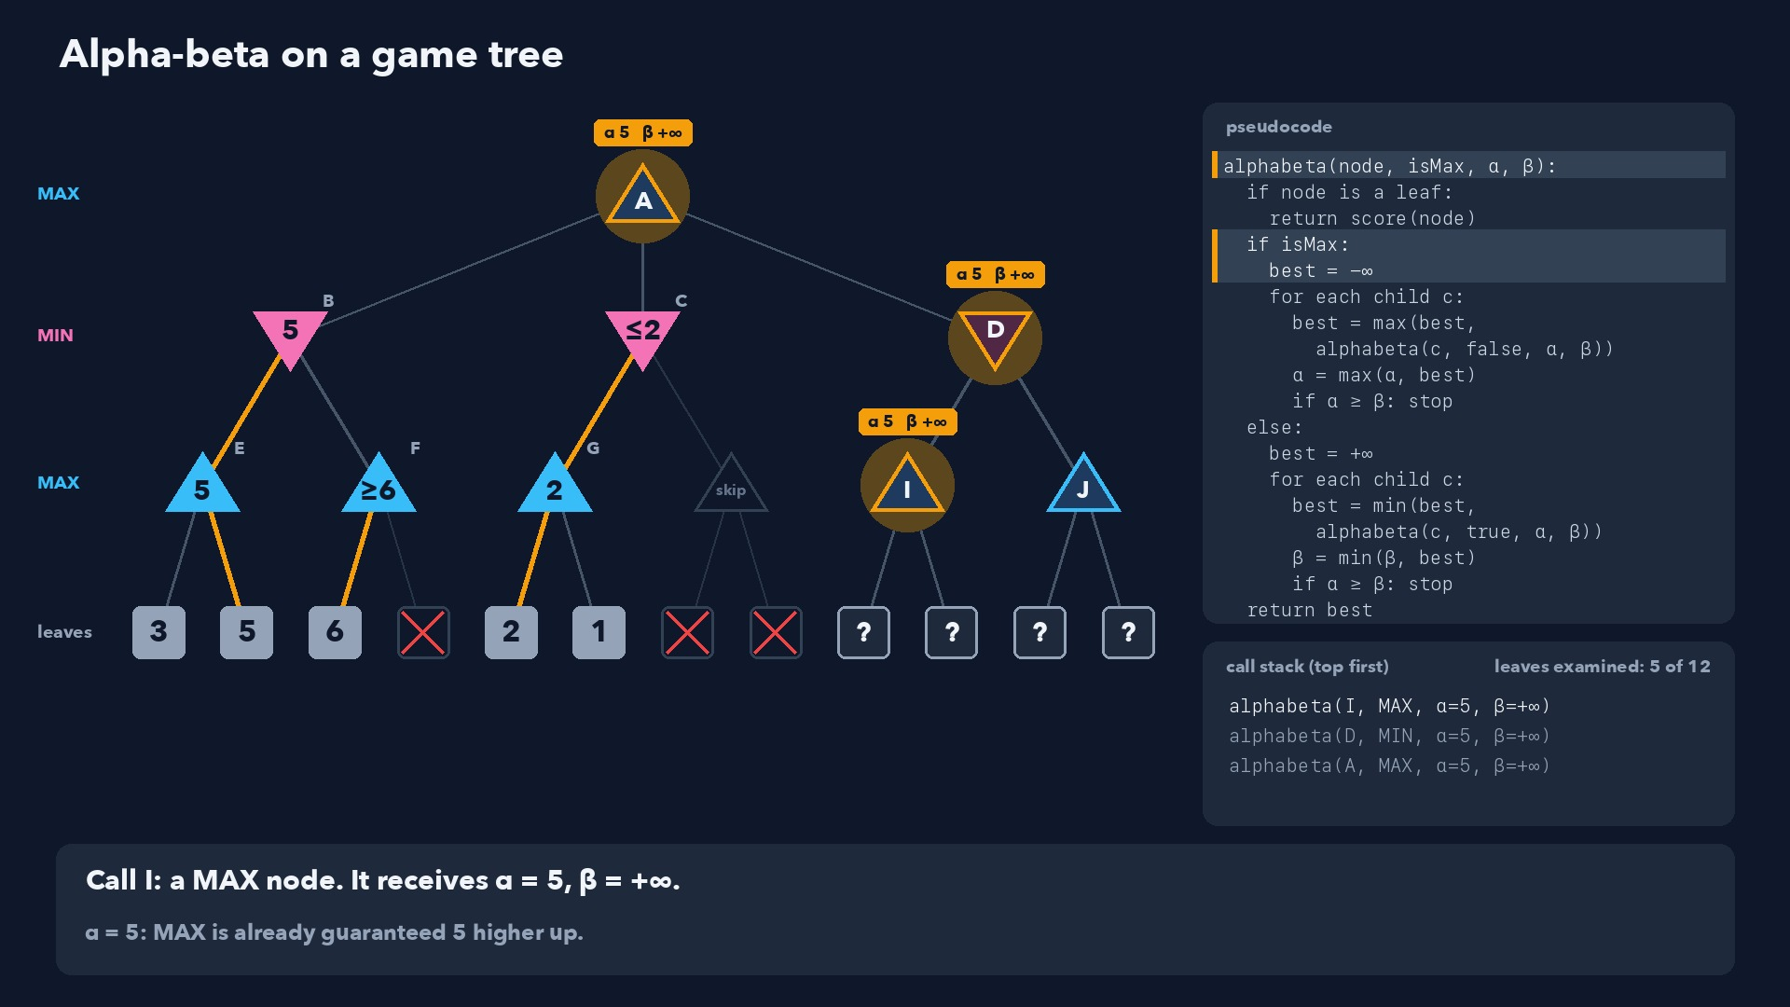
Notes:
Step 33 of 58
Call I: a MAX node. It receives α = 5, β = +∞.
α = 5: MAX is already guaranteed 5 higher up.

Slide 34
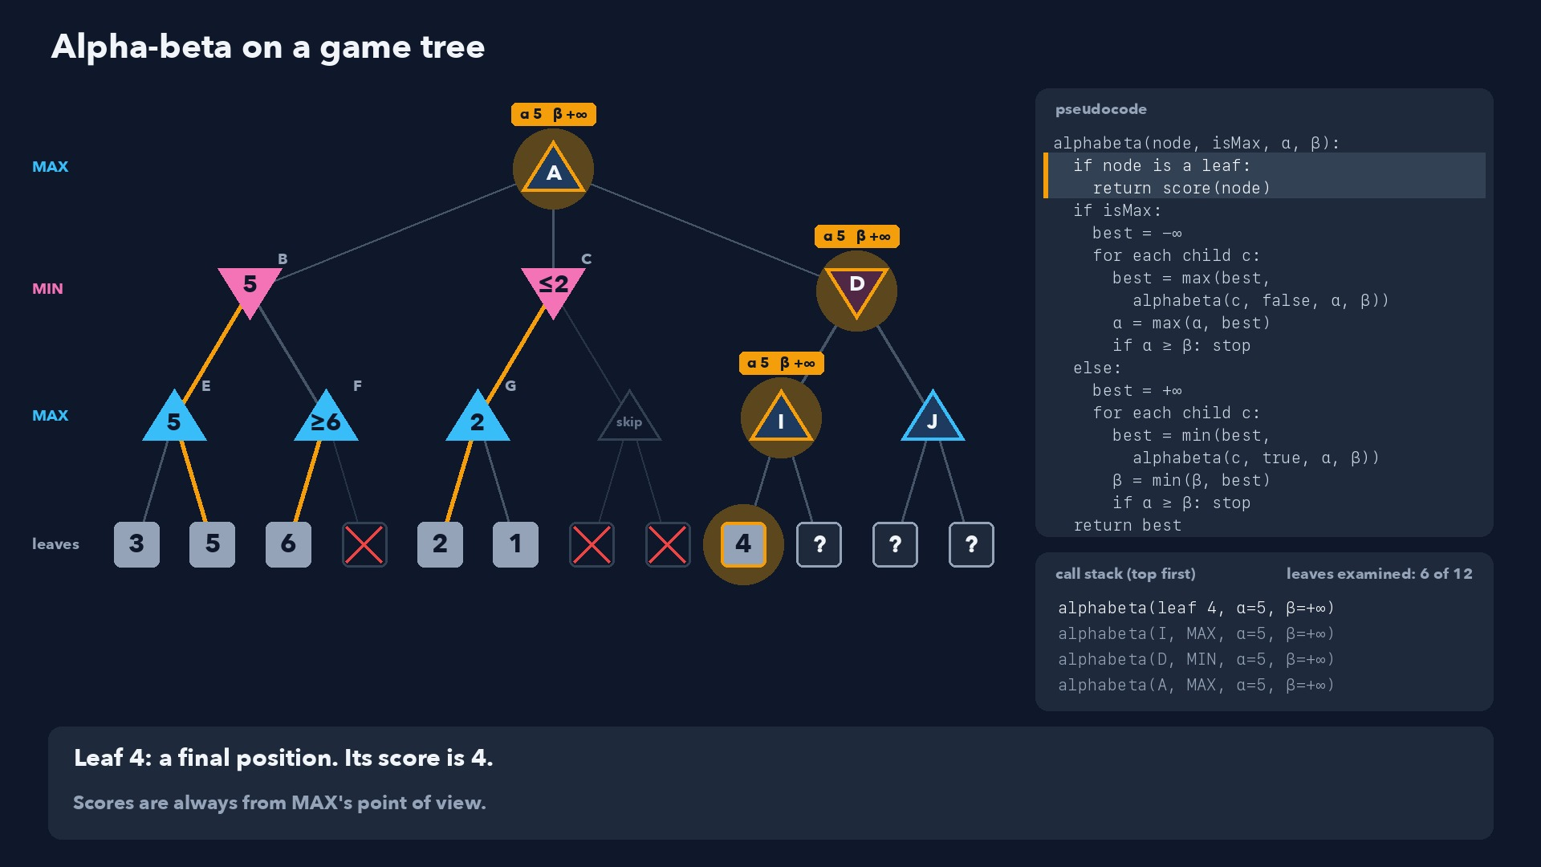
Notes:
Step 34 of 58
Leaf 4: a final position. Its score is 4.
Scores are always from MAX's point of view.

Slide 35
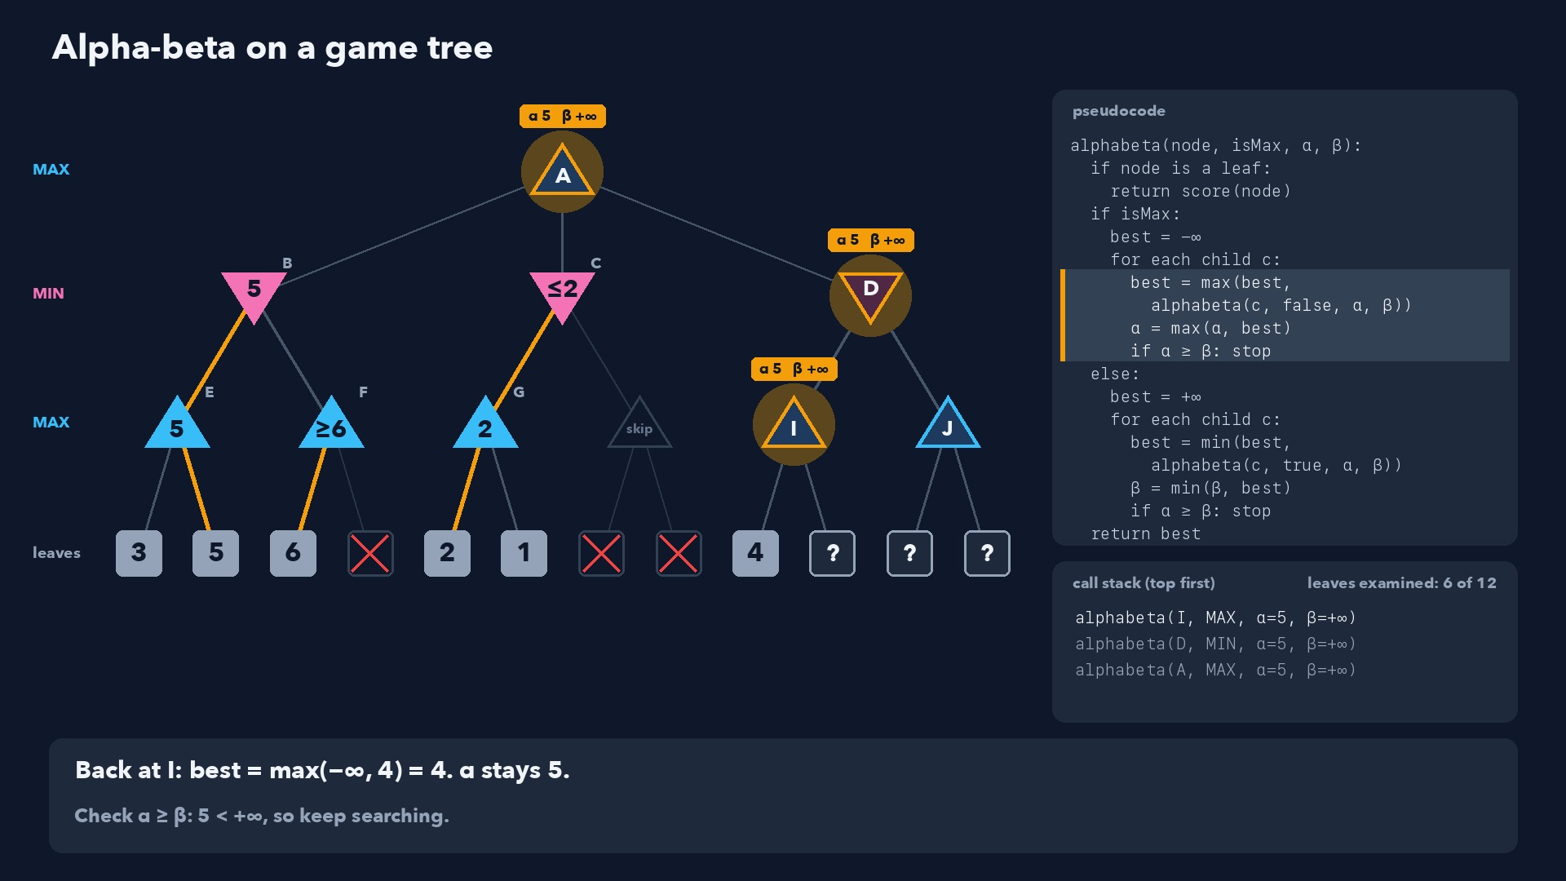
Notes:
Step 35 of 58
Back at I: best = max(−∞, 4) = 4. α stays 5.
Check α ≥ β: 5 < +∞, so keep searching.

Slide 36
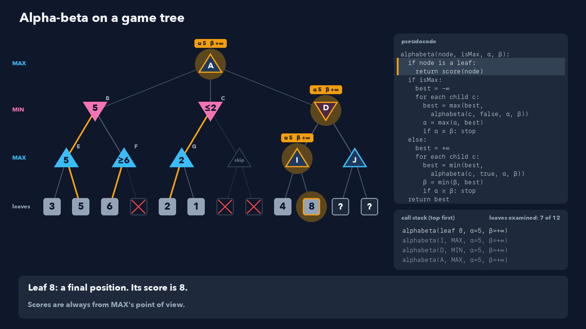
Notes:
Step 36 of 58
Leaf 8: a final position. Its score is 8.
Scores are always from MAX's point of view.

Slide 37
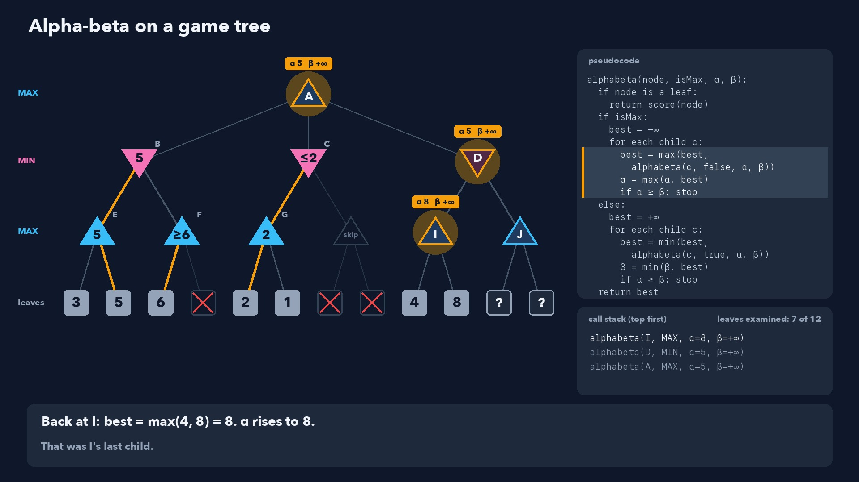
Notes:
Step 37 of 58
Back at I: best = max(4, 8) = 8. α rises to 8.
That was I's last child.

Slide 38
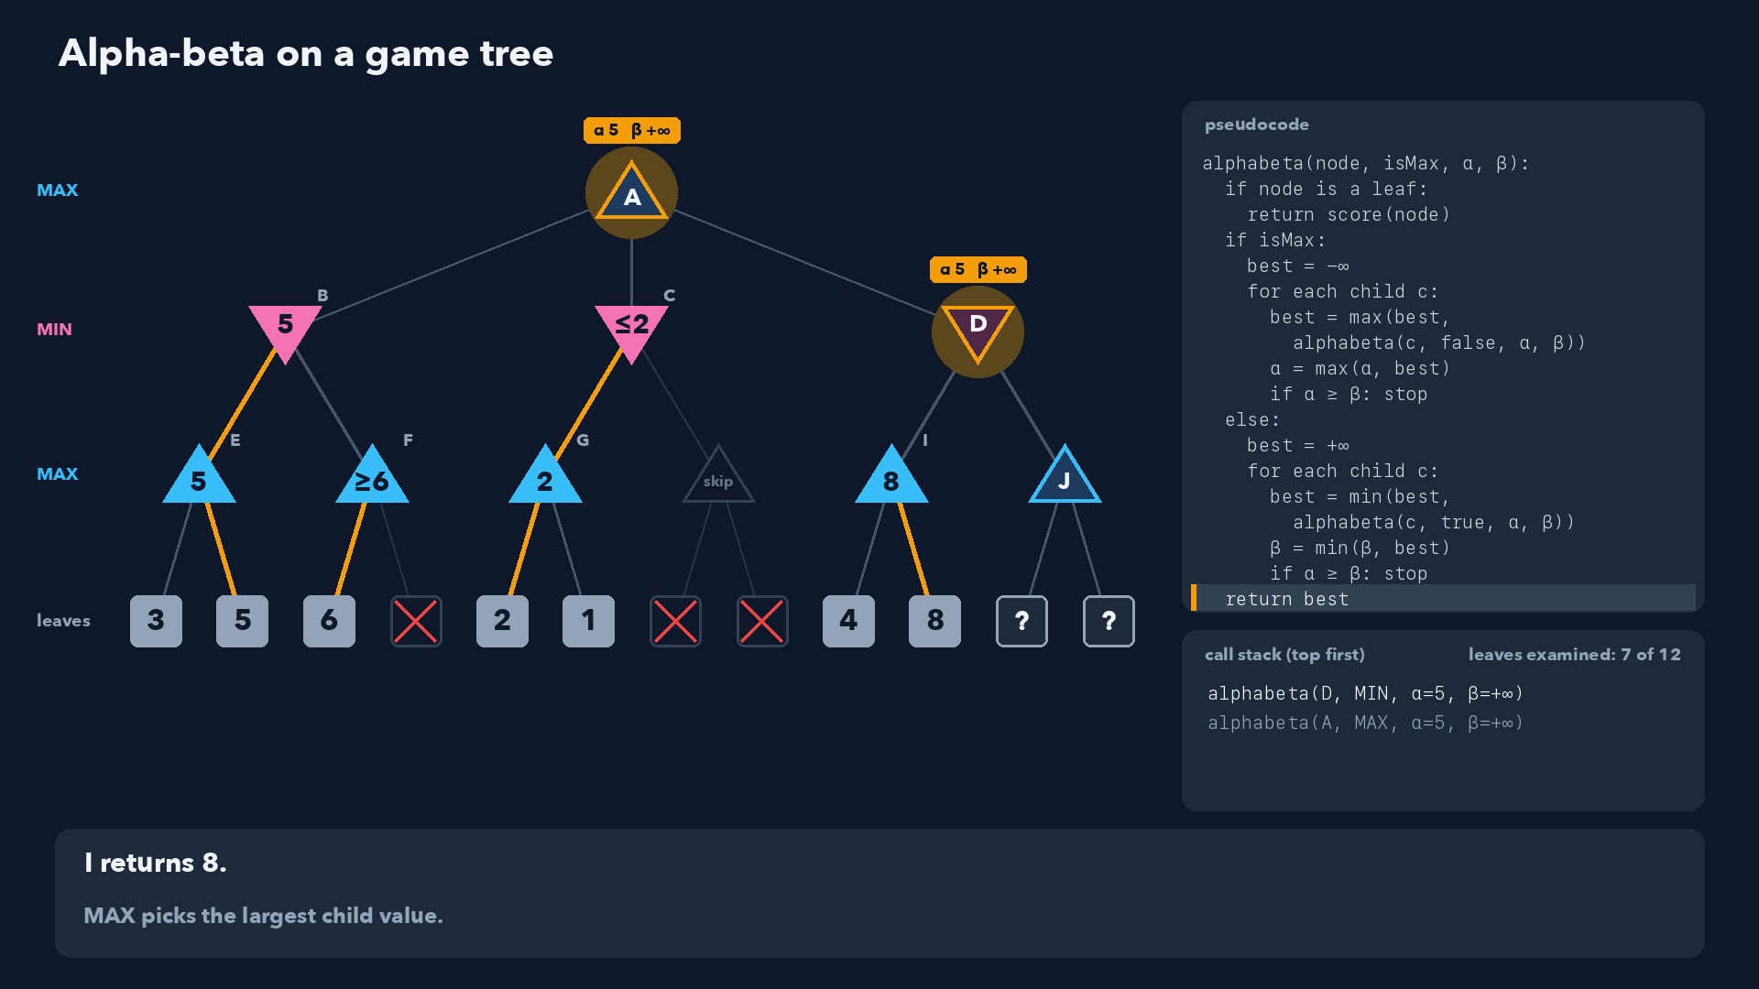
Notes:
Step 38 of 58
I returns 8.
MAX picks the largest child value.

Slide 39
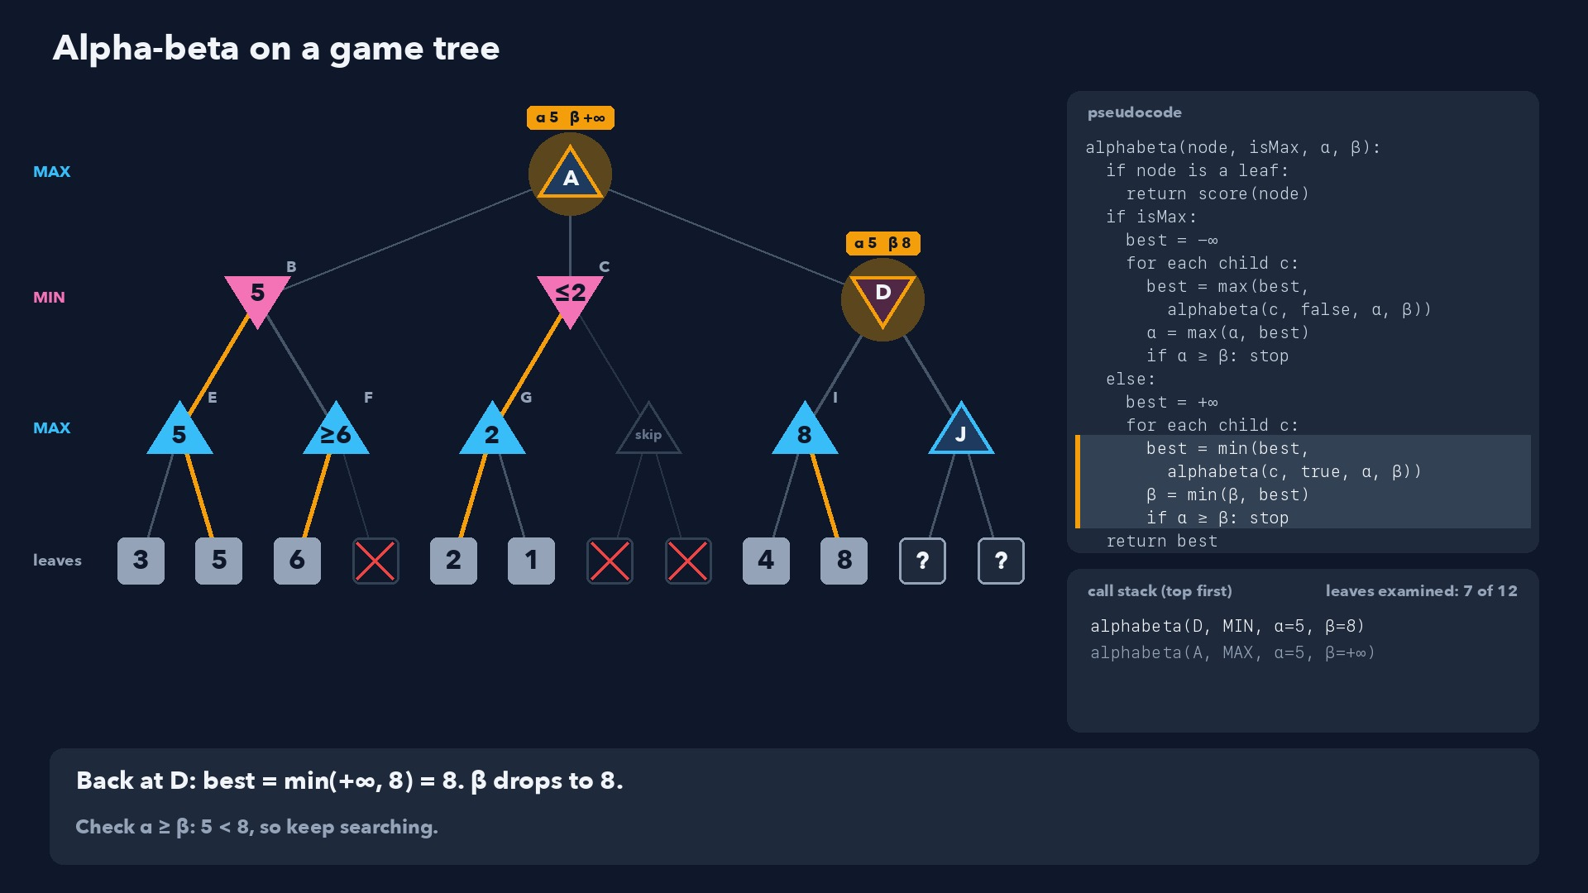
Notes:
Step 39 of 58
Back at D: best = min(+∞, 8) = 8. β drops to 8.
Check α ≥ β: 5 < 8, so keep searching.

Slide 40
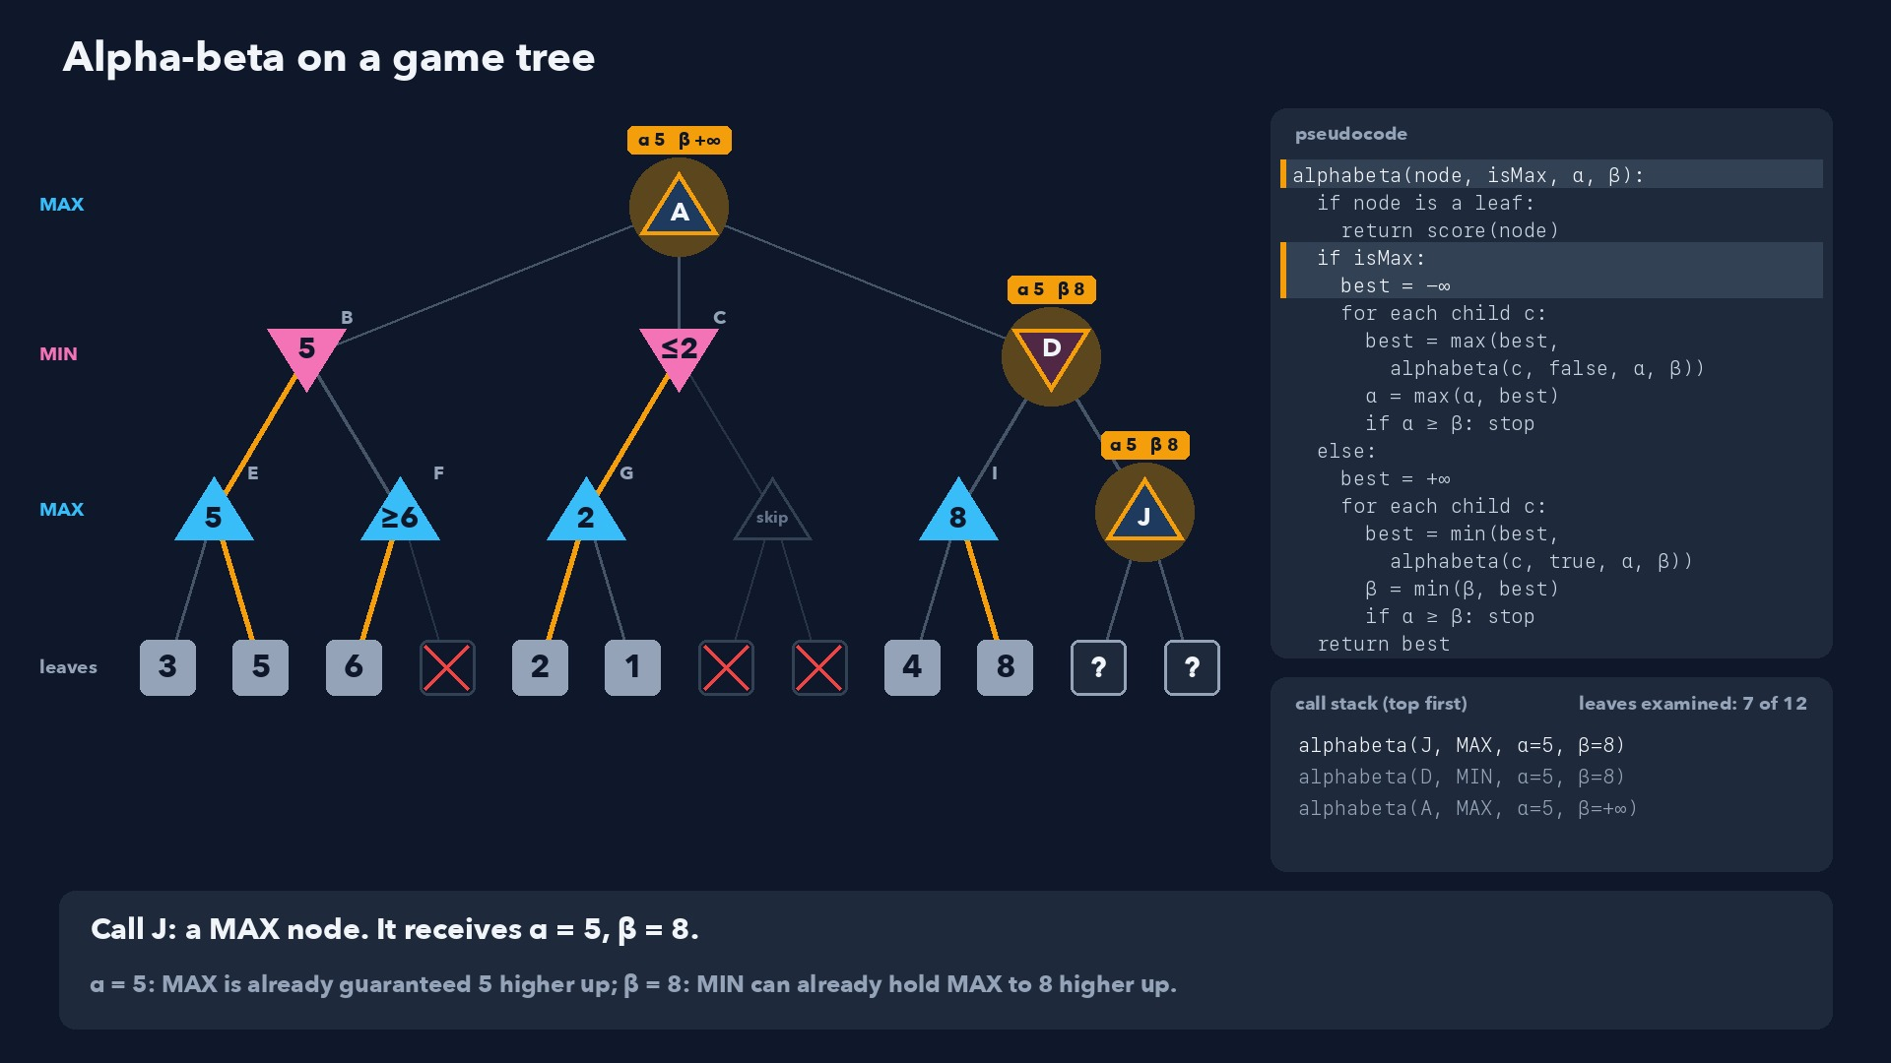
Notes:
Step 40 of 58
Call J: a MAX node. It receives α = 5, β = 8.
α = 5: MAX is already guaranteed 5 higher up; β = 8: MIN can already hold MAX to 8 higher up.

Slide 41
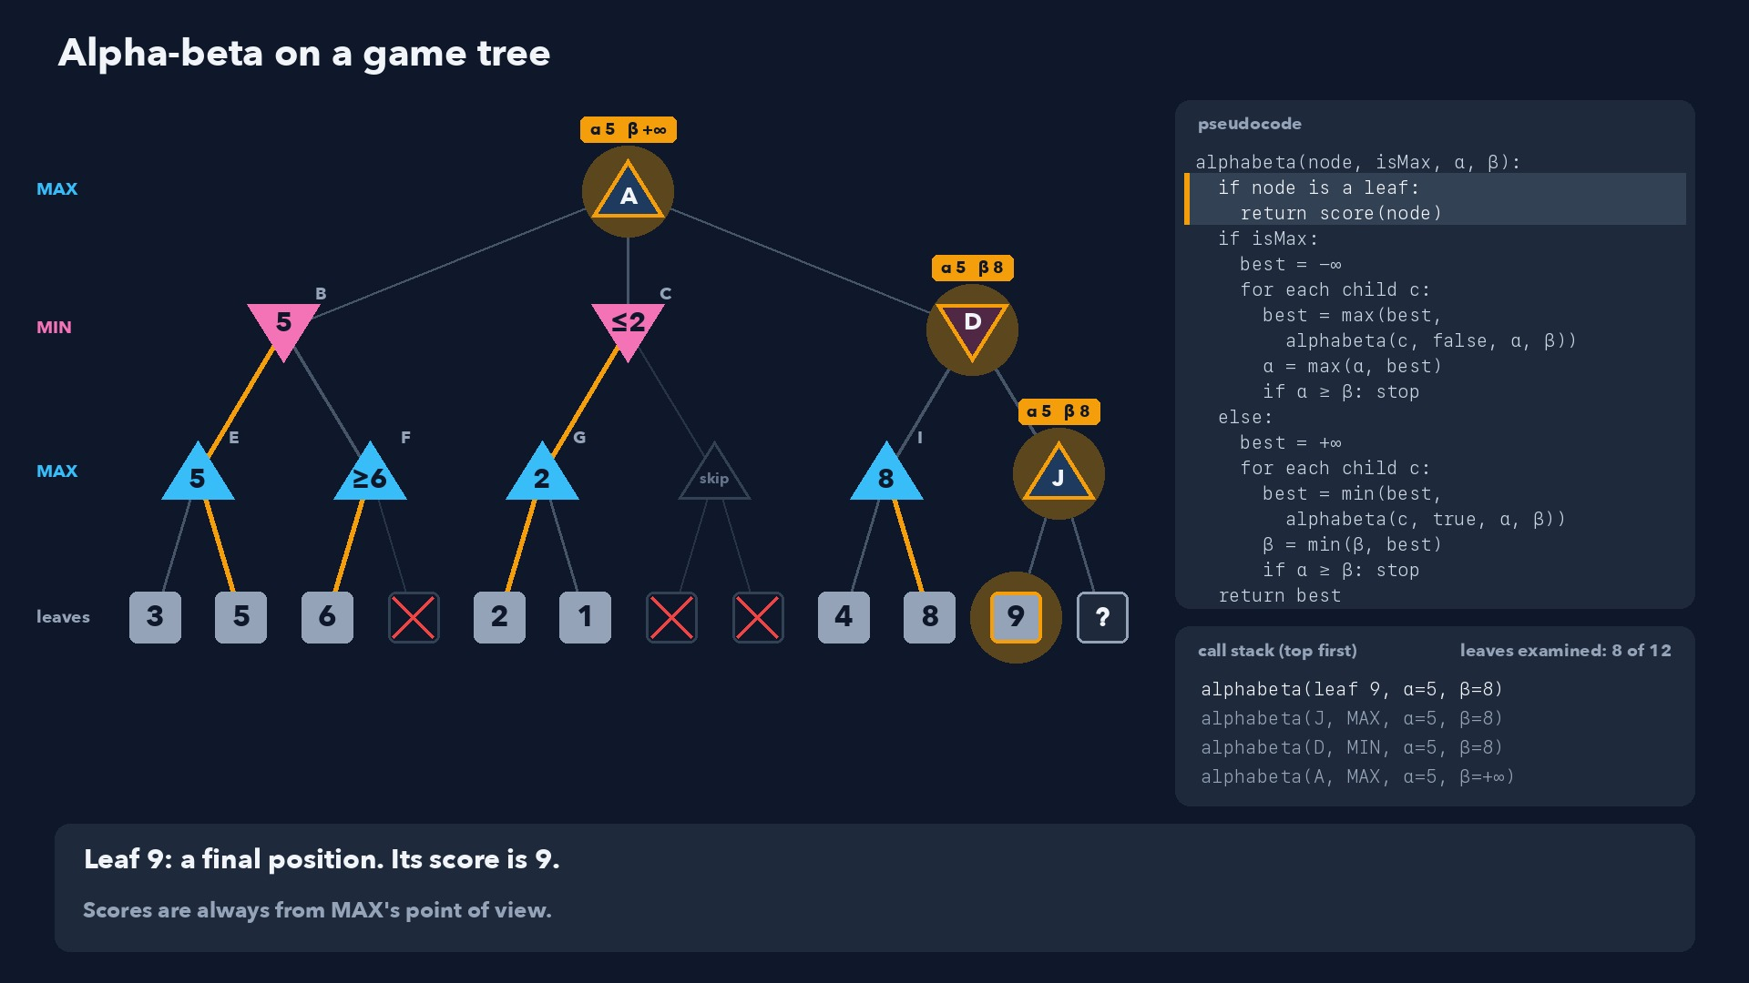
Notes:
Step 41 of 58
Leaf 9: a final position. Its score is 9.
Scores are always from MAX's point of view.

Slide 42
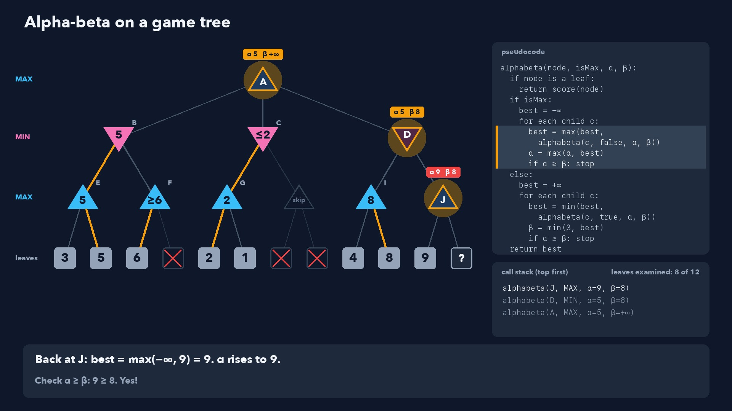
Notes:
Step 42 of 58
Back at J: best = max(−∞, 9) = 9. α rises to 9.
Check α ≥ β: 9 ≥ 8. Yes!

Slide 43
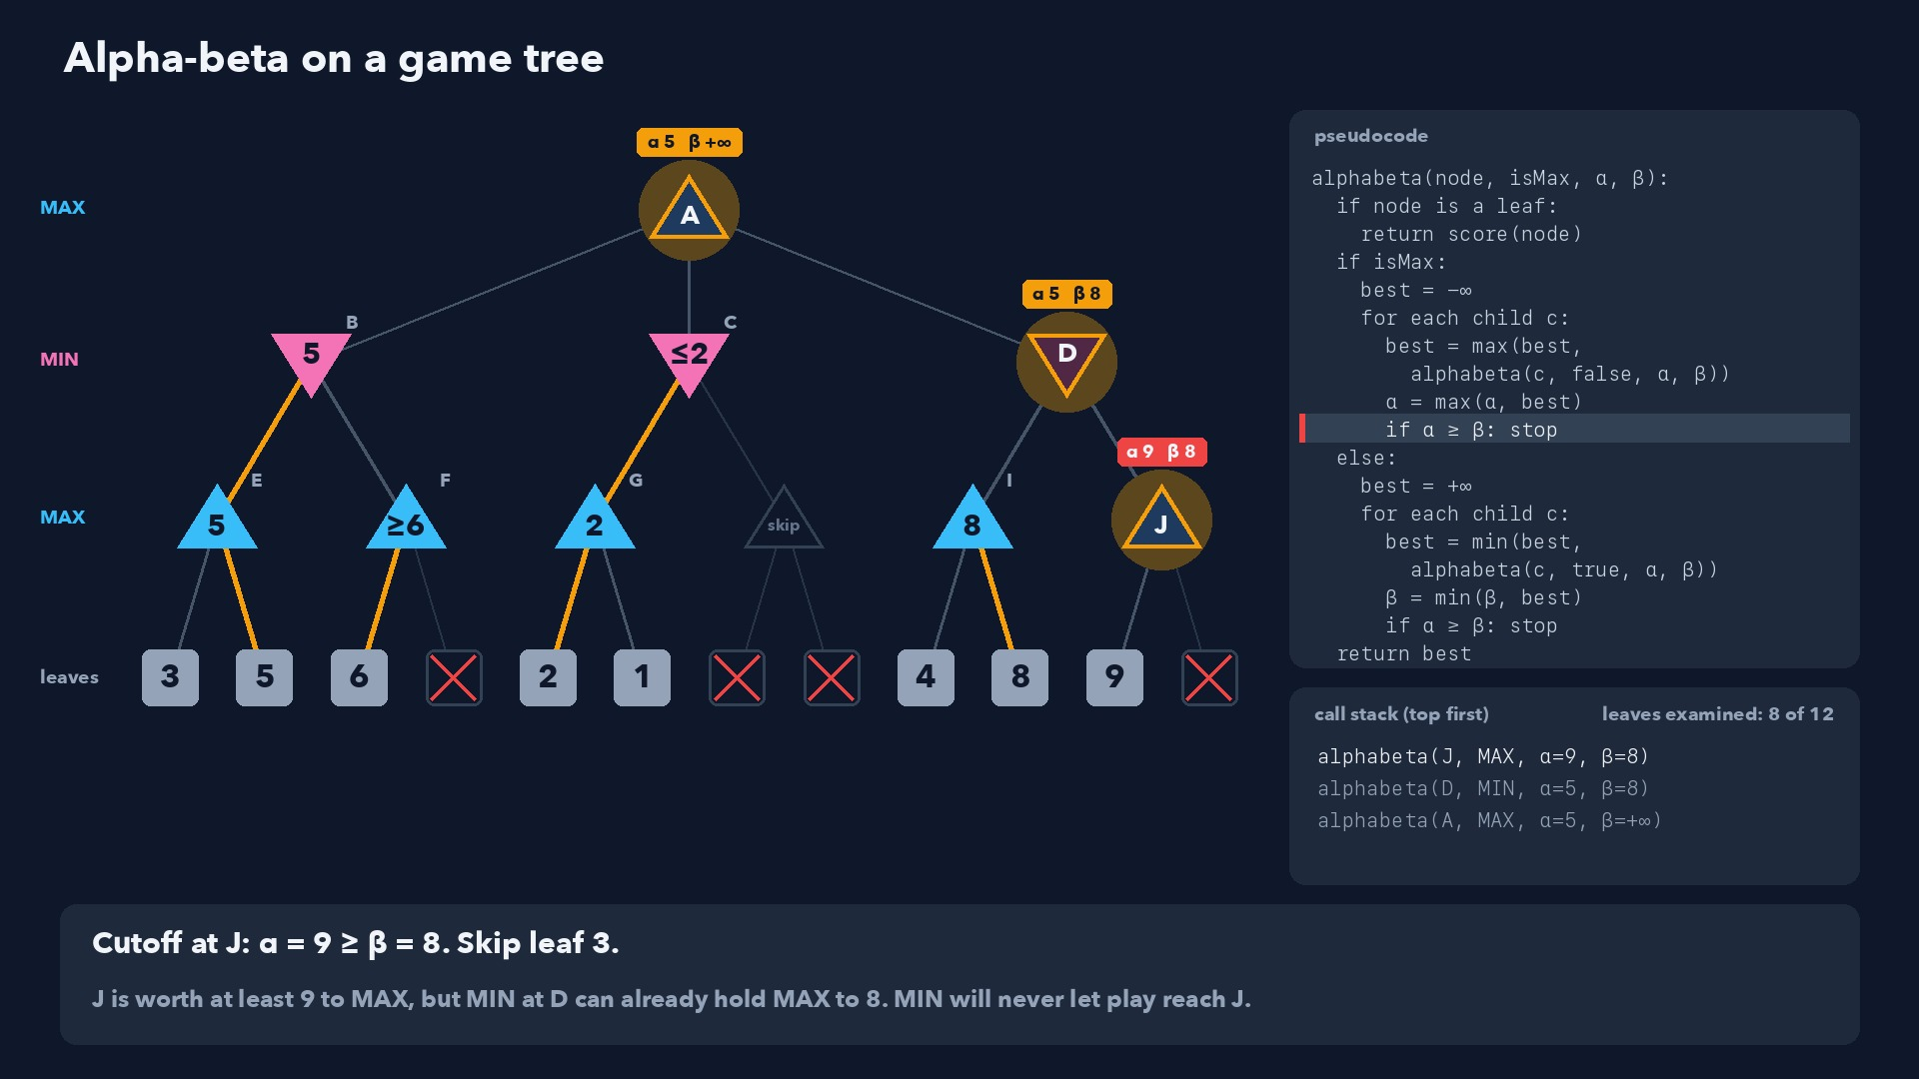
Notes:
Step 43 of 58
Cutoff at J: α = 9 ≥ β = 8. Skip leaf 3.
J is worth at least 9 to MAX, but MIN at D can already hold MAX to 8. MIN will never let play reach J.

Slide 44
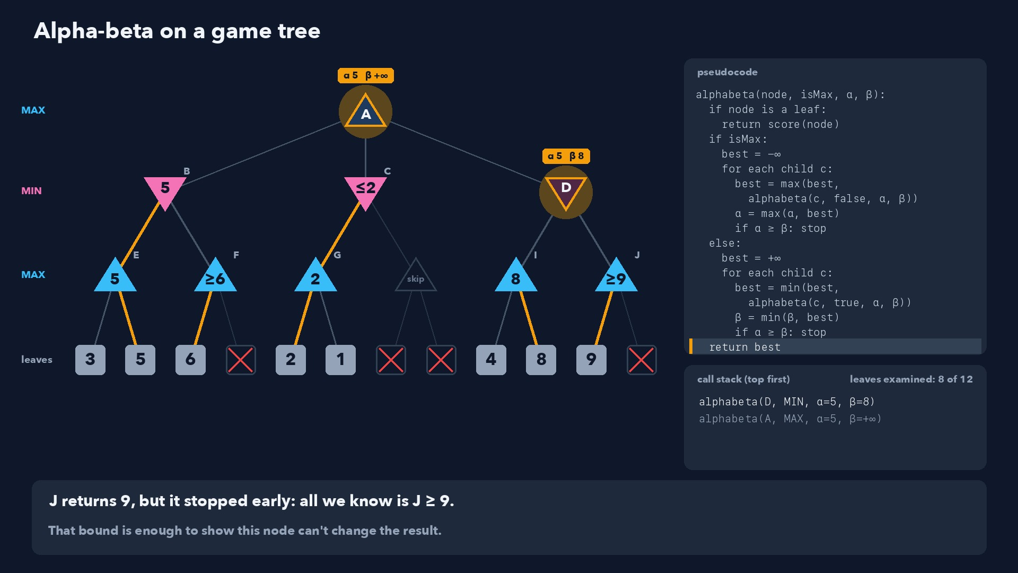
Notes:
Step 44 of 58
J returns 9, but it stopped early: all we know is J ≥ 9.
That bound is enough to show this node can't change the result.

Slide 45
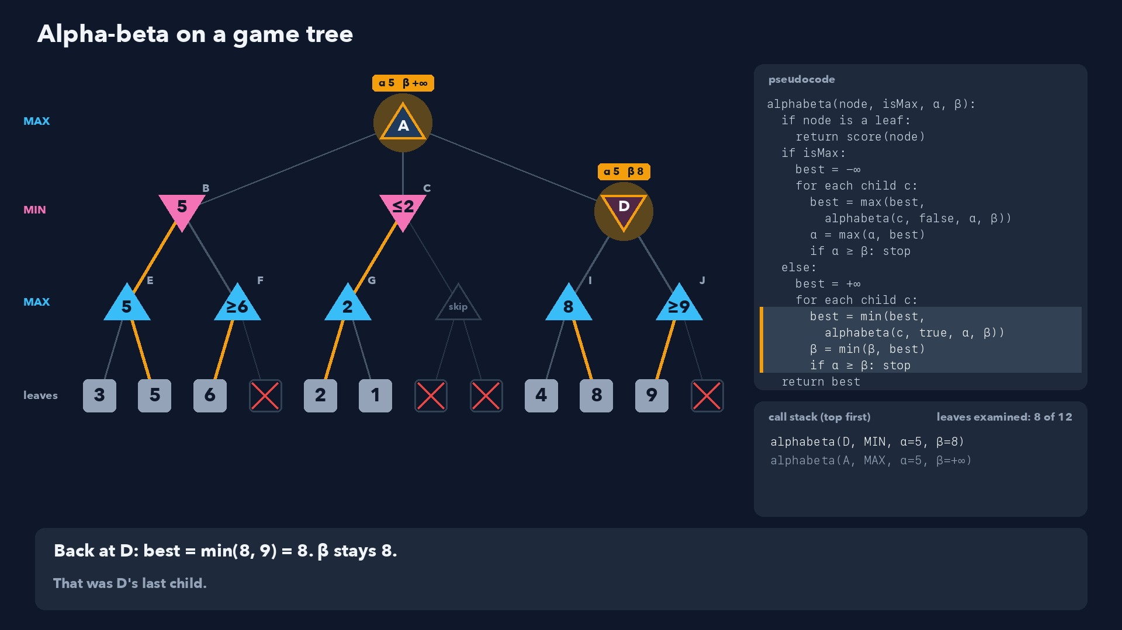
Notes:
Step 45 of 58
Back at D: best = min(8, 9) = 8. β stays 8.
That was D's last child.

Slide 46
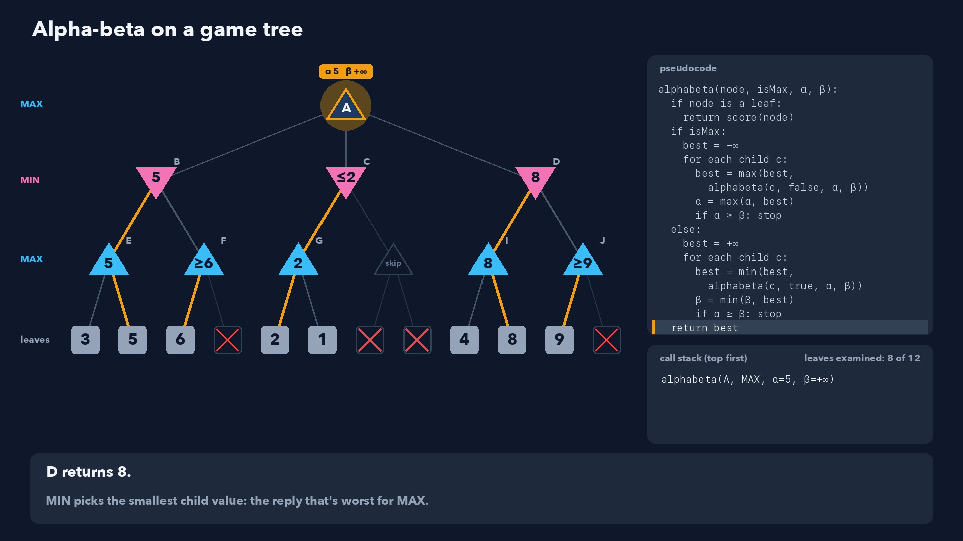
Notes:
Step 46 of 58
D returns 8.
MIN picks the smallest child value: the reply that's worst for MAX.

Slide 47
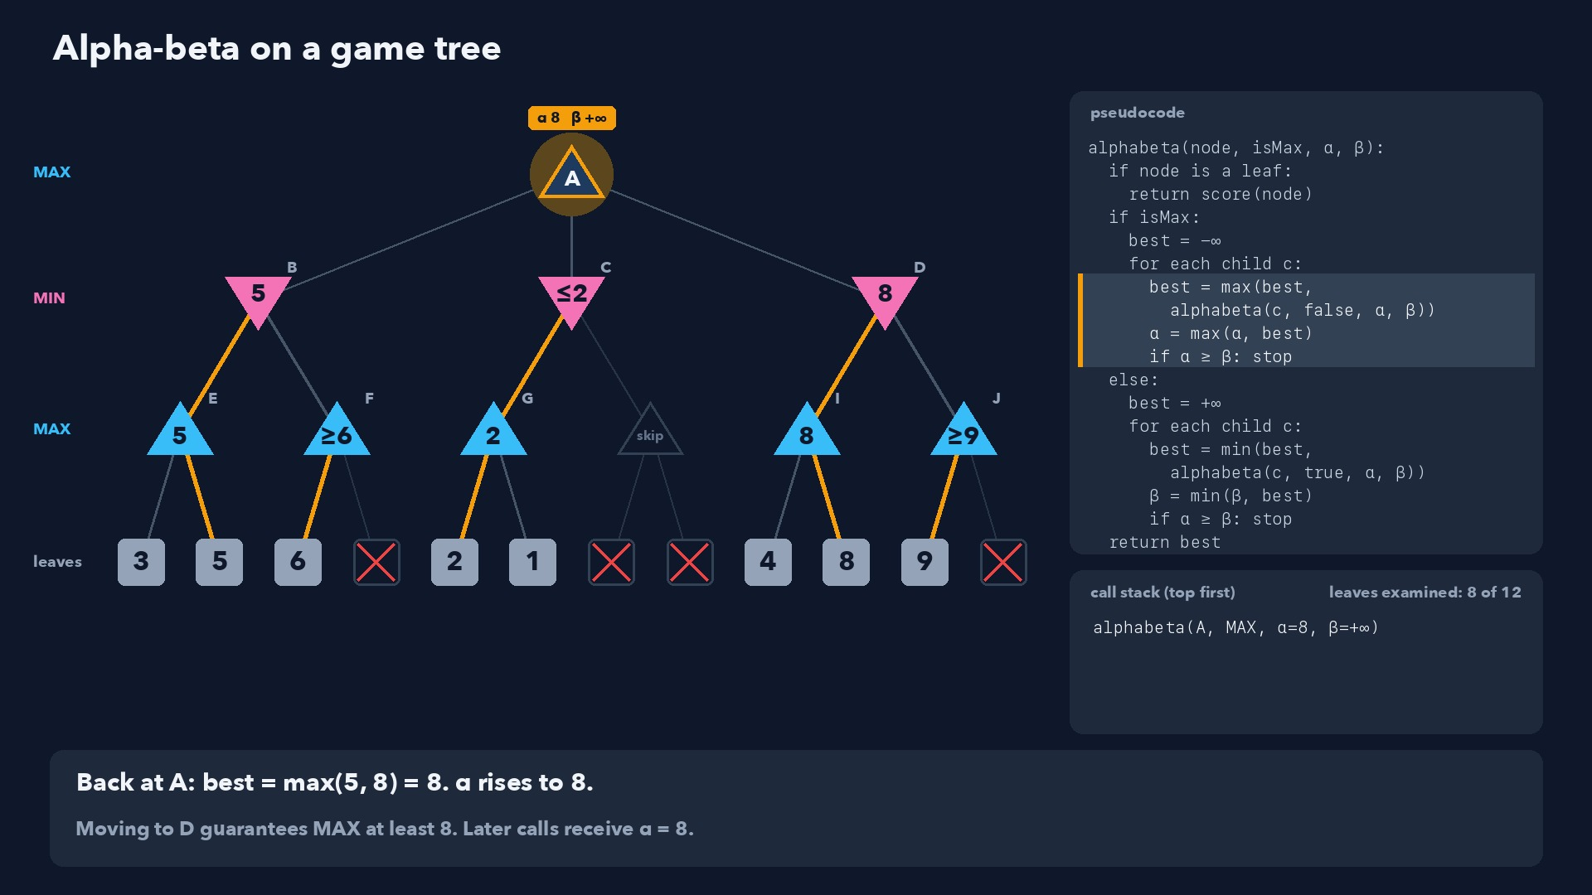
Notes:
Step 47 of 58
Back at A: best = max(5, 8) = 8. α rises to 8.
Moving to D guarantees MAX at least 8. Later calls receive α = 8.

Slide 48
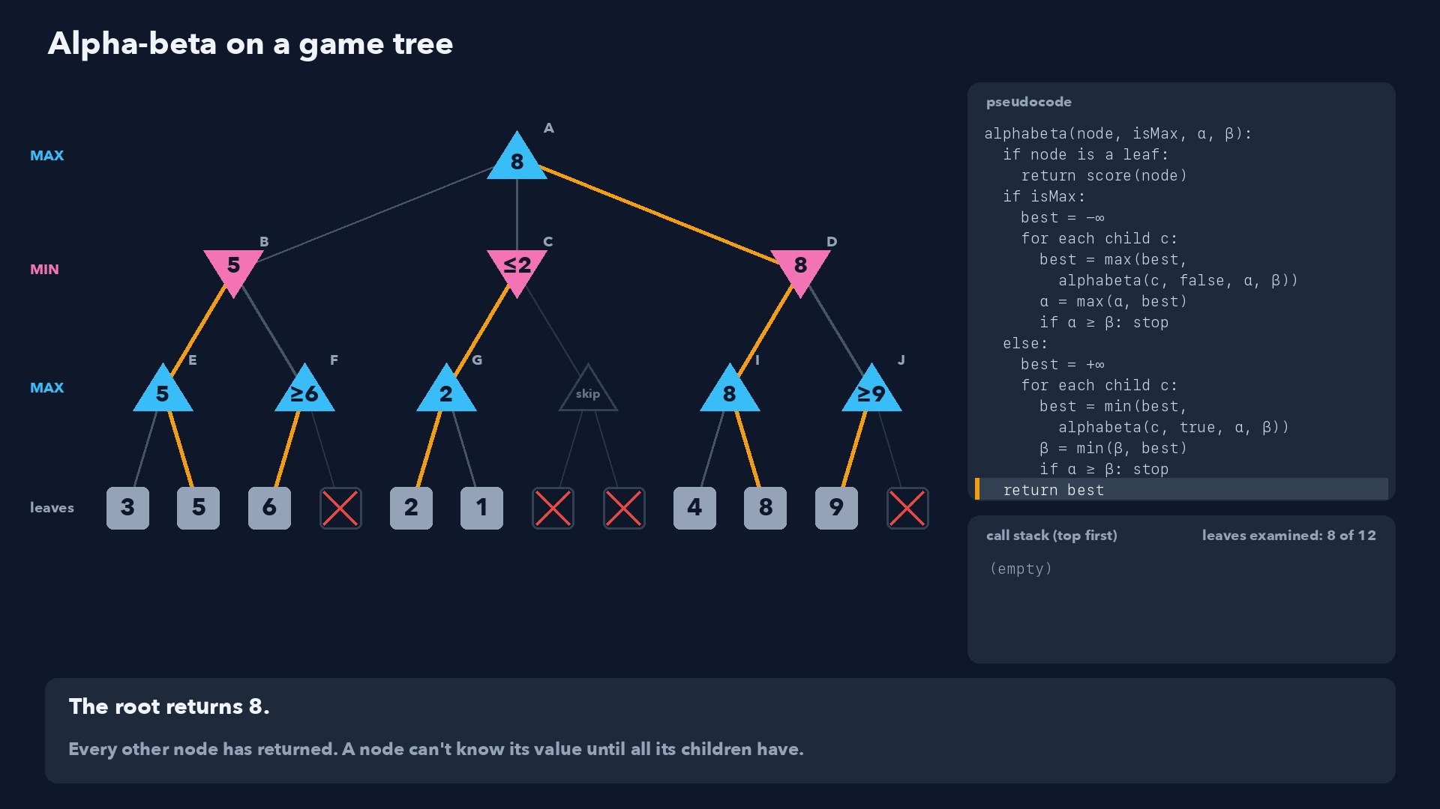
Notes:
Step 48 of 58
The root returns 8.
Every other node has returned. A node can't know its value until all its children have.

Slide 49
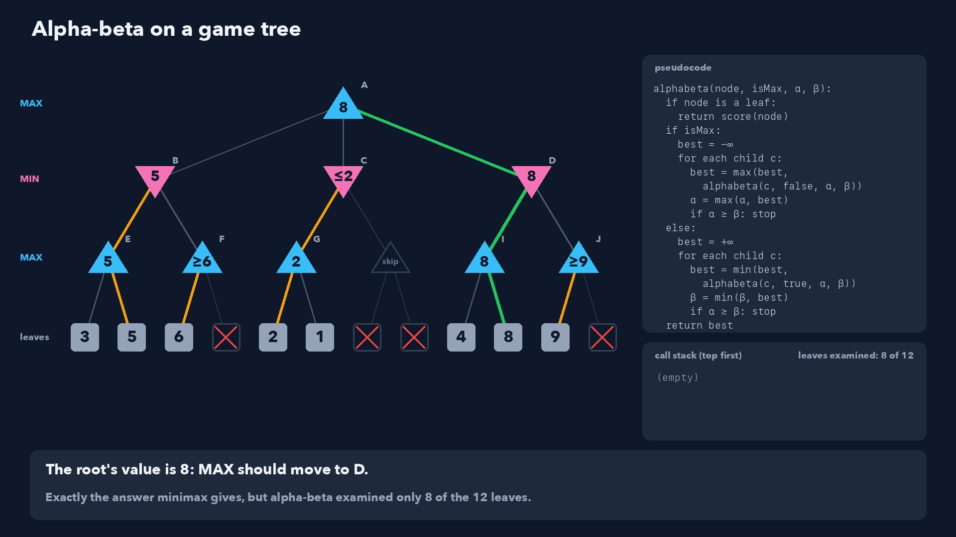
Notes:
Step 49 of 58
The root's value is 8: MAX should move to D.
Exactly the answer minimax gives, but alpha-beta examined only 8 of the 12 leaves.

Slide 50
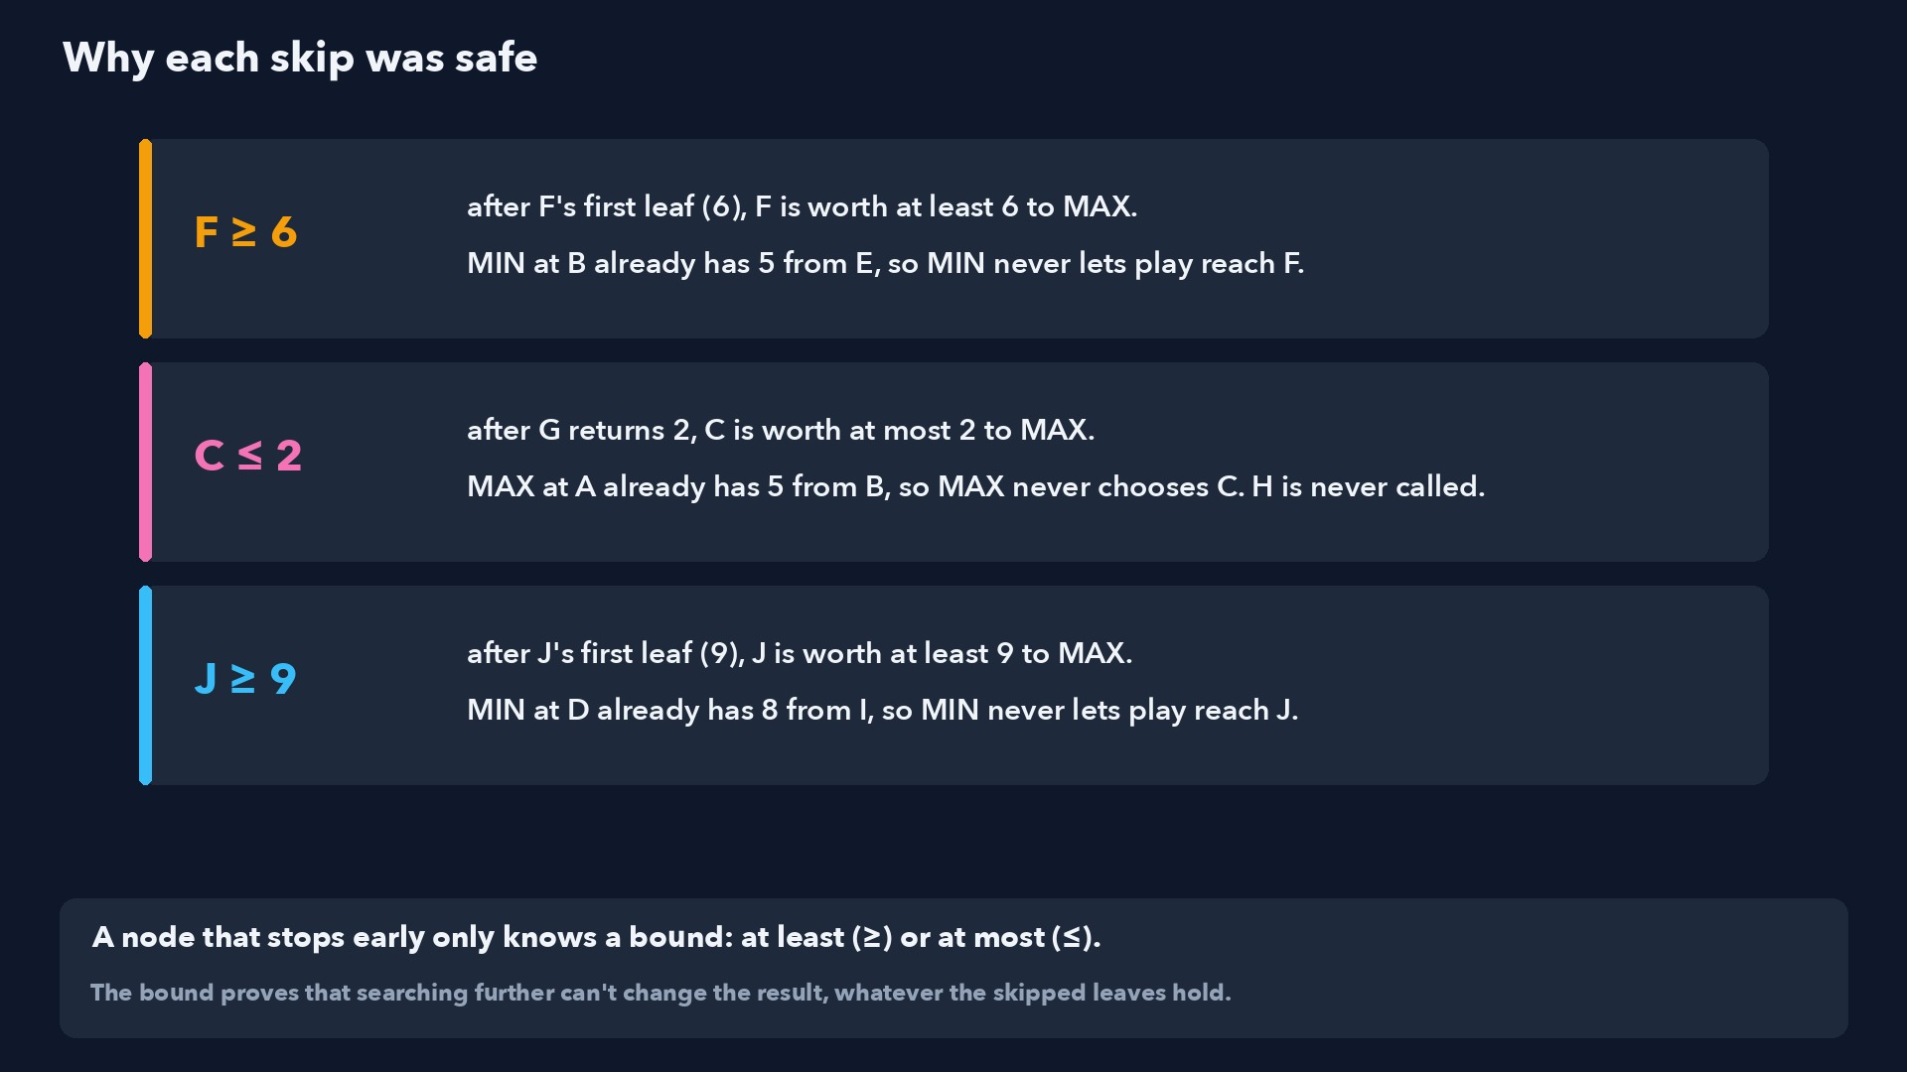
Notes:
Step 50 of 58
A node that stops early only knows a bound: at least (≥) or at most (≤).
The bound proves that searching further can't change the result, whatever the skipped leaves hold.

Slide 51

Notes:
Step 51 of 58
Searching the best move first: alpha-beta examines only 7 of the 12 leaves.
At MAX nodes try the highest-scoring child first, at MIN nodes the lowest. Then α and β tighten early.

Slide 52

Notes:
Step 52 of 58
The tic-tac-toe position from the minimax video, now with alpha-beta.
X tries its three moves in square order. Minimax looked at all 6 finished games.

Slide 53

Notes:
Step 53 of 58
X plays middle-center first: whatever O replies, X wins. Value +1, so α = +1.
+1 is the best score there is. Nothing X finds later can beat it.

Slide 54

Notes:
Step 54 of 58
Bottom-center: O's first reply wins for O (−1). β = −1 ≤ α = +1: cutoff.
That O node is worth at most −1 to X, and X already has +1. O's other reply is never examined.

Slide 55

Notes:
Step 55 of 58
Bottom-right: the same story. O's first reply wins for O, so cutoff.
Once X has a guaranteed win, each other move is ruled out by a single O reply.

Slide 56

Notes:
Step 56 of 58
X plays middle-center (+1), the same move minimax chose.
Alpha-beta examined 4 of the 6 finished games. In bigger games the skipped branches are huge.

Slide 57

Notes:
Step 57 of 58
Alpha-beta never changes the answer. It buys time to look deeper.
Real programs combine it with a depth limit, an estimate for unfinished positions, and good move ordering.

Slide 58

Notes:
Step 58 of 58
Alpha-beta: the same value as minimax, without looking at branches that can't change it.
Next: try it by hand in the in-class practice.

