Slide 1
What Is Concurrency, and Why Is It Hard?
Week 1 · Introduction to Concurrency · CS II

Slide 2
Today you will learn to…
1
Tell sequential from concurrent programs, and concurrency from parallelism
2
Give four reasons we write concurrent programs
3
Explain a race condition, and find every result of a small one by listing interleavings
4
Draw a simple state diagram of something real

Slide 3




What is your phone doing right now?
Playing audio
Downloading
Notifications
Your taps
decoding and sending sound to the speaker, without gaps
fetching the next song or a software update in the background
listening for messages from many apps at once
responding instantly, even while everything else runs
Each activity is a thread of control. They are all in progress at the same time.

Slide 4
Sequential vs concurrent programs
Sequential
Concurrent
A single thread of control: at any moment, exactly one "current line".
Multiple threads of control, all in progress at once, often sharing data.
Definitions: Magee & Kramer [MK06], ch. 1

Slide 5
Concurrency is not parallelism
One core: concurrency by interleaving
“Concurrency is about dealing with lots of things at once. Parallelism is about doing lots of things at once.”
Rob Pike, 2012
core 1
A
A
B
B
A
B
A
A
B
Two cores: parallelism
core 1
A
A
A
A
A
core 2
B
B
B
B
B
A concurrent design must be correct under every interleaving, on one core or many.
Pike, “Concurrency is not parallelism,” Heroku Waza, 2012 [Pik12]

Slide 6




Why write concurrent programs?
Performance
Throughput
Chips now add cores instead of speed. One sequential program uses one core [Sut05].
While one task waits for the network or disk, others make progress.
Responsiveness
Structure
The app keeps reacting to the user while slow work runs in the background.
Many independent activities: one thread each is often the clearest design.
Adapted from [MK06] ch. 1; Sutter, “The free lunch is over,” Dr. Dobb’s Journal, 2005 [Sut05]

Slide 7
A tiny concurrent program
x = 0 // shared variable
process 1: x := x + 1
process 2: x := x - 1
−1
0
+1
Both processes run at the same time. What is x at the end?
it depends
Example from Magee & Kramer [MK06], ch. 1 slides

Slide 8
One line, two atomic steps
x = 0
(shared memory)
R1: r1 = x
R2: r2 = x
W1: x = r1 + 1
W2: x = r2 − 1
process 1
register r1
process 2
register r2
Each R and W is atomic: it happens completely or not at all. The line x := x + 1 is not.

Slide 9
Six interleavings, three different answers
 | 1 | 2 | 3 | 4 | 5 | 6
step 1 | R1 | R1 | R1 | R2 | R2 | R2
step 2 | W1 | R2 | R2 | R1 | R1 | W2
step 3 | R2 | W1 | W2 | W1 | W2 | R1
step 4 | W2 | W2 | W1 | W2 | W1 | W1
final x | 0 | −1 | 1 | −1 | 1 | 0
Race condition
The result depends on the timing of the threads.
Non-deterministic
Same program, same input, different results from run to run.
Interleaving 2: both processes read 0, so process 1’s write is overwritten. A lost update.
Table from Magee & Kramer [MK06], ch. 1 slides

Slide 10
Live demo: lost likes
LikeCounter.java
2,000,000
static volatile int likes = 0;
static void like() {
likes = likes + 1; // not atomic
}
// 2 threads, each calls like()
// 1,000,000 times
likes expected (2 users × 1,000,000)
≈1,050,000
likes counted, and different on every run
1 user: 0 lost
no other thread, no interleaving, no race
Sample results: 16-core laptop, JDK 25. Run it yourself: LikeCounter in the Maven project week1-introduction/exercises/starter

Slide 11
Why testing is not enough
2 + 2 steps
6
The bad interleavings may be rare: a test passes 10,000 times, then fails
They depend on cores, load and compiler: “works on my laptop”
Debugging changes the timing, so the bug hides (a “Heisenbug”)
4 + 4 steps
70
10 + 10 steps
184,756
20 + 20 steps
137,846,528,820
interleavings of two processes

Slide 12



When concurrency goes wrong
Therac-25 · 1985–87
Mars Pathfinder · 1997
Northeast blackout · 2003
Radiation therapy machine gave massive overdoses. A race between operator input and machine set-up was among the causes [LT93].
Repeated resets on Mars. Priority inversion on a shared lock; fixed by a patch sent from Earth [Ree97].
About 50 million people lost power. Among several causes, the control-room alarms failed silently [TF04]; the vendor traced that to a race condition [Reg04].
Leveson & Turner, IEEE Computer, 1993; Reeves, 1997; U.S.–Canada Power System Outage Task Force, 2004. See REFERENCES.md

Slide 13
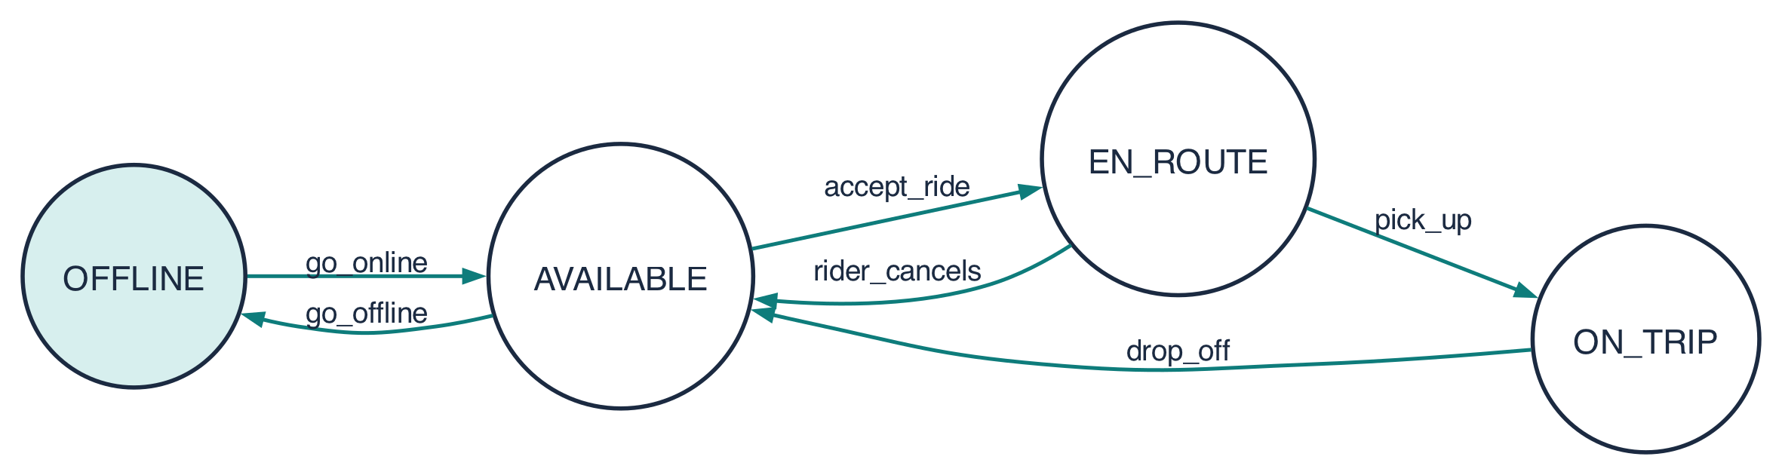
Thinking in states
States (circles): the situations the system can be in
Transitions (arrows): labelled with the action that causes them
Trace: go_online accept_ride pick_up drop_off
Impossible: go_online pick_up
A diagram leaves out detail (location, fare) and keeps what matters here: what can happen next.

Slide 14

This week’s exercises (about 60 minutes)
# | Exercise | Kind | Time
1 | Interleavings by hand | paper | 15 min
2 | Lost likes: run and explain | Java | 20 min
3 | Concurrent downloads | Java | 15 min
4 | A state diagram | paper | 10 min
Java 21+ & Maven
The code is in the Maven project exercises/starter. See SETUP.md.
Finished early? Try the optional extras: the interleavings challenge (exercises/challenge) or fixing the lost likes.

Slide 15
Summary
Concurrency
  Several threads of control in progress at once
  Not the same as parallelism
Races
  Results depend on the interleaving
  Testing alone cannot rule them out
State diagrams
  Show what can happen next, and in what order
Quick check
1. In one sentence: concurrency vs parallelism?
2. Two threads each run count = count + 1 once. count starts at 5. Possible final values?

Slide 16
References
Magee, J. & Kramer, J. (2006). Concurrency: State Models & Java Programs, 2nd ed. Wiley. Lecture slides: doc.ic.ac.uk/~jnm/book [MK06]
Pike, R. (2012). Concurrency is not parallelism. Heroku Waza. go.dev/blog/waza-talk [Pik12]
Sutter, H. (2005). The free lunch is over. Dr. Dobb’s Journal 30(3) [Sut05]
Leveson, N. & Turner, C. (1993). An investigation of the Therac-25 accidents. IEEE Computer 26(7) [LT93]
Reeves, G. (1997). What really happened on Mars? (Mars Pathfinder) [Ree97]
U.S.–Canada Power System Outage Task Force (2004). Final report on the August 14, 2003 blackout; Poulsen, K. (2004), The Register [TF04], [Reg04]

