Slide 1
Processes and Threads
Week 2 · Processes as state diagrams, and programming them as Java threads

Slide 2

Warm-up
count = 5
thread A: count = count + 1
thread B: count = count + 1
What final values of count are possible? Why?

Slide 3



Today: processes and threads
Concepts
State diagrams
Practice
A process is a unit of sequential execution: a sequence of actions
Draw a process as states joined by arrows labelled with actions
Java threads: Thread, Runnable, lambdas, virtual threads, life cycle
Structure from Magee & Kramer [MK06], ch. 2

Slide 4
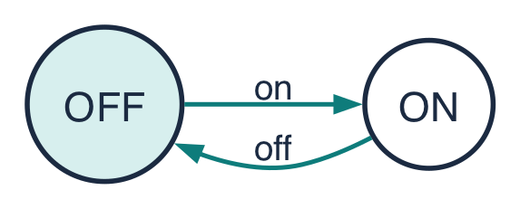
A process is a sequence of actions
A process is a sequence of actions. We draw it as a state diagram: it moves from state to state by performing atomic actions.
A light switch
Trace: on off on off on off …
Finite states, infinite trace
Each state = what can still happen from there
Definition and example from Magee & Kramer [MK06], ch. 2

Slide 5
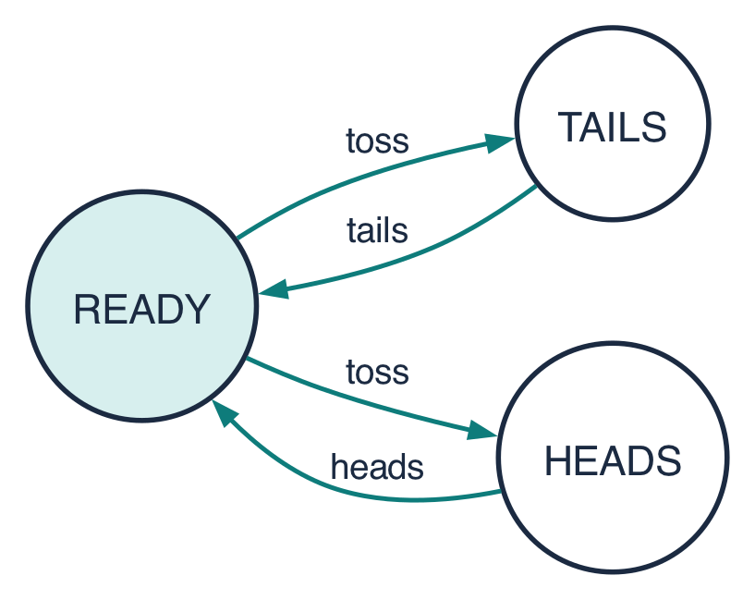
Choice: who decides?
Different actions out of a state: whoever acts next chooses
The same action twice (toss): the coin itself decides
This is non-deterministic choice: good for things we cannot control, like a lost message
Coin example from Magee & Kramer [MK06], ch. 2

Slide 6
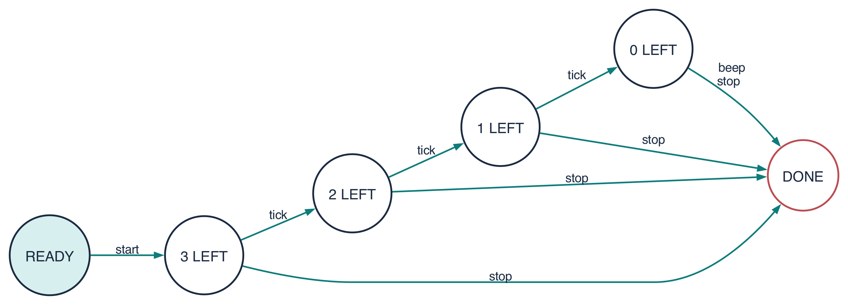
A countdown timer
Beeps after counting down, unless stopped first. DONE has no way out: the timer has finished. Later today we turn this diagram into a Java thread.
After the COUNTDOWN example in Magee & Kramer [MK06], ch. 2

Slide 7
Implementing processes in Java
From the model (process) to the program (thread)

Slide 8
Processes and threads: the OS view
one operating-system process
Each thread has its own stack: local variables, call frames
All threads share the heap: objects, fields
Shared data is cheap to communicate through, and easy to corrupt
code
heap: shared data
thread 1
stack
(locals)
thread 2
stack
(locals)
thread 3
stack
(locals)
After Magee & Kramer [MK06] §2.2; Chrome’s multi-process design: Kosaka, 2018 [Kos18]

Slide 9
Way 1: subclass Thread
Java
class Greeter extends Thread {
@Override
public void run() {
System.out.println("hi from " + getName());
}
}
Thread a = new Greeter();
a.start(); // new thread calls run()
A Thread runs the code in its run() method
start() creates a new thread of control, which calls run()
Drawback: Java has single inheritance, so Greeter cannot extend anything else
After Magee & Kramer [MK06] §2.2

Slide 10
Ways 2 and 3: Runnable and lambdas
Way 2: Runnable target [MK06]
Way 3: a lambda is a Runnable
class Countdown implements Runnable {
public void run() { /* ... */ }
}
Thread b = new Thread(new Countdown());
b.start();
Thread c = new Thread(() -> {
System.out.println("hi!");
});
c.start();
Separate the work (a Runnable) from the thread that runs it. Usually the better design.
Magee & Kramer [MK06] §2.2; lambdas: Java 8+

Slide 11
Way 4: virtual threads (Java 21+)
Java 21+ [JEP444]
1 s
Thread d = Thread.ofVirtual()
.start(task);
var ex = Executors
.newVirtualThreadPerTaskExecutor();
try (ex) {
for (var r : requests)
ex.submit(() -> handle(r));
} // close() waits for all tasks
2,000 one-second waits on 2,000 virtual threads
10 s
the same 2,000 waits on a pool of 200 platform threads
Virtual threads make waiting cheap. They do not make computing faster. (One test machine; your numbers will differ.)
JEP 444: Virtual Threads, OpenJDK 2023 [JEP444]. Timings: VirtualThreadsDemo (Maven project week2…/demos) on one machine: Apple M3 Max, 16 cores, JDK 25

Slide 12


start() vs run(), and join()
Java
start()
Thread[] all = {a, b, c, d};
for (Thread t : all) t.start(); // concurrent
for (Thread t : all) t.join(); // wait
System.out.println("all done");
Creates a new thread, which calls run(). Returns at once.
run()
The order of output from different threads changes from run to run.
An ordinary method call on the current thread. Nothing runs concurrently.
Try it: exercise J1, ThreadBasics (Maven project exercises/starter)

Slide 13
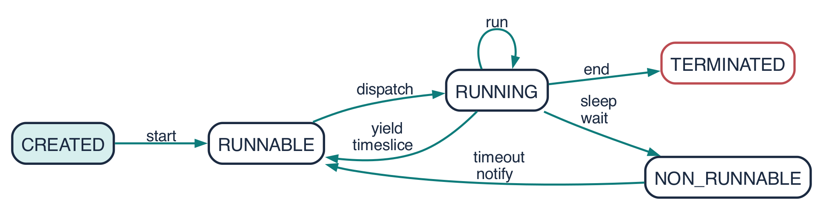
The life of a thread
Created, then alive (running, ready, or waiting), then terminated. Once terminated, a thread cannot be restarted.
Thread life cycle after Magee & Kramer [MK06] §2.2; drawn by LTSA

Slide 14
Java’s Thread.State
Thread.State | Meaning | In the diagram
NEW | created, not yet started | CREATED
RUNNABLE | running, or ready to run | RUNNABLE + RUNNING
BLOCKED | waiting to enter a synchronized block (Week 4) | NON_RUNNABLE
WAITING | waiting with no time limit: join(), wait() | NON_RUNNABLE
TIMED_WAITING | waiting with a limit: sleep(ms), join(ms) | NON_RUNNABLE
TERMINATED | run() has returned | TERMINATED
Java SE 21 API, java.lang.Thread.State [JDK-Thread]; diagram after [MK06]

Slide 15



sleep, join and interrupt
Thread.sleep(ms)
t.join()
t.interrupt()
Pause the current thread for a while. It waits, so it uses no CPU.
Wait until thread t has terminated.
Ask t to stop. If t is sleeping or waiting, it gets an InterruptedException.
try { Thread.sleep(1000); }
catch (InterruptedException e) { /* someone asked us to stop: clean up, return */ }

Slide 16
From diagram to code: the countdown
Diagram → code
start: create and start the thread
the “i LEFT” states: a while loop with i
tick: sleep 1 s, then i--
beep → DONE: return from run()
stop → DONE: interrupt(); catch it and return
Java: CountdownTimer.run()
public void run() {
int i = n;
try {
while (true) {
if (i > 0) { // tick
tick(i); Thread.sleep(1000); i--;
}
if (i == 0) { // beep -> DONE
beep(); return;
}
}
} catch (InterruptedException e) { // stop
System.out.println("stopped at " + i);
}
}
After the COUNTDOWN example in [MK06] ch. 2; console version of the book’s CountDown applet: CountdownTimer in week2…/demos

Slide 17
This week’s exercises (about 60 minutes)
# | Exercise | Kind | Time
D1 | A music player’s state diagram | paper | 10 min
J1 | Four ways to start a thread | Java | 15 min
J2 | Watching a thread’s life | Java | 15 min
J3 | From state diagram to thread: auto-lock | Java | 20 min
Finished early? Optional extras: removing the joins in J1, the state-diagram-in-Java challenge (exercises/challenge), and the virtual-threads comparison.

Slide 18
Summary
Processes
  A sequence of actions, drawn as a state diagram
Java threads
  Thread, Runnable, lambda, virtual thread
  start, join, sleep, interrupt
Diagram → code
  States become a loop; actions become steps
Quick check
1. What is the difference between t.start() and t.run()?
2. Which Thread.State does a thread have during Thread.sleep(1000)?

Slide 19
References
Magee, J. & Kramer, J. (2006). Concurrency: State Models & Java Programs, 2nd ed. Wiley, ch. 2, and lecture slides. doc.ic.ac.uk/~jnm/book [MK06]
Pressler, R. & Bateman, A. (2023). JEP 444: Virtual Threads. openjdk.org/jeps/444 [JEP444]
Oracle. Java SE 21 API: java.lang.Thread and Thread.State [JDK-Thread]
Oracle. The Java Tutorials: Concurrency. docs.oracle.com/javase/tutorial/essential/concurrency [JTut]
Kosaka, M. (2018). Inside look at modern web browser (part 1). Chrome for Developers [Kos18]
Goetz, B. et al. (2006). Java Concurrency in Practice. Addison-Wesley [Goe06]

