Slide 1


KAHE Campus Management System
KARPAGAM ACADEMY OF HIGHER EDUCATION
(Deemed to be University)
(Established Under Section 3 of UGC Act 1956)
Accredited with A+ Grade by NAAC in the Second Cycle
Coimbatore– 641021.
Title: KAHE Campus Management System
Team: Tech Squad
Members: Bebin R (25ADU153), Kamesh K (25ADU172)
Department: B.Sc AI & Data Science
Theme: AI for Better Tomorrow
Notes:
[Sources]
User-provided title, team name, members, department, and theme. Project details from local KAHE CMS codebase and current task requirements.

Slide 2
Pre-Development Round
Methodology
Overview: Role-based classroom availability and booking system.
Problem: Manual room coordination causes conflicts and delays.
Objective: Use CSP + GA to recommend optimized classrooms.
Notes:
[Sources]
Feature scope derived from local Django/React project modules: classroom booking, live rooms, sessions, role permissions, and CSP+GA recommendation endpoint.

Slide 3
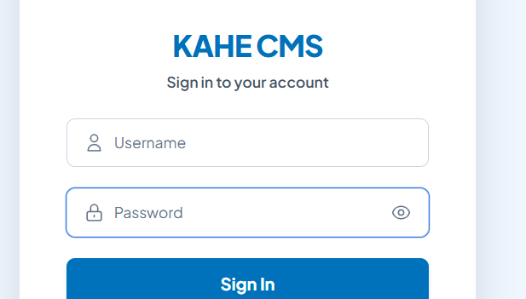
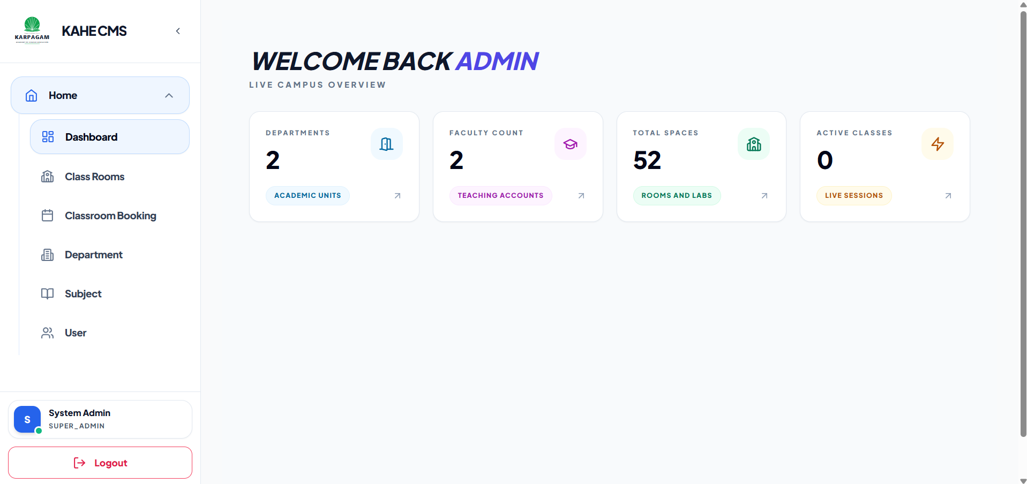
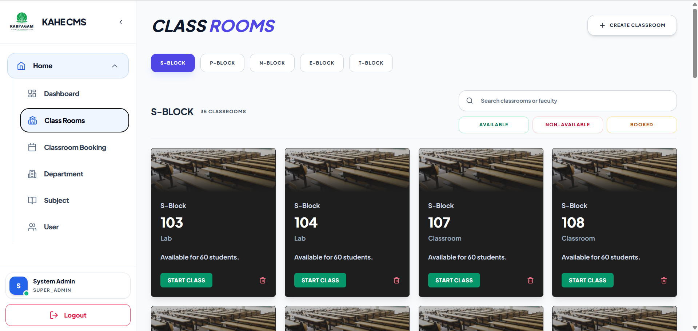
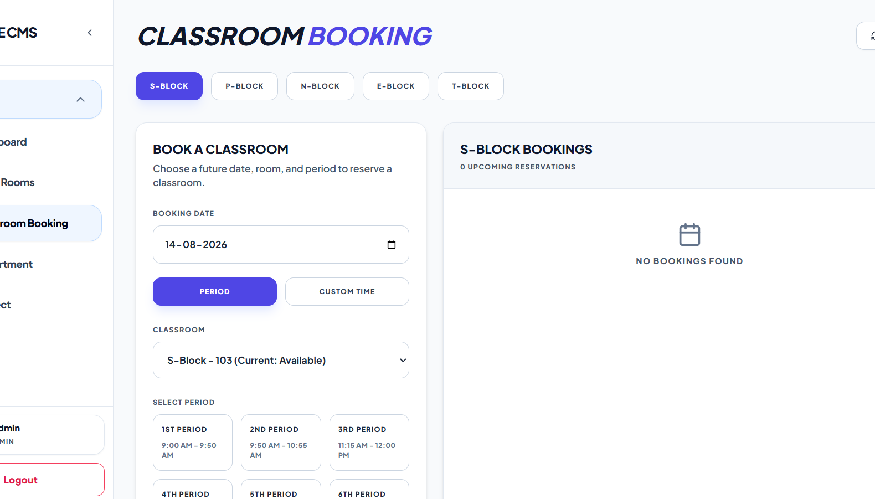
System Workflow
(Pictorial Representation)
How the system works
1. User logs in as Admin, Faculty, or Student.
2. Dashboard shows live campus counts and active classes.
3. Class Rooms displays block-wise classroom availability.
4. Booking selects a future date, room, and period.
5. CSP checks constraints and prevents time conflicts.
6. GA ranks suitable rooms; booking is saved and synced.
1. Login
2. Dashboard
AI Layer: CSP + Genetic Algorithm for conflict-free scheduling
3. Class Rooms
4. Booking
Notes:
[Sources]
- Screenshots supplied by the user on 2026-08-14: KAHE CMS Login, Admin Dashboard, Class Rooms, and Classroom Booking screens.
Workflow explanation: Users authenticate by role, view live dashboard/classroom availability, select block/date/period for booking, then the CSP layer detects conflicts while the Genetic Algorithm ranks suitable classrooms before the booking is saved and synchronized for all users.

Slide 4
Detailed Step-by-Step Methodology
(CSP + GA enabled classroom booking)
Step 1: Collect block, date, period/time, and capacity.
Step 2: Validate role, time window, and 14-day limit.
Step 3: CSP removes conflicts; GA ranks best-fit rooms.
Notes:
[Sources]
Detailed flow based on backend serializers.py booking validation and views.py score_classroom_recommendations implementation.

Slide 5
Algorithm / Logic Explanation
CSP: Removes rooms with booking, class, or capacity conflicts.
GA: Ranks valid rooms by capacity fit, room type, and usage.
Output: Top suggestions with AI score and reason.
Notes:
[Sources]
Algorithm details from backend/cms_project/cms/views.py and backend/cms_project/cms/serializers.py.

Slide 6
Validation & Evaluation Plan
Validate bookings for today and up to 14 days ahead.
Test overlap conflicts and active class sessions.
Success: correct status, saved booking, clear recommendation.
Notes:
[Sources]
Validation plan derived from required booking behavior and implemented CSP/GA constraints.

Slide 7
THANK YOU
Tech Squad
Notes:
[Sources]
Closing slide uses user-provided team name.

