Slide 1
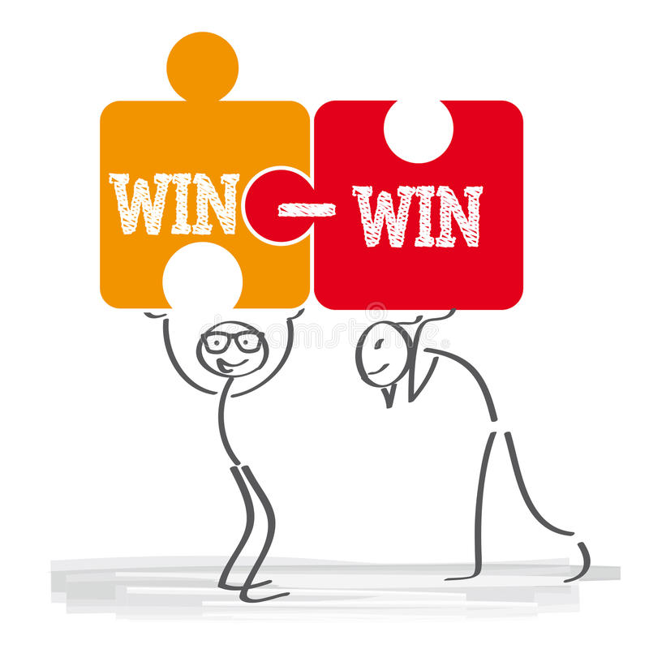
USING THE WIN-WIN STRATEGY TO YOUR ADVANTAGE.

Slide 2

Using a win-win strategy is a powerful way to get the outcomes you and others want, without unneeded conflict.
When you consider how you can reach a win-win solution in every interaction, you will help yourself and those you work with, achieve their outcomes a lot easier.

Slide 3
This is a strategy that ensures both sides are satisfied and there is added value for all stakeholders.
However, in this situation, COMPROMISE and COOPERATION are important factors that come to play.
WHAT IS A WIN-WIN STRATEGY?

Slide 4
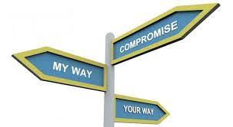

This is a strategy that ensures both sides are satisfied and there is added value for all stakeholders.
However, in this situation, COMPROMISE and COOPERATION are important factors that come to play.

Slide 5

WHAT DO YOU STAND TO GAIN?
A win-win strategy will help you achieve what you want faster, without affecting what others want. You can call it a habit of mutual benefit.
Better collaboration and support.
Conflicts are resolved quickly.
Everyone gets an outcome they want.
Improved negotiation and problem-solving skills.
Save time and money.
WHY?

Slide 6

Get clear on the outcome you and everyone want.
Focus on the long-term gain rather than a short-term benefit.
Use problem-solving skills to address objections or disagreements.
Aim to reach a consensus before ending the conversation or negotiation.
HOW?

Slide 7
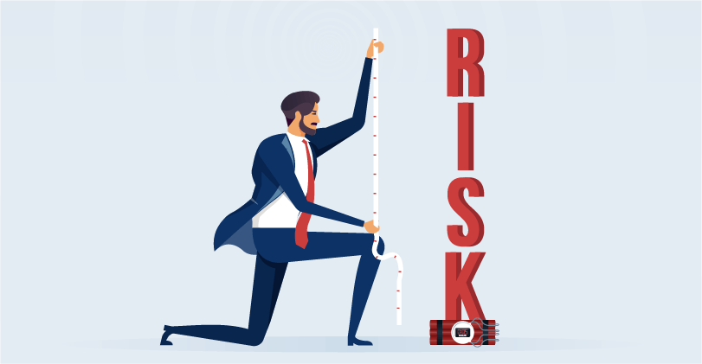
RISKS OF NOT USING THIS STRATEGY
More conflict, which means more time will be wasted getting to desired outcomes.
Higher levels of disengagement.
Delay in achieving goals.
Reduced motivation

Slide 8
Sources
https://neelraman.com/how-to-use-a-win-win-strategy-to-get-what-you-want/ /
https://www.igi-global.com/dictionary/win-win-strategy/77498

Slide 9


