Slide 1
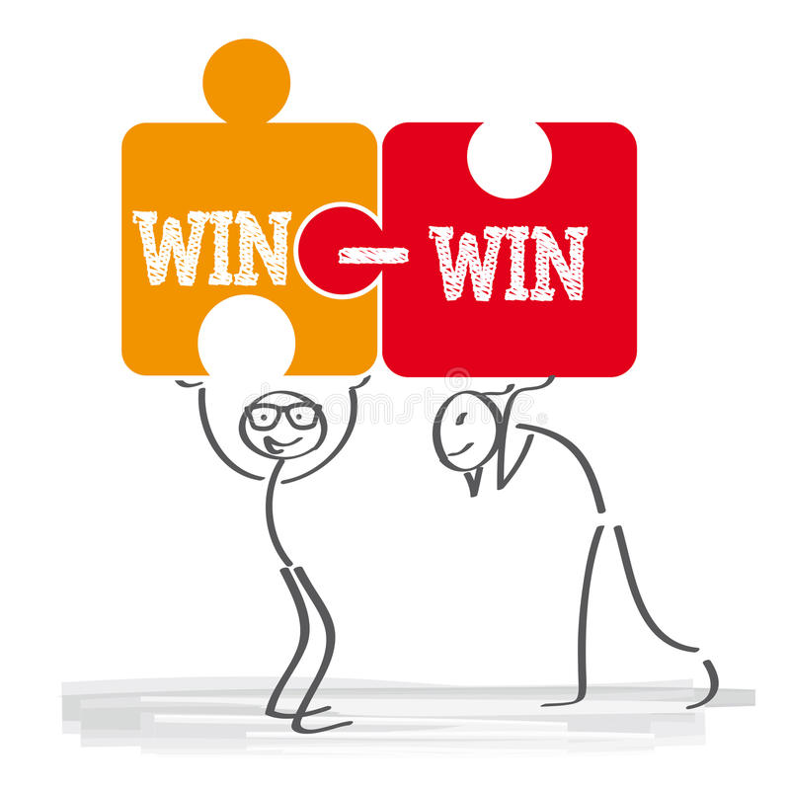
USING THE WIN-WIN STRATEGY TO YOUR ADVANTAGE.

Slide 2

Using a win-win strategy is a powerful way to get the outcomes you and others want, without unneeded conflict.
When you consider how you can reach a win-win solution in every interaction, you will help yourself and those you work with, achieve their outcomes a lot easier.

Slide 3
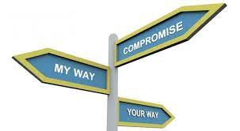

This is a strategy that ensures both sides are satisfied and there is added value for all stakeholders.
However, in this situation, COMPROMISE and COOPERATION are important factors that come to play.

Slide 4

WHAT DO YOU STAND TO GAIN?
A win-win strategy will help you achieve what you want faster, without affecting what others want. You can call it a habit of mutual benefit.
Better collaboration and support.
Conflicts are resolved quickly.
Everyone gets an outcome they want.
Improved negotiation and problem-solving skills.
Save time and money.
WHY?

Slide 5

Get clear on the outcome you and everyone want.
Focus on the long-term gain rather than a short-term benefit.
Use problem-solving skills to address objections or disagreements.
Aim to reach a consensus before ending the conversation or negotiation.
HOW?

Slide 6
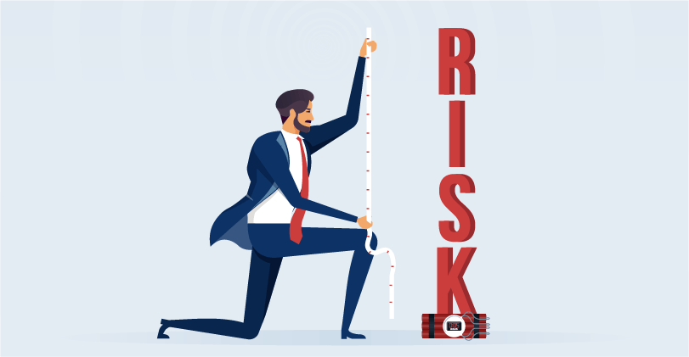
RISKS OF NOT USING THIS STRATEGY
More conflict, which means more time will be wasted getting to desired outcomes.
Higher levels of disengagement.
Delay in achieving goals.
Reduced motivation

Slide 7
Sources
https://neelraman.com/how-to-use-a-win-win-strategy-to-get-what-you-want/ /
https://www.igi-global.com/dictionary/win-win-strategy/77498

Slide 8


