Slide 1
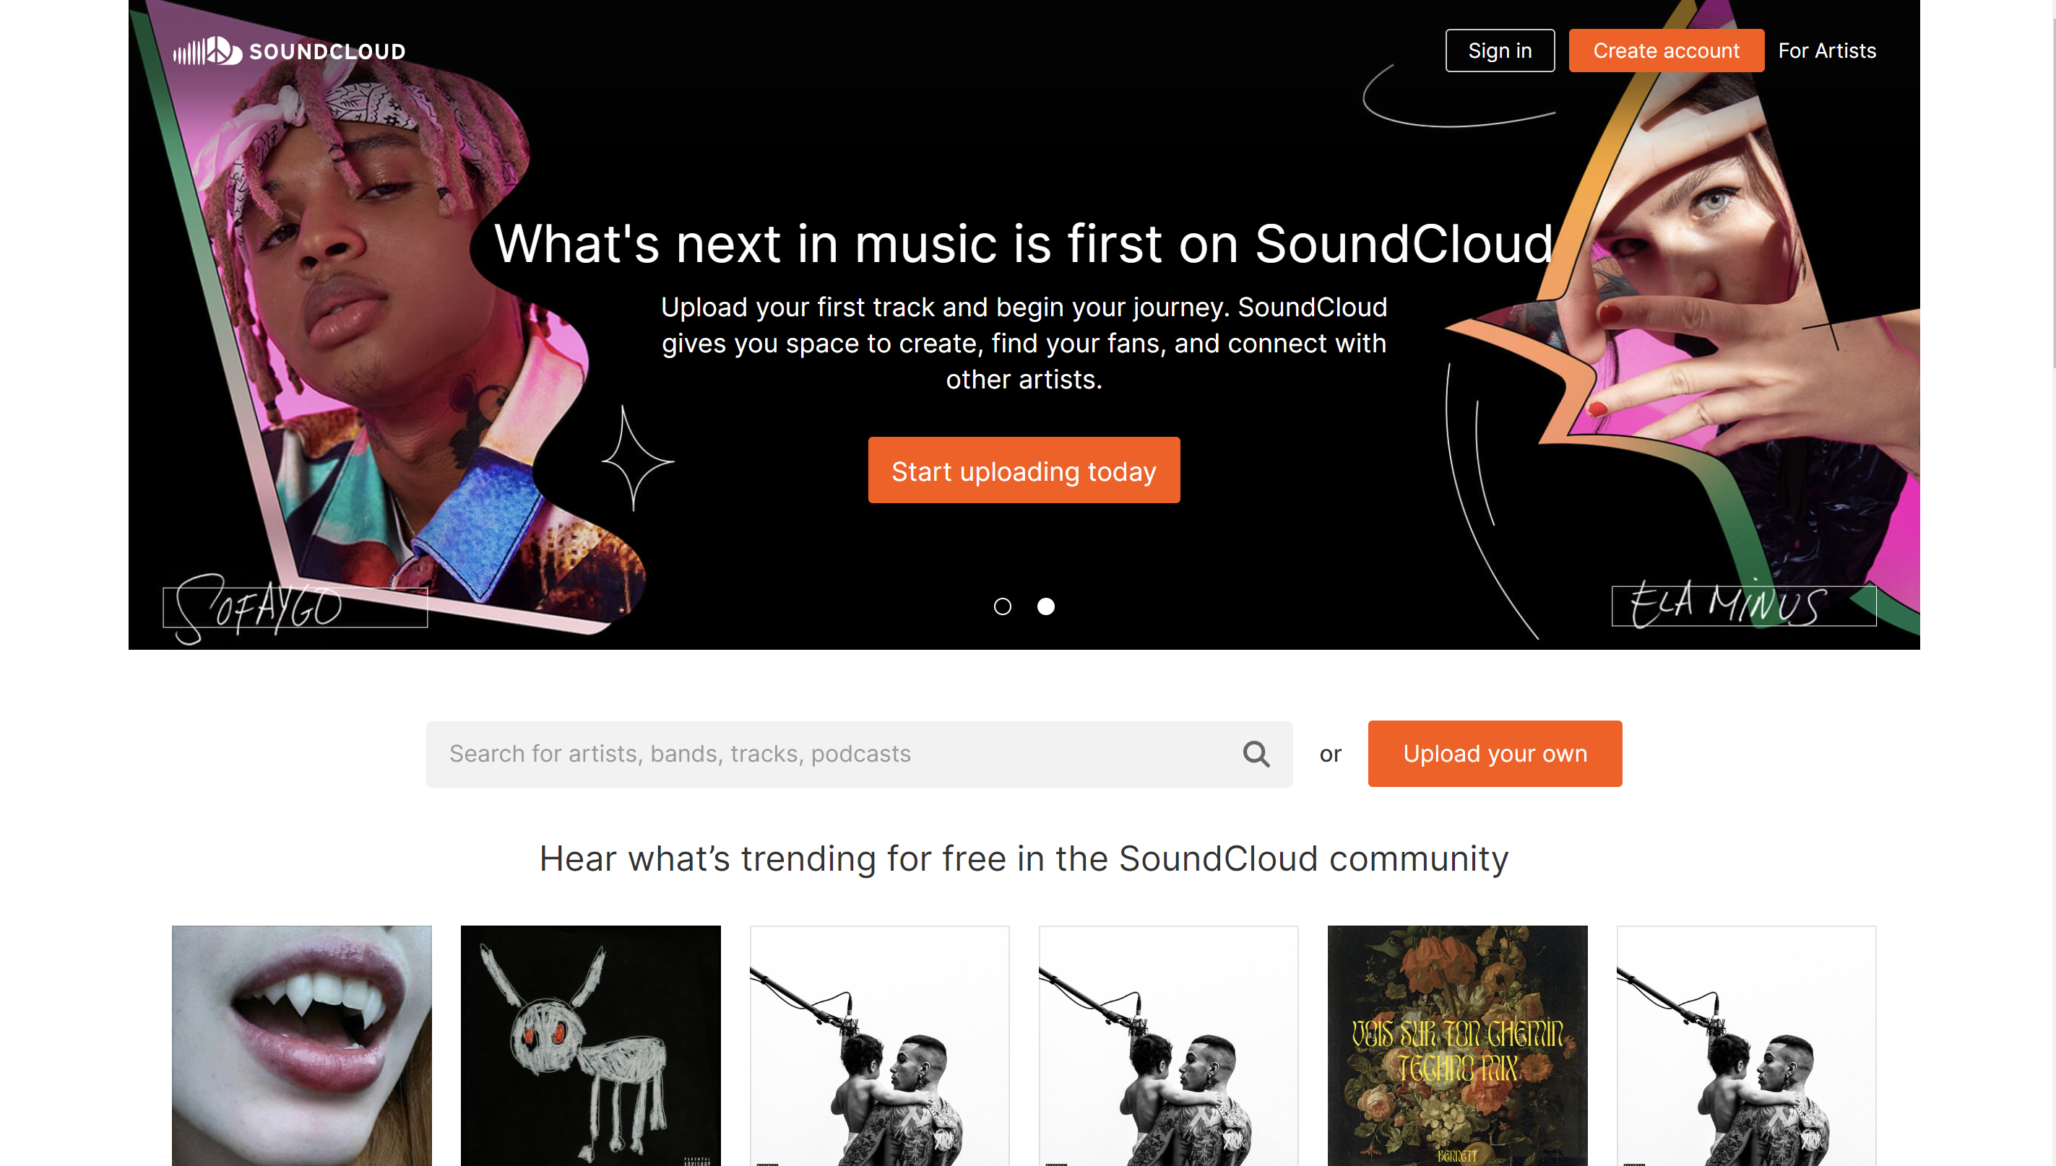

Slide 2
https://soundcloud.com/

