Slide 1






WORKING TITLE
AI Irrigation for Uzbekistan
Helping farms decide when and how much to irrigate — using soil/weather data and AI.
Prototype deck for Idrock Accelerator
Bakhtiyor Sultanov Solo technical founder

Slide 2
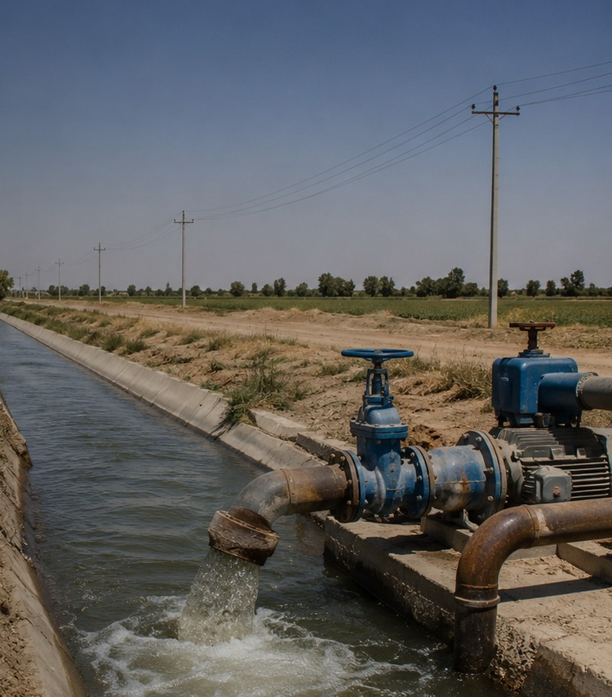
The bottleneck: water + energy
Uzbekistan cannot afford to waste water blindly anymore.
~90%
~80%
of national water use is agriculture
of water resources originate outside the country
7.2B kWh
annual electricity use by irrigation pumps
Irrigation efficiency is now a business problem, not only an environmental one.
Sources: World Bank; Uzbekistan national SDG platform; stat.uz
Bakhtiyor Sultanov • Idrock Accelerator
02

Slide 3

The farm-level pain
Many irrigation decisions still come from fixed schedules or intuition.
Unclear crop need
›
Over-irrigation
›
Pump cost rises
›
Productivity risk
Farmer does not know the exact water need today.
Extra water is applied “just to be safe.”
More water means more electricity and labor.
Too much or too little water can hurt crop performance.
Customer who feels the pain first: greenhouse operators and farms using pumps.
Bakhtiyor Sultanov • Idrock Accelerator
03

Slide 4


The solution
An AI irrigation system that helps farmers use less water and electricity by making smarter watering decisions.
Uses soil + weather data
Decision support based on real conditions.
Learns better irrigation actions
Reinforcement learning improves policy choices.
Recommends when/how much to water
First version can guide the farmer.
Can later connect to pump/valve control
Automation comes after field validation.
INITIAL CUSTOMER
Farms + greenhouse operators
Bakhtiyor Sultanov • Idrock Accelerator
04

Slide 5
How it works
Inputs
AI decision
Recommendation
Action
›
›
›
Soil moisture Weather data Crop context
Reinforcement learning Irrigation policy Risk-aware action
When to irrigate How much water Pump electricity impact
Farmer decision Pump / valve control Pilot feedback
The first version can be decision-support. Automation comes after field validation.
Bakhtiyor Sultanov • Idrock Accelerator
05

Slide 6
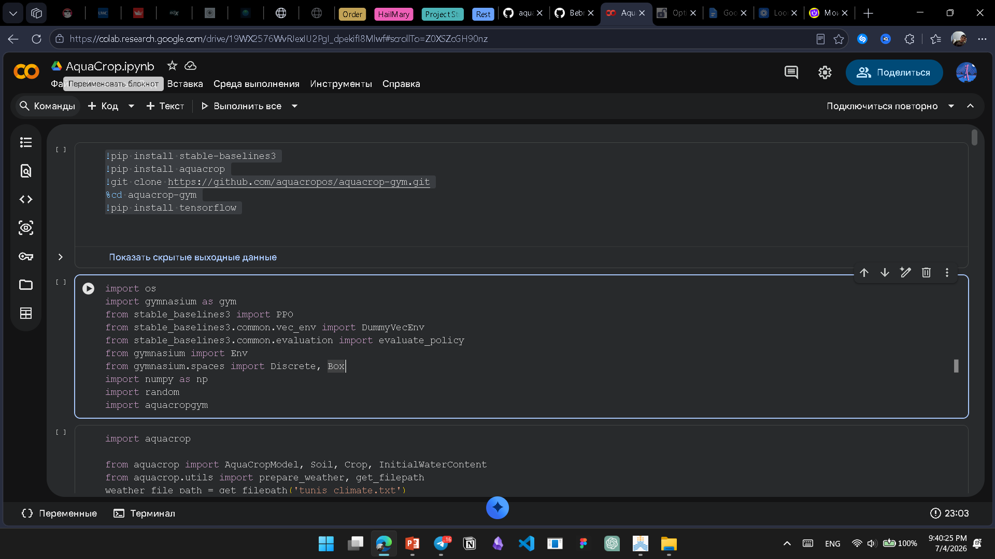
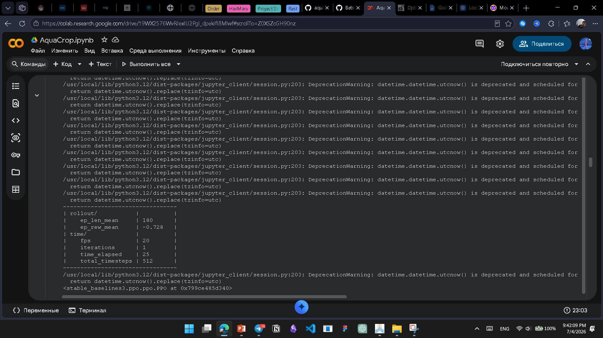
What I built so far
Stage: Prototype
AI logic
GitHub: https://surl.li/cifelp
Google_Collab: https://surl.li/dlrkyn
Irrigation decision-making with reinforcement learning
I am building the core decision logic that learns when and how much to irrigate from soil and weather signals.
Bakhtiyor Sultanov • Idrock Accelerator
06

Slide 7
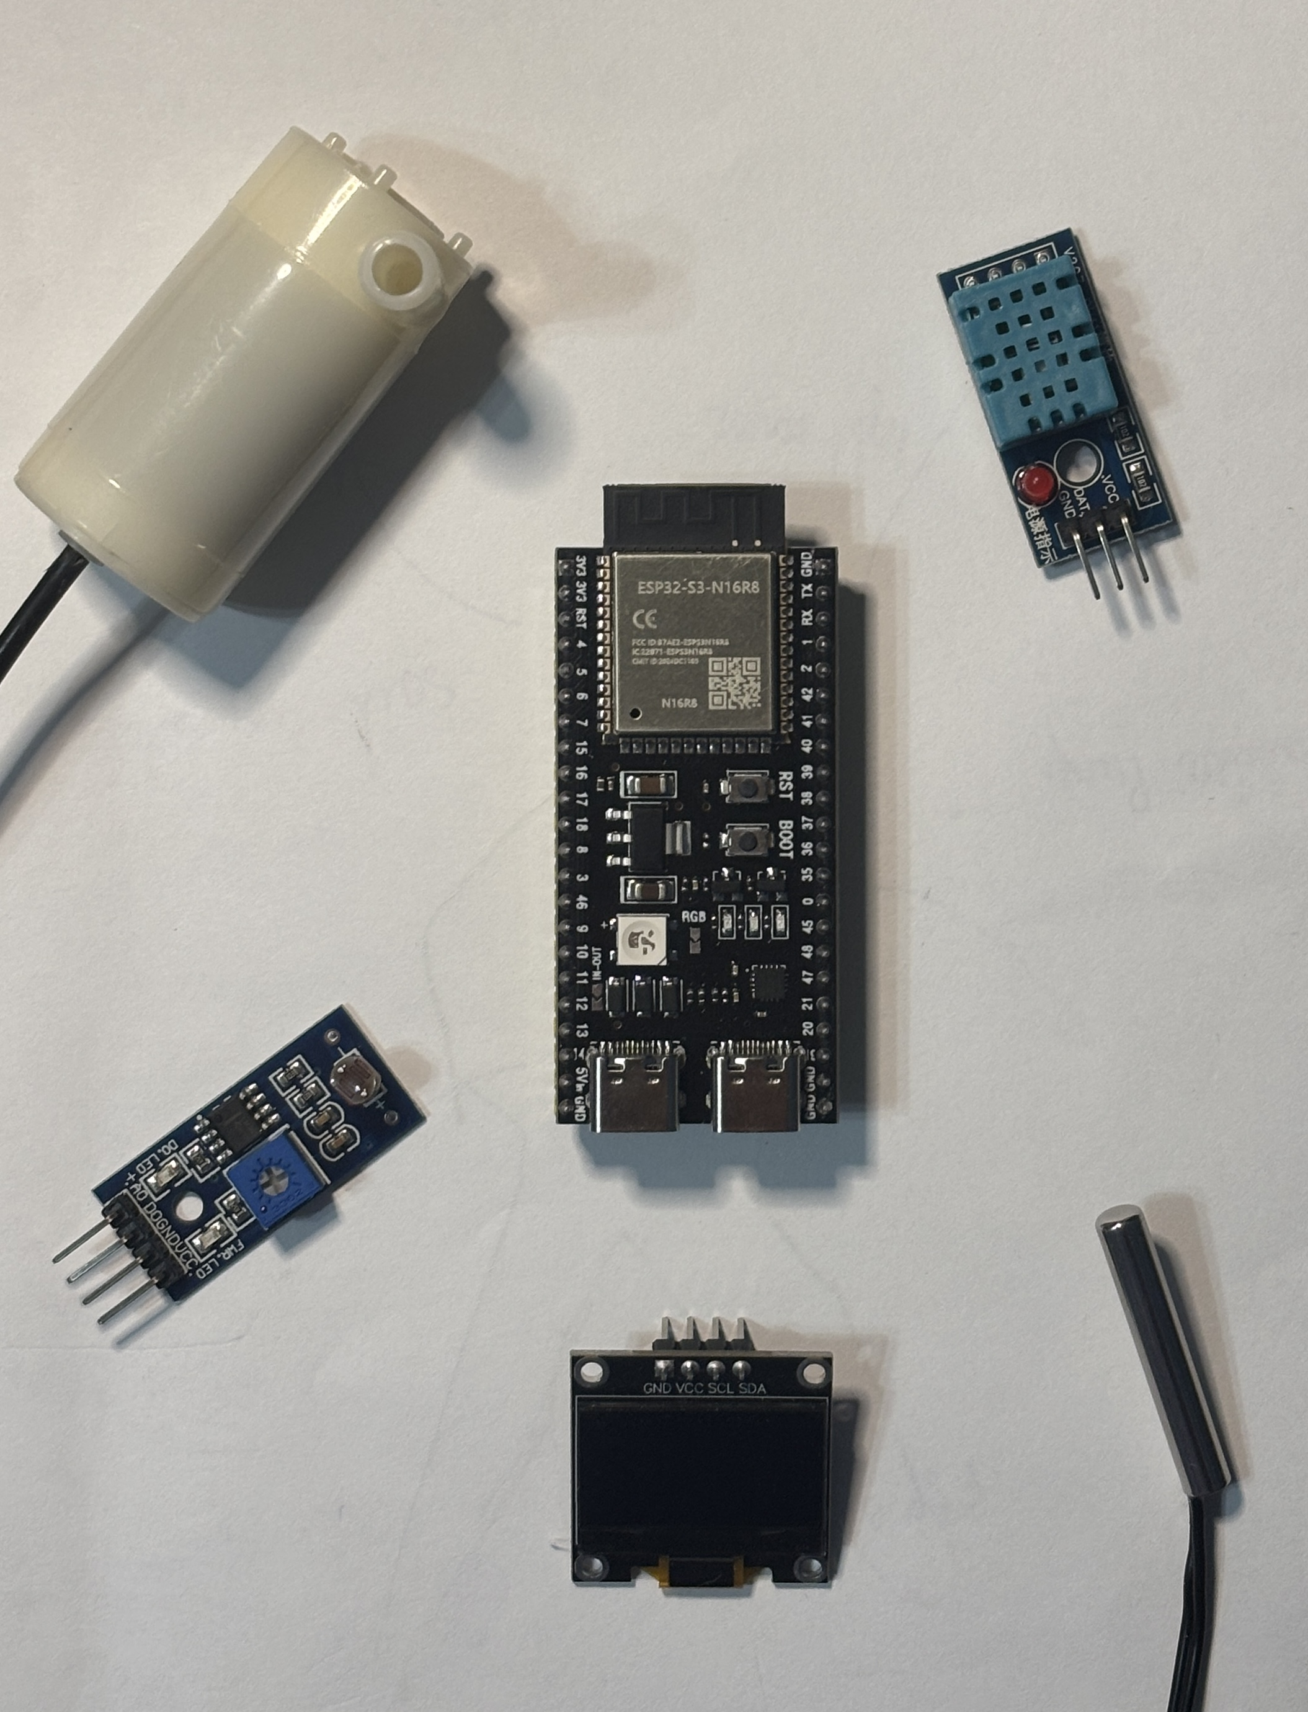
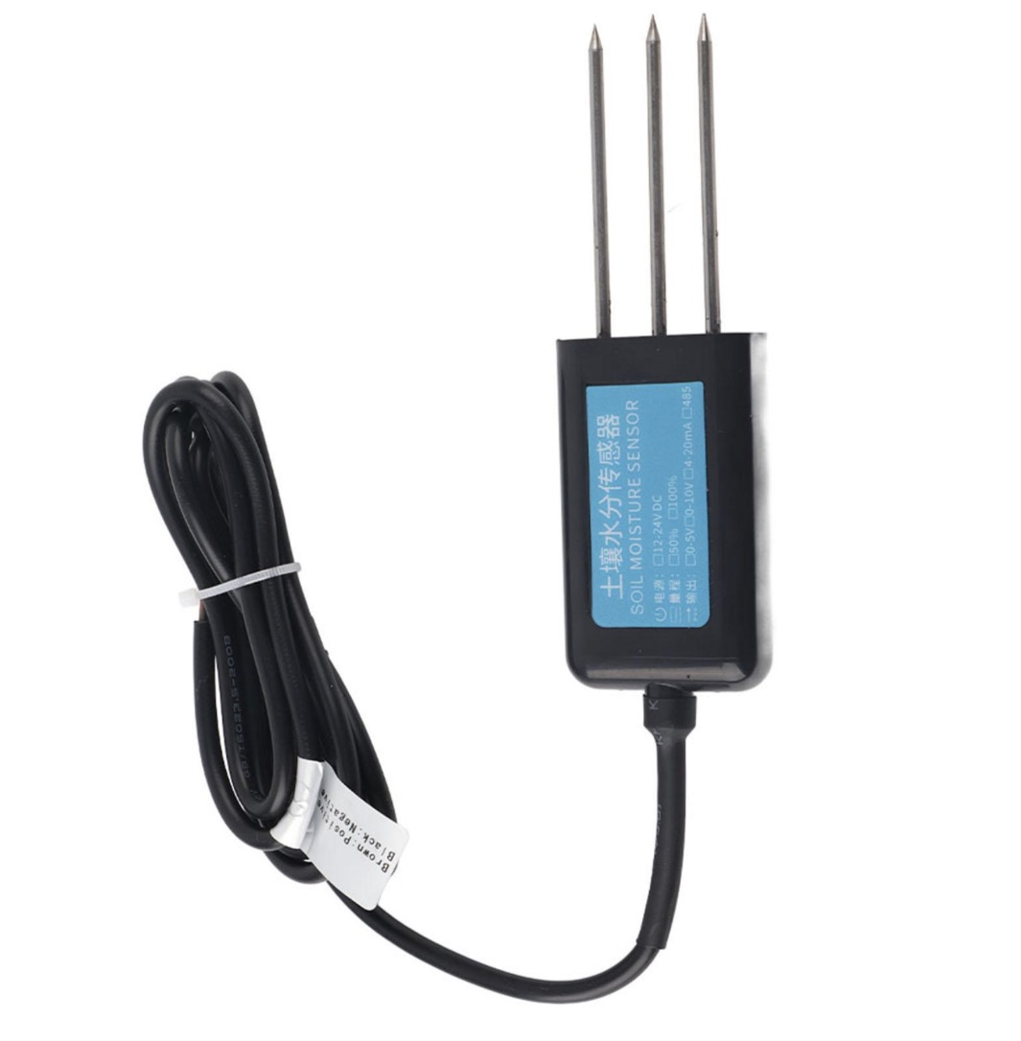
Soil Moisture Sensor (Coming soon!)
What I built so far
Stage: Prototype
ESP32 (N16R8)
Air Temp/Humid
Water Pump
IoT architecture
Soil sensor → model → pump/valve control design
Soil Temperature
Sensor
I designed the system architecture that connects field sensors, the AI model, and future pump/valve control.
Light Sensor
Display
Bakhtiyor Sultanov • Idrock Accelerator
07

Slide 8
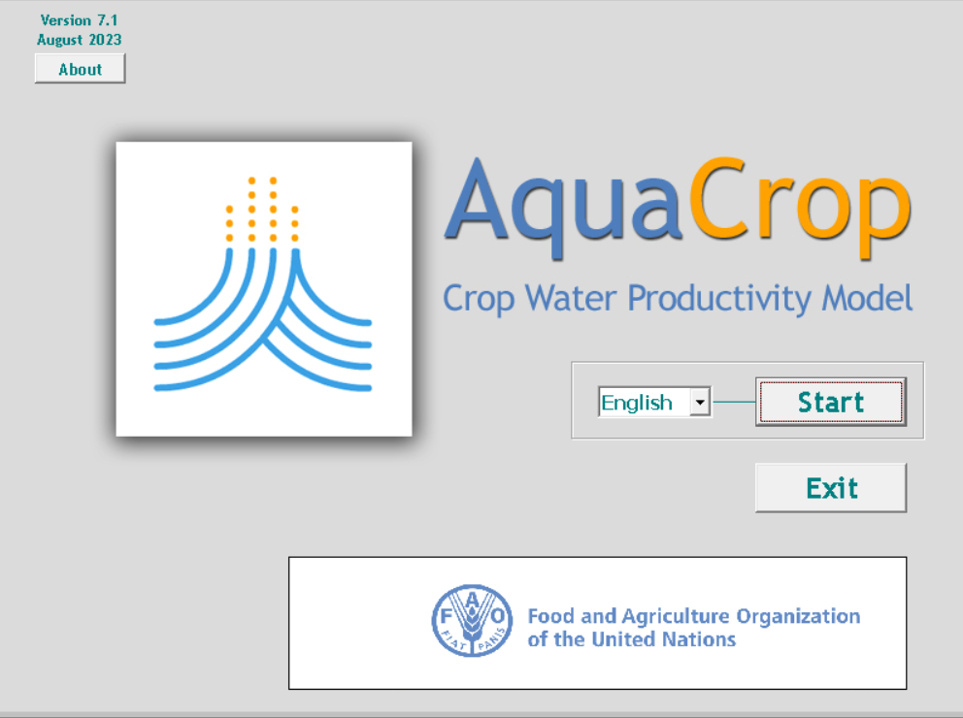
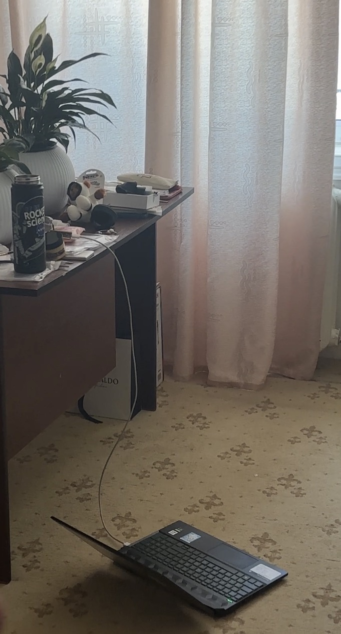
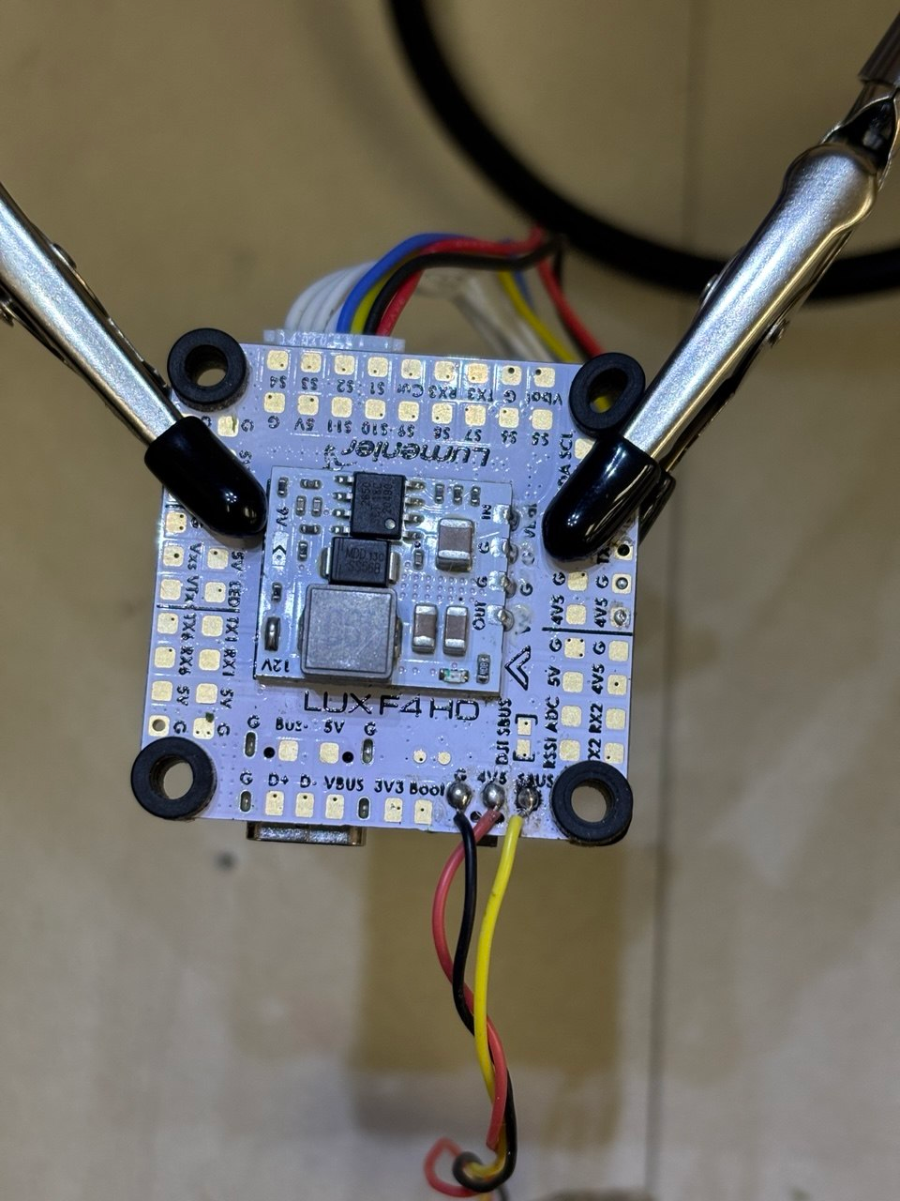
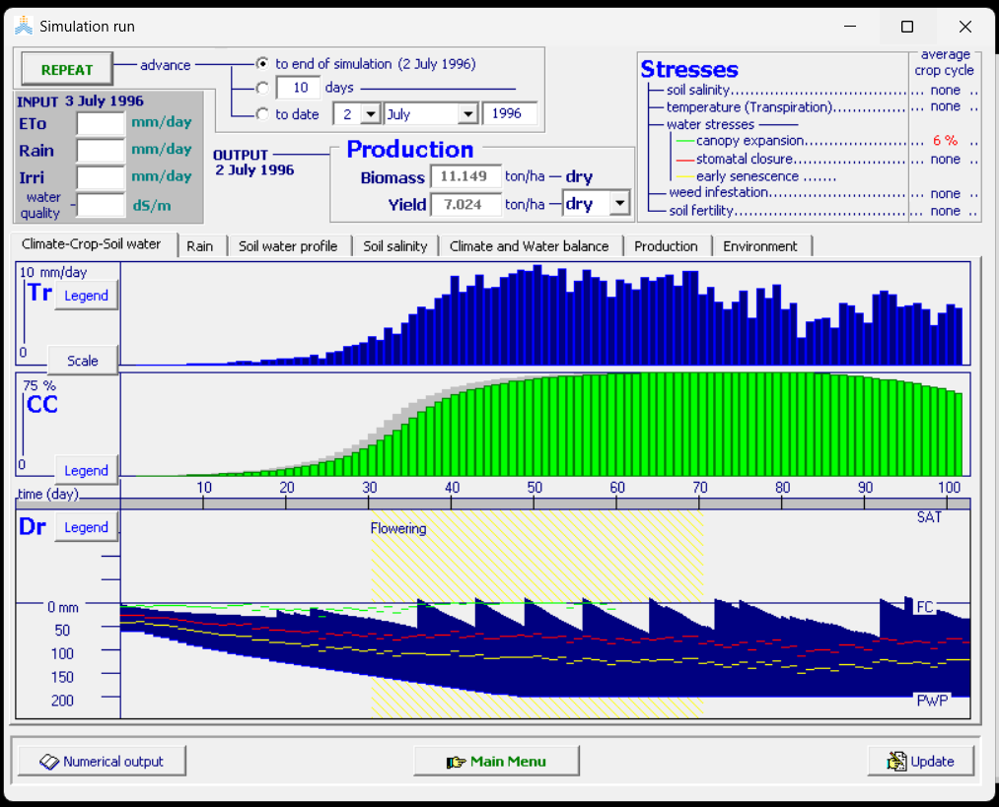
What I built so far
Stage: Prototype
Simulation work
AquaCrop / crop-water environment for testing policies
I use simulation to test irrigation policies before risking real crops or wasting real water.
Bakhtiyor Sultanov • Idrock Accelerator
08

Slide 9



60-day goal
Move from prototype to a testable MVP with real customer validation.
1
Interview 10–15 farms / greenhouse operators
2
Build MVP dashboard + irrigation recommendation flow
3
Run first controlled tests with soil/weather input
4
Design a credible method to measure water + electricity savings
Goal after 60 days: first validated MVP + clear pilot path.
Bakhtiyor Sultanov • Idrock Accelerator
10

Slide 10

What I need from Idrock
The product risk is not only technical. The biggest next step is customer validation.
Pilot connections
Agriculture mentors
Introductions to farms and greenhouse operators.
Feedback from people who understand irrigation in Uzbekistan.
Measurement design
Business model
How to prove water and electricity savings credibly.
Pricing, first customer segment, and go-to-market.
Goal after 60 days: first validated MVP + clear pilot path.
Bakhtiyor Sultanov • Idrock Accelerator
11

Slide 11
Sources for market context
1. World Bank, 2025
Uzbekistan irrigation modernization — agriculture water use and pump electricity data.
2. National SDG platform of Uzbekistan
Water resources from neighboring countries and agriculture/GDP context.
3. Statistics Agency of Uzbekistan, 2026 release
2025 GDP structure and agriculture share.
Bakhtiyor Sultanov • Idrock Accelerator
12

